Slide 1
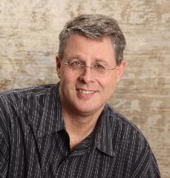
HOW TO FIND JOY IN THE CHRISTIAN LIFE
Dr. Andy Woods
Senior Pastor – Sugar Land Bible Church
President – Chafer Theological Seminary

Slide 2
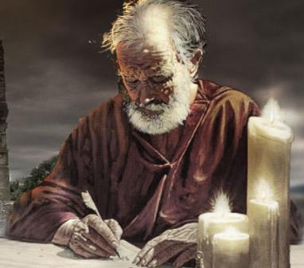
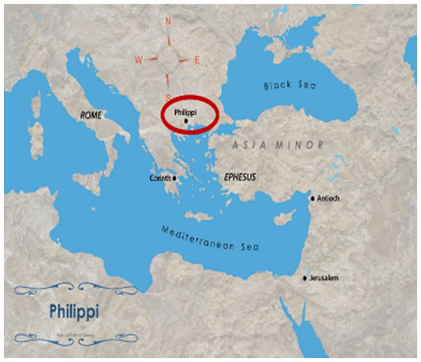
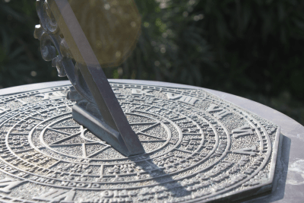
INTRODUCTORY MATTERS
Authorship
Destination
Place of writing
Date

Slide 3
INTRODUCTORY MATTERS
Occasion for writing
Opponents
Purpose
Outline

Slide 4
INTRODUCTORY MATTERS
Message
Unique characteristics

Slide 5
INTRODUCTORY MATTERS
Authorship
Destination
Place of writing
Date

Slide 6
Pauline Authorship
External: strong
Internal
Paul (Phil. 1:1)
Timothy (Phil. 1:1; 2:19-23)
Pre-conversion life (Phil. 3:4-6)
1st person pronouns throughout

Slide 7
Philippians 1:1-2
“¹ Paul and Timothy, bond-servants of Christ Jesus, To all the saints in Christ Jesus who are in Philippi, including the overseers and deacons: ² Grace to you and peace from God our Father and the Lord Jesus Christ.”

Slide 8
Philippians 1:1-2
“¹ Paul and Timothy, bond-servants of Christ Jesus, To all the saints in Christ Jesus who are in Philippi, including the overseers and deacons: ² Grace to you and peace from God our Father and the Lord Jesus Christ.”

Slide 9
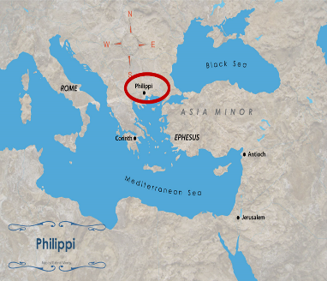
INTRODUCTORY MATTERS
Authorship
Destination
Place of writing
Date

Slide 10
Philippians 1:1-2
“¹ Paul and Timothy, bond-servants of Christ Jesus, To all the saints in Christ Jesus who are in Philippi, including the overseers and deacons: ² Grace to you and peace from God our Father and the Lord Jesus Christ.”

Slide 11
Three Tenses of Salvation
Phase | Justification | SANCTIFICATION | Glorification
Tense | Past | Present | Future
Saved from sin’s: | Penalty | Power | Presence
Scripture | Eph 2:8-9; Titus 3:5 | Philip 2:12 | Rom 5:10

Slide 12
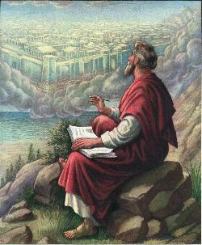
John 20:30-31
“Therefore many other signs Jesus also performed in the presence of the disciples, which are not written in this book; but these have been written so that you may believe that Jesus is the Christ, the Son of God; and that believing you may have life in His name.”

Slide 13
Philippians 1:1-2
“¹ Paul and Timothy, bond-servants of Christ Jesus, To all the saints in Christ Jesus who are in Philippi, including the overseers and deacons: ² Grace to you and peace from God our Father and the Lord Jesus Christ.”

Slide 15
Destination
Philippi (Phil. 1:1)
Citizenship (Phil. 3:20)
No synagogue

Slide 16
Charles Ryrie
The Ryrie Study Bible
Acts 16:13. “Apparently there was no Synagogue in Philippi, it required at least 10 Jewish men to organize one.”

Slide 17
Destination
Via Egnatia Highway
Chief city in Macedonia
Founded on 2nd missionary journey (Acts 16)

Slide 18
Destination
Via Egnatia Highway
Chief city in Macedonia
Founded on 2nd missionary journey (Acts 16)

Slide 19
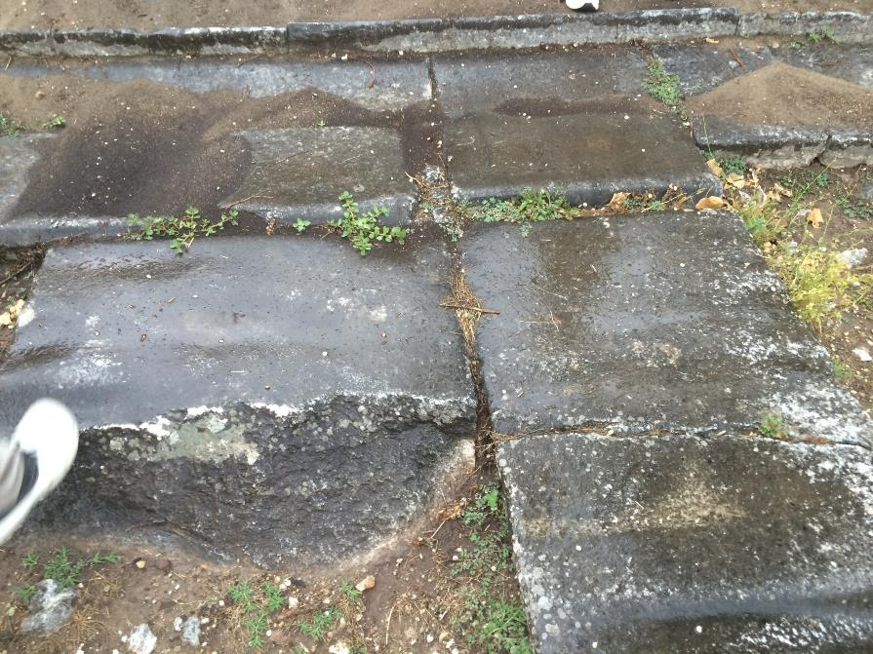
Via Egnatia Highway

Slide 20
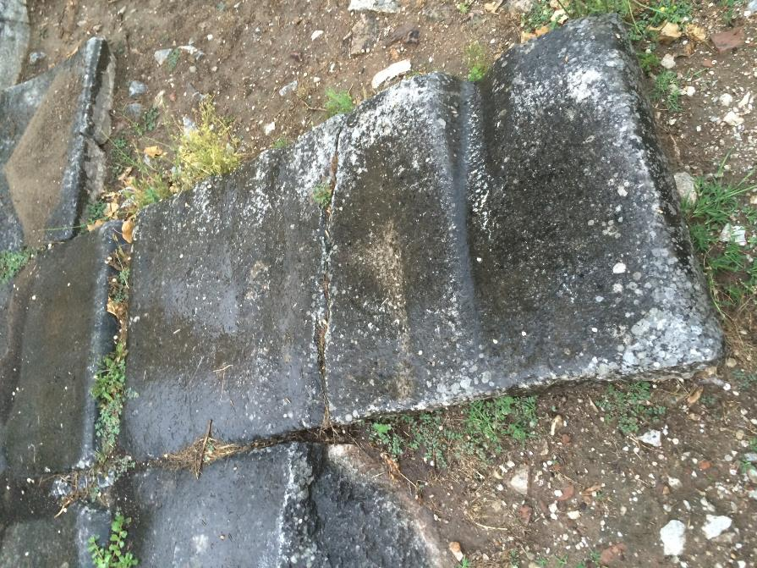
Via Egnatia Highway

Slide 22
Destination
Via Egnatia Highway
Chief city in Macedonia
Founded on 2nd missionary journey (Acts 16)

Slide 23
Destination
Via Egnatia Highway
Chief city in Macedonia
Founded on 2nd missionary journey (Acts 16)

Slide 24
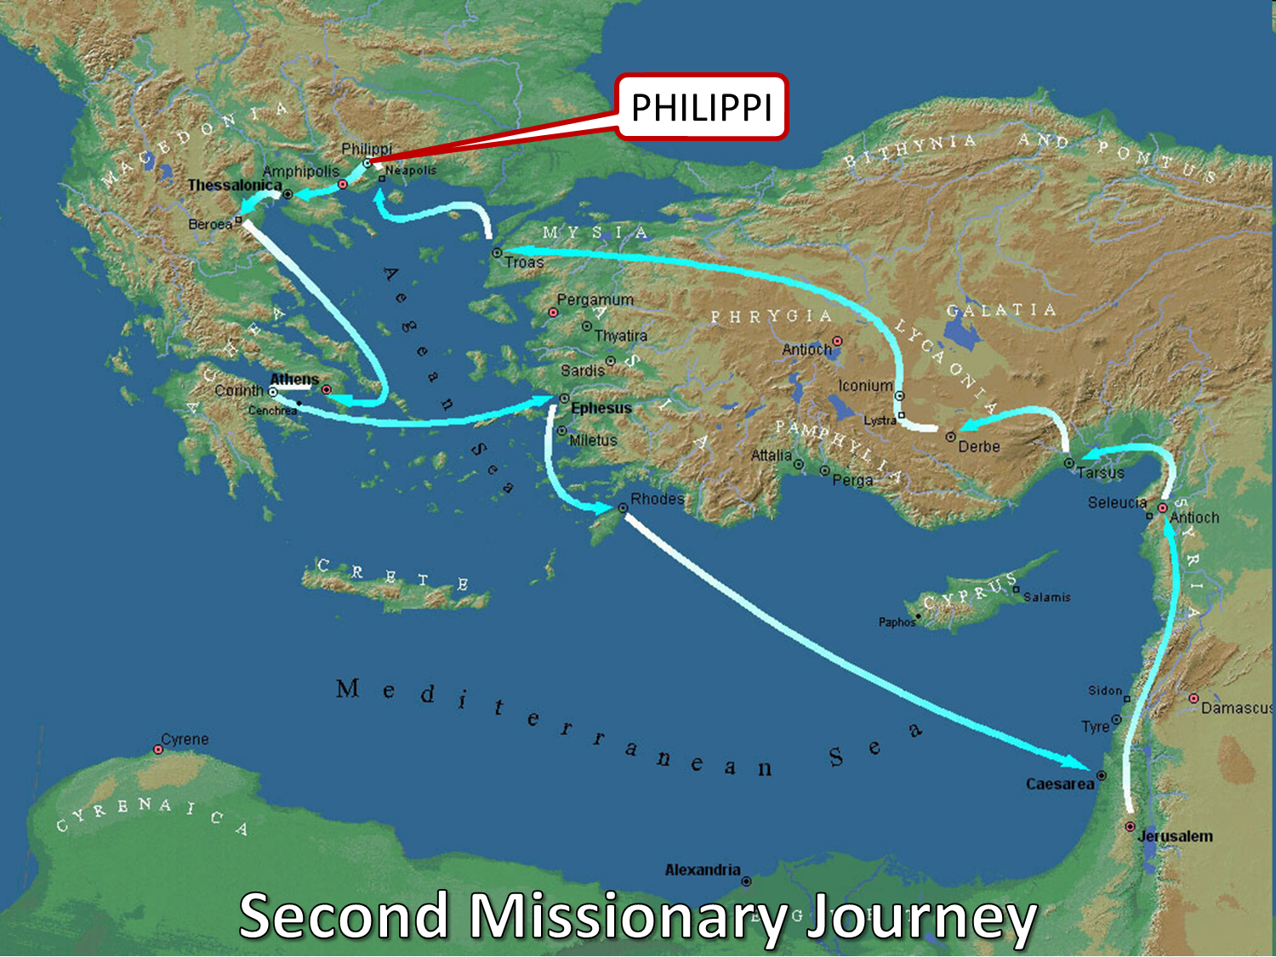

Slide 25
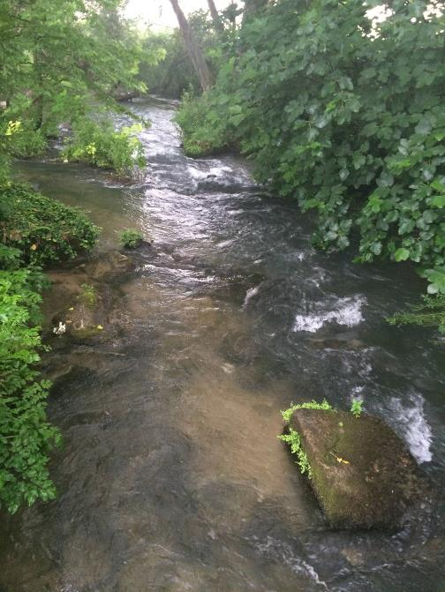

Slide 26
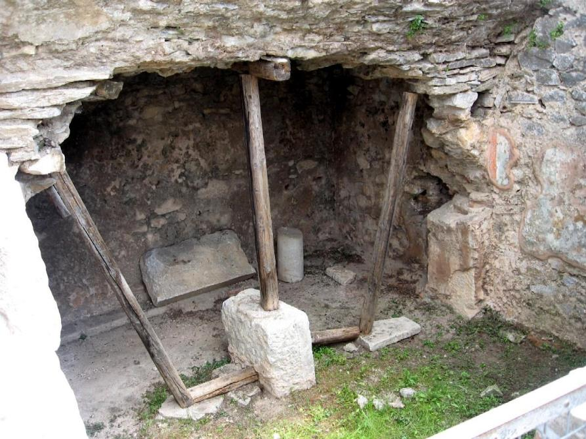

Slide 27
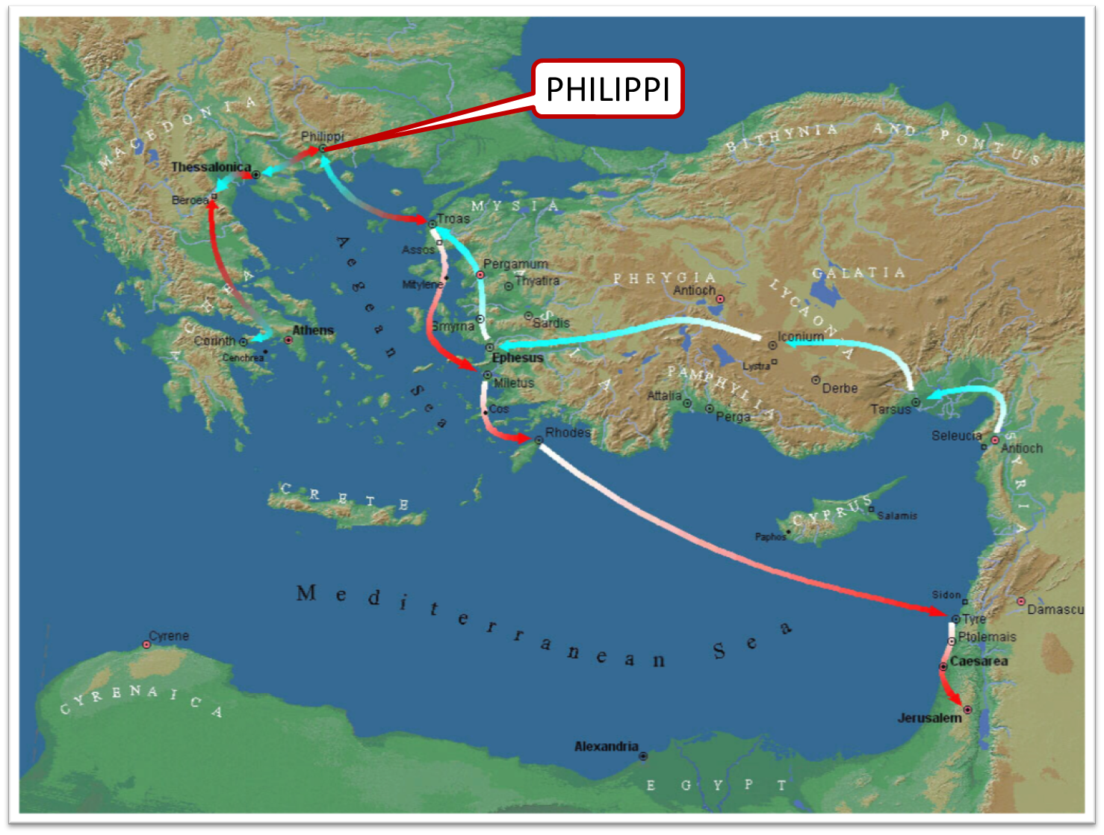

Slide 28
INTRODUCTORY MATTERS
Authorship
Destination
Place of writing
Date

Slide 29
Place of Writing and Date
1st Roman Imprisonment (Acts 28:16-31)
A.D. 62

Slide 30
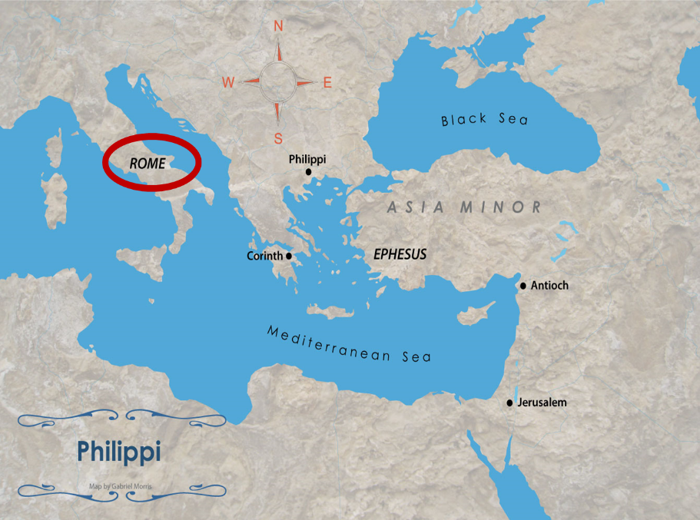

Slide 31
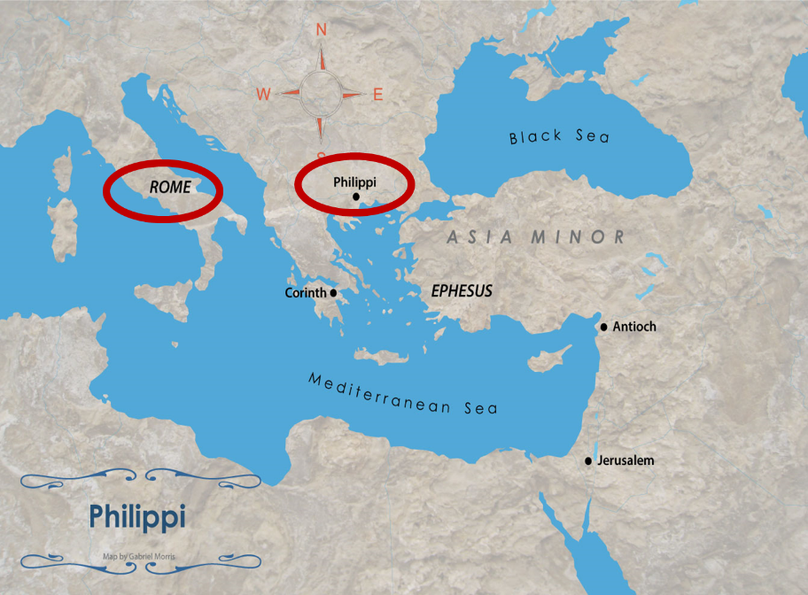

Slide 32
INTRODUCTORY MATTERS
Authorship
Destination
Place of writing
Date

Slide 33
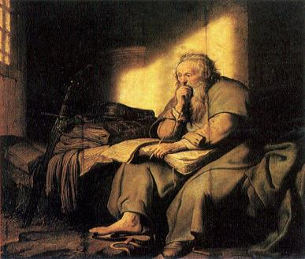
Place of Writing and Date
1st Roman Imprisonment (Acts 28:16-31)
A.D. 62

Slide 34
Order of Paul’s Letters
Galatians (A.D. 49)
1‒2 Thessalonians (A.D. 51)
1‒2 Corinthians (A.D. 56)
Romans (A.D. 57)
Ephesians, Colossians, Philemon, PHILIPPIANS (A.D. 60‒62)
1 Timothy, Titus (A.D. 62‒66)
2 Timothy (A.D. 67)

Slide 35
INTRODUCTORY MATTERS
Occasion for writing
Opponents
Purpose
Outline

Slide 36
Occasion
News of Paul’s imprisonment reaches Philippi
Epaphroditus comes from Philippi to Rome
Word of Epaphroditus’ sickness reaches Philippi
Some Philippians came to Rome to express concern over Epaphroditus’ condition
Epaphroditus returns to Philippi

Slide 37
INTRODUCTORY MATTERS
Occasion for writing
Opponents
Purpose
Outline

Slide 38
Opponents
Those in Rome preaching Christ out of selfish ambition (Phil. 1:15-18)
Those in Philippi persecuting the new church (Phil. 1:27-28)
Judaizers in Philippi (Phil. 3:2)
Antinomians in Philippi (Phil. 3:19)

Slide 39
INTRODUCTORY MATTERS
Occasion for writing
Opponents
Purpose
Outline

Slide 40
Purpose
Joy 18x
Adverse circumstances (1:27-30)
How to have joy during adverse circumstances

Slide 41
INTRODUCTORY MATTERS
Occasion for writing
Opponents
Purpose
Outline

Slide 42
Outline
CHAPTER 1
God can use negative circumstances to bring about positive results
CHAPTER 2
Christ’s example of servanthood
CHAPTER 3
Avoiding legalism
CHAPTER 4
Reliance upon Christ’s strength for daily life

Slide 43
INTRODUCTORY MATTERS
Message
Unique characteristics

Slide 44
Message
JOY DURING ADVERSE CIRCUMSTANCES IS POSSIBLE AS BELIEVERS:
understand that God uses adversity to bring about positive results,
follow Christ's example of servanthood,
avoid legalism,
and draw upon divine resources for daily life.

Slide 45
INTRODUCTORY MATTERS
Message
Unique characteristics

Slide 46
Unique Characteristics
Personal pronouns
Non-theological vocabulary
Abrupt transitions
Christology (2:5-13)
Believer's thought life
Military concepts
Women leaders

Slide 47
Conclusion

Slide 48
Answering Ten Questions
Who wrote it? – Paul
To Whom was it written? – The Believers at Philippi
Where was it written from? – Rome
When was it written? – A.D. 62
What was the book’s occasion? – Five contacts
Who are the opponents? – Four opponents threatening joy
What is the book’s purpose? – To give joy during adversity
How is it organized (outline)? – Four- part outline
What is it about? – Joy during adverstiy
What makes the book different? – Personal & informal

Slide 49
“The Lord bless you and keep you; the Lord make his face shine on you and be gracious to you; the Lord turn his face toward you and give you peace.” (NIV)

