Slide 1
Dr. Andy Woods
Senior Pastor – Sugar Land Bible Church
President – Chafer Theological Seminary

Slide 2
Preview of Angelology
Good angels
Satanology
Demonology
Gen. 6:1-4 controversy

Slide 3
Genesis 6:1-4
“¹ Now it came about, when men began to multiply on the face of the land, and daughters were born to them, ² that the sons of God saw that the daughters of men were beautiful; and they took wives for themselves, whomever they chose. ³ Then the Lord said, ‘My Spirit shall not strive with man forever, because he also is flesh; nevertheless his days shall be one hundred and twenty years.’ ⁴ The Nephilim were on the earth in those days, and also afterward, when the sons of God came in to the daughters of men, and they bore children to them. Those were the mighty men who were of old, men of renown.”

Slide 4
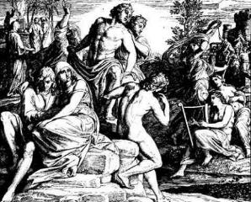
3 Major Alternative Views
Intermarriage between the Godly line of Seth and the ungodly lines of Cain
Polygamous Cainite despots
Fallen angels procreating with human women

Slide 5
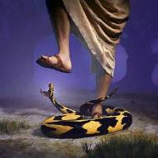
Genesis 3:15
“And I will put enmity Between you and the woman, And between your seed and her seed; He shall bruise you on the head, And you shall bruise him on the heel.”

Slide 6
Satanic Attempts to Stop Messiah
Herod; Mt.2; Rev 12:4
Cain; Gen. 4, 1 Jn. 3:12
Sons of God; Gen. 6:1-4
Pharaoh; Ex. 1
Athaliah; 2 Chron. 22
Haman; Esther
Matt 4:5-7

Slide 7
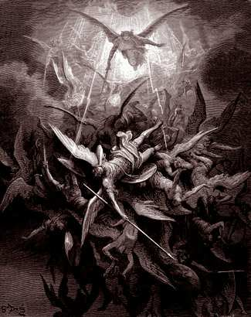
Lesson Overview
Defense of the Angel View
Old Testament
New Testament
Tradition
Objections

Slide 8
3 Reasons Supporting Sons of God
Men (6:1) versus the sons of God (6:2)
Old Testament uses (Gen 6:2, 4; Job 1:6; 2:1; 38:7)
Septuagint (LXX)

Slide 9
Lesson Overview
Defense of the Angel View
Old Testament
New Testament
Tradition
Objections

Slide 10
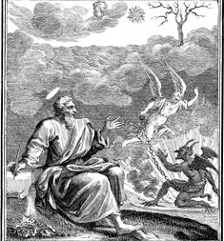
Relevant New Testament Passages
1 Peter 3:19-20
2 Peter 2:4-5
Jude 6-7

Slide 12
Lesson Overview
Defense of the Angel View
Old Testament
New Testament
Tradition
Objections

Slide 13
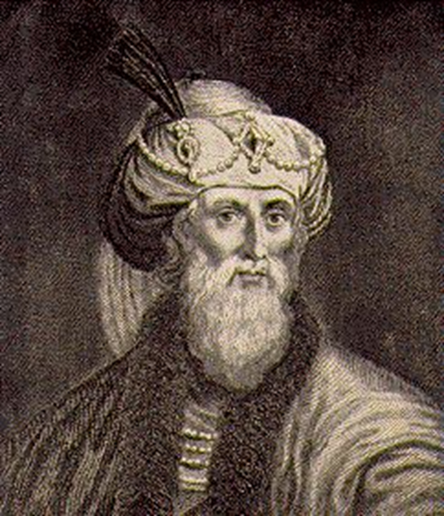
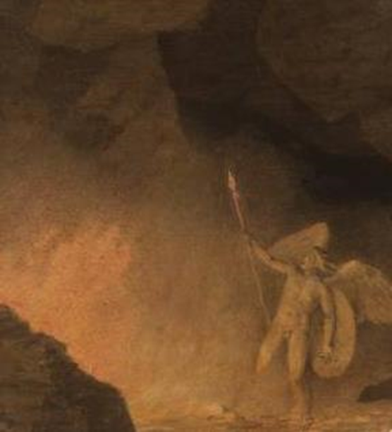
JEWISH TRADITION | CHRISTIAN TRADITION
Philo Josephus Most Rabbinical Writers Apocrypha Pseudepigrapha | Justin Clement Tertullian Cyprian Ambrose Lactantius
Renald Showers, Those Invisible Spirits Called Angels, 93-109

Slide 14
Lesson Overview
Defense of the Angel View
Old Testament
New Testament
Tradition
Objections

Slide 15
Objections
Angels do not marry? (Matt. 22:30)
Angels are spirits (Heb. 1:14)
Nephilim in the post – flood world? (Num. 13:33; Gen. 6:4a)
Nephilim in David’s day? (2 Sam. 21:20)
Why is this sin not replicated today?

Slide 16
Matthew 22:30
“For in the resurrection they neither marry nor are given in marriage, but are like angels in heaven.”

Slide 17
Objections
Angels do not marry? (Matt. 22:30)
Angels are spirits (Heb. 1:14)
Nephilim in the post – flood world? (Num. 13:33; Gen. 6:4a)
Nephilim in David’s day? (2 Sam. 21:20)
Why is this sin not replicated today?

Slide 18
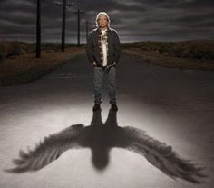
Hebrews 13:2
“Do not neglect to show hospitality to strangers, for by this some have entertained angels without knowing it.”

Slide 19
Objections
Angels do not marry? (Matt. 22:30)
Angels are spirits (Heb. 1:14)
Nephilim in the post – flood world? (Num. 13:33; Gen. 6:4a)
Nephilim in David’s day? (2 Sam. 21:20)
Why is this sin not replicated today?

Slide 20
Genesis 7:19-23
“They rose greatly on the earth, and all the high mountains under the entire heaven were covered…Every living thing that moved on the earth perished—birds, livestock, wild animals, all the creatures that swarm over the earth, and all mankind. Everything on dry land that had the breath of life in its nostrils died. Every living thing on the face of the earth was wiped out; men and animals and the creatures that move along the ground and the birds of the air were wiped from the earth. Only Noah was left, and those with him in the ark.”

Slide 21
Numbers 13:32-33
³² So they gave out to the sons of Israel a bad report of the land which they had spied out, saying, “The land through which we have gone, in spying it out, is a land that devours its inhabitants; and all the people whom we saw in it are men of great size. ³³ There also we saw the Nephilim (the sons of Anak are part of the Nephilim); and we became like grasshoppers in our own sight, and so we were in their sight.”

Slide 22
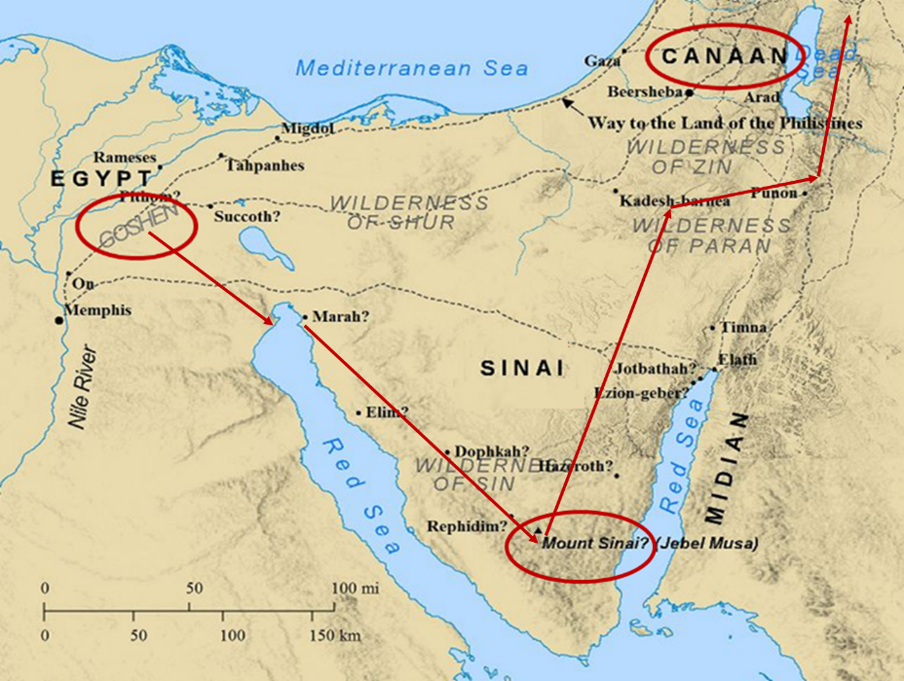

Slide 23
Numbers 13:32-33
³² So they gave out to the sons of Israel a bad report of the land which they had spied out, saying, “The land through which we have gone, in spying it out, is a land that devours its inhabitants; and all the people whom we saw in it are men of great size. ³³ There also we saw the Nephilim (the sons of Anak are part of the Nephilim); and we became like grasshoppers in our own sight, and so we were in their sight.”

Slide 24
Objections
Angels do not marry? (Matt. 22:30)
Angels are spirits (Heb. 1:14)
Nephilim in the post – flood world? (Num. 13:33; Gen. 6:4a)
Nephilim in David’s day? (2 Sam. 21:20)
Why is this sin not replicated today?

Slide 26
Objections
Angels do not marry? (Matt. 22:30)
Angels are spirits (Heb. 1:14)
Nephilim in the post – flood world? (Num. 13:33; Gen. 6:4a)
Nephilim in David’s day? (2 Sam. 21:20)
Why is this sin not replicated today?

Slide 27
Relevant New Testament Passages
1 Peter 3:19-20
2 Peter 2:4-5
Jude 6-7

Slide 28
1 Peter 3:19-20
“¹⁹ in which also He went and made proclamation the spirits now in prison, ²⁰ who once were disobedient, when the patience of God kept waiting in the days of Noah, during the construction of the ark, in which a few, that is, eight persons, were brought safely through the water.”

Slide 29
2 Peter 2:4-5
“⁴ For if God did not spare angels when they sinned, but cast them into hell and committed them to pits of darkness, reserved for judgment; ⁵ and did not spare the ancient world, but preserved Noah, a preacher of righteousness, with seven others, when He brought a flood upon the world of the ungodly.”

Slide 30
Jude 6-7
“⁶ And angels who did not keep their own domain, but abandoned their proper abode, He has kept in eternal bonds under darkness for the judgment of the great day, ⁷ just as Sodom and Gomorrah and the cities around them, since they in the same way as these indulged in gross immorality and went after strange flesh, are exhibited as an example in undergoing the punishment of eternal fire.”

Slide 32
Matthew 8:28-29
“²⁸ When He came to the other side into the country of the Gadarenes, two men who were demon-possessed met Him as they were coming out of the tombs. They were so extremely violent that no one could pass by that way. ²⁹ And they cried out, saying, ‘What business do we have with each other, Son of God? Have You come here to torment us before the time?’”

Slide 33
Genesis 3:15
“And I will put enmity Between you and the woman, And between your seed and her seed; He shall bruise you on the head, And you shall bruise him on the heel.”

Slide 34
Satanic Attempts to Stop Messiah
Herod; Mt.2; Rev 12:4
Cain; Gen. 4, 1 Jn. 3:12
Sons of God; Gen. 6:1-4
Pharaoh; Ex. 1
Athaliah; 2 Chron. 22
Haman; Esther
Matt 4:5-7

Slide 35
1 Peter 3:19-20
“¹⁹ in which also He went and made proclamation (kēryssō; not euanagelizō) the spirits now in prison, ²⁰ who once were disobedient, when the patience of God kept waiting in the days of Noah, during the construction of the ark, in which a few, that is, eight persons, were brought safely through the water.”

Slide 36
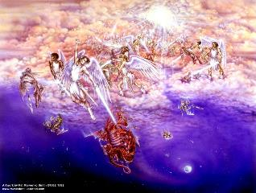
Satan’s Two Strategies
Rev 12:1-5 – Past failed strategy
Rev 12:6-17 – Present & future strategy

Slide 37
Satanic Attempts to Stop Messiah
Herod; Mt.2; Rev 12:4
Cain; Gen. 4, 1 Jn. 3:12
Sons of God; Gen. 6:1-4
Pharaoh; Ex. 1
Athaliah; 2 Chron. 22
Haman; Esther
Matt 4:5-7

Slide 38
Modern Angelic Incursions?
Three Verses Typically Used
Genesis 6:4
Numbers 13:33
Matthew 24:38-39

Slide 39
Modern Angelic Incursions?
Three Verses Typically Used
Genesis 6:4
Numbers 13:33
Matthew 24:38-39

Slide 40
Genesis 6:1-4
“¹ Now it came about, when men began to multiply on the face of the land, and daughters were born to them, ² that the sons of God saw that the daughters of men were beautiful; and they took wives for themselves, whomever they chose. ³ Then the Lord said, ‘My Spirit shall not strive with man forever, because he also is flesh; nevertheless his days shall be one hundred and twenty years.’ ⁴ The Nephilim were on the earth in those days, and also afterward, when the sons of God came in to the daughters of men, and they bore children to them. Those were the mighty men who were of old, men of renown.”

Slide 41
Finis Jennings Dake
God's Plan for Man: Revealing God's Perfect Plan for All Creation (Lawrenceville, GA: Dake Bible Sales, 1949), 197.
“There were two eruptions of the fallen angels among men. They produced races of giants on the Earth each time. The first eruption was before the flood, and the second one was after the flood. This is plainly stated in Gen. 6:4: ‘There were giants in the earth in those days [before the flood]; and also after that [after the flood], when the sons of God came in unto the daughters of men, and they bare children to them, the same became mighty men which were of old, men of renown.’”

Slide 42
Genesis 6:1-4
“¹ Now it came about, when men began to multiply on the face of the land, and daughters were born to them, ² that the sons of God saw that the daughters of men were beautiful; and they took wives for themselves, whomever they chose. ³ Then the Lord said, ‘My Spirit shall not strive with man forever, because he also is flesh; nevertheless his days shall be one hundred and twenty years.’ ⁴ The Nephilim were on the earth in those days, and also afterward, when the sons of God came in to the daughters of men, and they bore children to them. Those were the mighty men who were of old, men of renown.”

Slide 43
Modern Angelic Incursions?
Three Verses Typically Used
Genesis 6:4
Numbers 13:33
Matthew 24:38-39

Slide 44
Numbers 13:32-33
³² So they gave out to the sons of Israel a bad report of the land which they had spied out, saying, “The land through which we have gone, in spying it out, is a land that devours its inhabitants; and all the people whom we saw in it are men of great size. ³³ There also we saw the Nephilim (the sons of Anak are part of the Nephilim); and we became like grasshoppers in our own sight, and so we were in their sight.”

Slide 45
Modern Angelic Incursions?
Three Verses Typically Used
Genesis 6:4
Numbers 13:33
Matthew 24:38-39

Slide 46
Matthew 24:38-39
³⁸ For as in those days before the flood they were eating and drinking, marrying and giving in marriage, until the day that Noah entered the ark, ³⁹ and they did not understand until the flood came and took them all away; so will the coming of the Son of Man be.”

Slide 47
Matthew 24:32-33
³² “Now learn the parable from the fig tree: when its branch has already become tender and puts forth its leaves, you know that summer is near; ³³ so, you too, when you see all these things, recognize that He is near, right at the door.”

Slide 48
Dr. Roy B. Zuck
Roy B. Zuck, Basic Bible Interpretation, p. 215-16.
“﻿Usually a parable, like a sermon illustration, is teaching a single truth. When Jesus explained a number of His parables, He usually…stated one spiritual truth. For example when the man found his one lost sheep, he rejoiced, and Jesus said this illustrates the truth that there is rejoicing in heaven when a sinner repents (Luke 15:7)...He gave one simple spiritual lesson, and made no attempt to see any spiritual significance to the vineyard, the denarius, or the sixth hour, the ninth hour, or the eleventh hour, nor the vineyard foreman…To hunt for meanings in every detail in the parables is to turn them into allegories.”

Slide 49
Matthew 24:38-39
³⁸ For as in those days before the flood they were eating and drinking, marrying and giving in marriage, until the day that Noah entered the ark, ³⁹ and they did not understand until the flood came and took them all away; so will the coming of the Son of Man be.”

Slide 50
CONCLUSION

Slide 51
Objections
Angels do not marry? (Matt. 22:30)
Angels are spirits (Heb. 1:14)
Nephilim in the post – flood world? (Num. 13:33; Gen. 6:4a)
Nephilim in David’s day? (2 Sam. 21:20)
Why is this sin not replicated today?

Slide 52
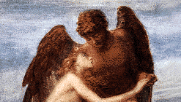
Lesson Overview
Defense of the Angel View
Old Testament
New Testament
Tradition
Objections

