Slide 1
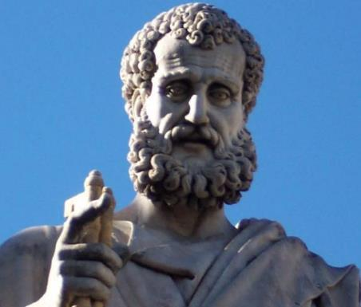

2 Peter
Dr. Andy Woods
Senior Pastor – Sugar Land Bible Church
President – Chafer Theological Seminary

Slide 2

INTRODUCTORY MATTERS
Authorship: Peter
Biography: Gospels & Acts
Date: A.D. 64
Recipients: Regenerated, Asia Minor, Hebrews
Place of writing: Babylon
Occasion for writing: Incipient Gnosticism
Purpose: Insulation from false teaching
Structure: 3 parts
Message: Protection from false teachers
Unique characteristics: Knowledge

Slide 3
STRUCTURE
2 Peter 1 – Call to maturity
2 Peter 2 – Characteristics of false teachers
2 Peter 3 – Doctrine of the false teachers (uniformitarianism)

Slide 4
STRUCTURE
2 Peter 1 – Call to maturity
2 Peter 2 – Characteristics of false teachers
2 Peter 3 – Doctrine of the false teachers (uniformitarianism)

Slide 5
2 PETER
Chapter 1
Introduction (1:1-2)
Call to Growth (1:3-11)
Purpose Statement (1:12-15)
Coming kingdom (1:16-21)

Slide 6
STRUCTURE
2 Peter 1 – Call to maturity
2 Peter 2 – Characteristics of false teachers
2 Peter 3 – Doctrine of the false teachers (uniformitarianism)

Slide 7

2 PETER 2 OUTLINE
Predicted arrival (2:1a)
Devices (2:1b-3)
Doom (2:4-9)
Depravity (2:10-16)
Emptiness (2:17-19)
Regression (2:20-22)

Slide 8
2 PETER 2 OUTLINE
Predicted arrival (2:1a)
Devices (2:1b-3)
Doom (2:4-9)
Depravity (2:10-16)
Emptiness (2:17-19)
Regression (2:20-22)

Slide 9

DOOM OF FALSE TEACHERS
V.4-9
Judgment of God (6-8) – 3 Historical Examples
  Fallen angels (4)
  Flood (5)
  Sodom & Gomorrah (6-8)
Conclusion (9)

Slide 10
2 PETER 2 OUTLINE
Predicted arrival (2:1a)
Devices (2:1b-3)
Doom (2:4-9)
Depravity (2:10-16)
Emptiness (2:17-19)
Regression (2:20-22)

Slide 11
DEPRAVITY OF FALSE TEACHERS
V.10-16
Licentious (10a)
Lawless (10b-11)
Animalistic (12)
Shameless pleasure seekers (13)
Eyes full of adultery (14a)
Entice unstable souls (14b)
Greedy (14c-16)

Slide 12
DEPRAVITY OF FALSE TEACHERS
V.10-16
Licentious (10a)
Lawless (10b-11)
Animalistic (12)
Shameless pleasure seekers (13)
Eyes full of adultery (14a)
Entice unstable souls (14b)
Greedy (14c-16)

Slide 13

Mark 7:20-23
“²⁰ And He was saying, ‘That which proceeds out of the man, that is what defiles the man. ²¹ For from within, out of the heart of men, proceed the evil thoughts, fornications, thefts, murders, adulteries, ²² deeds of coveting and wickedness, as well as deceit, sensuality, envy, slander, pride and foolishness. ²³ All these evil things proceed from within and defile the man.’”

Slide 14
1 Corinthians 6:9-11
“⁹ Or do you not know that the unrighteous will not inherit the kingdom of God? Do not be deceived; neither fornicators, nor idolaters, nor adulterers, nor effeminate, nor homosexuals, ¹⁰ nor thieves, nor the covetous, nor drunkards, nor revilers, nor swindlers, will inherit the kingdom of God. ¹¹ Such were some of you; but you were washed, but you were sanctified, but you were justified in the name of the Lord Jesus Christ and in the Spirit of our God.”

Slide 15
1 Corinthians 6:9-11
“⁹ Or do you not know that the unrighteous will not inherit the kingdom of God? Do not be deceived; neither fornicators, nor idolaters, nor adulterers, nor effeminate, nor homosexuals [arsenokoitēs], ¹⁰ nor thieves, nor the covetous, nor drunkards, nor revilers, nor swindlers, will inherit the kingdom of God. ¹¹ Such were some of you; but you were washed, but you were sanctified, but you were justified in the name of the Lord Jesus Christ and in the Spirit of our God.”

Slide 16


Charles Ryrie
The Ryrie Study Bible
2 Peter 2:10. “2:10 indulge the flesh. Some sexual perversion, likely homosexuality, since he has just written about Sodom and Gomorrah.”

Slide 17
DEPRAVITY OF FALSE TEACHERS
V.10-16
Licentious (10a)
Lawless (10b-11)
Animalistic (12)
Shameless pleasure seekers (13)
Eyes full of adultery (14a)
Entice unstable souls (14b)
Greedy (14c-16)

Slide 18
Ezekiel 28:12, 17
“¹² You were the anointed cherub who covers, And I placed you there. You were on the holy mountain of God; You walked in the midst of the stones of fire… ¹⁷ By the abundance of your trade You were internally filled with violence, And you sinned; Therefore I have cast you as profane From the mountain of God. And I have destroyed you, O covering cherub, From the midst of the stones of fire.”

Slide 19
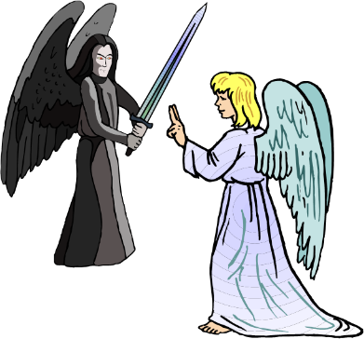
ARROGANCE OF FALSE TEACHERS
V.10b-11
Despise Authority
  Slander fallen angels
Daring and Self-willed

Slide 20


Satan’s Progressive Defeat
Initial eviction from heaven (Isa 14:12-15; Ezek 28:12-17)
Eden (Gen 3:15)
Pre-diluvian world (1 Pet 3:19-20)
Cross (John 12:31; 16:11; Col 2:15; Heb 2:14; 1 John 3:8)
Mid point of the Tribulation (Rev 12:9)
Beginning of millennium (Rev 20:2-3)
End of millennium (Rev 20:10)

Slide 21
Revelation 20:1-3
“Then I saw an angel coming down from heaven, holding the key of the abyss and a great chain in his hand. ² And he laid hold of the dragon, the serpent of old, who is the devil and Satan, and bound him for a thousand years; ³ and he threw him into the abyss, and shut it and sealed it over him, so that he would not deceive the nations any longer, until the thousand years were completed; after these things he must be released for a short time.”

Slide 22
DEPRAVITY OF FALSE TEACHERS
V.10-16
Licentious (10a)
Lawless (10b-11)
Animalistic (12)
Shameless pleasure seekers (13)
Eyes full of adultery (14a)
Entice unstable souls (14b)
Greedy (14c-16)

Slide 23

ANIMALISTIC NATURE OF FALSE TEACHERS
V. 12
Three contrasts (12a-c)
  Unreasoning animals (12a)
  Creatures of instinct (12b)
  Reviling with no knowledge (12c)
Their destruction (12d)

Slide 24
DEPRAVITY OF FALSE TEACHERS
V.10-16
Licentious (10a)
Lawless (10b-11)
Animalistic (12)
Shameless pleasure seekers (13)
Eyes full of adultery (14a)
Entice unstable souls (14b)
Greedy (14c-16)

Slide 25
DEPRAVITY OF FALSE TEACHERS
V.10-16
Licentious (10a)
Lawless (10b-11)
Animalistic (12)
Shameless pleasure seekers (13)
Eyes full of adultery (14a)
Entice unstable souls (14b)
Greedy (14c-16)

Slide 26
DEPRAVITY OF FALSE TEACHERS
V.10-16
Licentious (10a)
Lawless (10b-11)
Animalistic (12)
Shameless pleasure seekers (13)
Eyes full of adultery (14a)
Entice unstable souls (14b)
Greedy (14c-16)

Slide 27
STRUCTURE
2 Peter 1 – Call to maturity
2 Peter 2 – Characteristics of false teachers
2 Peter 3 – Doctrine of the false teachers (uniformitarianism)

Slide 28

Purposes of the Local Church
Glorify God (Eph 3:21)
Edify the saints (Eph 4:11-16)
Fulfill the Great Commission (Matt 28:18-20)

Slide 29

Ephesians 4:11-16
“¹¹ And He gave some as apostles, and some as prophets, and some as evangelists, and some as pastors and teachers, ¹² for the equipping of the saints for the work of service, to the building up of the body of Christ;”

Slide 30
Ephesians 4:11-16
“¹³ until we all attain to the unity of the faith, and of the knowledge of the Son of God, to a mature man, to the measure of the stature which belongs to the fullness of Christ. ¹⁴ As a result, we are no longer to be children, tossed here and there by waves and carried about by every wind of doctrine, by the trickery of men, by craftiness in deceitful scheming;”

Slide 31
Ephesians 4:11-16
“¹⁵ but speaking the truth in love, we are to grow up in all aspects into Him who is the head, even Christ, ¹⁶ from whom the whole body, being fitted and held together by what every joint supplies, according to the proper working of each individual part, causes the growth of the body for the building up of itself in love.”

Slide 32

2 Timothy 3:16-17; 4:2
“All Scripture is inspired by God [theopneustos] and profitable for teaching, for reproof, for correction, for training in righteousness; so that the man of God may be adequate, equipped for every good work…preach the word; be ready in season and out of season; reprove, rebuke, exhort, with great patience and instruction.”

Slide 33
DEPRAVITY OF FALSE TEACHERS
V.10-16
Licentious (10a)
Lawless (10b-11)
Animalistic (12)
Shameless pleasure seekers (13)
Eyes full of adultery (14a)
Entice unstable souls (14b)
Greedy (14c-16)

Slide 34


Slide 35
2 PETER 2 OUTLINE
Predicted arrival (2:1a)
Devices (2:1b-3)
Doom (2:4-9)
Depravity (2:10-16)
Emptiness (2:17-19)
Regression (2:20-22)

Slide 36
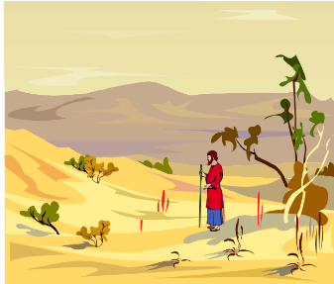
EMPTINESS OF FALSE TEACHERS
V. 17-19
Offer Nothing that is Permanently Satisfying
  Spring w/o water
  Mist

Slide 37
2 PETER 2 OUTLINE
Predicted arrival (2:1a)
Devices (2:1b-3)
Doom (2:4-9)
Depravity (2:10-16)
Emptiness (2:17-19)
Regression (2:20-22)

Slide 38
REGRESSION OF FALSE TEACHERS
V. 20-22
Return (20)
Accountability to God is Greater (21)
Two illustrations (22)

Slide 39
REGRESSION OF FALSE TEACHERS
V. 20-22
Return (20)
Accountability to God is Greater (21)
Two illustrations (22)

Slide 40
REGRESSION OF FALSE TEACHERS
V. 20-22
Return (20)
Accountability to God is Greater (21)
Two illustrations (22)

Slide 41
Matthew 11:20-24
²⁰ “Then He began to denounce the cities in which most of His miracles were done, because they did not repent. ^{21 ’}Woe to you, Chorazin! Woe to you, Bethsaida! For if the miracles had occurred in Tyre and Sidon which occurred in you, they would have repented long ago in sackcloth and ashes. ²² Nevertheless I say to you, it will be more tolerable for Tyre and Sidon in the day of judgment than for…

Slide 42
Matthew 11:20-24
…you.’” “²³And you, Capernaum, will not be exalted to heaven, will you? You will descend to Hades; for if the miracles had occurred in Sodom which occurred in you, it would have remained to this day. ²⁴Nevertheless I say to you that it will be more tolerable for the land of Sodom in the day of judgment, than for you.”

Slide 43
REGRESSION OF FALSE TEACHERS
V. 20-22
Return (20)
Accountability to God is Greater (21)
Two illustrations (22)

Slide 44
BELIEVER OR UNBELIEVER?
BELIEVER | UNBELIEVER
Purchased (1) | Dogs/pigs (22)
Knowledge of Christ (20) | Overcome (20)
Believers can sin (1:8-10) | Other unbelievers (4-6)
Examples of Lot and Balaam (7-8, 15-16) | Last state worse than the first (20)
 | Darkness reserved (17)

Slide 45
CONCLUSION

Slide 46
2 PETER 2 OUTLINE
Predicted arrival (2:1a)
Devices (2:1b-3)
Doom (2:4-9)
Depravity (2:10-16)
Emptiness (2:17-19)
Regression (2:20-22)

