Slide 1
Dr. Andy Woods
Senior Pastor – Sugar Land Bible Church
President – Chafer Theological Seminary

Slide 2
Preview of Angelology
Good angels
Satanology
Demonology
Gen. 6:1-4 controversy

Slide 3
Genesis 6:1-4
“¹ Now it came about, when men began to multiply on the face of the land, and daughters were born to them, ² that the sons of God saw that the daughters of men were beautiful; and they took wives for themselves, whomever they chose. ³ Then the Lord said, ‘My Spirit shall not strive with man forever, because he also is flesh; nevertheless his days shall be one hundred and twenty years.’ ⁴ The Nephilim were on the earth in those days, and also afterward, when the sons of God came in to the daughters of men, and they bore children to them. Those were the mighty men who were of old, men of renown.”

Slide 4
Genesis 6:1-4
“¹ Now it came about, when men began to multiply on the face of the land, and daughters were born to them, ² that the sons of God saw that the daughters of men were beautiful; and they took wives for themselves, whomever they chose. ³ Then the Lord said, ‘My Spirit shall not strive with man forever, because he also is flesh; nevertheless his days shall be one hundred and twenty years.’ ⁴ The Nephilim were on the earth in those days, and also afterward, when the sons of God came in to the daughters of men, and they bore children to them. Those were the mighty men who were of old, men of renown.”

Slide 5
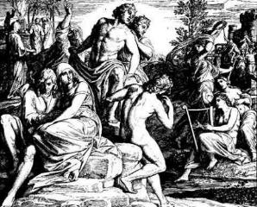
3 Major Alternative Views
Intermarriage between the Godly line of Seth and the ungodly lines of Cain
Polygamous Cainite despots
Fallen angels procreating with human women

Slide 6
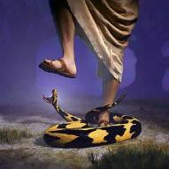
Genesis 3:15
“And I will put enmity Between you and the woman, And between your seed and her seed; He shall bruise you on the head, And you shall bruise him on the heel.”

Slide 7
Satanic Attempts to Stop Messiah
Herod; Mt.2; Rev 12:4
Cain; Gen. 4, 1 Jn. 3:12
Sons of God; Gen. 6:1-4
Pharaoh; Ex. 1
Athaliah; 2 Chron. 22
Haman; Esther
Matt 4:5-7

Slide 8
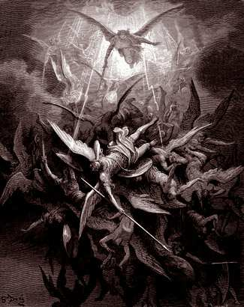
Lesson Overview
Defense of the Angel View
Old Testament
New Testament
Tradition
Objections

Slide 9
Lesson Overview
Defense of the Angel View
Old Testament
New Testament
Tradition
Objections

Slide 10
3 Reasons Supporting Sons of God
Men (6:1) versus the sons of God (6:2)
Old Testament uses (Gen 6:2, 4; Job 1:6; 2:1; 38:7)
Septuagint (LXX)

Slide 11
4 Additional Arguments From Genesis 6
Nephilim (Gen 6:4)
Noah’s perfection (6:9)
Evil of pre-flood humanity (Gen 6:3, 5-7, 11-13)
Necessity of the flood

Slide 12
Lesson Overview
Defense of the Angel View
Old Testament
New Testament
Tradition
Objections

Slide 13
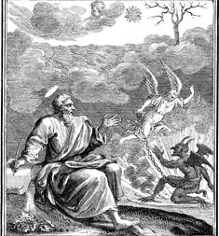
Relevant New Testament Passages
1 Peter 3:19-20
2 Peter 2:4-5
Jude 6-7

Slide 15
Ephesians 4:9-10
“⁹ (Now this expression, ‘He ascended,’ what does it mean except that He also had descended into the lower parts of the earth? ¹⁰ He who descended is Himself also He who ascended far above all the heavens, so that He might fill all things.)”

Slide 16
Carl Laney
Answers to Tough Questions, 277.
“Paul is saying in the context that Christ who went up to heaven (in His ascension) is the same one who had come down from heaven ( v. 10). That descent from heaven occurred when Christ came to the earth and was born as a human. This text refers to the incarnation of Jesus [and] not a descent into hell! The expression, ‘the lower parts of the earth,’ is an appositional genitive. This means that the ‘lower parts’ refers to ‘the earth.’ For example, ‘the city of Portland’ refers to the city, which is Portland. The ‘city’ and ‘Portland’ are one in the same.”

Slide 17
Lesson Overview
Defense of the Angel View
Old Testament
New Testament
Tradition
Objections

Slide 18
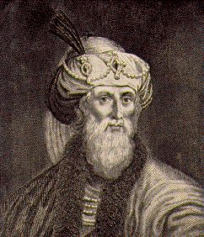
Jewish Tradition
Philo
Josephus
Most Rabbinical Writers
Apocrypha
Pseudepigrapha
Renald Showers, Those Invisible Spirits Called Angels, 93-109

Slide 19
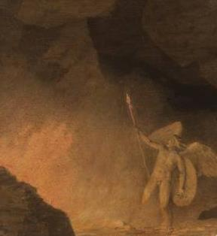
Christian Tradition
Justin
Clement
Tertullian
Cyprian
Ambrose
Lactantius
Renald Showers, Those Invisible Spirits Called Angels, 93-109

Slide 20
Renald Showers
Those Invisible Spirits Called Angels (Bellmawr, NJ: Friends of Israel, 1997), 96-97.
“﻿...it is interesting to note that the Sethite Line-Cainite View does not begin until the fourth century A.D. This makes it the newest of the three major views. The New Catholic Encyclopedia states that this view ‘that sees in these sons of God the Sethites and in the daughters of men the Cainites dates from the fourth century and is influenced by theological concern for maintaining the spirituality of the Angels.’ This seems to imply that the major motivation for starting this view was not exegesis of Scripture but opposition to the angel view...”

Slide 21
Lesson Overview
Defense of the Angel View
Old Testament
New Testament
Tradition
Objections

Slide 22
Objections
Angels do not marry? (Matt. 22:30)
Angels are spirits (Heb. 1:14)
Nephilim in the post – flood world? (Num. 13:33; Gen. 6:4a)
Nephilim in David’s day? (2 Sam. 21:20)
Why is this sin not replicated today?

Slide 23
Objections
Angels do not marry? (Matt. 22:30)
Angels are spirits (Heb. 1:14)
Nephilim in the post – flood world? (Num. 13:33; Gen. 6:4a)
Nephilim in David’s day? (2 Sam. 21:20)
Why is this sin not replicated today?

Slide 24
Matthew 22:30
“For in the resurrection they neither marry nor are given in marriage, but are like angels in heaven.”

Slide 25
Objections
Angels do not marry? (Matt. 22:30)
Angels are spirits (Heb. 1:14)
Nephilim in the post – flood world? (Num. 13:33; Gen. 6:4a)
Nephilim in David’s day? (2 Sam. 21:20)
Why is this sin not replicated today?

Slide 26
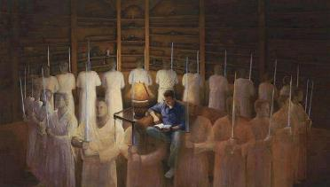
Hebrews 1:14
“Are they not all ministering spirits, sent out to render service for the sake of those who will inherit salvation?”

Slide 27
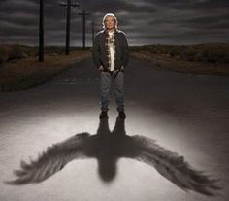
Hebrews 13:2
“Do not neglect to show hospitality to strangers, for by this some have entertained angels without knowing it.”

Slide 28
Genesis 18:22; 19:1
“^{18:22} Then the men turned away from there and went toward Sodom, while Abraham was still standing before the Lord… ^{19:1} Now the two angels came to Sodom in the evening as Lot was sitting in the gate of Sodom. When Lot saw them, he rose to meet them and bowed down with his face to the ground.”

Slide 29
Genesis 18:5-8
⁵ “and I will bring a piece of bread, that you may refresh yourselves; after that you may go on, since you have visited your servant.” And they said, “So do, as you have said.” ⁶ So Abraham hurried into the tent to Sarah, and said, “Quickly, prepare three measures of fine flour, knead it and make bread cakes.” ⁷ Abraham also ran to the herd, and took a tender and choice calf and gave it to the servant, and he hurried to prepare it. ⁸ He took curds and milk and the calf which he had prepared, and placed it before them; and he was standing by them under the tree as they ate.”

Slide 30
Objections
Angels do not marry? (Matt. 22:30)
Angels are spirits (Heb. 1:14)
Nephilim in the post – flood world? (Num. 13:33; Gen. 6:4a)
Nephilim in David’s day? (2 Sam. 21:20)
Why is this sin not replicated today?

Slide 31
Genesis 7:19-23
“They rose greatly on the earth, and all the high mountains under the entire heaven were covered…Every living thing that moved on the earth perished—birds, livestock, wild animals, all the creatures that swarm over the earth, and all mankind. Everything on dry land that had the breath of life in its nostrils died. Every living thing on the face of the earth was wiped out; men and animals and the creatures that move along the ground and the birds of the air were wiped from the earth. Only Noah was left, and those with him in the ark.”

Slide 32
Numbers 13:32-33
³² So they gave out to the sons of Israel a bad report of the land which they had spied out, saying, “The land through which we have gone, in spying it out, is a land that devours its inhabitants; and all the people whom we saw in it are men of great size. ³³ There also we saw the Nephilim (the sons of Anak are part of the Nephilim); and we became like grasshoppers in our own sight, and so we were in their sight.”

Slide 33
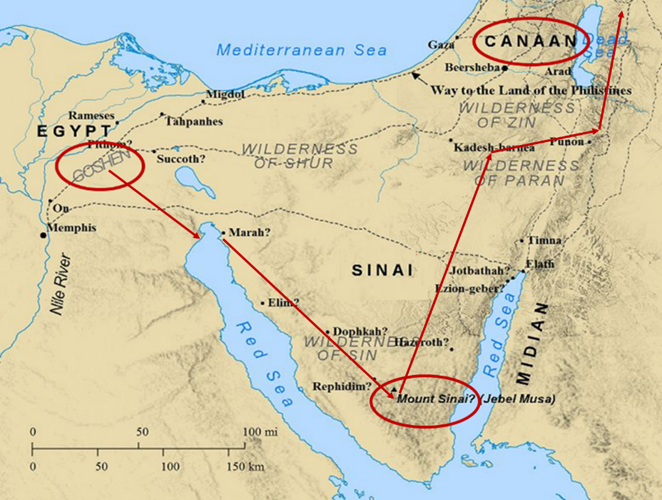

Slide 34
Finis Jennings Dake
God's Plan for Man: Revealing God's Perfect Plan for All Creation (Lawrenceville, GA: Dake Bible Sales, 1949), 197.
“There were two eruptions of the fallen angels among men. They produced races of giants on the Earth each time. The first eruption was before the flood, and the second one was after the flood. This is plainly stated in Gen. 6:4: ‘There were giants in the earth in those days [before the flood]; and also after that [after the flood], when the sons of God came in unto the daughters of men, and they bare children to them, the same became mighty men which were of old, men of renown.’”

Slide 35
Numbers 13:32-33
³² So they gave out to the sons of Israel a bad report of the land which they had spied out, saying, “The land through which we have gone, in spying it out, is a land that devours its inhabitants; and all the people whom we saw in it are men of great size. ³³ There also we saw the Nephilim (the sons of Anak are part of the Nephilim); and we became like grasshoppers in our own sight, and so we were in their sight.”

Slide 36
Ronald Allen
"Numbers," in Expositor's Bible Commentary, ed. Frank E. Gaebelein et al (Grand Rapids: Zondervan, 1981), Numbers 13:31-33.
“By speaking evil concerning the land, the faithless spies were speaking evil of him. At this point their words became exaggerations and distortions. The Anakites (who were of large size) were now said to be Nephilim, the race of giants described briefly in the mysterious context of the cohabitation of the sons of God and the daughters of men (Gen 6:4). The use of the term Nephilim seems to be deliberately provocative of fear, a term not unlike the concept of bogeymen and hobgoblins. The exaggeration of the faithless led them to their final folly: ‘We seemed like grasshoppers in our own eyes, and we looked the same to them.’ ” We have noted the possible use of rhetorical . . .

Slide 37
Ronald Allen
"Numbers," in Expositor's Bible Commentary, ed. Frank E. Gaebelein et al (Grand Rapids: Zondervan, 1981), Numbers 13:31-33.
“. . . exaggeration, hyperbole, in the numbers of the tribes of Israel—power numbers to bring encouragement to the nation in the confidence they must have in the fulfillment of the promises of God (see Introduction, sections on large numbers). In the report of the evil spies, we see that rhetorical exaggeration can work both ways. By describing themselves as mere grasshoppers in the sight of the fabulous Nephilim, they frightened the sandals off the people and led a nation to grievous sin of unbelief against their caring God.”

Slide 39
Finis Jennings Dake
God's Plan for Man: Revealing God's Perfect Plan for All Creation (Lawrenceville, GA: Dake Bible Sales, 1949), 197.
“There were two eruptions of the fallen angels among men. They produced races of giants on the Earth each time. The first eruption was before the flood, and the second one was after the flood. This is plainly stated in Gen. 6:4: ‘There were giants in the earth in those days [before the flood]; and also after that [after the flood], when the sons of God came in unto the daughters of men, and they bare children to them, the same became mighty men which were of old, men of renown.’”

Slide 40
Genesis 6:1-4
“¹ Now it came about, when men began to multiply on the face of the land, and daughters were born to them, ² that the sons of God saw that the daughters of men were beautiful; and they took wives for themselves, whomever they chose. ³ Then the Lord said, ‘My Spirit shall not strive with man forever, because he also is flesh; nevertheless his days shall be one hundred and twenty years.’ ⁴ The Nephilim were on the earth in those days, and also afterward, when the sons of God came in to the daughters of men, and they bore children to them. Those were the mighty men who were of old, men of renown.”

Slide 41
Genesis 6:1-4
“¹ Now it came about, when men began to multiply on the face of the land, and daughters were born to them, ² that the sons of God saw that the daughters of men were beautiful; and they took wives for themselves, whomever they chose. ³ Then the Lord said, ‘My Spirit shall not strive with man forever, because he also is flesh; nevertheless his days shall be one hundred and twenty years.’ ⁴ The Nephilim were on the earth in those days, and also afterward, when the sons of God came in to the daughters of men, and they bore children to them. Those were the mighty men who were of old, men of renown.”

Slide 42
Objections
Angels do not marry? (Matt. 22:30)
Angels are spirits (Heb. 1:14)
Nephilim in the post – flood world? (Num. 13:33; Gen. 6:4a)
Nephilim in David’s day? (2 Sam. 21:20)
Why is this sin not replicated today?

Slide 43
Finis Jennings Dake
God's Plan for Man: Revealing God's Perfect Plan for All Creation (Lawrenceville, GA: Dake Bible Sales, 1949), 197-198.
“The second eruption of fallen angels was evidently smaller in number and more limited in area; they were for the most part confined to the land of Canaan, and their offspring were known as the nations of Canaan. They were known as Rephaim (Gen. 14:5; 15:20; Deut. 2:11, 20, 21; 3:11-13; Josh. 12:4; 13:12; 15:8; 17:15; 18:16); Anakim (Num. 13:22; Deut. 1:28; 2:10-11, 21; 9:2; Josh. 11:21-22; 14:12-15); Horim (Gen. 14:6; Deut. 2:12, 20, 21); Avim (Deut. 2:23; Josh. 13:3); Zanzumim (Deut. 2:20); and other names. They are enumerated in Gen. 15:18-21; Exod. 3:8, 17; 23:23; Num. 13:22; Deut. 7:1; 20:17; Josh. 12:8...”

Slide 44
Finis Jennings Dake
God's Plan for Man: Revealing God's Perfect Plan for All Creation (Lawrenceville, GA: Dake Bible Sales, 1949), 197-198.
“…These were to be utterly destroyed by the sword of Israel just as the flood had destroyed the ones that had lived in the Dispensation of Conscience (Deut. 7:1-5; 20:17; Josh. 3:10). Israel failed in this purpose so the giants were left to test and prove the chosen people (Josh. 13:13; 15:63; 16:10; 17:18; Judg. 1:19-36; 2:1-5; 3:1-7). The giants made trouble for Israel until the time of David when the last of the races of the giants were killed (1 Sam. 17; 2 Sam. 21:15-22; 1 Chron. 20:4-8).”

Slide 45
2 Samuel 21:20
There was war at Gath again, where there was a man of great stature who had six fingers on each hand and six toes on each foot, twenty-four in number; and he also had been born to the giant.”

Slide 46
Deuteronomy 3:11
“For only Og king of Bashan was left of the remnant of the Rephaim. Behold, his bedstead was an iron bedstead; it is in Rabbah of the sons of Ammon. Its length was nine cubits and its width four cubits by ordinary cubit.”

Slide 47
1 Chronicles 11:22
“Benaiah the son of Jehoiada, the son of a valiant man of Kabzeel, mighty in deeds, struck down the two sons of Ariel of Moab. He also went down and killed a lion inside a pit on a snowy day.”

Slide 49
Finis Jennings Dake
God's Plan for Man: Revealing God's Perfect Plan for All Creation (Lawrenceville, GA: Dake Bible Sales, 1949), 197-198.
“…These were to be utterly destroyed by the sword of Israel just as the flood had destroyed the ones that had lived in the Dispensation of Conscience (Deut. 7:1-5; 20:17; Josh. 3:10). Israel failed in this purpose so the giants were left to test and prove the chosen people (Josh. 13:13; 15:63; 16:10; 17:18; Judg. 1:19-36; 2:1-5; 3:1-7). The giants made trouble for Israel until the time of David when the last of the races of the giants were killed (1 Sam. 17; 2 Sam. 21:15-22; 1 Chron. 20:4-8).”

Slide 50
Joshua 6:21
“They utterly destroyed everything in the city, both man and woman, young and old, and ox and sheep and donkey, with the edge of the sword.”

Slide 51
1 Samuel 15:2-3
^{“2} Thus says the Lord of hosts, ‘I will punish Amalek for what he did to Israel, how he set himself against him on the way while he was coming up from Egypt. ³ Now go and strike Amalek and utterly destroy all that he has, and do not spare him; but put to death both man and woman, child and infant, ox and sheep, camel and donkey.”

Slide 52
Daniel 6:24
“The king then gave orders, and they brought those men who had maliciously accused Daniel, and they cast them, their children and their wives into the lions’ den; and they had not reached the bottom of the den before the lions overpowered them and crushed all their bones.”

Slide 53
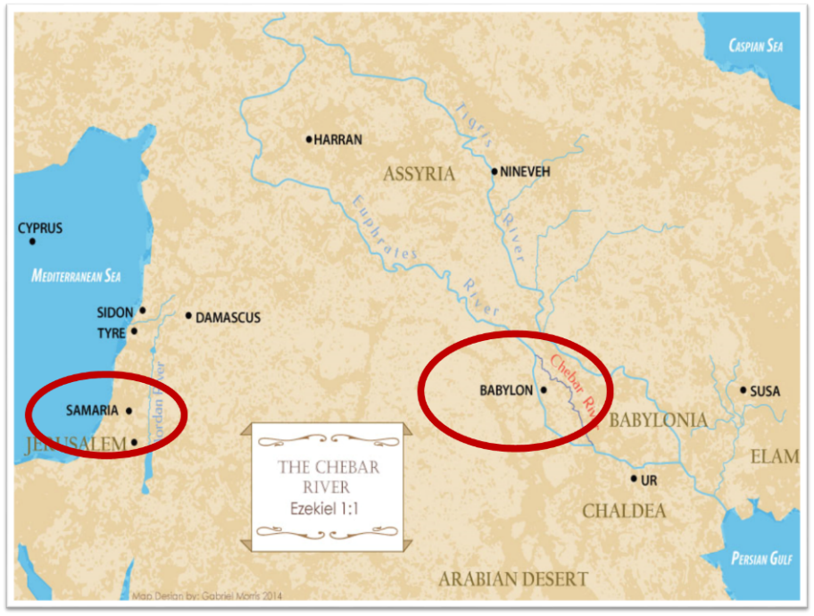

Slide 54
Objections
Angels do not marry? (Matt. 22:30)
Angels are spirits (Heb. 1:14)
Nephilim in the post – flood world? (Num. 13:33; Gen. 6:4a)
Nephilim in David’s day? (2 Sam. 21:20)
Why is this sin not replicated today?

Slide 55
Relevant New Testament Passages
1 Peter 3:19-20
2 Peter 2:4-5
Jude 6-7

Slide 56
1 Peter 3:19-20
“¹⁹ in which also He went and made proclamation the spirits now in prison, ²⁰ who once were disobedient, when the patience of God kept waiting in the days of Noah, during the construction of the ark, in which a few, that is, eight persons, were brought safely through the water.”

Slide 57
2 Peter 2:4-5
“⁴ For if God did not spare angels when they sinned, but cast them into hell and committed them to pits of darkness, reserved for judgment; ⁵ and did not spare the ancient world, but preserved Noah, a preacher of righteousness, with seven others, when He brought a flood upon the world of the ungodly.”

Slide 58
Jude 6-7
“⁶ And angels who did not keep their own domain, but abandoned their proper abode, He has kept in eternal bonds under darkness for the judgment of the great day, ⁷ just as Sodom and Gomorrah and the cities around them, since they in the same way as these indulged in gross immorality and went after strange flesh, are exhibited as an example in undergoing the punishment of eternal fire.”

Slide 60
Matthew 8:28-29
“²⁸ When He came to the other side into the country of the Gadarenes, two men who were demon-possessed met Him as they were coming out of the tombs. They were so extremely violent that no one could pass by that way. ²⁹ And they cried out, saying, ‘What business do we have with each other, Son of God? Have You come here to torment us before the time?’”

Slide 61
Genesis 3:15
“And I will put enmity Between you and the woman, And between your seed and her seed; He shall bruise you on the head, And you shall bruise him on the heel.”

Slide 62
Satanic Attempts to Stop Messiah
Herod; Mt.2; Rev 12:4
Cain; Gen. 4, 1 Jn. 3:12
Sons of God; Gen. 6:1-4
Pharaoh; Ex. 1
Athaliah; 2 Chron. 22
Haman; Esther
Matt 4:5-7

Slide 63
1 Peter 3:19-20
“¹⁹ in which also He went and made proclamation (kēryssō; not euanagelizō) the spirits now in prison, ²⁰ who once were disobedient, when the patience of God kept waiting in the days of Noah, during the construction of the ark, in which a few, that is, eight persons, were brought safely through the water.”

Slide 64
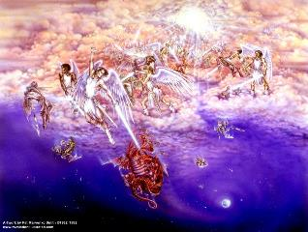
Satan’s Two Strategies
Rev 12:1-5 – Past failed strategy
Rev 12:6-17 – Present & future strategy

Slide 65
Modern Angelic Incursions?
Three Verses Typically Used
Genesis 6:4
Numbers 13:33
Matthew 24:38-39

Slide 66
Modern Angelic Incursions?
Three Verses Typically Used
Genesis 6:4
Numbers 13:33
Matthew 24:38-39

Slide 67
Genesis 6:1-4
“¹ Now it came about, when men began to multiply on the face of the land, and daughters were born to them, ² that the sons of God saw that the daughters of men were beautiful; and they took wives for themselves, whomever they chose. ³ Then the Lord said, ‘My Spirit shall not strive with man forever, because he also is flesh; nevertheless his days shall be one hundred and twenty years.’ ⁴ The Nephilim were on the earth in those days, and also afterward, when the sons of God came in to the daughters of men, and they bore children to them. Those were the mighty men who were of old, men of renown.”

Slide 68
Genesis 6:1-4
“¹ Now it came about, when men began to multiply on the face of the land, and daughters were born to them, ² that the sons of God saw that the daughters of men were beautiful; and they took wives for themselves, whomever they chose. ³ Then the Lord said, ‘My Spirit shall not strive with man forever, because he also is flesh; nevertheless his days shall be one hundred and twenty years.’ ⁴ The Nephilim were on the earth in those days, and also afterward, when the sons of God came in to the daughters of men, and they bore children to them. Those were the mighty men who were of old, men of renown.”

Slide 69
Modern Angelic Incursions?
Three Verses Typically Used
Genesis 6:4
Numbers 13:33
Matthew 24:38-39

Slide 70
Numbers 13:32-33
³² So they gave out to the sons of Israel a bad report of the land which they had spied out, saying, “The land through which we have gone, in spying it out, is a land that devours its inhabitants; and all the people whom we saw in it are men of great size. ³³ There also we saw the Nephilim (the sons of Anak are part of the Nephilim); and we became like grasshoppers in our own sight, and so we were in their sight.”

Slide 71
Modern Angelic Incursions?
Three Verses Typically Used
Genesis 6:4
Numbers 13:33
Matthew 24:38-39

Slide 72
Matthew 24:38-39
³⁸ For as in those days before the flood they were eating and drinking, marrying and giving in marriage, until the day that Noah entered the ark, ³⁹ and they did not understand until the flood came and took them all away; so will the coming of the Son of Man be.”

Slide 73
Matthew 24:32-33
³² “Now learn the parable from the fig tree: when its branch has already become tender and puts forth its leaves, you know that summer is near; ³³ so, you too, when you see all these things, recognize that He is near, right at the door.”

Slide 74
Dr. Roy B. Zuck
Roy B. Zuck, Basic Bible Interpretation, p. 215-16.
“﻿Usually a parable, like a sermon illustration, is teaching a single truth. When Jesus explained a number of His parables, He usually…stated one spiritual truth. For example when the man found his one lost sheep, he rejoiced, and Jesus said this illustrates the truth that there is rejoicing in heaven when a sinner repents (Luke 15:7)...He gave one simple spiritual lesson, and made no attempt to see any spiritual significance to the vineyard, the denarius, or the sixth hour, the ninth hour, or the eleventh hour, nor the vineyard foreman…To hunt for meanings in every detail in the parables is to turn them into allegories.”

Slide 75
Matthew 24:38-39
³⁸ For as in those days before the flood they were eating and drinking, marrying and giving in marriage, until the day that Noah entered the ark, ³⁹ and they did not understand until the flood came and took them all away; so will the coming of the Son of Man be.”

Slide 76
CONCLUSION

Slide 77
Objections
Angels do not marry? (Matt. 22:30)
Angels are spirits (Heb. 1:14)
Nephilim in the post – flood world? (Num. 13:33; Gen. 6:4a)
Nephilim in David’s day? (2 Sam. 21:20)
Why is this sin not replicated today?

Slide 78
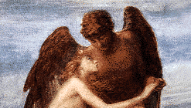
Lesson Overview
Defense of the Angel View
Old Testament
New Testament
Tradition
Objections

