Slide 1
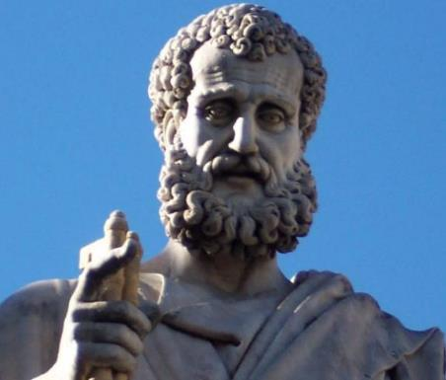

2 Peter
Dr. Andy Woods
Senior Pastor – Sugar Land Bible Church
President – Chafer Theological Seminary

Slide 2

INTRODUCTORY MATTERS
Authorship: Peter
Biography: Gospels & Acts
Date: A.D. 64
Recipients: Regenerated, Asia Minor, Hebrews
Place of writing: Babylon
Occasion for writing: Incipient Gnosticism
Purpose: Insulation from false teaching
Structure: 3 parts
Message: Protection from false teachers
Unique characteristics: Knowledge

Slide 3
STRUCTURE
2 Peter 1 – Call to maturity
2 Peter 2 – Characteristics of false teachers
2 Peter 3 – Doctrine of the false teachers (uniformitarianism)

Slide 4
STRUCTURE
2 Peter 1 – Call to maturity
2 Peter 2 – Characteristics of false teachers
2 Peter 3 – Doctrine of the false teachers (uniformitarianism)

Slide 5
2 PETER
Chapter 1
Introduction (1:1-2)
Call to Growth (1:3-11)
Purpose Statement (1:12-15)
Coming kingdom (1:16-21)

Slide 6
STRUCTURE
2 Peter 1 – Call to maturity
2 Peter 2 – Characteristics of false teachers
2 Peter 3 – Doctrine of the false teachers (uniformitarianism)

Slide 7
2 PETER
Characteristics of false teachers
(2 Peter 2)

Slide 8
2 PETER 2 OUTLINE
Predicted arrival (2:1a)
Devices (2:1b-3)
Doom (2:4-9)
Depravity (2:10-16)
Emptiness (2:17-19)
Regression (2:20-22)

Slide 9
2 PETER 2 OUTLINE
Predicted arrival (2:1a)
Devices (2:1b-3)
Doom (2:4-9)
Depravity (2:10-16)
Emptiness (2:17-19)
Regression (2:20-22)

Slide 10
DEVICES OF FALSE TEACHERS
V. 1b-3
False Teaching (1b)
License (2)
Greed (3a)
Exploit the Flock (3b)
False words (3c)

Slide 11
DEVICES OF FALSE TEACHERS
V. 1b-3
False Teaching (1b)
License (2)
Greed (3a)
Exploit the Flock (3b)
False words (3c)

Slide 12
DEVICES OF FALSE TEACHERS
V. 1b-3
False Teaching (1b)
License (2)
Greed (3a)
Exploit the Flock (3b)
False words (3c)

Slide 13
2 PETER 2 OUTLINE
Predicted arrival (2:1a)
Devices (2:1b-3)
Doom (2:4-9)
Depravity (2:10-16)
Emptiness (2:17-19)
Regression (2:20-22)

Slide 14
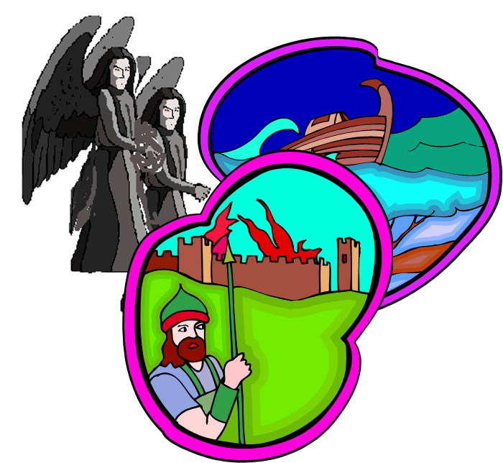
DOOM OF FALSE TEACHERS
V.4-9
Judgment of God (6-8) – 3 Historical Examples
  Fallen angels (4)
  Flood (5)
  Sodom & Gomorrah (6-8)
Conclusion (9)

Slide 15
DOOM OF FALSE TEACHERS
V.4-9
Judgment of God (6-8) – 3 Historical Examples
  Fallen angels (4)
  Flood (5)
  Sodom & Gomorrah (6-8)
Conclusion (9)

Slide 16
DOOM OF FALSE TEACHERS
V.4-9
Judgment of God (6-8) – 3 Historical Examples
  Fallen angels (4)
  Flood (5)
  Sodom & Gomorrah (6-8)
Conclusion (9)

Slide 17

2 Peter 2:4-5
“⁴ For if God did not spare angels when they sinned, but cast them into hell and committed them to pits of darkness, reserved for judgment; ⁵ and did not spare the ancient world, but preserved Noah, a preacher of righteousness, with seven others, when He brought a flood upon the world of the ungodly.”

Slide 18

Genesis 6:1-4
“¹ Now it came about, when men began to multiply on the face of the land, and daughters were born to them, ² that the sons of God saw that the daughters of men were beautiful; and they took wives for themselves, whomever they chose. ³ Then the Lord said, ‘My Spirit shall not strive with man forever, because he also is flesh; nevertheless his days shall be one hundred and twenty years.’ ⁴ The Nephilim were on the earth in those days, and also afterward, when the sons of God came in to the daughters of men, and they bore children to them. Those were the mighty men who were of old, men of renown.”

Slide 19
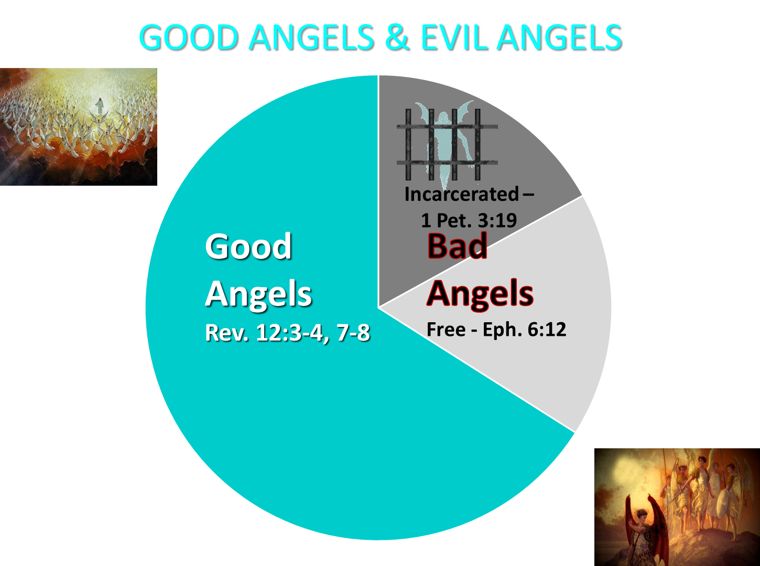

Slide 20
1 Peter 3:19-20
“¹⁹ in which also He went and made proclamation the spirits now in prison, ²⁰ who once were disobedient, when the patience of God kept waiting in the days of Noah, during the construction of the ark, in which a few, that is, eight persons, were brought safely through the water.”

Slide 21
Jude 6-7
“⁶ And angels who did not keep their own domain, but abandoned their proper abode, He has kept in eternal bonds under darkness for the judgment of the great day, ⁷ just as Sodom and Gomorrah and the cities around them, since they in the same way as these indulged in gross immorality and went after strange flesh, are exhibited as an example in undergoing the punishment of eternal fire.”

Slide 22
DOOM OF FALSE TEACHERS
V.4-9
Judgment of God (6-8) – 3 Historical Examples
  Fallen angels (4)
  Flood (5)
  Sodom & Gomorrah (6-8)
Conclusion (9)

Slide 23
2 Peter 2:4-5
“⁴ For if God did not spare angels when they sinned, but cast them into hell and committed them to pits of darkness, reserved for judgment; ⁵ and did not spare the ancient world, but preserved Noah, a preacher of righteousness, with seven others, when He brought a flood upon the world of the ungodly.”

Slide 24
1 Peter 3:19-20
“¹⁹ in which also He went and made proclamation the spirits now in prison, ²⁰ who once were disobedient, when the patience of God kept waiting in the days of Noah, during the construction of the ark, in which a few, that is, eight persons, were brought safely through the water.”

Slide 25
DOOM OF FALSE TEACHERS
V.4-9
Judgment of God (6-8) – 3 Historical Examples
  Fallen angels (4)
  Flood (5)
  Sodom & Gomorrah (6-8)
Conclusion (9)

Slide 26

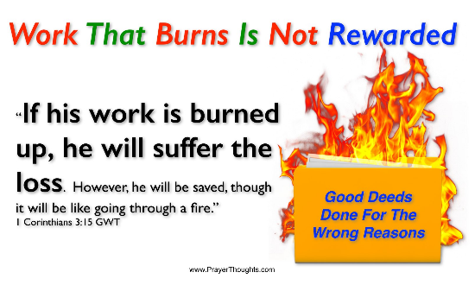
1 Corinthians 3:15
“If any man’s work is burned up, he will suffer loss; but he himself will be saved, yet so as through fire.”

Slide 27
1 Corinthians 3:1-3 (NKJV)
¹ And I, brethren, could not speak to you as to spiritual people but as to carnal, as to babes in Christ. ² I fed you with milk and not with solid food; for until now you were not able to receive it, and even now you are still not able; ³ for you are still carnal. For where there are envy, strife, and divisions among you, are you not carnal and behaving like mere men?

Slide 28

Notes:
Ray Steadman – “1st Californians”
Unbelievers vs Categories of Believers
Unbelievers – ψυχικός psuchikós; Natural, pertaining to the natural as distinguished from the spiritual
Spiritual Believers – πνευματικός pneumatikós; of persons who are spiritual, enlightened by the Holy Spirit
Infant Believers – σάρκινος sárkinos; with propensities of the flesh unto sin; νήπιος nḗpios; an infant, child, baby without any definite limitation of age. (This relates to immaturity and lack of instruction)
Carnal Believers – σαρκικός sarkikós; tendency to satisfy the flesh, implying sinfulness, sinful propensity, carnal (This relates to disobedience and open rebellion)

Slide 29
YIELDING TO THE OLD (SIN) NATURE
BELIEVER’S CONSEQUENCES | PASSAGE(S)
Lack of power | (Gal 5:16; 1 Thess. 5:19)
Grieving the Holy Spirit | (Eph 4:30-32)
Loss of joy | (Ps. 51:4, 12; Gal. 5:22-23)
Loss of spiritual sight | (2 Pet. 1:8-10; Luke 15:18-19)
Lack of growth | (1 Pet. 2:1-2)
Carnality | (1 Cor 3:1-3)
Unfruitfulness | (John 15:5, 8)
Lack of purpose | (Eccles. 1:2-3, 8; Mark 8:35)
Lack of stability | (Gal. 3:3; 2 Tim. 2:18; 2 Pet. 3:17)

Slide 30
YIELDING TO THE OLD (SIN) NATURE
BELIEVER’S CONSEQUENCES | PASSAGE(S)
Conviction | (2 Pet 2:7-8; Ps 32:1-5)
Divine discipline | (Heb. 12:5-11; Rev. 3:19)
Premature death | (Acts 5:1-11; 1 Cor 11:30; 1 John 5:16; Rev 2:22-23)
Loss of reward | (1 Cor. 3:15; 9:27; 2 John 8; Rev 3:11)
Loss of fellowship | (1 John 1:9)
Excommunication | (1 Cor 5:4-5; Matt 18:15-17)
Temporal consequences | (Gal 6:7-8)
Unanswered prayer | (Ps 66:18; 1 Pet 3:7)
Loss of testimony | (Gen 19:14)
Loss of leadership privileges | (1 Tim 3:1-13; 2 Sam. 12)

Slide 31
DOOM OF FALSE TEACHERS
V.4-9
Judgment of God (6-8) – 3 Historical Examples
  Fallen angels (4)
  Flood (5)
  Sodom & Gomorrah (6-8)
Conclusion (9)

Slide 32
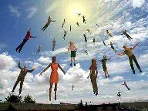
When Will the Rapture Take Place Relative to the Tribulation Period?
Pre-tribulation rapture theory
Mid-tribulation rapture theory
Post-tribulation rapture theory
Pre-wrath rapture theory
Partial rapture theory

Slide 33


Slide 34
2 PETER 2 OUTLINE
Predicted arrival (2:1a)
Devices (2:1b-3)
Doom (2:4-9)
Depravity (2:10-16)
Emptiness (2:17-19)
Regression (2:20-22)

Slide 35
DEPRAVITY OF FALSE TEACHERS
V.10-16
Licentious (10a)
Lawless (10b-11)
Animalistic (12)
Shameless pleasure seekers (13)
Eyes full of adultery (14a)
Entice unstable souls (14b)
Greedy (14c-16)

Slide 36
DEPRAVITY OF FALSE TEACHERS
V.10-16
Licentious (10a)
Lawless (10b-11)
Animalistic (12)
Shameless pleasure seekers (13)
Eyes full of adultery (14a)
Entice unstable souls (14b)
Greedy (14c-16)

Slide 37

Mark 7:20-23
“²⁰ And He was saying, ‘That which proceeds out of the man, that is what defiles the man. ²¹ For from within, out of the heart of men, proceed the evil thoughts, fornications, thefts, murders, adulteries, ²² deeds of coveting and wickedness, as well as deceit, sensuality, envy, slander, pride and foolishness. ²³ All these evil things proceed from within and defile the man.’”

Slide 38
DEPRAVITY OF FALSE TEACHERS
V.10-16
Licentious (10a)
Lawless (10b-11)
Animalistic (12)
Shameless pleasure seekers (13)
Eyes full of adultery (14a)
Entice unstable souls (14b)
Greedy (14c-16)

Slide 39
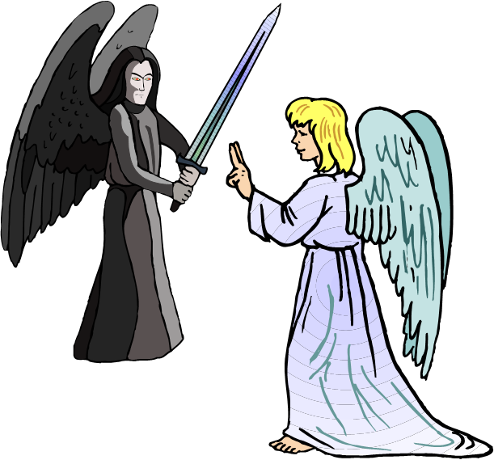
ARROGANCE OF FALSE TEACHERS
V.10b-11
Despise Authority
  Slander fallen angels
Daring and Self-willed

Slide 40
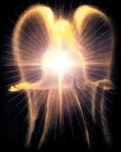

Satan’s Progressive Defeat
Initial eviction from heaven (Isa 14:12-15; Ezek 28:12-17)
Eden (Gen 3:15)
Pre-diluvian world (1 Pet 3:19-20)
Cross (John 12:31; 16:11; Col 2:15; Heb 2:14; 1 John 3:8)
Mid point of the Tribulation (Rev 12:9)
Beginning of millennium (Rev 20:2-3)
End of millennium (Rev 20:10)

Slide 41
Revelation 20:1-3
“Then I saw an angel coming down from heaven, holding the key of the abyss and a great chain in his hand. ² And he laid hold of the dragon, the serpent of old, who is the devil and Satan, and bound him for a thousand years; ³ and he threw him into the abyss, and shut it and sealed it over him, so that he would not deceive the nations any longer, until the thousand years were completed; after these things he must be released for a short time.”

Slide 42
DEPRAVITY OF FALSE TEACHERS
V.10-16
Licentious (10a)
Lawless (10b-11)
Animalistic (12)
Shameless pleasure seekers (13)
Eyes full of adultery (14a)
Entice unstable souls (14b)
Greedy (14c-16)

Slide 43
DEPRAVITY OF FALSE TEACHERS
V.10-16
Licentious (10a)
Lawless (10b-11)
Animalistic (12)
Shameless pleasure seekers (13)
Eyes full of adultery (14a)
Entice unstable souls (14b)
Greedy (14c-16)

Slide 44
DEPRAVITY OF FALSE TEACHERS
V.10-16
Licentious (10a)
Lawless (10b-11)
Animalistic (12)
Shameless pleasure seekers (13)
Eyes full of adultery (14a)
Entice unstable souls (14b)
Greedy (14c-16)

Slide 45
DEPRAVITY OF FALSE TEACHERS
V.10-16
Licentious (10a)
Lawless (10b-11)
Animalistic (12)
Shameless pleasure seekers (13)
Eyes full of adultery (14a)
Entice unstable souls (14b)
Greedy (14c-16)

Slide 46
STRUCTURE
2 Peter 1 – Call to maturity
2 Peter 2 – Characteristics of false teachers
2 Peter 3 – Doctrine of the false teachers (uniformitarianism)

Slide 47
DEPRAVITY OF FALSE TEACHERS
V.10-16
Licentious (10a)
Lawless (10b-11)
Animalistic (12)
Shameless pleasure seekers (13)
Eyes full of adultery (14a)
Entice unstable souls (14b)
Greedy (14c-16)

Slide 48
2 PETER 2 OUTLINE
Predicted arrival (2:1a)
Devices (2:1b-3)
Doom (2:4-9)
Depravity (2:10-16)
Emptiness (2:17-19)
Regression (2:20-22)

Slide 49
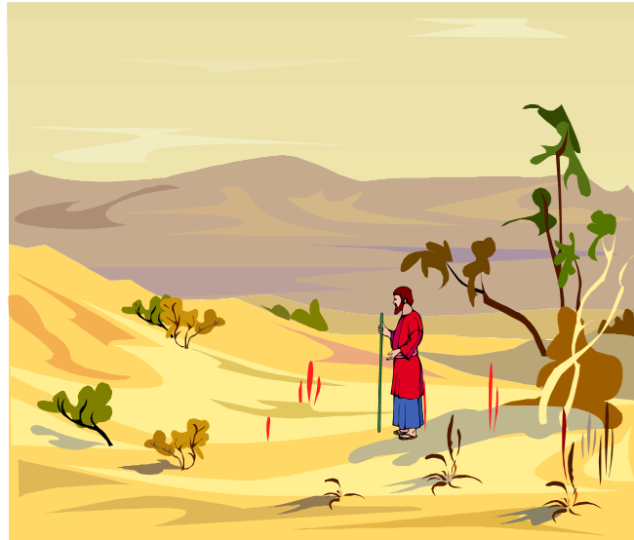
EMPTINESS OF FALSE TEACHERS
V. 17-19
Offer Nothing that is Permanently Satisfying
  Spring w/o water
  Mist

Slide 50
2 PETER 2 OUTLINE
Predicted arrival (2:1a)
Devices (2:1b-3)
Doom (2:4-9)
Depravity (2:10-16)
Emptiness (2:17-19)
Regression (2:20-22)

Slide 51
REGRESSION OF FALSE TEACHERS
V. 20-22
Return (20)
Accountability to God is Greater (21)
Two illustrations (22)

Slide 52
REGRESSION OF FALSE TEACHERS
V. 20-22
Return (20)
Accountability to God is Greater (21)
Two illustrations (22)

Slide 53
REGRESSION OF FALSE TEACHERS
V. 20-22
Return (20)
Accountability to God is Greater (21)
Two illustrations (22)

Slide 54
Matthew 11:20-24
²⁰ “Then He began to denounce the cities in which most of His miracles were done, because they did not repent. ^{21 ’}Woe to you, Chorazin! Woe to you, Bethsaida! For if the miracles had occurred in Tyre and Sidon which occurred in you, they would have repented long ago in sackcloth and ashes. ²² Nevertheless I say to you, it will be more tolerable for Tyre and Sidon in the day of judgment than for…

Slide 55
Matthew 11:20-24
…you.’” “²³And you, Capernaum, will not be exalted to heaven, will you? You will descend to Hades; for if the miracles had occurred in Sodom which occurred in you, it would have remained to this day. ²⁴Nevertheless I say to you that it will be more tolerable for the land of Sodom in the day of judgment, than for you.”

Slide 56
REGRESSION OF FALSE TEACHERS
V. 20-22
Return (20)
Accountability to God is Greater (21)
Two illustrations (22)

Slide 57
BELIEVER OR UNBELIEVER?
BELIEVER | UNBELIEVER
Purchased (1) | Dogs/pigs (22)
Knowledge of Christ (20) | Overcome (20)
Believers can sin (1:8-10) | Other unbelievers (4-6)
Examples of Lot and Balaam (7-8, 15-16) | Last state worse than the first (20)
 | Darkness reserved (17)

Slide 58
CONCLUSION

Slide 59
2 PETER 2 OUTLINE
Predicted arrival (2:1a)
Devices (2:1b-3)
Doom (2:4-9)
Depravity (2:10-16)
Emptiness (2:17-19)
Regression (2:20-22)

