Slide 1
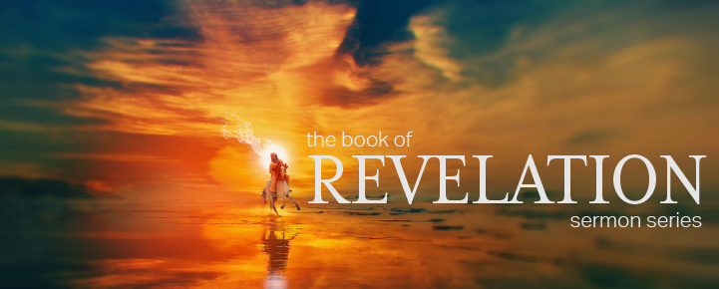
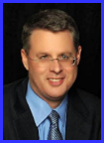
Dr. Andy Woods
Senior Pastor – Sugar Land Bible Church
President – Chafer Theological Seminary

Slide 2
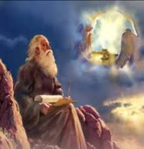
“After These Things” (Rev. 4‒22)
Before the Tribulation (4‒5)
During the Tribulation (6‒19)
After the Tribulation (20‒22)
Kingdom (20:1-10)
Great White Throne Judgment (20:11-15)
Destruction of the Earth (21:1)
New Heaven and New Earth (21‒22)

Slide 3
The Eternal State Revelation 21‒22
The New Heavens & Earth (21:1-8)
The New Jerusalem (21:9‒22:5)
Epilogue (22:6-21)

Slide 4
The Eternal State Revelation 21‒22
The New Heavens & Earth (21:1-8)
The New Jerusalem (21:9‒22:5)
Epilogue (22:6-21)

Slide 5
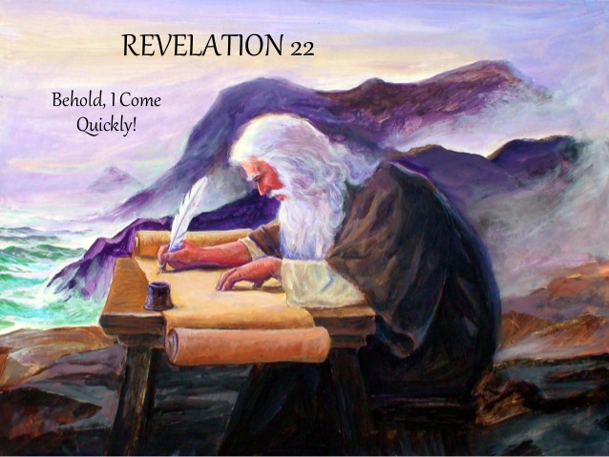
The Epilogue Revelation 22:6-21
Words of Comfort (22:6-17)
Words of Warning (22:18-19)
Words of Benediction (22:20-21)

Slide 6
The Epilogue Revelation 22:6-21
Words of Comfort (22:6-17)
Words of Warning (22:18-19)
Words of Benediction (22:20-21)

Slide 7
I. Words of Comfort Revelation 22:6-17
Faithful Words (6a)
Christ’s Soon Coming (6b-7a)
Blessing for Obedience (7b)
God Deserves Worship (8-9)
Prophecy Unsealed (10)
Destinies Fixed (11)
Rewards Given (12-13)
Redeemed Blessed (14-15)
God is Gracious (16-17)

Slide 8
I. Words of Comfort Revelation 22:6-17
Faithful Words (6a)
Christ’s Soon Coming (6b-7a)
Blessing for Obedience (7b)
God Deserves Worship (8-9)
Prophecy Unsealed (10)
Destinies Fixed (11)
Rewards Given (12-13)
Redeemed Blessed (14-15)
God is Gracious (16-17)

Slide 9
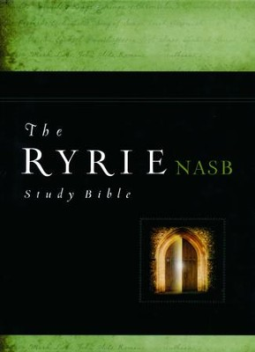
Charles Ryrie
The Ryrie Study Bible
Revelation 22:11. “When Christ comes there will be no more opportunity for a man to change his destiny. What he is then he will be forever.”

Slide 10
I. Words of Comfort Revelation 22:6-17
Faithful Words (6a)
Christ’s Soon Coming (6b-7a)
Blessing for Obedience (7b)
God Deserves Worship (8-9)
Prophecy Unsealed (10)
Destinies Fixed (11)
Rewards Given (12-13)
Redeemed Blessed (14-15)
God is Gracious (16-17)

Slide 12
Scripture’s Four Judgments
Name | Sheep and Goat | Judgment of the Jews | Bema Seat | Great White Throne
Scripture | Matt 25:31-46 | Ezek 20:33-44 | 1 Cor 3:10-15 | Rev 20:11-15
Place | Earth, Jerusalem | Earth, wilderness | Heaven | Earth
Audience | Gentile Tribulation survivors | Jewish Tribulation survivors | Church Age believers | All unsaved
When | After Tribulation | After Tribulation | After rapture | After Millennium
Purpose | Saved Gentiles enter kingdom | Saved Jews enter kingdom | Reward believers | Degree of punishment in hell
Evaluation | Treatment of Christ’s brethren | Passing under shepherd’s rod | Works taken through fire | Not in the book; judged by books

Slide 13
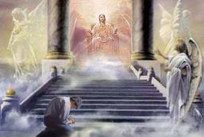
2 Corinthians 5:10
“For we must all appear before the judgment seat of Christ, so that each one may be recompensed for his deeds in the body, according to what he has done, whether good or bad.”

Slide 14
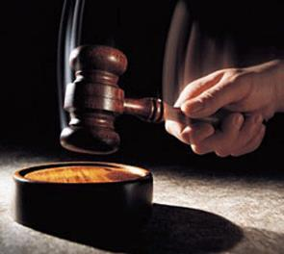
Why?
Not to judge sin (John 19:30)
Not to determine salvation (John 5:24)
But rather to give or not give rewards

Slide 15
Scripture’s Five Crowns (Rev 4:10: 3:11; 2 John 8)
SCRIPTURE | CROWN | PURPOSE
1 Cor. 9:24-27 | Incorruptible | Gaining mastery over the flesh
1 Thess. 2:19-20 | Rejoicing | Soul winning
Jas. 1:12; Rev. 2:10 | Life | Enduring trials
1 Pet. 5:2-4 | Glory | Shepherding God’s people
2 Tim. 4:8 | Righteousness | Longing for His appearing

Slide 16
2 Peter 1:8-11
⁸ For if these qualities are yours and are increasing, they render you neither useless nor unfruitful in the true knowledge of our Lord Jesus Christ. ⁹ For he who lacks these qualities is blind or short-sighted, having forgotten his purification from his former sins. ¹⁰ Therefore, brethren, be all the more diligent to make certain about His calling and choosing you; for as long as you practice these things, you will never stumble; ¹¹ for in this way the entrance into the eternal kingdom of our Lord and Savior Jesus Christ will be abundantly supplied to you.

Slide 17
Charles Ryrie
The Ryrie Study Bible
“2 Peter 1:11 (RSB:NASB1995U): 1:11 A Christian life that can be rewarded will provide that abundance into heaven.”

Slide 18
1 Corinthians 3:15
“If any man’s work is burned up, he will suffer loss; but he himself will be saved, yet so as through fire.”

Slide 19
1 Corinthians 9:24-27
“Do you not know that those who run in a race all run, but only one receives the prize? Run in such a way that you may win. ²⁵ Everyone who competes in the games exercises self-control in all things. They then do it to receive a perishable wreath, but we an imperishable. ²⁶ Therefore I run in such a way, as not without aim; I box in such a way, as not beating the air; ²⁷ but I discipline my body and make it my slave, so that, after I have preached to others, I myself will not be disqualified.”

Slide 20
2 John 8
“Watch yourselves, that you do not lose what we have accomplished, but that you may receive a full reward.”

Slide 21
Revelation 3:11
“I am coming quickly; hold fast what you have, so that no one will take your crown.”

Slide 22
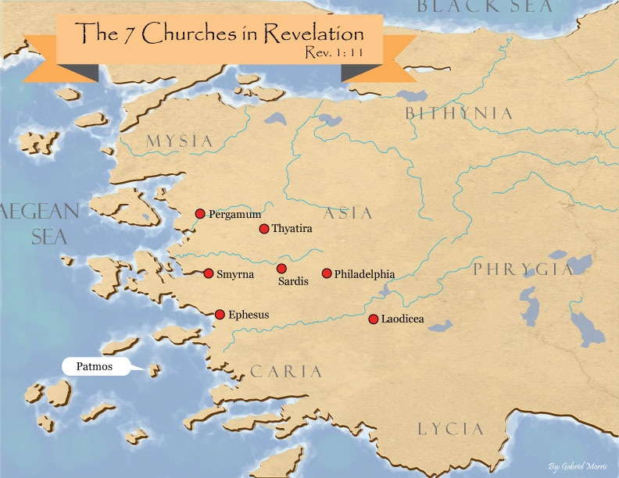

Slide 23
I. Words of Comfort Revelation 22:6-17
Faithful Words (6a)
Christ’s Soon Coming (6b-7a)
Blessing for Obedience (7b)
God Deserves Worship (8-9)
Prophecy Unsealed (10)
Destinies Fixed (11)
Rewards Given (12-13)
Redeemed Blessed (14-15)
God is Gracious (16-17)

Slide 24
Seven Beatitudes of Revelation: “Blessed” (makarios)
Blessing upon the reader & heeder of Revelation (1:3)
Blessing upon the Tribulation martyrs (14:13)
Blessing upon the spiritually prepared (16:15)
Blessing upon the Marriage Supper invitees (19:9)
Blessing upon the First Resurrection’s participants (20:6)
Blessing upon the heeder of Revelation (22:7)
Blessing upon the eternal city’s citizens (22:14)
John F. Walvoord, "Revelation," in Bible Knowledge Commentary, ed. John F. Walvoord and Roy B. Zuck (Colorado Springs, CO: Victor, 1983), 929

Slide 25
Seven Beatitudes of Revelation: “Blessed” (makarios)
Blessing upon the reader & heeder of Revelation (1:3)
Blessing upon the Tribulation martyrs (14:13)
Blessing upon the spiritually prepared (16:15)
Blessing upon the Marriage Supper invitees (19:9)
Blessing upon the First Resurrection’s participants (20:6)
Blessing upon the heeder of Revelation (22:7)
Blessing upon the eternal city’s citizens (22:14)
John F. Walvoord, "Revelation," in Bible Knowledge Commentary, ed. John F. Walvoord and Roy B. Zuck (Colorado Springs, CO: Victor, 1983), 929

Slide 26
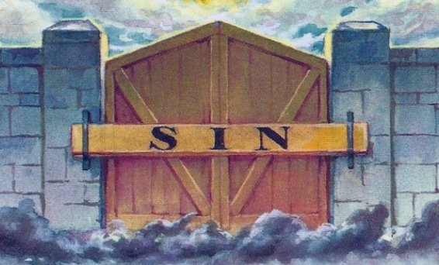
Revelation 22:15
“Outside are the dogs and the sorcerers and the immoral persons and the murderers and the idolaters, and everyone who loves and practices lying.”

Slide 27
Revelation 22:15
“Outside are the dogs and the sorcerers and the immoral persons and the murderers and the idolaters, and everyone who loves and practices lying.”

Slide 28
Revelation 21:8
“But for the cowardly and unbelieving and abominable and murderers and immoral persons and sorcerers and idolaters and all liars, their part will be in the lake that burns with fire and brimstone, which is the second death.”

Slide 29
Revelation 22:15
“Outside are the dogs and the sorcerers and the immoral persons and the murderers and the idolaters, and everyone who loves and practices lying.”

Slide 30
Charles Ryrie
The Ryrie Study Bible
Revelation 22:15. “dogs. Not animals, but people of low character (cf. Phil. 3:2).”

Slide 31
Revelation 22:15
“Outside are the dogs and the sorcerers [pharmakos] and the immoral persons and the murderers and the idolaters, and everyone who loves and practices lying.”

Slide 32
Revelation 9:20-21
“The rest of mankind, who were not killed by these plagues, did not repent of the works of their hands, so as not to worship demons, and the idols of gold and of silver and of brass and of stone and of wood, which can neither see nor hear nor walk; ²¹ and they did not repent of their murders nor of their sorceries (pharmakeia) nor of their immorality nor of their thefts.”

Slide 33
Revelation 22:15
“Outside are the dogs and the sorcerers and the immoral persons and the murderers and the idolaters, and everyone who loves and practices lying.”

Slide 34
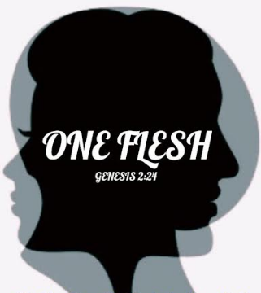
Genesis 2:24
For this reason a man shall leave his father and his mother, and be joined to his wife; and they shall become one flesh.”

Slide 35
Revelation 22:15
“Outside are the dogs and the sorcerers and the immoral persons and the murderers and the idolaters, and everyone who loves and practices lying.”

Slide 36
Revelation 22:15
“Outside are the dogs and the sorcerers and the immoral persons and the murderers and the idolaters, and everyone who loves and practices lying.”

Slide 37
Revelation 22:15
“Outside are the dogs and the sorcerers and the immoral persons and the murderers and the idolaters, and everyone who loves and practices lying.”

Slide 38
Revelation 22:15
“Outside are the dogs and the sorcerers and the immoral persons and the murderers and the idolaters, and everyone who loves and practices lying.”

Slide 39
John 3:19-21
“¹⁹ This is the judgment, that the Light has come into the world, and men loved the darkness rather than the Light, for their deeds were evil. ²⁰ For everyone who does evil hates the Light, and does not come to the Light for fear that his deeds will be exposed. ²¹ But he who practices the truth comes to the Light, so that his deeds may be manifested as having been wrought in God.”

Slide 40
I. Words of Comfort Revelation 22:6-17
Faithful Words (6a)
Christ’s Soon Coming (6b-7a)
Blessing for Obedience (7b)
God Deserves Worship (8-9)
Prophecy Unsealed (10)
Destinies Fixed (11)
Rewards Given (12-13)
Redeemed Blessed (14-15)
God is Gracious (16-17)

Slide 41
Charles Ryrie
The Ryrie Study Bible
Revelation 22:16–17. “Jesus is gracious because:
He gave the book of Revelation to the churches,
as the son of David He will fulfill Israel’s promises,
He is the morning star, the precursor of the new day, and
He offers the water of life freely.”

Slide 42
I. God is Gracious Revelation 22:16-17
Revealer (16a)
Covenant Keeper (16b)
Morning Star (16c)
Offers the Water of Life (17)

Slide 43
I. God is Gracious Revelation 22:16-17
Revealer (16a)
Covenant Keeper (16b)
Morning Star (16c)
Offers the Water of Life (17)

Slide 44
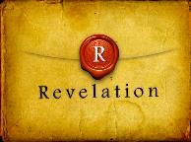
Revelation 1:1
“The Revelation [apokalypsis] of Jesus Christ, which God gave Him to show to His bond-servants, the things which must soon take place; and He sent and communicated it by His angel to His bond-servant John.”

Slide 45
Henry Morris
The Revelation Record, 323
“At the very least, it would be confusing to John’s first century readers, as well as to later generations, for him to write so much about Babylon when he really meant Rome (Paul was not afraid to speak directly against Rome in his writings, so why should John be?) or ‘the false church’ (all the apostles , including John, wrote plainly and scathingly about false teachers and false doctrines in the church and would not hide their teachings by symbols). It must be stressed that Revelation means “unveiling,” not “veiling.” In the absence of any statement in the text to the contrary, therefore, we must assume that the term Babylon applies to the real city of Babylon…”

Slide 46
Method of Communication
From the Father
to Christ the Son
to an angel
to John
to a book
to a reader or preacher
to a listener or the seven churches

Slide 47
Revelation 19:10
“Then I fell at his feet to worship him. But he said to me, ‘Do not do that; I am a fellow servant of yours and your brethren who hold the testimony of Jesus; worship God. For the testimony of Jesus is the spirit of prophecy.’”

Slide 48
I. God is Gracious Revelation 22:16-17
Revealer (16a)
Covenant Keeper (16b)
Morning Star (16c)
Offers the Water of Life (17)

Slide 50
2 Samuel 7:12-16
¹²“When your days are complete and you lie down with your fathers, I will raise up your descendant after you, who will come forth from you, and I will establish his kingdom. ¹³ He shall build a house for My name, and I will establish the throne of his kingdom forever. ¹⁴ I will be a father to him and he will be a son to Me; when he commits iniquity, I will correct him with the rod of men and the strokes of the . . .

Slide 51
2 Samuel 7:12-16
. . . sons of men, ¹⁵ but My lovingkindness shall not depart from him, as I took it away from Saul, whom I removed from before you. ¹⁶ Your house and your kingdom shall endure before Me forever; your throne shall be established forever.” ¹⁷ In accordance with all these words and all this vision, so Nathan spoke to David.”

Slide 52
John F. Walvoord
Israel in Prophecy (Grand Rapids: Zondervan, 1962), 84-85, 87.
“The covenant with David is not only given twice in its major content— namely, II Samuel 7 and I Chronicles 17—but it is also confirmed in Psalm 89. In this and other Old Testament references there is no allusion anywhere to the idea that these promises are to be understood in a spiritualized sense as referring to the church or to a reign of God in heaven. Rather, it is linked to the earth and to the seed of Israel, and to the land...There is no indication that this kingdom extended to a spiritual entity such as the church nor that the throne in view is the throne of God in heaven rather than the throne of David on earth...Such a situation does not prevail in this present age and is not related here or elsewhere to the reign of Christ from the throne of His Father in heaven.”

Slide 53
I. God is Gracious Revelation 22:16-17
Revealer (16a)
Covenant Keeper (16b)
Morning Star (16c)
Offers the Water of Life (17)

Slide 54
Genesis 1:5
“God called the light day, and the darkness He called night. And there was evening and there was morning, one day.”

Slide 56
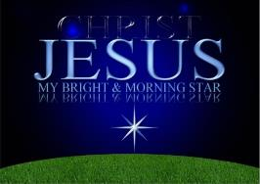
Revelation 2:28; 22:16
“^{2:28} and I will give him the morning star... ^{22:16} “I, Jesus, have sent My angel to testify to you these things for the churches. I am the root and the descendant of David, the bright morning star.”

Slide 57
2 Peter 1:19-21
“¹⁹ So we have the prophetic word made more sure, to which you do well to pay attention as to a lamp shining in a dark place, until the day dawns and the morning star arises in your hearts. ²⁰ But know this first of all, that no prophecy of Scripture is a matter of one’s own interpretation, ²¹ for no prophecy was ever made by an act of human will, but men moved by the Holy Spirit spoke from God.”

Slide 58
I. God is Gracious Revelation 22:16-17
Revealer (16a)
Covenant Keeper (16b)
Morning Star (16c)
Offers the Water of Life (17)

Slide 59
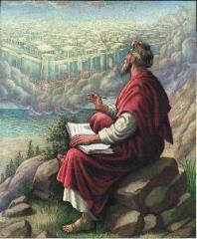
John 3:16
“For God so loved the world, that He gave His only begotten Son, that whoever believes in Him shall not perish, but have eternal life.”

Slide 60
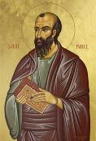
Romans 4:4-5
“Now to the one who works, his wage is not credited as a favor, but as what is due. But to the one who does not work, but believes in Him who justifies the ungodly, his faith is credited as righteousness.”

Slide 61
John 3:16
“For God so loved the world, that He gave His only begotten Son, that whoever believes in Him shall not perish, but have eternal life.”

Slide 62
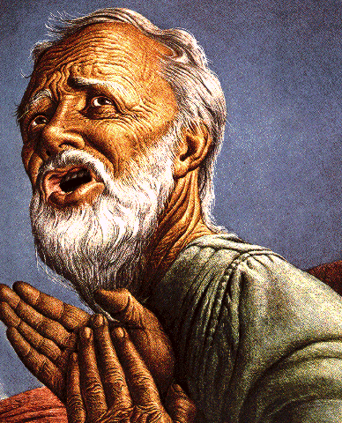
Belief – God’s One Condition for Justification
Gen 15:6
Then he believed in the LORD; and He reckoned it to him as righteousness.
John 3:16
For God so loved the world, that He gave His only begotten Son, that whoever believes in Him shall not perish, but have eternal life.
Acts 16:30-31
"Sirs, what must I do to be saved?" They said, "Believe in the Lord Jesus, and you will be saved..."

Slide 63
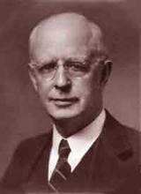
Lewis Sperry Chafer, vol. 7, Systematic Theology (Grand Rapids, MI: Kregel Publications, 1993), 265-66.
Belief – God’s One Condition for Justification
“…because upwards of 150 passages of Scripture condition salvation upon believing only (cf. John 3:16; Acts 16:31).

Slide 64
Chart courtesy of Thomas Stegall

Slide 65
Conclusion

Slide 66
I. Words of Comfort Revelation 22:6-17
Faithful Words (6a)
Christ’s Soon Coming (6b-7a)
Blessing for Obedience (7b)
God Deserves Worship (8-9)
Prophecy Unsealed (10)
Destinies Fixed (11)
Rewards Given (12-13)
Redeemed Blessed (14-15)
God is Gracious (16-17)

Slide 67
“The Lord bless you and keep you; the Lord make his face shine on you and be gracious to you; the Lord turn his face toward you and give you peace.” (NIV)

