Slide 1
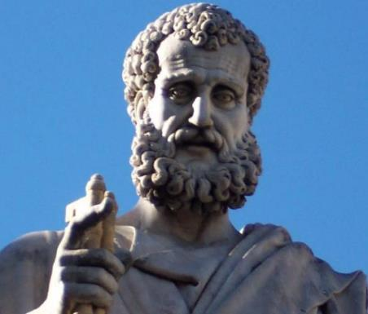

2 Peter
Dr. Andy Woods
Senior Pastor – Sugar Land Bible Church
President – Chafer Theological Seminary

Slide 2

INTRODUCTORY MATTERS
Authorship: Peter
Biography: Gospels & Acts
Date: A.D. 64
Recipients: Regenerated, Asia Minor, Hebrews
Place of writing: Babylon
Occasion for writing: Incipient Gnosticism
Purpose: Insulation from false teaching
Structure: 3 parts
Message: Protection from false teachers
Unique characteristics: Knowledge

Slide 3
STRUCTURE
2 Peter 1 – Call to maturity
2 Peter 2 – Characteristics of false teachers
2 Peter 3 – Doctrine of the false teachers (uniformitarianism)

Slide 4
STRUCTURE
2 Peter 1 – Call to maturity
2 Peter 2 – Characteristics of false teachers
2 Peter 3 – Doctrine of the false teachers (uniformitarianism)

Slide 5
2 PETER
Chapter 1
Introduction (1:1-2)
Call to Growth (1:3-11)
Purpose Statement (1:12-15)
Coming kingdom (1:16-21)

Slide 6
STRUCTURE
2 Peter 1 – Call to maturity
2 Peter 2 – Characteristics of false teachers
2 Peter 3 – Doctrine of the false teachers (uniformitarianism)

Slide 7
2 PETER
Characteristics of false teachers
(2 Peter 2)

Slide 8
2 PETER 2 OUTLINE
Predicted arrival (2:1a)
Devices (2:1b-3)
Doom (2:4-9)
Depravity (2:10-16)
Emptiness (2:17-19)
Regression (2:20-22)

Slide 9
2 PETER 2 OUTLINE
Predicted arrival (2:1a)
Devices (2:1b-3)
Doom (2:4-9)
Depravity (2:10-16)
Emptiness (2:17-19)
Regression (2:20-22)

Slide 10


Jeremiah 23:16
“Thus says the Lord of hosts, ‘Do not listen to the words of the prophets who are prophesying to you. They are leading you into futility; They speak a vision of their own imagination, Not from the mouth of the Lord.’”

Slide 11
Ezekiel 13:3, 6-7
“³ Thus says the Lord God, “Woe to the foolish prophets who are following their own spirit and have seen nothing...⁶ They see falsehood and lying divination who are saying, ‘The Lord declares,’ when the Lord has not sent them; yet they hope for the fulfillment of their word. ⁷ Did you not see a false vision and speak a lying divination when you said, ‘The Lord declares,’ but it is not I who have spoken?”’”

Slide 12
PREDICTED ARRIVAL
V.1A
Prediction
  False teachers
  Jude 4

Slide 13


APOSTASY IS INTERNAL
Jude 4
“For certain men have crept in unnoticed, who long ago were marked out for this condemnation, ungodly men, who turn the grace of our God into licentiousness and deny the only Lord God and our Lord Jesus Christ” (Italics added).

Slide 14

APOSTASY IS INTERNAL
Acts 20:29-31
“For I know this, that after my departure savage wolves will come in among you, not sparing the flock.”Also from among yourselves men will rise up, speaking perverse things, to draw away the disciples after themselves. Therefore be on the alert, remembering that night and day for a period of three years I did not cease to admonish each one with tears.” (Italics added).

Slide 15
2 PETER 2 OUTLINE
Predicted arrival (2:1a)
Devices (2:1b-3)
Doom (2:4-9)
Depravity (2:10-16)
Emptiness (2:17-19)
Regression (2:20-22)

Slide 16
DEVICES OF FALSE TEACHERS
V. 1b-3
False Teaching
License
Greed
Exploit the Flock
False words

Slide 17
DEVICES OF FALSE TEACHERS
V. 1b-3
False Teaching
License
Greed
Exploit the Flock
False words

Slide 18

1 John 4:2-3
“² By this you know the Spirit of God: every spirit that confesses that Jesus Christ has come in the flesh is from God; ³ and every spirit that does not confess Jesus is not from God; this is the spirit of the antichrist, of which you have heard that it is coming, and now it is already in the world.”

Slide 19
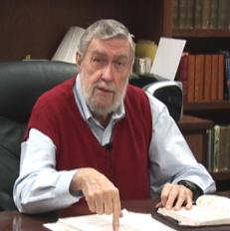
Jay Adams
Competent to Counsel, 70.
“But counselors, as Christians, are obligated to present the claims of Christ. They must present the good news that Christ Jesus died on the cross in the place of His own, that He bore the guilt and suffered the penalty for their sins. He died that all whom the Father had given to Him might come unto Him and have life everlasting. As a reformed Christian, the writer believes that counselors must not tell any unsaved counselee that Christ died for him, FOR THEY CANNOT SAY THAT. No man knows except Christ Himself who are His elect for whom He died." [emphasis mine]

Slide 20
DEVICES OF FALSE TEACHERS
V. 1b-3
False Teaching
License
Greed
Exploit the Flock
False words

Slide 21
DEVICES OF FALSE TEACHERS
V. 1b-3
False Teaching
License
Greed
Exploit the Flock
False words

Slide 22
DEVICES OF FALSE TEACHERS
V. 1b-3
False Teaching
License
Greed
Exploit the Flock
False words

Slide 23
DEVICES OF FALSE TEACHERS
V. 1b-3
False Teaching
License
Greed
Exploit the Flock
False words

Slide 24
2 PETER 2 OUTLINE
Predicted arrival (2:1a)
Devices (2:1b-3)
Doom (2:4-9)
Depravity (2:10-16)
Emptiness (2:17-19)
Regression (2:20-22)

Slide 25
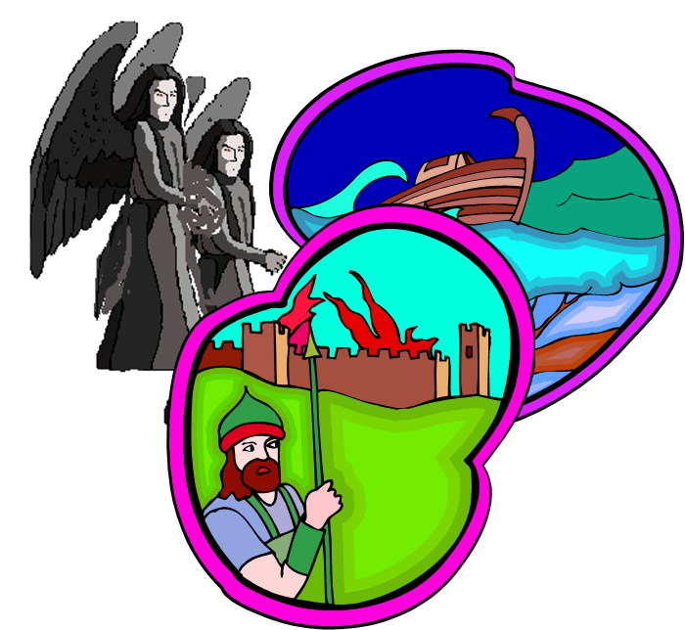
DOOM OF FALSE TEACHERS
V.4-9
Judgment of God – 3 Historical Examples
  Fallen angels
  Flood
  Sodom & Gomorrah

Slide 26
DOOM OF FALSE TEACHERS
V.4-9
Judgment of God – 3 Historical Examples
  Fallen angels
  Flood
  Sodom & Gomorrah

Slide 27

2 Peter 2:4-5
“⁴ For if God did not spare angels when they sinned, but cast them into hell and committed them to pits of darkness, reserved for judgment; ⁵ and did not spare the ancient world, but preserved Noah, a preacher of righteousness, with seven others, when He brought a flood upon the world of the ungodly.”

Slide 28

Genesis 6:1-4
“¹ Now it came about, when men began to multiply on the face of the land, and daughters were born to them, ² that the sons of God saw that the daughters of men were beautiful; and they took wives for themselves, whomever they chose. ³ Then the Lord said, ‘My Spirit shall not strive with man forever, because he also is flesh; nevertheless his days shall be one hundred and twenty years.’ ⁴ The Nephilim were on the earth in those days, and also afterward, when the sons of God came in to the daughters of men, and they bore children to them. Those were the mighty men who were of old, men of renown.”

Slide 29
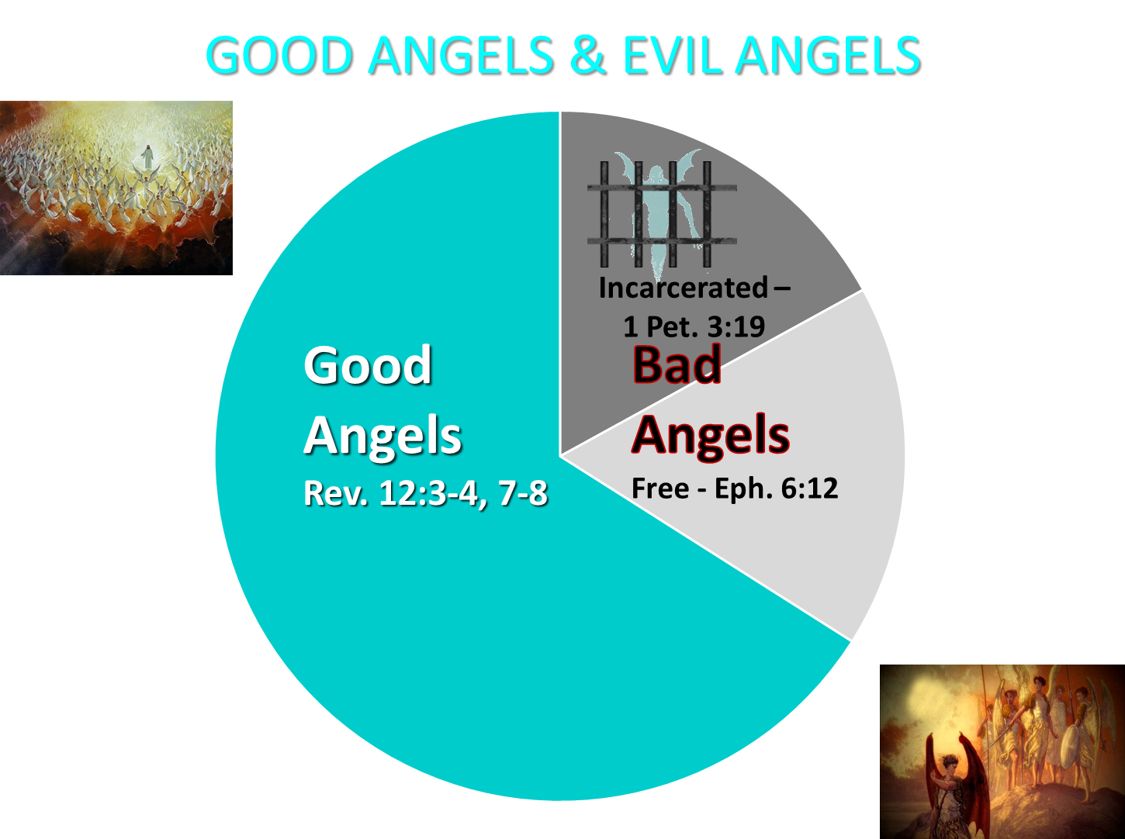

Slide 30
1 Peter 3:19-20
“¹⁹ in which also He went and made proclamation the spirits now in prison, ²⁰ who once were disobedient, when the patience of God kept waiting in the days of Noah, during the construction of the ark, in which a few, that is, eight persons, were brought safely through the water.”

Slide 31
Jude 6-7
“⁶ And angels who did not keep their own domain, but abandoned their proper abode, He has kept in eternal bonds under darkness for the judgment of the great day, ⁷ just as Sodom and Gomorrah and the cities around them, since they in the same way as these indulged in gross immorality and went after strange flesh, are exhibited as an example in undergoing the punishment of eternal fire.”

Slide 32
DOOM OF FALSE TEACHERS
V.4-9
Judgment of God – 3 Historical Examples
  Fallen angels
  Flood
  Sodom & Gomorrah

Slide 33
2 Peter 2:4-5
“⁴ For if God did not spare angels when they sinned, but cast them into hell and committed them to pits of darkness, reserved for judgment; ⁵ and did not spare the ancient world, but preserved Noah, a preacher of righteousness, with seven others, when He brought a flood upon the world of the ungodly.”

Slide 34
1 Peter 3:19-20
“¹⁹ in which also He went and made proclamation the spirits now in prison, ²⁰ who once were disobedient, when the patience of God kept waiting in the days of Noah, during the construction of the ark, in which a few, that is, eight persons, were brought safely through the water.”

Slide 35
DOOM OF FALSE TEACHERS
V.4-9
Judgment of God – 3 Historical Examples
  Fallen angels
  Flood
  Sodom & Gomorrah

Slide 36
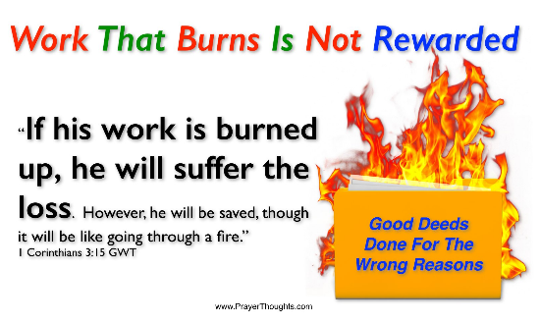
1 Corinthians 3:15
“If any man’s work is burned up, he will suffer loss; but he himself will be saved, yet so as through fire.”

Slide 37
1 Corinthians 3:1-3 (NKJV)
¹ And I, brethren, could not speak to you as to spiritual people but as to carnal, as to babes in Christ. ² I fed you with milk and not with solid food; for until now you were not able to receive it, and even now you are still not able; ³ for you are still carnal. For where there are envy, strife, and divisions among you, are you not carnal and behaving like mere men?

Slide 38

Notes:
Ray Steadman – “1st Californians”
Unbelievers vs Categories of Believers
Unbelievers – ψυχικός psuchikós; Natural, pertaining to the natural as distinguished from the spiritual
Spiritual Believers – πνευματικός pneumatikós; of persons who are spiritual, enlightened by the Holy Spirit
Infant Believers – σάρκινος sárkinos; with propensities of the flesh unto sin; νήπιος nḗpios; an infant, child, baby without any definite limitation of age. (This relates to immaturity and lack of instruction)
Carnal Believers – σαρκικός sarkikós; tendency to satisfy the flesh, implying sinfulness, sinful propensity, carnal (This relates to disobedience and open rebellion)

Slide 39
YIELDING TO THE OLD (SIN) NATURE
BELIEVER’S CONSEQUENCES | PASSAGE(S)
Lack of power | (Gal 5:16; 1 Thess. 5:19)
Grieving the Holy Spirit | (Eph 4:30-32)
Loss of joy | (Ps. 51:4, 12; Gal. 5:22-23)
Loss of spiritual sight | (2 Pet. 1:8-10; Luke 15:18-19)
Lack of growth | (1 Pet. 2:1-2)
Carnality | (1 Cor 3:1-3)
Unfruitfulness | (John 15:5, 8)
Lack of purpose | (Eccles. 1:2-3, 8; Mark 8:35)
Lack of stability | (Gal. 3:3; 2 Tim. 2:18; 2 Pet. 3:17)

Slide 40
YIELDING TO THE OLD (SIN) NATURE
BELIEVER’S CONSEQUENCES | PASSAGE(S)
Conviction | (2 Pet 2:7-8; Ps 32:1-5)
Divine discipline | (Heb. 12:5-11; Rev. 3:19)
Premature death | (Acts 5:1-11; 1 Cor 11:30; 1 John 5:16; Rev 2:22-23)
Loss of reward | (1 Cor. 3:15; 9:27; 2 John 8; Rev 3:11)
Loss of fellowship | (1 John 1:9)
Excommunication | (1 Cor 5:4-5; Matt 18:15-17)
Temporal consequences | (Gal 6:7-8)
Unanswered prayer | (Ps 66:18; 1 Pet 3:7)
Loss of testimony | (Gen 19:14)
Loss of leadership privileges | (1 Tim 3:1-13; 2 Sam. 12)

Slide 41
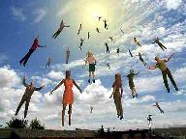
When Will the Rapture Take Place Relative to the Tribulation Period?
Pre-tribulation rapture theory
Mid-tribulation rapture theory
Post-tribulation rapture theory
Pre-wrath rapture theory
Partial rapture theory

Slide 42


Slide 43
2 PETER 2 OUTLINE
Predicted arrival (2:1a)
Devices (2:1b-3)
Doom (2:4-9)
Depravity (2:10-16)
Emptiness (2:17-19)
Regression (2:20-22)

Slide 44
DEPRAVITY OF FALSE TEACHERS
V.10-16
Licentious
Lawless
Animalistic
Shameless pleasure seekers
Eyes full of adultery
Entice unstable souls
Greedy

Slide 45
DEPRAVITY OF FALSE TEACHERS
V.10-16
Licentious
Lawless
Animalistic
Shameless pleasure seekers
Eyes full of adultery
Entice unstable souls
Greedy

Slide 46

Mark 7:20-23
“²⁰ And He was saying, ‘That which proceeds out of the man, that is what defiles the man. ²¹ For from within, out of the heart of men, proceed the evil thoughts, fornications, thefts, murders, adulteries, ²² deeds of coveting and wickedness, as well as deceit, sensuality, envy, slander, pride and foolishness. ²³ All these evil things proceed from within and defile the man.’”

Slide 47
DEPRAVITY OF FALSE TEACHERS
V.10-16
Licentious
Lawless
Animalistic
Shameless pleasure seekers
Eyes full of adultery
Entice unstable souls
Greedy

Slide 48
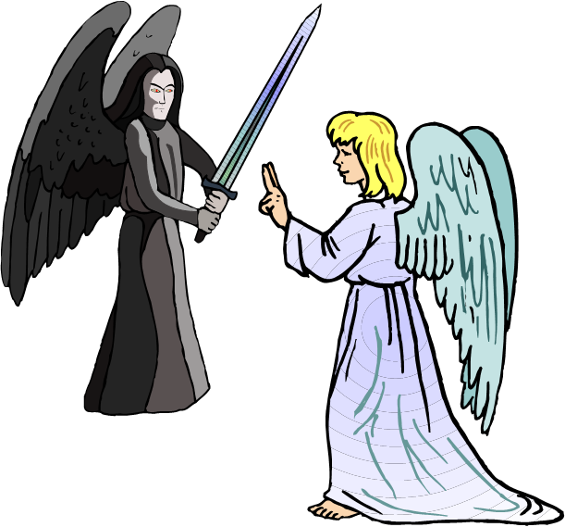
ARROGANCE OF FALSE TEACHERS
V.10b-11
Despise Authority
  Slander fallen angels
Daring and Self-willed

Slide 49
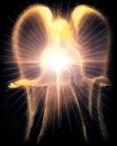

Satan’s Progressive Defeat
Initial eviction from heaven (Isa 14:12-15; Ezek 28:12-17)
Eden (Gen 3:15)
Pre-diluvian world (1 Pet 3:19-20)
Cross (John 12:31; 16:11; Col 2:15; Heb 2:14; 1 John 3:8)
Mid point of the Tribulation (Rev 12:9)
Beginning of millennium (Rev 20:2-3)
End of millennium (Rev 20:10)

Slide 50
Revelation 20:1-3
“Then I saw an angel coming down from heaven, holding the key of the abyss and a great chain in his hand. ² And he laid hold of the dragon, the serpent of old, who is the devil and Satan, and bound him for a thousand years; ³ and he threw him into the abyss, and shut it and sealed it over him, so that he would not deceive the nations any longer, until the thousand years were completed; after these things he must be released for a short time.”

Slide 51
DEPRAVITY OF FALSE TEACHERS
V.10-16
Licentious
Lawless
Animalistic
Shameless pleasure seekers
Eyes full of adultery
Entice unstable souls
Greedy

Slide 52
DEPRAVITY OF FALSE TEACHERS
V.10-16
Licentious
Lawless
Animalistic
Shameless pleasure seekers
Eyes full of adultery
Entice unstable souls
Greedy

Slide 53
DEPRAVITY OF FALSE TEACHERS
V.10-16
Licentious
Lawless
Animalistic
Shameless pleasure seekers
Eyes full of adultery
Entice unstable souls
Greedy

Slide 54
DEPRAVITY OF FALSE TEACHERS
V.10-16
Licentious
Lawless
Animalistic
Shameless pleasure seekers
Eyes full of adultery
Entice unstable souls
Greedy

Slide 55
STRUCTURE
2 Peter 1 – Call to maturity
2 Peter 2 – Characteristics of false teachers
2 Peter 3 – Doctrine of the false teachers (uniformitarianism)

Slide 56
DEPRAVITY OF FALSE TEACHERS
V.10-16
Licentious
Lawless
Animalistic
Shameless pleasure seekers
Eyes full of adultery
Entice unstable souls
Greedy

Slide 57
2 PETER 2 OUTLINE
Predicted arrival (2:1a)
Devices (2:1b-3)
Doom (2:4-9)
Depravity (2:10-16)
Emptiness (2:17-19)
Regression (2:20-22)

Slide 58
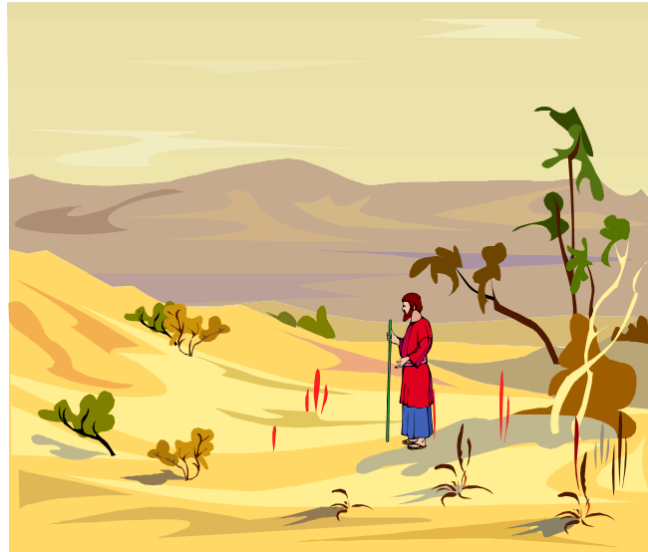
EMPTINESS OF FALSE TEACHERS
V. 17-19
Offer Nothing that is Permanently Satisfying
  Spring w/o water
  Mist

Slide 59
2 PETER 2 OUTLINE
Predicted arrival (2:1a)
Devices (2:1b-3)
Doom (2:4-9)
Depravity (2:10-16)
Emptiness (2:17-19)
Regression (2:20-22)

Slide 60
REGRESSION OF FALSE TEACHERS
V. 20-22
Return (20)
Accountability to God is Greater (21)
Two illustrations (22)

Slide 61
REGRESSION OF FALSE TEACHERS
V. 20-22
Return (20)
Accountability to God is Greater (21)
Two illustrations (22)

Slide 62
REGRESSION OF FALSE TEACHERS
V. 20-22
Return (20)
Accountability to God is Greater (21)
Two illustrations (22)

Slide 63
Matthew 11:20-24
²⁰ “Then He began to denounce the cities in which most of His miracles were done, because they did not repent. ^{21 ’}Woe to you, Chorazin! Woe to you, Bethsaida! For if the miracles had occurred in Tyre and Sidon which occurred in you, they would have repented long ago in sackcloth and ashes. ²² Nevertheless I say to you, it will be more tolerable for Tyre and Sidon in the day of judgment than for…

Slide 64
Matthew 11:20-24
…you.’” “²³And you, Capernaum, will not be exalted to heaven, will you? You will descend to Hades; for if the miracles had occurred in Sodom which occurred in you, it would have remained to this day. ²⁴Nevertheless I say to you that it will be more tolerable for the land of Sodom in the day of judgment, than for you.”

Slide 65
REGRESSION OF FALSE TEACHERS
V. 20-22
Return (20)
Accountability to God is Greater (21)
Two illustrations (22)

Slide 66
BELIEVER OR UNBELIEVER?
BELIEVER | UNBELIEVER
Purchased (1) | Dogs/pigs (22)
Knowledge of Christ (20) | Overcome (20)
Believers can sin (1:8-10) | Other unbelievers (4-6)
Examples of Lot and Balaam (7-8, 15-16) | Last state worse than the first (20)
 | Darkness reserved (17)

Slide 67
CONCLUSION

Slide 68
2 PETER 2 OUTLINE
Predicted arrival (2:1a)
Devices (2:1b-3)
Doom (2:4-9)
Depravity (2:10-16)
Emptiness (2:17-19)
Regression (2:20-22)

