Slide 1
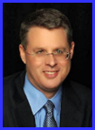
Dr. Andy Woods
Senior Pastor – Sugar Land Bible Church
President – Chafer Theological Seminary

Slide 2
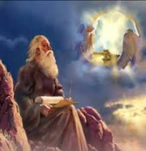
“After These Things” (Rev. 4‒22)
Before the Tribulation (4‒5)
During the Tribulation (6‒19)
After the Tribulation (20‒22)
Kingdom (20:1-10)
Great White Throne Judgment (20:11-15)
Destruction of the Earth (21:1)
New Heaven and New Earth (21‒22)

Slide 3
The Eternal State Revelation 21‒22
The New Heavens & Earth (21:1-8)
The New Jerusalem (21:9‒22:5)
Epilogue (22:6-21)

Slide 4
The Eternal State Revelation 21‒22
The New Heavens & Earth (21:1-8)
The New Jerusalem (21:9‒22:5)
Epilogue (22:6-21)

Slide 5
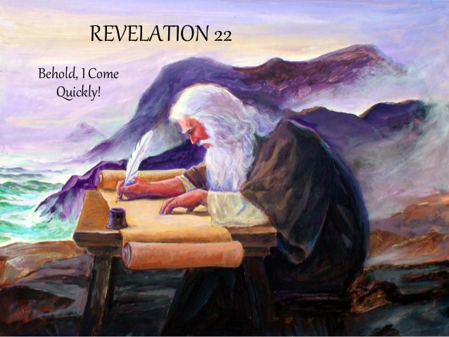
The Epilogue Revelation 22:6-21
Words of Comfort (22:6-17)
Words of Warning (22:18-19)
Words of Benediction (22:20-21)

Slide 6
The Epilogue Revelation 22:6-21
Words of Comfort (22:6-17)
Words of Warning (22:18-19)
Words of Benediction (22:20-21)

Slide 7
I. Words of Comfort Revelation 22:6-17
Faithful Words (6a)
Christ’s Soon Coming (6b-7a)
Blessing for Obedience (7b)
God Deserves Worship (8-9)
Prophecy Unsealed (10)
Destinies Fixed (11)
Rewards Given (12-13)
Redeemed Blessed (14-15)
God is Gracious (16-17)

Slide 8
I. Words of Comfort Revelation 22:6-17
Faithful Words (6a)
Christ’s Soon Coming (6b-7a)
Blessing for Obedience (7b)
God Deserves Worship (8-9)
Prophecy Unsealed (10)
Destinies Fixed (11)
Rewards Given (12-13)
Redeemed Blessed (14-15)
God is Gracious (16-17)

Slide 9
2 Peter 1:19-21
“¹⁹ So we have the prophetic word made more sure, to which you do well to pay attention as to a lamp shining in a dark place, until the day dawns and the morning star arises in your hearts. ²⁰ But know this first of all, that no prophecy of Scripture is a matter of one’s own interpretation, ²¹ for no prophecy was ever made by an act of human will, but men moved by the Holy Spirit spoke from God.”

Slide 10
I. Words of Comfort Revelation 22:6-17
Faithful Words (6a)
Christ’s Soon Coming (6b-7a)
Blessing for Obedience (7b)
God Deserves Worship (8-9)
Prophecy Unsealed (10)
Destinies Fixed (11)
Rewards Given (12-13)
Redeemed Blessed (14-15)
God is Gracious (16-17)

Slide 11
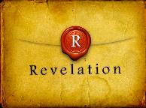
Revelation 19:10
“Then I fell at his feet to worship him. But he said to me, ‘Do not do that; I am a fellow servant of yours and your brethren who hold the testimony of Jesus; worship God. For the testimony of Jesus is the spirit of prophecy.’”

Slide 12
Method of Communication
From the Father
to Christ the Son
to an angel
to John
to a book
to a reader or preacher
to a listener or the seven churches

Slide 13
“TIME-TEXTS” IN REVELATION R.C. Sproul, The Last Days According to Jesus, p.139
SHORTLY, QUICKLY “TACOS”
1:1 | …Things which must shortly take place
2:16 | Repent, or else I will come to you quickly.
3:11 | Behold, I come quickly!
22:6 | …Which must shortly take place.
22:7 | Behold, I come quickly!
22:12 | Behold, I am coming quickly!
22:20 | Surely, I am coming quickly!
NEAR, AT HAND “ENGYS”
1:3 | The time is near.
22:10 | The time is at hand.
ABOUT TO, ON THE POINT OF “MELLŌ”
1:19 | Write…the things that are about to take place.
3:10 | …the hour of trial…is about to come upon the whole world.

Slide 14
Revelation 1:1
“The Revelation [apokalypsis] of Jesus Christ, which God gave Him to show to His bond-servants, the things which must soon take place; and He sent and communicated it by His angel to His bond-servant John.”

Slide 15
Revelation 1:3
“Blessed [makarios] is he who reads and those who hear the words of the prophecy, and heed the things which are written in it; for the time is near.”

Slide 16
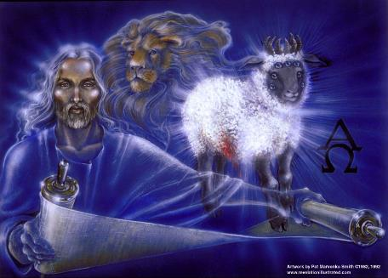
“Time Texts”
Preterist = chronological
Futurist = adverbial, qualitative, imminent

Slide 17
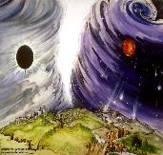
Chronological vs. Adverbial Use of Tacos
“I hope to come to you soon” (1 Tim 3:14) vs. “Leave Jerusalem quickly” (Acts 22:18)
LXX
Isaiah 13:22: “Her fateful time also will soon come”
Isaiah 51:5: “My righteous is near, My salvation has gone forth, And my arms will judge the peoples; The coastlands will wait upon me, And on My arms they will trust.”
Thomas Ice, End Times Controversy, pp.102-108

Slide 18
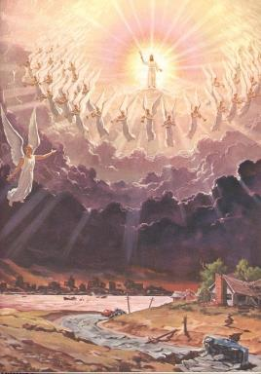
Imminency
Engys: “The Lord is near” (Phil 4:5)
Mellō: “and one who will share in the glory to be revealed” (1 Pet 5:1)

Slide 19
I. Words of Comfort Revelation 22:6-17
Faithful Words (6a)
Christ’s Soon Coming (6b-7a)
Blessing for Obedience (7b)
God Deserves Worship (8-9)
Prophecy Unsealed (10)
Destinies Fixed (11)
Rewards Given (12-13)
Redeemed Blessed (14-15)
God is Gracious (16-17)

Slide 20
Revelation 1:3
“Blessed [makarios] is he who reads and those who hear the words of the prophecy, and heed the things which are written in it; for the time is near.”

Slide 21
Seven Beatitudes of Revelation: “Blessed” (makarios)
Blessing upon the reader & heeder of Revelation (1:3)
Blessing upon the Tribulation martyrs (14:13)
Blessing upon the spiritually prepared (16:15)
Blessing upon the Marriage Supper invitees (19:9)
Blessing upon the First Resurrection’s participants (20:6)
Blessing upon the heeder of Revelation (22:7)
Blessing upon the eternal city’s citizens (22:14)
John F. Walvoord, "Revelation," in Bible Knowledge Commentary, ed. John F. Walvoord and Roy B. Zuck (Colorado Springs, CO: Victor, 1983), 929

Slide 22
I. Words of Comfort Revelation 22:6-17
Faithful Words (6a)
Christ’s Soon Coming (6b-7a)
Blessing for Obedience (7b)
God Deserves Worship (8-9)
Prophecy Unsealed (10)
Destinies Fixed (11)
Rewards Given (12-13)
Redeemed Blessed (14-15)
God is Gracious (16-17)

Slide 23
Method of Communication
From the Father
to Christ the Son
to an angel
to John
to a book
to a reader or preacher
to a listener or the seven churches

Slide 24
Revelation 19:10
“Then I fell at his feet to worship him. But he said to me, ‘Do not do that; I am a fellow servant of yours and your brethren who hold the testimony of Jesus; worship God. For the testimony of Jesus is the spirit of prophecy.’”

Slide 25
I. Words of Comfort Revelation 22:6-17
Faithful Words (6a)
Christ’s Soon Coming (6b-7a)
Blessing for Obedience (7b)
God Deserves Worship (8-9)
Prophecy Unsealed (10)
Destinies Fixed (11)
Rewards Given (12-13)
Redeemed Blessed (14-15)
God is Gracious (16-17)

Slide 26
Rick Warren
Purpose Driven Life, 285-86.
“When the disciples wanted to talk about prophecy, Jesus quickly switched the conversation to evangelism. He wanted them to concentrate on their mission in the world. He said in essence, “The details of my return are none of your business. What is your business is the mission I have given you. Focus on that!” If you want Jesus to come back sooner, focus on fulfilling your mission, not figuring out prophecy. Speculating on the exact timing of Christ’s return is futile, because Jesus said, “No one knows about that day or hour, not even the angels in heaven, nor the Son, but only the Father.” Since Jesus said He didn’t know the day or hour, why should you try to figure it out? What we do know for sure is this: Jesus will not return until everyone God wants to hear the Good News has heard it.”

Slide 27
Rick Warren
Purpose Driven Life, 285-86.
Jesus said, “The Good News about God’s kingdom will be preached in all the world, to every nation. Then the end will come.” If you want Jesus to come back sooner, focus on fulfilling your mission, not figuring out prophecy. It is easy to get distracted and sidetracked from your mission because Satan would rather have you do anything besides sharing your faith. He will let you do all kinds of good things as long as you don’t take anyone to heaven with you. But the moment you become serious about your mission, expect the Devil to throw all kinds of diversions at you. When that happens, remember the words of Jesus: “Anyone who lets himself be distracted from the work I plan for him is not fit for the Kingdom of God.”

Slide 28
Eschatology A Sin?
“Therefore, I conclude that it is sin to divide the body of Christ—to divide the body that he prayed would be united. Therefore for us to conclude that we must agree upon a certain view of alcohol, or a certain view of schooling, or a certain view of meat sacrificed to idols, or a certain view of the millennium in order to have fellowship together is, I think, not only unnecessary for the body of Christ, but it is therefore both unwarranted and therefore condemned by scripture. So if you’re a pastor and you’re listening to me, you understand me correctly if you think I’m saying you are in sin if you lead your congregation to have a statement of faith that requires a particular millennial view. I do not understand why that has to be a matter of uniformity in order to have Christian unity in a local congregation.”
28
Justin Taylor, “Dever: ‘You Are in Sin If You Lead Your Congregation to Have a Statement of Faith that Requires a Particular Millennial View,’” online: https://www.thegospelcoalition.org/blogs/justin-taylor/dever-you-are-in-sin-if-you-lead-your/, July 14 2009, accessed May 28, 2019.
Notes:
WRONG!!!

Slide 29
I. Words of Comfort Revelation 22:6-17
Faithful Words (6a)
Christ’s Soon Coming (6b-7a)
Blessing for Obedience (7b)
God Deserves Worship (8-9)
Prophecy Unsealed (10)
Destinies Fixed (11)
Rewards Given (12-13)
Redeemed Blessed (14-15)
God is Gracious (16-17)

Slide 30
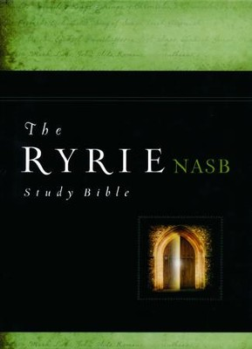
Charles Ryrie
The Ryrie Study Bible
Revelation 22:11. “When Christ comes there will be no more opportunity for a man to change his destiny. What he is then he will be forever.”

Slide 31
I. Words of Comfort Revelation 22:6-17
Faithful Words (6a)
Christ’s Soon Coming (6b-7a)
Blessing for Obedience (7b)
God Deserves Worship (8-9)
Prophecy Unsealed (10)
Destinies Fixed (11)
Rewards Given (12-13)
Redeemed Blessed (14-15)
God is Gracious (16-17)

Slide 32
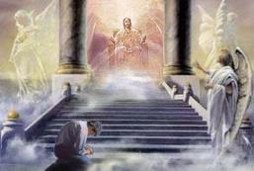
2 Corinthians 5:10
“For we must all appear before the judgment seat of Christ, so that each one may be recompensed for his deeds in the body, according to what he has done, whether good or bad.”

Slide 33
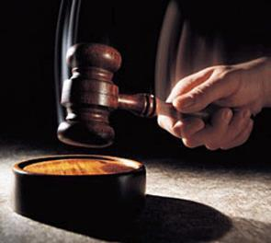
Why?
Not to judge sin (John 19:30)
Not to determine salvation (John 5:24)
But rather to give or not give rewards

Slide 34
Scripture’s Five Crowns (Rev 4:10: 3:11; 2 John 8)
SCRIPTURE | CROWN | PURPOSE
1 Cor. 9:24-27 | Incorruptible | Gaining mastery over the flesh
1 Thess. 2:19-20 | Rejoicing | Soul winning
Jas. 1:12; Rev. 2:10 | Life | Enduring trials
1 Pet. 5:2-4 | Glory | Shepherding God’s people
2 Tim. 4:8 | Righteousness | Longing for His appearing

Slide 35
2 Peter 1:8-11
⁸ For if these qualities are yours and are increasing, they render you neither useless nor unfruitful in the true knowledge of our Lord Jesus Christ. ⁹ For he who lacks these qualities is blind or short-sighted, having forgotten his purification from his former sins. ¹⁰ Therefore, brethren, be all the more diligent to make certain about His calling and choosing you; for as long as you practice these things, you will never stumble; ¹¹ for in this way the entrance into the eternal kingdom of our Lord and Savior Jesus Christ will be abundantly supplied to you.

Slide 36
1 Corinthians 3:15
“If any man’s work is burned up, he will suffer loss; but he himself will be saved, yet so as through fire.”

Slide 37
1 Corinthians 9:24-27
“Do you not know that those who run in a race all run, but only one receives the prize? Run in such a way that you may win. ²⁵ Everyone who competes in the games exercises self-control in all things. They then do it to receive a perishable wreath, but we an imperishable. ²⁶ Therefore I run in such a way, as not without aim; I box in such a way, as not beating the air; ²⁷ but I discipline my body and make it my slave, so that, after I have preached to others, I myself will not be disqualified.”

Slide 38
2 John 8
“Watch yourselves, that you do not lose what we have accomplished, but that you may receive a full reward.”

Slide 39
Revelation 3:11
“I am coming quickly; hold fast what you have, so that no one will take your crown.”

Slide 40
I. Words of Comfort Revelation 22:6-17
Faithful Words (6a)
Christ’s Soon Coming (6b-7a)
Blessing for Obedience (7b)
God Deserves Worship (8-9)
Prophecy Unsealed (10)
Destinies Fixed (11)
Rewards Given (12-13)
Redeemed Blessed (14-15)
God is Gracious (16-17)

Slide 41
Seven Beatitudes of Revelation: “Blessed” (makarios)
Blessing upon the reader & heeder of Revelation (1:3)
Blessing upon the Tribulation martyrs (14:13)
Blessing upon the spiritually prepared (16:15)
Blessing upon the Marriage Supper invitees (19:9)
Blessing upon the First Resurrection’s participants (20:6)
Blessing upon the heeder of Revelation (22:7)
Blessing upon the eternal city’s citizens (22:14)
John F. Walvoord, "Revelation," in Bible Knowledge Commentary, ed. John F. Walvoord and Roy B. Zuck (Colorado Springs, CO: Victor, 1983), 929

Slide 42
Revelation 21:8
“But for the cowardly and unbelieving and abominable and murderers and immoral persons and sorcerers and idolaters and all liars, their part will be in the lake that burns with fire and brimstone, which is the second death.”

Slide 43
Charles Ryrie
The Ryrie Study Bible
Revelation 22:15. “dogs. Not animals, but people of low character (cf. Phil. 3:2).”

Slide 44
Revelation 9:20-21
“The rest of mankind, who were not killed by these plagues, did not repent of the works of their hands, so as not to worship demons, and the idols of gold and of silver and of brass and of stone and of wood, which can neither see nor hear nor walk; ²¹ and they did not repent of their murders nor of their sorceries (pharmakeia) nor of their immorality nor of their thefts.”

Slide 45
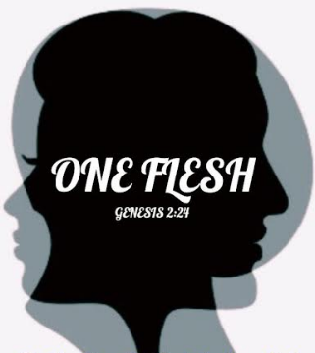
Genesis 2:24
For this reason a man shall leave his father and his mother, and be joined to his wife; and they shall become one flesh.”

Slide 46
I. Words of Comfort Revelation 22:6-17
Faithful Words (6a)
Christ’s Soon Coming (6b-7a)
Blessing for Obedience (7b)
God Deserves Worship (8-9)
Prophecy Unsealed (10)
Destinies Fixed (11)
Rewards Given (12-13)
Redeemed Blessed (14-15)
God is Gracious (16-17)

Slide 47
Charles Ryrie
The Ryrie Study Bible
Revelation 22:16–17. “Jesus is gracious because (1) He gave the book of Revelation to the churches, (2) as the son of David He will fulfill Israel’s promises, (3) He is the morning star, the precursor of the new day, and (4) He offers the water of life freely.”

Slide 48
I. God is Gracious Revelation 22:16-17
Revealer (16a)
Covenant Keeper (16b)
Morning Star (16c)
Offers the Water of Life (17)

Slide 49
I. God is Gracious Revelation 22:16-17
Revealer (16a)
Covenant Keeper (16b)
Morning Star (16c)
Offers the Water of Life (17)

Slide 50
Revelation 1:1
“The Revelation [apokalypsis] of Jesus Christ, which God gave Him to show to His bond-servants, the things which must soon take place; and He sent and communicated it by His angel to His bond-servant John.”

Slide 51
Henry Morris
The Revelation Record, 323
“At the very least, it would be confusing to John’s first century readers, as well as to later generations, for him to write so much about Babylon when he really meant Rome (Paul was not afraid to speak directly against Rome in his writings, so why should John be?) or ‘the false church’ (all the apostles , including John, wrote plainly and scathingly about false teachers and false doctrines in the church and would not hide their teachings by symbols). It must be stressed that Revelation means “unveiling,” not “veiling.” In the absence of any statement in the text to the contrary, therefore, we must assume that the term Babylon applies to the real city of Babylon…”

Slide 52
Method of Communication
From the Father
to Christ the Son
to an angel
to John
to a book
to a reader or preacher
to a listener or the seven churches

Slide 53
Revelation 19:10
“Then I fell at his feet to worship him. But he said to me, ‘Do not do that; I am a fellow servant of yours and your brethren who hold the testimony of Jesus; worship God. For the testimony of Jesus is the spirit of prophecy.’”

Slide 54
I. God is Gracious Revelation 22:16-17
Revealer (16a)
Covenant Keeper (16b)
Morning Star (16c)
Offers the Water of Life (17)

Slide 56
2 Samuel 7:12-16
¹²“When your days are complete and you lie down with your fathers, I will raise up your descendant after you, who will come forth from you, and I will establish his kingdom. ¹³ He shall build a house for My name, and I will establish the throne of his kingdom forever. ¹⁴ I will be a father to him and he will be a son to Me; when he commits iniquity, I will correct him with the rod of men and the strokes of the . . .

Slide 57
2 Samuel 7:12-16
. . . sons of men, ¹⁵ but My lovingkindness shall not depart from him, as I took it away from Saul, whom I removed from before you. ¹⁶ Your house and your kingdom shall endure before Me forever; your throne shall be established forever.” ¹⁷ In accordance with all these words and all this vision, so Nathan spoke to David.”

Slide 58
John F. Walvoord
Israel in Prophecy (Grand Rapids: Zondervan, 1962), 84-85, 87.
“The covenant with David is not only given twice in its major content— namely, II Samuel 7 and I Chronicles 17—but it is also confirmed in Psalm 89. In this and other Old Testament references there is no allusion anywhere to the idea that these promises are to be understood in a spiritualized sense as referring to the church or to a reign of God in heaven. Rather, it is linked to the earth and to the seed of Israel, and to the land...There is no indication that this kingdom extended to a spiritual entity such as the church nor that the throne in view is the throne of God in heaven rather than the throne of David on earth...Such a situation does not prevail in this present age and is not related here or elsewhere to the reign of Christ from the throne of His Father in heaven.”

Slide 59
I. God is Gracious Revelation 22:16-17
Revealer (16a)
Covenant Keeper (16b)
Morning Star (16c)
Offers the Water of Life (17)

Slide 61
2 Peter 1:19-21
“¹⁹ So we have the prophetic word made more sure, to which you do well to pay attention as to a lamp shining in a dark place, until the day dawns and the morning star arises in your hearts. ²⁰ But know this first of all, that no prophecy of Scripture is a matter of one’s own interpretation, ²¹ for no prophecy was ever made by an act of human will, but men moved by the Holy Spirit spoke from God.”

Slide 62
I. God is Gracious Revelation 22:16-17
Revealer (16a)
Covenant Keeper (16b)
Morning Star (16c)
Offers the Water of Life (17)

Slide 63
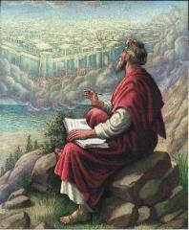
John 3:16
“For God so loved the world, that He gave His only begotten Son, that whoever believes in Him shall not perish, but have eternal life.”

Slide 64
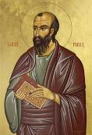
Romans 4:4-5
“Now to the one who works, his wage is not credited as a favor, but as what is due. But to the one who does not work, but believes in Him who justifies the ungodly, his faith is credited as righteousness.”

Slide 65
John 3:16
“For God so loved the world, that He gave His only begotten Son, that whoever believes in Him shall not perish, but have eternal life.”

Slide 66
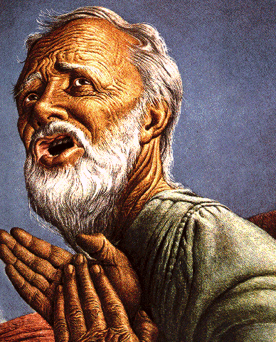
Belief – God’s One Condition for Justification
Gen 15:6
Then he believed in the LORD; and He reckoned it to him as righteousness.
John 3:16
For God so loved the world, that He gave His only begotten Son, that whoever believes in Him shall not perish, but have eternal life.
Acts 16:30-31
"Sirs, what must I do to be saved?" They said, "Believe in the Lord Jesus, and you will be saved..."

Slide 67
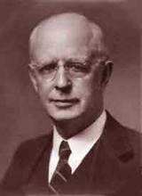
Lewis Sperry Chafer, vol. 7, Systematic Theology (Grand Rapids, MI: Kregel Publications, 1993), 265-66.
Belief – God’s One Condition for Justification
“…because upwards of 150 passages of Scripture condition salvation upon believing only (cf. John 3:16; Acts 16:31).

Slide 68
Chart courtesy of Thomas Stegall

Slide 69
Conclusion

Slide 70
I. Words of Comfort Revelation 22:6-17
Faithful Words (6a)
Christ’s Soon Coming (6b-7a)
Blessing for Obedience (7b)
God Deserves Worship (8-9)
Prophecy Unsealed (10)
Destinies Fixed (11)
Rewards Given (12-13)
Redeemed Blessed (14-15)
God is Gracious (16-17)

Slide 71
“The Lord bless you and keep you; the Lord make his face shine on you and be gracious to you; the Lord turn his face toward you and give you peace.” (NIV)

