Slide 1
Biblical Dispensationalism
Jim McGowan, MTS, Th.D.

Slide 2
What We’ve Covered So Far
Sessions 1-3: Introduction to Biblical Dispensationalism
Important Assumptions and Prerequisites
The Inspiration & Authority of Scripture
Definition of Biblical Dispensationalism
Biblical Dispensationalism is a theological system that emphasizes a CONSISTENT literal interpretation of the Bible, (including prophecy); recognizes a distinction between Israel and the church; and organizes the Bible into different dispensations, administrations, or economies.

Slide 3
What We’ve Covered So Far
Sessions 4-7: History of Biblical Dispensationalism
The Early Church
Justin Martyr – (A.D. 110–165)
Irenaeus – (A.D. 110–165)
Clement of Alexandria – (A.D. 150–220)
Augustine – (A.D. 354–430)
The Alexandrian Abdication
Two schools of opposing hermeneutical thought (Antiochian and Alexandrian) developed ~200 years after Christ, that greatly impacted the church for future generations.

Slide 4
What We’ve Covered So Far
Sessions 4-7: History of Biblical Dispensationalism
The Dark Ages
Lasted from the 4th to the 16th centuries (1200 yrs.)
Obsolescence of prophetic studies
Domination of Augustinian Amillennialism
Only one church: Roman Catholicism
The Bible is removed from the people
Illiteracy
Mass read in Latin
Church in need of rescue

Slide 5
What We’ve Covered So Far
Sessions 4-7: History of Biblical Dispensationalism
Positive Contributions of the Reformers
Recovered the truth of the Five solas (Scripture Alone; Grace Alone; Faith Alone; Christ Alone; and To the Glory of God Alone).
Emphasized a literal interpretation
Denunciation of Allegorization
Rejected church tradition as equal to Scripture
Recovered the truth of the Priesthood of all believers
Bible translations
Literacy
Rejection of celibacy of the priesthood
Notes:
The Roman Church taught that the foundation for faith and practice was a combination of the scriptures, sacred tradition, and the teachings of the magisterium and the pope.

Slide 6
What We’ve Covered So Far
Sessions 4-7: History of Biblical Dispensationalism
The Reformers’ Incomplete Reforms
Selective literalism
“Irresponsibly” dealt with eschatology
Retained and Perpetuated Augustinian Amillennialism
Perpetuated Roman Catholicism’s Errors
Wanted to ‘reform’ not leave the Church
Infant baptism / Consubstantiation
Church = the earthly kingdom / Anti-Semitism

Slide 7
What We’ve Covered So Far
Sessions 4-7: History of Biblical Dispensationalism
Contemporary Reformation Theology
Has frozen theological progress by erroneously assuming no further theological progress is to be made.
Their Creeds and Confessions are ultimately more authoritative than Scripture.
Augustinian Amillennialism fossilized into RT.
Inconsistent literal hermeneutic.
Eschatological texts are Commonly Allegorized (Zech. 14:4; Rev. 21-22; Ezek. 40-48)

Slide 8
What We’ve Covered So Far
Sessions 4-7: History of Biblical Dispensationalism
Dispensationalism's Contribution
Dispensational movement
Dispensational Systematized in 19th century
Key Dispensational Leaders
Took the Reformers’ hermeneutic and applied it to the whole bible
Retrieved key doctrines: Chiliasm (Millennialism), Israel-Church distinction, Pretribulationalism

Slide 9
Biblical Dispensationalism
Session 8
False Charges Against Dispensationalism
Part 1
http://www.middletownbiblechurch.org/dispen/dispensa.htm

Slide 10
Session 8 Outline
Dispensationalists Teach More Than One Way of Salvation.
Dispensationalists are Guilty of Antinomianism
Dispensationalists Teach that the Sermon on the Mount is Not for the Church Today – “TRUE” and “FALSE”!
Dispensationalists Teach that the Death of Christ was an Afterthought and that the Church is "Plan B" in God's program.
Dispensationalism is a ‘New’ doctrine.
Dispensationalism Teaches a ‘Secret Rapture’.
Dispensationalism falsely claims that God made a bona fide offer of the kingdom to Israel.
Dispensationalists revere C. I. Scofield but he was an immoral man, not qualified to be a spiritual leader.
Notes:
Antinomianism (from the Greek: ἀντί, "against" + νόμος, "law")

Slide 11
Dispensationalists Teach More Than One Way of Salvation.
“The different dispensations are different ways of God's administering His rule over the world. They are not different ways of salvation. Throughout history God has employed several dispensations but only one way of salvation. Salvation has always been by the grace of God through faith in the Word of God, and God has based salvation on the work of Jesus Christ”.
Dr. Renald Showers - There Really is a Difference, p. 31

Slide 12
Dispensationalists Teach More Than One Way of Salvation.

Slide 13
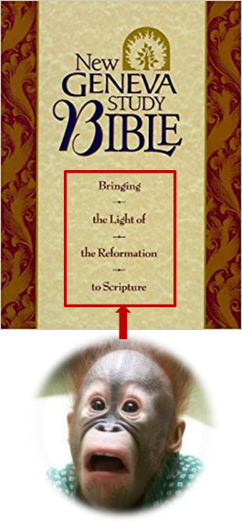
Dispensationalists are Guilty of Antinomianism
“Some dispensationalists have held that since Christians live under a dispensation of grace, not law, keeping the moral law is at no stage necessary for them” (New Geneva Study Bible, p. 1990).
The argument is this: If you are not under the law then you must be lawless. The Bible, however, gives this answer:

Slide 14
Romans 7:4
“Therefore, my brethren, you also were made to die to the Law through the body of Christ, so that you might be joined to another, to Him who was raised from the dead, in order that we might bear fruit for God.”
* θανατόω - aorist, passive, indicative, 2nd, plural – a past, completed, action
Galatians 2:19
“For through the Law I died to the Law, so that I might live to God.”

Slide 15
Romans 8:4
“so that the requirement of the Law might be fulfilled* in us, who do not walk according to the flesh but according to the Spirit.”
* πληρόω - aorist, passive, subjunctive, 3rd, singular – a past, completed, action
Romans 10:4
For Christ is the end of the law for righteousness to everyone who believes.

Slide 16
Galatians 5:22-23
“²² But the fruit of the Spirit is love, joy, peace, patience, kindness, goodness, faithfulness, ²³ gentleness, self-control; against such things there is no law.”
Titus 2:11-12
¹¹ For THE GRACE OF GOD has appeared, bringing salvation to all men, ¹² instructing us to deny ungodliness and worldly desires and to live sensibly, righteously and godly in the present age,

Slide 17
Dispensationalists are Guilty of Antinomianism

Slide 18
Dispensationalists Teach that the Sermon on the Mount is Not for the Church Today – “False!”
The original Scofield Reference Bible (1909) stated that the Sermon on the Mount "clearly has a beautiful moral application to the Christian" (p.1000).
Arno Gaebelein, wrote, concerning the Beatitudes, "The blessings in themselves are most wonderful in their scope and inexhaustible in their meaning" (p. 112).
John Walvoord – "The Sermon on the Mount is clearly intended to be a definitive statement of Christ’s teaching and should not be pushed aside lightly by unnecessary stricture which would relegate it to unimportant truth" (Matthew—Thy Kingdom Come, p. 45).

Slide 19
Dispensationalists Teach that the Sermon on the Mount is Not for the Church Today – “False!”
Dispensationalists are known for *exegetical and *expository preaching of God’s Word, preaching through books of the Bible verse by verse (Matt. 4:4, Acts 20:27).
All of God’s Word is important and is profitable for us (2 Tim. 3:16-17).
*Exegetical preaching – is an explanation of a text based on a careful, objective analysis which includes linguistics. Exegesis literally means “to lead out of.” The interpreter is led to his conclusions by following the text.
*Expository preaching involves a comprehensive explanation, of the Scripture; that is, the meaning and intent of a biblical text, providing commentary and examples to make the passage clear and understandable.

Slide 20
Matthew 4:4
⁴ But He answered and said, “It is written, ‘Man shall not live on bread alone, but on every word that proceeds out of the mouth of God.’ ”
Acts 20:27
“For I have not shunned to declare unto you all the counsel of God”
2 Timothy 4:2
"Preach the word; be instant in season, out of season; reprove, rebuke, exhort with all longsuffering and doctrine"

Slide 21
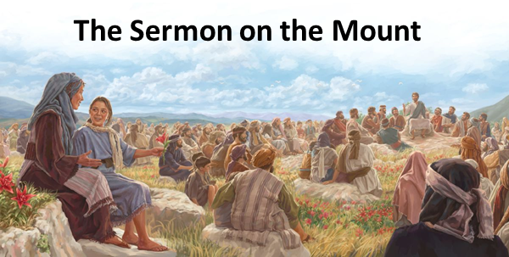
2 Tim. 3:16-17
"¹⁶ All Scripture is inspired by God and profitable for teaching, for reproof, for correction, for training in righteousness; ¹⁷ so that the man of God may be adequate, equipped for every good work."

Slide 22
Dispensationalists Teach that the Sermon on the Mount is Not for the Church Today – “False!”
The SOM is precious and valuable in that it provides believers rich secondary spiritual applications. For example, in:
the Beatitudes (5:1-12),
the ‘Disciple’s’ [Lord’s] prayer (6:9-15),
the passage on needless anxiety (6:25-34)
the parable of the two builders (7:24-27)

Slide 23
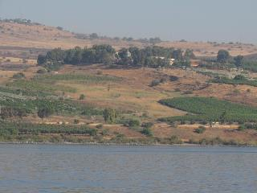
Dispensationalists Teach that the Sermon on the Mount is Not for the Church Today – “False!”
Dispensationalism teaches that believers of all dispensations:
are to recognize their own spiritual bankruptcy (5:3).
are to rejoice in spite of adverse circumstances (5:10-12).
are to abound in good works (5:16).
struggle with lust (5:28).
need to pray in secret (6:6).

Slide 24
Dispensationalists Teach that the Sermon on the Mount is Not for the Church Today – “False!”
The SOM embraces principles for all saints of all times.
Believers of all dispensations need to pray, “Thy will be done” (6:10).
Believers of all dispensations need to lay up treasures in heaven (6:20).
Believers of all dispensations struggle with the sin of worry (6:25-34).
Believers of all dispensations need to put God first (6:33).
Believers of all dispensations need to build their lives upon God’s Word (7:24-27).

Slide 25
Dispensationalists Teach that the Sermon on the Mount is Not for the Church Today – “False!”
The SOM contains trans-dispensational truths for all dispensations.
Those who hunger and thirst after righteousness will be filled (5:6).
God shines and showers His goodness on all men (5:45).
God sees what is done is secret (6:1-6).
God knows the needs of His believers (6:8,32).
What a man treasures reveals his heart (6:21).
No man can serve two masters (6:24).

Slide 26
Dispensationalists Teach that the Sermon on the Mount is Not for the Church Today – “False!”
The SOM contains trans-dispensational truths for all dispensations. (cont’d)
Those who honor God will be honored by God (6:33).
Before we can righteously judge, we must first judge ourselves (7:1-5).
Those who truly seek will truly find (7:7).
Men are evil and depraved (7:11).
The majority are headed for destruction; few will be saved (7:13-14).

Slide 27
Dispensationalists Teach that the Sermon on the Mount is Not for the Church Today – “False!”
The SOM contains trans-dispensational truths for all dispensations. (cont’d)
A tree is known by its fruit (7:17-20).
Mere profession does not necessarily mean true possession (7:21-23).
Our lives need to be built on a rock solid foundation (7:24-27).

Slide 28
Theological Bias? ‘Reformed Theology’ teaches that the SOM is for the Church Today!
Reformed Doctrine:
the Sermon was delivered to the Church.
the Church is made up of the saints of all ages.
the Church existed in the Old Testament and during our Lord’s earthly ministry.
there is but one people of God, and therefore that the Sermon applies equally to the one people of God no matter when they live on earth.

Slide 29
Dispensationalists Teach that the Sermon on the Mount is Not for the Church Today – “False!”

Slide 30
Dispensationalists Teach that the Sermon on the Mount is Not for the Church Today – “TRUE”!
The Lord gave this sermon to the Jews, not to the Church. The Church was not even in existence at the time this sermon was given. The SOM was a pre-cross message given to Jews who were told that the kingdom was near (Matthew 4:17).
The Sermon DOES NOT set forth distinctive Church truth.
The Sermon on the Mount is TOTALLY SILENT concerning truths revealed to the Church by the Apostles and N.T. Prophets because the Church was a mystery!
The purpose of the Sermon was primarily legal in character and condemnatory in effect.

Slide 31
2 Corinthians 3:6–9
⁶ [God] also made us adequate as servants of a new covenant, not of the letter [Mosaic Covenant] but of the Spirit; for THE LETTER KILLS [Mosaic Covenant], but the Spirit gives life. ⁷ But if THE MINISTRY OF DEATH, in letters engraved on stones [Mosaic Covenant], came with glory, so that the sons of Israel could not look intently at the face of Moses because of the glory of his face, fading as it was, ⁸ how will the ministry of the Spirit fail to be even more with glory? ⁹ For if THE MINISTRY OF CONDEMNATION [Mosaic Covenant] has glory, much more does the ministry of righteousness abound in glory. (cf. Rom. 7:3)

Slide 32
Dispensationalists Teach that the Sermon on the Mount is Not for the Church Today – “TRUE”!

Slide 33
END OF REVIEW
FINALLY

Slide 34
Biblical Dispensationalism
Session 9
False Charges Against Dispensationalism
Part 2
http://www.middletownbiblechurch.org/dispen/dispensa.htm

Slide 35
Session 9 Outline
Dispensationalists Teach More Than One Way of Salvation.
Dispensationalists are Guilty of Antinomianism
Dispensationalists Teach that the Sermon on the Mount is Not for the Church Today – "YES" and "NO"!
Dispensationalists Teach that the Death of Christ was an Afterthought and that the Church is "Plan B" in God's program.
Dispensationalism is a ‘New’ doctrine.
Dispensationalism Teaches a ‘Secret Rapture’.
Dispensationalism falsely claims that God made a bona fide offer of the kingdom to Israel.
Dispensationalists revere C. I. Scofield but he was an immoral man, not qualified to be a spiritual leader.

Slide 36
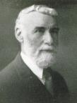
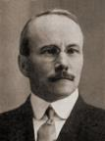
Dispensationalists Teach that the Death of Christ was an Afterthought…the Church is "Plan B" in God's program.
Philip Mauro – “When we press the vital question, what, in case the offer had been accepted, would have become of the Cross of Calvary and the atonement for the sins of the world?” (The Gospel of the Kingdom with an Examination of Modern Dispensationalism, p. 23).
O.T. Allis – “If the Jews had accepted the kingdom would there have been any place, any necessity for the cross?” (Prophecy and the Church, p. 75).

Slide 37
Dispensationalists Teach that the Death of Christ was an Afterthought…the Church is "Plan B" in God's program.
The Reformed System Theology – teaches that the underlying purpose of God in the world is Christological! Salvation is all.
The Dispensational System – teaches that the underlying purpose of God in the world is Doxological!
“Scripture is not man-centered as though salvation were the main theme, but it is God-centered because His glory is the center….The larger purpose of God is the manifestation of His own glory.”
Rryie, Dispensationalism, pg. 48
Notes:
RT – Holds the view that God’s Ultimate Purpose is Christological!
DT - Holds the view that God’s Ultimate Purpose is Doxological!
RT – does not rightly understand the theological definition of a “mystery”!

Slide 38
Dispensationalists Teach that the Death of Christ was an Afterthought…the Church is "Plan B" in God's program.
Dispensationalists know and teach that:
the cross of Christ is central and is the focal point of all history.
Christ was the sacrifice Lamb. (John 1:29; Rev. 13:8).
the centrality of the cross of our Savior and that we should glory or boast in nothing else (Gal. 6:14; 1 Cor. 2:2).

Slide 39
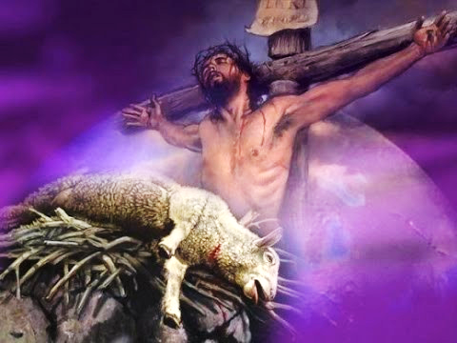
John 1:29
The next day [John the Baptist] saw Jesus coming to him and said, “Behold, the Lamb of God who takes away the sin of the world!
Revelation 13:8
All who dwell on the earth will worship him, everyone whose name has not been written from the foundation of the world, in the book of life of the Lamb who has been slain.

Slide 40
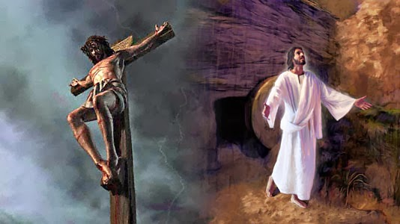
Galatians 6:14
¹⁴ But may it never be that I would boast, except in the cross of our Lord Jesus Christ, through which the world has been crucified to me, and I to the world.
1 Corinthians 2:22
For I determined to know nothing among you except Jesus Christ, and Him crucified.

Slide 41
Dispensationalists Teach that the Death of Christ was an Afterthought…the Church is "Plan B" in God's program.
R.C. Sproul Jr. – “We're not dispensationalists here... We believe that the church is essentially Israel. We believe that the answer to, "What about the Jews?" is, "Here we are." We deny that the church is God's "plan B." We deny that we are living in God's redemptive parenthesis, and that sometime in the next three, no two, no eight, no seven years, He'll get back to His real work, dealing with the Jews” (Table Talk magazine, published by Ligonier Ministries, Spring of 1999).

Slide 42
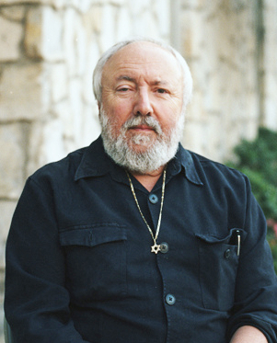
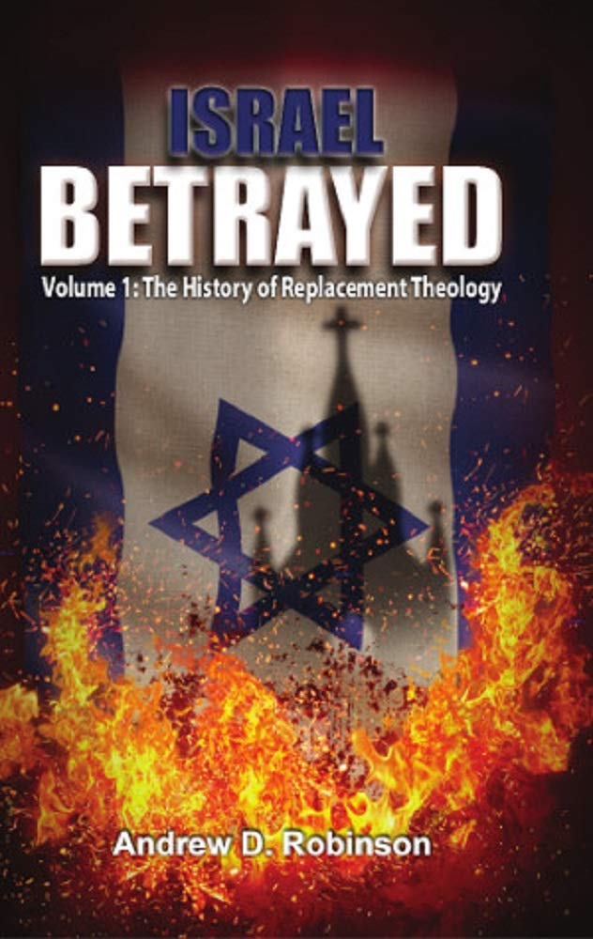
Dispensationalists Teach that the Death of Christ was an Afterthought…the Church is "Plan B" in God's program.
Jewish bible teacher Dr. Arnold G. Fruchtenbaum responded to Sproul’s outlandish statement with this piercing riposte: “Too bad you were not declaring this on the streets of Berlin around 1941.”
Andrew D. Robinson, author of Israel Betrayed, quoted in the Summer 2018 edition of the Ariel Ministries Magazine, Cover Story entitled, “A Doctrine of Demons” pgs. 10-13

Slide 43
Dispensationalists Teach that the Death of Christ was an Afterthought…the Church is "Plan B" in God's program.
Dispensationalists NEVER speak of the church being "Plan B“. It is a straw man argument. “Known unto God are all His works from the beginning of the world” (Acts 15:18), and this includes His distinct plans for Israel and the Church.
The “one new man” (Eph. 2:15), the “body of Christ”, “the Church”, was a “mystery” not made known to man for ages and for generations (Ephesians 3:3-10; Colossians 1:26-27).

Slide 44
Ephesians 2:13–15
¹³ But now in Christ Jesus you who formerly were far off have been brought near by the blood of Christ. ¹⁴ For He Himself is our peace, who made both groups into one and broke down the barrier of the dividing wall, ¹⁵ by abolishing in His flesh the enmity, which is the Law of commandments contained in ordinances, so that in Himself He might make the two into one new man, thus establishing peace,

Slide 45
Ephesians 3:3-10
³ that by revelation there was made known to me the mystery, as I wrote before in brief. ⁴ By referring to this, when you read you can understand my insight into the mystery of Christ, ⁵ which in other generations was not made known to the sons of men, as it has now been revealed to His holy apostles and prophets in the Spirit; ⁶ to be specific, that the Gentiles are fellow heirs and fellow members of the body, and fellow partakers of the promise in Christ Jesus through the gospel, ⁷ of which I was made. . .

Slide 46
Ephesians 3:3-10
. . . a minister, according to the gift of God’s grace which was given to me according to the working of His power. ⁸ To me, the very least of all saints, this grace was given, to preach to the Gentiles the unfathomable riches of Christ, ⁹ and to bring to light what is the administration of the mystery which for ages has been hidden in God who created all things; ¹⁰ so that the manifold wisdom of God might now be made known through the church to the rulers and the authorities in the heavenly places.

Slide 47
“Mystery” Defined
“In the N.T, it [mystērion] denotes, not the mysterious (as with the Eng. word), but that which, being outside the range of unassisted natural apprehension, can be made known only by Divine revelation, and is made known in a manner and at a time appointed by God, and to those who are illumined by His Spirit.”
W. E. Vine, Merrill F. Unger, and William White, Vine's Complete Expository Dictionary of the Old and New Testament Words (Nashville: Nelson, 1996), 424.

Slide 48
Origin of the Universal Church
BEFORE CHRIST’S ASCENSION
Matt 16:18 – future tense

Slide 49
Origin of the Universal Church
AFTER CHRIST’S ASCENSION
Eph 2:14-15; 3:9; Rom 16:25-26; Col 1:26-27 – mystery
Eph 1:20-22 – Christ’s headship over church
Eph 4:7-11 – spiritual gifts after Ascension
1 Cor. 12:13 – Spirit’s baptizing ministry
Acts 1:5 – to begin after Ascension
Acts 11:15-16 – began in the past
Acts 2 – only legitimate, biblical, place for beginning of Spirit’s baptizing ministry

Slide 50
Dispensationalists Teach that the Death of Christ was an Afterthought…the Church is "Plan B" in God's program.
“In almost 35 years since I have become a dispensationalist, I have never heard nor read of a dispensationalist teaching a plan B scenario. Yet opponents often present this straw man in their statement of what we supposedly believe. We believe that God’s single plan has always included the Church, but He did not reveal the church age part of the plan in the Old Testament....Paul states specifically that the church age ‘was in accordance with the eternal purpose which He carried out in Christ Jesus our Lord’ (verse 11). This is why dispensationalists have never taught the so-called plan A and plan B theory that critics suppose we hold. Dispensationalists have always taught that there is a single plan carried out in stages.”
Thomas Ice, “The Uniqueness of the Church,” Pre-Trib Perspectives 8, no. 6 (September 2003): 4.

Slide 51
Dispensationalists Teach that the Death of Christ was an Afterthought…the Church is "Plan B" in God's program.

Slide 52
Session 9 Outline
Dispensationalists Teach More Than One Way of Salvation.
Dispensationalists are Guilty of Antinomianism
Dispensationalists Teach that the Sermon on the Mount is Not for the Church Today – "YES" and "NO"!
Dispensationalists Teach that the Death of Christ was an Afterthought and that the Church is "Plan B" in God's program.
Dispensationalism is a ‘New’ doctrine.
Dispensationalism Teaches a ‘Secret Rapture’.
Dispensationalism falsely claims that God made a bona fide offer of the kingdom to Israel.
Dispensationalists revere C. I. Scofield but he was an immoral man, not qualified to be a spiritual leader.

Slide 53
Dispensationalism is a ‘New’ doctrine.
Students of church history all recognize that vital basic truths of God’s Word were lost for almost 1500 years and had to be rediscovered and recovered.
God used the Reformation to recover justification by faith, the supreme authority of the Bible and the priesthood of every believer, but this didn’t happen until the 16th century!
Regrettably, however, the Reformers failed to make a clean break from other Roman Catholic errors such as:
an allegorical approach to O.T. prophecies (Origin) &
the Church is the Kingdom (Augustine).

Slide 54
Dispensationalism is a ‘New’ doctrine.
Given the facts of church history, it should not be deemed inconceivable that New Testament mystery truths, relating to: 1) the nature of the Church and 2) God’s dual program and purpose for this present age, were not rediscovered and recovered until the 19th and 20th centuries.
Moreover, if Dispensationalism can be attacked for being ‘new’, then Covenant Theology, an outgrowth of the Reformation, not formally systematized until the 17th century by Johannes Cocceius, has the same weakness.

Slide 55
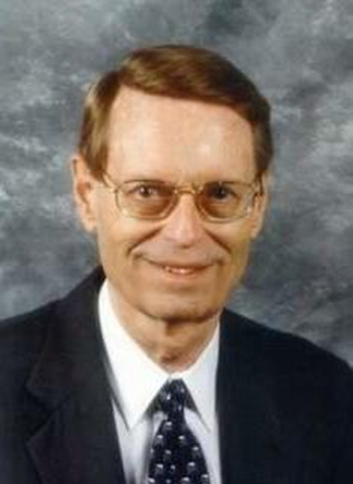
Charles Ryrie Dispensationalism, pgs. 215, 218
“Systematized Covenant theology is recent. It was not the expressed doctrine of the early church. It was never taught by church leaders in the Middle Ages. It was not even mentioned by the primary leaders of the Reformation. Indeed, Covenant theology as a system is only a little older than dispensationalism….Covenant theology does not appear in the writings of Luther, Zwingli, Calvin, or Melanchthon,… They had every opportunity to incorporate the covenant idea, but they did not. There were no references to Covenant theology in any of the great confessions of faith until the Westminster Confession in 1647, and even then Covenant theology was not as fully developed as it was later by Reformed theologians….Covenant theology is a . . .

Slide 56
Charles Ryrie Dispensationalism, pgs. 215, 218 (Cont’d)
...post-Reformation development in doctrine....Covenant theology is a refinement, and the refining did not antedate Darby by many years. Covenant theology cannot claim much more antiquity than dispensationalism....If lack of antiquity is detrimental and refinement is disallowed for dispensationalism, then by the same two criteria Covenant theology is discredited.”

Slide 57
Dispensationalism is a ‘New’ doctrine.
The real issue is not whether a system of theology is new or ancient, but whether it is Biblical.
BTW, “The charge of newness was leveled long ago at the doctrine of the Reformers.” (Ryrie, Dispensationalism, p. 71).

Slide 58
Dispensationalism is a ‘New’ doctrine.

Slide 59
Session 9 Outline
Dispensationalists Teach More Than One Way of Salvation.
Dispensationalists are Guilty of Antinomianism
Dispensationalists Teach that the Sermon on the Mount is Not for the Church Today – "YES" and "NO"!
Dispensationalists Teach that the Death of Christ was an Afterthought and that the Church is "Plan B" in God's program.
Dispensationalism is a ‘New’ doctrine.
Dispensationalism Teaches a ‘Secret Rapture’.
Dispensationalism falsely claims that God made a bona fide offer of the kingdom to Israel.
Dispensationalists revere C. I. Scofield but he was an immoral man, not qualified to be a spiritual leader.

Slide 60
Dispensationalism Teaches a ‘Secret Rapture’.
What is the so-called “secret rapture”?
It is the idea that Christ will come to take believers out of the world before His return with them at the Second Coming – usually just called the Rapture of the church:
“Secret rapture” is stereotypically used as a pejorative (expressing contempt and disapproval) by those who deny that the Rapture of the Church is separate from the Second Coming of Christ.
https://www.gotquestions.org/secret-rapture.html

Slide 61
Rapture Distinct from Second Advent
RAPTURE | PASSAGE | SECOND COMING | PASSAGE
Imminent | Titus 2:13 (1 Cor. 1:7; Phil. 3:20; 4:5) | Follows other end-times events | 2 Thess. 2:1–4 (Matt. 24:15–30)
Before the Tribulation | 1 Thess. 5:9 (1 Thess. 1:10) | After the Tribulation | Rev. 6–19
Christ comes in the air | 1 Thess 4:16-17 | Christ comes to the earth | Zech 14:4
For His saints | 1 Thess 4:15-17 | With His saints | Rev 19:14
Blessing (comfort) | 1 Thess 4:18 | Judgment | Rev 19:15
Effects only believers | 1 Thess 4:15-17 | Effects both believers and unbelievers | Rev 19:15
Invisible | 1 Cor. 15:51-53 (1 Thess 4:16) | Visible to all | Rev 1:7
Announced by one archangel | 1 Thess 4:16 | Involves myriads of angels | Jude 14
Resurrection | 1 Cor. 15: 51 | No resurrection | -----
Rescue of the Church | 1 Thess 1:10 | Rescue of Israel | Matt 23:37-39

Slide 62
Dispensationalism Teaches a ‘Secret Rapture’.
In what sense is the rapture a secret?
In 1 Corinthians 15:51 the truth pertaining to the Rapture is called a “mystery.”
“In the N.T, it [mystērion] denotes,…that which, being outside the range of unassisted natural apprehension, can be made known only by Divine revelation, and is made known in a manner and at a time appointed by God, and to those who are illumined by His Spirit.”
W. E. Vine, Merrill F. Unger, and William White, Vine's Complete Expository Dictionary of the Old and New Testament Words (Nashville: Nelson, 1996), 424.

Slide 63
1 Cor. 15:51-52
⁵¹ Behold, I tell you a mystery; we will not all sleep, but we will all be changed, ⁵² in a moment, in the twinkling of an eye, at the last trumpet; for the trumpet will sound, and the dead will be raised imperishable, and we will be changed.

Slide 64
Dispensationalism Teaches a ‘Secret Rapture’.
The “Secret Rapture” is no longer a secret!
God has made the rapture known to His saints. Paul said, “I tell you a mystery” (1 Cor. 15:51-52). In other words, it is a truth that has now been clearly revealed and is a secret no more!

Slide 65
Dispensationalism Teaches a ‘Secret Rapture’.
Bible believers should be making known the glorious truth that “in a moment, in the twinkling of an eye” living believers will be changed and those who have died ‘in Christ’ will be raised (1 Thess. 4:13-18).

Slide 66
1 Thess. 4:13-18
¹³ But we do not want you to be uninformed, brethren, about those who are asleep, so that you will not grieve as do the rest who have no hope. ¹⁴ For if we believe that Jesus died and rose again, even so God will bring with Him those who have fallen asleep in Jesus. ¹⁵ For this we say to you by the word of the Lord, that we who are alive and remain until the coming of the Lord, will not precede those who have fallen asleep. ¹⁶ For the Lord Himself will descend from heaven with a shout, with the voice of the archangel and. . .

Slide 67
1 Thess. 4:13-18
. . . with the trumpet of God, and the dead in Christ will rise first. ¹⁷ Then we who are alive and remain will be caught up together with them in the clouds to meet the Lord in the air, and so we shall always be with the Lord. ¹⁸ Therefore comfort one another with these words.

Slide 68
Dispensationalism Teaches a ‘Secret Rapture’.
It's no secret. It's a promised, wonderful, life-changing truth, that our living Lord expects us to believe and share!
We should be looking expectantly for this blessed and comforting and purifying hope (Titus 2:13)!

Slide 69
Titus 2:13
“…looking for the blessed hope and the appearing of the glory of our great God and Savior, Christ Jesus…”

Slide 70
Dispensationalism Teaches a ‘Secret Rapture’.

Slide 71
CONCLUSION

Slide 72
Sessions 8-9 Outline
Dispensationalists Teach More Than One Way of Salvation.
Dispensationalists are Guilty of Antinomianism
Dispensationalists Teach that the Sermon on the Mount is Not for the Church Today – "YES" and "NO"!
Dispensationalists Teach that the Death of Christ was an Afterthought and that the Church is "Plan B" in God's program.
Dispensationalism is a ‘New’ doctrine.
Dispensationalism Teaches a ‘Secret Rapture’.
Dispensationalism falsely claims that God made a bona fide offer of the kingdom to Israel.
Dispensationalists revere C. I. Scofield but he was an immoral man, not qualified to be a spiritual leader.

Slide 73
Resources
Alva J. McClain, Law & Grace, Moody, 1967 978-088469-001-6
Arnold H. Ehlert, “A Bibliography of Dispensationalism,” Bibliotheca Sacra (January 1944–January 1946): 101:95–101, 199–209, 319–28, 447–60; 102:84–92, 207–19, 322–34, 455–67; 103:57–67.
Charles C. Ryrie, Dispensationalism, Moody, 2007, 080242189X
Christopher Cone, gen. ed., Dispensationalism Tomorrow & Beyond, Tyndale Seminary Press, 2008 9780981479101
Christopher Cone, gen. ed., An Introduction To The New Covenant, Tyndale Seminary Press, 2013, 9781938484100
Walvoord, J. F., The Prophecy Knowledge Handbook. Wheaton, IL: Victor Books. 1990.
Lewis S. Chafer, Major Bible Themes, Zondervan, 1974, 0-310-22390-3
Mike Stallard, gen .ed., Dispensational Understanding of the New Covenant, Regular Baptist Books, 2012, 9781607764946
Paul Enns, The Moody Handbook of Theology, Moody 1989,
Renald E. Showers, There Really Is A Difference, Friend of Israel Gospel Ministry, 1990, 0915540509
Rene Pache, The Inspiration and Authority of Scripture, Sheffield Pub Co, 1992
Roy B. Zuck, Basic Bible Interpretation, SP Publications, 1991
Charting the End Times CD-Rom: A Visual Guide to Understanding Bible Prophecy, ISBN-10: 0736917624
Materials from:
Dr. Andy Woods, Sugar Land Bible Church, www.slbc.org
Dr. Vern Peterman, Holly Hills Bible Church, www.hollyhillsbiblechurch.org
George Zeller, Middletown Bible Church, www.middletownbiblechurch.org
Ed Allsteadt, Sugar Land Bible Church, www.slbc.org

