Slide 1
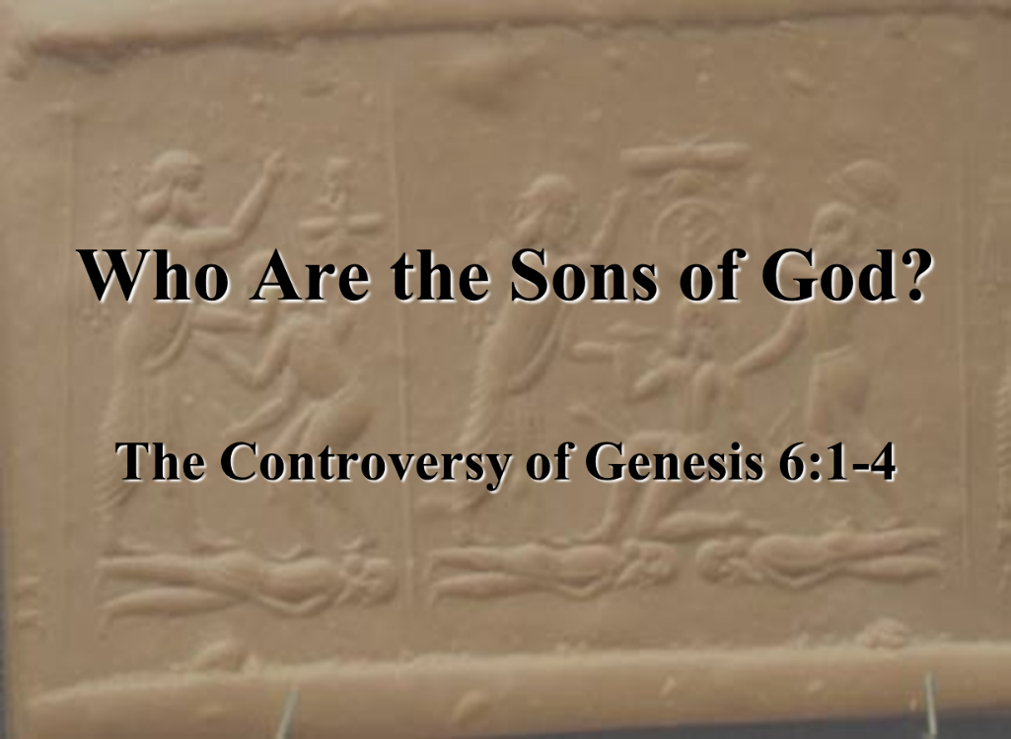

Dr. Andy Woods
Senior Pastor – Sugar Land Bible Church
President – Chafer Theological Seminary

Slide 2

Preview of Angelology
Good angels
Satanology
Demonology
Gen. 6:1-4 controversy

Slide 3

Genesis 6:1-4
“¹ Now it came about, when men began to multiply on the face of the land, and daughters were born to them, ² that the sons of God saw that the daughters of men were beautiful; and they took wives for themselves, whomever they chose. ³ Then the Lord said, ‘My Spirit shall not strive with man forever, because he also is flesh; nevertheless his days shall be one hundred and twenty years.’ ⁴ The Nephilim were on the earth in those days, and also afterward, when the sons of God came in to the daughters of men, and they bore children to them. Those were the mighty men who were of old, men of renown.”

Slide 4
Genesis 6:1-4
“¹ Now it came about, when men began to multiply on the face of the land, and daughters were born to them, ² that the sons of God saw that the daughters of men were beautiful; and they took wives for themselves, whomever they chose. ³ Then the Lord said, ‘My Spirit shall not strive with man forever, because he also is flesh; nevertheless his days shall be one hundred and twenty years.’ ⁴ The Nephilim were on the earth in those days, and also afterward, when the sons of God came in to the daughters of men, and they bore children to them. Those were the mighty men who were of old, men of renown.”

Slide 5
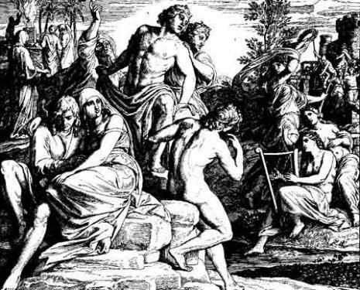
3 Major Alternative Views
Intermarriage between the Godly line of Seth and the ungodly lines of Cain
Polygamous Cainite despots
Fallen angels procreating with human women

Slide 6
3 Major Alternative Views
Intermarriage between the Godly line of Seth and the ungodly lines of Cain
Polygamous Cainite despots
Fallen angels procreating with human women

Slide 7

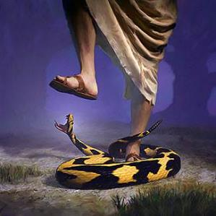
Genesis 3:15
“And I will put enmity Between you and the woman, And between your seed and her seed; He shall bruise you on the head, And you shall bruise him on the heel.”

Slide 8
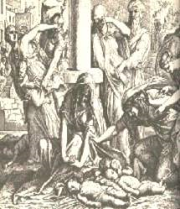
Satanic Attempts to Stop Messiah
Herod; Mt.2; Rev 12:4
Cain; Gen. 4, 1 Jn. 3:12
Pharaoh; Ex. 1
Athaliah; 2 Chron. 22
Haman; Esther
Matt 4:5-7

Slide 9
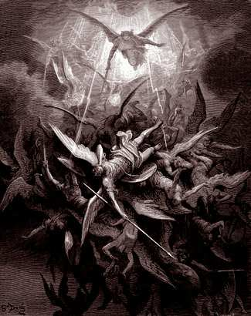
Lesson Overview
Defense of the Angel View
  Old Testament
  New Testament
  Tradition
  Objections

Slide 10
Lesson Overview
Defense of the Angel View
  Old Testament
  New Testament
  Tradition
  Objections

Slide 11
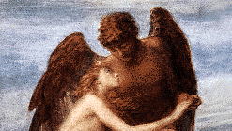
3 Reasons Supporting Sons of God
Men (6:1) versus the sons of God (6:2)
Old Testament uses (Gen 6:2, 4; Job 1:6; 2:1; 38:7)
Septuagint (LXX)

Slide 12
3 Reasons Supporting Sons of God
Men (6:1) versus the sons of God (6:2)
Old Testament uses (Gen 6:2, 4; Job 1:6; 2:1; 38:7)
Septuagint (LXX)

Slide 13
Genesis 6:1-4
“¹ Now it came about, when men began to multiply on the face of the land, and daughters were born to them, ² that the sons of God saw that the daughters of men were beautiful; and they took wives for themselves, whomever they chose. ³ Then the Lord said, ‘My Spirit shall not strive with man forever, because he also is flesh; nevertheless his days shall be one hundred and twenty years.’ ⁴ The Nephilim were on the earth in those days, and also afterward, when the sons of God came in to the daughters of men, and they bore children to them. Those were the mighty men who were of old, men of renown.”

Slide 14
3 Reasons Supporting Sons of God
Men (6:1) versus the sons of God (6:2)
Old Testament uses (Gen 6:2, 4; Job 1:6; 2:1; 38:7)
Septuagint (LXX)

Slide 15

Job 1:6
“Now there was a day when the sons of God came to present themselves before the Lord, and Satan also came among them.”

Slide 16

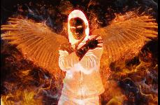
Ezekiel 28:14, 16
“¹⁴ You were the anointed cherub who covers, And I placed you there. You were on the holy mountain of God; You walked in the midst of the stones of fire.”… ¹⁶ By the abundance of your trade You were internally filled with violence, And you sinned; Therefore I have cast you as profane From the mountain of God. And I have destroyed you, O covering cherub, From the midst of the stones of fire.”

Slide 17
Job 2:1
“Again there was a day when the sons of God came to present themselves before the Lord, and Satan also came among them to present himself before the Lord.”

Slide 18
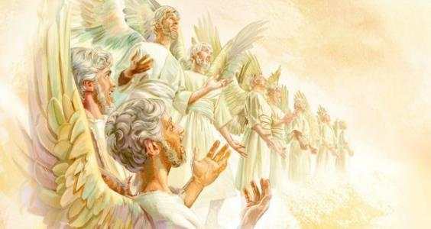
Job 38:7
“When the morning stars sang together
And all the sons of God shouted for joy?”

Slide 19
Authorship of the Book of Job
Thomas Constable, Notes on Job, www.soniclight.com
“The book does not identify its writer…From the patriarchal period, Job himself is the favored candidate, though some scholars have nominated Elihu…There are many examples of ancient extra-biblical writings in which the author spoke of himself in the third person, so we need not eliminate Job on that ground. The book reads as though an eyewitness of the events wrote it…I tend to prefer a contemporary of Job, or Job himself, because of the antiquity of this view, and the fact that no one has proved it unsatisfactory.”

Slide 20

Deuteronomy 14:1
“You are the sons of the Lord your God; you shall not cut yourselves nor shave your forehead for the sake of the dead.”
Notes:
Yahweh [LORD] is the memorial name of God given to Israel! לַֽיהוָ֖ה אֱלֹהֵיכֶ֑ם is LORD [Yahweh] your God [Elohim]. This is not the same as “sons of God [Elohim]”

Slide 21
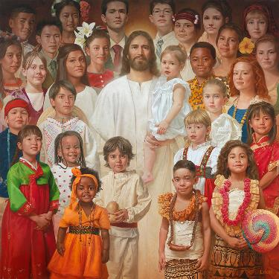
Romans 8:14
“For all who are being led by the Spirit of God, these are sons of God.”

Slide 22
3 Reasons Supporting Sons of God
Men (6:1) versus the sons of God (6:2)
Old Testament uses (Gen 6:2, 4; Job 1:6; 2:1; 38:7)
Septuagint (LXX)

Slide 23
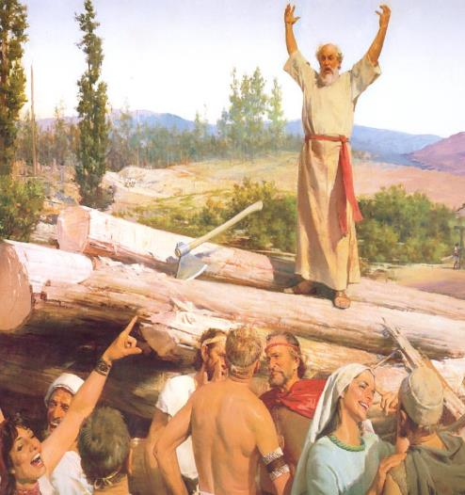
4 Additional Arguments From Genesis 6
Nephilim (Gen 6:4)
Noah’s perfection (6:9)
Evil of pre-flood humanity (Gen 6:3, 5-7, 11-13)
Necessity of the flood

Slide 24
4 Additional Arguments From Genesis 6
Nephilim (Gen 6:4)
Noah’s perfection (6:9)
Evil of pre-flood humanity (Gen 6:3, 5-7, 11-13)
Necessity of the flood

Slide 25
Genesis 6:1-4
“¹ Now it came about, when men began to multiply on the face of the land, and daughters were born to them, ² that the sons of God saw that the daughters of men were beautiful; and they took wives for themselves, whomever they chose. ³ Then the Lord said, ‘My Spirit shall not strive with man forever, because he also is flesh; nevertheless his days shall be one hundred and twenty years.’ ⁴ The Nephilim were on the earth in those days, and also afterward, when the sons of God came in to the daughters of men, and they bore children to them. Those were the mighty men who were of old, men of renown.”

Slide 26
4 Additional Arguments From Genesis 6
Nephilim (Gen 6:4)
Noah’s perfection (6:9)
Evil of pre-flood humanity (Gen 6:3, 5-7, 11-13)
Necessity of the flood

Slide 27

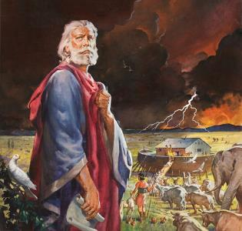
Genesis 6:8-9
“ ⁸ But Noah found favor in the eyes of the Lord. ⁹ These are the records of the generations of Noah. Noah was a righteous man, blameless in his time; Noah walked with God.”

Slide 28

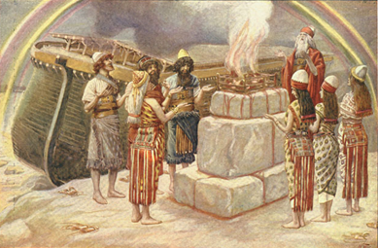
Genesis 8:21
The Lord smelled the soothing aroma; and the Lord said to Himself, “I will never again curse the ground on account of man, for the intent of man’s heart is evil from his youth; and I will never again destroy every living thing, as I have done.[emphasis mine].

Slide 29
Romans 3:23
“for all have sinned and fall short of the glory of God.”

Slide 30
Genesis 6:8-9
“ ⁸ But Noah found favor in the eyes of the Lord. ⁹ These are the records of the generations of Noah. Noah was a righteous man, blameless in his time; Noah walked with God.”

Slide 31
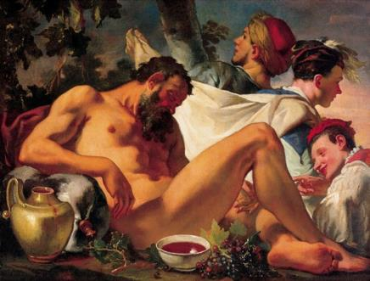
Genesis 9:20-21
“²⁰ Then Noah began farming and planted a vineyard. ²¹ He drank of the wine and became drunk, and uncovered himself inside his tent.”

Slide 32
Genesis 3:15
“And I will put enmity Between you and the woman, And between your seed and her seed; He shall bruise you on the head, And you shall bruise him on the heel.”

Slide 33
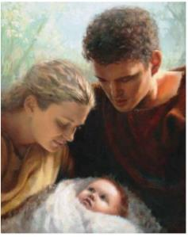
Genesis 4:1
“Now the man had relations with his wife Eve, and she conceived and gave birth to Cain, and she said, ‘I have gotten a manchild with the help of the Lord.’”

Slide 34
Genesis 5:29
“Now he called his name Noah, saying, ‘This one will give us rest from our work and from the toil of our hands arising from the ground which the Lord has cursed.’”

Slide 35
Genesis 6:8-9
“ ⁸ But Noah found favor in the eyes of the Lord. ⁹ These are the records of the generations of Noah. Noah was a righteous man, blameless in his time; Noah walked with God.”

Slide 36
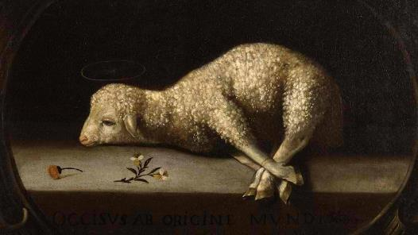
Exodus 12:5
“Your lamb shall be an unblemished male a year old; you may take it from the sheep or from the goats.”

Slide 37
Genesis 3:15
“And I will put enmity Between you and the woman, And between your seed and her seed; He shall bruise you on the head, And you shall bruise him on the heel.”

Slide 38
God’s Messianic Purposes Beginning in Genesis
Proto evangelium (3:15, 21)
Seth (4:25)
Noah (Gen 5:29)
Shem (9:26)
Abraham (12:3)
Isaac (21:12)
Jacob (25:23)
Judah (49:10)

Slide 39
Genesis 6:11-13
“¹¹ Now the earth was corrupt in the sight of God, and the earth was filled with violence. ¹² God looked on the earth, and behold, it was corrupt; for all flesh had corrupted their way upon the earth. ¹³ Then God said to Noah, “The end of all flesh has come before Me; for the earth is filled with violence because of them; and behold, I am about to destroy them with the earth.”

Slide 40
4 Additional Arguments From Genesis 6
Nephilim (Gen 6:4)
Noah’s perfection (6:9)
Evil of pre-flood humanity (Gen 6:3, 5-7, 11-13)
Necessity of the flood

Slide 41
Genesis 6:1-4
“¹ Now it came about, when men began to multiply on the face of the land, and daughters were born to them, ² that the sons of God saw that the daughters of men were beautiful; and they took wives for themselves, whomever they chose. ³ Then the Lord said, ‘My Spirit shall not strive with man forever, because he also is flesh; nevertheless his days shall be one hundred and twenty years.’ ⁴ The Nephilim were on the earth in those days, and also afterward, when the sons of God came in to the daughters of men, and they bore children to them. Those were the mighty men who were of old, men of renown.”

Slide 42
Genesis 6:5-7
“⁵ Then the Lord saw that the wickedness of man was great on the earth, and that every intent of the thoughts of his heart was only evil continually. ⁶ The Lord was sorry that He had made man on the earth, and He was grieved in His heart. ⁷ The Lord said, “I will blot out man whom I have created from the face of the land, from man to animals to creeping things and to birds of the sky; for I am sorry that I have made them.”

Slide 43
Genesis 6:11-13
“¹¹ Now the earth was corrupt in the sight of God, and the earth was filled with violence. ¹² God looked on the earth, and behold, it was corrupt; for all flesh had corrupted their way upon the earth. ¹³ Then God said to Noah, “The end of all flesh has come before Me; for the earth is filled with violence because of them; and behold, I am about to destroy them with the earth.”

Slide 44
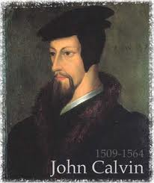
Total Depravity
What total depravity is not:
  Man is as evil as he can possibly be & indulges every possible sin
  Man is incapable of doing good things
    Gen. 3:22
    Matt. 7:11
    Acts 10:1-2; 11:14
    Rom. 2:14-15

Slide 45
Total Depravity
What total depravity is not:
  Man is as evil as he can possibly be & indulges every possible sin
  Man is incapable of doing good things
    Gen. 3:22
    Matt. 7:11
    Acts 10:1-2; 11:14
    Rom. 2:14-15

Slide 46
Genesis 3:22
“Then the Lord God said, ‘Behold, the man has become like one of Us, knowing good and evil; and now, he might stretch out his hand, and take also from the tree of life, and eat, and live forever’—.”

Slide 47
Total Depravity
What total depravity is not:
  Man is as evil as he can possibly be & indulges every possible sin
  Man is incapable of doing good things
    Gen. 3:22
    Matt. 7:11
    Acts 10:1-2; 11:14
    Rom. 2:14-15

Slide 48

Matthew 7:11
“If you then, being evil, know how to give good gifts to your children, how much more will your Father who is in heaven give what is good to those who ask Him!”

Slide 49
Total Depravity
What total depravity is not:
  Man is as evil as he can possibly be & indulges every possible sin
  Man is incapable of doing good things
    Gen. 3:22
    Matt. 7:11
    Acts 10:1-2; 11:14
    Rom. 2:14-15

Slide 50
Total Depravity
What total depravity is not:
  Man is as evil as he can possibly be & indulges every possible sin
  Man is incapable of doing good things
    Gen. 3:22
    Matt. 7:11
    Acts 10:1-2; 11:14
    Rom. 2:14-15

Slide 51
Romans 2:14-15
“¹⁴ For when Gentiles who do not have the Law do instinctively the things of the Law, these, not having the Law, are a law to themselves, ¹⁵ in that they show the work of the Law written in their hearts, their conscience bearing witness and their thoughts alternately accusing or else defending them.”

Slide 52
Henry Clarence Thiessen
“The Scriptures speak of human nature as totally depraved. However, the doctrine of ‘total depravity’ is easily misunderstood and misinterpreted. From the negative standpoint, it is important to know both what it does not mean and what it does mean. This does not mean that every sinner is devoid of all qualities pleasing to men; that he commits or is prone to every form of sin; or that he is bitterly opposed to God as it is possible for him to be. Jesus recognize the existence of pleasing qualities in some individuals (Mark 10:21); He said that the scribes . . .

Slide 53
Henry Clarence Thiessen
. . .and Pharisees did some things God demanded (Matt. 23:23); Paul asserted that some Gentiles ‘do instinctively the things of the law’ (Rom. 2:14); God told Abraham that the iniquity of the Amorites would grow worse (Gen. 15:16); and Paul says that ‘evil men and imposters will proceed from bad to worse’ (2 Tim. 3:13).”
Henry Clarence Thiessen, Lectures in Systematic Theology, rev. ed. (Grand Rapids: Eerdmans, 1979), 191.

Slide 54
4 Additional Arguments From Genesis 6
Nephilim (Gen 6:4)
Noah’s perfection (6:9)
Evil of pre-flood humanity (Gen 6:3, 5-7, 11-13)
Necessity of the flood

Slide 55

Genesis 7:19-23
“They rose greatly on the earth, and all the high mountains under the entire heaven were covered…Every living thing that moved on the earth perished—birds, livestock, wild animals, all the creatures that swarm over the earth, and all mankind. Everything on dry land that had the breath of life in its nostrils died. Every living thing on the face of the earth was wiped out; men and animals and the creatures that move along the ground and the birds of the air were wiped from the earth. Only Noah was left, and those with him in the ark.”

Slide 56
H.C. Leupold
Exposition of Genesis (Grand Rapids: Baker, 1942), vol. 1, p. 301-302.
“… ‘all the high mountains under all the heavens.’ One of these expressions alone would almost necessitate the impression that the author intends to convey the idea of the absolute universality of the Flood…Yet since ‘all’ is known to be used in a relative sense, the writer removes all ambiguity by adding the phrase ‘under all the heavens.’ A double ‘all’ (kol) cannot allow for so relative a sense. It almost constitutes a Hebrew superlative. So we believe that the text disposes of the question of the universality of the flood. By way of objection to this interpretation, those who believe in a limited flood…urge the fact that kol is used in a relative sense, as is clearly the case in passages such as Genesis 41:57; Exodus 9:25, 10:15; Deuteronomy 2:25; and 1 Kings 10:24. However, we still insist that this fact could overthrow a single kol, never a double kol, as our verse has it.”

Slide 57
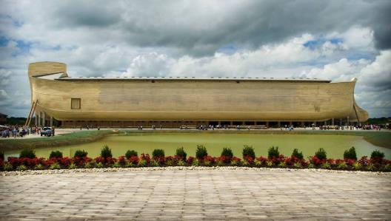
REASONS AGAINST A LOCAL FLOOD
Size of the ark (450 ft. long, 75 ft. wide, 45 ft. deep)?
Analogy to global Second Advent (Matt 24:37-39; Rev 1:7; 2 Pet 3:5-7)
Animals and birds on the ark?

Slide 58
BELIEVER OR UNBELIEVER?
Writer | Local Flood | Global Flood
Philo |  | X
Josephus |  | X
Justin Martyr |  | X
Theophilus of Antioch |  | X
Tertullian |  | X
Gregory of Nazianus |  | X
John Chrysostom |  | X
Augustine of Hippo |  | X
SOURCE: Jonathan Sarfati, Refuting Compromise (Green Forest, AR: Master Books), 244.

Slide 59
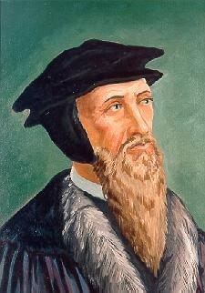
John Calvin
Genesis, 1554 (Edinburgh, UK: Banner of Truth, 1984), p. 272, emphasis mine.
“And the flood was forty days, etc. Moses conspicuously insists on this fact, in order to show that the whole world was immersed in the waters.”

Slide 60
UNIFORMITARIANISM IS NOT BIBLICISM
 | ERA | SCRIPTURE | DISTINCTIVES
1. | CREATION | Genesis 1-2 | No death
2. | FALL | Genesis 3-6 | Death, painful pregnancy & toil, long life spans, no human government
3. | FLOOD | Genesis 7-10 | Shorter life spans, human government, one language, no nations
4. | BABEL | Genesis 11-present | No global government, multiple languages, nations, ethnicities
5. | ANTICHRIST | Rapture to 2nd Advent | Global government, restrainer removed
6. | KINGDOM | Rev. 20:1-10 | Long life spans, kingdom conditions, reality of death, renovated earth
7. | ETERNAL STATE | Rev. 21-22 | No death, new earth

Slide 61
Alternative Views
Intermarriage between the Godly line of Seth and the ungodly lines of Cain
Polygamous Cainite despots
Fallen angels procreating with human women

Slide 62
CONCLUSION

Slide 63
Preview of Angelology
Good angels
Satanology
Demonology
Gen. 6:1-4 controversy

