Slide 1
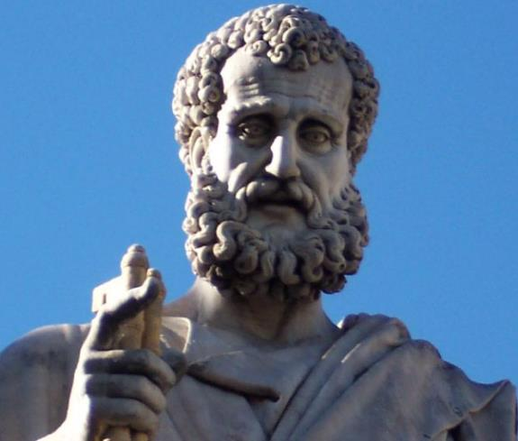

2 Peter
Dr. Andy Woods
Senior Pastor – Sugar Land Bible Church
President – Chafer Theological Seminary

Slide 2
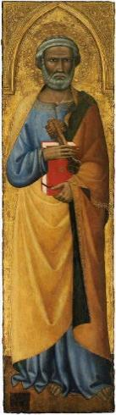
INTRODUCTORY MATTERS
Authorship: Peter
Biography: Gospels & Acts
Date: A.D. 64
Recipients: Regenerated, Asia Minor, Hebrews
Place of writing: Babylon
Occasion for writing: Incipient Gnosticism
Purpose: Insulation from false teaching
Structure: 3 parts
Message: Protection from false teachers
Unique characteristics: Knowledge

Slide 3
STRUCTURE
2 Peter 1 – Call to maturity
2 Peter 2 – Characteristics of false teachers
2 Peter 3 – Doctrine of the false teachers (uniformitarianism)

Slide 4
STRUCTURE
2 Peter 1 – Call to maturity
2 Peter 2 – Characteristics of false teachers
2 Peter 3 – Doctrine of the false teachers (uniformitarianism)

Slide 5
2 PETER
The Call to Maturity (2 Peter 1)

Slide 6
2 PETER
Chapter 1
Introduction (1:1-2)
Call to Growth (1:3-11)
Purpose Statement (1:12-15)
Coming kingdom (1:16-21)

Slide 7
2 PETER
Chapter 1
Introduction (1:1-2)
Call to Growth (1:3-11)
Purpose Statement (1:12-15)
Coming kingdom (1:16-21)

Slide 8
INTRODUCTION
(1:1-2)
Writer (1:1a)
Recipients (1:1b)
Greeting (1:2)

Slide 9
2 PETER
Chapter 1
Introduction (1:1-2)
Call to Growth (1:3-11)
Purpose Statement (1:12-15)
Coming kingdom (1:16-21)

Slide 10
The Call to Growth (1:3-11)
Provisions for Growth (1:3-4)
Portrait of Growth (1:5-7)
Benefits of Growth (1:8-11)

Slide 11
The Call to Growth (1:3-11)
Provisions for Growth (1:3-4)
Portrait of Growth (1:5-7)
Benefits of Growth (1:8-11)

Slide 12
PROVISIONS FOR GROWTH
(1:3-4)
Power (1:3a)
Knowledge (1:3b)
Promises (1:4a)
Participation in the divine nature (1:4b)

Slide 13
The Call to Growth (1:3-11)
Provisions for Growth (1:3-4)
Portrait of Growth (1:5-7)
Benefits of Growth (1:8-11)

Slide 14
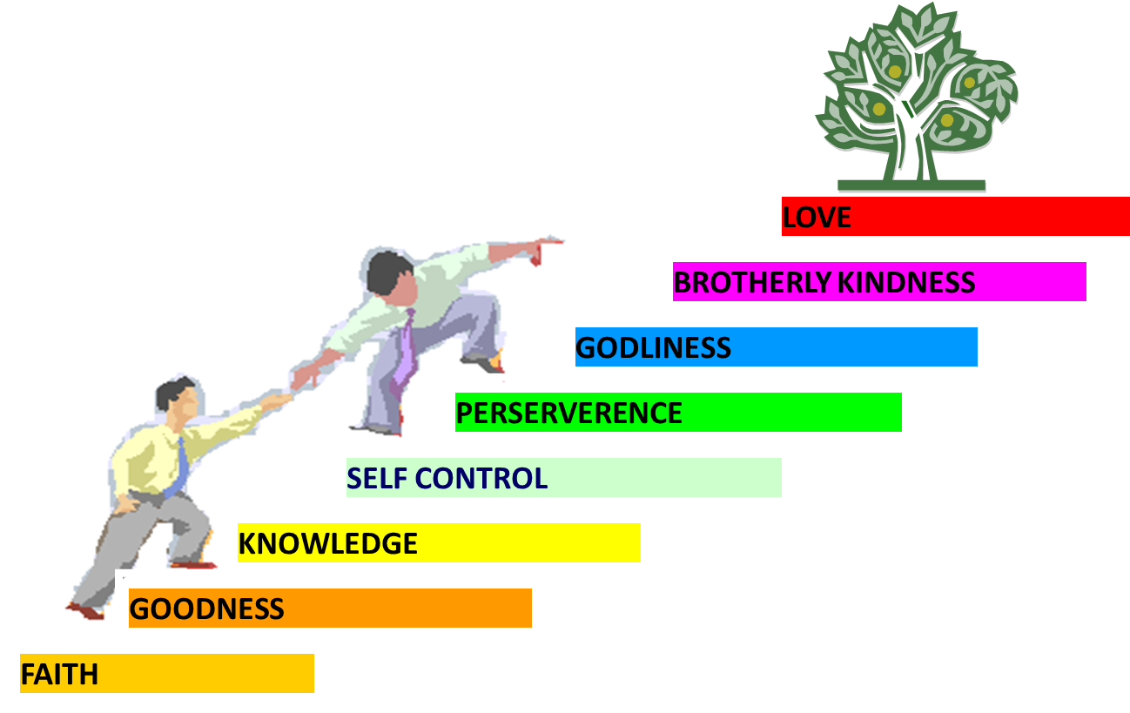
PORTRAIT OF GROWTH
1:5-7

Slide 15
The Call to Growth (1:3-11)
Provisions for Growth (1:3-4)
Portrait of Growth (1:5-7)
Benefits of Growth (1:8-11)

Slide 16

2 Peter 1:8-11
⁸ For if these qualities are yours and are increasing, they render you neither useless nor unfruitful in the true knowledge of our Lord Jesus Christ. ⁹ For he who lacks these qualities is blind or short-sighted, having forgotten his purification from his former sins. ¹⁰ Therefore, brethren, be all the more diligent to make certain about His calling and choosing you; for as long as you practice these things, you will never stumble; ¹¹ for in this way the entrance into the eternal kingdom of our Lord and Savior Jesus Christ will be abundantly supplied to you.

Slide 17
2 Peter 1:8-11
⁸ For if these qualities are yours and are increasing, they render you neither useless nor unfruitful in the true knowledge of our Lord Jesus Christ. ⁹ For he who lacks these qualities is blind or short-sighted, having forgotten his purification from his former sins. ¹⁰ Therefore, brethren, be all the more diligent to make certain about His calling and choosing you; for as long as you practice these things, you will never stumble; ¹¹ for in this way the entrance into the eternal kingdom of our Lord and Savior Jesus Christ will be abundantly supplied to you.

Slide 18
BENEFITS OF GROWTH
1:8-11
Productivity (1:8)
Harmony with identity (1:9)
Sureness of election (1:10a)
Stability (1:10b)
Eternal Reward (1:11)

Slide 19
BENEFITS OF GROWTH
1:8-11
Productivity (1:8)
Harmony with identity (1:9)
Sureness of election (1:10a)
Stability (1:10b)
Eternal Reward (1:11)

Slide 20
2 Peter 1:8-11
⁸ For if these qualities are yours and are increasing, they render you neither useless nor unfruitful in the true knowledge of our Lord Jesus Christ. ⁹ For he who lacks these qualities is blind or short-sighted, having forgotten his purification from his former sins. ¹⁰ Therefore, brethren, be all the more diligent to make certain about His calling and choosing you; for as long as you practice these things, you will never stumble; ¹¹ for in this way the entrance into the eternal kingdom of our Lord and Savior Jesus Christ will be abundantly supplied to you.

Slide 21
BENEFITS OF GROWTH
1:8-11
Productivity (1:8)
Harmony with identity (1:9)
Sureness of election (1:10a)
Stability (1:10b)
Eternal Reward (1:11)

Slide 22
2 Peter 1:8-11
⁸ For if these qualities are yours and are increasing, they render you neither useless nor unfruitful in the true knowledge of our Lord Jesus Christ. ⁹ For he who lacks these qualities is blind or short-sighted, having forgotten his purification from his former sins. ¹⁰ Therefore, brethren, be all the more diligent to make certain about His calling and choosing you; for as long as you practice these things, you will never stumble; ¹¹ for in this way the entrance into the eternal kingdom of our Lord and Savior Jesus Christ will be abundantly supplied to you.

Slide 23
BENEFITS OF GROWTH
1:8-11
Productivity (1:8)
Harmony with identity (1:9)
Sureness of election (1:10a)
Stability (1:10b)
Eternal Reward (1:11)

Slide 24
2 Peter 1:8-11
⁸ For if these qualities are yours and are increasing, they render you neither useless nor unfruitful in the true knowledge of our Lord Jesus Christ. ⁹ For he who lacks these qualities is blind or short-sighted, having forgotten his purification from his former sins. ¹⁰ Therefore, brethren, be all the more diligent to make certain about His calling and choosing you; for as long as you practice these things, you will never stumble; ¹¹ for in this way the entrance into the eternal kingdom of our Lord and Savior Jesus Christ will be abundantly supplied to you.

Slide 25


John 5:24
“Truly, truly, I say to you, he who hears My word, and believes Him who sent Me, has eternal life, and does not come into judgment, but has passed out of death into life.” (cf. 6:47)

Slide 26

Lewis Sperry Chafer, Salvation: A Clear Doctrinal Analysis
(Grand Rapids: Zondervan, 1977), 60. Italics added
Lewis Sperry Chafer
“There is a normal Christian experience. There are new and blessed emotions and desires. Old things do pass away; and behold all things do become new; but all such experiences are but secondary evidences, as to the fact of salvation, in that they grow out of that positive repose of faith which is the primary evidence.”

Slide 27
BENEFITS OF GROWTH
1:8-11
Productivity (1:8)
Harmony with identity (1:9)
Sureness of election (1:10a)
Stability (1:10b)
Eternal Reward (1:11)

Slide 28
2 Peter 1:8-11
⁸ For if these qualities are yours and are increasing, they render you neither useless nor unfruitful in the true knowledge of our Lord Jesus Christ. ⁹ For he who lacks these qualities is blind or short-sighted, having forgotten his purification from his former sins. ¹⁰ Therefore, brethren, be all the more diligent to make certain about His calling and choosing you; for as long as you practice these things, you will never stumble; ¹¹ for in this way the entrance into the eternal kingdom of our Lord and Savior Jesus Christ will be abundantly supplied to you.

Slide 29
BENEFITS OF GROWTH
1:8-11
Productivity (1:8)
Harmony with identity (1:9)
Sureness of election (1:10a)
Stability (1:10b)
Eternal Reward (1:11)

Slide 30
2 Peter 1:8-11
⁸ For if these qualities are yours and are increasing, they render you neither useless nor unfruitful in the true knowledge of our Lord Jesus Christ. ⁹ For he who lacks these qualities is blind or short-sighted, having forgotten his purification from his former sins. ¹⁰ Therefore, brethren, be all the more diligent to make certain about His calling and choosing you; for as long as you practice these things, you will never stumble; ¹¹ for in this way the entrance into the eternal kingdom of our Lord and Savior Jesus Christ will be abundantly supplied to you.

Slide 31
Three Tenses of Salvation
Phase | Justification | Sanctification | Glorification
Tense | Past | Present | Future
Saved from sin’s: | Penalty | Power | Presence
Scripture | Eph 2:8-9; Titus 3:5 | Philip 2:12 | Rom 5:10

Slide 32
Scripture’s Five Crowns (Rev 4:10: 3:11; 2 John 8)
SCRIPTURE | CROWN | PURPOSE
1 Cor. 9:24-27 | Incorruptible | Gaining mastery over the flesh
1 Thess. 2:19-20 | Rejoicing | Soul winning
Jas. 1:12; Rev. 2:10 | Life | Enduring trials
1 Pet. 5:2-4 | Glory | Shepherding God’s people
2 Tim. 4:8 | Righteousness | Longing for His appearing

Slide 33

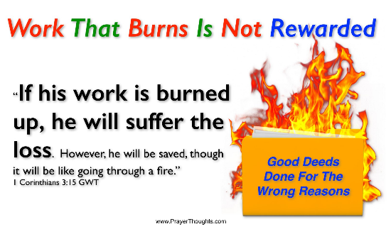
1 Corinthians 3:15
“If any man’s work is burned up, he will suffer loss; but he himself will be saved, yet so as through fire.”

Slide 34

1 Corinthians 9:24-27
“Do you not know that those who run in a race all run, but only one receives the prize? Run in such a way that you may win. ²⁵ Everyone who competes in the games exercises self-control in all things. They then do it to receive a perishable wreath, but we an imperishable. ²⁶ Therefore I run in such a way, as not without aim; I box in such a way, as not beating the air; ²⁷ but I discipline my body and make it my slave, so that, after I have preached to others, I myself will not be disqualified.”

Slide 35
RECIPIENTS
North-central portion of modern Turkey (1 Pet. 1:1)
Regenerated (1 Pet. 1:3-4; 2 Pet. 1:1)
Jewish
  Diaspora (1 Pet. 1:1; Jas. 1:1; John 7:35)
  Aliens/sojourners (1 Pet. 1:1)
  Pilgrims (1 Pet. 2:11)
  Distinguished from the Gentiles (1 Pet. 2:12; 4:3)
  1 Pet 2:9 (Exod. 19:6; Rom. 10:19)
  To the church/churches? (1 Pet. 1:1; 2 Pet. 1:1)
  Gal. 2:7-8

Slide 36

Isaiah 9:6-7
⁶ For a child will be born to us, a son will be given to us; And the government will rest on His shoulders; And His name will be called Wonderful Counselor, Mighty God, Eternal Father, Prince of Peace.⁷ There will be no end to the increase of His government or of peace, On the throne of David and over his kingdom, To establish it and to uphold it with justice and righteousness From then on and forevermore. The zeal of the Lord of hosts will accomplish this.

Slide 37
CONCLUSION

Slide 38
2 PETER
Chapter 1
Introduction (1:1-2)
Call to Growth (1:3-11)
Purpose Statement (1:12-15)
Coming kingdom (1:16-21)

