Slide 1
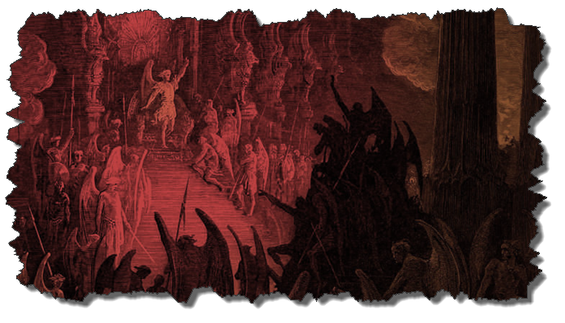
DEMONOLOGY
Dr. Andy Woods
Senior Pastor – Sugar Land Bible Church
President – Chafer Theological Seminary

Slide 2
Preview of Angelology
Good angels
Satanology
Demonology
Gen. 6:1-4 controversy

Slide 3
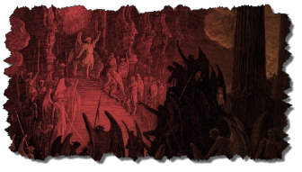
Overview
Existence Origin Personhood Characteristics | Powers Works Demon possession Defense

Slide 4
Overview
Existence Origin Personhood Characteristics | Powers Works Demon possession Defense

Slide 5
Christian’s Defense Against Satan/Demons
God’s responsibility
Believer’s responsibility

Slide 6
Christian’s Defense Against Satan/Demons
God’s responsibility
Believer’s responsibility

Slide 7
Christian’s Defense Against Satan/Demons
God’s responsibility
Divine restraint (Job 1:10, 12; 2:6; 2 Thess 2:6; 1 John 5:18)
Divine intercession (John 17:15; Rom 8:34; Heb 7:25)

Slide 8
Christian’s Defense Against Satan/Demons
God’s responsibility
Believer’s responsibility

Slide 9
Christian’s Defense Against Satan/Demons
Believer’s responsibility
Our defensive posture (Rev 20:2-3, 10; 2 Pet 2:10-11)
Avoid catering to the flesh (Eph 4:26-27)
Resist (Jas 4:7; 1 Pet 5:8-9; Eph 6:13)
Rely on the Spirit (1 John 4:4)
Put on the full armor of God (Eph 6:10-20)

Slide 10
Christian’s Defense Against Satan/Demons
Believer’s responsibility
Our defensive posture (Rev 20:2-3, 10; 2 Pet 2:10-11)
Avoid catering to the flesh (Eph 4:26-27)
Resist (Jas 4:7; 1 Pet 5:8-9; Eph 6:13)
Rely on the Spirit (1 John 4:4)
Put on the full armor of God (Eph 6:10-20)

Slide 11
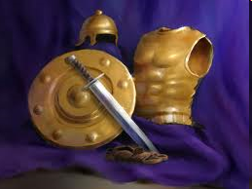
Ephesians
Dressed for Success!

Slide 12
8 Observations About the Armor (Eph 6:14-17)
Paul’s imprisonment (Eph 3:1; 6:20; Philip 1:13)
Soldier metaphor
Six pieces of armor described
Significance of the armor in the ancient world
Notes:
12

Slide 13
8 Observations About the Armor (Eph 6:14-17)
Paul is reinforcing prior concepts in Ephesians
Pieces mentioned in the order they are put on
Command: to put on the armor
Outline: description, represents, application
Notes:
13

Slide 14
Six aspects of our weaponry will summarize the key concepts of the letter and call the church to action.
Notes:
Richard M. Cozart
14

Slide 15
EPHESIANS: WHAT IS INSIDE?
1–3 | 4–6
Relationship | Responsibility
Doctrine | Deed
Orthodoxy | Orthopraxy
Knowledge | Wisdom
Belief | Behavior
Position | Practice
Privileges | Responsibility

Slide 16
6 Pieces of Armor (Eph 6:14-17)
Belt of truth (14a)
Breastplate of righteousness (14b)
Sandals of peace (15)
Shield of faith (16)
Helmet of salvation (17a)
Sword of the Spirit (17b)
Notes:
16

Slide 17
6 Pieces of Armor (Eph 6:14-17)
Belt of truth (14a)
Breastplate of righteousness (14b)
Sandals of peace (15)
Shield of faith (16)
Helmet of salvation (17a)
Sword of the Spirit (17b)
Notes:
17

Slide 18
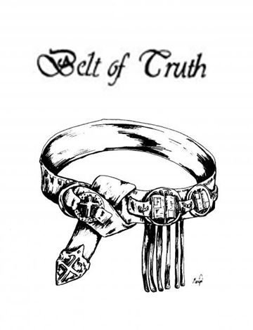
Belt of Truth (Eph 6:14a)
Represent
“Truth” [alēthia] used 6 times
Gospel (1:13; 4:21)
Doctrinal orthodoxy/stability (4:15)
Moral purity (4:24-25; 5:9)
Notes:
18

Slide 19
Belt of Truth (Eph 6:14a)
Definition
Foundation of our defense is standing firm in the truth of God’s Word as well as our personal integrity
Notes:
19

Slide 20
Belt of Truth (Eph 6:14a)
Application
Objective: Stand in the truth of God’s Word
Subjective: Personal integrity
Notes:
20

Slide 21
6 Pieces of Armor (Eph 6:14-17)
Belt of truth (14a)
Breastplate of righteousness (14b)
Sandals of peace (15)
Shield of faith (16)
Helmet of salvation (17a)
Sword of the Spirit (17b)
Notes:
21

Slide 22
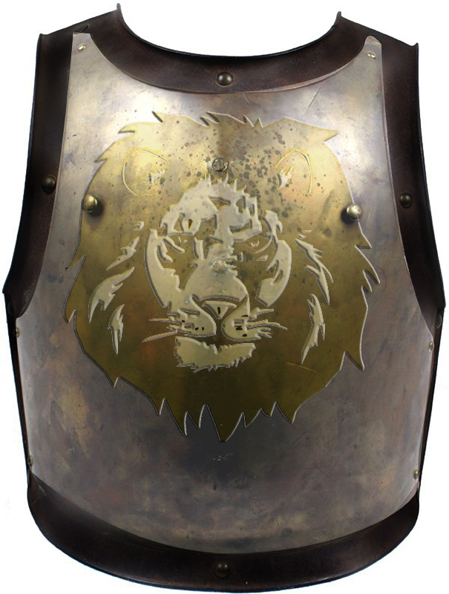
Breastplate of Righteousness (Eph 6:14b)
Description
Notes:
22

Slide 23
Breastplate of Righteousness (Eph 6:14b)
Represent
“Righteousness [dikaiosynē] used 2 times
4:24; 5:9
Practical righteousness
Notes:
23

Slide 24
Breastplate of Righteousness (Eph 6:14b)
Definition
Our underlying protection includes our righteous character and deeds stemming from our positional righteousness
Notes:
24

Slide 25
Breastplate of Righteousness (Eph 6:14b)
Application
Live consistently with our position
When we engage in a sinful or impure lifestyle, we are vulnerable and can take an arrow through the chest
Notes:
25

Slide 26
6 Pieces of Armor (Eph 6:14-17)
Belt of truth (14a)
Breastplate of righteousness (14b)
Sandals of peace (15)
Shield of faith (16)
Helmet of salvation (17a)
Sword of the Spirit (17b)
Notes:
26

Slide 27
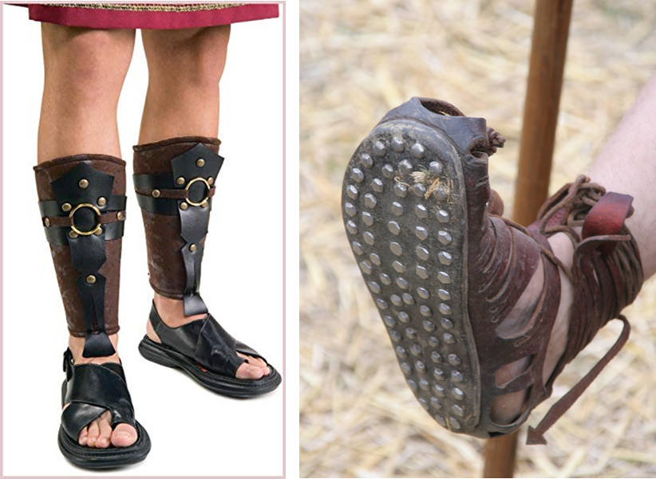
Sandals of Peace (Eph 6:15)
Description
Notes:
27

Slide 28
Sandals of Peace (Eph 6:15)
Represent
“Peace” [eirēnē] used 7 times
Positional peace (1:2; 6:23)
Racial harmony (2:14, 15, 17)
Unity (4:3)
Notes:
28

Slide 29
Sandals of Peace (Eph 6:15)
Definition
Because we are at peace with God, we should pursue peace and unity within the church
Notes:
29

Slide 30
Sandals of Peace (Eph 6:15)
Application
When we pursue unity in the church, we are putting on the sandals of peace
Negative example: Philip 4:2-3
Notes:
30

Slide 31
6 Pieces of Armor (Eph 6:14-17)
Belt of truth (14a)
Breastplate of righteousness (14b)
Sandals of peace (15)
Shield of faith (16)
Helmet of salvation (17a)
Sword of the Spirit (17b)
Notes:
31

Slide 32
Shield of Faith (Eph 6:16)
Description
Notes:
32

Slide 33
Shield of Faith (Eph 6:16)
Represent
“Faith” [pistis, pisteuō] used 9 times
Noun (1:15; 2:8; 3:12, 17; 4:5, 13; 6:23)
Verb (1:13, 19)
Content of what Christians believe
Notes:
33

Slide 34
Shield of Faith (Eph 6:16)
Definition
Our confident trust in God’s ways in order to withstand Satan’s attacks
Notes:
34

Slide 35
Shield of Faith (Eph 6:16)
Application
Flaming arrows in the ancient world
Examples of Satan’s flaming arrows
Our trust in God’s ways extinguishes them all
Unbelieving believer (Num 13-14; Mat. 14:28)
Notes:
35

Slide 36
6 Pieces of Armor (Eph 6:14-17)
Belt of truth (14a)
Breastplate of righteousness (14b)
Sandals of peace (15)
Shield of faith (16)
Helmet of salvation (17a)
Sword of the Spirit (17b)
Notes:
36

Slide 37
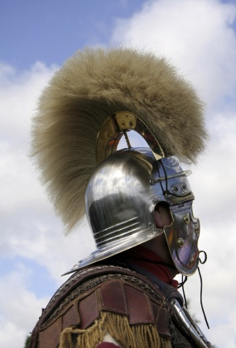
Helmet of Salvation (Eph 6:17a)
Description
Notes:
37

Slide 38
Helmet of Salvation (Eph 6:17a)
Represent
“Salvation” [sōtēria, sōtērion] used 1 time
Eph 1:13
Full ramification of salvation
Notes:
38

Slide 39
Three Tenses of Salvation
Phase | Justification | Sanctification | Glorification
Tense | Past | Present | Future
Saved from sin’s: | Penalty | Power | Presence
Scripture | Eph 2:8-9; Titus 3:5 | Philip 2:12 | Rom 5:10

Slide 40
Helmet of Salvation (Eph 6:17a)
Definition
Maintaining confidence of our past, present, and future deliverance in the mist of battle.
Notes:
40

Slide 41
Helmet of Salvation (Eph 6:17a)
Application
Confidence in the full ramifications of our salvation no matter what Satan throws at us that causes our assurance to wane
John 10:28-29; Rom 8:35; Philip 1:6; 1 Pet 1:4-5
Notes:
41

Slide 42
6 Pieces of Armor (Eph 6:14-17)
Belt of truth (14a)
Breastplate of righteousness (14b)
Sandals of peace (15)
Shield of faith (16)
Helmet of salvation (17a)
Sword of the Spirit (17b)
Notes:
42

Slide 43
Sword of the Spirit (Eph 6:17b)
Description
Notes:
43

Slide 44
Sword of the Spirit (Eph 6:17b)
Represent
Communication by the Spirit through the Word [rhēma] of God
2 Pet 1:21
Eph 1:8-9, 13, 17-18; 2:18; 3:5-6, 16
Notes:
44

Slide 45
John 17:17, 20-23
“¹⁷ Sanctify them in the truth; Your word is truth…²⁰ I do not ask on behalf of these alone, but for those also who believe in Me through their word; ²¹ that they may all be one; even as You, Father, are in Me and I in You, that they also may be in Us, so that the world may believe that You sent Me. ²² The glory which You have given Me I have given to them, that they may be one, just as We are one; ²³ I in them and You in Me, that they may be perfected in unity, so that the world may know that You sent Me, and loved them, even as You have loved Me.”

Slide 46
Sword of the Spirit (Eph 6:17b)
Represent
Communication by the Spirit through the Word [rhēma] of God
2 Pet 1:21
Eph 1:8-9, 13, 17-18; 2:18; 3:5-6, 16
Notes:
46

Slide 47
2 Timothy 3:16-17
“All Scripture is inspired by God [theopneustos] and profitable for teaching, for reproof, for correction, for training in righteousness; so that the man of God may be adequate, equipped for every good work.”

Slide 48
2 Peter 1:20-21
“²⁰ But know this first of all, that no prophecy of Scripture is a matter of one’s own interpretation, ²¹ for no prophecy was ever made by an act of human will, but men moved (pherō) by the Holy Spirit spoke from God.”

Slide 49
INSPIRATION OF SCRIPTURE 2 Peter 1:20-21
Men Wrote as they were inspired by Holy Spirit
“pherō” = to carry
Acts 27:15,17
Opposite of Knowledge of False Teachers
Which is their own imagination
Jer. 23:16

Slide 50
Sword of the Spirit (Eph 6:17b)
Represent
Communication by the Spirit through the Word [rhēma] of God
2 Pet 1:21
Eph 1:8-9, 13, 17-18; 2:18; 3:5-6, 16
Notes:
50

Slide 51
Sword of the Spirit (Eph 6:17b)
Definition
Specific skillful speaking and application of God’s written revelation in order to overcome Satan’s schemes
Notes:
51

Slide 52
Sword of the Spirit (Eph 6:17b)
Application
Positive example – Christ (Luke 4:1-13)
Negative example – Eve (Gen 2:16-17; 3:2-3)
Notes:
52

Slide 53
Sword of the Spirit (Eph 6:17b)
Application
Positive example – Christ (Luke 4:1-13)
Negative example – Eve (Gen 2:16-17; 3:2-3)
Notes:
53

Slide 54
Sword of the Spirit (Eph 6:17b)
Application
Positive example – Christ (Luke 4:1-13)
Negative example – Eve (Gen 2:16-17; 3:2-3)
Notes:
54

Slide 55
Genesis 2:16-17
“¹⁶ The Lord God commanded the man, saying, ‘From any tree of the garden you may eat freely; ¹⁷ but from the tree of the knowledge of good and evil you shall not eat, for in the day that you eat from it you will surely die.’”

Slide 56
Genesis 3:2-3
“² The woman said to the serpent, ‘From the fruit of the trees of the garden we may eat; ³ but from the fruit of the tree which is in the middle of the garden, God has said, ‘You shall not eat from it or touch it, or you will die.’”

Slide 57
CONCLUSION

Slide 58
6 Pieces of Armor (Eph 6:14-17)
Belt of truth (14a)
Breastplate of righteousness (14b)
Sandals of peace (15)
Shield of faith (16)
Helmet of salvation (17a)
Sword of the Spirit (17b)
Notes:
58

Slide 59
Review
Existence Origin Personhood Characteristics | Powers Works Demon possession Defense

Slide 60
Preview of Angelology
Good angels
Satanology
Demonology
Gen. 6:1-4 controversy

