Slide 1


Dr. Andy Woods
Senior Pastor – Sugar Land Bible Church
President – Chafer Theological Seminary

Slide 2

“After These Things”
(Rev. 4‒22)
Before the Tribulation (4‒5)
During the Tribulation (6‒19)
After the Tribulation (20‒22)
  Kingdom (20:1-10)
  Great White Throne Judgment (20:11-15)
  Destruction of the Earth (21:1)
  New Heaven and New Earth (21‒22)

Slide 3
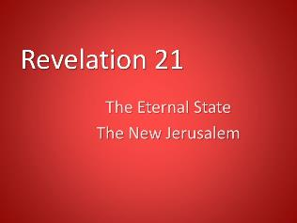
The Eternal State
Revelation 21‒22
The New Heavens & Earth (21:1-8)
The New Jerusalem (21:9‒22:5)
Epilogue (22:6-21)

Slide 4
The Eternal State
Revelation 21‒22
The New Heavens & Earth (21:1-8)
The New Jerusalem (21:9‒22:5)
Epilogue (22:6-21)

Slide 5
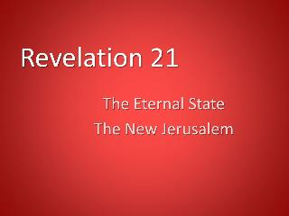
I. The New Heavens & Earth
Revelation 21:1-8
A New Creation (1)
A New City (2)
A New Fellowship (3)
A New Order (4-5)
A New Satisfaction (6)
A New Realization (7)
A New Holiness (8)

Slide 6
The Eternal State
Revelation 21‒22
The New Heavens & Earth (21:1-8)
The New Jerusalem (21:9‒22:5)
Epilogue (22:6-21)

Slide 7
II. The New Jerusalem
Revelation 21:9‒22:5
Four Titles (9-10)
Glory (11)
Construction (12-14)
Measurements (15-17)
Materials (18-21)
Relationship to God (22-23)
Relationship to the Nations (24-26)
Holiness (27)
Contents (22:1-5)

Slide 8
II. The New Jerusalem
Revelation 21:9‒22:5
Four Titles (9-10)
Glory (11)
Construction (12-14)
Measurements (15-17)
Materials (18-21)
Relationship to God (22-23)
Relationship to the Nations (24-26)
Holiness (27)
Contents (22:1-5)

Slide 9

Jerusalem Descending
Notes:
The descending city is described as being like a stone called Jasper, only unlike the earthly stone, this one is clear as crystal. The ultimate state of heaven sounds more like a diamond, doesn’t it?

Slide 10

Galatians 4:26
“But the Jerusalem above is free; she is our mother.”

Slide 11

Romans 8:19-22
¹⁹ For the anxious longing of the creation waits eagerly for the revealing of the sons of God. ²⁰ For the creation was subjected to futility, not willingly, but because of Him who subjected it, in hope ²¹ that the creation itself also will be set free from its slavery to corruption into the freedom of the glory of the children of God. ²² For we know that the whole creation groans and suffers the pains of childbirth together until now.

Slide 12

The whole creation groans and suffers!

Slide 13
Millennium | Eternal State
Rev. 20 | Rev. 21-22
Sin restrained | Sin removed
Curse restrained | Curse removed
Death | No death
Mortals / resurrected | Resurrected only
Mortals Destinies undecided | All Destinies sealed
Renovation | Recreation
Temporary | Eternal
Transitional | Non-transitional

Slide 14
Millennium and Eternal State
 | Rev. 20:1-10 | Rev. 21–22
Time | 20:4 | 22:5
Luminaries | Isa. 30:26 | 21:23; 22:5
Temple | Ezek. 40–48 | 21:22
Death | Isa. 65:20 | 21:4
Satanic activity | 20:7 | 20:10
Rebellion | 20:8-9 | 21:27

Slide 15

Zechariah 14:16-18
“Then it will come about that any who are left of all the nations that went against Jerusalem will go up from year to year to worship the King, the Lord of hosts, and to celebrate the Feast of Booths. ¹⁷ And it will be that whichever of the families of the earth does not go up to Jerusalem to worship the King, the Lord of hosts, there will be no rain on them. ¹⁸ If the family of Egypt does not go up or enter, then no rain will fall on them; it will be the plague with which the Lord smites the nations who do not go up to celebrate the Feast of Booths.”

Slide 16
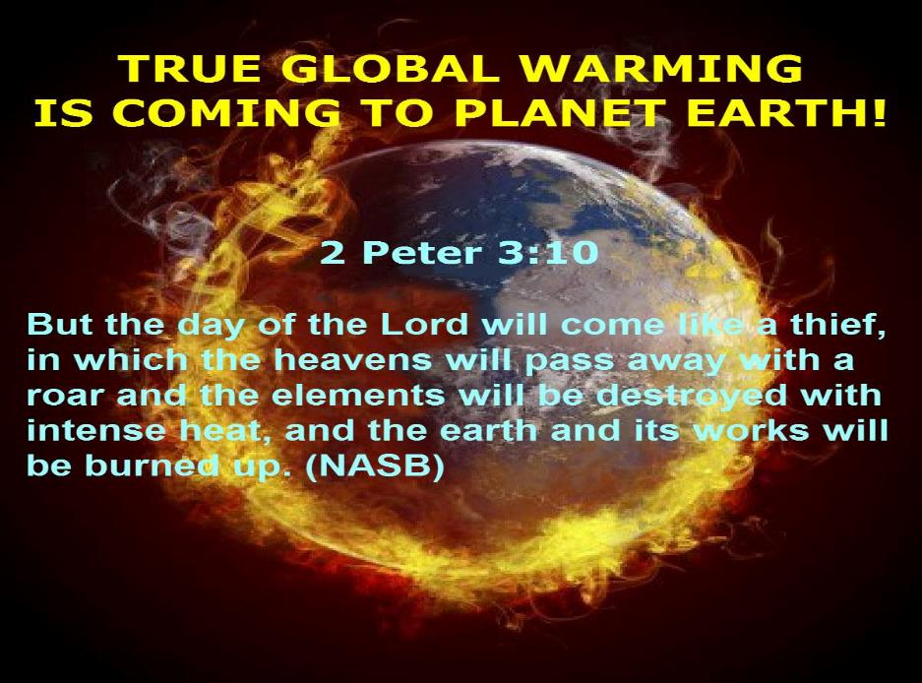

Slide 17
Jerusalem Descending
Notes:
The descending city is described as being like a stone called Jasper, only unlike the earthly stone, this one is clear as crystal. The ultimate state of heaven sounds more like a diamond, doesn’t it?

Slide 18
II. The New Jerusalem
Revelation 21:9‒22:5
Four Titles (9-10)
Glory (11)
Construction (12-14)
Measurements (15-17)
Materials (18-21)
Relationship to God (22-23)
Relationship to the Nations (24-26)
Holiness (27)
Contents (22:1-5)

Slide 19
Dispensational Theology is a
System of Theology
Traditional-normative dispensational theology is a system that embodies three essential, fundamental concepts called the sine qua non (lit. “without which is not”):
The consistent use of a plain, normal, literal, grammatical-historical method of interpretation;
Which reveals that the Church is distinct from Israel;
God’s overall purpose is to bring glory to Himself (Eph. 1:6, 12, 14).
Dr. Charles Ryrie, Dispensationalism, pp. 38-41

Slide 20
Dispensational Theology:
Doxological Purpose
God’s ultimate purpose for the ages is to glorify Himself. Scripture is not human-centered, as though salvation were the principle point, but God-centered, because His glory is at the center.
The glory of God is the primary principle that unifies all dispensations, the program of salvation being just one of the means by which God glorifies Himself. Each successive revelation of God’s plan for the ages, as well as His dealing with the elect, non-elect, angels, and nations all manifest His glory.
Dictionary of Premillennial Theology, Charles Ryrie, p. 94

Slide 21
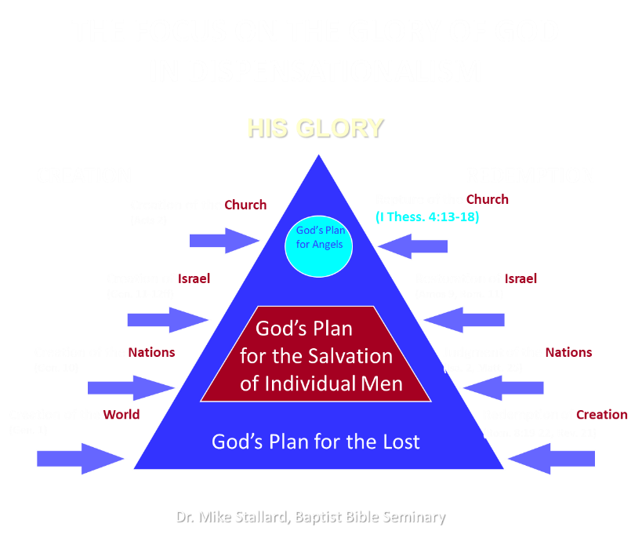

Slide 22

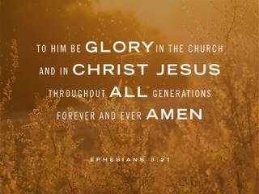
Ephesians 3:21
“to Him be the glory in the church and in Christ Jesus to all generations forever and ever. Amen.”

Slide 23
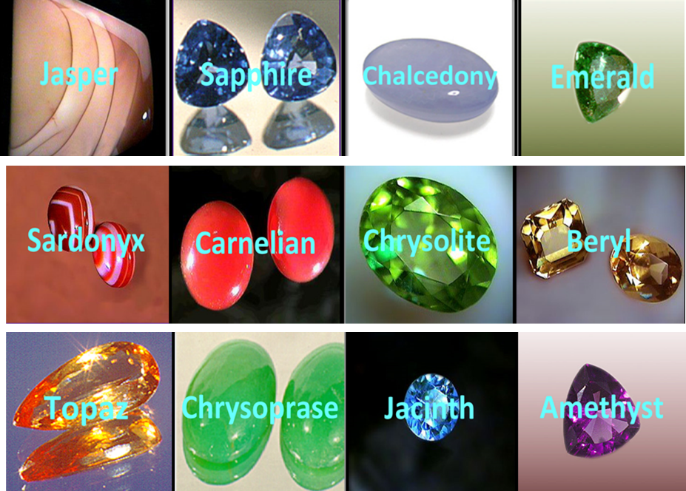

Slide 24
II. The New Jerusalem
Revelation 21:9‒22:5
Four Titles (9-10)
Glory (11)
Construction (12-14)
Measurements (15-17)
Materials (18-21)
Relationship to God (22-23)
Relationship to the Nations (24-26)
Holiness (27)
Contents (22:1-5)

Slide 25
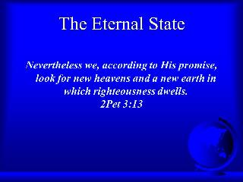
C. The City’s Construction
Revelation 21:12-14
Its Wall (12a)
Its Gates (12b-13)
Its Foundations (14)

Slide 26
C. The City’s Construction
Revelation 21:12-14
Its Wall (12a)
Its Gates (12b-13)
Its Foundations (14)

Slide 27
C. The City’s Construction
Revelation 21:12-14
Its Wall (12a)
Its Gates (12b-13)
Its Foundations (14)

Slide 28

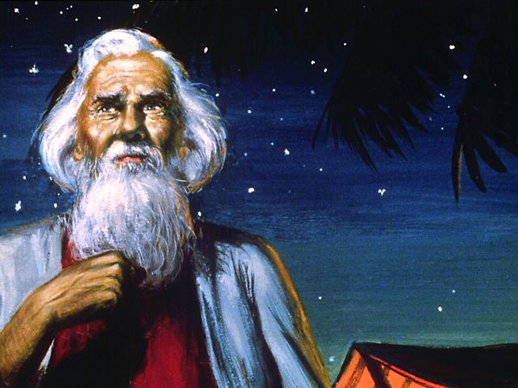
Genesis 12:3
“And I will bless those who bless you, And the one who curses you I will curse. And in you all the families of the earth will be blessed.”

Slide 29
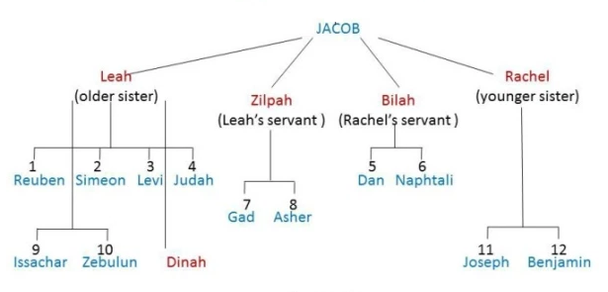

Slide 30
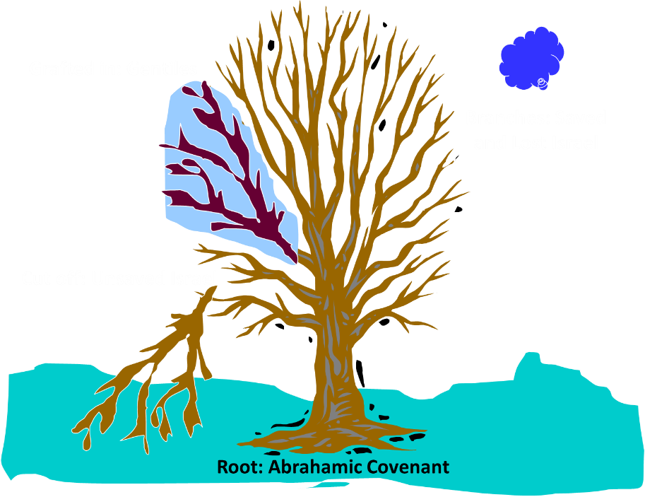
Notes:
30

Slide 31
Romans 11:13, 17-21
“But I am speaking to you who are Gentiles. Inasmuch then as I am an apostle of Gentiles, I magnify my ministry…But if some of the branches were broken off, and you, being a wild olive, were grafted in among them and became partaker with them of the rich root of the olive tree, ¹⁸ do not be arrogant toward the branches; but if you are arrogant, remember that it is not you who . . .

Slide 32
Romans 11:13, 17-21
. . . supports the root, but the root supports you. ¹⁹ You will say then, “Branches were broken off so that I might be grafted in.” ²⁰ Quite right, they were broken off for their unbelief, but you stand by your faith. Do not be conceited, but fear; ²¹ for if God did not spare the natural branches, He will not spare you, either.”

Slide 33
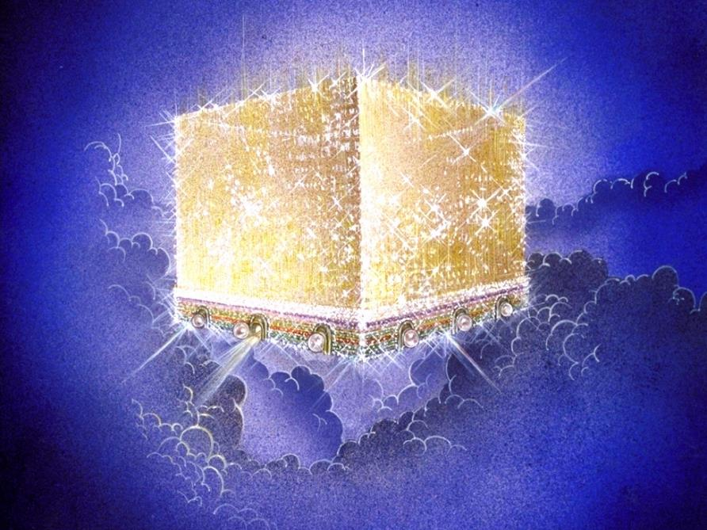
Notes:
Every city needs light. God, the ultimate source of power, illumines the city from his glory. Have you ever taken time to look at a sunset just after it has rained? As the sun sets, there is a kind of a glow cast on everything. It captures the spirit. This is just a little foretaste of the glory and splendor of heaven.

Slide 34
C. The City’s Construction
Revelation 21:12-14
Its Wall (12a)
Its Gates (12b-13)
Its Foundations (14)

Slide 35

Matthew 16:18
“I also say to you that you are Peter, and upon this rock I will build [oikodomeō] My church; and the gates of Hades WILL NOT overpower it.”

Slide 36

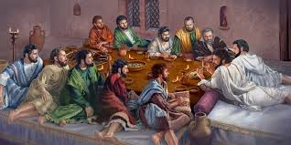
Ephesians 2:20
“having been built on the foundation of the apostles and prophets, Christ Jesus Himself being the corner stone.”

Slide 37
Dispensational Theology is a
System of Theology
Traditional-normative dispensational theology is a system that embodies three essential, fundamental concepts called the sine qua non (lit. “without which is not”):
The consistent use of a plain, normal, literal, grammatical-historical method of interpretation;
Which reveals that the Church is distinct from Israel;
God’s overall purpose is to bring glory to Himself (Eph. 1:6, 12, 14).
Dr. Charles Ryrie, Dispensationalism, pp. 38-41

Slide 38

Charles Ryrie
The Ryrie Study Bible
“Revelation 21:12–20 (RSBEE:NASB1995U): 21:12–14 Though both Jewish saints and Christian saints will inhabit the city, the names of the twelve tribes and the twelve apostles are a witness to their continued distinction.”

Slide 39
II. The New Jerusalem
Revelation 21:9‒22:5
Four Titles (9-10)
Glory (11)
Construction (12-14)
Measurements (15-17)
Materials (18-21)
Relationship to God (22-23)
Relationship to the Nations (24-26)
Holiness (27)
Contents (22:1-5)

Slide 40
D. The City’s Construction
Revelation 21:15-17
The Measuring Angel (15)
The Cube (16)
The Wall (17)

Slide 41
D. The City’s Construction
Revelation 21:15-17
The Measuring Angel (15)
The Cube (16)
The Wall (17)

Slide 42
D. The City’s Construction
Revelation 21:15-17
The Measuring Angel (15)
The Cube (16)
The Wall (17)

Slide 43

Revelation 21
¹⁶ The city was laid out like a square, as long as it was wide. He measured the city with the rod and found it to be [1500 miles] in length, and as wide and high as it is long. ¹⁷ He measured its wall and it was 144 cubits thick, by man's measurement, which the angel was using.
Notes:
READ…

Slide 44
The New Jerusalem

Slide 45
D. The City’s Construction
Revelation 21:15-17
The Measuring Angel (15)
The Cube (16)
The Wall (17)

Slide 46
Revelation 21
¹⁶ The city was laid out like a square, as long as it was wide. He measured the city with the rod and found it to be [1500 miles] in length, and as wide and high as it is long. ¹⁷ He measured its wall and it was 144 cubits thick, by man's measurement, which the angel was using.
Notes:
READ…

Slide 47
Charles Ryrie
The Ryrie Study Bible
“21:16–17 Shaped foursquare like a cube, the city is 1,380 mi. (2,220 km) on each face, including height, with a wall 72 yd (66 m) thick. It has been calculated that even if only 25 percent of this space were used for dwellings, 20 billion people could be accommodated spaciously.”

Slide 48
The Eternal State’s Literal Nature
“city,” “Jerusalem” | (21:2) | “pearls” | (21:21)
“gold,” “jasper,” “glass,” “wall” | (21:18) | “tribes” | (21:12)
“square,” “miles” | (21:16) | “foundations,” “apostles” | (21:14)
“high” | (21:12) | “street” | (21:21)
“seventy-two yards” | (21:17) | “river” | (22:1)
“gates” | (21:12) | “tree of life” | (22:2)
 |  | “fruit,” “month,” “nations,” “leaves” | (22:2)

Slide 49
Paul Lee Tan
Cited in, The Interpretation of Prophecy (Winona Lake, IN: BMH, 1974), 285-86.
    Swete: “Such dimensions defy imagination and are permissible only in the language of symbolism.”
    Barnes: “Of course, this must preclude all idea of there being such a city literally in Palestine…this cannot be understood literally; and the very idea of a literal fulfillment of this shows the absurdity of that method of interpretation…this cannot be taken literally; and an attempt to explain all of this literally would show that that method of interpreting the Apocalypse is impracticable.”

Slide 50
Paul Lee Tan
Cited in, The Interpretation of Prophecy (Winona Lake, IN: BMH, 1974), 285-86.
    Grant: “no clearer proof…that all is figurative. Such a height is simply out of harmony with the constitution of our world.”
    Boettner: “Neither the shape nor the dimensions of the city can be taken with mathematical exactness, as if it were a gigantic apartment house.”

Slide 51
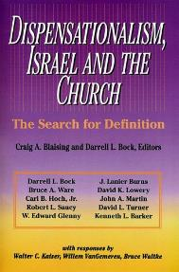
David L. Turner
“The New Jerusalem in Revelation 21:1-22:5; Consummation of a Biblical Continuum,” Dispensationalism, Israel, and the Church, ed., Craig A. Blaising and Darrell L. Bock (Grand Rapids: Zondervan, 1992), 277.
“Perhaps the absence of oysters large enough to produce such pearls and the absence of sufficient gold to pave such a city (viewed literally 1380 miles squared and high) is viewed as sufficient reason not to take these images as fully literal!…the preceding discussion serves to warn against a ‘hyper-literal’ approach to apocalyptic imagery….”

Slide 52
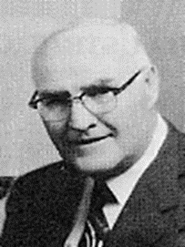
“When the plain sense of Scripture makes common sense, seek no other sense; therefore, take every word at its primary, ordinary, usual, literal meaning unless the facts of the immediate context, studied in light of related passages and axiomatic and fundamental truths, indicate clearly otherwise.”
David L. Cooper
The World’s Greatest Library Graphically Illustrated (Los Angeles: Biblical Research Society, 1970), 11.

Slide 53


Slide 54
“He (or she) who spiritualizes tells spiritual lies.”

Slide 55
II. The New Jerusalem
Revelation 21:9‒22:5
Four Titles (9-10)
Glory (11)
Construction (12-14)
Measurements (15-17)
Materials (18-21)
Relationship to God (22-23)
Relationship to the Nations (24-26)
Holiness (27)
Contents (22:1-5)

Slide 56
E. The City’s Materials
Revelation 21:18-21
Its Wall (18)
Its Foundations (19-20)
Its Gate (21a)
Its Street (21b)

Slide 57
E. The City’s Materials
Revelation 21:18-21
Its Wall (18)
Its Foundations (19-20)
Its Gate (21a)
Its Street (21b)

Slide 59
E. The City’s Materials
Revelation 21:18-21
Its Wall (18)
Its Foundations (19-20)
Its Gate (21a)
Its Street (21b)

Slide 60
Charles Ryrie
The Ryrie Study Bible
“21:19–20 chalcedony. Probably a greenish-blue agate stone. (The exact composition and color of all these precious stones is unknown.) sardonyx. Red and white stone. sardius. Bright red. chrysolite. Golden in color. beryl. Sea green. topaz. Yellow-green. chrysoprase. Apple green. jacinth. Blue. amethyst. Purple.”

Slide 62
E. The City’s Materials
Revelation 21:18-21
Its Wall (18)
Its Foundations (19-20)
Its Gate (21a)
Its Street (21b)

Slide 63
Notes:
Every city needs light. God, the ultimate source of power, illumines the city from his glory. Have you ever taken time to look at a sunset just after it has rained? As the sun sets, there is a kind of a glow cast on everything. It captures the spirit. This is just a little foretaste of the glory and splendor of heaven.

Slide 64
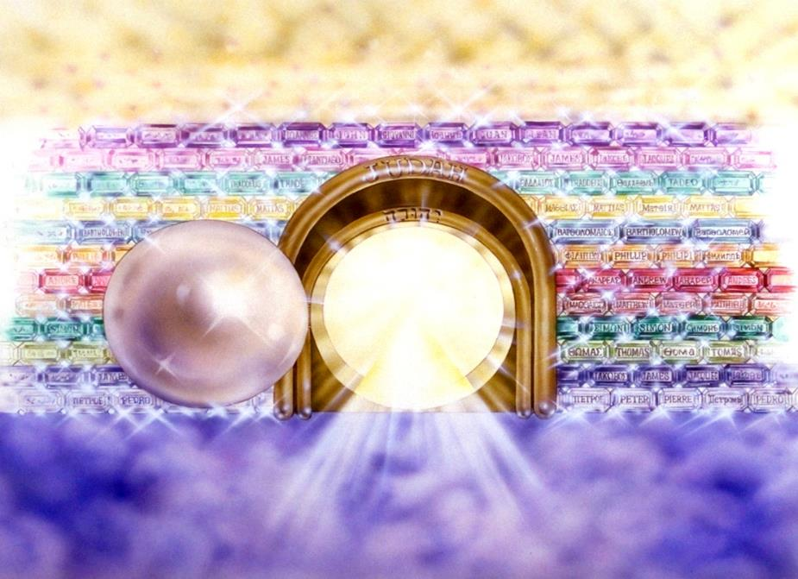
Notes:
Here you see an artist’s ideas of…
12 Gates = 12 Tribes of Israel
12 Foundation Stones = 12 Apostles of the Church

Slide 65
E. The City’s Materials
Revelation 21:18-21
Its Wall (18)
Its Foundations (19-20)
Its Gate (21a)
Its Street (21b)

Slide 66

Notes:
And the streets are made of what? Gold. When a man heard he was about to die, he desperately gathered up his life’s greatest accumulation—gold bars. When he did finally enter heaven, toting the heaven load, one angel poked another angel in the ribs. He said, “Hey, look, that guy brought pavement!”

Slide 67
David L. Turner
“The New Jerusalem in Revelation 21:1-22:5; Consummation of a Biblical Continuum,” Dispensationalism, Israel, and the Church, ed., Craig A. Blaising and Darrell L. Bock (Grand Rapids: Zondervan, 1992), 277.
“Perhaps the absence of oysters large enough to produce such pearls and the absence of sufficient gold to pave such a city (viewed literally 1380 miles squared and high) is viewed as sufficient reason not to take these images as fully literal!…the preceding discussion serves to warn against a ‘hyper-literal’ approach to apocalyptic imagery….”

Slide 68
II. The New Jerusalem
Revelation 21:9‒22:5
Four Titles (9-10)
Glory (11)
Construction (12-14)
Measurements (15-17)
Materials (18-21)
Relationship to God (22-23)
Relationship to the Nations (24-26)
Holiness (27)
Contents (22:1-5)

Slide 69
E. The City’s Relationship to God
Revelation 21:22-23
No Temple (22)
No Luminaries (23)

Slide 70
E. The City’s Relationship to God
Revelation 21:22-23
No Temple (22)
No Luminaries (23)

Slide 71
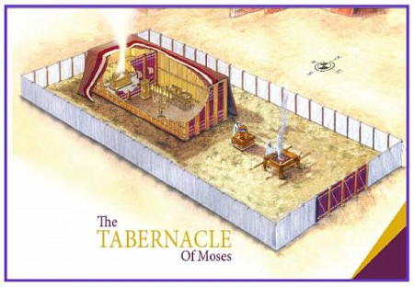

Slide 72
Israel’s Four Temples
Solomon’s pre exilic temple (Kings and Chronicles)
Zerubbabel’s post exilic temple (Ezra 1-6; John 2:20)
Antichrist's temple (Dan 9:27; Matt 24:15; 2 Thess 2:4; Rev 11:1-2)
Millennial temple (Ezek 40-48)

Slide 73


Slide 74


Slide 75
E. The City’s Relationship to God
Revelation 21:22-23
No Temple (22)
No Luminaries (23)

Slide 76
Millennium and Eternal State
 | Rev. 20:1-10 | Rev. 21–22
Time | 20:4 | 22:5
Luminaries | Isa. 30:26 | 21:23; 22:5
Temple | Ezek. 40–48 | 21:22
Death | Isa. 65:20 | 21:4
Satanic activity | 20:7 | 20:10
Rebellion | 20:8-9 | 21:27

Slide 77
Genesis 1:1-3
“¹ In the beginning God created the heavens and the earth. ² The earth was formless and void, and darkness was over the surface of the deep, and the Spirit of God was moving over the surface of the waters. ³ Then God said, ‘Let there be light’; and there was light.”

Slide 78
Deuteronomy 4:19
“And beware not to lift up your eyes to heaven and see the sun and the moon and the stars, all the host of heaven, and be drawn away and worship them and serve them, those which the Lord your God has allotted to all the peoples under the whole heaven.”

Slide 79
II. The New Jerusalem
Revelation 21:9‒22:5
Four Titles (9-10)
Glory (11)
Construction (12-14)
Measurements (15-17)
Materials (18-21)
Relationship to God (22-23)
Relationship to the Nations (24-26)
Holiness (27)
Contents (22:1-5)

Slide 80
Genesis 11:1-4
¹ Now the whole earth used the same language and the same words. ² It came about as they journeyed east, that they found a plain in the land of Shinar and settled there. ³ They said to one another, “Come, let us make bricks and burn them thoroughly.” And they used brick for stone, and they used tar for mortar. ⁴ They said, “Come, let us build for ourselves a city, and a tower whose top will reach into heaven, and let us make for ourselves a name, otherwise we will be scattered abroad over the face of the whole earth.”

Slide 81

Genesis 11:6
The Lord said, “Behold, they are one people, and they all have the same language. And this is what they began to do, and now nothing which they purpose to do will be impossible for them.”

Slide 82
God’s Doctrine of Nations
Since Babel | Deut. 32:8; Acts 17:26
Millennium | Isaiah 2:4; 66:18; Zech. 14:16-18 Rev.12:5; 20:3
Eternal State | Rev. 21:24, 26

Slide 83
Zechariah 14:16-18
“Then it will come about that any who are left of all the nations that went against Jerusalem will go up from year to year to worship the King, the Lord of hosts, and to celebrate the Feast of Booths. ¹⁷ And it will be that whichever of the families of the earth does not go up to Jerusalem to worship the King, the Lord of hosts, there will be no rain on them. ¹⁸ If the family of Egypt does not go up or enter, then no rain will fall on them; it will be the plague with which the Lord smites the nations who do not go up to celebrate the Feast of Booths.”

Slide 84

Revelation 12:5
“And she gave birth to a son, a male child, who is to rule all the nations with a rod of iron; and her child was caught up to God and to His throne.”

Slide 85
God’s Doctrine of Nations
Since Babel | Deut. 32:8; Acts 17:26
Millennium | Isaiah 2:4; 66:18; Zech. 14:16-18 Rev.12:5; 20:3
Eternal State | Rev. 21:24, 26

Slide 86
Eden = Probationary Environment
Eden (Genesis 1-2) | Eternal State (Rev 21-22)
Division: light/darkness 1:4 | No night 21:25
Division: land/sea 1:10 | No sea 21:1
Sun & moon 1:16 | No sun & moon 21:23
Garden 2:8-9 | City (21:2)
River flowing out of Eden 2:10 | River flowing from throne 22:1
Gold in the land 2:12 | Gold in the city 21:21
Tree of life in the middle of garden 2:9 | Tree of life throughout city 22:2
Bdellium and onyx stone 2:12 | All manner of stones 21:19
God walking in the garden 3:8 | God dwelling with His people 21:3
Henry Morris, Genesis Record, p.33

Slide 87
II. The New Jerusalem
Revelation 21:9‒22:5
Four Titles (9-10)
Glory (11)
Construction (12-14)
Measurements (15-17)
Materials (18-21)
Relationship to God (22-23)
Relationship to the Nations (24-26)
Holiness (27)
Contents (22:1-5)

Slide 88
Revelation 21:8
“But for the cowardly and unbelieving and abominable and murderers and immoral persons and sorcerers and idolaters and all liars, their part will be in the lake that burns with fire and brimstone, which is the second death.”

Slide 89
Philippians 3:9
“and may be found in Him, not having a righteousness of my own derived from the Law, but that which is through faith in Christ, the righteousness which comes from God on the basis of faith.”

Slide 90
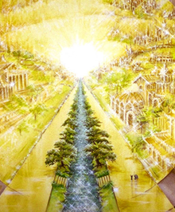
Eternal State is Future
No Satan (Rev 20:10)
No sea (Rev 21:1)
No death, crying, or pain (Rev 21:4)
No Sun (Rev 22:5)
No Moon (Rev 21:23)
No temple (Rev. 21:22)
No night (Rev 21:25)
No evil (Rev 21:27)
No Tree of Knowledge (22:1)
No curse (Rev 22:3)

Slide 91
II. The New Jerusalem
Revelation 21:9‒22:5
Four Titles (9-10)
Glory (11)
Construction (12-14)
Measurements (15-17)
Materials (18-21)
Relationship to God (22-23)
Relationship to the Nations (24-26)
Holiness (27)
Contents (22:1-5)

Slide 92
I. The City’s Contents
Revelation 22:1-5
Its River (1)
Its Trees (2)
No Curse (3a)
God’s Presence (3b-5)

Slide 93
I. The City’s Contents
Revelation 22:1-5
Its River (1)
Its Trees (2)
No Curse (3a)
God’s Presence (3b-5)

Slide 94
Revelation 22:1
“Then he showed me a river of the water of life, clear as crystal, coming from the throne of God and of the Lamb.”

Slide 95
Eden = Probationary Environment
Eden (Genesis 1-2) | Eternal State (Rev 21-22)
Division: light/darkness 1:4 | No night 21:25
Division: land/sea 1:10 | No sea 21:1
Sun & moon 1:16 | No sun & moon 21:23
Garden 2:8-9 | City (21:2)
River flowing out of Eden 2:10 | River flowing from throne 22:1
Gold in the land 2:12 | Gold in the city 21:21
Tree of life in the middle of garden 2:9 | Tree of life throughout city 22:2
Bdellium and onyx stone 2:12 | All manner of stones 21:19
God walking in the garden 3:8 | God dwelling with His people 21:3
Henry Morris, Genesis Record, p.33

Slide 96

Revelation 3:21
promise to the overcomers
“He who overcomes, I will grant [future tense of didōmi] to him to sit down with Me on My throne, as I also overcame and sat down [aorist tense of kathizō] with My Father on His throne.”

Slide 97
Revelation 3:21 in Progressive Dispensationalism
“One may object that the throne at the right hand of God is not the Davidic throne, which is earthly. The objection might be raised by appealing to a text like Revelation 3:21, where Jesus distinguishes between ‘my throne,’ in which the overcomer will sit, and the Father’s throne, on which Jesus currently sits. The argument is made that the throne on which Jesus sits in Acts is the Father’s throne, not David’s…this throne of the lamb, set next to the Father, is alluded to again in Revelation 22:1. This is the same throne that Jesus occupies in the consummation! He exercises Davidic rule now even as he will exercises it then.”
Darrell Bock, “The Reign of the Lord Christ,” in Dispensationalism, Israel and the Church, ed. Craig Blaising and Darrell Bock (Grand Rapids: Zondervan, 1992), 50, 62.
Notes:
WRONG!!!

Slide 98


Slide 99
Eternal State is Future
No Satan (Rev 20:10)
No sea (Rev 21:1)
No death, crying, or pain (Rev 21:4)
No Sun (Rev 22:5)
No Moon (Rev 21:23)
No temple (Rev. 21:22)
No night (Rev 21:25)
No evil (Rev 21:27)
No Tree of Knowledge (22:1)
No curse (Rev 22:3)

Slide 100
I. The City’s Contents
Revelation 22:1-5
Its River (1)
Its Trees (2)
No Curse (3a)
God’s Presence (3b-5)

Slide 101
Eden = Probationary Environment
Eden (Genesis 1-2) | Eternal State (Rev 21-22)
Division: light/darkness 1:4 | No night 21:25
Division: land/sea 1:10 | No sea 21:1
Sun & moon 1:16 | No sun & moon 21:23
Garden 2:8-9 | City (21:2)
River flowing out of Eden 2:10 | River flowing from throne 22:1
Gold in the land 2:12 | Gold in the city 21:21
Tree of life in the middle of garden 2:9 | Tree of life throughout city 22:2
Bdellium and onyx stone 2:12 | All manner of stones 21:19
God walking in the garden 3:8 | God dwelling with His people 21:3
Henry Morris, Genesis Record, p.33

Slide 102
Eternal State is Future
No Satan (Rev 20:10)
No sea (Rev 21:1)
No death, crying, or pain (Rev 21:4)
No Sun (Rev 22:5)
No Moon (Rev 21:23)
No temple (Rev. 21:22)
No night (Rev 21:25)
No evil (Rev 21:27)
No Tree of Knowledge (22:1)
No curse (Rev 22:3)

Slide 103
Heaven
Q: Will there be time in Heaven?
Notes:
Will there be time in heaven?
Revelation talks about the leaves of trees bearing fruit each month. The breakdown into months reflects time. So I believe there will be time in heaven.

Slide 104
Genesis 1:14
Then God said, “Let there be lights in the expanse of the heavens to separate the day from the night, and let them be for signs and for seasons and for days and years.”

Slide 105
I. The City’s Contents
Revelation 22:1-5
Its River (1)
Its Trees (2)
No Curse (3a)
God’s Presence (3b-5)

Slide 106
Romans 8:19-22
¹⁹ For the anxious longing of the creation waits eagerly for the revealing of the sons of God. ²⁰ For the creation was subjected to futility, not willingly, but because of Him who subjected it, in hope ²¹ that the creation itself also will be set free from its slavery to corruption into the freedom of the glory of the children of God. ²² For we know that the whole creation groans and suffers the pains of childbirth together until now.

Slide 107
The whole creation groans and suffers!

Slide 108
GENESIS 3: THE FALL OF MAN
“This chapter is the pivot on which the whole Bible turns”
W. H. Griffith Thomas

Slide 109
Genesis 3 Structure
3:1-5 Temptation by the serpent
3:6 Sin of Adam and Eve
3:7-13 Results of the sin
3:14-19 Imposition of divine judgments
3:20-24 God’s provision in spite of the sin

Slide 110
Divine Judgments (3:14-19)
Serpent (3:14-15)
Woman (3:16)
Man (3:17-19)

Slide 111
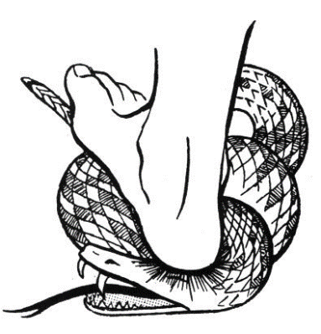
Serpent (3:14-15)
Serpent’s body (3:14)
Protevangelium (3:15)

Slide 112
Woman (3:16)
Painful child birth (3:16a)
Relational conflict (3:16b)

Slide 113
Man (3:17-19)
Painful labor (3:17-19a)
Death (3:19b)

Slide 114
I. The City’s Contents
Revelation 22:1-5
Its River (1)
Its Trees (2)
No Curse (3a)
God’s Presence (3b-5)

Slide 115
Millennium and Eternal State
 | Rev. 20:1-10 | Rev. 21–22
Time | 20:4 | 22:5
Luminaries | Isa. 30:26 | 21:23; 22:5
Temple | Ezek. 40–48 | 21:22
Death | Isa. 65:20 | 21:4
Satanic activity | 20:7 | 20:10
Rebellion | 20:8-9 | 21:27

Slide 116
Genesis 1:1-3
“¹ In the beginning God created the heavens and the earth. ² The earth was formless and void, and darkness was over the surface of the deep, and the Spirit of God was moving over the surface of the waters. ³ Then God said, ‘Let there be light’; and there was light.”

Slide 117
Deuteronomy 4:19
“And beware not to lift up your eyes to heaven and see the sun and the moon and the stars, all the host of heaven, and be drawn away and worship them and serve them, those which the Lord your God has allotted to all the peoples under the whole heaven.”

Slide 118
Mark Hitchcock
101 Answers to the Most Asked Questions About the End Times (Sisters, OR: Multnomah, 2001), 212.
“Christ will rule over His kingdom on this present earth for one thousand years, and He will reign forever. The future kingdom of God has two parts or phases. Phase one is the millennial reign of Christ on this earth (Rev. 20:1–6), and phase two is the eternal state (Rev. 22:5). As I once heard it described, the Millennium is the front porch of eternity.”

Slide 119
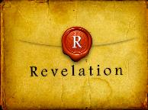
Revelation 5:10
“You have made them to be a kingdom and priests to our God; and they will reign [basileuō] upon the earth [gē].”

Slide 121
Conclusion

Slide 122
II. The New Jerusalem
Revelation 21:9‒22:5
Four Titles (9-10)
Glory (11)
Construction (12-14)
Measurements (15-17)
Materials (18-21)
Relationship to God (22-23)
Relationship to the Nations (24-26)
Holiness (27)
Contents (22:1-5)

Slide 123

“The Lord bless you and keep you; the Lord make his face shine on you and be gracious to you; the Lord turn his face toward you and give you peace.” (NIV)

