Slide 1
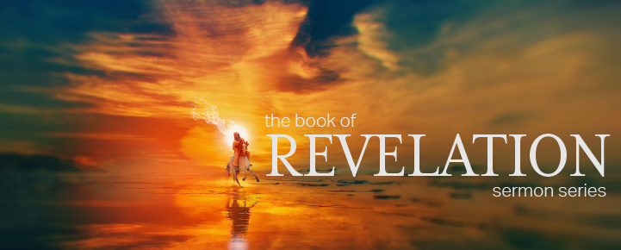
Dr. Andy Woods
Senior Pastor – Sugar Land Bible Church
President – Chafer Theological Seminary

Slide 2
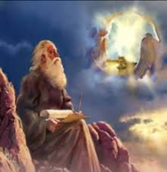
“After These Things” (Rev. 4‒22)
Before the Tribulation (4‒5)
During the Tribulation (6‒19)
After the Tribulation (20‒22)
Kingdom (20:1-10)
Great White Throne Judgment (20:11-15)
Destruction of the Earth (21:1)
New Heaven and New Earth (21‒22)

Slide 3
“After These Things” (Rev. 4‒22)
Before the Tribulation (4‒5)
During the Tribulation (6‒19)
After the Tribulation (20‒22)
Kingdom (20:1-10)
Great White Throne Judgment (20:11-15)
Destruction of the Earth (21:1)
New Heaven and New Earth (21‒22)

Slide 6
“After These Things” (Rev. 4‒22)
Before the Tribulation (4‒5)
During the Tribulation (6‒19)
After the Tribulation (20‒22)
Kingdom (20:1-10)
Great White Throne Judgment (20:11-15)
Destruction of the Earth (21:1)
New Heaven and New Earth (21‒22)

Slide 8
“After These Things” (Rev. 4‒22)
Before the Tribulation (4‒5)
During the Tribulation (6‒19)
After the Tribulation (20‒22)
Kingdom (20:1-10)
Great White Throne Judgment (20:11-15)
Destruction of the Earth (21:1)
New Heaven and New Earth (21‒22)

Slide 9
“After These Things” (Rev. 4‒22)
Before the Tribulation (4‒5)
During the Tribulation (6‒19)
After the Tribulation (20‒22)
Kingdom (20:1-10)
Great White Throne Judgment (20:11-15)
Destruction of the Earth (21:1)
New Heaven and New Earth (21‒22)

Slide 10
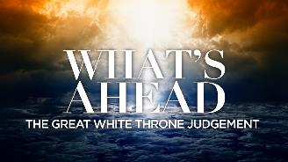
The Great White Throne Judgment Revelation 20:11-15
The Judge (11)
The Judged (12-13)
The Judgment (14-15)
Willmington, Outline Bible, p. 773

Slide 11
“After These Things” (Rev. 4‒22)
Before the Tribulation (4‒5)
During the Tribulation (6‒19)
After the Tribulation (20‒22)
Kingdom (20:1-10)
Great White Throne Judgment (20:11-15)
Destruction of the Earth (21:1)
New Heaven and New Earth (21‒22)

Slide 12
The Eternal State Revelation 21‒22
The New Heavens & Earth (21:1-8)
The New Jerusalem (21:9‒22:5)
Epilogue (22:6-21)

Slide 13
The Eternal State Revelation 21‒22
The New Heavens & Earth (21:1-8)
The New Jerusalem (21:9‒22:5)
Epilogue (22:6-21)

Slide 14
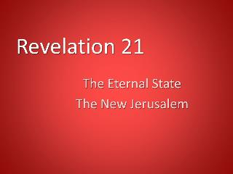
I. The New Heavens & Earth Revelation 21:1-8
A New Creation (1)
A New City (2)
A New Fellowship (3)
A New Order (4-5)
A New Satisfaction (6)
A New Realization (7)
A New Holiness (8)

Slide 15
I. The New Heavens & Earth Revelation 21:1-8
A New Creation (1)
A New City (2)
A New Fellowship (3)
A New Order (4-5)
A New Satisfaction (6)
A New Realization (7)
A New Holiness (8)

Slide 16
I. The New Heavens & Earth Revelation 21:1-8
A New Creation (1)
A New City (2)
A New Fellowship (3)
A New Order (4-5)
A New Satisfaction (6)
A New Realization (7)
A New Holiness (8)

Slide 17
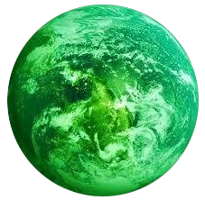
Jerusalem Descending
Notes:
The descending city is described as being like a stone called Jasper, only unlike the earthly stone, this one is clear as crystal. The ultimate state of heaven sounds more like a diamond, doesn’t it?

Slide 18
I. The New Heavens & Earth Revelation 21:1-8
A New Creation (1)
A New City (2)
A New Fellowship (3)
A New Order (4-5)
A New Satisfaction (6)
A New Realization (7)
A New Holiness (8)

Slide 19
I. The New Heavens & Earth Revelation 21:1-8
A New Creation (1)
A New City (2)
A New Fellowship (3)
A New Order (4-5)
A New Satisfaction (6)
A New Realization (7)
A New Holiness (8)

Slide 20
D. A New Order Revelation 21:4-5
The Old Order Passes (4)
The New Order Comes (5)

Slide 21
D. A New Order Revelation 21:4-5
The Old Order Passes (4)
The New Order Comes (5)

Slide 22
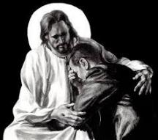
Revelation 21:4
“and He will wipe away every tear from their eyes; and there will no longer be any death; there will no longer be any mourning, or crying, or pain; the first things have passed away.”

Slide 23
Revelation 21:4
“and He will wipe away every tear from their eyes; and there will no longer be any death; there will no longer be any mourning, or crying, or pain; the first things have passed away.”

Slide 24
D. A New Order Revelation 21:4-5
The Old Order Passes (4)
The New Order Comes (5)

Slide 25
2 Peter 1:19-21
“¹⁹ So we have the prophetic word made more sure, to which you do well to pay attention as to a lamp shining in a dark place, until the day dawns and the morning star arises in your hearts. ²⁰ But know this first of all, that no prophecy of Scripture is a matter of one’s own interpretation, ²¹ for no prophecy was ever made by an act of human will, but men moved by the Holy Spirit spoke from God.”

Slide 26
I. The New Heavens & Earth Revelation 21:1-8
A New Creation (1)
A New City (2)
A New Fellowship (3)
A New Order (4-5)
A New Satisfaction (6)
A New Realization (7)
A New Holiness (8)

Slide 27
Eden = Probationary Environment
Eden (Genesis 1-2) | Eternal State (Rev 21-22)
Division: light/darkness 1:4 | No night 21:25
Division: land/sea 1:10 | No sea 21:1
Sun & moon 1:16 | No sun & moon 21:23
Garden 2:8-9 | City (21:2)
River flowing out of Eden 2:10 | River flowing from throne 22:1
Gold in the land 2:12 | Gold in the city 21:21
Tree of life in the middle of garden 2:9 | Tree of life throughout city 22:2
Bdellium and onyx stone 2:12 | All manner of stones 21:19
God walking in the garden 3:8 | God dwelling with His people 21:3
Henry Morris, Genesis Record, p.33

Slide 28
“Believe” Defined
W. E. Vine, Merrill F. Unger, and William White, Vine's Complete Expository Dictionary of the Old and New Testament Words (Nashville: Nelson, 1996), 61.
“pisteuō…’to believe,’ also ‘to be persuaded of,’ and hence, ‘to place confidence in, to trust,’ signifies, in this sense of the word, reliance upon, not mere credence. It is most frequent in the writings of the apostle John, especially the Gospel. He does not use the noun…Of the writers of the Gospels…uses of the verb…John ninety-nine.”

Slide 29
I. The New Heavens & Earth Revelation 21:1-8
A New Creation (1)
A New City (2)
A New Fellowship (3)
A New Order (4-5)
A New Satisfaction (6)
A New Realization (7)
A New Holiness (8)

Slide 30
1 John 5:4-5
^{“4} For whatever is born of God overcomes the world; and this is the victory that has overcome the world—our faith. ⁵ Who is the one who overcomes the world, but he who believes that Jesus is the Son of God?”

Slide 31
1 Peter 1:3-5
“³ Blessed be the God and Father of our Lord Jesus Christ, who according to His great mercy has caused us to be born again to a living hope through the resurrection of Jesus Christ from the dead, ⁴ to obtain an inheritance [klēronomia] which is imperishable and undefiled and will not fade away, reserved in heaven for you, ⁵ who are protected by the power of God through faith for a salvation ready to be revealed in the last time.”

Slide 32
I. The New Heavens & Earth Revelation 21:1-8
A New Creation (1)
A New City (2)
A New Fellowship (3)
A New Order (4-5)
A New Satisfaction (6)
A New Realization (7)
A New Holiness (8)

Slide 33
Revelation 21:8
“But for the cowardly and unbelieving and abominable and murderers and immoral persons and sorcerers and idolaters and all liars, their part will be in the lake that burns with fire and brimstone, which is the second death.”

Slide 34
Revelation 21:8
“But for the cowardly and unbelieving and abominable and murderers and immoral persons and sorcerers and idolaters and all liars, their part will be in the lake that burns with fire and brimstone, which is the second death.”

Slide 35
Revelation 21:8
“But for the cowardly and unbelieving and abominable and murderers and immoral persons and sorcerers and idolaters and all liars, their part will be in the lake that burns with fire and brimstone, which is the second death.”

Slide 36
Revelation 21:8
“But for the cowardly and unbelieving and abominable and murderers and immoral persons and sorcerers and idolaters and all liars, their part will be in the lake that burns with fire and brimstone, which is the second death.”

Slide 37
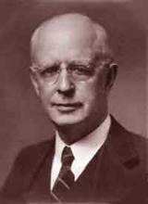
Lewis Sperry Chafer, vol. 7, Systematic Theology (Grand Rapids, MI: Kregel Publications, 1993), 265-66.
Belief-God’s One Condition for Justification
“…because upwards of 150 passages of Scripture condition salvation upon believing only (cf. John 3:16; Acts 16:31).

Slide 38
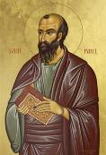
Romans 4:4-5
“Now to the one who works, his wage is not credited as a favor, but as what is due. But to the one who does not work, but believes in Him who justifies the ungodly, his faith is credited as righteousness.”

Slide 39
Revelation 21:8
“But for the cowardly and unbelieving and abominable and murderers and immoral persons and sorcerers and idolaters and all liars, their part will be in the lake that burns with fire and brimstone, which is the second death.”

Slide 40
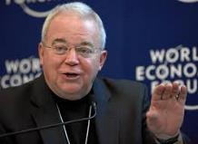
Jim Wallis
Mary Danielson, The Dangerous Truth About the Social-Justice “Gospel,” n. 21
“Abomination is a pretty strong word...there is a debate and questions over the meaning of the word ‘abomination.’” (Referring to Leviticus 18:22; as heard on Moody Christian Radio Network, in Chicago, Feb.19, 2008, when asked about government sanctions on civil unions for gays.)

Slide 41
Revelation 21:8
“But for the cowardly and unbelieving and abominable and murderers and immoral persons and sorcerers and idolaters and all liars, their part will be in the lake that burns with fire and brimstone, which is the second death.”

Slide 42
Revelation 21:8
“But for the cowardly and unbelieving and abominable and murderers and immoral persons and sorcerers and idolaters and all liars, their part will be in the lake that burns with fire and brimstone, which is the second death.”

Slide 43
Genesis 1:26-28
²⁶ Then God said, “Let Us make man in Our image, according to Our likeness; and let them rule over the fish of the sea and over the birds of the sky and over the cattle and over all the earth, and over every creeping thing that creeps on the earth.” ²⁷ God created man in His own image, in the image of God He created him; male and female He created them. ²⁸ God blessed them; and God said to them, “Be fruitful and multiply, and fill the earth, and subdue it; and rule over the fish of the sea and over the birds of the sky and over every living thing that moves on the earth.”

Slide 44
Revelation 21:8
“But for the cowardly and unbelieving and abominable and murderers and immoral persons and sorcerers and idolaters and all liars, their part will be in the lake that burns with fire and brimstone, which is the second death.”

Slide 45
Revelation 9:20-21
“The rest of mankind, who were not killed by these plagues, did not repent of the works of their hands, so as not to worship demons, and the idols of gold and of silver and of brass and of stone and of wood, which can neither see nor hear nor walk; ²¹ and they did not repent of their murders nor of their sorceries (pharmakeia) nor of their immorality nor of their thefts.”

Slide 46
Revelation 21:8
“But for the cowardly and unbelieving and abominable and murderers and immoral persons and sorcerers and idolaters and all liars, their part will be in the lake that burns with fire and brimstone, which is the second death.”

Slide 47
Revelation 21:8
“But for the cowardly and unbelieving and abominable and murderers and immoral persons and sorcerers and idolaters and all liars, their part will be in the lake that burns with fire and brimstone, which is the second death.”

Slide 48
Revelation 21:8
“But for the cowardly and unbelieving and abominable and murderers and immoral persons and sorcerers and idolaters and all liars, their part will be in the lake that burns with fire and brimstone, which is the second death.”

Slide 49
Conclusion

Slide 50
I. The New Heavens & Earth Revelation 21:1-8
A New Creation (1)
A New City (2)
A New Fellowship (3)
A New Order (4-5)
A New Satisfaction (6)
A New Realization (7)
A New Holiness (8)

Slide 51
“The Lord bless you and keep you; the Lord make his face shine on you and be gracious to you; the Lord turn his face toward you and give you peace.” (NIV)

