Slide 1
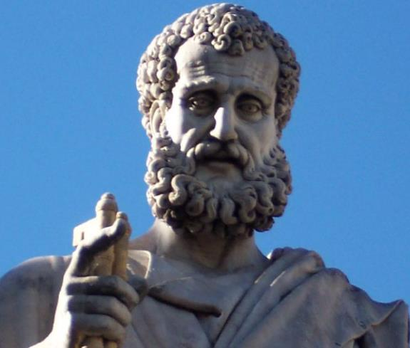

2 Peter
Dr. Andy Woods
Senior Pastor – Sugar Land Bible Church
President – Chafer Theological Seminary

Slide 2
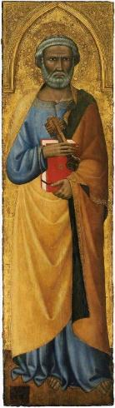
INTRODUCTORY MATTERS
Authorship: Peter
Biography: Gospels & Acts
Date: A.D. 64
Recipients: Regenerated, Asia Minor, Hebrews
Place of writing: Babylon
Occasion for writing: Incipient Gnosticism
Purpose: Insulation from false teaching
Structure: 3 parts
Message: Protection from false teachers
Unique characteristics: Knowledge

Slide 3
STRUCTURE
2 Peter 1 – Call to maturity
2 Peter 2 – Characteristics of false teachers
2 Peter 3 – Doctrine of the false teachers

Slide 4
STRUCTURE
2 Peter 1 – Call to maturity
2 Peter 2 – Characteristics of false teachers
2 Peter 3 – Doctrine of the false teachers

Slide 5
2 PETER
The Call to Maturity (2 Peter 1)

Slide 6
2 PETER
Chapter 1
Introduction (1:1-2)
Call to Growth (1:3-11)
Purpose Statement (1:12-15)
Coming kingdom (1:16-21)

Slide 7
2 PETER
Chapter 1
Introduction (1:1-2)
Call to Growth (1:3-11)
Purpose Statement (1:12-15)
Coming kingdom (1:16-21)

Slide 8
INTRODUCTION
(1:1-2)
Writer (1:1a)
Recipients (1:1b)
Greeting (1:2)

Slide 9
INTRODUCTION
(1:1-2)
Writer (1:1a)
Recipients (1:1b)
Greeting (1:2)

Slide 10
WRITER
(1:1a)
Simon Peter
Bond-servant (doulos)
Apostle of Jesus Christ

Slide 11
WRITER
(1:1a)
Simon Peter
Bond-servant (doulos)
Apostle of Jesus Christ

Slide 12
WRITER
(1:1a)
Simon Peter
Bond-servant (doulos)
Apostle of Jesus Christ

Slide 13
WRITER
(1:1a)
Simon Peter
Bond-servant (doulos)
Apostle of Jesus Christ

Slide 14
INTRODUCTION
(1:1-2)
Writer (1:1a)
Recipients (1:1b)
Greeting (1:2)

Slide 15
RECIPIEINTS
(1:1b)
“Received a faith”
“Same kind as ours”
By the righteousness of Jesus Christ

Slide 16
RECIPIEINTS
(1:1b)
“Received a faith”
“Same kind as ours”
By the righteousness of Jesus Christ

Slide 17
RECIPIEINTS
(1:1b)
“Received a faith”
“Same kind as ours”
By the righteousness of Jesus Christ

Slide 18
RECIPIEINTS
(1:1b)
“Received a faith”
“Same kind as ours”
By the righteousness of Jesus Christ

Slide 19
INTRODUCTION
(1:1-2)
Writer (1:1a)
Recipients (1:1b)
Greeting (1:2)

Slide 20
Greeting
(1:2)
“Grace and Peace”
“Knowledge”

Slide 21
Greeting
(1:2)
“Grace and Peace”
“Knowledge”

Slide 22
Greeting
(1:2)
“Grace and Peace”
“Knowledge”

Slide 23
2 PETER
Chapter 1
Introduction (1:1-2)
Call to Growth (1:3-11)
Purpose Statement (1:12-15)
Coming kingdom (1:16-21)

Slide 24
The Call to Growth (1:3-11)
Provisions for Growth (1:3-4)
Portrait of Growth (1:5-7)
Benefits of Growth (1:8-11)

Slide 25
The Call to Growth (1:3-11)
Provisions for Growth (1:3-4)
Portrait of Growth (1:5-7)
Benefits of Growth (1:8-11)

Slide 26

2 Peter 1:3-4
“³ Seeing that His divine power has granted to us everything pertaining to life and godliness, through the true knowledge of Him who called us by His own glory and excellence. ⁴For by these He has granted to us His precious and magnificent promises, so that by them you may become partakers of the divine nature, having escaped the corruption that is in the world by lust.”

Slide 27
2 Timothy 3:16-17
“¹⁶ All Scripture is inspired by God and profitable for teaching, for reproof, for correction, for training in righteousness; ¹⁷ so that the man of God may be adequate, equipped for every good work.”

Slide 28

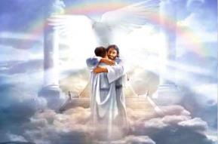
Ephesians 1:3
“Blessed be the God and Father of our Lord Jesus Christ, who has blessed us with every spiritual blessing in the heavenly places in Christ.”

Slide 29
Ephesians 6:16
“in addition to all, taking up the shield of faith with which you will be able to extinguish all the flaming arrows of the evil one.”

Slide 30
PROVISIONS FOR GROWTH
(1:3-4)
Power (1:3a)
Knowledge (1:3b)
Promises (1:4a)
Participation in the divine nature (1:4b)

Slide 31
PROVISIONS FOR GROWTH
(1:3-4)
Power (1:3a)
Knowledge (1:3b)
Promises (1:4a)
Participation in the divine nature (1:4b)

Slide 32
2 Peter 1:3-4
“³ Seeing that His divine power has granted to us everything pertaining to life and godliness, through the true knowledge of Him who called us by His own glory and excellence. ⁴For by these He has granted to us His precious and magnificent promises, so that by them you may become partakers of the divine nature, having escaped the corruption that is in the world by lust.”

Slide 33
PROVISIONS FOR GROWTH
(1:3-4)
Power (1:3a)
Knowledge (1:3b)
Promises (1:4a)
Participation in the divine nature (1:4b)

Slide 34
2 Peter 1:3-4
“³ Seeing that His divine power has granted to us everything pertaining to life and godliness, through the true knowledge of Him who called us by His own glory and excellence. ⁴For by these He has granted to us His precious and magnificent promises, so that by them you may become partakers of the divine nature, having escaped the corruption that is in the world by lust.”

Slide 35
PROVISIONS FOR GROWTH
(1:3-4)
Power (1:3a)
Knowledge (1:3b)
Promises (1:4a)
Participation in the divine nature (1:4b)

Slide 36
2 Peter 1:3-4
“³ Seeing that His divine power has granted to us everything pertaining to life and godliness, through the true knowledge of Him who called us by His own glory and excellence. ⁴For by these He has granted to us His precious and magnificent promises, so that by them you may become partakers of the divine nature, having escaped the corruption that is in the world by lust.”

Slide 37
PROVISIONS FOR GROWTH
(1:3-4)
Power (1:3a)
Knowledge (1:3b)
Promises (1:4a)
Participation in the divine nature (1:4b)

Slide 38
2 Peter 1:3-4
“³ Seeing that His divine power has granted to us everything pertaining to life and godliness, through the true knowledge of Him who called us by His own glory and excellence. ⁴For by these He has granted to us His precious and magnificent promises, so that by them you may become partakers of the divine nature, having escaped the corruption that is in the world by lust.”

Slide 39
The Call to Growth (1:3-11)
Provisions for Growth (1:3-4)
Portrait of Growth (1:5-7)
Benefits of Growth (1:8-11)

Slide 40
2 Peter 1:5-7
⁵ Now for this very reason also, applying all diligence, in your faith supply moral excellence, and in your moral excellence, knowledge, ⁶ and in your knowledge, self-control, and in your self-control, perseverance, and in your perseverance, godliness, ⁷ and in your godliness, brotherly kindness, and in your brotherly kindness, love.

Slide 41
Thomas L. Constable
“Notes on 2 Peter,” online: www.soniclight.com, accessed 21 July 2019, 12.
“Unlike other New Testament ethical lists (except Rom. 5:3-5), Peter used a literary device called ‘sorites’ (also called ‘climax’ or gradatio). Sorites (from the Gr. soros, ‘a heap’) is a set of statements that proceed, step by step, to a climactic conclusion through the force of logic or reliance upon a series of indisputable facts. Each new statement picks up the last key word or phrase of the preceding one.”

Slide 42

PORTRAIT OF GROWTH
1:5-7
LOVE
BROTHERLY KINDNESS
GODLINESS
PERSERVERENCE
SELF CONTROL
KNOWLEDGE
GOODNESS
FAITH

Slide 43
2 Peter 1:5-7
⁵ Now for this very reason also, applying all diligence, in your faith supply moral excellence, and in your moral excellence, knowledge, ⁶ and in your knowledge, self-control, and in your self-control, perseverance, and in your perseverance, godliness, ⁷ and in your godliness, brotherly kindness, and in your brotherly kindness, love.

Slide 44
PORTRAIT OF GROWTH
1:5-7
LOVE
BROTHERLY KINDNESS
GODLINESS
PERSERVERENCE
SELF CONTROL
KNOWLEDGE
GOODNESS
FAITH

Slide 45
2 Peter 1:5-7
⁵ Now for this very reason also, applying all diligence, in your faith supply moral excellence, and in your moral excellence, knowledge, ⁶ and in your knowledge, self-control, and in your self-control, perseverance, and in your perseverance, godliness, ⁷ and in your godliness, brotherly kindness, and in your brotherly kindness, love.

Slide 46
2 Peter 1:5-7
⁵ Now for this very reason also, applying all diligence, in your faith supply moral excellence, and in your moral excellence, knowledge, ⁶ and in your knowledge, self-control, and in your self-control, perseverance, and in your perseverance, godliness, ⁷ and in your godliness, brotherly kindness, and in your brotherly kindness, love.

Slide 47
2 Peter 1:5-7
⁵ Now for this very reason also, applying all diligence, in your faith supply moral excellence, and in your moral excellence, knowledge, ⁶ and in your knowledge, self-control, and in your self-control, perseverance, and in your perseverance, godliness, ⁷ and in your godliness, brotherly kindness, and in your brotherly kindness, love.

Slide 48
2 Peter 1:5-7
⁵ Now for this very reason also, applying all diligence, in your faith supply moral excellence, and in your moral excellence, knowledge, ⁶ and in your knowledge, self-control, and in your self-control, perseverance, and in your perseverance, godliness, ⁷ and in your godliness, brotherly kindness, and in your brotherly kindness, love.

Slide 49
2 Peter 1:5-7
⁵ Now for this very reason also, applying all diligence, in your faith supply moral excellence, and in your moral excellence, knowledge, ⁶ and in your knowledge, self-control, and in your self-control, perseverance, and in your perseverance, godliness, ⁷ and in your godliness, brotherly kindness, and in your brotherly kindness, love.

Slide 50
2 Peter 1:5-7
⁵ Now for this very reason also, applying all diligence, in your faith supply moral excellence, and in your moral excellence, knowledge, ⁶ and in your knowledge, self-control, and in your self-control, perseverance, and in your perseverance, godliness, ⁷ and in your godliness, brotherly kindness, and in your brotherly kindness, love.

Slide 51
2 Peter 1:5-7
⁵ Now for this very reason also, applying all diligence, in your faith supply moral excellence, and in your moral excellence, knowledge, ⁶ and in your knowledge, self-control, and in your self-control, perseverance, and in your perseverance, godliness, ⁷ and in your godliness, brotherly kindness, and in your brotherly kindness, love.

Slide 52
2 Peter 1:5-7
⁵ Now for this very reason also, applying all diligence, in your faith supply moral excellence, and in your moral excellence, knowledge, ⁶ and in your knowledge, self-control, and in your self-control, perseverance, and in your perseverance, godliness, ⁷ and in your godliness, brotherly kindness, and in your brotherly kindness, love.

Slide 53
The Call to Growth (1:3-11)
Provisions for Growth (1:3-4)
Portrait of Growth (1:5-7)
Benefits of Growth (1:8-11)

Slide 54
BENEFITS OF GROWTH
1:8-11
Productivity (1:8)
Harmony with identity (1:9)
Sureness of election (1:10a)
Stability (1:10b)
Eternal Reward (1:11)

Slide 55
BENEFITS OF GROWTH
1:8-11
Productivity (1:8)
Harmony with identity (1:9)
Sureness of election (1:10a)
Stability (1:10b)
Eternal Reward (1:11)

Slide 56
BENEFITS OF GROWTH
1:8-11
Productivity (1:8)
Harmony with identity (1:9)
Sureness of election (1:10a)
Stability (1:10b)
Eternal Reward (1:11)

Slide 57
BENEFITS OF GROWTH
1:8-11
Productivity (1:8)
Harmony with identity (1:9)
Sureness of election (1:10a)
Stability (1:10b)
Eternal Reward (1:11)

Slide 58
John 5:24
“Truly, truly, I say to you, he who hears My word, and believes Him who sent Me, has eternal life, and does not come into judgment, but has passed out of death into life.”

Slide 59

Lewis Sperry Chafer, Salvation: A Clear Doctrinal Analysis
(Grand Rapids: Zondervan, 1977), 60. Italics added
Lewis Sperry Chafer
“There is a normal Christian experience. There are new and blessed emotions and desires. Old things do pass away; and behold all things do become new; but all such experiences are but secondary evidences, as to the fact of salvation, in that they grow out of that positive repose of faith which is the primary evidence.”

Slide 60
BENEFITS OF GROWTH
1:8-11
Productivity (1:8)
Harmony with identity (1:9)
Sureness of election (1:10a)
Stability (1:10b)
Eternal Reward (1:11)

Slide 61
BENEFITS OF GROWTH
1:8-11
Productivity (1:8)
Harmony with identity (1:9)
Sureness of election (1:10a)
Stability (1:10b)
Eternal Reward (1:11)

Slide 62
Three Tenses of Salvation
Phase | Justification | Sanctification | Glorification
Tense | Past | Present | Future
Saved from sin’s: | Penalty | Power | Presence
Scripture | Eph 2:8-9; Titus 3:5 | Philip 2:12 | Rom 5:10

Slide 63
Scripture’s Five Crowns (Rev 4:10: 3:11; 2 John 8)
SCRIPTURE | CROWN | PURPOSE
1 Cor. 9:24-27 | Incorruptible | Gaining mastery over the flesh
1 Thess. 2:19-20 | Rejoicing | Soul winning
Jas. 1:12; Rev. 2:10 | Life | Enduring trials
1 Pet. 5:2-4 | Glory | Shepherding God’s people
2 Tim. 4:8 | Righteousness | Longing for His appearing

Slide 64

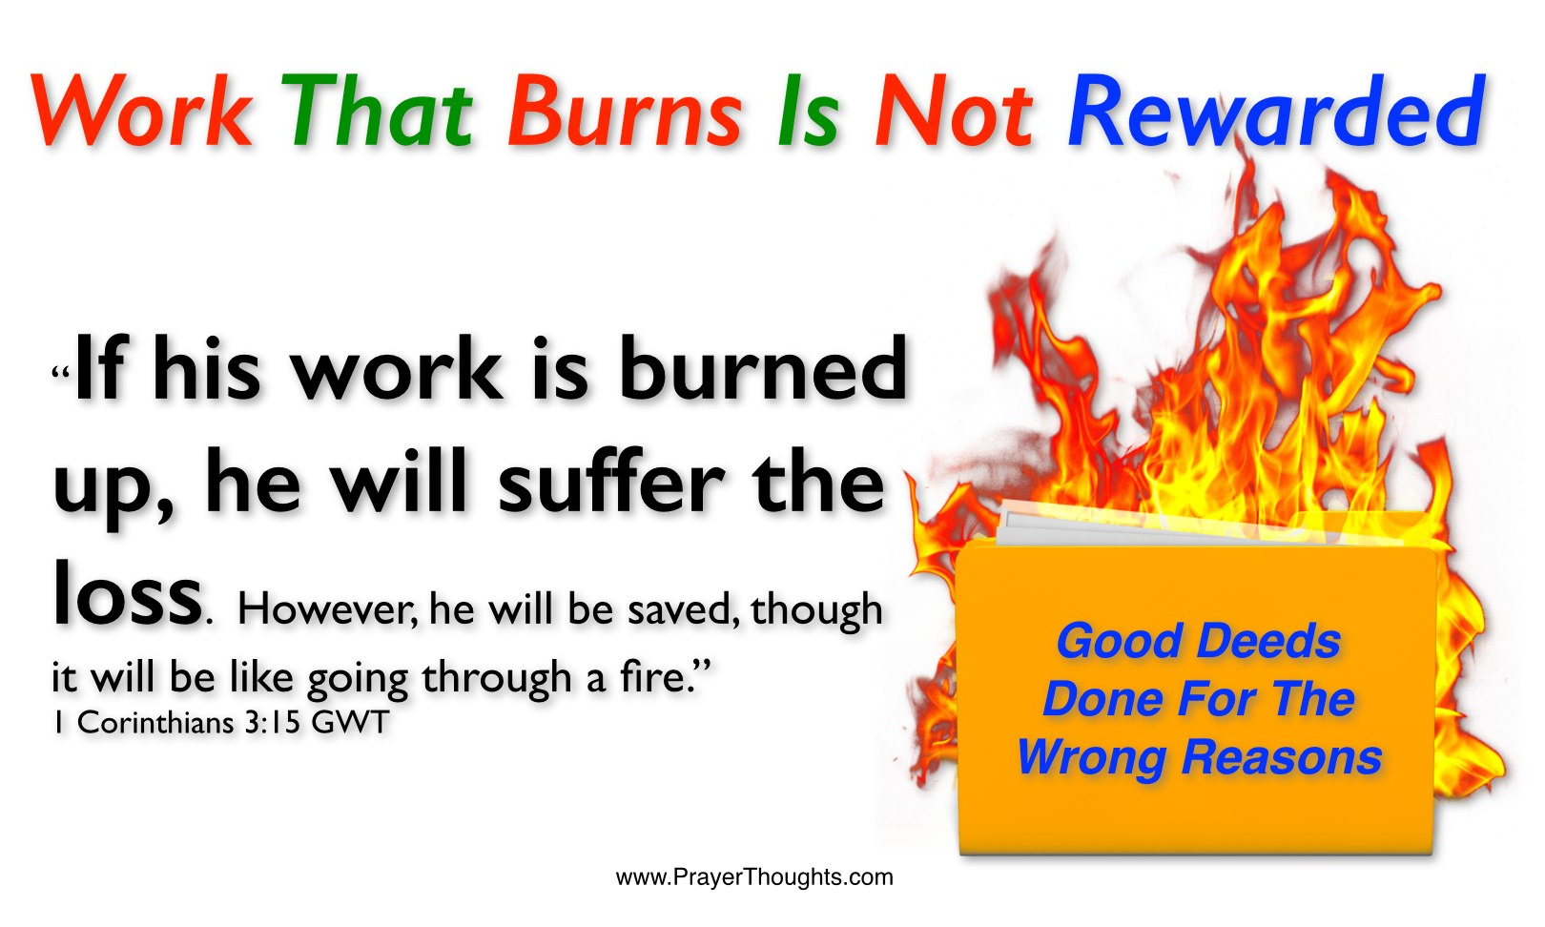
1 Corinthians 3:15
“If any man’s work is burned up, he will suffer loss; but he himself will be saved, yet so as through fire.”

Slide 65

1 Corinthians 9:24-27
“Do you not know that those who run in a race all run, but only one receives the prize? Run in such a way that you may win. ²⁵ Everyone who competes in the games exercises self-control in all things. They then do it to receive a perishable wreath, but we an imperishable. ²⁶ Therefore I run in such a way, as not without aim; I box in such a way, as not beating the air; ²⁷ but I discipline my body and make it my slave, so that, after I have preached to others, I myself will not be disqualified.”

Slide 66
RECIPIENTS
North-central portion of modern Turkey (1 Pet. 1:1)
Regenerated (1 Pet. 1:3-4; 2 Pet. 1:1)
Jewish
  Diaspora (1 Pet. 1:1; Jas. 1:1; John 7:35)
  Aliens/sojourners (1 Pet. 1:1)
  Pilgrims (1 Pet. 2:11)
  Distinguished from the Gentiles (1 Pet. 2:12; 4:3)
  1 Pet 2:9 (Exod. 19:6; Rom. 10:19)
  To the church/churches? (1 Pet. 1:1; 2 Pet. 1:1)
  Gal. 2:7-8

Slide 67

Isaiah 9:6-7
⁶ For a child will be born to us, a son will be given to us; And the government will rest on His shoulders; And His name will be called Wonderful Counselor, Mighty God, Eternal Father, Prince of Peace.⁷ There will be no end to the increase of His government or of peace, On the throne of David and over his kingdom, To establish it and to uphold it with justice and righteousness From then on and forevermore. The zeal of the Lord of hosts will accomplish this.

Slide 68
CONCLUSION

Slide 69
2 PETER
Chapter 1
Introduction (1:1-2)
Call to Growth (1:3-11)
Purpose Statement (1:12-15)
Coming kingdom (1:16-21)

