Slide 1
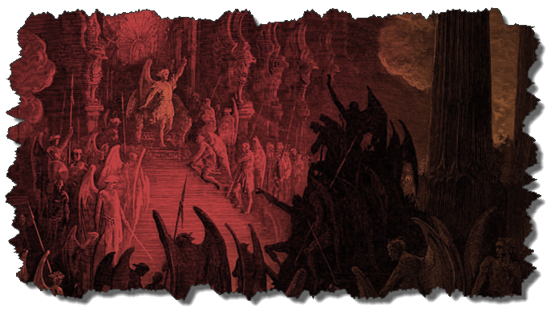

DEMONOLOGY
Dr. Andy Woods
Senior Pastor – Sugar Land Bible Church
President – Chafer Theological Seminary

Slide 2

Preview of Angelology
Good angels
Satanology
Demonology
Gen. 6:1-4 controversy

Slide 3
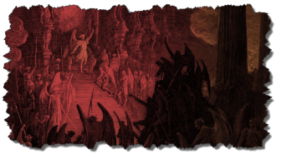
Overview
Existence Origin Personhood Characteristics | Powers Works Demon possession Defense

Slide 4
Overview
Existence Origin Personhood Characteristics | Powers Works Demon possession Defense

Slide 5
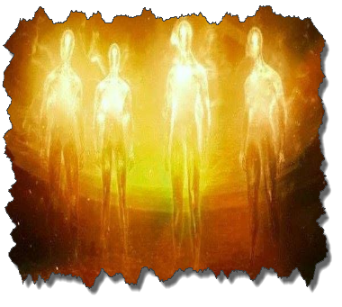
Existence
OT
  Deut 32:17
  Ps 106:37
NT
  Over 100x
  All NT writers (except Hebrews)
  Christ (Matt 8:29; 10:1; 12:43-45)

Slide 6
Overview
Existence Origin Personhood Characteristics | Powers Works Demon possession Defense

Slide 7
Origin
 | Demons | Fallen Angels
Satan is leader | Matt 12:24 | Matt 25:41; Rev 12:7-9
Spirit beings | Matt 8:16 | Heb 1:14
Capacity to enter people | Matt 12:22; Luke 11:14-15 | John 13:27

Slide 8
Overview
Existence Origin Personhood Characteristics | Powers Works Demon possession Defense

Slide 9
Personhood
Attributes of personhood
  Intellect – Acts 19:15
  Emotions – Luke 8:28; Jas 2:19
  Will – Luke 8:32
  Personal pronouns – Mark 1:24-25

Slide 10
Overview
Existence Origin Personhood Characteristics | Powers Works Demon possession Defense

Slide 11

Characteristics
Spirits-Matt 8:16; Eph 6:12
Corrupt
  Unclean – Matt 10:1
  Evil – Luke 7:21
  Rulers of darkness in spiritual wickedness – Eph 6:12
  Degrees of wickedness – Matt 12:45

Slide 12
Overview
Existence Origin Personhood Characteristics | Powers Works Demon possession Defense

Slide 13
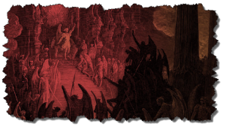
Powers
Great strength (Mark 5:3-4; Acts 19:16) but not omnipotent (Dan 10:13)
Superhuman intelligence (2 Sam. 14:20; Luke 8:28; 20:35-36) but not omniscient (Acts 19:15)
Not confined by physical space or barriers (Mark 5:9) but not omnipresent (Mark 5:12)

Slide 14
Overview
Existence Origin Personhood Characteristics | Powers Works Demon possession Defense

Slide 15

Works
General
  Satan’s lack of omnipresence (Job 1:7; 2:2) forces him to work through demons (Matt 12:24; 25:41; Rev 12:7; 2 Cor 12:7)
  Work in harmony with one another (Eph 6:11-12)
  Influence human government (Dan 10:13, 20)
  Promote false religion (1 Cor 10:20; 1 Tim 4:1)

Slide 16
Works (cont’d)
General
  Afflict the mind (Mark 5:3, 5)
  Afflict the body (Matt 12:22; Mark 9:22; Luke 13:11, 16)
  Hinder believers’ prayers (Dan 10:12-20)

Slide 17
Occult Works
NAME | DEFINITION | SCRIPTURE
Divination | Fortune telling | Deut 18:10; Acts 16:16
Spiritism | Contacting the dead | Deut 18:11
Magic | Performance of miraculous powers | Deut 18:11
Pharamkeia | Illicit drug use | Rev 9:20-21; 18:2, 23

Slide 18

Overview
Existence Origin Personhood Characteristics | Powers Works Demon possession Defense

Slide 19
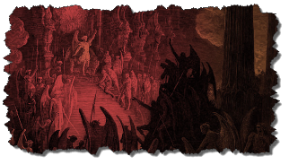
7. Demon Possession
Definition
Cause
Balance – Human evil is not all attributable to Satan/demons – Jer 17:9; Matt 15:19ff; Rev 20:7-9; Zech 14:16-18
Characteristics
Demon possession & the believer

Slide 20
7. Demon Possession
Definition
Cause
Balance – Human evil is not all attributable to Satan/demons – Jer 17:9; Matt 15:19ff; Rev 20:7-9; Zech 14:16-18
Characteristics
Demon possession & the believer

Slide 21


2 Timothy 3:16-17
“All Scripture is inspired by God [theopneustos] and profitable for teaching, for reproof, for correction, for training in righteousness; so that the man of God may be adequate, equipped for every good work.”

Slide 22
INSPIRATION OF SCRIPTURE
2 Peter 1:20-21
Men Wrote as they were inspired by Holy Spirit
  “phero” = to carry
    Acts 27:15,17
Opposite of Knowledge of False Teachers
  Which is their own imagination
    Jer. 23:16

Slide 23
7. Demon Possession
Definition
Cause
Balance – Human evil is not all attributable to Satan/demons – Jer 17:9; Matt 15:19ff; Rev 20:7-9; Zech 14:16-18
Characteristics
Demon possession & the believer

Slide 24
7. Demon Possession
Definition
Cause
Balance – Human evil is not all attributable to Satan/demons – Jer 17:9; Matt 15:19ff; Rev 20:7-9; Zech 14:16-18
Characteristics
Demon possession & the believer

Slide 25

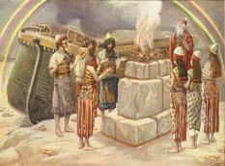
Genesis 8:21
The Lord smelled the soothing aroma; and the Lord said to Himself, “I will never again curse the ground on account of man, for the intent of man’s heart is evil from his youth; and I will never again destroy every living thing, as I have done.[emphasis mine].

Slide 26

Jeremiah 17:9
“The heart is more deceitful than all else And is desperately sick; Who can understand it?.”

Slide 27
Mark 7:20-23
“²⁰ And He was saying, ‘That which proceeds out of the man, that is what defiles the man. ²¹ For from within, out of the heart of men, proceed the evil thoughts, fornications, thefts, murders, adulteries, ²² deeds of coveting and wickedness, as well as deceit, sensuality, envy, slander, pride and foolishness. ²³ All these evil things proceed from within and defile the man.’”

Slide 28

Revelation 20:7-9
“⁷ When the thousand years are completed, Satan will be released from his prison, ⁸ and will come out to deceive the nations which are in the four corners of the earth, Gog and Magog, to gather them together for the war; the number of them is like the sand of the seashore. ⁹ And they came up on the broad plain of the earth and surrounded the camp of the saints and the beloved city, and fire came down from heaven and devoured them.

Slide 29
7. Demon Possession
Definition
Cause
Balance – Human evil is not all attributable to Satan/demons – Jer 17:9; Matt 15:19ff; Rev 20:7-9; Zech 14:16-18
Characteristics
Demon possession & the believer

Slide 30
Demon Possession Matt 8:28-34; Mark 5:1-20; 9:17-29; Luke 8:26-39
MANIFESTATION | VERSES | MANIFESTATION | VERSES
Strength | 5:24 | Insight | 5:5
Withdrawn | 5:22 | Voice alterations | 5:7
Rage | 5:5 | Seizures & mouth foaming | Mark 9:18
Split personality | 5:6-7 | Uncleanness | Luke 8:27
Resistance against spiritual things | 5:7 | Suicidal tendencies | 5:5

Slide 31
7. Demon Possession
Definition
Cause
Balance – Human evil is not all attributable to Satan/demons – Jer 17:9; Matt 15:19ff; Rev 20:7-9; Zech 14:16-18
Characteristics
Demon possession & the believer

Slide 32
E. The Christian & Demon Possession
Possession? No!
  1 Cor 6:19; John 14:16-17; 1 John 4:4
  No biblical references to:
    A Christian being demon possessed
    How to cast a demon out of a Christian
    Generation curses?

Slide 33
E. The Christian & Demon Possession
Possession? No!
  1 Cor 6:19; John 14:16-17; 1 John 4:4
  No biblical references to:
    A Christian being demon possessed
    How to cast a demon out of a Christian
    Generation curses?

Slide 34

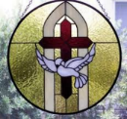
John 14:16-17
¹⁶ I will ask the Father, and He will give you another Helper, that He may be with you forever; ¹⁷ that is the Spirit of truth, whom the world cannot receive, because it does not see Him or know Him, but you know Him because He abides with you and will be in you.

Slide 35
E. The Christian & Demon Possession
Possession? No!
  1 Cor 6:19; John 14:16-17; 1 John 4:4
  No biblical references to:
    A Christian being demon possessed
    How to cast a demon out of a Christian
    Generation curses?

Slide 36
E. The Christian & Demon Possession
Possession? No!
  1 Cor 6:19; John 14:16-17; 1 John 4:4
  No biblical references to:
    A Christian being demon possessed
    How to cast a demon out of a Christian
    Generation curses?

Slide 37
E. The Christian & Demon Possession
Possession? No!
  1 Cor 6:19; John 14:16-17; 1 John 4:4
  No biblical references to:
    A Christian being demon possessed
    How to cast a demon out of a Christian
    Generation curses?

Slide 38
E. The Christian & Demon Possession
Possession? No!
  1 Cor 6:19; John 14:16-17; 1 John 4:4
  No biblical references to:
    A Christian being demon possessed
    How to cast a demon out of a Christian
    Generation curses?

Slide 39
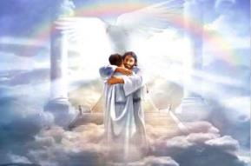
Ephesians 1:3
“Blessed be the God and Father of our Lord Jesus Christ, who has blessed us with every spiritual blessing in the heavenly places in Christ.”

Slide 40
E. The Christian & Demon Possession
Oppression? Yes!
  1 Chr 21:1; Luke 13:11, 16; Matt 16:23; Acts 5:3-4; 2 Cor 12:7; Eph 6:12
  Temporary
  Not loss of salvation
  Sometimes the believer opens the door to oppression (Eph 4:26-27)

Slide 41
CONCLUSION

Slide 42
Overview
Existence Origin Personhood Characteristics | Powers Works Demon possession Defense

