Slide 1


Dr. Andy Woods
Senior Pastor – Sugar Land Bible Church
President – Chafer Theological Seminary

Slide 2


Slide 3
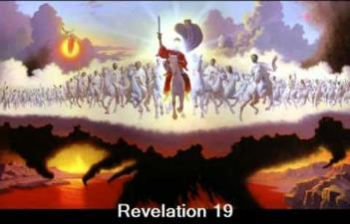
End of the Tribulation Period
Revelation 19:7-21
The Marriage Supper of the Lamb (7-9)
John Responds to the Revelation (10)
The Second Advent (11-16)
The Supper of God (17-18)
Christ Defeats: Beast’s Armies & False Prophet (19-21)

Slide 4

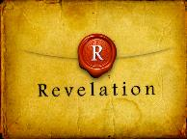
Revelation 1:19
“Therefore write the things which you have seen, and the things which are, and the things which will take place after these things [meta tauta].”

Slide 5

Revelation 1:19
Seen (Chapter 1)
Are (Chapters 2–3)
After these things (Chapters 4–22)

Slide 6
Revelation 4:1
“After these things [meta tauta] I looked, and behold, a door standing open in heaven, and the first voice which I had heard, like the sound of a trumpet speaking with me, said, ‘Come up here, and I will show you what must take place after these things [meta tauta].’”

Slide 7
Revelation 1:19
Seen (Chapter 1)
Are (Chapters 2–3)
After these things (Chapters 4–22)

Slide 8
“After These Things”
(Rev. 4‒22)
Before the Tribulation (4‒5)
During the Tribulation (6‒19)
After the Tribulation (20‒22)
  Kingdom (20:1-10)
  Great White Throne Judgment (20:11-15)
  Destruction of the Earth (21:1)
  New Heaven and New Earth (21‒22)

Slide 9
“After These Things”
(Rev. 4‒22)
Before the Tribulation (4‒5)
During the Tribulation (6‒19)
After the Tribulation (20‒22)
  Kingdom (20:1-10)
  Great White Throne Judgment (20:11-15)
  Destruction of the Earth (21:1)
  New Heaven and New Earth (21‒22)

Slide 10


Slide 11
“After These Things”
(Rev. 4‒22)
Before the Tribulation (4‒5)
During the Tribulation (6‒19)
After the Tribulation (20‒22)
  Kingdom (20:1-10)
  Great White Throne Judgment (20:11-15)
  Destruction of the Earth (21:1)
  New Heaven and New Earth (21‒22)

Slide 12


Slide 13
“After These Things”
(Rev. 4‒22)
Before the Tribulation (4‒5)
During the Tribulation (6‒19)
After the Tribulation (20‒22)
  Kingdom (20:1-10)
  Great White Throne Judgment (20:11-15)
  Destruction of the Earth (21:1)
  New Heaven and New Earth (21‒22)

Slide 14
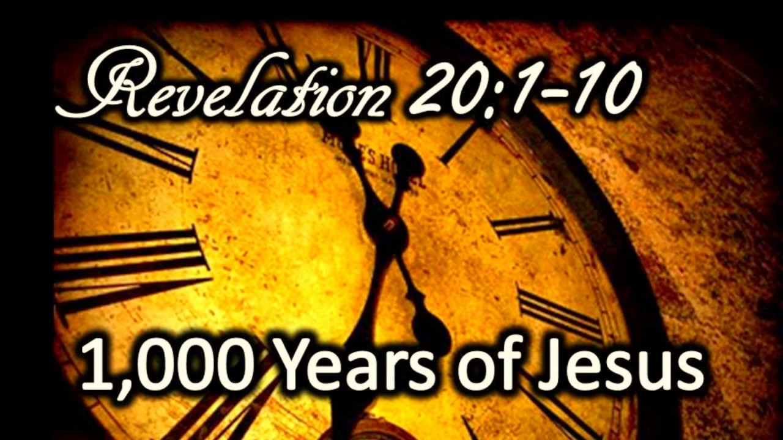
The Millennial Kingdom
Revelation 20:1-10
Satan: The Great Chain (1-3)
Saints: The Great Reign (4-6)
Sinners: The Great Revolt (7-10)
Willmington, Outline Bible, p. 772-73

Slide 15
The Millennial Kingdom
Revelation 20:1-10
Satan: The Great Chain (1-3)
Saints: The Great Reign (4-6)
Sinners: The Great Revolt (7-10)
Willmington, Outline Bible, p. 772-73

Slide 16
I. Satan: The Great Chain
Revelation 20:1-3
The Prisoner (1-2)
The Prison (3)
Willmington, Outline Bible, p. 772-73

Slide 17
I. Satan: The Great Chain
Revelation 20:1-3
The Prisoner (1-2)
The Prison (3)
Willmington, Outline Bible, p. 772-73

Slide 18

Revelation 20:1-3
“¹ Then I saw an angel coming down from heaven, holding the key of the abyss and a great chain in his hand. ² And he laid hold of the dragon, the serpent of old, who is the devil and Satan, and bound him for a thousand years; ³ and he threw him into the abyss, and shut it and sealed it over him, so that he would not deceive the nations any longer, until the thousand years were completed; after these things he must be released for a short time.”

Slide 19
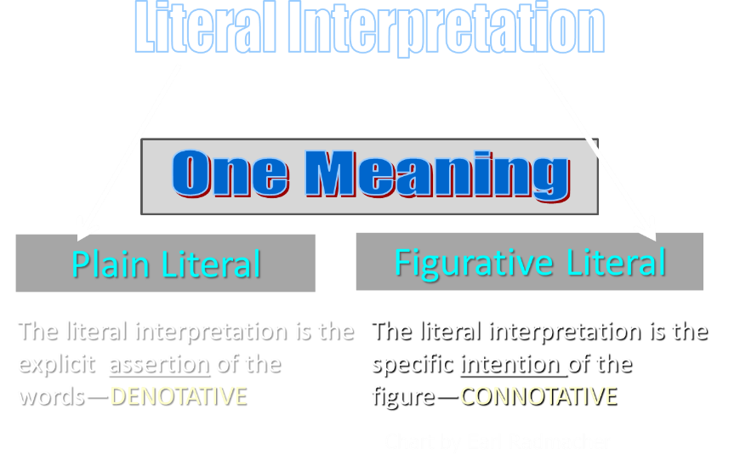

Slide 20
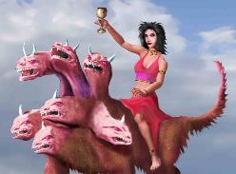
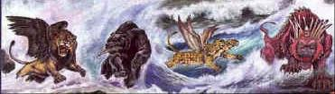
Revelation's Symbols and Figures of Speech
“Spiritually” (11:8)
“Sign” (12:1)
“Like” or “as” (8:8)
OT correspondence (Rev 13:2; Dan 7)
Contextual interpretations (17:18)
Absurdity (12:1)

Slide 21
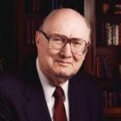
Two Rules of Interpretation
Search the immediate context
  Walvoord: 26X
Search the remote context
  Old Testament
  Thomas: 278 / 404 verses

Slide 22

Morris
The Revelation Record, 323
“At the very least, it would be confusing to John’s first century readers, as well as to later generations, for him to write so much about Babylon when he really meant Rome (Paul was not afraid to speak directly against Rome in his writings, so why should John be?) or ‘the false church’ (all the apostles , including John, wrote plainly and scathingly about false teachers and false doctrines in the church and would not hide their teachings by symbols). It must be stressed that Revelation means “unveiling,” not “veiling.” In the absence of any statement in the text to the contrary, therefore, we must assume that the term Babylon applies to the real city of Babylon…”

Slide 23
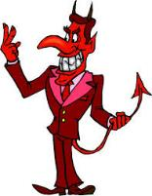
Names & Titles Demonstrating Satan’s Post-Fall, Earthly Authority
(Job 1:7; 2:2; Luke 4:5-8; Rom. 8:19-22)
Prince of this world (John 12:31; 14:30; 16:11)
God of this age (2 Cor. 4:4)
Prince and power of the air (Eph. 2:2)
Who the believer wrestles with (Eph. 6:12)
Roaring lion (1 Pet. 5:8)
Whole world lies in his power (1 John 5:19)

Slide 24

Revelation 11:15
“Then the seventh angel sounded; and there were loud voices in heaven, saying, ‘The kingdom of the world has become the kingdom of our Lord and of His Christ; and He will reign forever and ever.’”

Slide 25
Ultimate Exodus
(Rev 11:15)
Sores: 6th plague (Ex 9:8-12), 1st bowl (Rev 16:1-2)
Rivers to blood: 1st plague (Ex 7:19-21), 3rd bowl (Rev 16:4-7)
Darkness: 9th plague (Ex 10:21-23), 5th bowl (Rev 16:10-11)
Frogs: 2nd plague (Ex 7:25‒8:15), 6th bowl (Rev 16:13)
Hail: 7th plague (Ex 9:22-26), 7th bowl (Rev 16:17-21)

Slide 26
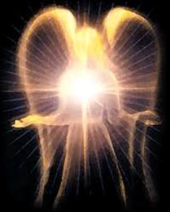

Satan’s Progressive Defeat
Initial eviction from heaven (Isa 14:12-15; Ezek 28:12-17)
Eden (Gen 3:15)
Pre-diluvian world (1 Pet 3:19-20)
Cross (John 12:31; 16:11; Col 2:15; Heb 2:14; 1 John 3:8)
Mid point of the Tribulation (Rev 12:9)
Beginning of millennium (Rev 20:2-3)
End of millennium (Rev 20:10)

Slide 27
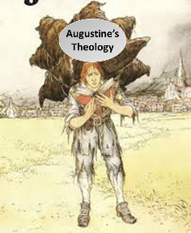
Augustine
The City of God, trans., Marcus Dods (NY: Random House, 1950), Book XX, chap. 9, p. 725-26.
Augustine wrote, “the saints reign with Christ during the same thousand years, understood in the same way, that is, of the time of His first coming” and “Therefore the Church even now is the kingdom of Christ, and the kingdom of heaven. Accordingly, even now His saints reign with Him.”

Slide 28
Augustine
The City of God, trans., Marcus Dods (NY: Random House, 1950), Book XX, chap. 7, p. 719.
“And this opinion would not be objectionable…for I myself, too, once held this opinion. But, as they assert that those who then rise again shall enjoy the leisure of immoderate carnal banquets, furnished with an amount of meat and drink such as not only to shock the feeling of the temperate, but even to surpass the measure of credulity itself, such assertions can be believed only by the carnal. They who do believe them are called by the spiritual Chiliasts, which we may literally reproduce by the name Millenarians.”

Slide 29

John Calvin
Institutes of the Christian Religion, III, xxv, 5.
“But Satan has not only befuddled men’s senses to make them bury with the corpses the memory of resurrection; he has also attempted to corrupt this part of the doctrine with various falsifications…Now their fiction is too childish either to need or to be worth a refutation. And the Apocalypse, from which they undoubtedly drew a pretext for their error, does not support them. For the number ‘one thousand’ [Rev. 20:4] does not apply to the eternal blessedness of the church but only to the various disturbances that awaited the church, while still toiling on earth…Those who assign the children of God a thousand years in which to enjoy the inheritance of the life to come do not realize how much reproach they are casting upon Christ and his Kingdom.”

Slide 30
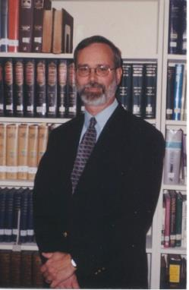
Kenneth L. Gentry
He Shall Have Dominion: A Post Millennial Eschatology (Tyler, Texas: Institute for Christian economics, 1992), page 335.
“The proper understanding of the thousand-year time frame in Revelation 20 is that it is representative of a long and glorious era and is not limited to a literal 365,000 days. The figure represents a perfect cube of 10, which is the number of quantitative perfection.”

Slide 31
Reasons for Understanding 1000 Literally
John’s use of indefinite concepts elsewhere
  Revelation 20:8, 20:3
Exception to the “# of years” examples?
Other numbers are taken literally
  Two witnesses (11:3), 7000 people (11:13), 4 Angels (7:1) 7 Angels (8:6),144,000 Jews (7:4), 42 months (11:2), 1260 days (11:3)
Not always a symbolic interpretation
  (Rev. 17:18)

Slide 32

Robert Thomas
Revelation 8 to 22: An Exegetical Commentary (Chicago: Moody Press, 1992), 408.
Robert Thomas observes that, "no number in Revelation is verifiably a symbolic number.”

Slide 33
I. Satan: The Great Chain
Revelation 20:1-3
The Prisoner (1-2)
The Prison (3)
Willmington, Outline Bible, p. 772-73

Slide 34
Revelation 20:1-3
“¹ Then I saw an angel coming down from heaven, holding the key of the abyss and a great chain in his hand. ² And he laid hold of the dragon, the serpent of old, who is the devil and Satan, and bound him for a thousand years; ³ and he threw him into the abyss, and shut it and sealed it over him, so that he would not deceive the nations any longer, until the thousand years were completed; after these things he must be released for a short time.”

Slide 35
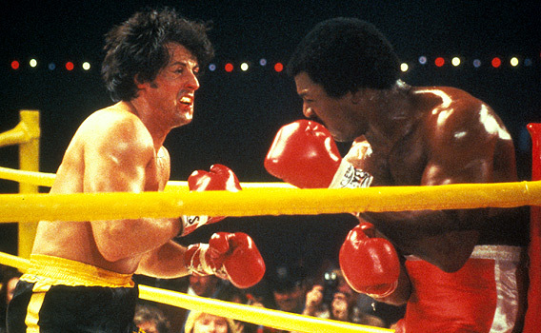

Slide 36

Ezekiel 28:13, 15
“¹³ You were in Eden, the garden of God; Every precious stone was your covering: The ruby, the topaz and the diamond; The beryl, the onyx and the jasper; The lapis lazuli, the turquoise and the emerald; And the gold, the workmanship of your settings and sockets, Was in you. On the day that you were created They were prepared… ¹⁵ You were blameless in your ways From the day you were created Until unrighteousness was found in you.”

Slide 37
Original State and First Sin
Ezek 28:12-17
  Attributes
    Creature (15)
    Angel (14, 16)
    Powerful (14)
    Without sin (15)
    Beautiful (12-13)
    Intelligent (12)
  Nature of 1st sin (17)

Slide 38
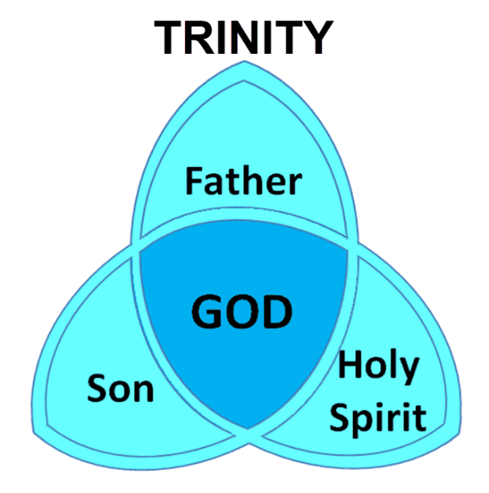

Slide 39
The Millennial Kingdom
Revelation 20:1-10
Satan: The Great Chain (1-3)
Saints: The Great Reign (4-6)
Sinners: The Great Revolt (7-10)
Willmington, Outline Bible, p. 772-73

Slide 40
II. Saints: The Great Reign
Revelation 20:4-6
The Resurrection of the Just (4a)
The Rule of the Just (4b-6)
Willmington, Outline Bible, p. 772-73

Slide 41
II. Saints: The Great Reign
Revelation 20:4-6
The Resurrection of the Just (4a)
The Rule of the Just (4b-6)
Willmington, Outline Bible, p. 772-73

Slide 42
Matthew 19:28
“And Jesus said to them, “Truly I say to you, that you who have followed Me, in the regeneration when the Son of Man will sit on His glorious throne, you also shall sit upon twelve thrones, judging the twelve tribes of Israel.”

Slide 43


Revelation 3:21
PROMISE TO THE OVERCOMERS
“He who overcomes, I will grant to him to sit down with Me on My throne, as I also overcame and sat down with My Father on His throne.”

Slide 44
Revelation 1:6
“and He has made us to be a kingdom, priests to His God and Father—to Him be the glory and the dominion forever and ever. Amen.”

Slide 45
Revelation 5:10
“You have made them to be a kingdom and priests to our God; and they will reign [basileuō] upon the earth [gē].”

Slide 46

1 Corinthians 15:20-23
“²⁰ But now Christ has been raised from the dead, the first fruits of those who are asleep. ²¹-For since by a man came death, by a man also came the resurrection of the dead. ²² For as in Adam all die, so also in Christ all will be made alive. ²³ But each in his own order: Christ the first fruits, after that those who are Christ’s at His coming.”

Slide 47
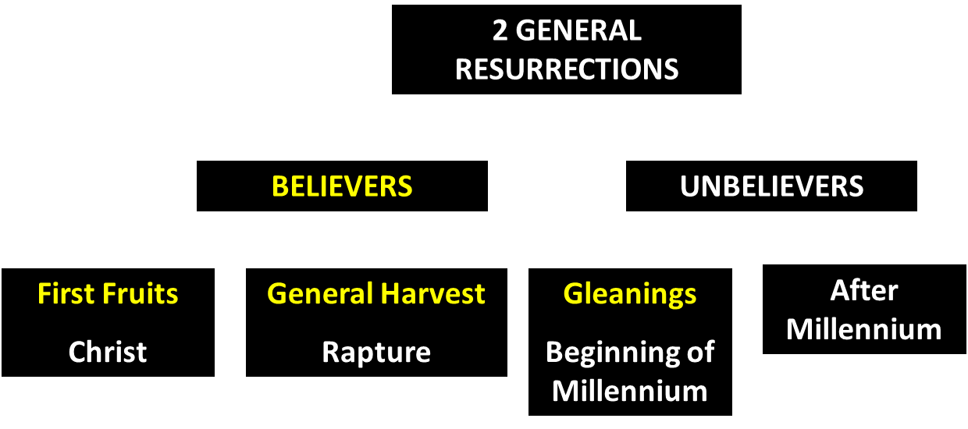
God’s Resurrection Program

Slide 48
1 Corinthians 15:20-23
“²⁰ But now Christ has been raised from the dead, the first fruits of those who are asleep. ²¹-For since by a man came death, by a man also came the resurrection of the dead. ²² For as in Adam all die, so also in Christ all will be made alive. ²³ But each in his own order (tagma): Christ the first fruits, after that those who are Christ’s at His coming.”

Slide 49
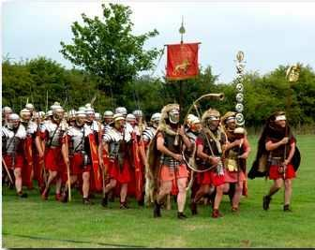
Order or Tagma (1 Cor. 15:23)
General – Christ’s resurrection (1 Cor 15:23)
Officer – Rapture (1 Thess 4:13-18)
Soldiers – OT saints & Tribulation martyrs (Rev 20:4)
Captives – Unsaved of all ages (Rev 20:5)

Slide 51
Revelation 20:4-6
“⁴ Then I saw thrones, and they sat on them, and judgment was given to them. And I saw the souls of those who had been beheaded because of their testimony of Jesus and because of the word of God, and those who had not worshiped the beast or his image, and had not received the mark on their forehead and on their hand; and they came to life [zaō] and reigned with Christ for a thousand years….

Slide 52
Revelation 20:4-6
…⁵ The rest of the dead did not come to life [zaō] until the thousand years were completed. This is the first resurrection [anastasis]. ⁶ Blessed and holy is the one who has a part in the first resurrection [anastasis]; over these the second death has no power, but they will be priests of God and of Christ and will reign with Him for a thousand years.”

Slide 53
II. Saints: The Great Reign
Revelation 20:4-6
The Resurrection of the Just (4a)
The Rule of the Just (4b-6)
Willmington, Outline Bible, p. 772-73

Slide 54
Revelation 3:21
PROMISE TO THE OVERCOMERS
“He who overcomes, I will grant to him to sit down with Me on My throne, as I also overcame and sat down with My Father on His throne.”

Slide 55
Revelation 1:6
“and He has made us to be a kingdom, priests to His God and Father—to Him be the glory and the dominion forever and ever. Amen.”

Slide 56
Revelation 5:10
“You have made them to be a kingdom and priests to our God; and they will reign [basileuō] upon the earth [gē].”

Slide 57

OT PROPHETS DESCRIBE THE KINGDOM
Established by God (Dan. 2:44)
Eternal (Dan. 7:27)
Christ’s direct rule (Zech. 9:9-10)
Earthly (Zech. 14:9)
Land promises realized (Gen. 15:18-21)
Israel’s preeminence (Isa. 49:22-23)
Millennial Temple (Ezek. 40‒46)

Slide 58
OT PROPHETS DESCRIBE THE KINGDOM
Millennial David (Jer. 30:9)
Righteousness (Isa. 9:6-7)
Curse curtailed (Isa. 65:20, 22)
Peace (Isa. 2:4)
Prosperity (Amos 9:13-14; Isa 65:22)
Topographical changes (Ezek. 47:1-12)
Immediate answers to prayer (Isa. 65:24)

Slide 59

Justin Martyr
Dialogue with Trypho, 80.
“But I and every other completely orthodox Christian feel certain that there will be a resurrection of the flesh, followed by a thousand years in the rebuilt, embellished, and enlarged city of Jerusalem as was announced by the prophets Ezekiel, Isaiah, and the others.”

Slide 60
1 Corinthians 15:20-23
“²⁰ But now Christ has been raised from the dead, the first fruits of those who are asleep. ²¹-For since by a man came death, by a man also came the resurrection of the dead. ²² For as in Adam all die, so also in Christ all will be made alive. ²³ But each in his own order: Christ the first fruits, after that those who are Christ’s at His coming.”

Slide 61
God’s Resurrection Program

Slide 62
1 Corinthians 15:20-23
“²⁰ But now Christ has been raised from the dead, the first fruits of those who are asleep. ²¹-For since by a man came death, by a man also came the resurrection of the dead. ²² For as in Adam all die, so also in Christ all will be made alive. ²³ But each in his own order (tagma): Christ the first fruits, after that those who are Christ’s at His coming.”

Slide 63
Order or Tagma (1 Cor. 15:23)
General – Christ’s resurrection (1 Cor 15:23)
Officer – Rapture (1 Thess 4:13-18)
Soldiers – OT saints & Tribulation martyrs (Rev 20:4)
Captives – Unsaved of all ages (Rev 20:5)

Slide 64
Daniel 12:2
“Many of those who sleep in the dust of the ground will awake, these to everlasting (olam) life, but the others to disgrace and everlasting (olam) contempt.”

Slide 65
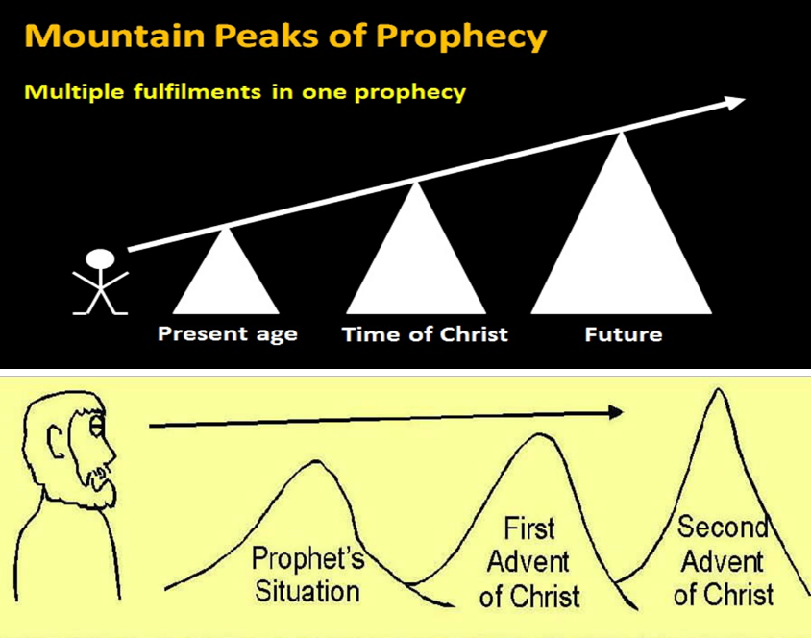

Slide 66
Isaiah 9:6-7
⁶ For a child will be born to us, a son will be given to us; And the government will rest on His shoulders; And His name will be called Wonderful Counselor, Mighty God, Eternal Father, Prince of Peace.⁷ There will be no end to the increase of His government or of peace, On the throne of David and over his kingdom, To establish it and to uphold it with justice and righteousness From then on and forevermore. The zeal of the Lord of hosts will accomplish this.

Slide 67
Isaiah 61:1-2
¹ The Spirit of the Lord God is upon me, Because the Lord has anointed me To bring good news to the afflicted; He has sent me to bind up the brokenhearted, To proclaim liberty to captives And freedom to prisoners; ² To proclaim the favorable year of the Lord And the day of vengeance of our God; To comfort all who mourn.

Slide 68
Luke 4:16-21
¹⁶ And He came to Nazareth, where He had been brought up; and as was His custom, He entered the synagogue on the Sabbath, and stood up to read. ¹⁷ And the book of the prophet Isaiah was handed to Him. And He opened the book and found the place where it was written,¹⁸ “The Spirit of the Lord is upon Me, Because He anointed Me to preach the gospel to the poor. He has sent Me to proclaim release to the …

Slide 69

Luke 4:16-21
… captives, And recovery of sight to the blind, To set free those who are oppressed,¹⁹ To proclaim the favorable year of the Lord.” ²⁰ And He closed the book, gave it back to the attendant and sat down; and the eyes of all in the synagogue were fixed on Him. ²¹ And He began to say to them, “Today this Scripture has been fulfilled in your hearing.”

Slide 70
Isaiah 61:1-2
¹ The Spirit of the Lord God is upon me, Because the Lord has anointed me To bring good news to the afflicted; He has sent me to bind up the brokenhearted, To proclaim liberty to captives And freedom to prisoners; ² To proclaim the favorable year of the Lord And the day of vengeance of our God; To comfort all who mourn.

Slide 71


Statue
&
Stone

Slide 72

CHART1

Slide 73
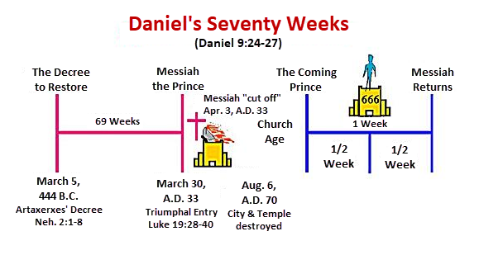

Slide 74
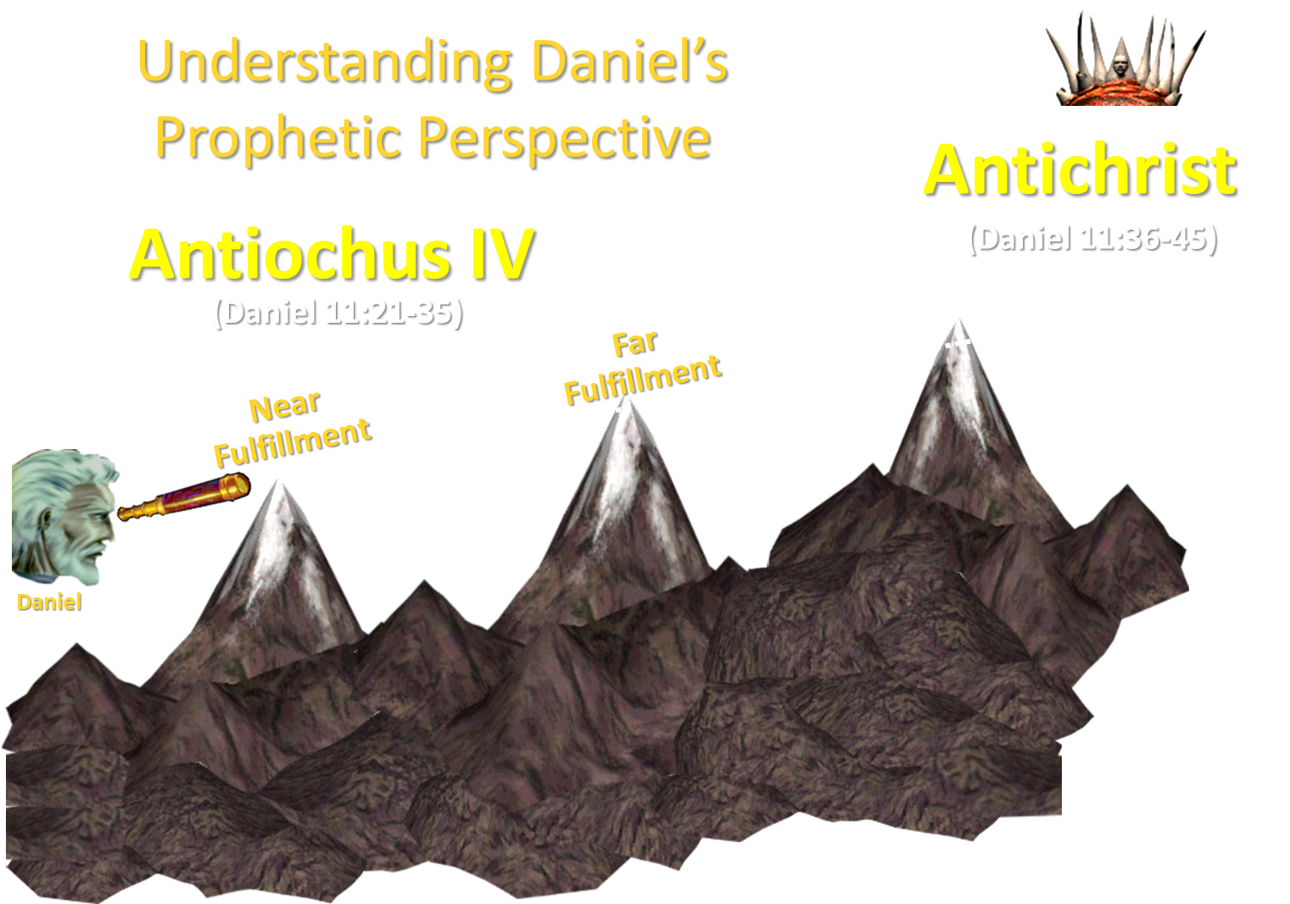

Slide 75
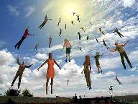
When Will the Rapture Take Place Relative to the Tribulation Period?
Pre-tribulation rapture theory
Mid-tribulation rapture theory
Post-tribulation rapture theory
Pre-wrath rapture theory
Partial rapture theory

Slide 76


Slide 77

Seven Beatitudes of Revelation:
“Blessed” (makarios)
Blessing upon the reader & heeder of Revelation (1:3)
Blessing upon the Tribulation martyrs (14:13)
Blessing upon the spiritually prepared (16:15)
Blessing upon the Marriage Supper invitees (19:9)
Blessing upon the First Resurrection’s participants (20:6)
Blessing upon the heeder of Revelation (22:7)
Blessing upon the eternal city’s citizens (22:14)
John F. Walvoord, "Revelation," in Bible Knowledge Commentary, ed. John F. Walvoord and Roy B. Zuck (Colorado Springs, CO: Victor, 1983), 929

Slide 78
Seven Beatitudes of Revelation:
“Blessed” (makarios)
Blessing upon the reader & heeder of Revelation (1:3)
Blessing upon the Tribulation martyrs (14:13)
Blessing upon the spiritually prepared (16:15)
Blessing upon the Marriage Supper invitees (19:9)
Blessing upon the First Resurrection’s participants (20:6)
Blessing upon the heeder of Revelation (22:7)
Blessing upon the eternal city’s citizens (22:14)
John F. Walvoord, "Revelation," in Bible Knowledge Commentary, ed. John F. Walvoord and Roy B. Zuck (Colorado Springs, CO: Victor, 1983), 929

Slide 79
Revelation 1:6
“and He has made us to be a kingdom, priests to His God and Father—to Him be the glory and the dominion forever and ever. Amen.”

Slide 80
Revelation 5:10
“You have made them to be a kingdom and priests to our God; and they will reign [basileuō] upon the earth [gē].”

Slide 81
The Millennial Kingdom
Revelation 20:1-10
Satan: The Great Chain (1-3)
Saints: The Great Reign (4-6)
Sinners: The Great Revolt (7-10)
Willmington, Outline Bible, p. 772-73

Slide 82
III. Sinners: The Great Revolt
Revelation 20:7-10
The Adversary (7)
The Apostasy (8)
The Attack (9a)
The Annihilation (9b-10)
Willmington, Outline Bible, p. 772-73

Slide 83
III. Sinners: The Great Revolt
Revelation 20:7-10
The Adversary (7)
The Apostasy (8)
The Attack (9a)
The Annihilation (9b-10)
Willmington, Outline Bible, p. 772-73

Slide 84
Revelation 20:7-9
“⁷ When the thousand years are completed, Satan will be released from his prison, ⁸ and will come out to deceive the nations which are in the four corners of the earth, Gog and Magog, to gather them together for the war; the number of them is like the sand of the seashore. ⁹ And they came up on the broad plain of the earth and surrounded the camp of the saints and the beloved city, and fire came down from heaven and devoured them.

Slide 85
III. Sinners: The Great Revolt
Revelation 20:7-10
The Adversary (7)
The Apostasy (8)
The Attack (9a)
The Annihilation (9b-10)
Willmington, Outline Bible, p. 772-73

Slide 86

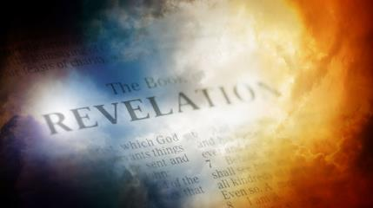
David Hocking
The Book of Revelation: Understanding the Future (Tustin, CA: Hope For Today Publications, 2014), 530. .
“God demonstrates by this one final event that even under the best conditions, mankind‘s problem is the heart. God demonstrates that Satan’s depravity cannot be cured. God demonstrates that He is fully justified in exacting eternal punishment.”

Slide 87

Revelation 20:7-9
“⁷When the thousand years are completed, Satan will be released from his prison, ⁸ and will come out to deceive the nations which are in the four corners of the earth, Gog and Magog, to gather them together for the war; the number of them is like the sand of the seashore. ⁹And they came up on the broad plain of the earth and surrounded the camp of the saints and the beloved city, and fire came down from heaven and devoured them.”

Slide 89
Millennial Fulfillment?
EZEK. 38-39 | REV. 20:7-9
Northern invasion | All nation invade
Invasion leads to Millennium (Ezek 40-48) | Invasion comes at end of Millennium
Invasion leads to Millennium (Ezek 40-48) | Invasion leads to Eternal State (Rev 21-22)
7 months necessary to dispose of the dead (39:12) | Dead disposed of instantaneously (20:9)
Satan not bound prior to invasion | Satan bound prior to invasion (Rev 20:2)
Pentecost, Things To Come, 349-50

Slide 90
David J. MacLeod
David J. MacLeod, “The Fifth ‘Last Thing’: The Release of Satan and Man’s Final Rebellion (Rev. 20: 7–10),” Bibliotheca Sacra 157, no. 626 (April 2000): p. 209.
“How can Gog and Magog refer to a battle in Revelation 19 before the millennium and this battle at the end of the millennium? The most likely explanation is that Antichrist is Gog and will be defeated at the Second Coming. During the millennium his defeat will become a legend among the nations, something like Napoleon’s defeat at Waterloo. Then at the end of the millennial kingdom the Gog and Magog ‘legend’ is applied to a new historical situation (20: 8), with Satan leading the new ‘Gog and Magog.’ Satan will meet his ‘Waterloo’—his ‘Gog and Magog.’”

Slide 91

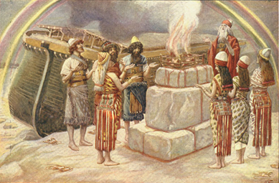
Genesis 8:21
The Lord smelled the soothing aroma; and the Lord said to Himself, “I will never again curse the ground on account of man, for the intent of man’s heart is evil from his youth; and I will never again destroy every living thing, as I have done.[emphasis mine].

Slide 92

Jeremiah 17:9
“The heart is more deceitful than all else And is desperately sick; Who can understand it?.”

Slide 93
Mark 7:20-23
“²⁰ And He was saying, ‘That which proceeds out of the man, that is what defiles the man. ²¹ For from within, out of the heart of men, proceed the evil thoughts, fornications, thefts, murders, adulteries, ²² deeds of coveting and wickedness, as well as deceit, sensuality, envy, slander, pride and foolishness. ²³ All these evil things proceed from within and defile the man.’”

Slide 94
David Hocking
The Book of Revelation: Understanding the Future (Tustin, CA: Hope For Today Publications, 2014), 530.
“God demonstrates by this one final event that even under the best conditions, mankind‘s problem is the heart. God demonstrates that Satan’s depravity cannot be cured. God demonstrates that He is fully justified in exacting eternal punishment.”

Slide 95
III. Sinners: The Great Revolt
Revelation 20:7-10
The Adversary (7)
The Apostasy (8)
The Attack (9a)
The Annihilation (9b-10)
Willmington, Outline Bible, p. 772-73

Slide 96

Isaiah 2:2-3
“Now it will come about that In the last days The mountain of the house of the Lord Will be established as the chief of the mountains, And will be raised above the hills; And all the nations will stream to it.³ And many peoples will come and say, ‘Come, let us go up to the mountain of the Lord, To the house of the God of Jacob; That He may teach us concerning His ways And that we may walk in His paths.’ For the law will go forth from Zion And the word of the Lord from Jerusalem.”

Slide 97

Zechariah 14:16-18
“Then it will come about that any who are left of all the nations that went against Jerusalem will go up from year to year to worship the King, the Lord of hosts, and to celebrate the Feast of Booths. ¹⁷ And it will be that whichever of the families of the earth does not go up to Jerusalem to worship the King, the Lord of hosts, there will be no rain on them. ¹⁸ If the family of Egypt does not go up or enter, then no rain will fall on them; it will be the plague with which the Lord smites the nations who do not go up to celebrate the Feast of Booths.”

Slide 98

Robert Thomas
Four Views on the Book of Revelation, page 207.
“At the end of the Millennium that city will be Satan’s prime objective with his rebel army, because Israel will be a leader among the nations.”

Slide 99
III. Sinners: The Great Revolt
Revelation 20:7-10
The Adversary (7)
The Apostasy (8)
The Attack (9a)
The Annihilation (9b-10)
Willmington, Outline Bible, p. 772-73

Slide 100
D. The Annihilation
Revelation 20:9b-10
Satan’s henchmen are consumed by the fires of heaven (9b)
Satan himself is consumed by the fires of hell (10)
Willmington, Outline Bible, p. 772-73

Slide 101
D. The Annihilation
Revelation 20:9b-10
Satan’s henchmen are consumed by the fires of heaven (9b)
Satan himself is consumed by the fires of hell (10)
Willmington, Outline Bible, p. 772-73

Slide 102
D. The Annihilation
Revelation 20:9b-10
Satan’s henchmen are consumed by the fires of heaven (9b)
Satan himself is consumed by the fires of hell (10)
Willmington, Outline Bible, p. 772-73

Slide 103
Satan’s Progressive Defeat
Initial eviction from heaven (Isa 14:12-15; Ezek 28:12-17)
Eden (Gen 3:15)
Pre-diluvian world (1 Pet 3:19-20)
Cross (John 12:31; 16:11; Col 2:15; Heb 2:14; 1 John 3:8)
Mid point of the Tribulation (Rev 12:9)
Beginning of millennium (Rev 20:2-3)
End of millennium (Rev 20:10)

Slide 105
Revelation 20:10
“And the devil who deceived them was thrown into the lake of fire and brimstone, where the beast and the false prophet are also; and they will be tormented day and night forever and ever.”

Slide 106
Revelation 20:10
“And the devil who deceived them was thrown into the lake of fire and brimstone, where the beast and the false prophet are also; and they will be tormented day and night forever (aiōn) and ever (aiōn).”

Slide 107
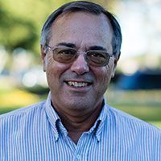
Dr. Alan W. Gomes
(Summer 1991). “Evangelicals and the Annihilation of Hell” (Part 2). In the Christian Research Journal. Page 11.
“A punishment [such as torment] that is not felt is not a punishment. It is an odd use of language to speak of an insensate state (i.e., unfeeling), an inanimate object receiving punishment. To say, ‘I punished my car for not starting by slowly plucking out it’s spark plug wires, one by one,’ would invoke laughter, not serious consideration.”

Slide 108
Daniel 12:2
“Many of those who sleep in the dust of the ground will awake, these to everlasting (olam) life, but the others to disgrace and everlasting (olam) contempt.”

Slide 109
Psalm 90:2
“Before the mountains were born Or You gave birth to the earth and the world, Even from everlasting (olam) to everlasting (olam), You are God.”

Slide 110
Matthew 25:46
“These will go away into eternal (aiōnios) punishment, but the righteous into eternal (aiōnios) life.

Slide 111
Romans 16:26
“but now is manifested, and by the Scriptures of the prophets, according to the commandment of the eternal (aiōnios) God, has been made known to all the nations, leading to obedience of faith.

Slide 112
Revelation 14:11
“And the smoke of their torment goes up forever (aiōn) and ever (aiōn); they have no rest day and night, those who worship the beast and his image, and whoever receives the mark of his name.”

Slide 113
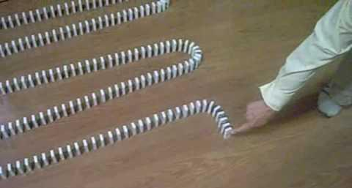
Dominoes in a Row

Slide 114
Conclusion

Slide 115
The Millennial Kingdom
Revelation 20:1-10
Satan: The Great Chain (1-3)
Saints: The Great Reign (4-6)
Sinners: The Great Revolt (7-10)
Willmington, Outline Bible, p. 772-73

Slide 116

“The Lord bless you and keep you; the Lord make his face shine on you and be gracious to you; the Lord turn his face toward you and give you peace.” (NIV)

