Slide 1
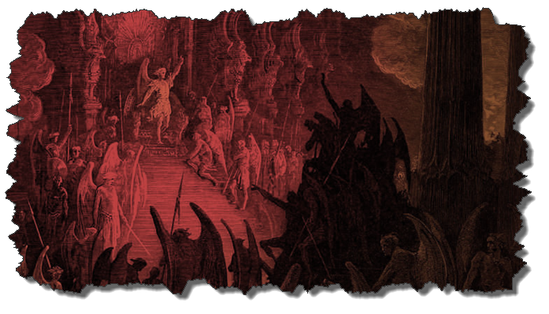
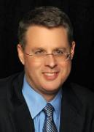
DEMONOLOGY
Dr. Andy Woods
Senior Pastor – Sugar Land Bible Church
President – Chafer Theological Seminary

Slide 2
Preview of Angelology
Good angels
Satanology
Demonology
Gen. 6:1-4 controversy

Slide 3
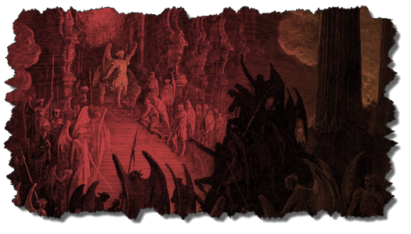
Overview
Existence Origin Personhood Characteristics | Powers Works Demon possession Defense

Slide 4
Overview
Existence Origin Personhood Characteristics | Powers Works Demon possession Defense

Slide 5
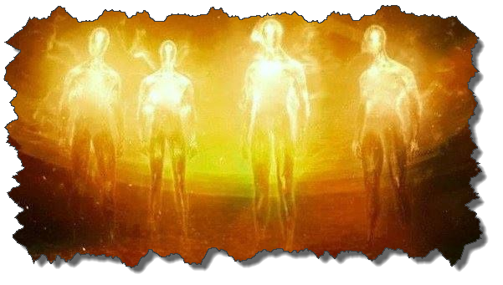
Existence
OT
Deut 32:17
Ps 106:37
NT
Over 100x
All NT writers (except Hebrews)
Christ (Matt 8:29; 10:1; 12:43-45)

Slide 6
Overview
Existence Origin Personhood Characteristics | Powers Works Demon possession Defense

Slide 7
Origin
 | Demons | Fallen Angels
Satan is leader | Matt 12:24 | Matt 25:41; Rev 12:7-9
Spirit beings | Matt 8:16 | Heb 1:14
Capacity to enter people | Matt 12:22; Luke 11:14-15 | John 13:27

Slide 8
Overview
Existence Origin Personhood Characteristics | Powers Works Demon possession Defense

Slide 9
Personhood
Attributes of personhood
Intellect – Acts 19:15
Emotions – Luke 8:28; Jas 2:19
Will – Luke 8:32
Personal pronouns – Mark 1:24-25

Slide 10
Overview
Existence Origin Personhood Characteristics | Powers Works Demon possession Defense

Slide 11
Characteristics
Spirits-Matt 8:16; Eph 6:12
Corrupt
Unclean – Matt 10:1
Evil – Luke 7:21
Rulers of darkness in spiritual wickedness – Eph 6:12
Degrees of wickedness – Matt 12:45

Slide 12
Characteristics (cont’d)
Manifestation
Invisible
Prophetic events = ugly/hideous (Rev 9:7-10; 16:13-16)

Slide 13
Overview
Existence Origin Personhood Characteristics | Powers Works Demon possession Defense

Slide 14
Powers
Great strength (Mark 5:3-4; Acts 19:16) but not omnipotent (Dan 10:13)
Superhuman intelligence (2 Sam. 14:20; Luke 8:28; 20:35-36) but not omniscient (Acts 19:15)
Not confined by physical space or barriers (Mark 5:9) but not omnipresent (Mark 5:12)

Slide 15
Overview
Existence Origin Personhood Characteristics | Powers Works Demon possession Defense

Slide 16
Works
General
Satan’s lack of omnipresence (Job 1:7; 2:2) forces him to work through demons (Matt 12:24; 25:41; Rev 12:7; 2 Cor 12:7)
Work in harmony with one another (Eph 6:11-12)
Influence human government (Dan 10:13, 20)
Promote false religion (1 Cor 10:20; 1 Tim 4:1)

Slide 17
Works (cont’d)
General
Afflict the mind (Mark 5:3, 5)
Afflict the body (Matt 12:22; Mark 9:22; Luke 13:11, 16)
Hinder believers’ prayers (Dan 10:12-20)

Slide 18
Occult Works
NAME | DEFINITION | SCRIPTURE
Divination | Fortune telling | Deut 18:10; Acts 16:16
Spiritism | Contacting the dead | Deut 18:11
Magic | Performance of miraculous powers | Deut 18:11
Pharamkeia | Illicit drug use | Rev 9:20-21; 18:2, 23

Slide 19
Occult Works
NAME | DEFINITION | SCRIPTURE
Divination | Fortune telling | Deut 18:10; Acts 16:16
Spiritism | Contacting the dead | Deut 18:11
Magic | Performance of miraculous powers | Deut 18:11
Pharamkeia | Illicit drug use | Rev 9:20-21; 18:2, 23

Slide 20
Occult Works
NAME | DEFINITION | SCRIPTURE
Divination | Fortune telling | Deut 18:10; Acts 16:16
Spiritism | Contacting the dead | Deut 18:11
Magic | Performance of miraculous powers | Deut 18:11
Pharamkeia | Illicit drug use | Rev 9:20-21; 18:2, 23

Slide 21
Bible Verses Against Necromancy
Lev. 19:13
Deut. 18:9-14
1 Sam. 28:7-8
2 Kgs. 21:6
1 Chron. 10:13
Isa. 8:19-20

Slide 22
Steve Berger
Steve Berger & Sarah Berger, Have Heart: Bridging the Gulf Between Heaven and Earth (Franklin, TN: Grace Chapel, 2010).
“And then one night, Josiah showed up in a dream” (p. 69)
“Josiah came into the sanctuary…It wasn’t like he just appeared there. It was a sense of him coming into the aisle, and he got down on one knee and bent into my ear…Then, as quickly as he came, he left. It wasn’t that he disappeared; rather, it was a sense of him leaving the sanctuary…. He had a sense of speed about him, not that he was hurried, but as if life on earth was much slower than in Heaven—it’s a different place, a different plane. I stood up and went over to my wife and told her, ‘Josiah was just here.’” p. 99-100.

Slide 23
Steve Berger
Steve Berger & Sarah Berger, Have Heart: Bridging the Gulf Between Heaven and Earth (Franklin, TN: Grace Chapel, 2010).
“The next thing I knew, Josiah came into [the church] sanctuary…and he got down on one knee and bent to speak into my ear….I stood up and went over to my wife and told her, ‘Josiah was just here’” (pp. 99-100).
“God granted Josiah permission to make an appearance…it demonstrates his continued presence in not only our lives but in the lives of his friends as well” (p. 100; italics added).
“Yes, the residents of Heaven are personally present, they are aware, and they are near!” p. 100-101.

Slide 24
Steve Berger
Steve Berger & Sarah Berger, Have Heart: Bridging the Gulf Between Heaven and Earth (Franklin, TN: Grace Chapel, 2010).
“Yes, the residents of Heaven are personally present, they are aware, and they are near!” p. 100-101.
“We want all of us to continue to have relationship with Siah right up until the day that we are face-to-face in Heaven with him” (p. 103).
“We know that [Josiah] can see us, hear us, and even be involved, not only in our lives but also in the lives of his friends. We are continually hearing of Siah coming to friends in dreams…” (p. 104).

Slide 25
Steve Berger
Steve Berger & Sarah Berger, Have Heart: Bridging the Gulf Between Heaven and Earth (Franklin, TN: Grace Chapel, 2010).
“The cloud of witnesses [of ‘Christian loved ones in Heaven’] is personal, and we believe it is part of their work in the spiritual realm to cheer on their loved ones still on earth…” (p. 107; italics added).
“Our loved ones may show up in dreams or visits or other ways (who can limit God’s imagination?), but the fact is that we’re connected….There is a thin veil, and we’re connected to them, forever, in Christ” (p. 110)

Slide 26
Steve Berger
Steve Berger & Sarah Berger, Have Heart: Bridging the Gulf Between Heaven and Earth (Franklin, TN: Grace Chapel, 2010).
“You don’t father or mother a child for nineteen years and then hear God say, ‘Oh, now you can’t talk to him. You no longer have a relationship with him until you see him face to face in Heaven….’ We still talk to Josiah, and it’s going to be so great when we’re together again” (p. 125).

Slide 27
Occult Works
NAME | DEFINITION | SCRIPTURE
Divination | Fortune telling | Deut 18:10; Acts 16:16
Spiritism | Contacting the dead | Deut 18:11
Magic | Performance of miraculous powers | Deut 18:11
Pharamkeia | Illicit drug use | Rev 9:20-21; 18:2, 23

Slide 28
Occult Works
NAME | DEFINITION | SCRIPTURE
Divination | Fortune telling | Deut 18:10; Acts 16:16
Spiritism | Contacting the dead | Deut 18:11
Magic | Performance of miraculous powers | Deut 18:11
Pharamkeia | Illicit drug use | Rev 9:20-21; 18:2, 23

Slide 29
Revelation 9:20-21
“The rest of mankind, who were not killed by these plagues, did not repent of the works of their hands, so as not to worship demons, and the idols of gold and of silver and of brass and of stone and of wood, which can neither see nor hear nor walk; ²¹ and they did not repent of their murders nor of their sorceries (pharmakeia) nor of their immorality nor of their thefts.”

Slide 30
OT Descriptions of Babylon in Rev 17–18
 | Revelation 17–18 | Old Testament
Waters | 17:1 | Psalm 137:1
Babylon the Great | 17:5 | Daniel 4:30
Mother harlots | 17:5 | Genesis 11:1-9
Fallen, fallen is Babylon | 18:2 | Isaiah 21:9
Will not see widowhood | 18:7 | Isaiah 47:7-9
Colorful attire | 17:4; 18:16 | Daniel 5:7, 16, 29
Sorcery | 18:23 | Isaiah 47:9-13
Destroyed in a day | 18:8, 10 | Daniel 5:30

Slide 31
Acts 19:19
“And many of those who practiced magic brought their books together and began burning them in the sight of everyone; and they counted up the price of them and found it fifty thousand pieces of silver.”

Slide 32
Charles Ryrie
The Ryrie Study Bible
“19:19 Magic. Magical spells written on scrolls. Fifty thousand pieces of silver. If the silver drachma is meant, the value would have been the equivalent of about 138 years’ pay for a rural worker.”

Slide 33
Harry Potter
“A Roman Catholic school in Tennessee has banished JK Rowling's universally popular series of Harry Potter novels from its library shelves after its pastor took exception to their portrayal of magic, warning the spells and curses the author describes are real and ‘risk conjuring evil spirits’ when read…‘These books present magic as both good and evil, which is not true, but in fact a clever deception. The curses and spells used in the books are actual curses and spells; which when read by a human being risk conjuring evil spirits into the presence of the person reading the text,’ the Reverend Reehill wrote, apparently in all seriousness.
Joe Sommerlad, Harry Potter books removed from school library because they contain 'real' curses and spells, “Independent,” online: https://www.independent.co.uk/news/world/americas/harry-potter-banned-school-library-nashville-tennessee-exorcist-a9087676.htmlwww.soniclight.com, September 1, 2019; accessed 13 December 219, p. 1.

Slide 34
Dangerous Influences on our Children & Youth Dr. Christine J. Tan (May 21, 2017)
Sue Bohlin (PROBE.org) – on Harry Potter
https://www.probe.org/harry-potter/
Sue Bohlin (PROBE.org) – on Twilight
https://www.probe.org/the-darkness-of-twilight
Matt Slick (CARM) – on Pokemon
https://carm.org/what-is-pokemon
Patrick Zukeran (EvidenceAndAnswers.org) – on Worldview of Star Wars
http://evidenceandanswers.org/article/worldvie w-star-wars/

Slide 35
Dangerous Influences on our Children & Youth Dr. Christine J. Tan (May 21, 2017)
Kerby Anderson (PROBE.org) – on High Tech Witchcraft
https://www.probe.org/high-tech-witchcraft/
Patrick Zukeran (EvidenceAndAnswers.org) – on the Occult
http://evidenceandanswers.org/article/the-world-of-the-occult/
Michael Gleghorn (PROBE.org) – on Yoga and Christianity
https://www.probe.org/yoga-and-christianity-are-they-compatible/
Michael Gleghorn (PROBE.org) – OK for Christian to do yoga?
https://www.probe.org/is-it-ok-for-a-christian-to-practice-yoga/

Slide 36
Dangerous Influences on our Children & Youth Dr. Christine J. Tan (May 21, 2017)
Patrick Zukeran (EvidenceAndAnswers.org) – on Yoga
http://evidenceandanswers.org/podcast/episode-280-yoga-great-exercise-or-dangerous-worship/
Michael Gleghorn (PROBE.org) – on Hypnosis
https://www.probe.org/is-hypnosis-ok-or-a-problem/
Oropeza (Christian Research Institute) – on some Martial Arts
http://www.equip.org/articles/should-a-christian-practice-the-martial-arts/

Slide 37
CONCLUSION

Slide 38
Overview
Existence Origin Personhood Characteristics | Powers Works Demon possession Defense

