Slide 1


Slide 2

Kingdom Study Outline
What does the Bible Says About the Kingdom?
Why do some believe that we are in the kingdom now?
Why does it matter?

Slide 3

9 Ways Kingdom Now Theology
Impacts the Church
Loss of “pilgrim” status
Social Gospel
Ecumenical & interfaith alliances
Rejection or marginalization of Bible prophecy
Building the wrong kingdom
Charismatic theology
Prosperity Gospel
Anti-Israelism
Lordship Salvation

Slide 4

John 5:24
“Truly, truly, I say to you, he who hears My word, and believes Him who sent Me, has eternal life, and does not come into judgment, but has passed out of death into life.”

Slide 5


Lordship Salvation Defined
“Lordship Salvation refers to the belief which says the sinner who wants to be saved must not only trust Christ as his substitute for sin, but must also surrender every area of his life to the complete control of Christ.”
Lightner, Sin, the Savior, and Salvation, 202

Slide 6

John MacArthur
Faith Works, p. 25
“Jesus is Lord of all, and the faith He demands involves unconditional surrender…He does not bestow eternal life on those whose hearts remain set against Him.”

Slide 7

Lordship Salvation: 7 Problems
Changes the gospel
Places an impossible burden upon the unsaved
Confuses justification with sanctification
Confuses the result of with requirement for salvation
Fails to make basic dispensational distinctions
Ignores the reality of a carnal Christian
Destroys the assurance of salvation

Slide 8
Lordship Salvation: 7 Problems
Changes the gospel
Places an impossible burden upon the unsaved
Confuses justification with sanctification
Confuses the result of with requirement for salvation
Fails to make basic dispensational distinctions
Ignores the reality of a carnal Christian
Destroys the assurance of salvation

Slide 9
Dispensational Theology is a
System of Theology
Traditional-normative dispensational theology is a system that embodies three essential, fundamental concepts called the sine qua non (lit. “without which is not”):
The consistent use of a plain, normal, literal, grammatical-historical method of interpretation;
Which reveals that the Church is distinct from Israel;
God’s overall purpose is to bring glory to Himself (Eph. 1:6, 12, 14).
Dr. Charles Ryrie, Dispensationalism, pp. 38-41

Slide 10


Slide 11

Hebrews 5:11-14
¹¹ Concerning him we have much to say, and it is hard to explain, since you have become dull of hearing. ¹² For though by this time you ought to be teachers, you have need again for someone to teach you the elementary principles of the oracles of God, and you have come to need milk and not solid food. ¹³ For everyone who partakes only of milk is not accustomed to the word of righteousness, for he is an infant. ¹⁴ But solid food is for the mature, who because of practice have their senses trained to discern good and evil.

Slide 12
1 Corinthians 3:1-3
¹ And I, brethren, could not speak to you as to spiritual people but as to carnal, as to babes in Christ. ² I fed you with milk and not with solid food; for until now you were not able to receive it, and even now you are still not able; ³ for you are still carnal. For where there are envy, strife, and divisions among you, are you not carnal and behaving like mere men? (NKJV)

Slide 13
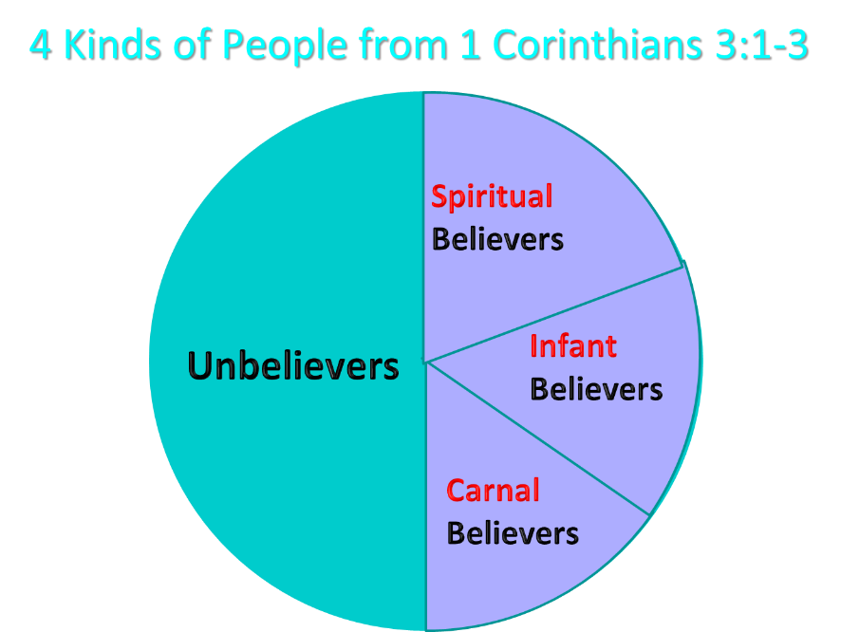
Notes:
Ray Steadman – “1st Californians”
Unbelievers vs Categories of Believers
Unbelievers – ψυχικός psuchikós; Natural, pertaining to the natural as distinguished from the spiritual
Spiritual Believers – πνευματικός pneumatikós; of persons who are spiritual, enlightened by the Holy Spirit
Infant Believers – σάρκινος sárkinos; with propensities of the flesh unto sin; νήπιος nḗpios; an infant, child, baby without any definite limitation of age. (This relates to immaturity and lack of instruction)
Carnal Believers – σαρκικός sarkikós; tendency to satisfy the flesh, implying sinfulness, sinful propensity, carnal (This relates to disobedience and open rebellion)

Slide 14
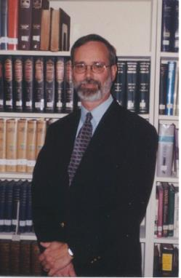
Kenneth L. Gentry
He Shall Have Dominion: A Post Millennial Eschatology (Tyler, Texas: Institute for Christian economics, 1992), page 335.
“The proper understanding of the thousand-year time frame in Revelation 20 is that it is representative of a long and glorious era and is not limited to a literal 365,000 days. The figure represents a perfect cube of 10, which is the number of quantitative perfection.”

Slide 15

  “Regrettably, some published materials written by DTS faculty members confirm my earlier concern. First there was Dr. Darrell Bock’s review of MacArthur’s The Gospel According to Jesus which showed significant confusion on the subject of assurance (see Bib Sac, Jan–Mar, 1989, pp. 21–40; see my review in the GES Journal, Spring 1989, pp. 79–83 and especially pp. 81–83). Darrell has told me both in person and in writing that his position is “soft lordship” salvation—a view that would have been rejected by the founder and first president of Dallas Seminary, Dr. Lewis Sperry Chafer.”
Zane Hodges
Zane C. Hodges, “Assurance and Works: An Evangelical Trainwreck,” Grace in Focus (March‒April 1994), accessed April 1, 2016, http://www.faithalone.org.

Slide 16
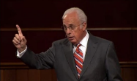
John MacArthur
“Israel and the Church are separate entities…and in that regard, I consider myself a…dispensationalist…There is a tendency, however, for dispensationalists to get carried away with compartmentalizing truth to the point that they make unbiblical differentiations. An almost obsessive desire to categorize and contrast related truths has carried various dispensationalist interpreters [Chafer, Ryrie, Hodges, etc.] far beyond the legitimate distinctions between Israel and the Church. Many would also draw hard lines between salvation and discipleship [justification and sanctification], the church and the kingdom, Christ's preaching and the apostolic message, faith and repentance, and the age of law and the age of grace." (bold & emphasis mine) “The Gospel According to Jesus,” page 31

Slide 17

John MacArthur
“Unfortunately, traditional dispensationalism tends to miss that simple point. Some dispensationalists teach that ‘the gospel of the kingdom’ Jesus proclaimed (Matt. 4: 23) is distinct from ‘the gospel of the grace of God.’ The substance of this ‘gospel of the kingdom,’ one popular source says, is ‘that God purposes to set up on earth the kingdom of Christ . . . in fulfillment of the Davidic Covenant.’ Lewis Sperry Chafer wrote that the gospel of the kingdom was for the nation of Israel only ‘and should in no wise be confused with the gospel of saving grace.’”

Slide 18
John MacArthur
“Another early dispensationalist writer declared that the gospel Jesus preached had nothing to do with salvation but was simply an announcement that the time had come to set up the kingdom of Christ on earth. That may fit neatly into a particular dispensational scheme, but Scripture does not support it. We must not forget that Jesus came to seek and to save the lost, not merely to announce an earthly kingdom. When Jesus proclaimed His kingdom, He was preaching salvation.” “The Gospel According to Jesus,” page 96

Slide 19
Messengers of the Kingdom In Matthew
John the Baptist – 3:2
Jesus Christ – 4:17
12 Apostles – 10:5-7
Seventy – Luke 10:1, 9
Toussaint, Behold the King, 18-20

Slide 20

Matthew 3:1-2
“Now in those days John the Baptist came, preaching in the wilderness of Judea, saying, ‘Repent, for the kingdom of heaven is at hand.”

Slide 21
Matthew 4:17
“From that time Jesus began to preach and say, ‘Repent, for the kingdom of heaven is at hand.’”

Slide 22
Matthew 10:5-7
“These twelve Jesus sent out after instructing them: “Do not go in the way of the Gentiles, and do not enter any city of the Samaritans; ⁶ but rather go to the lost sheep of the house of Israel. ⁷ And as you go, preach, saying, ‘The kingdom of heaven is at hand.’”

Slide 23

Matthew 15:24
“But He answered and said, ‘I was sent only to the lost sheep of the house of Israel.’”

Slide 24
Luke 10:9
“Now after this the Lord appointed seventy others, and sent them in pairs ahead of Him to every city and place where He Himself was going to come…and heal those in it who are sick, and say to them, ‘The kingdom of God has come near to you.’”

Slide 25
Matthew 4:23
“Jesus was going throughout all Galilee, teaching in their synagogues and proclaiming the gospel of the kingdom, and healing every kind of disease and every kind of sickness among the people.”

Slide 26

Matthew 28:18-20
“And Jesus came up and spoke to them, saying, ‘All authority has been given to Me in heaven and on earth. ¹⁹ Go therefore and make disciples of all the nations, baptizing them in the name of the Father and the Son and the Holy Spirit, ²⁰ teaching them to observe all that I commanded you; and lo, I am with you always, even to the end of the age.’”

Slide 27

Matthew 12:24
“But when the Pharisees heard this, they said, “This man casts out demons only by Beelzebul the ruler of the demons.”

Slide 28
Matthew Outline
Pedigree of the king (1–2)
  Preparation of the king (3–4)
    Pedagogy of the king (5–7)
      Power of the king (8–9)
        Program of the king (10)
          Progressive rejection of the king (11–12)
        Preparation of the king’s disciples (13–20)
      Presentation & rejection of the king (21–23)
    Prophecies of the king (24–25)
  Passion of the king (26–27)
Proof of the king (28)

Slide 29
Matthew Outline
Pedigree of the king (1–2)
  Preparation of the king (3–4)
    Pedagogy of the king (5–7)
      Power of the king (8–9)
        Program of the king (10)
          Progressive rejection of the king (11–12)
        Preparation of the king’s disciples (13–20)
      Presentation & rejection of the king (21–23)
    Prophecies of the king (24–25)
  Passion of the king (26–27)
Proof of the king (28)

Slide 30
Matthew 24:14
“This gospel of the kingdom shall be preached in the whole world as a testimony to all the nations, and then the end will come.”
Notes:
Cf. Rev, 7 144,000 Jewish Evangelists

Slide 31
Acts 16:30-31
“and after he brought them out, he said, ‘Sirs, what must I do to be saved?’ ³¹ They said, ‘Believe in the Lord Jesus, and you will be saved, you and your household.’”

Slide 32
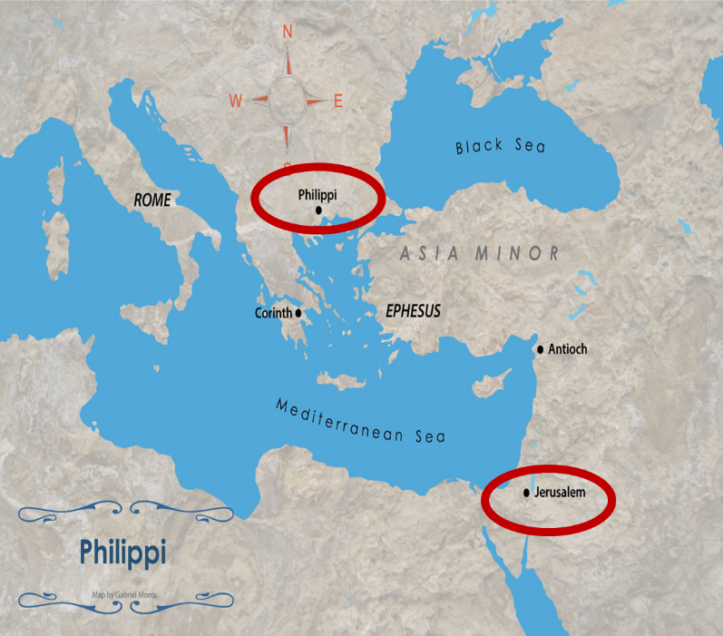

Slide 33
Kingdom Gospel vs. Personal Gospel
 | KINGDOM GOSPEL | PERSONAL GOSPEL
BIBLICAL EXAMPLE | Matt. 3:2; 4:17; 10:5-7 | Acts 16:30-31
TARGET AUDIENCE | National Israel (Matt. 10:5-7) | All nations (Matt. 28:18-20)
TYPE OF SALVATION OFFERED | National | Personal and individual
PORTRAYAL OF CHRIST | National Savior and King | Personal Savior
KINGDOM EXPECTANCY | Imminent | Absent
CONTRIBUTION TO GOD’S PROGRAM | Appearing of the kingdom | Building of the church (Matt. 16:18; Rom. 11:25b)

Slide 34
Kingdom Gospel vs. Personal Gospel
 | KINGDOM GOSPEL | PERSONAL GOSPEL
SCRIPTURAL FOUNDATION | Mosaic Covenant (Exod. 19:5-6; Deut. 28:15-68) | Gen. 3:15; 15:6; John 3:16; Gal 3:16
WHEN PREACHED? | Early Gospels and Tribulation (Matt. 3:2; 24:14) | Church Age
PREACHED TODAY? | No | Yes
PERPETUAL AVAILABILITY? | No | Yes
WHICH GOSPELS? | Synoptics | John
CROSS, ATONEMENT, RESURRECTION, ASCENSION, HOLY SPIRIT, FORGIVENESS OF SINS | No | Yes

Slide 35
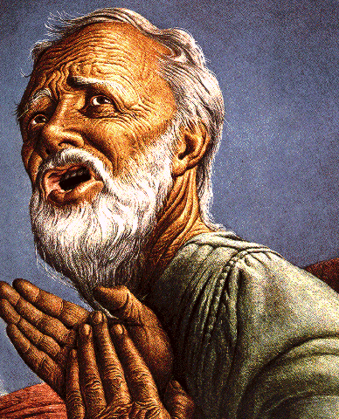
Belief – God’s One Condition for Justification
Gen 15:6
Then he believed in the LORD; and He reckoned it to him as righteousness.
John 3:16
For God so loved the world, that He gave His only begotten Son, that whoever believes in Him shall not perish, but have eternal life.
Acts 16:30-31
"Sirs, what must I do to be saved?" They said, "Believe in the Lord Jesus, and you will be saved..."

Slide 36

Lewis Sperry Chafer
Salvation: God’s Marvelous Work of Grace (Grand Rapids: Kregel, 1991), 49–50; idem, Grace: The Glorious Theme (Grand Rapids: Zondervan, 1972), 132.
“Such insistence is too often based on Scripture which is addressed to the covenant people, Israel. They . . . being covenant people, are privileged to return to God on the grounds of their covenant by repentance. There is much Scripture both in the Old Testament and in the New that calls this one nation to its long-predicted repentance....The preaching of John the Baptist, of Jesus and the early message of the disciples, was, ‘repent for the kingdom of heaven is at hand’; but it was addressed only to Israel (Matt. 10:5, 6).” “This good news to that nation was the ‘gospel of the kingdom,’ and should in no wise be confused with the Gospel of saving grace.”

Slide 37

Charles Ryrie
So Great A Salvation, Pages 36-37
“Even the New Testament uses the word gospel to mean various types of good news, so one has to describe what good news is in view. . . . In the Gospel of Matthew, all but one time the word gospel is used concerning the good news of the gospel of the kingdom. This is the message of John the Baptist (Matthew 3:1–2), of our Lord (Matthew 4:17), and of the twelve disciples when they were first sent out by the Lord (Matthew 10:5–7). What was the good news about the kingdom? The correct answer lies in the concept and hope of the kingdom that the Jewish people had at the time of the first coming of Christ. In fact, their hope was for the establishment of the promised rule of the Messiah in His …

Slide 38
Charles Ryrie
So Great A Salvation, Pages 36-37
“…kingdom on this earth, and in the kingdom that would exalt the Jewish people and free them from the rule of Rome under which they lived. But the rule of heaven did not arrive during Jesus’ lifetime because the people refused to repent and meet the spiritual conditions for the kingdom. Most only wanted a political deliverance without having to meet any personal requirements for change of life. So the kingdom did not arrive because the people would not prepare properly for it.”

Slide 39
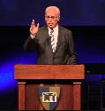
John MacArthur
https://www.gty.org/library/print/study-guide-chapter/2197
“Listen, the Jews were looking for a political kingdom but Jesus never offered one...There’s no politics in the Sermon on the Mount. None. There is not one reference to the social, political aspect of the kingdom made here, not one. The Jews were so concerned about the politics and the social life. Jesus makes no reference to that at all...The stress is on being. It’s not on ruling or possessing, it is on being...So the political aspect of this message was devastating. It was absolutely everything was the opposite of what they expected a Messiah to say.”

Slide 40

George Zeller
“John MacArthur and Dispensationalism: And Our Response,” 14, accessed April 5, 2016, http://www.middletownbiblechurch.org/dispen/jmacdis.htm.
“MacArthur also runs counter to traditional Dispensationalism in his understanding of ‘the gospel of the kingdom’.... He sees this phrase as simply meaning that Jesus was ‘preaching salvation’.... Dispensationalists understand this as a reference to that preaching which takes place when the Messianic kingdom is ‘at hand’ which was true in the days of John the Baptist and Christ, and will also be true during the closing years of this age (Matthew 24:14). Nowhere in the New Testament does it say that the gospel of the kingdom is being preached during this church age.”

Slide 41
John MacArthur
“I was raised in a dispensational environment; there’s no question… But, as I got into seminary, I began to test some of those things. I have been perhaps aptly designated as a leaky dispensationalist….Here’s my dispensationalism – I’ll give it to you in one sentence: there’s a difference between the church and Israel – period!... At the same time in seminary, I began to be exposed to reading among more Reformed theologians… And over the years of exegeting the scripture, it has again yielded to me a Reformed theology….”

Slide 42
John MacArthur
“I was convinced of it (Reformed theology) when I started and I’m more convinced of it now as I’ve gone through the text. I was convinced of it when I started because I read so many noble men who have held that view (Reformed Theology). It was more at that point hero worship, and now it’s become my own.” (bold mine)
Transcribed from tape, #GC 70-15, entitled "Bible Questions and Answers." A copy of the tape can be obtained by writing, Word of Grace, P.O. Box 4000, Panorama City, CA 91412. Copyright 1994 by John MacArthur Jr., All Rights Reserved.
(My point here is only to demonstrate how John MacArthur, who claims to be a dispensationalist, has arrived at his position on Lordship salvation.)

Slide 43
John MacArthur
“When I wrote [GAJ] I didn’t know anybody outside of my circles really, and I didn’t know how this book would be received. But Jim Boice agreed to write the foreword, and John Piper wrote an endorsement that was absolutely stunning to me, because I was really not moving in Reformed circles at that time. I was a leaky dispensationalist. That was my world, and I realized that I was much more one of you than I was one of them.” Interview with John Piper and Justin Taylor, Stand, p. 129.

Slide 44
John MacArthur
“The lordship debate has had a devastating effect on dispensationalism. Because no-lordship theology [a pejorative term for Free Grace] is so closely associated with dispensationalism, many have imagined a cause-and-effect relationship between the two...Frankly, some mongrel species of dispensationalism [which he has defined as the Dispensationalism of Ryrie, Chafer, and others] ought to die, and I will be happy to join the cortege.” “The Gospel According to the Apostles,” page 221

Slide 45
John MacArthur
“Who are the defenders of no-lordship dispensationalism? Nearly all of them stand in a tradition that has its roots in the teaching of Lewis Sperry Chafer. I will show…that Dr. Chafer is the father of modern no-lordship teaching. Every prominent figure on the no-lordship side descends from Dr. Chafer’s spiritual lineage. Though Dr. Chafer did not invent or originate any of the key elements of no-lordship teaching, he codified the system of dispensationalism on which all contemporary no-lordship doctrine is founded. That system is the common link between those who attempt to defend no-lordship doctrine on theological grounds.” “The Gospel According to the Apostles,” page 35

Slide 46
Conclusion

Slide 47
9 Ways Kingdom Now Theology
Impacts the Church
Loss of “pilgrim” status
Social Gospel
Ecumenical & interfaith alliances
Rejection or marginalization of Bible prophecy
Building the wrong kingdom
Charismatic theology
Prosperity Gospel
Anti-Israelism
Lordship Salvation

