Slide 1
Dr. Andy Woods
Senior Pastor – Sugar Land Bible Church
President – Chafer Theological Seminary

Slide 4
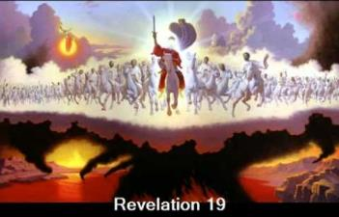
End of the Tribulation Period Revelation 19:7-21
The Marriage Supper of the Lamb (7-9)
John Responds to the Revelation (10)
The Second Advent (11-16)
The Supper of God (17-18)
Christ Defeats: Beast’s Armies & False Prophet (19-21)

Slide 5
End of the Tribulation Period Revelation 19:7-21
The Marriage Supper of the Lamb (7-9)
John Responds to the Revelation (10)
The Second Advent (11-16)
The Supper of God (17-18)
Christ Defeats: Beast’s Armies & False Prophet (19-21)

Slide 6
Completion of Two Important Themes Revelation 19:7-9
The Bema Seat Judgment of Christ (8)
The Marriage Supper of the Lamb (9)

Slide 7
End of the Tribulation Period Revelation 19:7-21
The Marriage Supper of the Lamb (7-9)
John Responds to the Revelation (10)
The Second Advent (11-16)
The Supper of God (17-18)
Christ Defeats: Beast’s Armies & False Prophet (19-21)

Slide 8
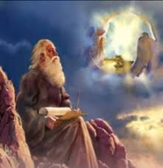
Method of Communication
From the Father
to Christ the Son
to an angel
to John
to a book
to a reader or preacher
to a listener or the seven churches

Slide 9
End of the Tribulation Period Revelation 19:7-21
The Marriage Supper of the Lamb (7-9)
John Responds to the Revelation (10)
The Second Advent (11-16)
The Supper of God (17-18)
Christ Defeats: Beast’s Armies & False Prophet (19-21)

Slide 10
III. The Second Advent Revelation 19:11-16
His Qualities (11-14)
His Activities (15-16)

Slide 11
III. The Second Advent Revelation 19:11-16
His Qualities (11-14)
His Activities (15-16)

Slide 12
A. His Qualities Revelation 19:11-14
His celestial origin (11a) His white horse (11b) His fidelity to His promises (11c) His righteous judgment (11d) His fiery eyes (12a) |  | His many crowns (12b) His unknown name (12c) His blood-soaked vesture (13a) His identification as the Word of God (13b) His following armies (14)

Slide 13
III. The Second Advent Revelation 19:11-16
His Qualities (11-14)
His Activities (15-16)

Slide 14
B. His Activities Revelation 19:15-16
His spoken word (15a)
His smiting of the nations (15b)
His ruling of the nations (15c)
His treading of the winepress (15d)
His rulership as King (16)

Slide 15
B. His Activities Revelation 19:15-16
His spoken word (15a)
His smiting of the nations (15b)
His ruling of the nations (15c)
His treading of the winepress (15d)
His rulership as King (16)

Slide 16
B. His Activities Revelation 19:15-16
His spoken word (15a)
His smiting of the nations (15b)
His ruling of the nations (15c)
His treading of the winepress (15d)
His rulership as King (16)

Slide 17
Genesis 11:1-4
¹ Now the whole earth used the same language and the same words. ² It came about as they journeyed east, that they found a plain in the land of Shinar and settled there. ³ They said to one another, “Come, let us make bricks and burn them thoroughly.” And they used brick for stone, and they used tar for mortar. ⁴ They said, “Come, let us build for ourselves a city, and a tower whose top will reach into heaven, and let us make for ourselves a name, otherwise we will be scattered abroad over the face of the whole earth.”

Slide 18
B. His Activities Revelation 19:15-16
His spoken word (15a)
His smiting of the nations (15b)
His ruling of the nations (15c)
His treading of the winepress (15d)
His rulership as King (16)

Slide 20
DIFFERENCES BETWEEN THE MILLENNIUM & ETERNAL STATE
MILLENNIUM (REV. 20:1-10) | ETERNAL STATE (REV. 21‒22)
Present earth (Gen. 13:17) | New Earth (Rev. 21:1)
Waters (Gen. 15:18-21) | No sea (Rev. 21:1)
Rebellion (Zech. 14:16-18) | No rebellion (Rev. 21:4)
Tribal land (Ezek. 47:13-23) | Tribal city gates (Rev. 21:12)
Sin exists (Ezek 45:22) | No sin (Rev. 21:4)
Temple (Ezek. 40‒46) | No temple (Rev. 21:22)
Rod of iron (Ps. 2:6-8) | No rod needed (Rev. 21:8)
Death (Isa. 65:20) | No death (Rev. 21:4)
Sun exists (Isa. 30:26) | No sun (Rev. 21:23; 22:5)

Slide 21
B. His Activities Revelation 19:15-16
His spoken word (15a)
His smiting of the nations (15b)
His ruling of the nations (15c)
His treading of the winepress (15d)
His rulership as King (16)

Slide 22
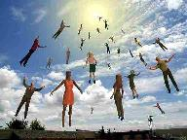
When Will the Rapture Take Place Relative to the Tribulation Period?
Pre-tribulation rapture theory
Mid-tribulation rapture theory
Post-tribulation rapture theory
Pre-wrath rapture theory
Partial rapture theory

Slide 24
Promised Exemption from Divine Wrath
The promise (1 Thess 1:10; 5:9; Rom 5:9; 8:1; Rev 3:10)
Tribulation = divine wrath (Rev 6:16-17; 11:18; 15:1, 7; 16:1, 19; 19:15)

Slide 25
B. His Activities Revelation 19:15-16
His spoken word (15a)
His smiting of the nations (15b)
His ruling of the nations (15c)
His treading of the winepress (15d)
His rulership as King (16)

Slide 26
Daniel 9:25
So you are to know and discern that from the issuing of a decree to restore and rebuild Jerusalem until Messiah the Prince there will be seven weeks and sixty-two weeks; it will be built again, with plaza and moat, even in times of distress.

Slide 27
Daniel 9:26
Then after the sixty-two weeks the Messiah will be cut off and have nothing, and the people of the prince who is to come will destroy the city and the sanctuary. And its end will come with a flood; even to the end there will be war; desolations are determined.

Slide 28
End of the Tribulation Period Revelation 19:7-21
The Marriage Supper of the Lamb (7-9)
John Responds to the Revelation (10)
The Second Advent (11-16)
The Supper of God (17-18)
Christ Defeats: Beast’s Armies & False Prophet (19-21)

Slide 29
End of the Tribulation Period Revelation 19:7-21
The Marriage Supper of the Lamb (7-9)
John Responds to the Revelation (10)
The Second Advent (11-16)
The Supper of God (17-18)
Christ Defeats: Beast’s Armies & False Prophet (19-21)

Slide 30
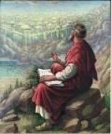
Revelation 17:3
“And he carried me away in the Spirit into a wilderness; and I saw a woman sitting on a scarlet beast, full of blasphemous names, having seven heads and ten horns.”

Slide 31
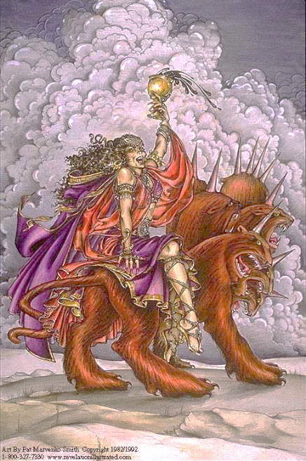

Slide 32
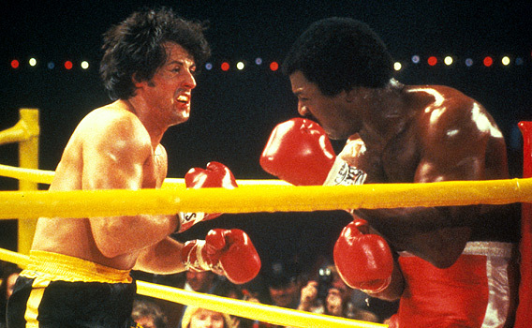

Slide 33
Ezekiel 28:13, 15
“¹³ You were in Eden, the garden of God; Every precious stone was your covering: The ruby, the topaz and the diamond; The beryl, the onyx and the jasper; The lapis lazuli, the turquoise and the emerald; And the gold, the workmanship of your settings and sockets, Was in you. On the day that you were created They were prepared… ¹⁵ You were blameless in your ways From the day you were created Until unrighteousness was found in you.”

Slide 34
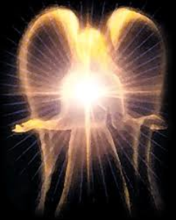
Original State and First Sin
Ezek 28:12-17
Attributes
Creature (15)
Angel (14, 16)
Powerful (14)
Without sin (15)
Beautiful (12-13)
Intelligent (12)
Nature of 1st sin (17)

Slide 35
Revelation 20:10
And the devil who deceived them was thrown into the lake of fire and brimstone, where the beast and the false prophet are also; and they will be tormented day and night forever and ever.”

Slide 36
Antichrist’s Satanic Miracles (2 Thessalonians 2:9)
MIRACLE | GREEK | CHRIST’S MINISTRY
Powers | Dynamis | Matt. 11:20
Signs | Sēmeíon | John 20:30
Wonders | Teras | Acts 2:22

Slide 37
Satanic/Demonic Miracles
Exod. 7–8
Deut. 13:1-3
Job 1:12-19; 2:7-8
1 Sam. 28?
Matt. 7:21-23; 24:24
Acts 8:9; 16:16
Gal. 1:6-9
2 Thess. 2:9
Rev. 13:3, 13, 15; 16:13-14

Slide 39
Revelation 20:1-3
“¹ Then I saw an angel coming down from heaven, holding the key of the abyss and a great chain in his hand. ² And he laid hold of the dragon, the serpent of old, who is the devil and Satan, and bound him for a thousand years; ³ and he threw him into the abyss, and shut it and sealed it over him, so that he would not deceive the nations any longer, until the thousand years were completed; after these things he must be released for a short time.”

Slide 40
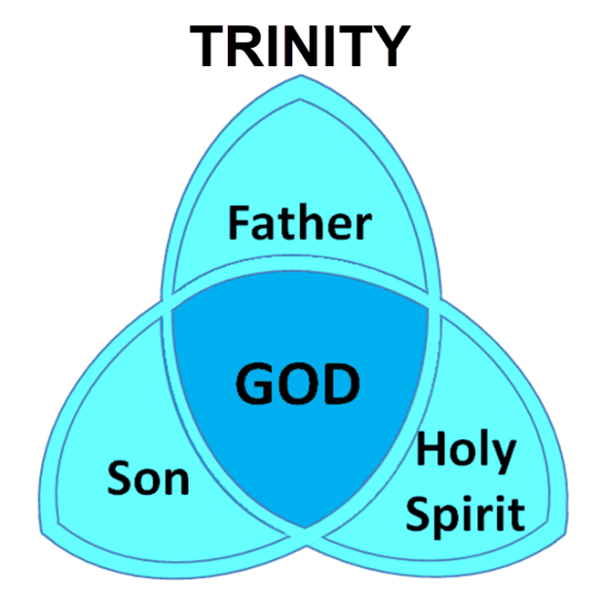

Slide 41
Revelation 20:7-10
“⁷ When the thousand years are completed, Satan will be released from his prison, ⁸ and will come out to deceive the nations which are in the four corners of the earth, Gog and Magog, to gather them together for the war; the number of them is like the sand of the seashore. ⁹ And they came up on the broad plain of the earth and surrounded the camp of the saints and the beloved city, and fire came down from. . .

Slide 42
Revelation 20:7-10
. . . heaven and devoured them. 10 And the devil who deceived them was thrown into the lake of fire and brimstone, where the beast and the false prophet are also; and they will be tormented day and night forever and ever.”

Slide 43
Conclusion

Slide 44
End of the Tribulation Period Revelation 19:7-21
The Marriage Supper of the Lamb (7-9)
John Responds to the Revelation (10)
The Second Advent (11-16)
The Supper of God (17-18)
Christ Defeats: Beast’s Armies & False Prophet (19-21)

Slide 45
“The Lord bless you and keep you; the Lord make his face shine on you and be gracious to you; the Lord turn his face toward you and give you peace.” (NIV)

