Slide 1
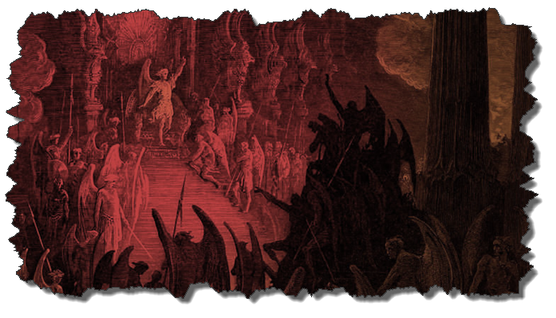
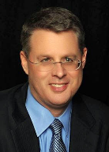
DEMONOLOGY
Dr. Andy Woods
Senior Pastor – Sugar Land Bible Church
President – Chafer Theological Seminary

Slide 2
Preview of Angelology
Good angels
Satanology
Demonology
Gen. 6:1-4 controversy

Slide 3
Overview
Existence Origin Personhood Characteristics | Powers Works Demon possession Defense

Slide 4
Overview
Existence Origin Personhood Characteristics | Powers Works Demon possession Defense

Slide 5
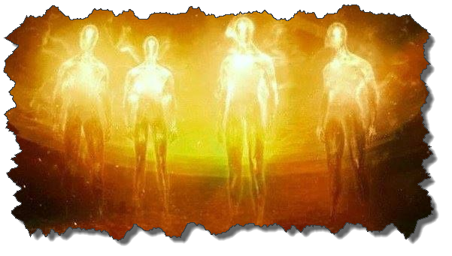
Existence
OT
Deut 32:17
Ps 106:37
NT
Over 100x
All NT writers (except Hebrews)
Christ (Matt 8:29; 10:1; 12:43-45)

Slide 6
Overview
Existence Origin Personhood Characteristics | Powers Works Demon possession Defense

Slide 7
Origin
 | Demons | Fallen Angels
Satan is leader | Matt 12:24 | Matt 25:41; Rev 12:7-9
Spirit beings | Matt 8:16 | Heb 1:14
Capacity to enter people | Matt 12:22; Luke 11:14-15 | John 13:27

Slide 8
Origin
Two classes
Free (Eph 6:12)
Confined (1 Pet 3:19-20; 2 Pet 2:4; Jude 6; Rev. 9:1-12)
No plan of salvation
Confirmed in wickedness
Matt 8:29; 25:41; Jas 2:19

Slide 9
Overview
Existence Origin Personhood Characteristics | Powers Works Demon possession Defense

Slide 10
Personhood
Attributes of personhood
Intellect – Acts 19:15
Emotions – Luke 8:28; Jas 2:19
Will – Luke 8:32
Personal pronouns – Mark 1:24-25

Slide 11
Overview
Existence Origin Personhood Characteristics | Powers Works Demon possession Defense

Slide 12
Characteristics
Spirits-Matt 8:16; Eph 6:12
Corrupt
Unclean – Matt 10:1
Evil – Luke 7:21
Rulers of darkness in spiritual wickedness – Eph 6:12
Degrees of wickedness – Matt 12:45

Slide 13
Characteristics (cont’d)
Manifestation
Invisible
Prophetic events = ugly/hideous (Rev 9:7-10; 16:13-16)

Slide 14
Overview
Existence Origin Personhood Characteristics | Powers Works Demon possession Defense

Slide 15
Powers
Great strength (Mark 5:3-4; Acts 19:16) but not omnipotent (Dan 10:13)
Superhuman intelligence (2 Sam. 14:20; Luke 8:28; 20:35-36) but not omniscient (Acts 19:15)
Not confined by physical space or barriers (Mark 5:9) but not omnipresent (Mark 5:12)

Slide 16
Satanic/Demonic Miracles
Exod. 7–8
Deut. 13:1-3
Job 1:12-19; 2:7-8
1 Sam. 28?
Matt. 7:21-23; 24:24
Acts 8:9; 16:16
Gal. 1:6-9
2 Thess. 2:9
Rev. 13:3, 13, 15; 16:13-14

Slide 17
Overview
Existence Origin Personhood Characteristics | Powers Works Demon possession Defense

Slide 18
Works
General
Satan’s lack of omnipresence (Job 1:7; 2:2) forces him to work through demons (Matt 12:24; 25:41; Rev 12:7; 2 Cor 12:7)
Work in harmony with one another (Eph 6:11-12)
Influence human government (Dan 10:13, 20)
Promote false religion (1 Cor 10:20; 1 Tim 4:1)

Slide 19
Works (cont’d)
General
Afflict the mind (Mark 5:3, 5)
Afflict the body (Matt 12:22; Mark 9:22; Luke 13:11, 16)
Hinder believers’ prayers (Dan 10:12-20)

Slide 20
Not all Physical Infirmities are Attributable to Satan/Demon (works cont’d)
Matt 8:5-13
Matt 9:19-20, 27-30
Matt 12:9-14
Matt 14:35-36

Slide 21
Romans 8:19-23
¹⁹ For the anxious longing of the creation waits eagerly for the revealing of the sons of God. ²⁰ For the creation was subjected to futility, not willingly, but because of Him who subjected it, in hope ²¹ that the creation itself also will be set free from its slavery to corruption into the freedom of the glory of the children of God. ²² For we know that the whole creation groans and suffers the pains of childbirth . . .

Slide 22
Romans 8:19-23 (cont’d)
. . .together until now. ²³ And not only this, but also we ourselves, having the first fruits of the Spirit, even we ourselves groan within ourselves, waiting eagerly for our adoption as sons, the redemption of our body.

Slide 23
Occult Works
NAME | DEFINITION | SCRIPTURE
Divination | Fortune telling | Deut 18:10; Acts 16:16
Spiritism | Contacting the dead | Deut 18:11
Magic | Performance of miraculous powers | Deut 18:11
Pharamkeia | Illicit drug use | Rev 9:20-21; 18:2, 23

Slide 24
Revelation 9:20-21
“The rest of mankind, who were not killed by these plagues, did not repent of the works of their hands, so as not to worship demons, and the idols of gold and of silver and of brass and of stone and of wood, which can neither see nor hear nor walk; ²¹ and they did not repent of their murders nor of their sorceries (pharmakeia) nor of their immorality nor of their thefts.”

Slide 25
OT Descriptions of Babylon in Rev 17–18
 | Revelation 17–18 | Old Testament
Waters | 17:1 | Psalm 137:1
Babylon the Great | 17:5 | Daniel 4:30
Mother harlots | 17:5 | Genesis 11:1-9
Fallen, fallen is Babylon | 18:2 | Isaiah 21:9
Will not see widowhood | 18:7 | Isaiah 47:7-9
Colorful attire | 17:4; 18:16 | Daniel 5:7, 16, 29
Sorcery | 18:23 | 1saiah 47:9-13
Destroyed in a day | 18:8, 10 | Daniel 5:30

Slide 26
Acts 19:19
“And many of those who practiced magic brought their books together and began burning them in the sight of everyone; and they counted up the price of them and found it fifty thousand pieces of silver.”

Slide 27
Charles Ryrie
The Ryrie Study Bible
“19:19 Magic. Magical spells written on scrolls. Fifty thousand pieces of silver. If the silver drachma is meant, the value would have been the equivalent of about 138 years’ pay for a rural worker.”

Slide 28
Dangerous Influences on our Children & Youth Dr. Christine J. Tan (May 21, 2017)
Sue Bohlin (PROBE.org) – on Harry Potter
https://www.probe.org/harry-potter/
Sue Bohlin (PROBE.org) – on Twilight
https://www.probe.org/the-darkness-of-twilight
Matt Slick (CARM) – on Pokemon
https://carm.org/what-is-pokemon
Patrick Zukeran (EvidenceAndAnswers.org) – on Worldview of Star Wars
http://evidenceandanswers.org/article/worldvie w-star-wars/

Slide 29
Dangerous Influences on our Children & Youth Dr. Christine J. Tan (May 21, 2017)
Kerby Anderson (PROBE.org) – on High Tech Witchcraft
https://www.probe.org/high-tech-witchcraft/
Patrick Zukeran (EvidenceAndAnswers.org) – on the Occult
http://evidenceandanswers.org/article/the-world-of-the-occult/
Michael Gleghorn (PROBE.org) – on Yoga and Christianity
https://www.probe.org/yoga-and-christianity-are-they-compatible/
Michael Gleghorn (PROBE.org) – OK for Christian to do yoga?
https://www.probe.org/is-it-ok-for-a-christian-to-practice-yoga/

Slide 30
Dangerous Influences on our Children & Youth Dr. Christine J. Tan (May 21, 2017)
Patrick Zukeran (EvidenceAndAnswers.org) – on Yoga
http://evidenceandanswers.org/podcast/episode-280-yoga-great-exercise-or-dangerous-worship/
Michael Gleghorn (PROBE.org) – on Hypnosis
https://www.probe.org/is-hypnosis-ok-or-a-problem/
Oropeza (Christian Research Institute) – on some Martial Arts
http://www.equip.org/articles/should-a-christian-practice-the-martial-arts/

Slide 31
CONCLUSION

Slide 32
Overview
Existence Origin Personhood Characteristics | Powers Works Demon possession Defense

