Slide 1


Slide 2

Kingdom Study Outline
What does the Bible Says About the Kingdom?
Why do some believe that we are in the kingdom now?
Why does it matter?

Slide 3

9 Ways Kingdom Now Theology
Impacts the Church
Loss of “pilgrim” status
Social Gospel
Ecumenical & interfaith alliances
Rejection or marginalization of Bible prophecy
Building the wrong kingdom
Charismatic theology
Prosperity Gospel
Anti-Israelism
Lordship Salvation

Slide 4
9 Ways Kingdom Now Theology
Impacts the Church
Loss of “pilgrim” status
Social Gospel
Ecumenical & interfaith alliances
Rejection or marginalization of Bible prophecy
Building the wrong kingdom
Charismatic theology
Prosperity Gospel
Anti-Israelism
Lordship Salvation

Slide 5


Slide 6
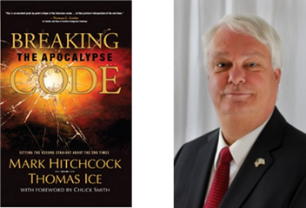
Mark Hitchcock and Thomas Ice
Breaking the Apocalypse Code (Costa Mesa, CA: Word for Today, 2007), 136-37.
"Every Old Testament prophet, except Jonah, speaks of a permanent return to the Land of Israel by the Jews."

Slide 7
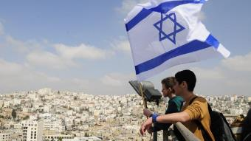
Reliability of the “Divine Regathering” Predictions
 | RETURN | PREDICTED | FULFILLED
1st | From Egypt to Canaan | Gen. 15:13-14 | Joshua 1‒12
2nd | From Babylon to Israel | Jer. 25:11; 29:10 | Ezra & Nehemiah
3rd | From the Diaspora to Israel’s restoration | Ezekiel 36:24-28 | Millennial Kingdom

Slide 8

Alva J. McClain
Alva J. McClain, The Greatness of the Kingdom: An Inductive Study of the Kingdom of God as Set Forth in the Scriptures (Grand Rapids: Zondervan, 1959), 438.
“The confusion of our . . . Lord’s rule . . . leads to serious consequences. . . . [I]t makes the present age the period of the Mediatorial Kingdom. . . . [I]t dissolves the divinely covenanted purpose in the nation of Israel.”

Slide 9

Gary DeMar
Gary DeMar and Gary North quotes, can be found in H. Wayne House and Thomas Ice, Dominion Theology: Blessing or Curse? (Portland, OR: Multnomah, 1988), 409–11.
“God has not called us to forsake the earth, but to impress heaven’s pattern on earth.” He similarly notes, “Christians must be obedient to the mandate God has given to extend His kingdom to every sphere of life, to every corner of the globe (Gen. 1:26–28; Matt. 28:18–20).”

Slide 10
Gary DeMar
End Times Fiction: A Biblical Consideration of the Left Behind Theology (Nashville, TN: Nelson, 2001), 203.
“Where is this ‘super sign’ found in the Bible? Not in the New Testament. There is not a single verse in the entire New Testament that says anything about Israel becoming a nation again. Nothing prophetic in the New Testament depends on Israel becoming a nation again. If Israel becoming a nation again is such ‘a significant sign,’ then why doesn't the New Testament specifically mention it?”

Slide 11
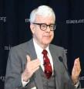
Gary North
Gary DeMar and Gary North quotes, can be found in H. Wayne House and Thomas Ice, Dominion Theology: Blessing or Curse? (Portland, OR: Multnomah, 1988), 409–11.
“The goal of establishing Christ’s international kingdom can be presented to citizens of any nation.”…“Christians are required to become active in the building God’s visible kingdom.”…“If the Christian church fails to build the visible kingdom by means of biblical law and the power of the gospel, despite the resurrection of Christ and the presence of the Holy Spirit, then what kind of religion are we preaching?”…“The parable (Matt. 13:24–30, 36–43) refers to the building of the kingdom of God, not simply to the institutional church.”

Slide 12

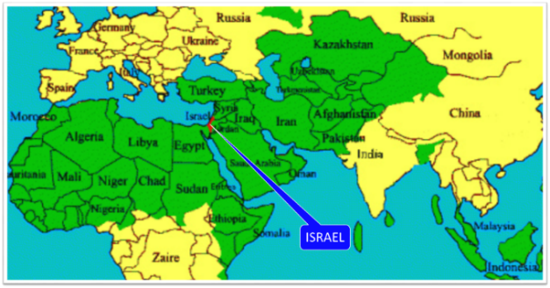
Thomas Ice
Personal letter from Gary North to Peter Lalonde, April 30, 1987 on file; cited in Thomas Ice, “Answering Those Who Oppose Israel,” 1, accessed October 21, 2015, http://www.pre-trib.org.
Thomas Ice reports, “Gary North has boasted that he has a book already in his computer for when ‘Israel gets pushed into the sea or converted to Christ.’”

Slide 13
Reformed Theology’s Denial of the Church as an Intercalation
“We’re not dispensationalists here....We believe that the church is essentially Israel. We believe that the answer to, ‘What about the Jews?’ is, ‘Here we are.’ We deny that the church is God’s ‘plan B.’ We deny that we are living in God’s redemptive parenthesis. There, we are again one people. In His holy and heavenly temple there is neither Jew nor Greek, male nor female, pre-mil nor post-mil. There, we are all together, the Israel of God, princes with God, and the ekklesia, the set apart ones.”
From Table Talk magazine, Spring of 1999, p. 2 (inside cover), by R. C. Sproul Jr., editor, emphasis is mine

Slide 14

“The story of the church begins with Israel, the Old Testament people of God…The identity of the church is necessary for the mission of the church. Only as a holy nation, called out of the darkness into the light of God‘s presence, can the church discharge it’s mission…Peter affirms that the church’s right to the titles of Israel, then describes the church’s witness of praise (1 Peter 2:9–10)...This understanding of the church as the new and true Israel of Christ must inspire our mission in the contemporary world.”
Edmund P. Clowney
Edmund P. Clowney, The Church, ed. Gerald Bray, Contours of Christian Theology (Downers Grove, ILL: InterVarsity Press, 1995), 28, 162-63.

Slide 15
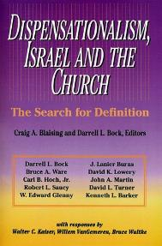
David L. Turner
“The New Jerusalem in Revelation 21:1-22:5; Consummation of a Biblical Continuum,” Dispensationalism, Israel, and the Church, ed., Craig A. Blaising and Darrell L. Bock (Grand Rapids: Zondervan, 1992), 288.
“It is clear that all the above are connected with the number twelve (cf. Rev. 7:5-8; 12:1, 12). This number is perhaps the most familiar number of the Bible, most frequently associated with the sons of Jacob, the twelve tribes of Israel, and the twelve apostles of the ‘new Israel,’ the church.”

Slide 16
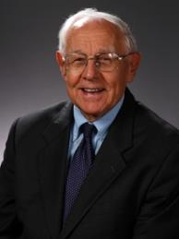
Stanley D. Toussaint
“Israel and the Church of a Traditional Dispensationalist,” in Three Central Issues in Contemporary Dispensationalism, ed. Herbert W. Bateman (Grand Rapids: Kregel, 1999), 259.
Of this designation, normative dispensationalist Stanley Toussaint appropriately comments, “This is precariously close to replacement theology.”

Slide 17

Romans 11:12-15
¹² “Now if their transgression is riches for the world and their failure is riches for the Gentiles, how much more will their fulfillment be! ¹³ But I am speaking to you who are Gentiles. Inasmuch then as I am an apostle of Gentiles, I magnify my ministry, ¹⁴ if somehow I might move to jealousy my fellow countrymen and save some of them. ¹⁵ For if their rejection is the reconciliation of the world, what will their acceptance be but life from the dead?”

Slide 18

Matthew 23:37-39
“Jerusalem, Jerusalem, who kills the prophets and stones those who are sent to her! How often I wanted to gather your children together, the way a hen gathers her chicks under her wings, and you were unwilling. ³⁸ Behold, your house is being left to you desolate! ³⁹ For I say to you, from now on you will not see Me until you say, ‘Blessed is He who comes in the name of the Lord!’”

Slide 19
Isaiah 2:2-3
“Now it will come about that In the last days The mountain of the house of the Lord Will be established as the chief of the mountains, And will be raised above the hills; And all the nations will stream to it.³ And many peoples will come and say, ‘Come, let us go up to the mountain of the Lord, To the house of the God of Jacob; That He may teach us concerning His ways And that we may walk in His paths.’ For the law will go forth from Zion And the word of the Lord from Jerusalem.”

Slide 20

Zechariah 14:16-18
“Then it will come about that any who are left of all the nations that went against Jerusalem will go up from year to year to worship the King, the Lord of hosts, and to celebrate the Feast of Booths. ¹⁷ And it will be that whichever of the families of the earth does not go up to Jerusalem to worship the King, the Lord of hosts, there will be no rain on them. ¹⁸ If the family of Egypt does not go up or enter, then no rain will fall on them; it will be the plague with which the Lord smites the nations who do not go up to celebrate the Feast of Booths.”

Slide 21

Robert Thomas
Four Views on the Book of Revelation, page 207.
“At the end of the Millennium that city will be Satan’s prime objective with his rebel army, because Israel will be a leader among the nations.”

Slide 22

John Walvoord
Israel in Prophecy, Page 26
“Of the many peculiar phenomena which characterize the present generation, few events can claim equal significance as far as Biblical prophecy is concerned with that of the return of Israel to their land. It constitutes a preparation for the end of the age, the setting for the coming of the Lord for His church, and the fulfillment of Israel’s prophetic destiny.”

Slide 23
Israel’s Two Regatherings
THE PRESENT (FIRST) REGATHERING | THE PERMANENT (SECOND) REGATHERING
Return to part of the land | Return to all the land
Return in unbelief | Return in faith
Restored to the land only | Restored to the land and the Lord
Sets the stage for Tribulation (discipline) | Sets the stage for Millennium (blessing)
Adapted from: Price, Jerusalem In Prophecy, 219

Slide 24
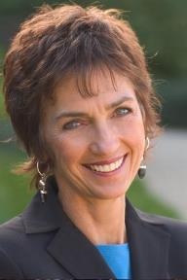
Lynne Hybels
Lynne Hybels, cited in Paul R. Wilkinson, Israel Betrayed: Volume 2: The Rise of Christian Palestinianism (San Antonio, TX: Ariel, 2018), 155.
“It is true: I am not a Christian Zionist…I do not hold to a theology asserting that the modern state of Israel represents a divinely mandated return of ancient Israel to the Promised Land… At the same time, I wholeheartedly support justice for the Palestinians.”

Slide 25

Tony Campolo
Tony Campolo, cited in Paul R. Wilkinson, Israel Betrayed: Volume 2: The Rise of Christian Palestinianism (San Antonio, TX: Ariel, 2018), 140.
“…a little nation that has survived primarily because of the wealth and the war materials supplied by the U.S. government.”

Slide 26
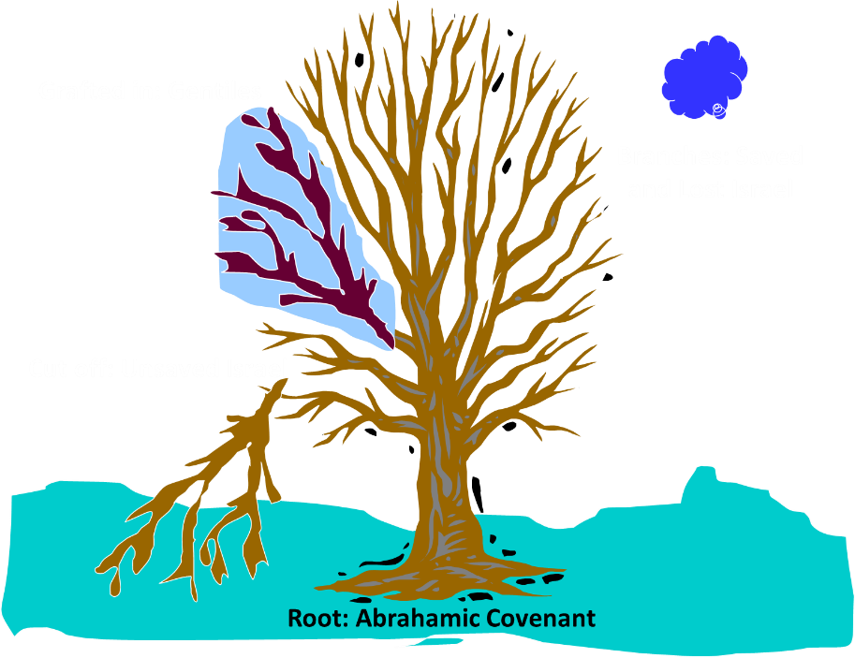
Notes:
26

Slide 27
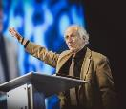
John Piper
John Piper, cited in Paul R. Wilkinson, Israel Betrayed: Volume 2: The Rise of Christian Palestinianism (San Antonio, TX: Ariel, 2018), 331-32.
“[God] has a saving purpose for Israel. All Israel will someday turn to the Lord Christ as a group. This is my deep understanding in belief of Romans 11. The broken off branches will be grafted in one day to the people of God, the bride of Christ, His church.”

Slide 28

Paul Wilkinson
Paul R. Wilkinson, Israel Betrayed: Volume 2: The Rise of Christian Palestinianism (San Antonio, TX: Ariel, 2018), 332.
“On the basis of this kind of statement, many in the church are being misled into believing that Piper stands with Israel, but he does not. What Piper said is not what Paul taught. Israel’s destiny as a nation is not one of spiritual incorporation into the church, which is the classic Reformed, Calvinistic teaching. The church comprises individual Jews and Gentiles, not ‘Israel,’ which is a distinct national entity. The appointed destiny for Israel is for her to remain a nation in the sight of God and in the midst of all the nations, for as long as God’s ‘fixed order’ of creation endures (Jer. 31:36).”

Slide 29
Jeremiah 31:35-37
“Thus says the Lord, Who gives the sun for light by day And the fixed order of the moon and the stars for light by night, Who stirs up the sea so that its waves roar; The Lord of hosts is His name:³⁶ “If this fixed order departs From before Me,” declares the Lord, “Then the offspring of Israel also will cease From being a nation before Me forever.”³⁷ Thus says the Lord, “If the heavens above can be measured And the foundations of the earth searched out below, Then I will also cast off all the offspring of Israel For all that they have done,” declares the Lord.”

Slide 30

  “First, their synagogues should be set on fire…Secondly, their homes should likewise be broken down and destroyed…Thirdly, they should be deprived of their prayer books and Talmuds…”

Slide 31
  “…Fourthly, their rabbis must be forbidden under threat of death to teach any more…Fifthly, passport and traveling privileges should be absolutely forbidden to the Jews…Sixthly, they ought to be stopped from usury (charging interest on loans…”

Slide 32
  “Seventhly, let the young and strong Jews and Jewesses be given the flail, the ax, the hoe, the spade, the distaff, and spindle, and let the earn their bread by the sweat of their noses…We ought to drive the rascally lazy bones out of our system...”
Martin Luther, Concerning the Jews and Their Lies, cited in Michael Brown’s Our Hands Are Stained with Blood, pp. 14-15.

Slide 33
  “…Therefore away with them… To sum up, dear princes and nobles who have Jews in your domains, if this advice of mine does not suit you, then find a better one so that you and we may all be free of this insufferable devilish burden–the Jews.”
Martin Luther, Concerning the Jews and Their Lies, cited in Michael Brown’s Our Hands Are Stained with Blood, pp. 14-15.

Slide 34
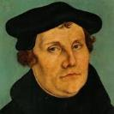
The Encyclopaedia Judaica says “Short of the Auschwitz oven and the extermination, the whole Nazi holocaust is pre-outlined here.”
Martin Luther
“Luther, Martin,” in Encyclopaedia Judaica, Vol. 8, 693.

Slide 35

Martin Luther
Rabbi Joseph Telushkin, "Martin Luther and the Protestant Reformation" in Jewish Literacy--The Most Important Things to Know About the Jewish Religion, Its People and Its History, [William Morrow and Company, NY, 1991], pages 204-206.
Telushkin likens Luther to Mohammed, because both men initially had a love for the Jews but later turned in hate against the Jews when the Jews would not convert. Here are some of Rabbi Telushkin's shocking quotes:
“[Luther] was to pen the most anti-Semitic writings produced in Germany until the time of Hitler.”
“On one occasion, this earlier exponent of Christian love said: ‘I would threaten to cut their tongues out from their throats, if they refuse to acknowledge the truth that God is a trinity and not a plain unity.’”

Slide 36
Martin Luther
Rabbi Joseph Telushkin, "Martin Luther and the Protestant Reformation" in Jewish Literacy--The Most Important Things to Know About the Jewish Religion, Its People and Its History, [William Morrow and Company, NY, 1991], pages 204-206.
“At the Nuremberg trials, Nazi propagandist Julius Streicher defended himself with the claim that he had not said anything worse about the Jews than had Martin Luther.”
“Hitler proudly claimed Luther as an ally: ‘He saw the Jew as we are only beginning to see him today.’”

Slide 37

  “But here he [the rabbi] not only betrays his ignorance, but his utter stupidity, since God so blinded the whole people that they were like restive dogs. I have had much conversation with many Jews: I have never seen either a drop of piety or a grain of truth or ingenuousness—nay, I have never found common sense in any Jew. But this fellow, who seems so sharp and ingenious, displays his own impudence to his great disgrace.”
John Calvin
Commentary on the Prophet Daniel (Vol 1, p. 185). Bellingham, WA: Logos Bible Software. Commentary on Daniel 2:44-45. (2010).

Slide 38

Rick Wiles
“Jan Markell on the Mockery of Bible Prophecy,” online: http://christinprophecy.org/sermons/jan-markell-on-the-mockery-of-bible-prophecy/, October 14 2018, accessed 19 November 2018.
Rick Wiles: The secret Pre-Trib Rapture story and Christian Zionism that is a two headed–
Doc Burkhart: Monster.
Rick Wiles: –monster. It is a two headed freak monster. Okay. They come together, both of them come together because they were started by the same people. The Christian Zionists started the Pre-Trib Rapture doctrine.
Doc Burkhart: And this was seed planted decades ago, but it came into full fruit in within the last 30 years.

Slide 39
Rick Wiles
“Jan Markell on the Mockery of Bible Prophecy,” online: http://christinprophecy.org/sermons/jan-markell-on-the-mockery-of-bible-prophecy/, October 14 2018, accessed 19 November 2018.
Rick Wiles: That’s right. They had to create the Pre-Trib Rapture doctrine to justify Christian Zionism. That’s where it all came from. But isn’t it interesting that in the recent decades where the American Evangelical Church has been taken over by Christian Zionism, that the American Evangelical Church has lost its flavor.
Doc Burkhart: Yes.

Slide 40
Rick Wiles
“Jan Markell on the Mockery of Bible Prophecy,” online: http://christinprophecy.org/sermons/jan-markell-on-the-mockery-of-bible-prophecy/, October 14 2018, accessed 19 November 2018.
Rick Wiles: They are strong words, and I mean it. They took control of the churches in America, the Christian Zionist. They changed the Gospel. They took Jesus off the cross. They replaced the cross with the Star of David. They took the focus off God, and holiness. They put it all on a piece of land in the Middle East. And America has gone to hell. America has gone to hell. We’ve become a pagan, heathen nation because the Christian Zionists have taken our eyes off Jesus.

Slide 41


Slide 42
9 Ways Kingdom Now Theology
Impacts the Church
Loss of “pilgrim” status
Social Gospel
Ecumenical & interfaith alliances
Rejection or marginalization of Bible prophecy
Building the wrong kingdom
Charismatic theology
Prosperity Gospel
Anti-Israelism
Lordship Salvation

Slide 43


Lordship Salvation Defined
“Lordship Salvation refers to the belief which says the sinner who wants to be saved must not only trust Christ as his substitute for sin, but must also surrender every area of his life to the complete control of Christ.”
Lightner, Sin, the Savior, and Salvation, 202

Slide 44

John MacArthur
Faith Works, p. 25
“Jesus is Lord of all, and the faith He demands involves unconditional surrender…He does not bestow eternal life on those whose hearts remain set against Him.”

Slide 45

Lordship Salvation: 7 Problems
Changes the gospel
Places an impossible burden upon the unsaved
Confuses justification with sanctification
Confuses the result of with requirement for salvation
Fails to make basic dispensational distinctions
Ignores the reality of a carnal Christian
Destroys the assurance of salvation

Slide 46
Lordship Salvation: 7 Problems
Changes the gospel
Places an impossible burden upon the unsaved
Confuses justification with sanctification
Confuses the result of with requirement for salvation
Fails to make basic dispensational distinctions
Ignores the reality of a carnal Christian
Destroys the assurance of salvation

Slide 47
Dispensational Theology is a
System of Theology
Traditional-normative dispensational theology is a system that embodies three essential, fundamental concepts called the sine qua non (lit. “without which is not”):
The consistent use of a plain, normal, literal, grammatical-historical method of interpretation;
Which reveals that the Church is distinct from Israel;
God’s overall purpose is to bring glory to Himself (Eph. 1:6, 12, 14).
Dr. Charles Ryrie, Dispensationalism, pp. 38-41

Slide 48


Slide 49

1 Corinthians 3:1-3 (NKJV)
¹ And I, brethren, could not speak to you as to spiritual people but as to carnal, as to babes in Christ. ² I fed you with milk and not with solid food; for until now you were not able to receive it, and even now you are still not able; ³ for you are still carnal. For where there are envy, strife, and divisions among you, are you not carnal and behaving like mere men?

Slide 50
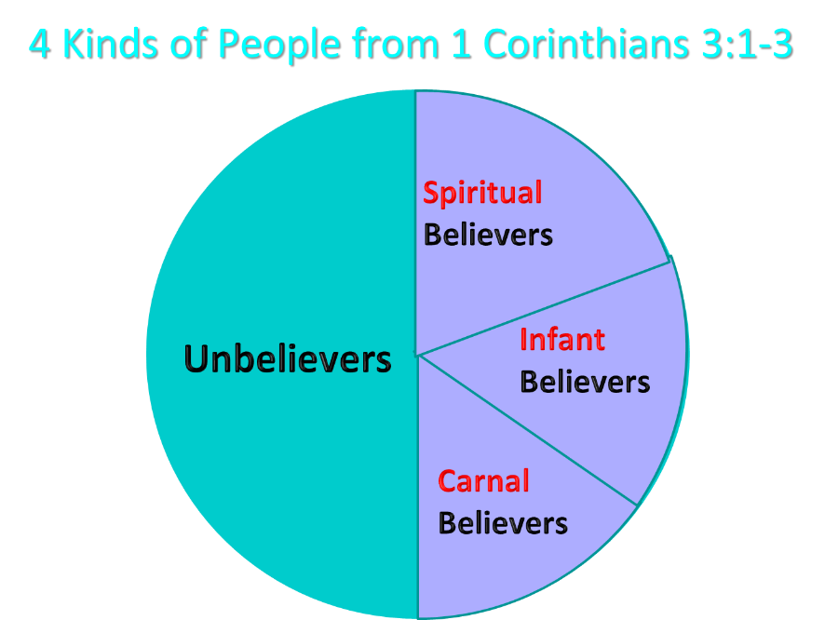
Notes:
Ray Steadman – “1st Californians”
Unbelievers vs Categories of Believers
Unbelievers – ψυχικός psuchikós; Natural, pertaining to the natural as distinguished from the spiritual
Spiritual Believers – πνευματικός pneumatikós; of persons who are spiritual, enlightened by the Holy Spirit
Infant Believers – σάρκινος sárkinos; with propensities of the flesh unto sin; νήπιος nḗpios; an infant, child, baby without any definite limitation of age. (This relates to immaturity and lack of instruction)
Carnal Believers – σαρκικός sarkikós; tendency to satisfy the flesh, implying sinfulness, sinful propensity, carnal (This relates to disobedience and open rebellion)

Slide 51

  “Regrettably, some published materials written by DTS faculty members confirm my earlier concern. First there was Dr. Darrell Bock’s review of MacArthur’s The Gospel According to Jesus which showed significant confusion on the subject of assurance (see Bib Sac, Jan–Mar, 1989, pp. 21–40; see my review in the GES Journal, Spring 1989, pp. 79–83 and especially pp. 81–83). Darrell has told me both in person and in writing that his position is “soft lordship” salvation—a view that would have been rejected by the founder and first president of Dallas Seminary, Dr. Lewis Sperry Chafer.”
Zane Hodges
Zane C. Hodges, “Assurance and Works: An Evangelical Trainwreck,” Grace in Focus (March‒April 1994), accessed April 1, 2016, http://www.faithalone.org.

Slide 52
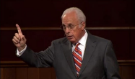
John MacArthur
John MacArthur Jr. writes:
“There is a tendency, however, for dispensationalists to get carried away with compartmentalizing truth to the point that they make unbiblical differentiations. An almost obsessive desire to categorize and contrast related truths has carried various dispensationalist interpreters [Chafer, Ryrie, Hodges, etc.] far beyond the legitimate distinctions between Israel and the Church. Many would also draw hard lines between salvation and discipleship [justification and sanctification], the church and the kingdom, Christ's preaching and the apostolic message, faith and repentance, and the age of law and the age of grace." (bold & emphasis mine) “The Gospel According to Jesus,” page 31

Slide 53

John MacArthur
“Unfortunately, traditional dispensationalism tends to miss that simple point. Some dispensationalists teach that ‘the gospel of the kingdom’ Jesus proclaimed (Matt. 4: 23) is distinct from ‘the gospel of the grace of God.’ The substance of this ‘gospel of the kingdom,’ one popular source says, is ‘that God purposes to set up on earth the kingdom of Christ . . . in fulfillment of the Davidic Covenant.’ Lewis Sperry Chafer wrote that the gospel of the kingdom was for the nation of Israel only ‘and should in no wise be confused with the gospel of saving grace.’”

Slide 54
John MacArthur
“Another early dispensationalist writer declared that the gospel Jesus preached had nothing to do with salvation but was simply an announcement that the time had come to set up the kingdom of Christ on earth. That may fit neatly into a particular dispensational scheme, but Scripture does not support it. We must not forget that Jesus came to seek and to save the lost, not merely to announce an earthly kingdom. When Jesus proclaimed His kingdom, He was preaching salvation.” “The Gospel According to Jesus,” page 96

Slide 55
Messengers of the Kingdom In Matthew
John the Baptist – 3:2
Jesus Christ – 4:17
12 Apostles – 10:5-7
Seventy – Luke 10:1, 9
Toussaint, Behold the King, 18-20

Slide 56
Matthew 3:1-2
“Now in those days John the Baptist came, preaching in the wilderness of Judea, saying, ‘Repent, for the kingdom of heaven is at hand.”

Slide 57
Matthew 4:17
“From that time Jesus began to preach and say, ‘Repent, for the kingdom of heaven is at hand.’”

Slide 58
Matthew 10:5-7
“These twelve Jesus sent out after instructing them: “Do not go in the way of the Gentiles, and do not enter any city of the Samaritans; ⁶ but rather go to the lost sheep of the house of Israel. ⁷ And as you go, preach, saying, ‘The kingdom of heaven is at hand.’”

Slide 59
John MacArthur
“I was raised in a dispensational environment; there’s no question… But, as I got into seminary, I began to test some of those things. I have been perhaps aptly designated as a leaky dispensationalist….Here’s my dispensationalism – I’ll give it to you in one sentence: there’s a difference between the church and Israel – period!... At the same time in seminary, I began to be exposed to reading among more Reformed theologians… And over the years of exegeting the scripture, it has again yielded to me a Reformed theology….”

Slide 60
John MacArthur
“I was convinced of it (Reformed theology) when I started and I’m more convinced of it now as I’ve gone through the text. I was convinced of it when I started because I read so many noble men who have held that view (Reformed Theology). It was more at that point hero worship, and now it’s become my own.” (bold mine)
Transcribed from tape, #GC 70-15, entitled "Bible Questions and Answers." A copy of the tape can be obtained by writing, Word of Grace, P.O. Box 4000, Panorama City, CA 91412. Copyright 1994 by John MacArthur Jr., All Rights Reserved.
(My point here is only to demonstrate how John MacArthur, who claims to be a dispensationalist, has arrived at his position on Lordship salvation.)

Slide 61
John MacArthur
“When I wrote [GAJ] I didn’t know anybody outside of my circles really, and I didn’t know how this book would be received. But Jim Boice agreed to write the foreword, and John Piper wrote an endorsement that was absolutely stunning to me, because I was really not moving in Reformed circles at that time. I was a leaky dispensationalist. That was my world, and I realized that I was much more one of you than I was one of them.” Interview with John Piper and Justin Taylor, Stand, p. 129.

Slide 62
John MacArthur
“The lordship debate has had a devastating effect on dispensationalism. Because no-lordship theology [a pejorative term for Free Grace] is so closely associated with dispensationalism, many have imagined a cause-and-effect relationship between the two...Frankly, some mongrel species of dispensationalism [which he has defined as the Dispensationalism of Ryrie, Chafer, and others] ought to die, and I will be happy to join the cortege.” “The Gospel According to the Apostles,” page 221

Slide 63
John MacArthur
“Who are the defenders of no-lordship dispensationalism? Nearly all of them stand in a tradition that has its roots in the teaching of Lewis Sperry Chafer. I will show…that Dr. Chafer is the father of modern no-lordship teaching. Every prominent figure on the no-lordship side descends from Dr. Chafer’s spiritual lineage. Though Dr. Chafer did not invent or originate any of the key elements of no-lordship teaching, he codified the system of dispensationalism on which all contemporary no-lordship doctrine is founded. That system is the common link between those who attempt to defend no-lordship doctrine on theological grounds.” “The Gospel According to the Apostles,” page 35

Slide 64
Conclusion

Slide 65
9 Ways Kingdom Now Theology
Impacts the Church
Loss of “pilgrim” status
Social Gospel
Ecumenical & interfaith alliances
Rejection or marginalization of Bible prophecy
Building the wrong kingdom
Charismatic theology
Prosperity Gospel
Anti-Israelism
Lordship Salvation

