Slide 1


Dr. Andy Woods
Senior Pastor – Sugar Land Bible Church
President – Chafer Theological Seminary

Slide 2


Slide 3
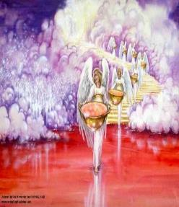
7. The Seventh Bowl
Revelation 16:17-21
7th angel pours out the bowl (17)
Lightning & thunder (18a)
Greatest earthquake (18b)
Jerusalem destroyed (19a)
Babylon destroyed (19b)
Every mountain & island moved (20)
100-pound hailstones (21a)
Man’s sinful reaction (21b)

Slide 4


Revelation 16:19
“The great city was split into three parts, and the cities of the nations fell. Babylon the great was remembered before God, to give her the cup of the wine of His fierce wrath.”

Slide 5


Revelation 17:1
“Then one of the seven angels who had the seven bowls came and spoke with me, saying, “Come here, I will show you the judgment of the great harlot who sits on many waters.”

Slide 6
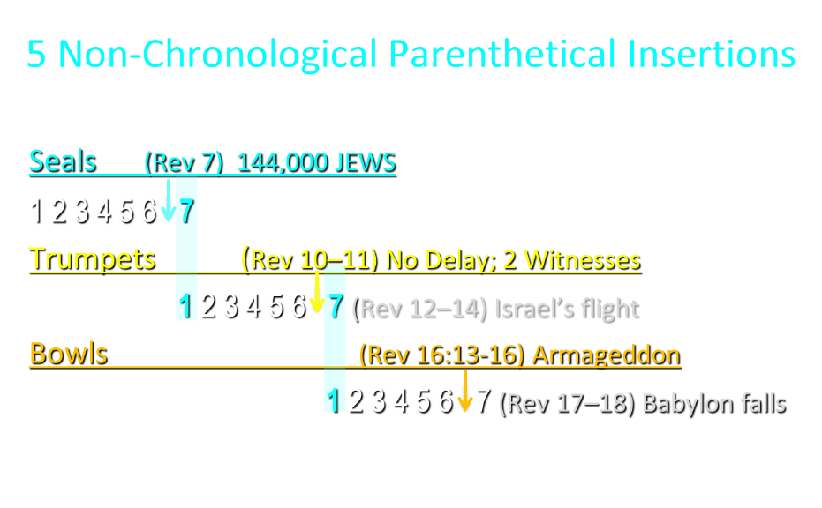

Slide 7
5 Non-Chronological Parenthetical Insertions
Rev 7 – 144,000 Jews
Rev 10:1-11:13 – Announcement of no more delay and the two witnesses
Rev 12-14 – Israel’s flight, two beasts, six scenes of hope
Rev 16:13-16 – Gathering of the nations to Armageddon
Rev 17:1-19:6 – Babylon’s fall

Slide 8
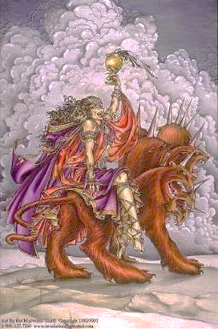
The Woman Rides the Beast
Revelation 17
The Vision Concerning Babylon (1-6a)
The Interpretation Concerning Babylon (6b-18)

Slide 9
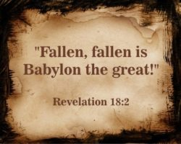
The Great City of Babylon
Revelation 18
The Prediction of Babylon’s Fall (18:1-3)
The Appeal to Separate From Babylon (18:4-8)
The Reactions to Babylon’s Fall (18:9-20)
The Description of Babylon’s Fall (18:21-24)

Slide 10
Heaven Celebrates Babylon’s Fall
Revelation 19:1-6
The Great Multitude (19:1-3)
The 24 Elders & the 4 Living Creatures (19:4)
The Voice from the Throne (19:5)
The Great Multitude (19:6)

Slide 11


Slide 12
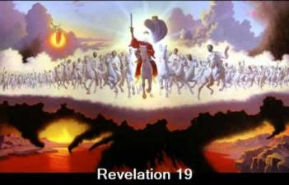
End of the Tribulation Period
Revelation 19:7-21
The Marriage Supper of the Lamb (7-9)
John Responds to the Revelation (10)
The Second Advent (11-16)
The Supper of God (17-18)
Christ Defeats: Beast’s Armies & False Prophet (19-21)

Slide 13
End of the Tribulation Period
Revelation 19:7-21
The Marriage Supper of the Lamb (7-9)
John Responds to the Revelation (10)
The Second Advent (11-16)
The Supper of God (17-18)
Christ Defeats: Beast’s Armies & False Prophet (19-21)

Slide 14

Completion of Two Important Themes
Revelation 19:7-9
The Bema Seat Judgment of Christ (8)
The Marriage Supper of the Lamb (9)

Slide 15
Completion of Two Important Themes
Revelation 19:7-9
The Bema Seat Judgment of Christ (8)
The Marriage Supper of the Lamb (9)

Slide 16


Slide 17
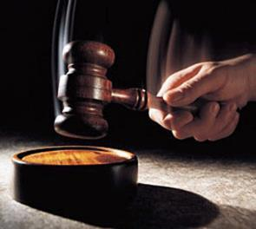
Why?
Not to judge sin (John 19:30)
Not to determine salvation (John 5:24)
But rather to give or not give rewards

Slide 18
Scripture’s Five Crowns (Rev 4:10: 3:11; 2 John 8)
SCRIPTURE | CROWN | PURPOSE
1 Cor. 9:24-27 | Incorruptible | Gaining mastery over the flesh
1 Thess. 2:19-20 | Rejoicing | Soul winning
Jas. 1:12; Rev. 2:10 | Life | Enduring trials
1 Pet. 5:2-4 | Glory | Shepherding God’s people
2 Tim. 4:8 | Righteousness | Longing for His appearing

Slide 19
Six Questions
When? After the Rapture
Where? In Heaven
Who? All Church Age Believers
Why? To Give or Not Give Rewards
What? Athletic Contest, Stewardship, Building
How? Individually, Stewards, Motive, Reliance Upon Grace
Outline adapted from Mark Hitchcock, The End: A Complete Overview of Bible Prophecy and the End of Days (Carol Stream, IL: Tyndale, 2012), 207-17.

Slide 20
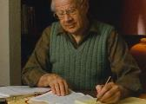
J. Dwight Pentecost
Thy kingdom Come, Page 220-21
“When the Lord returns to the earth with His bride to reign, the bride is seen to be already rewarded. This is observed in Revelation 19: 8, where it must be observed that the ‘righteousness of the saints’ is plural and can not refer to the imparted righteousness of Christ, which is the believer’s portion, but the righteousnesses which have survived examination and have become the basis of reward.”

Slide 21

Samuel Hoyt
“The Judgment Seat of Christ in Theological Perspective,” Part 2, Bibliotheca Sacra, electronic media.
“The judgment seat of Christ might be compared to a commencement ceremony. At graduation there is some measure of disappointment and remorse that one did not do better and work harder. However, at such an event the overwhelming emotion is joy, not remorse. The graduates do not leave the auditorium weeping because they did not earn better grades. Rather, they are thankful that they have been graduated, and they are grateful for what they did achieve. To overdo the sorrow aspect of the judgment seat of Christ is to make heaven hell. To under do the sorrow aspect is to make faithfulness inconsequential” (underlining mine).

Slide 22
Completion of Two Important Themes
Revelation 19:7-9
The Bema Seat Judgment of Christ (8)
The Marriage Supper of the Lamb (9)

Slide 23

Seven Beatitudes of Revelation:
“Blessed” (makarios)
Blessing upon the reader & heeder of Revelation (1:3)
Blessing upon the Tribulation martyrs (14:13)
Blessing upon the spiritually prepared (16:15)
Blessing upon the Marriage Supper invitees (19:9)
Blessing upon the First Resurrection’s participants (20:6)
Blessing upon the heeder of Revelation (22:7)
Blessing upon the eternal city’s citizens (22:14)
John F. Walvoord, "Revelation," in Bible Knowledge Commentary, ed. John F. Walvoord and Roy B. Zuck (Colorado Springs, CO: Victor, 1983), 929

Slide 24
Seven Beatitudes of Revelation:
“Blessed” (makarios)
Blessing upon the reader & heeder of Revelation (1:3)
Blessing upon the Tribulation martyrs (14:13)
Blessing upon the spiritually prepared (16:15)
Blessing upon the Marriage Supper invitees (19:9)
Blessing upon the First Resurrection’s participants (20:6)
Blessing upon the heeder of Revelation (22:7)
Blessing upon the eternal city’s citizens (22:14)
John F. Walvoord, "Revelation," in Bible Knowledge Commentary, ed. John F. Walvoord and Roy B. Zuck (Colorado Springs, CO: Victor, 1983), 929

Slide 25
Jewish Marriage Analogy
STEP | JEWISH MARRIAGE | CHURCH ANALOGY
1. Marriage covenant | Groom initiated; Covenant established upon payment for bride; drank same cup | Christ initiated; Christ’s sacrificial death (1 Cor. 6:19-20; 11:25)
2. Bride set apart | Bride set apart exclusively for groom | Church’s positionally sanctified (1 Cor. 1:2; 6:9-11)
3. Bridal chamber prepared | Groom separates from bride and returns to his father’s house to prepare bridal chamber | Christ’s 2000-year separation from church; Ascension; return to heaven to prepare dwellings (John 14:2; Acts 1:9-11)
Showers, Maranatha Our Lord, Come!, 164-69.

Slide 26
Jewish Marriage Analogy
STEP | JEWISH MARRIAGE | CHURCH ANALOGY
4. Betrothal period | Loyalty test | Reward determined by orthodoxy and orthopraxy (Jas. 4:4)
5. Bride retrieved | Groom returns at unknown time preceded by a shout with escorts to retrieve bride | Rapture at unknown time (John 14:3; 1 Thess. 4:16-17)
6. Bride and groom hidden in Father’s house for seven days | Hidden in the Father’s house for seven days: three events transpire | Church hidden from world during Daniel’s 70th Week
7. Bride cleansed | Bride undergoes ritual cleansing prior to wedding ceremony | Bema Seat Judgment (1 Cor 3:10-15; 2 Cor 5:10)
Showers, Maranatha Our Lord, Come!, 164-69.

Slide 27
Jewish Marriage Analogy
STEP | JEWISH MARRIAGE | CHURCH ANALOGY
8. Wedding ceremony | Meeting with the Father’s assembled wedding guests; Private wedding ceremony | Meeting with OT saints; Rev 19:7
9. Consummation | Bride and groom consummate the marriage | Eph 5:27
10. Marriage feast | Public presentation; Bride unveiled; marriage feast | Col 3:3-4; Rev 19:9
Showers, Maranatha Our Lord, Come!, 164-69.

Slide 28
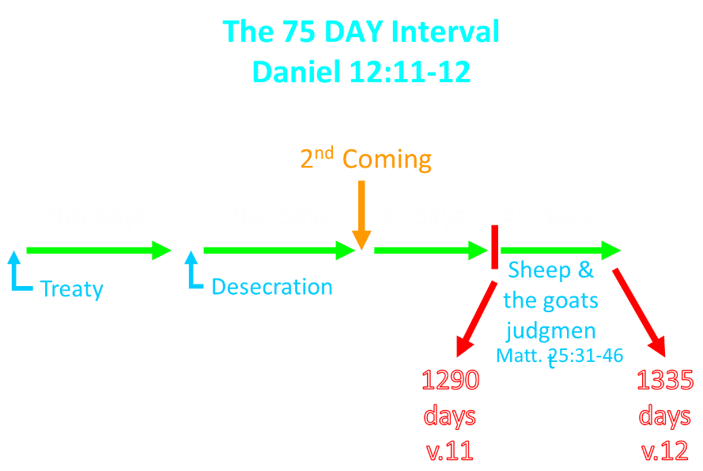

Slide 29
End of the Tribulation Period
Revelation 19:7-21
The Marriage Supper of the Lamb (7-9)
John Responds to the Revelation (10)
The Second Advent (11-16)
The Supper of God (17-18)
Christ Defeats: Beast’s Armies & False Prophet (19-21)

Slide 30

Method of Communication
From the Father
to Christ the Son
to an angel
to John
to a book
to a reader or preacher
to a listener or the seven churches

Slide 31
End of the Tribulation Period
Revelation 19:7-21
The Marriage Supper of the Lamb (7-9)
John Responds to the Revelation (10)
The Second Advent (11-16)
The Supper of God (17-18)
Christ Defeats: Beast’s Armies & False Prophet (19-21)

Slide 32
III. The Second Advent
Revelation 19:11-16
His Qualities (11-14)
His Activities (15-16)

Slide 33
III. The Second Advent
Revelation 19:11-16
His Qualities (11-14)
His Activities (15-16)

Slide 34

A. His Qualities
Revelation 19:11-14
His celestial origin (11a) His white horse (11b) His fidelity to His promises (11c) His righteous judgment (11d) His fiery eyes (12a) |  | His many crowns (12b) His unknown name (12c) His blood-soaked vesture (13a) His identification as the Word of God (13b) His following armies (14)

Slide 35
A. His Qualities
Revelation 19:11-14
His celestial origin (11a) His white horse (11b) His fidelity to His promises (11c) His righteous judgment (11d) His fiery eyes (12a) |  | His many crowns (12b) His unknown name (12c) His blood-soaked vesture (13a) His identification as the Word of God (13b) His following armies (14)

Slide 36


Revelation 3:21
PROMISE TO THE OVERCOMERS
“He who overcomes, I will grant to him to sit down with Me on My throne, as I also overcame and sat down with My Father on His throne.”

Slide 37

Christ’s Three Offices
Prophet – 1st Coming (Matt. 4:17)
Priest – Present Session (Heb. 4:15)
King – 2nd Coming (Isa. 9:6-7; Matt. 25:31)

Slide 38
Christ’s High Priestly Activities
in His Present Session
Sustains creation (Col. 1:16-17) Head over the Church (Eph. 1:22-23) Groom of the Church (Eph. 5:22-33) Building the Church (Matt. 16:18; Acts 2:41; 4:4) Bestowal of Spiritual Gifts (Eph. 4:7-12) Melchizedekian High Priestly role (Heb. 6:20) |  | Keeps the Saints (John 10:27-29; 1 Pet. 1:5) Intercedes for the Saints (Rom. 8:34; Heb. 7:25) Advocate for the Saints (Heb. 9:24; 1 John 2:1) Restores broken fellowship (1 John 1:9) Disciplines His children (Heb. 12:5-13)

Slide 39
Christ’s Three Offices
Prophet – 1st Coming (Matt. 4:17)
Priest – Present Session (Heb. 4:15)
King – 2nd Coming (Isa. 9:6-7; Matt. 25:31)

Slide 40
1 Thessalonians 4:13-18
¹³ "But we do not want you to be uninformed, brethren, about those who are asleep, so that you will not grieve as do the rest who have no hope. ¹⁴ For if we believe that Jesus died and rose again, even so God will bring with Him those who have fallen asleep in Jesus. ¹⁵ For this we say to you by the word of the Lord, that we who are alive and remain until the coming of the Lord, will not . . .

Slide 41
1 Thessalonians 4:13-18
…precede those who have fallen asleep. ¹⁶ For the Lord Himself will descend from heaven with a shout, with the voice of the archangel and with the trumpet of God, and the dead in Christ will rise first. ¹⁷ Then we who are alive and remain will be caught up together with them in the clouds to meet the Lord in the air, and so we shall always be with the Lord. ¹⁸ Therefore comfort one another with these words."

Slide 43
A. His Qualities
Revelation 19:11-14
His celestial origin (11a) His white horse (11b) His fidelity to His promises (11c) His righteous judgment (11d) His fiery eyes (12a) |  | His many crowns (12b) His unknown name (12c) His blood-soaked vesture (13a) His identification as the Word of God (13b) His following armies (14)

Slide 46
Isaiah 9:6-7
⁶ For a child will be born to us, a son will be given to us; And the government will rest on His shoulders; And His name will be called Wonderful Counselor, Mighty God, Eternal Father, Prince of Peace.⁷ There will be no end to the increase of His government or of peace, On the throne of David and over his kingdom, To establish it and to uphold it with justice and righteousness From then on and forevermore. The zeal of the Lord of hosts will accomplish this.

Slide 47
A. His Qualities
Revelation 19:11-14
His celestial origin (11a) His white horse (11b) His fidelity to His promises (11c) His righteous judgment (11d) His fiery eyes (12a) |  | His many crowns (12b) His unknown name (12c) His blood-soaked vesture (13a) His identification as the Word of God (13b) His following armies (14)

Slide 48
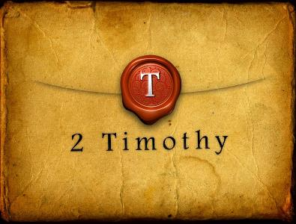
2 Timothy 2:13
“If we are faithless [without faith], He remains faithful, for He cannot deny Himself.”

Slide 49
A. His Qualities
Revelation 19:11-14
His celestial origin (11a) His white horse (11b) His fidelity to His promises (11c) His righteous judgment (11d) His fiery eyes (12a) |  | His many crowns (12b) His unknown name (12c) His blood-soaked vesture (13a) His identification as the Word of God (13b) His following armies (14)

Slide 50
A. His Qualities
Revelation 19:11-14
His celestial origin (11a) His white horse (11b) His fidelity to His promises (11c) His righteous judgment (11d) His fiery eyes (12a) |  | His many crowns (12b) His unknown name (12c) His blood-soaked vesture (13a) His identification as the Word of God (13b) His following armies (14)

Slide 51
A. His Qualities
Revelation 19:11-14
His celestial origin (11a) His white horse (11b) His fidelity to His promises (11c) His righteous judgment (11d) His fiery eyes (12a) |  | His many crowns (12b) His unknown name (12c) His blood-soaked vesture (13a) His identification as the Word of God (13b) His following armies (14)

Slide 52
A. His Qualities
Revelation 19:11-14
His celestial origin (11a) His white horse (11b) His fidelity to His promises (11c) His righteous judgment (11d) His fiery eyes (12a) |  | His many crowns (12b) His unknown name (12c) His blood-soaked vesture (13a) His identification as the Word of God (13b) His following armies (14)

Slide 53
A. His Qualities
Revelation 19:11-14
His celestial origin (11a) His white horse (11b) His fidelity to His promises (11c) His righteous judgment (11d) His fiery eyes (12a) |  | His many crowns (12b) His unknown name (12c) His blood-soaked vesture (13a) His identification as the Word of God (13b) His following armies (14)

Slide 54


Slide 55
A. His Qualities
Revelation 19:11-14
His celestial origin (11a) His white horse (11b) His fidelity to His promises (11c) His righteous judgment (11d) His fiery eyes (12a) |  | His many crowns (12b) His unknown name (12c) His blood-soaked vesture (13a) His identification as the Word of God (13b) His following armies (14)

Slide 56
A. His Qualities
Revelation 19:11-14
His celestial origin (11a) His white horse (11b) His fidelity to His promises (11c) His righteous judgment (11d) His fiery eyes (12a) |  | His many crowns (12b) His unknown name (12c) His blood-soaked vesture (13a) His identification as the Word of God (13b) His following armies (14)

Slide 57

Revelation 1:6
“and He has made us to be a kingdom, priests to His God and Father—to Him be the glory and the dominion forever and ever. Amen.”

Slide 58
Revelation 5:10
“You have made them to be a kingdom and priests to our God; and they will reign [basileuō] upon the earth [gē].”

Slide 59
III. The Second Advent
Revelation 19:11-16
His Qualities (11-14)
His Activities (15-16)

Slide 60
B. His Activities
Revelation 19:15-16
His spoken word (15a)
His smiting of the nations (15b)
His ruling of the nations (15c)
His treading of the winepress(15d)
His rulership as King (16)

Slide 61
B. His Activities
Revelation 19:15-16
His spoken word (15a)
His smiting of the nations (15b)
His ruling of the nations (15c)
His treading of the winepress (15d)
His rulership as King (16)

Slide 62
B. His Activities
Revelation 19:15-16
His spoken word (15a)
His smiting of the nations (15b)
His ruling of the nations (15c)
His treading of the winepress (15d)
His rulership as King (16)

Slide 63
Genesis 11:1-4
¹ Now the whole earth used the same language and the same words. ² It came about as they journeyed east, that they found a plain in the land of Shinar and settled there. ³ They said to one another, “Come, let us make bricks and burn them thoroughly.” And they used brick for stone, and they used tar for mortar. ⁴ They said, “Come, let us build for ourselves a city, and a tower whose top will reach into heaven, and let us make for ourselves a name, otherwise we will be scattered abroad over the face of the whole earth.”

Slide 64
B. His Activities
Revelation 19:15-16
His spoken word (15a)
His smiting of the nations (15b)
His ruling of the nations (15c)
His treading of the winepress (15d)
His rulership as King (16)

Slide 65
DIFFERENCES BETWEEN THE MILLENNIUM & ETERNAL STATE
MILLENNIUM (REV. 20:1-10) | ETERNAL STATE (REV. 21‒22)
Present earth (Gen. 13:17) | New Earth (Rev. 21:1)
Waters (Gen. 15:18-21) | No sea (Rev. 21:1)
Rebellion (Zech. 14:16-18) | No rebellion (Rev. 21:4)
Tribal land (Ezek. 47:13-23) | Tribal city gates (Rev. 21:12)
Sin exists (Ezek 45:22) | No sin (Rev. 21:4)
Temple (Ezek. 40‒46) | No temple (Rev. 21:22)
Rod of iron (Ps. 2:6-8) | No rod needed (Rev. 21:8)
Death (Isa. 65:20) | No death (Rev. 21:4)
Sun exists (Isa. 30:26) | No sun (Rev. 21:23; 22:5)

Slide 66
B. His Activities
Revelation 19:15-16
His spoken word (15a)
His smiting of the nations (15b)
His ruling of the nations (15c)
His treading of the winepress (15d)
His rulership as King (16)

Slide 67
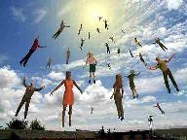
When Will the Rapture Take Place Relative to the Tribulation Period?
Pre-tribulation rapture theory
Mid-tribulation rapture theory
Post-tribulation rapture theory
Pre-wrath rapture theory
Partial rapture theory

Slide 68


Slide 69

Promised Exemption from Divine Wrath
The promise (1 Thess 1:10; 5:9; Rom 5:9; 8:1; Rev 3:10)
Tribulation = divine wrath (Rev 6:16-17; 11:18; 15:1, 7; 16:1, 19; 19:15)

Slide 70
B. His Activities
Revelation 19:15-16
His spoken word (15a)
His smiting of the nations (15b)
His ruling of the nations (15c)
His treading of the winepress (15d)
His rulership as King (16)

Slide 71
Daniel 9:25
So you are to know and discern that from the issuing of a decree to restore and rebuild Jerusalem until Messiah the Prince there will be seven weeks and sixty-two weeks; it will be built again, with plaza and moat, even in times of distress.

Slide 72
Daniel 9:26
Then after the sixty-two weeks the Messiah will be cut off and have nothing, and the people of the prince who is to come will destroy the city and the sanctuary. And its end will come with a flood; even to the end there will be war; desolations are determined.

Slide 73
End of the Tribulation Period
Revelation 19:7-21
The Marriage Supper of the Lamb (7-9)
John Responds to the Revelation (10)
The Second Advent (11-16)
The Supper of God (17-18)
Christ Defeats: Beast’s Armies & False Prophet (19-21)

Slide 74
End of the Tribulation Period
Revelation 19:7-21
The Marriage Supper of the Lamb (7-9)
John Responds to the Revelation (10)
The Second Advent (11-16)
The Supper of God (17-18)
Christ Defeats: Beast’s Armies & False Prophet (19-21)

Slide 75

Revelation 17:3
“And he carried me away in the Spirit into a wilderness; and I saw a woman sitting on a scarlet beast, full of blasphemous names, having seven heads and ten horns.”

Slide 76
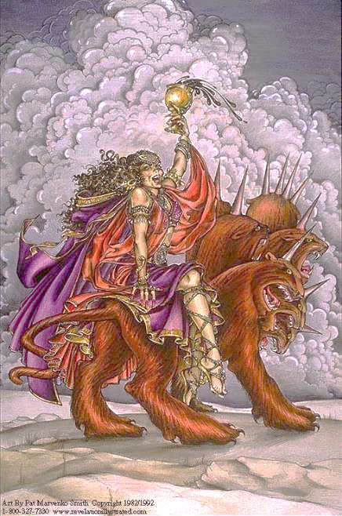

Slide 77

Revelation 20:10
¹⁰ And the devil who deceived them was thrown into the lake of fire and brimstone, where the beast and the false prophet are also; and they will be tormented day and night forever and ever.”

Slide 78
Antichrist’s Satanic Miracles (2 Thessalonians 2:9)
MIRACLE | GREEK | CHRIST’S MINISTRY
Powers | Dynamis | Matt. 11:20
Signs | Sēmeíon | John 20:30
Wonders | Teras | Acts 2:22

Slide 79

Satanic/Demonic Miracles
Exod. 7–8
Deut. 13:1-3
Job 1:12-19; 2:7-8
1 Sam. 28?
Matt. 7:21-23; 24:24
Acts 8:9; 16:16
Gal. 1:6-9
2 Thess. 2:9
Rev. 13:3, 13, 15; 16:13-14

Slide 80
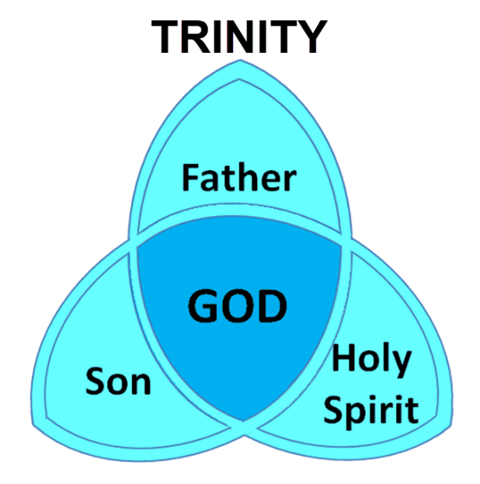

Slide 81
Revelation 20:1-3
“Then I saw an angel coming down from heaven, holding the key of the abyss and a great chain in his hand. ² And he laid hold of the dragon, the serpent of old, who is the devil and Satan, and bound him for a thousand years; ³ and he threw him into the abyss, and shut it and sealed it over him, so that he would not deceive the nations any longer, until the thousand years were completed; after these things he must be released for a short time.”

Slide 82
Revelation 20:7-10
“⁷ When the thousand years are completed, Satan will be released from his prison, ⁸ and will come out to deceive the nations which are in the four corners of the earth, Gog and Magog, to gather them together for the war; the number of them is like the sand of the seashore. ⁹ And they came up on the broad plain of the earth and surrounded the camp of the saints and the beloved city, and fire came down from heaven and devoured them. ¹⁰ And the devil who . . .

Slide 83
Revelation 20:7-10
. . .deceived them was thrown into the lake of fire and brimstone, where the beast and the false prophet are also; and they will be tormented day and night forever and ever.”

Slide 84
Conclusion

Slide 85
End of the Tribulation Period
Revelation 19:7-21
The Marriage Supper of the Lamb (7-9)
John Responds to the Revelation (10)
The Second Advent (11-16)
The Supper of God (17-18)
Christ Defeats: Beast’s Armies & False Prophet (19-21)

Slide 86

“The Lord bless you and keep you; the Lord make his face shine on you and be gracious to you; the Lord turn his face toward you and give you peace.” (NIV)

