Slide 1
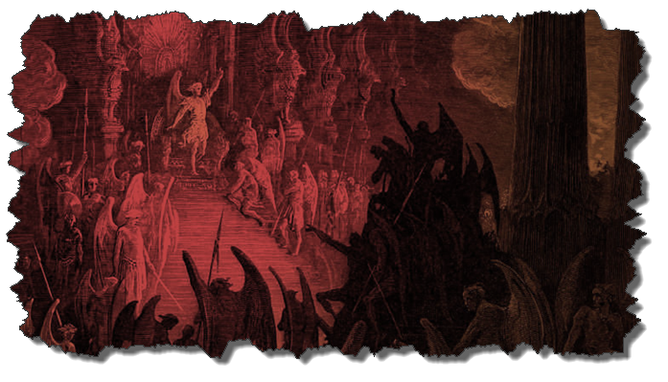
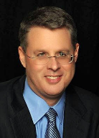
DEMONOLOGY
Dr. Andy Woods
Senior Pastor – Sugar Land Bible Church
President – Chafer Theological Seminary

Slide 2
Preview of Angelology
Good angels
Satanology
Demonology
Gen. 6:1-4 controversy

Slide 3
Overview
Existence Origin Personhood Characteristics | Powers Works Demon possession Defense

Slide 4
Overview
Existence Origin Personhood Characteristics | Powers Works Demon possession Defense

Slide 5
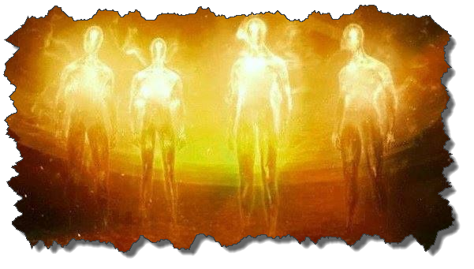
Existence
OT
Deut 32:17
Ps 106:37
NT
Over 100x
All NT writers (except Hebrews)
Christ (Matt 8:29; 10:1; 12:43-45)

Slide 6
Overview
Existence Origin Personhood Characteristics | Powers Works Demon possession Defense

Slide 7
Origin
 | Demons | Fallen Angels
Satan is leader | Matt 12:24 | Matt 25:41; Rev 12:7-9
Spirit beings | Matt 8:16 | Heb 1:14
Capacity to enter people | Matt 12:22; Luke 11:14-15 | John 13:27

Slide 8
Origin (cont’d)
Two classes
Free (Eph 6:12)
Confined (1 Pet 3:19-20; 2 Pet 2:4; Jude 6; Rev. 9:1-12)
No plan of salvation
Confirmed in wickedness
Matt 8:29; 25:41; Jas 2:19

Slide 9
Origin (cont’d)
“Because the angels are a company and not a race, they sinned individually, and not in some federal head of the race [as was true with humanity's fall in the person of Adam]. It may be that because of this that God made no provision of salvation for the fallen angels.”
Thiessen, Lectures in ST, 134 (emphasis and insertion added)

Slide 10
Human vs. Angelic Accountability
Humans | Angels
Sinned as a class (Rom 5:12) | Sinned individually
Sin nature | No sin nature
Did not stand in God’s glory | Stood in God’s glory

Slide 11
Overview
Existence Origin Personhood Characteristics | Powers Works Demon possession Defense

Slide 12
Personhood
Attributes of personhood
Intellect-Acts 19:15
Emotions-Luke 8:28; Jas 2:19
Will-Luke 8:32
Personal pronouns-Mrk 1:24-25

Slide 13
Overview
Existence Origin Personhood Characteristics | Powers Works Demon possession Defense

Slide 14
Characteristics
Spirits-Matt 8:16; Eph 6:12
Corrupt
Unclean-Matt 10:1
Evil-Luke 7:21
Rulers of darkness in spiritual wickedness-Eph 6:12
Degrees of wickedness-Matt 12:45

Slide 15
Characteristics (cont’d)
Manifestation
Invisible
Prophetic events = ugly/hideous (Rev 9:7-10; 16:13-16)

Slide 16
Overview
Existence Origin Personhood Characteristics | Powers Works Demon possession Defense

Slide 17
Powers
Great strength (Mark 5:3-4; Acts 19:16) but not omnipotent (Dan 10:13)
Superhuman intelligence (2 Sam. 14:20; Luke 8:28; 20:35-36) but not omniscient (Acts 19:15)
Not confined by physical space or barriers (Mark 5:9) but not omnipresent (Mark 5:12)

Slide 18
Satanic/Demonic Miracles
Exod. 7–8
Deut. 13:1-3
Job 1:12-19; 2:7-8
1 Sam. 28?
Matt. 7:21-23; 24:24
Acts 8:9; 16:16
Gal. 1:6-9
2 Thess. 2:9
Rev. 13:3, 13, 15; 16:13-14

Slide 19
CONCLUSION

Slide 20
Overview
Existence Origin Personhood Characteristics | Powers Works Demon possession Defense

