Slide 1
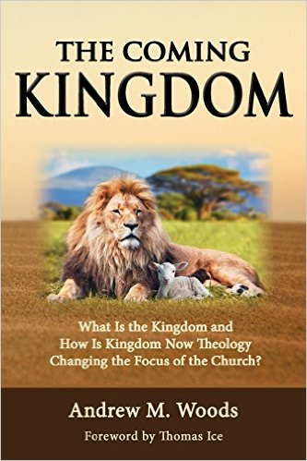

Slide 2
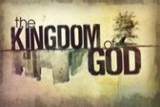
Kingdom Study Outline
What does the Bible Says About the Kingdom?
Why do some believe that we are in the kingdom now?
Why does it matter?

Slide 3

9 Ways Kingdom Now Theology
Impacts the Church
Loss of “pilgrim” status
Social Gospel
Ecumenical & interfaith alliances
Rejection or marginalization of Bible prophecy
Building the wrong kingdom
Charismatic theology
Prosperity Gospel
Anti-Israelism
Lordship Salvation

Slide 4
9 Ways Kingdom Now Theology
Impacts the Church
Loss of “pilgrim” status
Social Gospel
Ecumenical & interfaith alliances
Rejection or marginalization of Bible prophecy
Building the wrong kingdom
Charismatic theology
Prosperity Gospel
Anti-Israelism
Lordship Salvation

Slide 5

John Wimber
John Wimber and Kevin Springer, Power Evangelism (Bloomington, MN: Chosen, 2009), 19.
“I was already acquainted with George Eldon Ladd’s writings (he was a Fuller Theological Seminary professor), but it was not until I read his book Jesus and the Kingdom that I realized how his work on the kingdom formed a theological basis for power evangelism. As I read Dr. Ladd’s works, and then read afresh the gospel accounts, I became convinced that power evangelism was for today.”

Slide 6
John Wimber
The Vineyard Mission Statement
http://www.vineyardusa.org/site/about/vineyard-values/kingdom-of-god
“Commitment to the theology and practice of the kingdom of God is the most fundamental core value in the Vineyard. When the Vineyard talks about the kingdom, we are talking about the kingdom of God as a dynamic reality that is the future reign of God breaking into the present through the life and ministry of Jesus. We have been commissioned to proclaim the good news of the kingdom of God, bearing witness to the already and the not yet of the kingdom in words and deeds. This understanding of the kingdom of God is the central motif that gives both structure and definition to all of our theology. We view the kingdom of God as the overarching and integrating theme of the Bible (italics added).”

Slide 7
9 Ways Kingdom Now Theology
Impacts the Church
Loss of “pilgrim” status
Social Gospel
Ecumenical & interfaith alliances
Rejection or marginalization of Bible prophecy
Building the wrong kingdom
Charismatic theology
Prosperity Gospel
Anti-Israelism
Lordship Salvation

Slide 8

Isaiah 35:5-6
“⁵ Then the eyes of the blind will be opened And the ears of the deaf will be unstopped. ⁶ Then the lame will leap like a deer, And the tongue of the mute will shout for joy. For waters will break forth in the wilderness And streams in the Arabah.”

Slide 9


Amos 9:13
“Behold, days are coming,” declares the Lord,
“When the plowman will overtake the reaper
And the treader of grapes him who sows seed;
When the mountains will drip sweet wine
And all the hills will be dissolved.”

Slide 10
Isaiah 65:21-22
“²¹ They will build houses and inhabit them;
They will also plant vineyards and eat their fruit.
²² They will not build and another inhabit,
They will not plant and another eat;
For as the lifetime of a tree, so will be the days of My people, And My chosen ones will wear out the work of their hands.”

Slide 11
Zechariah 8:12
“For there will be peace for the seed: the vine will yield its fruit, the land will yield its produce and the heavens will give their dew; and I will cause the remnant of this people to inherit all these things.”

Slide 12

D.R. McConnell
A Different Gospel: A Bold and Revealing Look at the Historical Basis of the Word of Faith Movement, Updated and electronic ed. (Peabody, MA: Hendrickson, 2011), loc. 4813–4846.
“The Faith teachers deny that the kingdom of God is in the process of realization, claiming that it is present in the earth to the point that believers can be delivered from all sin, sickness, and poverty of the devil. They . . . claim that the believer has absolute authority to conquer and eradicate these forces of evil completely from his life. The only process of realization is in the faith of the believer, not in the presence of God’s kingdom. In the jargon of biblical theology, the Faith interpretation of the kingdom of God could be labeled as a ‘hyper-realized’ eschatology.”

Slide 13
D.R. McConnell
A Different Gospel: A Bold and Revealing Look at the Historical Basis of the Word of Faith Movement, Updated and electronic ed. (Peabody, MA: Hendrickson, 2011), loc. 4813–4846.
“The Faith eschatology is ‘hyper realized’ because of its extreme promises to the believer of a life which is absolutely invulnerable to any type of evil. It claims ‘that the powers of the age to come’ have completely come in this life and that these powers can be used at will by the believer with enough faith and knowledge of how to operate them. There is no process of realization of God’s kingdom in Faith eschatology; the kingdom can be completely realized in the lives of those who exercise Faith principles. We see this hyper-realized eschatology in the Faith doctrines of healing, authority, prosperity, . . .

Slide 14
D.R. McConnell
A Different Gospel: A Bold and Revealing Look at the Historical Basis of the Word of Faith Movement, Updated and electronic ed. (Peabody, MA: Hendrickson, 2011), loc. 4813–4846.
. . .healing, authority, prosperity, identification and deification. The over-realized nature of Faith eschatology emphasizes the ‘Now’ of the kingdom of God. . . . The . . . ‘Not yet’ mystery of the kingdom and its powers is distorted by the hyper-realized eschatology of the Faith movement.”

Slide 15
Galatians 4:13-14
“¹³ but you know that it was because of a bodily illness that I preached the gospel to you the first time; ¹⁴ and that which was a trial to you in my bodily condition you did not despise or loathe, but you received me as an angel of God, as Christ Jesus Himself.”

Slide 16
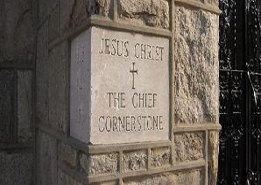
1 Timothy 5:23
“No longer drink water exclusively, but use a little wine for the sake of your stomach and your frequent ailments.”

Slide 17
Order of Paul’s Letters
Galatians (A.D. 49)
1‒2 Thessalonians (A.D. 51)
1‒2 Corinthians (A.D. 56)
Romans (A.D. 57)
Ephesians, Colossians, Philemon, Philippians (A.D. 60‒62)
1 Timothy, Titus (A.D. 62‒66)
2 Timothy (A.D. 67)

Slide 18
2 Timothy 4:20
“Erastus remained at Corinth, but Trophimus I left sick at Miletus.”

Slide 19
Philippians 4:12
“I know how to get along with humble means, and I also know how to live in prosperity; in any and every circumstance I have learned the secret of being filled and going hungry, both of having abundance and suffering need.”

Slide 20
2 Corinthians 8:2-3
“² that in a great ordeal of affliction their abundance of joy and their deep poverty overflowed in the wealth of their liberality. ³ For I testify that according to their ability, and beyond their ability, they gave of their own accord.”

Slide 21

Revelation 2:9
“I know your tribulation and your poverty (but you are rich), and the blasphemy by those who say they are Jews and are not, but are a synagogue of Satan.”

Slide 22

Romans 8:19-22
¹⁹ For the anxious longing of the creation waits eagerly for the revealing of the sons of God. ²⁰ For the creation was subjected to futility, not willingly, but because of Him who subjected it, in hope ²¹ that the creation itself also will be set free from its slavery to corruption into the freedom of the glory of the children of God. ²² For we know that the whole creation groans and suffers the pains of childbirth together until now.

Slide 23
9 Ways Kingdom Now Theology
Impacts the Church
Loss of “pilgrim” status
Social Gospel
Ecumenical & interfaith alliances
Rejection or marginalization of Bible prophecy
Building the wrong kingdom
Charismatic theology
Prosperity Gospel
Anti-Israelism
Lordship Salvation

Slide 24


Slide 25
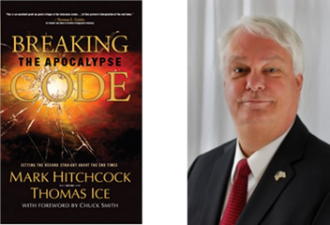
Mark Hitchcock and Thomas Ice
Breaking the Apocalypse Code (Costa Mesa, CA: Word for Today, 2007), 136-37.
"Every Old Testament prophet, except Jonah, speaks of a permanent return to the Land of Israel by the Jews."

Slide 26
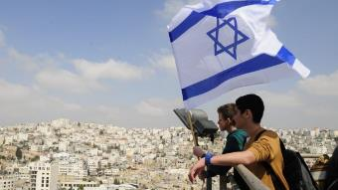
Reliability of the “Divine Regathering” Predictions
 | RETURN | PREDICTED | FULFILLED
1st | From Egypt to Canaan | Gen. 15:13-14 | Joshua 1‒12
2nd | From Babylon to Israel | Jer. 25:11; 29:10 | Ezra & Nehemiah
3rd | From the Diaspora to Israel’s restoration | Ezekiel 36:24-28 | Millennial Kingdom

Slide 27

Alva J. McClain
Alva J. McClain, The Greatness of the Kingdom: An Inductive Study of the Kingdom of God as Set Forth in the Scriptures (Grand Rapids: Zondervan, 1959), 438.
“The confusion of our . . . Lord’s rule . . . leads to serious consequences. . . . [I]t makes the present age the period of the Mediatorial Kingdom. . . . [I]t dissolves the divinely covenanted purpose in the nation of Israel.”

Slide 28

Gary DeMar
Gary DeMar and Gary North quotes, can be found in H. Wayne House and Thomas Ice, Dominion Theology: Blessing or Curse? (Portland, OR: Multnomah, 1988), 409–11.
“God has not called us to forsake the earth, but to impress heaven’s pattern on earth.” He similarly notes, “Christians must be obedient to the mandate God has given to extend His kingdom to every sphere of life, to every corner of the globe (Gen. 1:26–28; Matt. 28:18–20).”

Slide 29
Gary DeMar
End Times Fiction: A Biblical Consideration of the Left Behind Theology (Nashville, TN: Nelson, 2001), 203.
“Where is this ‘super sign’ found in the Bible? Not in the New Testament. There is not a single verse in the entire New Testament that says anything about Israel becoming a nation again. Nothing prophetic in the New Testament depends on Israel becoming a nation again. If Israel becoming a nation again is such ‘a significant sign,’ then why doesn't the New Testament specifically mention it?”

Slide 30
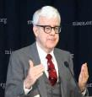
Gary North
Gary DeMar and Gary North quotes, can be found in H. Wayne House and Thomas Ice, Dominion Theology: Blessing or Curse? (Portland, OR: Multnomah, 1988), 409–11.
“The goal of establishing Christ’s international kingdom can be presented to citizens of any nation.”…“Christians are required to become active in the building God’s visible kingdom.”…“If the Christian church fails to build the visible kingdom by means of biblical law and the power of the gospel, despite the resurrection of Christ and the presence of the Holy Spirit, then what kind of religion are we preaching?”…“The parable (Matt. 13:24–30, 36–43) refers to the building of the kingdom of God, not simply to the institutional church.”

Slide 31

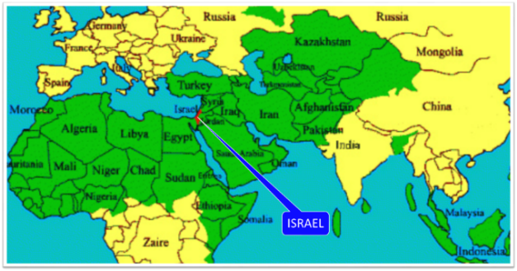
Thomas Ice
Personal letter from Gary North to Peter Lalonde, April 30, 1987 on file; cited in Thomas Ice, “Answering Those Who Oppose Israel,” 1, accessed October 21, 2015, http://www.pre-trib.org.
Thomas Ice reports, “Gary North has boasted that he has a book already in his computer for when ‘Israel gets pushed into the sea or converted to Christ.’”

Slide 32
Reformed Theology’s Denial of the Church as an Intercalation
“We’re not dispensationalists here....We believe that the church is essentially Israel. We believe that the answer to, ‘What about the Jews?’ is, ‘Here we are.’ We deny that the church is God’s ‘plan B.’ We deny that we are living in God’s redemptive parenthesis. There, we are again one people. In His holy and heavenly temple there is neither Jew nor Greek, male nor female, pre-mil nor post-mil. There, we are all together, the Israel of God, princes with God, and the ekklesia, the set apart ones.”
From Table Talk magazine, Spring of 1999, p. 2 (inside cover), by R. C. Sproul Jr., editor, emphasis is mine

Slide 33

“The story of the church begins with Israel, the Old Testament people of God…The identity of the church is necessary for the mission of the church. Only as a holy nation, called out of the darkness into the light of God‘s presence, can the church discharge it’s mission…Peter affirms that the church’s right to the titles of Israel, then describes the church’s witness of praise (1 Peter 2:9–10)...This understanding of the church as the new and true Israel of Christ must inspire our mission in the contemporary world.”
Edmund P. Clowney
Edmund P. Clowney, The Church, ed. Gerald Bray, Contours of Christian Theology (Downers Grove, ILL: InterVarsity Press, 1995), 28, 162-63.

Slide 34
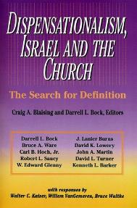
David L. Turner
“The New Jerusalem in Revelation 21:1-22:5; Consummation of a Biblical Continuum,” Dispensationalism, Israel, and the Church, ed., Craig A. Blaising and Darrell L. Bock (Grand Rapids: Zondervan, 1992), 288.
“It is clear that all the above are connected with the number twelve (cf. Rev. 7:5-8; 12:1, 12). This number is perhaps the most familiar number of the Bible, most frequently associated with the sons of Jacob, the twelve tribes of Israel, and the twelve apostles of the ‘new Israel,’ the church.”

Slide 35
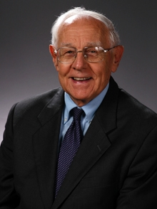
Stanley D. Toussaint
“Israel and the Church of a Traditional Dispensationalist,” in Three Central Issues in Contemporary Dispensationalism, ed. Herbert W. Bateman (Grand Rapids: Kregel, 1999), 259.
Of this designation, normative dispensationalist Stanley Toussaint appropriately comments, “This is precariously close to replacement theology.”

Slide 36

Romans 11:12-15
¹² “Now if their transgression is riches for the world and their failure is riches for the Gentiles, how much more will their fulfillment be! ¹³ But I am speaking to you who are Gentiles. Inasmuch then as I am an apostle of Gentiles, I magnify my ministry, ¹⁴ if somehow I might move to jealousy my fellow countrymen and save some of them. ¹⁵ For if their rejection is the reconciliation of the world, what will their acceptance be but life from the dead?”

Slide 37
Matthew 23:37-39
“Jerusalem, Jerusalem, who kills the prophets and stones those who are sent to her! How often I wanted to gather your children together, the way a hen gathers her chicks under her wings, and you were unwilling. ³⁸ Behold, your house is being left to you desolate! ³⁹ For I say to you, from now on you will not see Me until you say, ‘Blessed is He who comes in the name of the Lord!’”

Slide 38
Isaiah 2:2-3
“Now it will come about that In the last days The mountain of the house of the Lord Will be established as the chief of the mountains, And will be raised above the hills; And all the nations will stream to it.³ And many peoples will come and say, ‘Come, let us go up to the mountain of the Lord, To the house of the God of Jacob; That He may teach us concerning His ways And that we may walk in His paths.’ For the law will go forth from Zion And the word of the Lord from Jerusalem.”

Slide 39
Zechariah 14:16-18
“Then it will come about that any who are left of all the nations that went against Jerusalem will go up from year to year to worship the King, the Lord of hosts, and to celebrate the Feast of Booths. ¹⁷ And it will be that whichever of the families of the earth does not go up to Jerusalem to worship the King, the Lord of hosts, there will be no rain on them. ¹⁸ If the family of Egypt does not go up or enter, then no rain will fall on them; it will be the plague with which the Lord smites the nations who do not go up to celebrate the Feast of Booths.”

Slide 40

Robert Thomas
Four Views on the Book of Revelation, page 207.
“At the end of the Millennium that city will be Satan’s prime objective with his rebel army, because Israel will be a leader among the nations.”

Slide 41
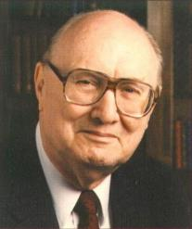
John Walvoord
Israel in Prophecy, Page 26
“Of the many peculiar phenomena which characterize the present generation, few events can claim equal significance as far as Biblical prophecy is concerned with that of the return of Israel to their land. It constitutes a preparation for the end of the age, the setting for the coming of the Lord for His church, and the fulfillment of Israel’s prophetic destiny.”

Slide 42
Israel’s Two Regatherings
THE PRESENT (FIRST) REGATHERING | THE PERMANENT (SECOND) REGATHERING
Return to part of the land | Return to all the land
Return in unbelief | Return in faith
Restored to the land only | Restored to the land and the Lord
Sets the stage for Tribulation (discipline) | Sets the stage for Millennium (blessing)
Adapted from: Price, Jerusalem In Prophecy, 219

Slide 43
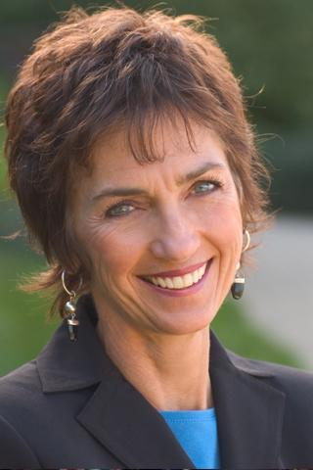
Lynne Hybels
Lynne Hybels, cited in Paul R. Wilkinson, Israel Betrayed: Volume 2: The Rise of Christian Palestinianism (San Antonio, TX: Ariel, 2018), 155.
“It is true: I am not a Christian Zionist…I do not hold to a theology asserting that the modern state of Israel represents a divinely mandated return of ancient Israel to the Promised Land… At the same time, I wholeheartedly support justice for the Palestinians.”

Slide 44
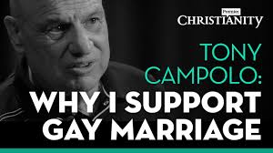
Tony Campolo
Tony Campolo, cited in Paul R. Wilkinson, Israel Betrayed: Volume 2: The Rise of Christian Palestinianism (San Antonio, TX: Ariel, 2018), 140.
“…a little nation that has survived primarily because of the wealth and the war materials supplied by the U.S. government.”

Slide 45
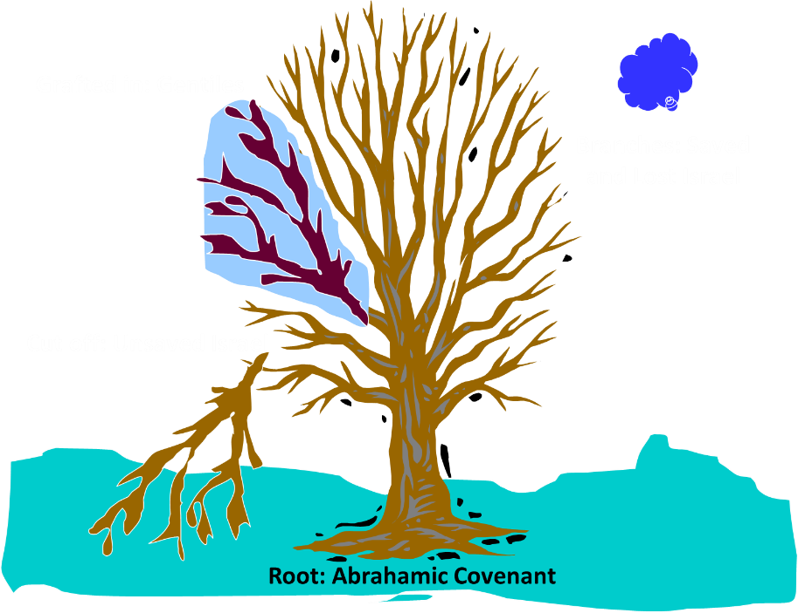
Notes:
45

Slide 46
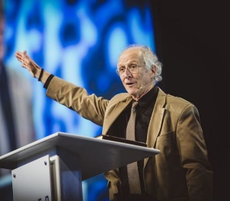
John Piper
John Piper, cited in Paul R. Wilkinson, Israel Betrayed: Volume 2: The Rise of Christian Palestinianism (San Antonio, TX: Ariel, 2018), 331-32.
“[God] has a saving purpose for Israel. All Israel will someday turn to the Lord Christ as a group. This is my deep understanding in belief of Romans 11. The broken off branches will be grafted in one day to the people of God, the bride of Christ, His church.”

Slide 47
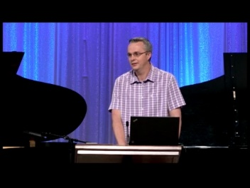
Paul Wilkinson
Paul R. Wilkinson, Israel Betrayed: Volume 2: The Rise of Christian Palestinianism (San Antonio, TX: Ariel, 2018), 332.
“On the basis of this kind of statement, many in the church are being misled into believing that Piper stands with Israel, but he does not. What Piper said is not what Paul taught. Israel’s destiny as a nation is not one of spiritual incorporation into the church, which is the classic Reformed, Calvinistic teaching. The church comprises individual Jews and Gentiles, not ‘Israel,’ which is a distinct national entity. The appointed destiny for Israel is for her to remain a nation in the sight of God and in the midst of all the nations, for as long as God’s ‘fixed order’ of creation endures (Jer. 31:36).”

Slide 48
Jeremiah 31:35-37
“Thus says the Lord, Who gives the sun for light by day And the fixed order of the moon and the stars for light by night, Who stirs up the sea so that its waves roar; The Lord of hosts is His name:³⁶ “If this fixed order departs From before Me,” declares the Lord, “Then the offspring of Israel also will cease From being a nation before Me forever.”³⁷ Thus says the Lord, “If the heavens above can be measured And the foundations of the earth searched out below, Then I will also cast off all the offspring of Israel For all that they have done,” declares the Lord.”

Slide 49

  “First, their synagogues should be set on fire…Secondly, their homes should likewise be broken down and destroyed…Thirdly, they should be deprived of their prayer books and Talmuds…”

Slide 50
  “…Fourthly, their rabbis must be forbidden under threat of death to teach any more…Fifthly, passport and traveling privileges should be absolutely forbidden to the Jews…Sixthly, they ought to be stopped from usury (charging interest on loans…”

Slide 51
  “Seventhly, let the young and strong Jews and Jewesses be given the flail, the ax, the hoe, the spade, the distaff, and spindle, and let the earn their bread by the sweat of their noses…We ought to drive the rascally lazy bones out of our system...”
Martin Luther, Concerning the Jews and Their Lies, cited in Michael Brown’s Our Hands Are Stained with Blood, pp. 14-15.

Slide 52
  “…Therefore away with them… To sum up, dear princes and nobles who have Jews in your domains, if this advice of mine does not suit you, then find a better one so that you and we may all be free of this insufferable devilish burden–the Jews.”
Martin Luther, Concerning the Jews and Their Lies, cited in Michael Brown’s Our Hands Are Stained with Blood, pp. 14-15.

Slide 53

  “But here he [the rabbi] not only betrays his ignorance, but his utter stupidity, since God so blinded the whole people that they were like restive dogs. I have had much conversation with many Jews: I have never seen either a drop of piety or a grain of truth or ingenuousness—nay, I have never found common sense in any Jew. But this fellow, who seems so sharp and ingenious, displays his own impudence to his great disgrace.”
John Calvin
Commentary on the Prophet Daniel (Vol 1, p. 185). Bellingham, WA: Logos Bible Software. Commentary on Daniel 2:44-45. (2010).

Slide 54
Conclusion

Slide 55
9 Ways Kingdom Now Theology
Impacts the Church
Loss of “pilgrim” status
Social Gospel
Ecumenical & interfaith alliances
Rejection or marginalization of Bible prophecy
Building the wrong kingdom
Charismatic theology
Prosperity Gospel
Anti-Israelism
Lordship Salvation

