Slide 1
Dr. Andy Woods
Senior Pastor – Sugar Land Bible Church
President – Chafer Theological Seminary

Slide 3
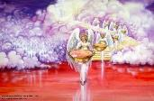
Seven Bowls (Revelation 16)
1st Bowl (16:1-2) – Boils
2nd Bowl (16:3) – Sea becomes blood
3rd Bowl (16:4-7) – Freshwater destroyed
4th Bowl (16:8-9) – Sun scorches man
5th Bowl (16:10-11) – Darkness
6th Bowl (16:13-16) – Euphrates dried
7th Bowl (16:17-21) – Greatest earthquake

Slide 4
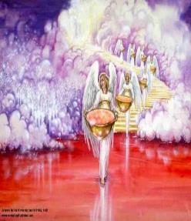
7. The Seventh Bowl Revelation 16:17-21
7th angel pours out the bowl (17)
Lightning & thunder (18a)
Greatest earthquake (18b)
Jerusalem destroyed (19a)
Babylon destroyed (19b)
Every mountain & island moved (20)
100-pound hailstones (21a)
Man’s sinful reaction (21b)

Slide 5
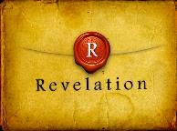
Revelation 16:19
“The great city was split into three parts, and the cities of the nations fell. Babylon the great was remembered before God, to give her the cup of the wine of His fierce wrath.”

Slide 6
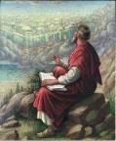
Revelation 17:1
“Then one of the seven angels who had the seven bowls came and spoke with me, saying, “Come here, I will show you the judgment of the great harlot who sits on many waters.”

Slide 8
5 Non-Chronological Parenthetical Insertions
Rev 7 – 144,000 Jews
Rev 10:1-11:13 – Announcement of no more delay and the two witnesses
Rev 12-14 – Israel’s flight, two beasts, six scenes of hope
Rev 16:13-16 – Gathering of the nations to Armageddon
Rev 17:1-19:6 – Babylon’s fall

Slide 9
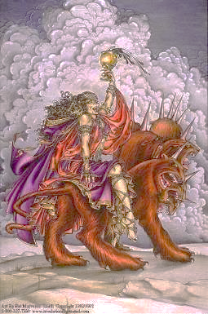
The Woman Rides the Beast Revelation 17
The Vision Concerning Babylon (1-6a)
The Interpretation Concerning Babylon (6b-18)

Slide 10
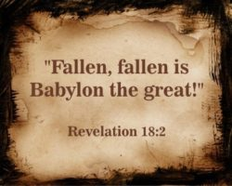
The Great City of Babylon Revelation 18
The Prediction of Babylon’s Fall (18:1-3)
The Appeal to Separate From Babylon (18:4-8)
The Reactions to Babylon’s Fall (18:9-20)
The Description of Babylon’s Fall (18:21-24)

Slide 11
Heaven Celebrates Babylon’s Fall Revelation 19:1-6
The Great Multitude (19:1-3)
The 24 Elders & the 4 Living Creatures (19:4)
The Voice from the Throne (19:5)
The Great Multitude (19:6)

Slide 12
Heaven Celebrates Babylon’s Fall Revelation 19:1-6
The Great Multitude (19:1-3)
The 24 Elders & the 4 Living Creatures (19:4)
The Voice from the Throne (19:5)
The Great Multitude (19:6)

Slide 13
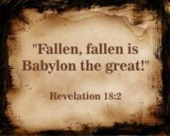
I. The Great Multitude Revelation 19:1-3
Introduction (1a)
First Hallelujah (1b-2)
Second Hallelujah (3)

Slide 14
I. The Great Multitude Revelation 19:1-3
Introduction (1a)
First Hallelujah (1b-2)
Second Hallelujah (3)

Slide 15
I. The Great Multitude Revelation 19:1-3
Introduction (1a)
First Hallelujah (1b-2)
Second Hallelujah (3)

Slide 16
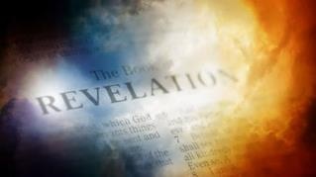
David Hocking
David Hocking, The Book of Revelation: Understanding the Future (Tustin, CA: Hope For Today Publications, 2014), 500.
“The word ‘hallelujah’ is the same in all languages of the world, and simply means ‘praise the Lord’ and not a quiet expression of prayer but rather the sound of a ‘great voice of much people in heaven.’ This outburst of praise sounded like ‘many waters’ and the voice of ‘mighty thundering.’ Apparently, God is going to change the ability of ears to hear that which is loud – because heaven is filled with the word ‘loud’!”

Slide 18
Parallels Between Jeremiah 50-51 & Revelation 17-18
 | Jeremiah | Revelation
Associated with a Golden cup | 51:7a | 17:3-4; 18:6
Dwelling on many waters | 51:13 | 17:1
Intoxicating the nations | 51:7b | 17:2
Same name | 50:1 | 17:5
Persecution of the saints | 51:49 | 17:6; 18:24
Stone sinking into Euphrates | 51:63-64 | 18:21
Sudden destruction | 51:8 | 18:8
Destroyed by fire | 51:30 | 17:16
Final, uninhabitable | 50:39 | 18:21
Deserved | 50:29 | 18:6
God’s people flee | 51:6, 45 | 18:4
Heaven rejoices | 51:48 | 18:20
Dyer, "The Identity of Babylon in Revelation 17–18 (Part 2)," 441-43.

Slide 19
Genesis 11:1-4
¹ Now the whole earth used the same language and the same words. ² It came about as they journeyed east, that they found a plain in the land of Shinar and settled there. ³ They said to one another, “Come, let us make bricks and burn them thoroughly.” And they used brick for stone, and they used tar for mortar. ⁴ They said, “Come, let us build for ourselves a city, and a tower whose top will reach into heaven, and let us make for ourselves a name, otherwise we will be scattered abroad over the face of the whole earth.”

Slide 20
Spread of the Mother-Child Cult
 | Mother | Child
Assyria | Ishtar | Tammuz
Phoenicia | Astarte | Baal
Egypt | Isis | Osirus/Horus
Greece | Aphrodite | Eros
Rome | Venus | Cupid
Asia | Cybele | Desius
India | Isi | Aswara
Roman Catholicism | Mary | Jesus
Israel | Queen of Heaven (Jer. 7:18; 44:17) | Tammuz (Ezek. 8:14-15)
Alexander Hislop, Two Babylons

Slide 21
Parallels Between Jeremiah 50-51 & Revelation 17-18
 | Jeremiah | Revelation
Associated with a Golden cup | 51:7a | 17:3-4; 18:6
Dwelling on many waters | 51:13 | 17:1
Intoxicating the nations | 51:7b | 17:2
Same name | 50:1 | 17:5
Persecution of the saints | 51:49 | 17:6; 18:24
Stone sinking into Euphrates | 51:63-64 | 18:21
Sudden destruction | 51:8 | 18:8
Destroyed by fire | 51:30 | 17:16
Final, uninhabitable | 50:39 | 18:21
Deserved | 50:29 | 18:6
God’s people flee | 51:6, 45 | 18:4
Heaven rejoices | 51:48 | 18:20
Dyer, "The Identity of Babylon in Revelation 17–18 (Part 2)," 441-43.

Slide 22
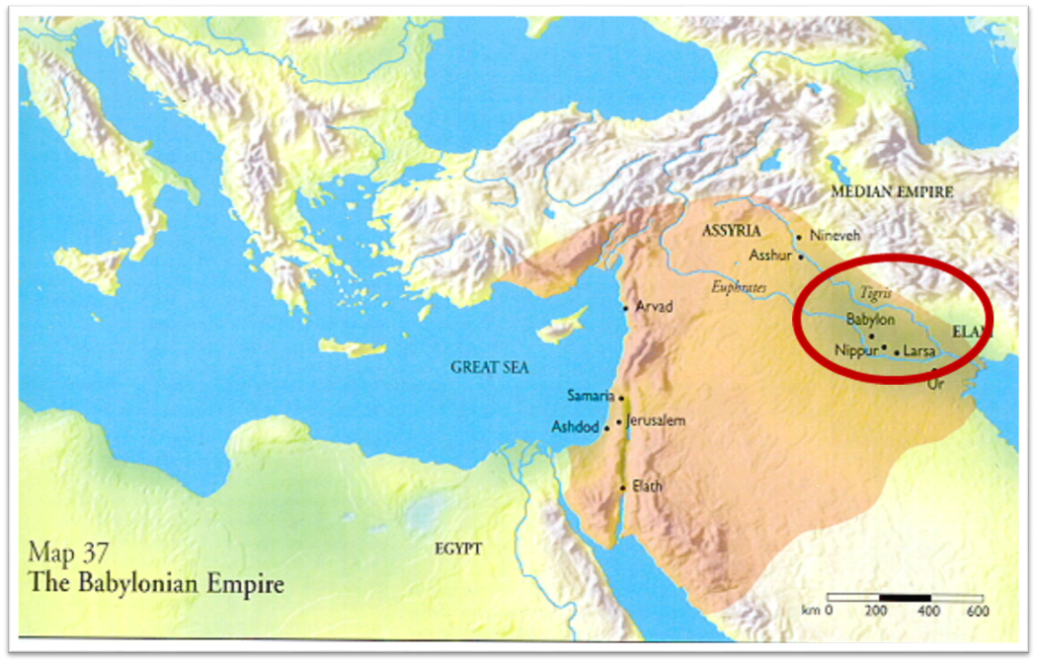

Slide 23
I. The Great Multitude Revelation 19:1-3
Introduction (1a)
First Hallelujah (1b-2)
Second Hallelujah (3)

Slide 25
Millennium Rev. 20 | Eternal State Rev. 21-22
Sin restrained | Sin removed
Curse restrained | Curse removed
Death | No death
Mortals / resurrected | Resurrected only
Mortals Destinies undecided | All Destinies sealed
Renovation | Recreation
Temporary | Eternal
Transitional | Non-transitional

Slide 26
Classification | Millennium Rev 20:1-10 | Eternal State Rev 21–22
Time | Rev. 20:4 | Rev. 22:5
Luminaries | Isa. 30:26 | Rev. 21:23; 22:5
Temple | Ezek. 40–48 | Rev. 21:22
Death | Isa. 65:20 | Rev. 21:4
Satanic activity | Rev. 20:7 | Rev. 20:10
Rebellion | Rev. 20:8-9 | Rev. 21:27

Slide 27
John F. Walvoord
The Revelation of Jesus Christ: A Commentary (Chicago: Moody, 1966), 267.
“Babylon, ecclesiastically symbolized by the woman in Revelation 17, proposes a common worship and a common religion through uniting in a world church. This is destroyed by the beast in Revelation 17:16 who thus fulfills the will of God (Rev. 17:17). Babylon, politically symbolized by the great city of Revelation 18, attempts to achieve its domination of the world by a world common market and a world government. These are destroyed by Christ at His second coming (Rev. 19:11–21).”

Slide 28
John F. Walvoord
The Revelation of Jesus Christ: A Commentary (Chicago: Moody, 1966), 257, 263.
“The city here according to verse 5 is a mystery, not a literal city...The ultimate decision depends upon the judgment of the expositor, but in many respects it is simpler to postulate a rebuilt Babylon as fulfilling literally the Old Testament prophecies as well as that embodied in this chapter.”

Slide 29
Two Babylons View
BABYLON | Ecclesiastical | Commercial
Chapter | Revelation 17 | Revelation 18
Literalness | Not literal | Literal
Time of Destruction | 1st half of Tribulation | Second Advent
Emphasis | Religion | Commercial & Political

Slide 30
ONE BABYLON
 | Rev. 17 | Rev. 18
Same name | 17:5 | 18:2
City | 17:18 | 18:10
Same clothing | 17:4 | 18:16
Holding a cup | 17:4 | 18:6
Fornicating with Kings | 17:2 | 18:3
Drunk with wine of immorality | 17:2 | 18:3
Persecuting believers | 17:6 | 18:20, 24
Destroyed by fire | 17:16 | 18:8, 18
Destroyed by God | 17:17 | 18:5, 8
Dyer, "The Identity of Babylon in Revelation 17–18 (Part 1)," 311-13.

Slide 31
Revelation 16:19
“The great city was split into three parts, and the cities of the nations fell. Babylon the great was remembered before God, to give her the cup of the wine of His fierce wrath.”

Slide 32
Revelation 17:1
“Then one of the seven angels who had the seven bowls came and spoke with me, saying, “Come here, I will show you the judgment of the great harlot who sits on many waters.”

Slide 33
Revelation 14:8
“And another angel, a second one, followed, saying, ‘Fallen, fallen is Babylon the great, she who has made all the nations drink of the wine of the passion of her immorality.’”

Slide 34
Revelation 14:8
“And another angel, a second one, followed, saying, ‘Fallen, fallen is Babylon the great, she who has made all the nations drink of the wine of the passion of her immorality.’”

Slide 35
“MYSTERY” IN HARLOT’S TITLE? REV. 17:5
And on her forehead a name was written: MYSTERY, BABYLON THE GREAT, THE MOTHER OF HARLOTS AND OF THE ABOMINATIONS OF THE EARTH. (KJV, NIV)
… and upon her forehead a name was written, a mystery, “BABYLON THE GREAT, THE MOTHER OF HARLOTS AND OF THE ABOMINATIONS OF THE EARTH.” (NASB)

Slide 36
ONE BABYLON
 | Rev. 17 | Rev. 18
Same name | 17:5 | 18:2
City | 17:18 | 18:10
Same clothing | 17:4 | 18:16
Holding a cup | 17:4 | 18:6
Fornicating with Kings | 17:2 | 18:3
Drunk with wine of immorality | 17:2 | 18:3
Persecuting believers | 17:6 | 18:20, 24
Destroyed by fire | 17:16 | 18:8, 18
Destroyed by God | 17:17 | 18:5, 8
Dyer, "The Identity of Babylon in Revelation 17–18 (Part 1)," 311-13.

Slide 37
Revelation 14:8
“And another angel, a second one, followed, saying, ‘Fallen, fallen is Babylon the great, she who has made all the nations drink of the wine of the passion of her immorality.’”

Slide 38
ONE BABYLON
 | Rev. 17 | Rev. 18
Same name | 17:5 | 18:2
City | 17:18 | 18:10
Same clothing | 17:4 | 18:16
Holding a cup | 17:4 | 18:6
Fornicating with Kings | 17:2 | 18:3
Drunk with wine of immorality | 17:2 | 18:3
Persecuting believers | 17:6 | 18:20, 24
Destroyed by fire | 17:16 | 18:8, 18
Destroyed by God | 17:17 | 18:5, 8
Dyer, "The Identity of Babylon in Revelation 17–18 (Part 1)," 311-13.

Slide 39
Two Babylons View?
 | TWO BABYLONS ARGUMENT | SINGLE BABYLON RESPONSE
1. Chapter division | Different prophetic subject | Non-inspired chapter divisions
2. “After these things” (18:1) | Takes place later chronologically (1:19; 4:1b; 9:12; 20:3) | Sequence in which visions were shown to John (4:1a; 7:1, 9; 15:5; 19:1)
3. “Another angel” (18:1) | A new vision (10:1; 14:6, 8, 9) | Same vision (7:2; 8:3; 14:15, 17, 18)

Slide 40
Two Babylons View?
 | TWO BABYLONS ARGUMENT | SINGLE BABYLON RESPONSE
4. Different Destructions | Destroyed by the kings (Rev. 17:16) vs. destroyed by God (18:9) | Destroyed by God (17:17; 18:9) and by fire (17:16; 18:8-9, 18)
5. Different reactions | Kings hate Babylon (17:16) vs. kings weep over Babylon (18:9) | Kings united with the Beast (17:16) vs. kings united with Babylon (Rev. 18:9)
6. Different symbols | Woman (17:3) vs. a city (18:10) | Woman called a city (17:18; 18:10)

Slide 41
Heaven Celebrates Babylon’s Fall Revelation 19:1-6
The Great Multitude (19:1-3)
The 24 Elders & the 4 Living Creatures (19:4)
The Voice from the Throne (19:5)
The Great Multitude (19:6)

Slide 42
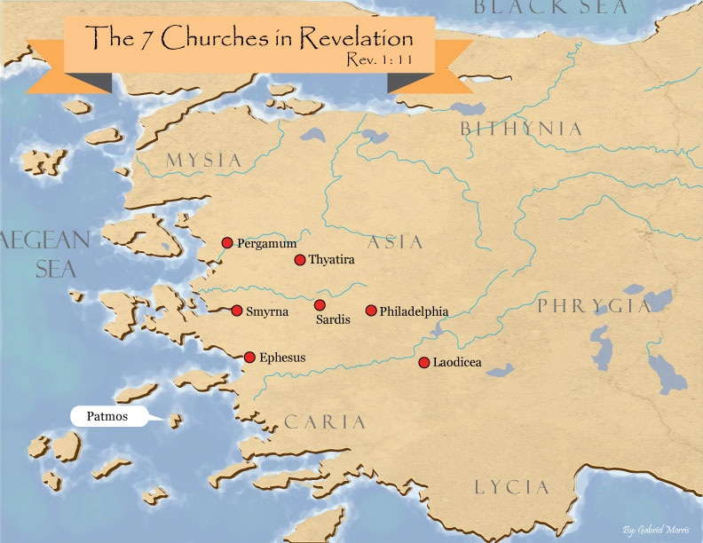

Slide 43
DESCRIPTION OF THE SEVEN CHURCHES Revelation 2‒3
CHURCH | SCRIPTURE | DESCRIPTION
Ephesus | 2:1-7 | Loveless
Smyrna | 2:8-11 | Persecuted
Pergamum | 2:12-17 | Compromised
Thyatira | 2:18-29 | Corrupt
Sardis | 3:1-6 | Dead
Philadelphia | 3:7-13 | Missionary
Laodicea | 3:14-22 | Man-centered

Slide 44
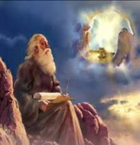
Twenty-Four Elders (Rev. 4:4; 5:8-10)
Church
Crowned (2:10)
Resurrected (4:4)
Clothed in White (3:5)
Redeemed (5:8-10)
Global (5:9; Matt. 28:19)
Enthroned (3:21)
Elders (1 Tim. 3:1-7)
Kingdom of Priests (Rev. 1:6)
Twenty-four (Rev. 1:6)

Slide 45
Revelation 3:21
PROMISE TO THE OVERCOMERS
“He who overcomes, I will grant to him to sit down with Me on My throne, as I also overcame and sat down with My Father on His throne.”

Slide 46
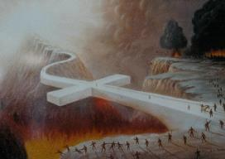
John 5:24
“Truly, truly, I say to you, he who hears My word, and believes Him who sent Me, has eternal life, and does not come into judgment, but has passed out of death into life.”

Slide 47
Heaven Celebrates Babylon’s Fall Revelation 19:1-6
The Great Multitude (19:1-3)
The 24 Elders & the 4 Living Creatures (19:4)
The Voice from the Throne (19:5)
The Great Multitude (19:6)

Slide 48
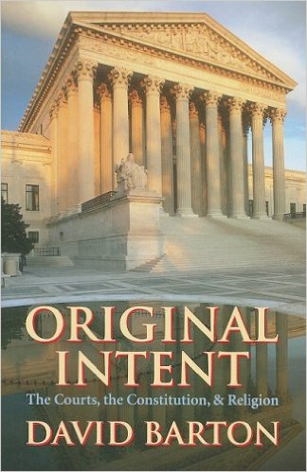
David Barton, Original Intent, p. 245

Slide 49
Revelation 14:7
“and he said with a loud voice, ‘Fear God, and give Him glory, because the hour of His judgment has come; worship Him who made the heaven and the earth and sea and springs of waters.’”

Slide 50
Heaven Celebrates Babylon’s Fall Revelation 19:1-6
The Great Multitude (19:1-3)
The 24 Elders & the 4 Living Creatures (19:4)
The Voice from the Throne (19:5)
The Great Multitude (19:6)

Slide 51
Ultimate Exodus (Rev 11:15)
Sores: 6th plague (Ex 9:8-12), 1st bowl (Rev 16:1-2)
Rivers to blood: 1st plague (Ex 7:19-21), 3rd bowl (Rev 16:4-7)
Darkness: 9th plague (Ex 10:21-23), 5th bowl (Rev 16:10-11)
Frogs: 2nd plague (Ex 7:25‒8:15), 6th bowl (Rev 16:13)
Hail: 7th plague (Ex 9:22-26), 7th bowl (Rev 16:17-21)

Slide 53
Revelation 11:15
“Then the seventh angel sounded; and there were loud voices in heaven, saying, ‘The kingdom of the world has become the kingdom of our Lord and of His Christ; and He will reign forever and ever.’”

Slide 54
Revelation 1:6
“and He has made us to be a kingdom, priests to His God and Father—to Him be the glory and the dominion forever and ever. Amen.”

Slide 55
Revelation 5:10
“You have made them to be a kingdom and priests to our God; and they will reign [basileuō] upon the earth [gē].”

Slide 56
Conclusion

Slide 57
Heaven Celebrates Babylon’s Fall Revelation 19:1-6
The Great Multitude (19:1-3)
The 24 Elders & the 4 Living Creatures (19:4)
The Voice from the Throne (19:5)
The Great Multitude (19:6)

Slide 58
“The Lord bless you and keep you; the Lord make his face shine on you and be gracious to you; the Lord turn his face toward you and give you peace.” (NIV)

