Slide 1
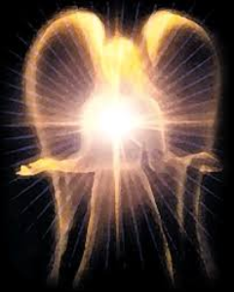
SATANOLOGY
Dr. Andy Woods
Senior Pastor – Sugar Land Bible Church
President – Chafer Theological Seminary

Slide 2
Preview of Angelology
Good angels
Satanology
Demonology
Gen. 6:1-4 controversy

Slide 3
Preview
Existence
Personhood
Names and titles
Original state and first sin
Works

Slide 4
Works
Past
Present
Future

Slide 5
Works
Past
Present
Future

Slide 6
Works - Past
Lied to Adam and Eve (Gen 3:1ff)
Corrupted the pre-flood gene pool (Gen 6:1-4)
Accused and afflicted Job (Job 1–2)
Disputed Michael regarding Moses’ body (Jude 9)
Tempted David to take a census (1 Chr 21:1)
Accused Joshua (Zech 3:1-3)

Slide 7
Works – Past (cont’d)
Tempted Christ (Matt 4:1-11)
Tested Peter (Luke 22:31-33)
Possessed Judas (John 13:27)
Hindered Paul (1 Thess 2:18)
Afflicted Paul (2 Cor 12:7-10)
Influenced Ananias & Sapphira to lie (Acts 5:3-4, 8)

Slide 8
Works
Past
Present
Future

Slide 9
Works – Present
Snatches God’s Word (Luke 8:12)
Rules world (1 John 5:19)
Blinds the mind (2 Cor 4:4)
Sends false ministers (2 Cor 11:14-15)
Sends false gospels (2 Cor 11:3-4)
Sows unbelievers among believers (Matt 13:38-39)
Performs miracles (2 Thess 2:9)
Promotes immorality (Eph 2:1-3)
Opposes God’s people (Eph 6:11-12)

Slide 10
Works – Present (cont’d )
Tempts God’s people (1 Cor 7:5)
Uses the carnality of Christians (Eph 4:26-27)
Causes physical problems (Luke 13:11, 16)
Influences civil government (Dan 10:10ff)
Lies (John 8:44)
Deceives (Rev 12:9; 20:3)

Slide 11
Works
Past
Present
Future

Slide 12
Works – Future
World government (Rev 13:3-4)
Oppose the 2nd Advent (Rev 17:14)
Attempt to annihilate Israel (Rev 12)
Bound (Rev 20:1-3)
Lead a final rebellion (Rev 20:7-9)
Cast into the Lake of Fire (Rev 20:10)

Slide 13
Works – Future
World government (Rev 13:3-4)
Oppose the 2nd Advent (Rev 17:14)
Attempt to annihilate Israel (Rev 12)
Bound (Rev 20:1-3)
Lead a final rebellion (Rev 20:7-9)
Cast into the Lake of Fire (Rev 20:10)

Slide 14
Revelation 20:10
“And the devil who deceived them was thrown into the lake of fire and brimstone, where the beast and the false prophet are also; and they will be tormented day and night forever and ever.”

Slide 15
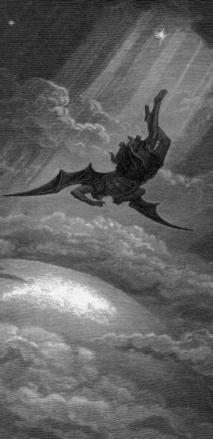
Satan’s Progressive Defeat
Initial eviction from heaven (Isa 14:12-15; Ezek 28:12-17)
Eden (Gen 3:15)
Pre-diluvian world (1 Pet 3:19-20)
Cross (John 12:31; 16:11; Col 2:15; Heb 2:14; 1 John 3:8)
Mid point of the Tribulation (Rev 12:9)
Beginning of millennium (Rev 20:2-3)
End of millennium (Rev 20:10)

Slide 16
Satan’s Progressive Defeat
Initial eviction from heaven (Isa 14:12-15; Ezek 28:12-17)
Eden (Gen 3:15)
Pre-diluvian world (1 Pet 3:19-20)
Cross (John 12:31; 16:11; Col 2:15; Heb 2:14; 1 John 3:8)
Mid point of the Tribulation (Rev 12:9)
Beginning of millennium (Rev 20:2-3)
End of millennium (Rev 20:10)

Slide 17
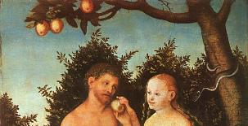
Genesis 3:15
“And I will put enmity between you and the woman, and between your seed and her seed; He shall bruise you on the head, and you shall bruise him on the heel.”

Slide 18
Satan’s Progressive Defeat
Initial eviction from heaven (Isa 14:12-15; Ezek 28:12-17)
Eden (Gen 3:15)
Pre-diluvian world (1 Pet 3:19-20)
Cross (John 12:31; 16:11; Col 2:15; Heb 2:14; 1 John 3:8)
Mid point of the Tribulation (Rev 12:9)
Beginning of millennium (Rev 20:2-3)
End of millennium (Rev 20:10)

Slide 19
 | David/Saul | Jesus/Satan
ANOINTED | David (1 Sam 16:13) | Jesus-Res./Ascension (Ps 2:7; 110:1)
NOW RULING | Saul (1 Sam 16:14) | Satan (Luke 4:5-7)
ILLEGITIMACY | Benjamin (Gen 49:10; 1 Sam. 9:21) | Gen. 1:26-28; 2:19-20; Dan 1:6-7)
FAITH | David (1 Sam 16:7) | Jesus (Heb 11:6)
MINORITY | David’s men (2 Sam 23:8-39) | Narrow road (Matt 7:14)
SIGHT | Saul (1 Sam 9:2) | Satan (2 Cor. 4:18; 1 John 2:15-17)
MAJORITY | Israel | Broad road (Matt. 7:13)
McClain, Greatness of the Kingdom, 440

Slide 20
Review
Existence
Personhood
Names and titles
Original state and first sin
Works

Slide 21
Preview of Angelology
Good angels
Satanology
Demonology
Gen. 6:1-4 controversy

Slide 22
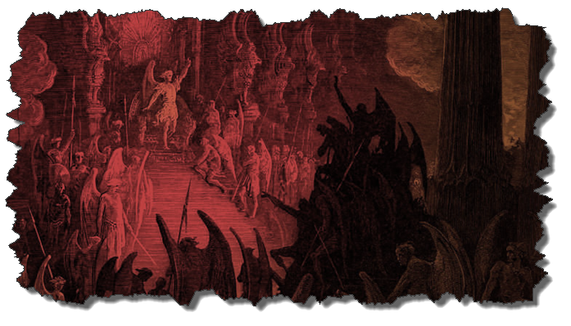
DEMONOLOGY
Dr. Andy Woods
Senior Pastor – Sugar Land Bible Church
President – Chafer Theological Seminary

Slide 23
Overview
Existence Origin Personhood Characteristics | Powers Works Demon possession Defense

Slide 24
Overview
Existence Origin Personhood Characteristics | Powers Works Demon possession Defense

Slide 25
Existence
OT
Deut 32:17
Ps 106:37
NT
Over 100x
All NT writers (except Hebrews)
Christ (Matt 8:29; 10:1; 12:43-45)

Slide 26
Overview
Existence Origin Personhood Characteristics | Powers Works Demon possession Defense

Slide 27
Origin
 | Demons | Fallen Angels
Satan is leader | Matt 12:24 | Matt 25:41; Rev 12:7-9
Spirit beings | Matt 8:16 | Heb 1:14
Capacity to enter people | Matt 12:22; Luke 11:14-15 | John 13:27

Slide 28
Origin (cont’d)
Two classes
Free (Eph 6:12)
Confined (1 Pet 3:19-20; 2 Pet 2:4; Jude 6; Rev. 9:1-12)
No plan of salvation
Confirmed in wickedness
Matt 8:29; 25:41; Jas 2:19

Slide 29
Origin (cont’d)
“Because the angels are a company and not a race, they sinned individually, and not in some federal head of the race [as was true with humanity's fall in the person of Adam]. It may be that because of this that God made no provision of salvation for the fallen angels.”
Thiessen, Lectures in ST, 134 (emphasis and insertion added)

Slide 30
Human vs. Angelic Accountability
Humans | Angels
Sinned as a class (Rom 5:12) | Sinned individually
Sin nature | No sin nature
Did not stand in God’s glory | Stood in God’s glory

Slide 31
Overview
Existence Origin Personhood Characteristics | Powers Works Demon possession Defense

Slide 32
Personhood
Attributes of personhood
Intellect-Acts 19:15
Emotions-Luke 8:28; Jas 2:19
Will-Luke 8:32
Personal pronouns-Mrk 1:24-25

Slide 33
CONCLUSION

Slide 34
Overview
Existence Origin Personhood Characteristics | Powers Works Demon possession Defense

