Slide 1


Slide 2

Kingdom Study Outline
What does the Bible Says About the Kingdom?
Why do some believe that we are in the kingdom now?
Why does it matter?

Slide 3

9 Ways Kingdom Now Theology
Impacts the Church
Loss of “pilgrim” status
Social Gospel
Ecumenical & interfaith alliances
Rejection or marginalization of Bible prophecy
Building the wrong kingdom
Charismatic theology
Prosperity Gospel
Anti-Israelism
Lordship Salvation

Slide 4
9 Ways Kingdom Now Theology
Impacts the Church
Loss of “pilgrim” status
Social Gospel
Ecumenical & interfaith alliances
Rejection or marginalization of Bible prophecy
Building the wrong kingdom
Charismatic theology
Prosperity Gospel
Anti-Israelism
Lordship Salvation

Slide 5
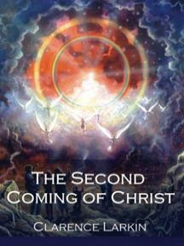
Clarence Larkin
The Second Coming of Christ, 51.
“When the Church enters into an ‘Alliance with the World,’. . . the end of such an ‘Alliance’ will be a ‘Religious Political Regime’ that will pave the way for the revelation of Satan’s great ‘Religious Political Leader’ and ‘Superman’—the ANTICHRIST.”

Slide 6
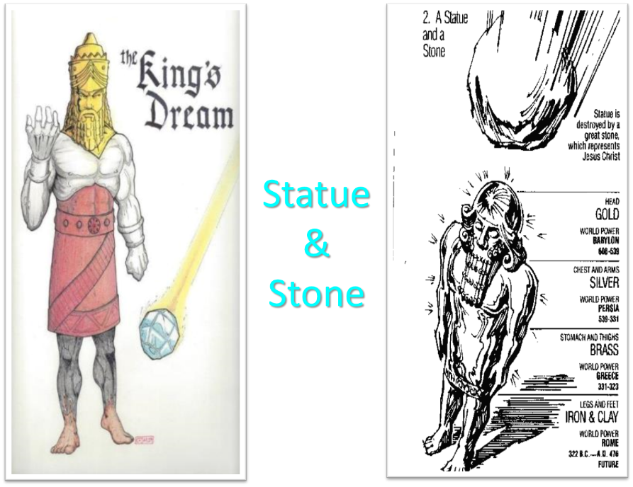

Slide 7


Slide 8
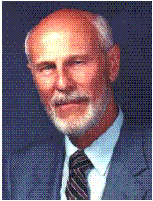
Dave Hunt
“Kingdom/Dominion Theology – Part 1” (February 1, 1987), accessed July 12, 2015, https://www.thebereancall.org/content/kingdomdominion-theology-part-i.
“There are many factors that make up the growing apostasy and seduction of the church. One of the most alarming, least understood, and fastest spreading errors is the teaching that earth instead of heaven is the ultimate home for the church, and that her goal is to take over the world and establish the kingdom of God. Only then, it is said, can Christ return—not, however, to take us to His Father’s house as He promised His disciples in John 14, but to reign over the Kingdom which we have established for Him. . . . [I]f the real Jesus Christ is going to catch His bride up from earth to meet Him in the air (1 Thess. 4:17), then those who work to build a kingdom for a ‘Christ’ whom they will meet with their feet planted on earth have been under heavy delusion indeed! They have been working for the Antichrist!”

Slide 9

Hal Lindsey
The Road to Holocaust, 269
Bestselling author Hal Lindsey warned what could happen to the church in the last days if she began to see herself as the establisher of God's kingdom: “The last days of the church on the earth may be largely wasted seeking to accomplish a task that only the LORD Himself can and will do directly.”

Slide 10
9 Ways Kingdom Now Theology
Impacts the Church
Loss of “pilgrim” status
Social Gospel
Ecumenical & interfaith alliances
Rejection or marginalization of Bible prophecy
Building the wrong kingdom
Charismatic theology
Prosperity Gospel
Anti-Israelism
Lordship Salvation

Slide 11
The 7 Disputed Gifts
Apostle
Prophet
Worker of Miracles
Tongues
Interpretation of tongues
Healing
Knowledge

Slide 12
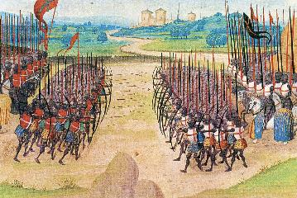
Two Camps
Charismatics – All the spiritual gifts are in operation today
Cessationists (selective)– Most of the spiritual gifts are in operation today

Slide 13
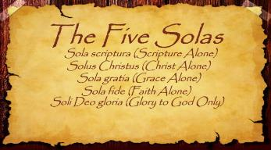
The Five Solas (Alone or By Itself)
Solus Christus – Christ alone
Sola Fide – faith alone
Sola Gratia – grace alone
Sola Scriptura – Scripture alone
Soli Deo Gloria – To the glory of God alone

Slide 14

SLBC Position Statement No. 7
TEMPORARY SPIRITUAL GIFTS – This church teaches that the miraculous sign gifts, including the gift of tongues, (always the ability to speak in a previously unlearned, known language) along with the gift of healings were temporal gifts, given by the Holy Spirit solely to authenticate both the apostles and their message before the close of the canon of Scripture (1 Cor. 13:8-10). We do not believe that these are active as gifts today. However, we affirm that God is sovereign and may heal today. We believe that the majority of what is termed “miraculous” within the contemporary charismatic movement is something other than the Biblical gifts of tongues or healing.

Slide 15

Isaiah 35:5-6
“⁵ Then the eyes of the blind will be opened And the ears of the deaf will be unstopped. ⁶ Then the lame will leap like a deer, And the tongue of the mute will shout for joy. For waters will break forth in the wilderness And streams in the Arabah.”

Slide 16

John Wimber
John Wimber and Kevin Springer, Power Evangelism (Bloomington, MN: Chosen, 2009), 19.
“I was already acquainted with George Eldon Ladd’s writings (he was a Fuller Theological Seminary professor), but it was not until I read his book Jesus and the Kingdom that I realized how his work on the kingdom formed a theological basis for power evangelism. As I read Dr. Ladd’s works, and then read afresh the gospel accounts, I became convinced that power evangelism was for today.”

Slide 17
John Wimber
The Vineyard Mission Statement
http://www.vineyardusa.org/site/about/vineyard-values/kingdom-of-god
“Commitment to the theology and practice of the kingdom of God is the most fundamental core value in the Vineyard. When the Vineyard talks about the kingdom, we are talking about the kingdom of God as a dynamic reality that is the future reign of God breaking into the present through the life and ministry of Jesus. We have been commissioned to proclaim the good news of the kingdom of God, bearing witness to the already and the not yet of the kingdom in words and deeds. This understanding of the kingdom of God is the central motif that gives both structure and definition to all of our theology. We view the kingdom of God as the overarching and integrating theme of the Bible (italics added).”

Slide 18

Charles Ryrie
Dispensationalism, Page 177
“Non-charismatic progressive dispensationalists have not faced the question as to why signs and wonders are not characteristic of the church if in fact Christ is already on David’s throne. During our Lord’s earthly life many signs validated His claim to be the promised Davidic king for Israel. Now that He is allegedly reigning as Davidic King (according to progressives), why are there not miraculous signs happening today in the ‘already’ stage of his Davidic reign?”

Slide 19
Order of Paul’s Letters
Galatians (A.D. 49)
1‒2 Thessalonians (A.D. 51)
1‒2 Corinthians (A.D. 56)
Romans (A.D. 57)
Ephesians, Colossians, Philemon, Philippians (A.D. 60‒62)
1 Timothy, Titus (A.D. 62‒66)
2 Timothy (A.D. 67)

Slide 20
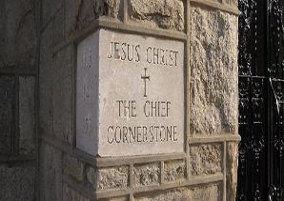
2 Timothy 4:20
“Erastus remained at Corinth, but Trophimus I left sick at Miletus.”

Slide 21
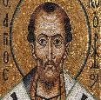
Chrysostom (A.D. 345‒407)
Patriarch of Constantinople
Chrysostom, Homily 29 on First Corinthians.
“This whole place is very obscure: but the obscurity is produced by our ignorance of the facts referred to and by their cessation, being such as then used to occur but now no longer take place. And why do they not happen now? Why look now, the cause too of the obscurity has produced us again another question: namely, why did they then happen, and now do so no more?”

Slide 22
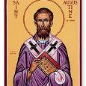
Augustine (A.D. 354‒430)
Bishop of Hippo
Homily 6:10 on the First Epistle of John.
“In the earliest times, the Holy Ghost fell upon them that believed: and they spoke with tongues, which they had not learned, as the Spirit gave them utterance. Acts 2:4 These were signs adapted to the time. For there behooved to be that betokening of the Holy Spirit in all tongues, to show that the Gospel of God was to run through all tongues over the whole earth. That thing was done for a betokening, and it passed away. . . . If then the witness of the presence of the Holy Ghost be not now given through these miracles, by what is it given, by what does one get to know that he has received the Holy Ghost?”

Slide 23

Philip Schaff
History of the Christian Church, vol. 1 , p. 236-37.
“We do not know how long the glossolalia, as thus described by Paul, continued. It passed away gradually with the other extraordinary or strictly supernatural gifts of the apostolic age. It is not mentioned in the Pastoral, nor in the Catholic Epistles. We have but a few allusions to it at the close of the second century. Irenæus (Adv. Haer. 1. v. c. 6 § 1,) speaks of ‘many brethren’ whom he heard in the church having the gift of prophecy and of speaking in ‘diverse tongues’ (παντοδαπαῖς γλώσσαις), bringing the hidden things of men (τὰ κρύφια τῶν ἀνθρώπων) to light and expounding the mysteries of God (τὰ μυστήρια τοῦ θεοῦ). It is not clear whether by the term ‘diverse,’ which does not elsewhere occur, he means a speaking in foreign languages, or in diversities of tongues altogether peculiar, like those meant by Paul.”

Slide 24
Philip Schaff
History of the Christian Church, vol. 1 , p. 236-37.
“The latter is more probable. Irenæus himself had to learn the language of Gaul. Tertullian (Adv. Marc. V. 8; comp. De Anima, c. 9) obscurely speaks of the spiritual gifts, including the gift of tongues, as being still manifest among the Montanists to whom he belonged. At the time of Chrysostom it had entirely disappeared; at least he accounts for the obscurity of the gift from our ignorance of the fact. From that time on the glossolalia was usually misunderstood as a miraculous and permanent gift of foreign languages for missionary purposes. But the whole history of missions furnishes no clear example of such a gift for such a purpose.”

Slide 25
9 Ways Kingdom Now Theology
Impacts the Church
Loss of “pilgrim” status
Social Gospel
Ecumenical & interfaith alliances
Rejection or marginalization of Bible prophecy
Building the wrong kingdom
Charismatic theology
Prosperity Gospel
Anti-Israelism
Lordship Salvation

Slide 26
Isaiah 35:5-6
“⁵ Then the eyes of the blind will be opened And the ears of the deaf will be unstopped. ⁶ Then the lame will leap like a deer, And the tongue of the mute will shout for joy. For waters will break forth in the wilderness And streams in the Arabah.”

Slide 27


Amos 9:13
“Behold, days are coming,” declares the Lord,
“When the plowman will overtake the reaper
And the treader of grapes him who sows seed;
When the mountains will drip sweet wine
And all the hills will be dissolved.”

Slide 28
Isaiah 65:21-22
“²¹ They will build houses and inhabit them;
They will also plant vineyards and eat their fruit.
²² They will not build and another inhabit,
They will not plant and another eat;
For as the lifetime of a tree, so will be the days of My people, And My chosen ones will wear out the work of their hands.”

Slide 29
Zechariah 8:12
“For there will be peace for the seed: the vine will yield its fruit, the land will yield its produce and the heavens will give their dew; and I will cause the remnant of this people to inherit all these things.”

Slide 30

D.R. McConnell
A Different Gospel: A Bold and Revealing Look at the Historical Basis of the Word of Faith Movement, Updated and electronic ed. (Peabody, MA: Hendrickson, 2011), loc. 4813–4846.
“The Faith teachers deny that the kingdom of God is in the process of realization, claiming that it is present in the earth to the point that believers can be delivered from all sin, sickness, and poverty of the devil. They . . . claim that the believer has absolute authority to conquer and eradicate these forces of evil completely from his life. The only process of realization is in the faith of the believer, not in the presence of God’s kingdom. In the jargon of biblical theology, the Faith interpretation of the kingdom of God could be labeled as a ‘hyper-realized’ eschatology.”

Slide 31
D.R. McConnell
A Different Gospel: A Bold and Revealing Look at the Historical Basis of the Word of Faith Movement, Updated and electronic ed. (Peabody, MA: Hendrickson, 2011), loc. 4813–4846.
“The Faith eschatology is ‘hyper realized’ because of its extreme promises to the believer of a life which is absolutely invulnerable to any type of evil. It claims ‘that the powers of the age to come’ have completely come in this life and that these powers can be used at will by the believer with enough faith and knowledge of how to operate them. There is no process of realization of God’s kingdom in Faith eschatology; the kingdom can be completely realized in the lives of those who exercise Faith principles. We see this hyper-realized eschatology in the Faith doctrines of healing, authority, prosperity, identification and deification. The over-realized nature of Faith eschatology emphasizes the ‘Now’ of the kingdom of God. . . . The . . . ‘Not yet’ mystery of the kingdom and its powers is distorted by the hyper-realized eschatology of the Faith movement.”

Slide 32
Galatians 4:13-14
“¹³ but you know that it was because of a bodily illness that I preached the gospel to you the first time; ¹⁴ and that which was a trial to you in my bodily condition you did not despise or loathe, but you received me as an angel of God, as Christ Jesus Himself.”

Slide 33
1 Timothy 5:23
“No longer drink water exclusively, but use a little wine for the sake of your stomach and your frequent ailments.”

Slide 34
Order of Paul’s Letters
Galatians (A.D. 49)
1‒2 Thessalonians (A.D. 51)
1‒2 Corinthians (A.D. 56)
Romans (A.D. 57)
Ephesians, Colossians, Philemon, Philippians (A.D. 60‒62)
1 Timothy, Titus (A.D. 62‒66)
2 Timothy (A.D. 67)

Slide 35
2 Timothy 4:20
“Erastus remained at Corinth, but Trophimus I left sick at Miletus.”

Slide 36

Revelation 2:9
“I know your tribulation and your poverty (but you are rich), and the blasphemy by those who say they are Jews and are not, but are a synagogue of Satan.”

Slide 37
Conclusion

Slide 38
9 Ways Kingdom Now Theology
Impacts the Church
Loss of “pilgrim” status
Social Gospel
Ecumenical & interfaith alliances
Rejection or marginalization of Bible prophecy
Building the wrong kingdom
Charismatic theology
Prosperity Gospel
Anti-Israelism
Lordship Salvation

