Slide 1


Dr. Andy Woods
Senior Pastor – Sugar Land Bible Church
President – Chafer Theological Seminary

Slide 2


Slide 3
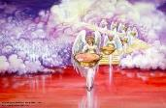

Seven Bowls
(Revelation 16)
1st Bowl (16:1-2) – Boils
2nd Bowl (16:3) – Sea becomes blood
3rd Bowl (16:4-7) – Freshwater destroyed
4th Bowl (16:8-9) – Sun scorches man
5th Bowl (16:10-11) – Darkness
6th Bowl (16:13-16) – Euphrates dried
7th Bowl (16:17-21) – Greatest earthquake

Slide 4
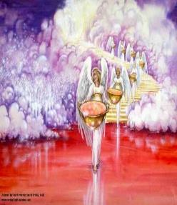
7. The Seventh Bowl
Revelation 16:17-21
7th angel pours out the bowl (17)
Lightning & thunder (18a)
Greatest earthquake (18b)
Jerusalem destroyed (19a)
Babylon destroyed (19b)
Every mountain & island moved (20)
100-pound hailstones (21a)
Man’s sinful reaction (21b)

Slide 5

Revelation 16:19
“The great city was split into three parts, and the cities of the nations fell. Babylon the great was remembered before God, to give her the cup of the wine of His fierce wrath.”

Slide 6


Revelation 17:1
“Then one of the seven angels who had the seven bowls came and spoke with me, saying, “Come here, I will show you the judgment of the great harlot who sits on many waters.”

Slide 7
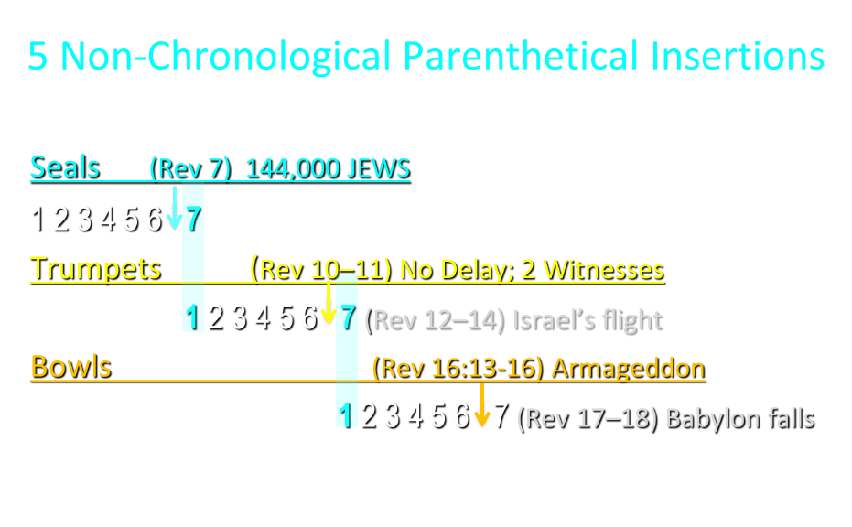

Slide 8
5 Non-Chronological Parenthetical Insertions
Rev 7 – 144,000 Jews
Rev 10:1-11:13 – Announcement of no more delay and the two witnesses
Rev 12-14 – Israel’s flight, two beasts, six scenes of hope
Rev 16:13-16 – Gathering of the nations to Armageddon
Rev 17:1-19:6 – Babylon’s fall

Slide 9
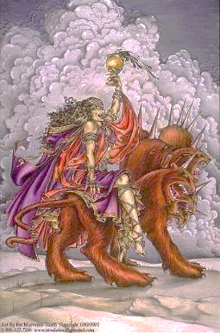
The Woman Rides the Beast
Revelation 17
The Vision Concerning Babylon (1-6a)
The Interpretation Concerning Babylon (6b-18)

Slide 10
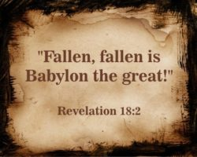
The Great City of Babylon
Revelation 18
The Prediction of Babylon’s Fall (18:1-3)
The Appeal to Separate From Babylon (18:4-8)
The Reactions to Babylon’s Fall (18:9-20)
The Description of Babylon’s Fall (18:21-24)

Slide 11
The Great City of Babylon
Revelation 18
The Prediction of Babylon’s Fall (18:1-3)
The Appeal to Separate From Babylon (18:4-8)
The Reactions to Babylon’s Fall (18:9-20)
The Description of Babylon’s Fall (18:21-24)

Slide 12
The Great City of Babylon
Revelation 18
The Prediction of Babylon’s Fall (18:1-3)
The Appeal to Separate From Babylon (18:4-8)
The Reactions to Babylon’s Fall (18:9-20)
The Description of Babylon’s Fall (18:21-24)

Slide 13
The Great City of Babylon
Revelation 18
The Prediction of Babylon’s Fall (18:1-3)
The Appeal to Separate From Babylon (18:4-8)
The Reactions to Babylon’s Fall (18:9-20)
The Description of Babylon’s Fall (18:21-24)

Slide 14
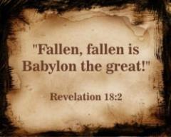
III. The Reactions Babylon’s Fall
Revelation 18:9-20
The Kings (9-10)
The Merchants (11-16)
The Sea Merchants (17-19)
Those in Heaven (20)

Slide 15
III. The Reactions Babylon’s Fall
Revelation 18:9-20
The Kings (9-10)
The Merchants (11-16)
The Sea Merchants (17-19)
Those in Heaven (20)

Slide 16
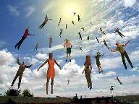
When Will the Rapture Take Place Relative to the Tribulation Period?
Pre-tribulation rapture theory
Mid-tribulation rapture theory
Post-tribulation rapture theory
Pre-wrath rapture theory
Partial rapture theory

Slide 17


Slide 18

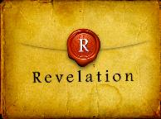
Revelation 1:19
“Therefore write the things which you have seen, and the things which are, and the things which will take place after these things [meta tauta].”

Slide 19

Revelation 1:19
Seen (Chapter 1)
Are (Chapters 2–3)
After these things (Chapters 4–22)

Slide 20

Psalm 50:5 (NKJV)
“Gather My saints together to Me,
Those who have made a covenant with Me by sacrifice.”

Slide 21
Psalm 149:1 (NKJV)
“Praise the Lord! Sing to the Lord a new song, And His praise in the assembly of saints.”

Slide 22
Parallels Between Jeremiah 50-51 & Revelation 17-18
 | Jeremiah | Revelation
Associated with a Golden cup | 51:7a | 17:3-4; 18:6
Dwelling on many waters | 51:13 | 17:1
Intoxicating the nations | 51:7b | 17:2
Same name | 50:1 | 17:5
Persecution of the saints | 51:49 | 17:6; 18:24
Stone sinking into Euphrates | 51:63-64 | 18:21
Sudden destruction | 51:8 | 18:8
Destroyed by fire | 51:30 | 17:16
Final, uninhabitable | 50:39 | 18:21
Deserved | 50:29 | 18:6
God’s people flee | 51:6, 45 | 18:4
Heaven rejoices | 51:48 | 18:20
Dyer, "The Identity of Babylon in Revelation 17–18 (Part 2)," 441-43.

Slide 23
The Great City of Babylon
Revelation 18
The Prediction of Babylon’s Fall (18:1-3)
The Appeal to Separate From Babylon (18:4-8)
The Reactions to Babylon’s Fall (18:9-20)
The Description of Babylon’s Fall (18:21-24)

Slide 24
II. The Description of Babylon’s Fall
Revelation 18:21-24
Description (21)
Nine Affected Groups (22-23a)
Cause (23b-24)
  Sorcery (23b)
  Martyrdoms (24)

Slide 25
II. The Description of Babylon’s Fall
Revelation 18:21-24
Description (21)
Nine Affected Groups (22-23a)
Cause (23b-24)
  Sorcery (23b)
  Martyrdoms (24)

Slide 26
Parallels Between Jeremiah 50-51 & Revelation 17-18
 | Jeremiah | Revelation
Associated with a Golden cup | 51:7a | 17:3-4; 18:6
Dwelling on many waters | 51:13 | 17:1
Intoxicating the nations | 51:7b | 17:2
Same name | 50:1 | 17:5
Persecution of the saints | 51:49 | 17:6; 18:24
Stone sinking into Euphrates | 51:63-64 | 18:21
Sudden destruction | 51:8 | 18:8
Destroyed by fire | 51:30 | 17:16
Final, uninhabitable | 50:39 | 18:21
Deserved | 50:29 | 18:6
God’s people flee | 51:6, 45 | 18:4
Heaven rejoices | 51:48 | 18:20
Dyer, "The Identity of Babylon in Revelation 17–18 (Part 2)," 441-43.

Slide 27
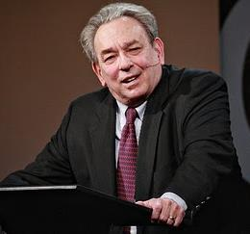
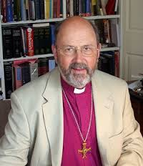
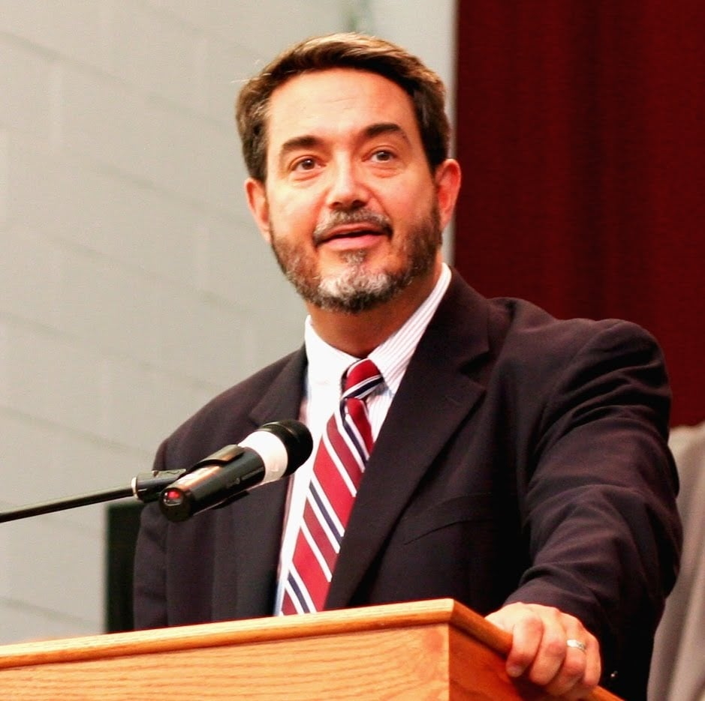


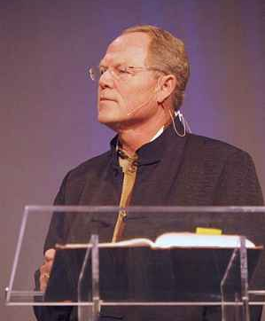
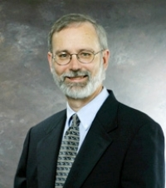
Preterism Advocates
Recent Preterist Commentators
  R.C. Sproul
  N.T. Wright
  Scott Hahn
  J. Massyngbaerde Ford
  David Chilton
  Hank Hanegraaff
  Kenneth Gentry

Slide 28
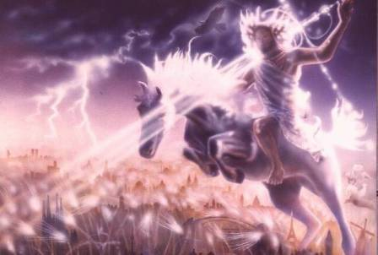
Isaiah 13-14
Day of the Lord (13:6-9)
Cosmic disturbances (13:10-13)
Global judgment (13:11-12)
Sodom and Gomorrah (13:19)
Complete and final desolation (13:20-22)
Universal peace and rest (14:5-8)
Israel’s regeneration (14:1-4)
Morris, Revelation Record, 348.

Slide 29
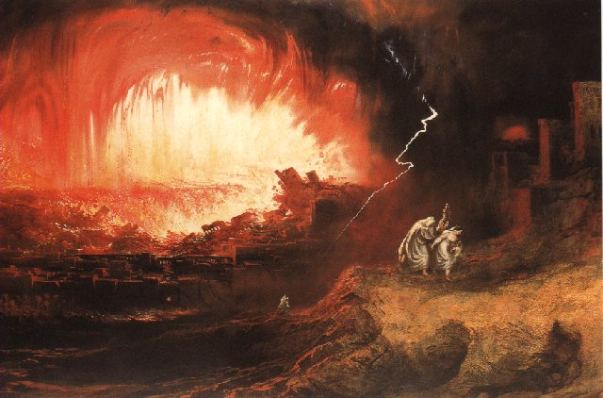
Jeremiah 50-51
Sudden destruction (51:8)
Complete destruction (50:3, 13, 26, 39-40; 51:29, 43, 62)
No reuse of building materials (51:26)
Believers flee (50:8; 51:6, 45)
Israel’s regeneration (50:2, 4-5, 20; 51:50)
Dyer, "The Identity of Babylon in Revelation 17–18 (Part 2)," 443-49.

Slide 30
Parallels Between Jeremiah 50-51 & Revelation 17-18
 | Jeremiah | Revelation
Associated with a Golden cup | 51:7a | 17:3-4; 18:6
Dwelling on many waters | 51:13 | 17:1
Intoxicating the nations | 51:7b | 17:2
Same name | 50:1 | 17:5
Persecution of the saints | 51:49 | 17:6; 18:24
Stone sinking into Euphrates | 51:63-64 | 18:21
Sudden destruction | 51:8 | 18:8
Destroyed by fire | 51:30 | 17:16
Final, uninhabitable | 50:39 | 18:21
Deserved | 50:29 | 18:6
God’s people flee | 51:6, 45 | 18:4
Heaven rejoices | 51:48 | 18:20
Dyer, "The Identity of Babylon in Revelation 17–18 (Part 2)," 441-43.

Slide 31
Babylon’s History After 539 B.C.
Herodotus gives Babylon’s measurements (450 B.C.)
Alexander the Great visits and dies in Babylon (323 B.C.)
Seleucus seizes Babylon (312 B.C.)
Strabo pronounces Babylon’s hanging gardens as one of “seven wonders of the world” (25 B.C)
Babylonians present on Pentecost (Acts 2:9)
Talmud promulgated from Babylon (A.D. 500)
Haukal mentions Babylonian village (A.D. 917)
Babylon known as “Two Mosques” and “Hilah” (A.D. 1100)
Hitchcock and Ice, The Truth Behind Left Behind, 109

Slide 32

John F. Walvoord
The Nations in Prophecy, 63-64
“As far as the historic fulfillment is concerned, it is obvious from both Scripture and history that these verses have not been literally fulfilled. The city of Babylon continued to flourish after the Medes conquered it, and though its glory dwindled, especially after the control of the Medes and the Persians ended in 323 B.C., the city continued in some form or substance until A.D. 1000 and did not experience a sudden termination such as anticipated in this prophecy.”

Slide 33
Isaiah 2:2-3
“Now it will come about that In the last days The mountain of the house of the Lord Will be established as the chief of the mountains, And will be raised above the hills; And all the nations will stream to it.³ And many peoples will come and say, ‘Come, let us go up to the mountain of the Lord, To the house of the God of Jacob; That He may teach us concerning His ways And that we may walk in His paths.’ For the law will go forth from Zion And the word of the Lord from Jerusalem.”

Slide 34
Zechariah 14:16-18
“Then it will come about that any who are left of all the nations that went against Jerusalem will go up from year to year to worship the King, the Lord of hosts, and to celebrate the Feast of Booths. ¹⁷ And it will be that whichever of the families of the earth does not go up to Jerusalem to worship the King, the Lord of hosts, there will be no rain on them. ¹⁸ If the family of Egypt does not go up or enter, then no rain will fall on them; it will be the plague with which the Lord smites the nations who do not go up to celebrate the Feast of Booths.”

Slide 35

Robert Thomas
Four Views on the Book of Revelation, page 207.
“At the end of the Millennium that city will be Satan’s prime objective with his rebel army, because Israel will be a leader among the nations.”

Slide 36
II. The Description of Babylon’s Fall
Revelation 18:21-24
Description (21)
Nine Affected Groups (22-23a)
Cause (23b-24)
  Sorcery (23b)
  Martyrdoms (24)

Slide 37
II. The Description of Babylon’s Fall
Revelation 18:21-24
Description (21)
Nine Affected Groups (22-23a)
Cause (23b-24)
  Sorcery (23b)
  Martyrdoms (24)

Slide 38
II. The Description of Babylon’s Fall
Revelation 18:21-24
Description (21)
Nine Affected Groups (22-23a)
Cause (23b-24)
  Sorcery (23b)
  Martyrdoms (24)

Slide 39
Genesis 11:1-4
¹ Now the whole earth used the same language and the same words. ² It came about as they journeyed east, that they found a plain in the land of Shinar and settled there. ³ They said to one another, “Come, let us make bricks and burn them thoroughly.” And they used brick for stone, and they used tar for mortar. ⁴ They said, “Come, let us build for ourselves a city, and a tower whose top will reach into heaven, and let us make for ourselves a name, otherwise we will be scattered abroad over the face of the whole earth.”

Slide 40
Spread of the Mother-Child Cult
 | Mother | Child
Assyria | Ishtar | Tammuz
Phoenicia | Astarte | Baal
Egypt | Isis | Osirus/Horus
Greece | Aphrodite | Eros
Rome | Venus | Cupid
Asia | Cybele | Desius
India | Isi | Aswara
Roman Catholicism | Mary | Jesus
Israel | Queen of Heaven (Jer. 7:18; 44:17) | Tammuz (Ezek. 8:14-15)
Alexander Hislop, Two Babylons

Slide 41
OT Descriptions of Babylon in Rev 17–18
 | Revelation 17–18 | Old Testament
Waters | 17:1 | Psalm 137:1
Babylon the Great | 17:5 | Daniel 4:30
Mother harlots | 17:5 | Genesis 11:1-9
Fallen, fallen is Babylon | 18:2 | Isaiah 21:9
Will not see widowhood | 18:7 | Isaiah 47:7-9
Colorful attire | 17:4; 18:16 | Daniel 5:7, 16, 29
Sorcery | 18:23 | 1saiah 47:9-13
Destroyed in a day | 18:8, 10 | Daniel 5:30

Slide 42

Revelation 9:20-21
“The rest of mankind, who were not killed by these plagues, did not repent of the works of their hands, so as not to worship demons, and the idols of gold and of silver and of brass and of stone and of wood, which can neither see nor hear nor walk; ²¹ and they did not repent of their murders nor of their sorceries (pharmakeia) nor of their immorality nor of their thefts.”

Slide 43
II. The Description of Babylon’s Fall
Revelation 18:21-24
Description (21)
Nine Affected Groups (22-23a)
Cause (23b-24)
  Sorcery (23b)
  Martyrdoms (24)

Slide 44
Parallels Between Jeremiah 50-51 & Revelation 17-18
 | Jeremiah | Revelation
Associated with a Golden cup | 51:7a | 17:3-4; 18:6
Dwelling on many waters | 51:13 | 17:1
Intoxicating the nations | 51:7b | 17:2
Same name | 50:1 | 17:5
Persecution of the saints | 51:49 | 17:6; 18:24
Stone sinking into Euphrates | 51:63-64 | 18:21
Sudden destruction | 51:8 | 18:8
Destroyed by fire | 51:30 | 17:16
Final, uninhabitable | 50:39 | 18:21
Deserved | 50:29 | 18:6
God’s people flee | 51:6, 45 | 18:4
Heaven rejoices | 51:48 | 18:20
Dyer, "The Identity of Babylon in Revelation 17–18 (Part 2)," 441-43.

Slide 45
When Will the Rapture Take Place Relative to the Tribulation Period?
Pre-tribulation rapture theory
Mid-tribulation rapture theory
Post-tribulation rapture theory
Pre-wrath rapture theory
Partial rapture theory

Slide 47
Revelation 1:19
“Therefore write the things which you have seen, and the things which are, and the things which will take place after these things [meta tauta].”

Slide 48
Revelation 1:19
Seen (Chapter 1)
Are (Chapters 2–3)
After these things (Chapters 4–22)

Slide 49
Psalm 50:5 (NKJV)
“Gather My saints together to Me,
Those who have made a covenant with Me by sacrifice.”

Slide 50
Psalm 149:1 (NKJV)
“Praise the Lord! Sing to the Lord a new song, And His praise in the assembly of saints.”

Slide 51


Slide 52
Conclusion

Slide 53
The Great City of Babylon
Revelation 18
The Prediction of Babylon’s Fall (18:1-3)
The Appeal to Separate From Babylon (18:4-8)
The Reactions to Babylon’s Fall (18:9-20)
The Description of Babylon’s Fall (18:21-24)

Slide 54

“The Lord bless you and keep you; the Lord make his face shine on you and be gracious to you; the Lord turn his face toward you and give you peace.” (NIV)

