Slide 1
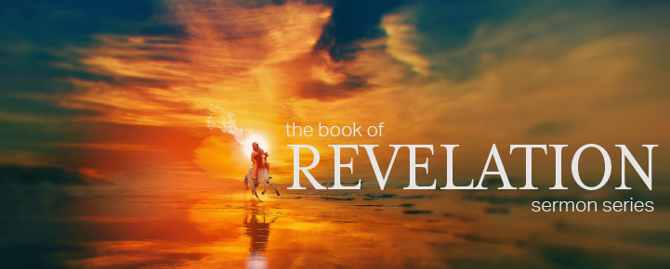

Dr. Andy Woods
Senior Pastor – Sugar Land Bible Church
President – Chafer Theological Seminary

Slide 2


Slide 3
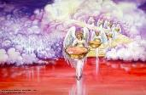

Seven Bowls
(Revelation 16)
1st Bowl (16:1-2) – Boils
2nd Bowl (16:3) – Sea becomes blood
3rd Bowl (16:4-7) – Freshwater destroyed
4th Bowl (16:8-9) – Sun scorches man
5th Bowl (16:10-11) – Darkness
6th Bowl (16:13-16) – Euphrates dried
7th Bowl (16:17-21) – Greatest earthquake

Slide 4
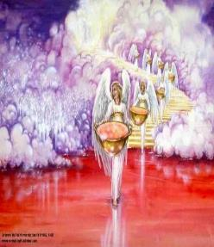
7. The Seventh Bowl
Revelation 16:17-21
7th angel pours out the bowl (17)
Lightning & thunder (18a)
Greatest earthquake (18b)
Jerusalem destroyed (19a)
Babylon destroyed (19b)
Every mountain & island moved (20)
100-pound hailstones (21a)
Man’s sinful reaction (21b)

Slide 5

Revelation 16:19
“The great city was split into three parts, and the cities of the nations fell. Babylon the great was remembered before God, to give her the cup of the wine of His fierce wrath.”

Slide 6


Revelation 17:1
“Then one of the seven angels who had the seven bowls came and spoke with me, saying, “Come here, I will show you the judgment of the great harlot who sits on many waters.”

Slide 7
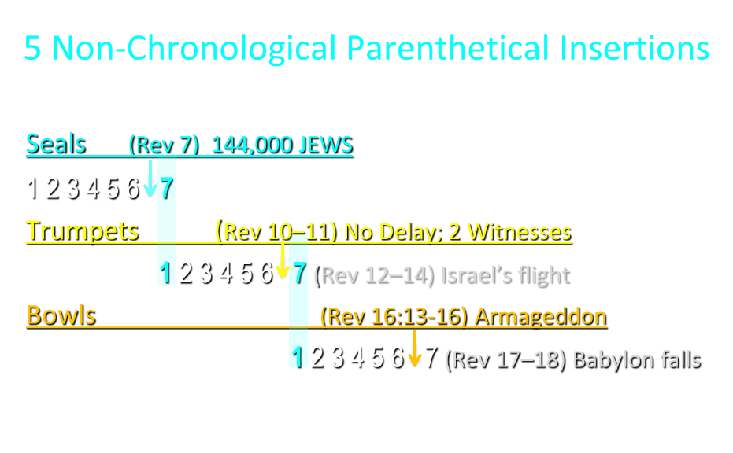

Slide 8
5 Non-Chronological Parenthetical Insertions
Rev 7 – 144,000 Jews
Rev 10:1-11:13 – Announcement of no more delay and the two witnesses
Rev 12-14 – Israel’s flight, two beasts, six scenes of hope
Rev 16:13-16 – Gathering of the nations to Armageddon
Rev 17:1-19:6 – Babylon’s fall

Slide 9
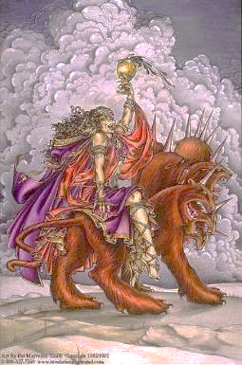
The Woman Rides the Beast
Revelation 17
The Vision Concerning Babylon (1-6a)
The Interpretation Concerning Babylon (6b-18)

Slide 10
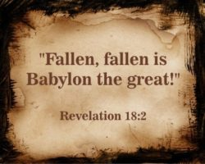
The Great City of Babylon
Revelation 18
The Prediction of Babylon’s Fall (18:1-3)
The Appeal to Separate From Babylon (18:4-8)
The Reactions to Babylon’s Fall (18:9-20)
The Description of Babylon’s Fall (18:21-24)

Slide 11
The Great City of Babylon
Revelation 18
The Prediction of Babylon’s Fall (18:1-3)
The Appeal to Separate From Babylon (18:4-8)
The Reactions to Babylon’s Fall (18:9-20)
The Description of Babylon’s Fall (18:21-24)

Slide 12
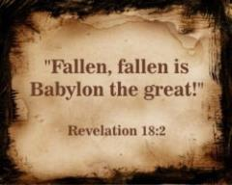
I. The Prediction of Babylon’s Fall
Revelation 18:1-3
Proclamation (1-2a)
Reasons (2b-3)
  Demonic Involvement (2b)
  Corruption of Nations (3a)
  Corruption of Kings (3b)
  Corruption of Merchants (3c)

Slide 13
The Great City of Babylon
Revelation 18
The Prediction of Babylon’s Fall (18:1-3)
The Appeal to Separate From Babylon (18:4-8)
The Reactions to Babylon’s Fall (18:9-20)
The Description of Babylon’s Fall (18:21-24)

Slide 14
II. Appeal to Separate From Babylon
Revelation 18:4-8
Appeal (4)
Reasons (5-8)
  Her Sins (5)
  Her Retribution (6)
  Her Arrogance (7)
  Her Destruction (8)

Slide 15
The Great City of Babylon
Revelation 18
The Prediction of Babylon’s Fall (18:1-3)
The Appeal to Separate From Babylon (18:4-8)
The Reactions to Babylon’s Fall (18:9-20)
The Description of Babylon’s Fall (18:21-24)

Slide 16
III. The Reactions Babylon’s Fall
Revelation 18:9-20
The Kings (9-10)
The Merchants (11-16)
The Sea Merchants (17-19)
Those in Heaven (20)

Slide 17
III. The Reactions Babylon’s Fall
Revelation 18:9-20
The Kings (9-10)
The Merchants (11-16)
The Sea Merchants (17-19)
Those in Heaven (20)

Slide 18
Two Babylons View
BABYLON | Ecclesiastical | Commercial
Chapter | Revelation 17 | Revelation 18
Literalness | Not literal | Literal
Time of Destruction | 1st half of Tribulation | Second Advent
Emphasis | Religion | Commercial & Political

Slide 19
Two Babylons View?
 | TWO BABYLON’S ARGUMENT | SINGLE BABYLON RESPONSE
1. Chapter division | Different prophetic subject | Non-inspired chapter divisions
2. “After these things” (18:1) | Takes place later chronologically (1:19; 4:1b; 9:12; 20:3) | Sequence in which visions were shown to John (4:1a; 7:1, 9; 15:5; 19:1)
3. “Another angel” (18:1) | A new vision (10:1; 14:6, 8, 9) | Same vision (7:2; 8:3; 14:15, 17, 18)

Slide 20
Two Babylons View?
 | TWO BABYLON’S ARGUMENT | SINGLE BABYLON RESPONSE
4. Different Destructions | Destroyed by the kings (Rev. 17:16) vs. destroyed by God (18:9) | Destroyed by God (17:17; 18:9) and by fire (17:16; 18:8-9, 18)
5. Different reactions | Kings hate Babylon (17:16) vs. kings weep over Babylon (18:9) | Kings united with the Beast (17:16) vs. kings united with Babylon (Rev. 18:9)
6. Different symbols | Woman (17:3) vs. a city (18:10) | Woman called a city (17:18; 18:10)

Slide 21

Revelation 17:3
“And he carried me away in the Spirit into a wilderness; and I saw a woman sitting on a scarlet beast, full of blasphemous names, having seven heads and ten horns.”

Slide 22
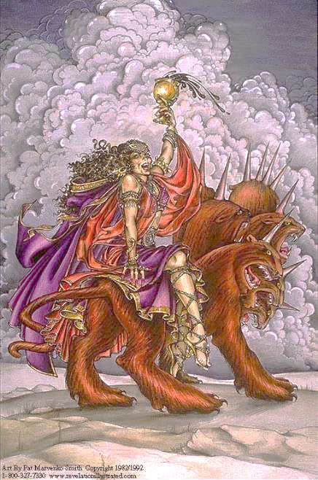

Slide 23
Parallels Between Jeremiah 50-51 & Revelation 17-18
 | Jeremiah | Revelation
Associated with a Golden cup | 51:7a | 17:3-4; 18:6
Dwelling on many waters | 51:13 | 17:1
Intoxicating the nations | 51:7b | 17:2
Same name | 50:1 | 17:5
Persecution of the saints | 51:49 | 17:6; 18:24
Stone sinking into Euphrates | 51:63-64 | 18:21
Sudden destruction | 51:8 | 18:8
Destroyed by fire | 51:30 | 17:16
Final, uninhabitable | 50:39 | 18:21
Deserved | 50:29 | 18:6
God’s people flee | 51:6, 45 | 18:4
Heaven rejoices | 51:48 | 18:20
Dyer, "The Identity of Babylon in Revelation 17–18 (Part 2)," 441-43.

Slide 24
ONE BABYLON
 | Rev. 17 | Rev. 18
Same name | 17:5 | 18:2
City | 17:18 | 18:10
Same clothing | 17:4 | 18:16
Holding a cup | 17:4 | 18:6
Fornicating with Kings | 17:2 | 18:3
Drunk with wine of immorality | 17:2 | 18:3
Persecuting believers | 17:6 | 18:20, 24
Destroyed by fire | 17:16 | 18:8, 18
Destroyed by God | 17:17 | 18:5, 8
Dyer, "The Identity of Babylon in Revelation 17–18 (Part 1)," 311-13.

Slide 25
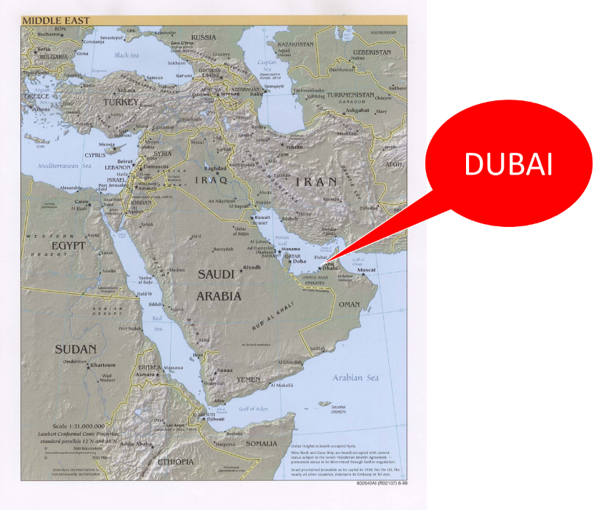

Slide 26
OT Descriptions of Babylon in Rev 17–18
 | Revelation 17–18 | Old Testament
Waters | 17:1 | Psalm 137:1
Babylon the Great | 17:5 | Daniel 4:30
Mother harlots | 17:5 | Genesis 11:1-9
Fallen, fallen is Babylon | 18:2 | Isaiah 21:9
Will not see widowhood | 18:7 | Isaiah 47:7-9
Colorful attire | 17:4; 18:16 | Daniel 5:7, 16, 29
Sorcery | 18:23 | 1saiah 47:9-13
Destroyed in a day | 18:8, 10 | Daniel 5:30

Slide 27
OT Descriptions of Babylon in Rev 17–18
 | Revelation 17–18 | Old Testament
Waters | 17:1 | Psalm 137:1
Babylon the Great | 17:5 | Daniel 4:30
Mother harlots | 17:5 | Genesis 11:1-9
Fallen, fallen is Babylon | 18:2 | Isaiah 21:9
Will not see widowhood | 18:7 | Isaiah 47:7-9
Colorful attire | 17:4; 18:16 | Daniel 5:7, 16, 29
Sorcery | 18:23 | 1saiah 47:9-13
Destroyed in a day | 18:8, 10 | Daniel 5:30

Slide 28
III. The Reactions Babylon’s Fall
Revelation 18:9-20
The Kings (9-10)
The Merchants (11-16)
The Sea Merchants (17-19)
Those in Heaven (20)

Slide 29
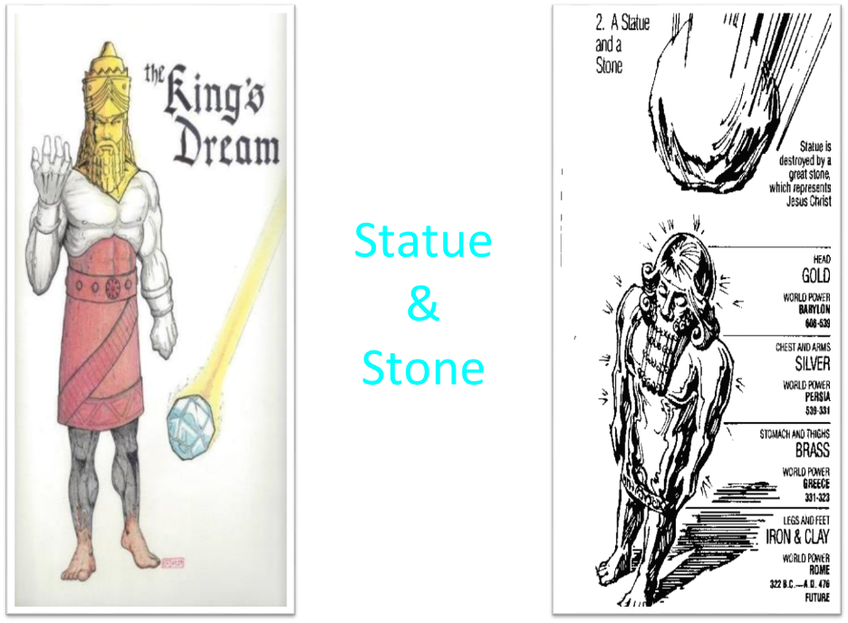

Slide 30


Daniel 2:37-38
You, O king, are the king of kings, to whom the God of heaven has given the kingdom, the power, the strength and the glory; ³⁸ and wherever the sons of men dwell, or the beasts of the field, or the birds of the sky, He has given them into your hand and has caused you to rule over them all. You are the head of gold.

Slide 31
OT Descriptions of Babylon in Rev 17–18
 | Revelation 17–18 | Old Testament
Waters | 17:1 | Psalm 137:1
Babylon the Great | 17:5 | Daniel 4:30
Mother harlots | 17:5 | Genesis 11:1-9
Fallen, fallen is Babylon | 18:2 | Isaiah 21:9
Will not see widowhood | 18:7 | Isaiah 47:7-9
Colorful attire | 17:4; 18:16 | Daniel 5:7, 16, 29
Sorcery | 18:23 | 1saiah 47:9-13
Destroyed in a day | 18:8, 10 | Daniel 5:30

Slide 32
June 2007 Conventional Oil Reserves
Rank | Country | Percentage of oil reserves
1 | Saudia Arabia | 21.9 %
2 | Iran | 11.4 %
3 | Iraq | 9.5 %
4 | Kuwait | 8.4 %
5 | United Arab Emirates | 8.1 %
6 | Venezuela | 6.6 %
7 | Russia | 6.6 %
8 | Libya | 3.4 %
David Jeremiah, What in the World is Going On, 207

Slide 33
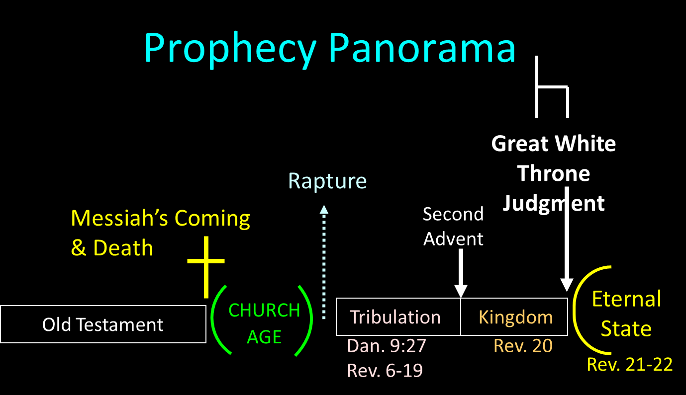

Slide 34

Genesis 1:26-28
²⁶ Then God said, “Let Us make man in Our image, according to Our likeness; and let them rule over the fish of the sea and over the birds of the sky and over the cattle and over all the earth, and over every creeping thing that creeps on the earth.” ²⁷ God created man in His own image, in the image of God He created him; male and female He created them. ²⁸ God blessed them; and God said to them, “Be fruitful and multiply, and fill the earth, and subdue it; and rule over the fish of the sea and over the birds of the sky and over every living thing that moves on the earth.”

Slide 35


Slide 37
OT Descriptions of Babylon in Rev 17–18
 | Revelation 17–18 | Old Testament
Waters | 17:1 | Psalm 137:1
Babylon the Great | 17:5 | Daniel 4:30
Mother harlots | 17:5 | Genesis 11:1-9
Fallen, fallen is Babylon | 18:2 | Isaiah 21:9
Will not see widowhood | 18:7 | Isaiah 47:7-9
Colorful attire | 17:4; 18:16 | Daniel 5:7, 16, 29
Sorcery | 18:23 | 1saiah 47:9-13
Destroyed in a day | 18:8, 10 | Daniel 5:30

Slide 38
OT Descriptions of Babylon in Rev 17–18
 | Revelation 17–18 | Old Testament
Waters | 17:1 | Psalm 137:1
Babylon the Great | 17:5 | Daniel 4:30
Mother harlots | 17:5 | Genesis 11:1-9
Fallen, fallen is Babylon | 18:2 | Isaiah 21:9
Will not see widowhood | 18:7 | Isaiah 47:7-9
Colorful attire | 17:4; 18:16 | Daniel 5:7, 16, 29
Sorcery | 18:23 | 1saiah 47:9-13
Destroyed in a day | 18:8, 10 | Daniel 5:30

Slide 39
ONE BABYLON
 | Rev. 17 | Rev. 18
Same name | 17:5 | 18:2
City | 17:18 | 18:10
Same clothing | 17:4 | 18:16
Holding a cup | 17:4 | 18:6
Fornicating with Kings | 17:2 | 18:3
Drunk with wine of immorality | 17:2 | 18:3
Persecuting believers | 17:6 | 18:20, 24
Destroyed by fire | 17:16 | 18:8, 18
Destroyed by God | 17:17 | 18:5, 8
Dyer, "The Identity of Babylon in Revelation 17–18 (Part 1)," 311-13.

Slide 40
III. The Reactions Babylon’s Fall
Revelation 18:9-20
The Kings (9-10)
The Merchants (11-16)
The Sea Merchants (17-19)
Those in Heaven (20)

Slide 41
OT Descriptions of Babylon in Rev 17–18
 | Revelation 17–18 | Old Testament
Waters | 17:1 | Psalm 137:1
Babylon the Great | 17:5 | Daniel 4:30
Mother harlots | 17:5 | Genesis 11:1-9
Fallen, fallen is Babylon | 18:2 | Isaiah 21:9
Will not see widowhood | 18:7 | Isaiah 47:7-9
Colorful attire | 17:4; 18:16 | Daniel 5:7, 16, 29
Sorcery | 18:23 | 1saiah 47:9-13
Destroyed in a day | 18:8, 10 | Daniel 5:30

Slide 42
Babylon Needs a Harbor?
“It was unacceptable to Saddam [Hussein] that a country as great as Iraq did not have a long coastline. Over and over he talked about the necessity of building a Navy and becoming a seafaring power. Iraq’s isolation from the sea was a cruel accident of history, he believed, and one that had to be rectified—a theme he continued to dwell on after his invasion of Kuwait.”
Elaine Sciolino, The Outlaw State: Saddam Hussein’s Quest for Power and the Gulf Crisis (New York: John Wiley & Sons, Inc., 1991), 191-192.

Slide 43
Babylon Needs a Harbor?
“Actually, the Tigris and Euphrates Rivers converge in southern Iraq and enter the Persian Gulf in Iraqi territory. The problem has been that Iran and Kuwait squeeze Iraq into a bottleneck at the mouth of the rivers and Iraq’s attempts to forge a harbor there have been thwarted by the hostile refusals of those two countries. But suppose international pressures were brought to bear upon Iran to allow Iraq access to the Shatt al-Arab waterway all the way to Basra and cooperation could be coerced from Kuwait to open up the area around its little island of Bubiyan and Warba.”
Dan Hayden, Iraq: In the Crosshairs of Destiny: What the Bible Says About the Future of Iraq (Altamonte Springs, FL: Advantage Books, 2008), 115.

Slide 44
Babylon Needs a Harbor?
“A commercial port and harbor for ships could become a reality for Babylon in a relatively short period of time. With modern dredging equipment, a deep channel waterway could be opened from the Persian Gulf all the way to Babylon. With its location on the Euphrates River, ships and sailors could indeed have access to this future queen of modern cities. The Antichrist ruler, with his political and economic power and global influence, could easily make that happen. So, as you can see, a harbor in Babylon is not at all out of the question.”
Dan Hayden, Iraq: In the Crosshairs of Destiny: What the Bible Says About the Future of Iraq (Altamonte Springs, FL: Advantage Books, 2008), 115.

Slide 45
Parallels Between Jeremiah 50-51 & Revelation 17-18
 | Jeremiah | Revelation
Associated with a Golden cup | 51:7a | 17:3-4; 18:6
Dwelling on many waters | 51:13 | 17:1
Intoxicating the nations | 51:7b | 17:2
Same name | 50:1 | 17:5
Persecution of the saints | 51:49 | 17:6; 18:24
Stone sinking into Euphrates | 51:63-64 | 18:21
Sudden destruction | 51:8 | 18:8
Destroyed by fire | 51:30 | 17:16
Final, uninhabitable | 50:39 | 18:21
Deserved | 50:29 | 18:6
God’s people flee | 51:6, 45 | 18:4
Heaven rejoices | 51:48 | 18:20
Dyer, "The Identity of Babylon in Revelation 17–18 (Part 2)," 441-43.

Slide 46
ONE BABYLON
 | Rev. 17 | Rev. 18
Same name | 17:5 | 18:2
City | 17:18 | 18:10
Same clothing | 17:4 | 18:16
Holding a cup | 17:4 | 18:6
Fornicating with Kings | 17:2 | 18:3
Drunk with wine of immorality | 17:2 | 18:3
Persecuting believers | 17:6 | 18:20, 24
Destroyed by fire | 17:16 | 18:8, 18
Destroyed by God | 17:17 | 18:5, 8
Dyer, "The Identity of Babylon in Revelation 17–18 (Part 1)," 311-13.

Slide 47
OT Descriptions of Babylon in Rev 17–18
 | Revelation 17–18 | Old Testament
Waters | 17:1 | Psalm 137:1
Babylon the Great | 17:5 | Daniel 4:30
Mother harlots | 17:5 | Genesis 11:1-9
Fallen, fallen is Babylon | 18:2 | Isaiah 21:9
Will not see widowhood | 18:7 | Isaiah 47:7-9
Colorful attire | 17:4; 18:16 | Daniel 5:7, 16, 29
Sorcery | 18:23 | 1saiah 47:9-13
Destroyed in a day | 18:8, 10 | Daniel 5:30

Slide 48
OT Descriptions of Babylon in Rev 17–18
 | Revelation 17–18 | Old Testament
Waters | 17:1 | Psalm 137:1
Babylon the Great | 17:5 | Daniel 4:30
Mother harlots | 17:5 | Genesis 11:1-9
Fallen, fallen is Babylon | 18:2 | Isaiah 21:9
Will not see widowhood | 18:7 | Isaiah 47:7-9
Colorful attire | 17:4; 18:16 | Daniel 5:7, 16, 29
Sorcery | 18:23 | 1saiah 47:9-13
Destroyed in a day | 18:8, 10 | Daniel 5:30

Slide 49
III. The Reactions Babylon’s Fall
Revelation 18:9-20
The Kings (9-10)
The Merchants (11-16)
The Sea Merchants (17-19)
Those in Heaven (20)

Slide 50
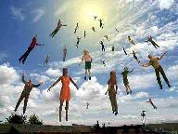
When Will the Rapture Take Place Relative to the Tribulation Period?
Pre-tribulation rapture theory
Mid-tribulation rapture theory
Post-tribulation rapture theory
Pre-wrath rapture theory
Partial rapture theory

Slide 51


Slide 52


Revelation 1:19
“Therefore write the things which you have seen, and the things which are, and the things which will take place after these things [meta tauta].”

Slide 53

Revelation 1:19
Seen (Chapter 1)
Are (Chapters 2–3)
After these things (Chapters 4–22)

Slide 54

Psalm 50:5 (NKJV)
“Gather My saints together to Me,
Those who have made a covenant with Me by sacrifice.”

Slide 55
Psalm 149:1 (NKJV)
“Praise the Lord! Sing to the Lord a new song, And His praise in the assembly of saints.”

Slide 56
Parallels Between Jeremiah 50-51 & Revelation 17-18
 | Jeremiah | Revelation
Associated with a Golden cup | 51:7a | 17:3-4; 18:6
Dwelling on many waters | 51:13 | 17:1
Intoxicating the nations | 51:7b | 17:2
Same name | 50:1 | 17:5
Persecution of the saints | 51:49 | 17:6; 18:24
Stone sinking into Euphrates | 51:63-64 | 18:21
Sudden destruction | 51:8 | 18:8
Destroyed by fire | 51:30 | 17:16
Final, uninhabitable | 50:39 | 18:21
Deserved | 50:29 | 18:6
God’s people flee | 51:6, 45 | 18:4
Heaven rejoices | 51:48 | 18:20
Dyer, "The Identity of Babylon in Revelation 17–18 (Part 2)," 441-43.

Slide 57
The Great City of Babylon
Revelation 18
The Prediction of Babylon’s Fall (18:1-3)
The Appeal to Separate From Babylon (18:4-8)
The Reactions to Babylon’s Fall (18:9-20)
The Description of Babylon’s Fall (18:21-24)

Slide 58
II. The Description of Babylon’s Fall
Revelation 18:21-24
Description (21)
Nine Affected Groups (22-23a)
Cause (23b-24)
  Sorcery (23b)
  Martyrdoms (24)

Slide 59
II. The Description of Babylon’s Fall
Revelation 18:21-24
Description (21)
Nine Affected Groups (22-23a)
Cause (23b-24)
  Sorcery (23b)
  Martyrdoms (24)

Slide 60
Parallels Between Jeremiah 50-51 & Revelation 17-18
 | Jeremiah | Revelation
Associated with a Golden cup | 51:7a | 17:3-4; 18:6
Dwelling on many waters | 51:13 | 17:1
Intoxicating the nations | 51:7b | 17:2
Same name | 50:1 | 17:5
Persecution of the saints | 51:49 | 17:6; 18:24
Stone sinking into Euphrates | 51:63-64 | 18:21
Sudden destruction | 51:8 | 18:8
Destroyed by fire | 51:30 | 17:16
Final, uninhabitable | 50:39 | 18:21
Deserved | 50:29 | 18:6
God’s people flee | 51:6, 45 | 18:4
Heaven rejoices | 51:48 | 18:20
Dyer, "The Identity of Babylon in Revelation 17–18 (Part 2)," 441-43.

Slide 61
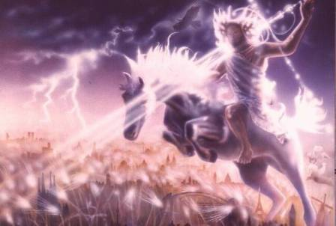
Isaiah 13-14
Day of the Lord (13:6-9)
Cosmic disturbances (13:10-13)
Global judgment (13:11-12)
Sodom and Gomorrah (13:19)
Complete and final desolation (13:20-22)
Universal peace and rest (14:5-8)
Israel’s regeneration (14:1-4)
Morris, Revelation Record, 348.

Slide 62
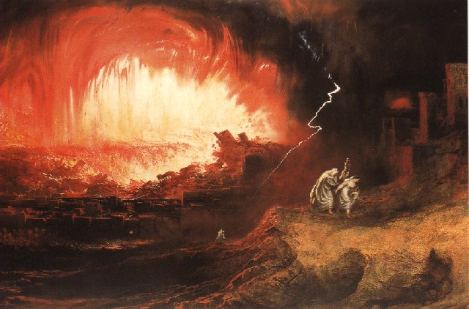
Jeremiah 50-51
Sudden destruction (51:8)
Complete destruction (50:3, 13, 26, 39-40; 51:29, 43, 62)
No reuse of building materials (51:26)
Believers flee (50:8; 51:6, 45)
Israel’s regeneration (50:2, 4-5, 20; 51:50)
Dyer, "The Identity of Babylon in Revelation 17–18 (Part 2)," 443-49.

Slide 63
Parallels Between Jeremiah 50-51 & Revelation 17-18
 | Jeremiah | Revelation
Associated with a Golden cup | 51:7a | 17:3-4; 18:6
Dwelling on many waters | 51:13 | 17:1
Intoxicating the nations | 51:7b | 17:2
Same name | 50:1 | 17:5
Persecution of the saints | 51:49 | 17:6; 18:24
Stone sinking into Euphrates | 51:63-64 | 18:21
Sudden destruction | 51:8 | 18:8
Destroyed by fire | 51:30 | 17:16
Final, uninhabitable | 50:39 | 18:21
Deserved | 50:29 | 18:6
God’s people flee | 51:6, 45 | 18:4
Heaven rejoices | 51:48 | 18:20
Dyer, "The Identity of Babylon in Revelation 17–18 (Part 2)," 441-43.

Slide 64
Babylon’s History After 539 B.C.
Herodotus gives Babylon’s measurements (450 B.C.)
Alexander the Great visits and dies in Babylon (323 B.C.)
Seleucus seizes Babylon (312 B.C.)
Strabo pronounces Babylon’s hanging gardens as one of “seven wonders of the world” (25 B.C)
Babylonians present on Pentecost (Acts 2:9)
Talmud promulgated from Babylon (A.D. 500)
Haukal mentions Babylonian village (A.D. 917)
Babylon known as “Two Mosques” and “Hilah” (A.D. 1100)
Hitchcock and Ice, The Truth Behind Left Behind, 109

Slide 65

John F. Walvoord
The Nations in Prophecy, 63-64
“As far as the historic fulfillment is concerned, it is obvious from both Scripture and history that these verses have not been literally fulfilled. The city of Babylon continued to flourish after the Medes conquered it, and though its glory dwindled, especially after the control of the Medes and the Persians ended in 323 B.C., the city continued in some form or substance until A.D. 1000 and did not experience a sudden termination such as anticipated in this prophecy.”

Slide 66
Isaiah 2:2-3
“Now it will come about that In the last days The mountain of the house of the Lord Will be established as the chief of the mountains, And will be raised above the hills; And all the nations will stream to it.³ And many peoples will come and say, ‘Come, let us go up to the mountain of the Lord, To the house of the God of Jacob; That He may teach us concerning His ways And that we may walk in His paths.’ For the law will go forth from Zion And the word of the Lord from Jerusalem.”

Slide 67
Zechariah 14:16-18
“Then it will come about that any who are left of all the nations that went against Jerusalem will go up from year to year to worship the King, the Lord of hosts, and to celebrate the Feast of Booths. ¹⁷ And it will be that whichever of the families of the earth does not go up to Jerusalem to worship the King, the Lord of hosts, there will be no rain on them. ¹⁸ If the family of Egypt does not go up or enter, then no rain will fall on them; it will be the plague with which the Lord smites the nations who do not go up to celebrate the Feast of Booths.”

Slide 68

Robert Thomas
Four Views on the Book of Revelation, page 207.
“At the end of the Millennium that city will be Satan’s prime objective with his rebel army, because Israel will be a leader among the nations.”

Slide 69
II. The Description of Babylon’s Fall
Revelation 18:21-24
Description (21)
Nine Affected Groups (22-23a)
Cause (23b-24)
  Sorcery (23b)
  Martyrdoms (24)

Slide 70
II. The Description of Babylon’s Fall
Revelation 18:21-24
Description (21)
Nine Affected Groups (22-23a)
Cause (23b-24)
  Sorcery (23b)
  Martyrdoms (24)

Slide 71
II. The Description of Babylon’s Fall
Revelation 18:21-24
Description (21)
Nine Affected Groups (22-23a)
Cause (23b-24)
  Sorcery (23b)
  Martyrdoms (24)

Slide 72
Genesis 11:1-4
¹ Now the whole earth used the same language and the same words. ² It came about as they journeyed east, that they found a plain in the land of Shinar and settled there. ³ They said to one another, “Come, let us make bricks and burn them thoroughly.” And they used brick for stone, and they used tar for mortar. ⁴ They said, “Come, let us build for ourselves a city, and a tower whose top will reach into heaven, and let us make for ourselves a name, otherwise we will be scattered abroad over the face of the whole earth.”

Slide 73
Spread of the Mother-Child Cult
 | Mother | Child
Assyria | Ishtar | Tammuz
Phoenicia | Astarte | Baal
Egypt | Isis | Osirus/Horus
Greece | Aphrodite | Eros
Rome | Venus | Cupid
Asia | Cybele | Desius
India | Isi | Aswara
Roman Catholicism | Mary | Jesus
Israel | Queen of Heaven (Jer. 7:18; 44:17) | Tammuz (Ezek. 8:14-15)
Alexander Hislop, Two Babylons

Slide 74
OT Descriptions of Babylon in Rev 17–18
 | Revelation 17–18 | Old Testament
Waters | 17:1 | Psalm 137:1
Babylon the Great | 17:5 | Daniel 4:30
Mother harlots | 17:5 | Genesis 11:1-9
Fallen, fallen is Babylon | 18:2 | Isaiah 21:9
Will not see widowhood | 18:7 | Isaiah 47:7-9
Colorful attire | 17:4; 18:16 | Daniel 5:7, 16, 29
Sorcery | 18:23 | 1saiah 47:9-13
Destroyed in a day | 18:8, 10 | Daniel 5:30

Slide 75

Revelation 9:20-21
“The rest of mankind, who were not killed by these plagues, did not repent of the works of their hands, so as not to worship demons, and the idols of gold and of silver and of brass and of stone and of wood, which can neither see nor hear nor walk; ²¹ and they did not repent of their murders nor of their sorceries (pharmakeia) nor of their immorality nor of their thefts.”

Slide 76
II. The Description of Babylon’s Fall
Revelation 18:21-24
Description (21)
Nine Affected Groups (22-23a)
Cause (23b-24)
  Sorcery (23b)
  Martyrdoms (24)

Slide 77
Parallels Between Jeremiah 50-51 & Revelation 17-18
 | Jeremiah | Revelation
Associated with a Golden cup | 51:7a | 17:3-4; 18:6
Dwelling on many waters | 51:13 | 17:1
Intoxicating the nations | 51:7b | 17:2
Same name | 50:1 | 17:5
Persecution of the saints | 51:49 | 17:6; 18:24
Stone sinking into Euphrates | 51:63-64 | 18:21
Sudden destruction | 51:8 | 18:8
Destroyed by fire | 51:30 | 17:16
Final, uninhabitable | 50:39 | 18:21
Deserved | 50:29 | 18:6
God’s people flee | 51:6, 45 | 18:4
Heaven rejoices | 51:48 | 18:20
Dyer, "The Identity of Babylon in Revelation 17–18 (Part 2)," 441-43.

Slide 78
When Will the Rapture Take Place Relative to the Tribulation Period?
Pre-tribulation rapture theory
Mid-tribulation rapture theory
Post-tribulation rapture theory
Pre-wrath rapture theory
Partial rapture theory

Slide 80
Revelation 1:19
“Therefore write the things which you have seen, and the things which are, and the things which will take place after these things [meta tauta].”

Slide 81
Revelation 1:19
Seen (Chapter 1)
Are (Chapters 2–3)
After these things (Chapters 4–22)

Slide 82
Psalm 50:5 (NKJV)
“Gather My saints together to Me,
Those who have made a covenant with Me by sacrifice.”

Slide 83
Psalm 149:1 (NKJV)
“Praise the Lord! Sing to the Lord a new song, And His praise in the assembly of saints.”

Slide 85
Conclusion

Slide 86
The Great City of Babylon
Revelation 18
The Prediction of Babylon’s Fall (18:1-3)
The Appeal to Separate From Babylon (18:4-8)
The Reactions to Babylon’s Fall (18:9-20)
The Description of Babylon’s Fall (18:21-24)

Slide 87

“The Lord bless you and keep you; the Lord make his face shine on you and be gracious to you; the Lord turn his face toward you and give you peace.” (NIV)

