Slide 1
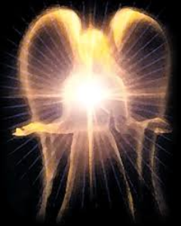
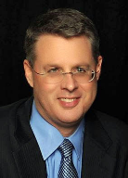
SATANOLOGY
Dr. Andy Woods
Senior Pastor – Sugar Land Bible Church
President – Chafer Theological Seminary

Slide 2
Preview of Angelology
Good angels
Satanology
Demonology
Gen. 6:1-4 controversy

Slide 3
Preview
Existence
Personhood
Names and titles
Original state and first sin
Works

Slide 4
Works
Past
Present
Future

Slide 5
Works
Past
Present
Future

Slide 6
Works - Past
Lied to Adam and Eve (Gen 3:1ff)
Corrupted the pre-flood gene pool (Gen 6:1-4)
Accused and afflicted Job (Job 1–2)
Disputed Michael regarding Moses’ body (Jude 9)
Tempted David to take a census (1 Chr 21:1)
Accused Joshua (Zech 3:1-3)

Slide 7
Works – Past (cont’d)
Tempted Christ (Matt 4:1-11)
Tested Peter (Luke 22:31-33)
Possessed Judas (John 13:27)
Hindered Paul (1 Thess 2:18)
Afflicted Paul (2 Cor 12:7-10)
Influenced Ananias & Sapphira to lie (Acts 5:3-4, 8)

Slide 8
Works
Past
Present
Future

Slide 9
Works – Present
Snatches God’s Word (Luke 8:12)
Rules world (1 John 5:19)
Blinds the mind (2 Cor 4:4)
Sends false ministers (2 Cor 11:14-15)
Sends false gospels (2 Cor 11:3-4)
Sows unbelievers among believers (Matt 13:38-39)
Performs miracles (2 Thess 2:9)
Promotes immorality (Eph 2:1-3)
Opposes God’s people (Eph 6:11-12)

Slide 10
Works – Present (cont’d )
Tempts God’s people (1 Cor 7:5)
Uses the carnality of Christians (Eph 4:26-27)
Causes physical problems (Luke 13:11, 16)
Influences civil government (Dan 10:10ff)
Lies (John 8:44)
Deceives (Rev 12:9; 20:3)

Slide 11
Works – Present (cont’d )
Tempts God’s people (1 Cor 7:5)
Uses the carnality of Christians (Eph 4:26-27)
Causes physical problems (Luke 13:11, 16)
Influences civil government (Dan 10:10ff)
Lies (John 8:44)
Deceives (Rev 12:9; 20:3)

Slide 12
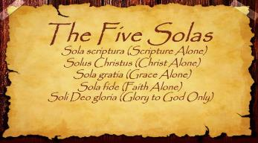
The Five Solas (Alone or By Itself)
Solus Christus – Christ alone
Sola Fide – faith alone
Sola Gratia – grace alone
Sola Scriptura – Scripture alone
Soli Deo Gloria – To the glory of God alone

Slide 13
“First, their synagogues should be set on fire…Secondly, their homes should likewise be broken down and destroyed…Thirdly, they should be deprived of their prayer books and Talmuds…”

Slide 14
“…Fourthly, their rabbis must be forbidden under threat of death to teach any more…Fifthly, passport and traveling privileges should be absolutely forbidden to the Jews…Sixthly, they ought to be stopped from usury (charging interest on loans…”

Slide 15
“Seventhly, let the young and strong Jews and Jewesses be given the flail, the ax, the hoe, the spade, the distaff, and spindle, and let the earn their bread by the sweat of their noses…We ought to drive the rascally lazy bones out of our system...”
Martin Luther, Concerning the Jews and Their Lies, cited in Michael Brown’s Our Hands Are Stained with Blood, pp. 14-15.

Slide 16
“…Therefore away with them… To sum up, dear princes and nobles who have Jews in your domains, if this advice of mine does not suit you, then find a better one so that you and we may all be free of this insufferable devilish burden–the Jews.”
Martin Luther, Concerning the Jews and Their Lies, cited in Michael Brown’s Our Hands Are Stained with Blood, pp. 14-15.

Slide 17
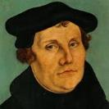
The Encyclopaedia Judaica says “Short of the Auschwitz oven and the extermination, the whole Nazi holocaust is pre-outlined here.”
Martin Luther
“Luther, Martin,” in Encyclopaedia Judaica, Vol. 8, 693.

Slide 18
Works – Present (cont’d )
Tempts God’s people (1 Cor 7:5)
Uses the carnality of Christians (Eph 4:26-27)
Causes physical problems (Luke 13:11, 16)
Influences civil government (Dan 10:10ff)
Lies (John 8:44)
Deceives (Rev 12:9; 20:3)

Slide 19
Romans 8:19-22
¹⁹ For the anxious longing of the creation waits eagerly for the revealing of the sons of God. ²⁰ For the creation was subjected to futility, not willingly, but because of Him who subjected it, in hope ²¹ that the creation itself also will be set free from its slavery to corruption into the freedom of the glory of the children of God. ²² For we know that the whole creation groans and suffers the pains of childbirth together until now.

Slide 20
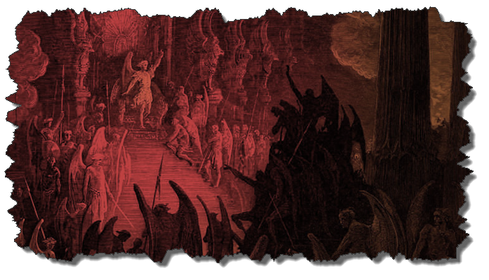
Not all Physical Infirmities are Attributable to Satan/Demon (works cont’d)
Matt 8:5-13
Matt 9:19-20, 27-30
Matt 12:9-14
Matt 14:35-36

Slide 21
Works – Present (cont’d )
Tempts God’s people (1 Cor 7:5)
Uses the carnality of Christians (Eph 4:26-27)
Causes physical problems (Luke 13:11, 16)
Influences civil government (Dan 10:10ff)
Lies (John 8:44)
Deceives (Rev 12:9; 20:3)

Slide 22
Works
Past
Present
Future

Slide 23
Works – Future
World government (Rev 13:3-4)
Oppose the 2nd Advent (Rev 17:14)
Attempt to annihilate Israel (Rev 12)
Bound (Rev 20:1-3)
Lead a final rebellion (Rev 20:7-9)
Cast into the Lake of Fire (Rev 20:10)

Slide 24
Works – Future
World government (Rev 13:3-4)
Oppose the 2nd Advent (Rev 17:14)
Attempt to annihilate Israel (Rev 12)
Bound (Rev 20:1-3)
Lead a final rebellion (Rev 20:7-9)
Cast into the Lake of Fire (Rev 20:10)

Slide 25
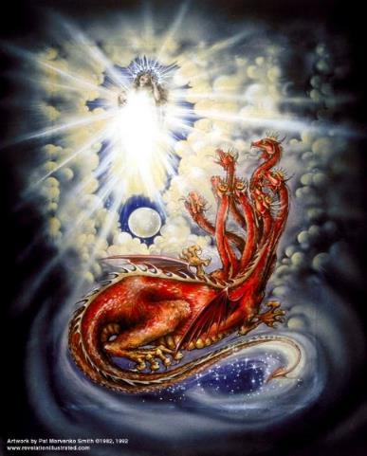
CAST OF 3 CHARACTERS Revelation 12:1-5
SON = MESSIAH
Ps. 2:9; Acts 1:9
DRAGON = SATAN
Rev. 12:9; 20:2
WOMAN = ISRAEL
Gen. 37:9-10

Slide 26
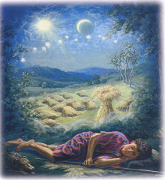
Genesis 37:9
Now he had still another dream, and related it to his brothers, and said, “Lo, I have had still another dream; and behold, the sun and the moon and eleven stars were bowing down to me.

Slide 27
Genesis 37:10
He related it to his father and to his brothers; and his father rebuked him and said to him, “What is this dream that you have had? Shall I and your mother and your brothers actually come to bow ourselves down before you to the ground?”

Slide 28
2 CYCLES OF SATANIC PERSECUTION
“Pursues the woman” = persecution of Israel 12:13-14
“Flood from his mouth” = tries to destroy Israel 12:15-16

Slide 29
Works – Future
World government (Rev 13:3-4)
Oppose the 2nd Advent (Rev 17:14)
Attempt to annihilate Israel (Rev 12)
Bound (Rev 20:1-3)
Lead a final rebellion (Rev 20:7-9)
Cast into the Lake of Fire (Rev 20:10)

Slide 30
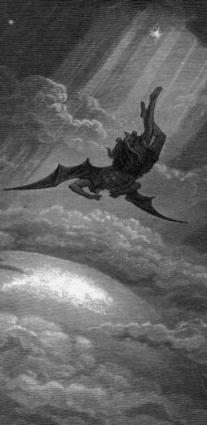
Satan’s Progressive Defeat
Initial eviction from heaven (Isa 14:12-15; Ezek 28:12-17)
Eden (Gen 3:15)
Pre-diluvian world (1 Pet 3:19-20)
Cross (John 12:31; 16:11; Col 2:15; Heb 2:14; 1 John 3:8)
Mid point of the Tribulation (Rev 12:9)
Beginning of millennium (Rev 20:2-3)
End of millennium (Rev 20:10)

Slide 31
Satan’s Progressive Defeat
Initial eviction from heaven (Isa 14:12-15; Ezek 28:12-17)
Eden (Gen 3:15)
Pre-diluvian world (1 Pet 3:19-20)
Cross (John 12:31; 16:11; Col 2:15; Heb 2:14; 1 John 3:8)
Mid point of the Tribulation (Rev 12:9)
Beginning of millennium (Rev 20:2-3)
End of millennium (Rev 20:10)

Slide 32
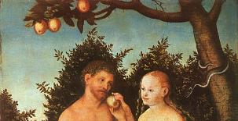
Genesis 3:15
“And I will put enmity between you and the woman, and between your seed and her seed; He shall bruise you on the head, and you shall bruise him on the heel.”

Slide 33
Satan’s Progressive Defeat
Initial eviction from heaven (Isa 14:12-15; Ezek 28:12-17)
Eden (Gen 3:15)
Pre-diluvian world (1 Pet 3:19-20)
Cross (John 12:31; 16:11; Col 2:15; Heb 2:14; 1 John 3:8)
Mid point of the Tribulation (Rev 12:9)
Beginning of millennium (Rev 20:2-3)
End of millennium (Rev 20:10)

Slide 34
 | David/Saul | Jesus/Satan
ANOINTED | David (1 Sam 16:13) | Jesus-Res./Ascension (Ps 2:7; 110:1)
NOW RULING | Saul (1 Sam 16:14) | Satan (Luke 4:5-7)
ILLEGITIMACY | Benjamin (Gen 49:10; 1 Sam. 9:21) | Gen. 1:26-28; 2:19-20; Dan 1:6-7)
FAITH | David (1 Sam 16:7) | Jesus (Heb 11:6)
MINORITY | David’s men (2 Sam 23:8-39) | Narrow road (Matt 7:14)
SIGHT | Saul (1 Sam 9:2) | Satan (2 Cor. 4:18; 1 John 2:15-17)
MAJORITY | Israel | Broad road (Matt. 7:13)
McClain, Greatness of the Kingdom, 440

Slide 35
CONCLUSION

Slide 36
Review
Existence
Personhood
Names and titles
Original state and first sin
Works

