Slide 1


Dr. Andy Woods
Senior Pastor – Sugar Land Bible Church
President – Chafer Theological Seminary

Slide 2


Slide 3
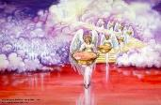

Seven Bowls
(Revelation 16)
1st Bowl (16:1-2) – Boils
2nd Bowl (16:3) – Sea becomes blood
3rd Bowl (16:4-7) – Freshwater destroyed
4th Bowl (16:8-9) – Sun scorches man
5th Bowl (16:10-11) – Darkness
6th Bowl (16:13-16) – Euphrates dried
7th Bowl (16:17-21) – Greatest earthquake

Slide 4
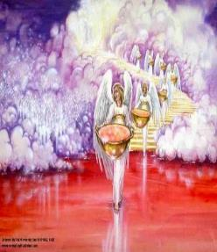
7. The Seventh Bowl
Revelation 16:17-21
7th angel pours out the bowl (17)
Lightning & thunder (18a)
Greatest earthquake (18b)
Jerusalem destroyed (19a)
Babylon destroyed (19b)
Every mountain & island moved (20)
100-pound hailstones (21a)
Man’s sinful reaction (21b)

Slide 5

Revelation 16:19
“The great city was split into three parts, and the cities of the nations fell. Babylon the great was remembered before God, to give her the cup of the wine of His fierce wrath.”

Slide 6


Revelation 17:1
“Then one of the seven angels who had the seven bowls came and spoke with me, saying, “Come here, I will show you the judgment of the great harlot who sits on many waters.”

Slide 7
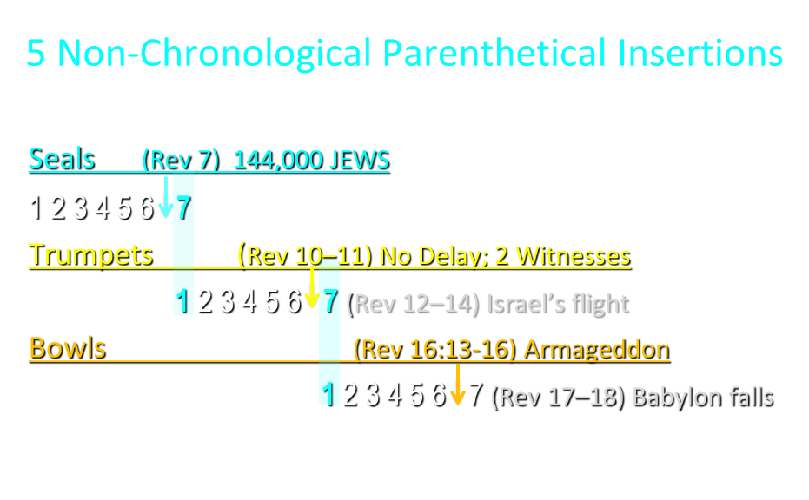

Slide 8
5 Non-Chronological Parenthetical Insertions
Rev 7 – 144,000 Jews
Rev 10:1-11:13 – Announcement of no more delay and the two witnesses
Rev 12-14 – Israel’s flight, two beasts, six scenes of hope
Rev 16:13-16 – Gathering of the nations to Armageddon
Rev 17:1-19:6 – Babylon’s fall

Slide 9
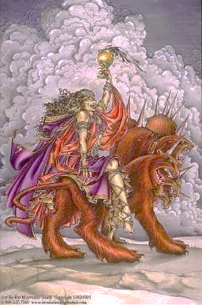
The Woman Rides the Beast
Revelation 17
The Vision Concerning Babylon (1-6a)
The Interpretation Concerning Babylon (6b-18)

Slide 10
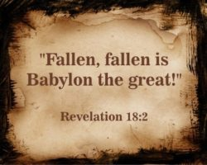
The Great City of Babylon
Revelation 18
The Prediction of Babylon’s Fall (18:1-3)
The Appeal to Separate From Babylon (18:4-8)
The Reactions to Babylon’s Fall (18:9-20)
The Description of Babylon’s Fall (18:21-24)

Slide 11
The Great City of Babylon
Revelation 18
The Prediction of Babylon’s Fall (18:1-3)
The Appeal to Separate From Babylon (18:4-8)
The Reactions to Babylon’s Fall (18:9-20)
The Description of Babylon’s Fall (18:21-24)

Slide 12
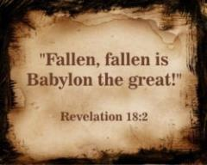
I. The Prediction of Babylon’s Fall
Revelation 18:1-3
Proclamation (1-2a)
Reasons (2b-3)
  Demonic Involvement (2b)
  Corruption of Nations (3a)
  Corruption of Kings (3b)
  Corruption of Merchants (3c)

Slide 13
I. The Prediction of Babylon’s Fall
Revelation 18:1-3
Proclamation (1-2a)
Reasons (2b-3)
  Demonic Involvement (2b)
  Corruption of Nations (3a)
  Corruption of Kings (3b)
  Corruption of Merchants (3c)

Slide 14
Two Babylons View
BABYLON | Ecclesiastical | Commercial
Chapter | Revelation 17 | Revelation 18
Literalness | Not literal | Literal
Time of Destruction | 1st half of Tribulation | Second Advent
Emphasis | Religion | Commercial & Political

Slide 15

John F. Walvoord
The Revelation of Jesus Christ: A Commentary (Chicago: Moody, 1966), 267.
“Babylon, ecclesiastically symbolized by the woman in Revelation 17, proposes a common worship and a common religion through uniting in a world church. This is destroyed by the beast in Revelation 17:16 who thus fulfills the will of God (Rev. 17:17). Babylon, politically symbolized by the great city of Revelation 18, attempts to achieve its domination of the world by a world common market and a world government. These are destroyed by Christ at His second coming (Rev. 19:11–21).”

Slide 16
John F. Walvoord
The Revelation of Jesus Christ: A Commentary (Chicago: Moody, 1966), 257, 263.
“The city here according to verse 5 is a mystery, not a literal city...The ultimate decision depends upon the judgment of the expositor, but in many respects it is simpler to postulate a rebuilt Babylon as fulfilling literally the Old Testament prophecies as well as that embodied in this chapter.”

Slide 17
Two Babylons View?
 | TWO BABYLON’S ARGUMENT | SINGLE BABYLON RESPONSE
1. Chapter division | Different prophetic subject | Non-inspired chapter divisions
2. “After these things” (18:1) | Takes place later chronologically (1:19; 4:1b; 9:12; 20:3) | Sequence in which visions were shown to John (4:1a; 7:1, 9; 15:5; 19:1)
3. “Another angel” (18:1) | A new vision (10:1; 14:6, 8, 9) | Same vision (7:2; 8:3; 14:15, 17, 18)

Slide 18
Two Babylons View?
 | TWO BABYLON’S ARGUMENT | SINGLE BABYLON RESPONSE
4. Different Destructions | Destroyed by the kings (Rev. 17:16) vs. destroyed by God (18:9) | Destroyed by God (17:17; 18:9) and by fire (17:16; 18:8-9, 18)
5. Different reactions | Kings hate Babylon (17:16) vs. kings weep over Babylon (18:9) | Kings united with the Beast (17:16) vs. kings united with Babylon (Rev. 18:9)
6. Different symbols | Woman (17:3) vs. a city (18:10) | Woman called a city (17:18; 18:10)

Slide 19
OT Descriptions of Babylon in Rev 17–18
 | Revelation 17–18 | Old Testament
Waters | 17:1 | Psalm 137:1
Babylon the Great | 17:5 | Daniel 4:30
Mother harlots | 17:5 | Genesis 11:1-9
Fallen, fallen is Babylon | 18:2 | Isaiah 21:9
Will not see widowhood | 18:7 | Isaiah 47:7-9
Colorful attire | 17:4; 18:16 | Daniel 5:7, 16, 29
Sorcery | 18:23 | 1saiah 47:9-13
Destroyed in a day | 18:8, 10 | Daniel 5:30

Slide 20
I. The Prediction of Babylon’s Fall
Revelation 18:1-3
Proclamation (1-2a)
Reasons (2b-3)
  Demonic Involvement (2b)
  Corruption of Nations (3a)
  Corruption of Kings (3b)
  Corruption of Merchants (3c)

Slide 21
I. The Prediction of Babylon’s Fall
Revelation 18:1-3
Proclamation (1-2a)
Reasons (2b-3)
  Demonic Involvement (2b)
  Corruption of Nations (3a)
  Corruption of Kings (3b)
  Corruption of Merchants (3c)

Slide 22
I. The Prediction of Babylon’s Fall
Revelation 18:1-3
Proclamation (1-2a)
Reasons (2b-3)
  Demonic Involvement (2b)
  Corruption of Nations (3a)
  Corruption of Kings (3b)
  Corruption of Merchants (3c)

Slide 23
Parallels Between Jeremiah 50-51 & Revelation 17-18
 | Jeremiah | Revelation
Associated with a Golden cup | 51:7a | 17:3-4; 18:6
Dwelling on many waters | 51:13 | 17:1
Intoxicating the nations | 51:7b | 17:2
Same name | 50:1 | 17:5
Persecution of the saints | 51:49 | 17:6; 18:24
Stone sinking into Euphrates | 51:63-64 | 18:21
Sudden destruction | 51:8 | 18:8
Destroyed by fire | 51:30 | 17:16
Final, uninhabitable | 50:39 | 18:21
Deserved | 50:29 | 18:6
God’s people flee | 51:6, 45 | 18:4
Heaven rejoices | 51:48 | 18:20
Dyer, "The Identity of Babylon in Revelation 17–18 (Part 2)," 441-43.

Slide 24
ONE BABYLON
 | Rev. 17 | Rev. 18
Same name | 17:5 | 18:2
City | 17:18 | 18:10
Same clothing | 17:4 | 18:16
Holding a cup | 17:4 | 18:6
Fornicating with Kings | 17:2 | 18:3
Drunk with wine of immorality | 17:2 | 18:3
Persecuting believers | 17:6 | 18:20, 24
Destroyed by fire | 17:16 | 18:8, 18
Destroyed by God | 17:17 | 18:5, 8
Dyer, "The Identity of Babylon in Revelation 17–18 (Part 1)," 311-13.

Slide 25

Genesis 11:1-4
¹ Now the whole earth used the same language and the same words. ² It came about as they journeyed east, that they found a plain in the land of Shinar and settled there. ³ They said to one another, “Come, let us make bricks and burn them thoroughly.” And they used brick for stone, and they used tar for mortar. ⁴ They said, “Come, let us build for ourselves a city, and a tower whose top will reach into heaven, and let us make for ourselves a name, otherwise we will be scattered abroad over the face of the whole earth.”

Slide 26
Spread of the Mother-Child Cult
 | Mother | Child
Assyria | Ishtar | Tammuz
Phoenicia | Astarte | Baal
Egypt | Isis | Osirus/Horus
Greece | Aphrodite | Eros
Rome | Venus | Cupid
Asia | Cybele | Desius
India | Isi | Aswara
Roman Catholicism | Mary | Jesus
Israel | Queen of Heaven (Jer. 7:18; 44:17) | Tammuz (Ezek. 8:14-15)
Alexander Hislop, Two Babylons

Slide 27
I. The Prediction of Babylon’s Fall
Revelation 18:1-3
Proclamation (1-2a)
Reasons (2b-3)
  Demonic Involvement (2b)
  Corruption of Nations (3a)
  Corruption of Kings (3b)
  Corruption of Merchants (3c)

Slide 28
ONE BABYLON
 | Rev. 17 | Rev. 18
Same name | 17:5 | 18:2
City | 17:18 | 18:10
Same clothing | 17:4 | 18:16
Holding a cup | 17:4 | 18:6
Fornicating with Kings | 17:2 | 18:3
Drunk with wine of immorality | 17:2 | 18:3
Persecuting believers | 17:6 | 18:20, 24
Destroyed by fire | 17:16 | 18:8, 18
Destroyed by God | 17:17 | 18:5, 8
Dyer, "The Identity of Babylon in Revelation 17–18 (Part 1)," 311-13.

Slide 29
I. The Prediction of Babylon’s Fall
Revelation 18:1-3
Proclamation (1-2a)
Reasons (2b-3)
  Demonic Involvement (2b)
  Corruption of Nations (3a)
  Corruption of Kings (3b)
  Corruption of Merchants (3c)

Slide 30
The Great City of Babylon
Revelation 18
The Prediction of Babylon’s Fall (18:1-3)
The Appeal to Separate From Babylon (18:4-8)
The Reactions to Babylon’s Fall (18:9-20)
The Description of Babylon’s Fall (18:21-24)

Slide 31
II. Appeal to Separate From Babylon
Revelation 18:4-8
Appeal (4)
Reasons (5-8)
  Her Sins (5)
  Her Retribution (6)
  Her Arrogance (7)
  Her Destruction (8)

Slide 32
II. Appeal to Separate From Babylon
Revelation 18:4-8
Appeal (4)
Reasons (5-8)
  Her Sins (5)
  Her Retribution (6)
  Her Arrogance (7)
  Her Destruction (8)

Slide 33
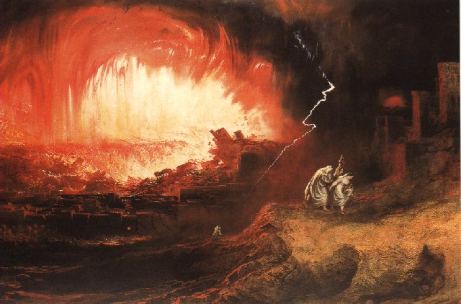
Jeremiah 50-51
Sudden destruction (51:8)
Complete destruction (50:3, 13, 26, 39-40; 51:29, 43, 62)
No reuse of building materials (51:26)
Believers flee (50:8; 51:6, 45)
Israel’s regeneration (50:2, 4-5, 20; 51:50)
Dyer, "The Identity of Babylon in Revelation 17–18 (Part 2)," 443-49.

Slide 34
Parallels Between Jeremiah 50-51 & Revelation 17-18
 | Jeremiah | Revelation
Associated with a Golden cup | 51:7a | 17:3-4; 18:6
Dwelling on many waters | 51:13 | 17:1
Intoxicating the nations | 51:7b | 17:2
Same name | 50:1 | 17:5
Persecution of the saints | 51:49 | 17:6; 18:24
Stone sinking into Euphrates | 51:63-64 | 18:21
Sudden destruction | 51:8 | 18:8
Destroyed by fire | 51:30 | 17:16
Final, uninhabitable | 50:39 | 18:21
Deserved | 50:29 | 18:6
God’s people flee | 51:6, 45 | 18:4
Heaven rejoices | 51:48 | 18:20
Dyer, "The Identity of Babylon in Revelation 17–18 (Part 2)," 441-43.

Slide 35
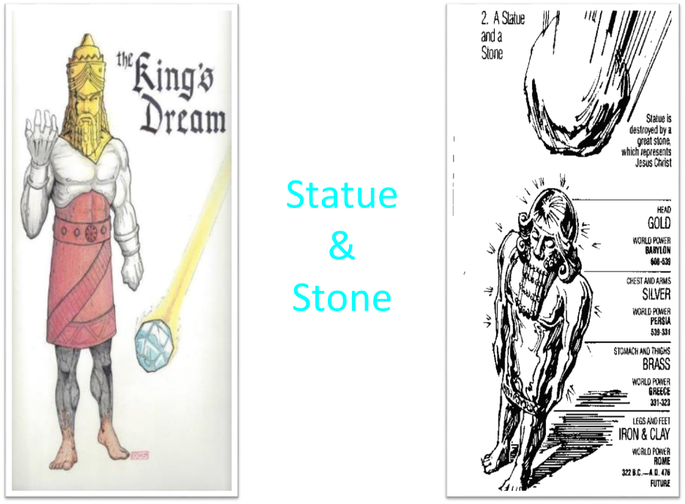

Slide 36
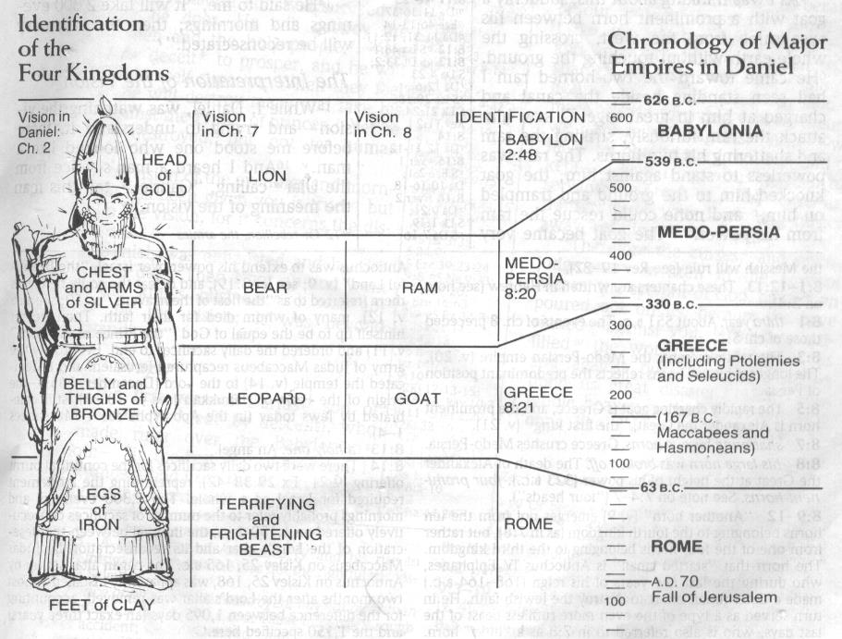
CHART OF NATIONS

Slide 37
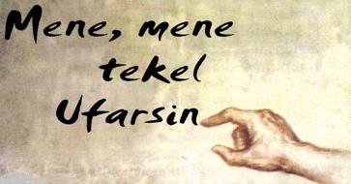
Daniel Interprets the Writing (5:24-28)

Slide 38
II. Appeal to Separate From Babylon
Revelation 18:4-8
Appeal (4)
Reasons (5-8)
  Her Sins (5)
  Her Retribution (6)
  Her Arrogance (7)
  Her Destruction (8)

Slide 39
II. Appeal to Separate From Babylon
Revelation 18:4-8
Appeal (4)
Reasons (5-8)
  Her Sins (5)
  Her Retribution (6)
  Her Arrogance (7)
  Her Destruction (8)

Slide 40
Genesis 11:1-4
¹ Now the whole earth used the same language and the same words. ² It came about as they journeyed east, that they found a plain in the land of Shinar and settled there. ³ They said to one another, “Come, let us make bricks and burn them thoroughly.” And they used brick for stone, and they used tar for mortar. ⁴ They said, “Come, let us build for ourselves a city, and a tower whose top will reach into heaven, and let us make for ourselves a name, otherwise we will be scattered abroad over the face of the whole earth.”

Slide 41
Revelation 16:19
“The great city was split into three parts, and the cities of the nations fell. Babylon the great was remembered before God, to give her the cup of the wine of His fierce wrath.”

Slide 42
II. Appeal to Separate From Babylon
Revelation 18:4-8
Appeal (4)
Reasons (5-8)
  Her Sins (5)
  Her Retribution (6)
  Her Arrogance (7)
  Her Destruction (8)

Slide 43
Parallels Between Jeremiah 50-51 & Revelation 17-18
 | Jeremiah | Revelation
Associated with a Golden cup | 51:7a | 17:3-4; 18:6
Dwelling on many waters | 51:13 | 17:1
Intoxicating the nations | 51:7b | 17:2
Same name | 50:1 | 17:5
Persecution of the saints | 51:49 | 17:6; 18:24
Stone sinking into Euphrates | 51:63-64 | 18:21
Sudden destruction | 51:8 | 18:8
Destroyed by fire | 51:30 | 17:16
Final, uninhabitable | 50:39 | 18:21
Deserved | 50:29 | 18:6
God’s people flee | 51:6, 45 | 18:4
Heaven rejoices | 51:48 | 18:20
Dyer, "The Identity of Babylon in Revelation 17–18 (Part 2)," 441-43.

Slide 44
Parallels Between Jeremiah 50-51 & Revelation 17-18
 | Jeremiah | Revelation
Associated with a Golden cup | 51:7a | 17:3-4; 18:6
Dwelling on many waters | 51:13 | 17:1
Intoxicating the nations | 51:7b | 17:2
Same name | 50:1 | 17:5
Persecution of the saints | 51:49 | 17:6; 18:24
Stone sinking into Euphrates | 51:63-64 | 18:21
Sudden destruction | 51:8 | 18:8
Destroyed by fire | 51:30 | 17:16
Final, uninhabitable | 50:39 | 18:21
Deserved | 50:29 | 18:6
God’s people flee | 51:6, 45 | 18:4
Heaven rejoices | 51:48 | 18:20
Dyer, "The Identity of Babylon in Revelation 17–18 (Part 2)," 441-43.

Slide 45
ONE BABYLON
 | Rev. 17 | Rev. 18
Same name | 17:5 | 18:2
City | 17:18 | 18:10
Same clothing | 17:4 | 18:16
Holding a cup | 17:4 | 18:6
Fornicating with Kings | 17:2 | 18:3
Drunk with wine of immorality | 17:2 | 18:3
Persecuting believers | 17:6 | 18:20, 24
Destroyed by fire | 17:16 | 18:8, 18
Destroyed by God | 17:17 | 18:5, 8
Dyer, "The Identity of Babylon in Revelation 17–18 (Part 1)," 311-13.

Slide 46

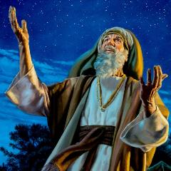
Genesis 12:3
“And I will bless those who bless you, And the one who curses you I will curse. And in you all the families of the earth will be blessed.”

Slide 47


Slide 48
II. Appeal to Separate From Babylon
Revelation 18:4-8
Appeal (4)
Reasons (5-8)
  Her Sins (5)
  Her Retribution (6)
  Her Arrogance (7)
  Her Destruction (8)

Slide 49
OT Descriptions of Babylon in Rev 17–18
 | Revelation 17–18 | Old Testament
Waters | 17:1 | Psalm 137:1
Babylon the Great | 17:5 | Daniel 4:30
Mother harlots | 17:5 | Genesis 11:1-9
Fallen, fallen is Babylon | 18:2 | Isaiah 21:9
Will not see widowhood | 18:7 | Isaiah 47:7-9
Colorful attire | 17:4; 18:16 | Daniel 5:7, 16, 29
Sorcery | 18:23 | 1saiah 47:9-13
Destroyed in a day | 18:8, 10 | Daniel 5:30

Slide 50
II. Appeal to Separate From Babylon
Revelation 18:4-8
Appeal (4)
Reasons (5-8)
  Her Sins (5)
  Her Retribution (6)
  Her Arrogance (7)
  Her Destruction (8)

Slide 51
OT Descriptions of Babylon in Rev 17–18
 | Revelation 17–18 | Old Testament
Waters | 17:1 | Psalm 137:1
Babylon the Great | 17:5 | Daniel 4:30
Mother harlots | 17:5 | Genesis 11:1-9
Fallen, fallen is Babylon | 18:2 | Isaiah 21:9
Will not see widowhood | 18:7 | Isaiah 47:7-9
Colorful attire | 17:4; 18:16 | Daniel 5:7, 16, 29
Sorcery | 18:23 | 1saiah 47:9-13
Destroyed in a day | 18:8, 10 | Daniel 5:30

Slide 52
Parallels Between Jeremiah 50-51 & Revelation 17-18
 | Jeremiah | Revelation
Associated with a Golden cup | 51:7a | 17:3-4; 18:6
Dwelling on many waters | 51:13 | 17:1
Intoxicating the nations | 51:7b | 17:2
Same name | 50:1 | 17:5
Persecution of the saints | 51:49 | 17:6; 18:24
Stone sinking into Euphrates | 51:63-64 | 18:21
Sudden destruction | 51:8 | 18:8
Destroyed by fire | 51:30 | 17:16
Final, uninhabitable | 50:39 | 18:21
Deserved | 50:29 | 18:6
God’s people flee | 51:6, 45 | 18:4
Heaven rejoices | 51:48 | 18:20
Dyer, "The Identity of Babylon in Revelation 17–18 (Part 2)," 441-43.

Slide 53
ONE BABYLON
 | Rev. 17 | Rev. 18
Same name | 17:5 | 18:2
City | 17:18 | 18:10
Same clothing | 17:4 | 18:16
Holding a cup | 17:4 | 18:6
Fornicating with Kings | 17:2 | 18:3
Drunk with wine of immorality | 17:2 | 18:3
Persecuting believers | 17:6 | 18:20, 24
Destroyed by fire | 17:16 | 18:8, 18
Destroyed by God | 17:17 | 18:5, 8
Dyer, "The Identity of Babylon in Revelation 17–18 (Part 1)," 311-13.

Slide 54
Conclusion

Slide 55
The Great City of Babylon
Revelation 18
The Prediction of Babylon’s Fall (18:1-3)
The Appeal to Separate From Babylon (18:4-8)
The Reactions to Babylon’s Fall (18:9-20)
The Description of Babylon’s Fall (18:21-24)

Slide 56

“The Lord bless you and keep you; the Lord make his face shine on you and be gracious to you; the Lord turn his face toward you and give you peace.” (NIV)

