Slide 1
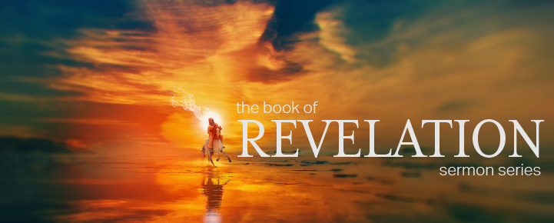
Dr. Andy Woods
Senior Pastor – Sugar Land Bible Church
President – Chafer Theological Seminary

Slide 3
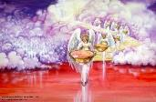
Seven Bowls (Revelation 16)
1st Bowl (16:1-2) – Boils
2nd Bowl (16:3) – Sea becomes blood
3rd Bowl (16:4-7) – Freshwater destroyed
4th Bowl (16:8-9) – Sun scorches man
5th Bowl (16:10-11) – Darkness
6th Bowl (16:13-16) – Euphrates dried
7th Bowl (16:17-21) – Greatest earthquake

Slide 4
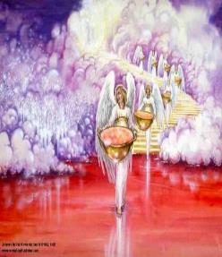
7. The Seventh Bowl Revelation 16:17-21
7th angel pours out the bowl (17)
Lightning & thunder (18a)
Greatest earthquake (18b)
Jerusalem destroyed (19a)
Babylon destroyed (19b)
Every mountain & island moved (20)
100-pound hailstones (21a)
Man’s sinful reaction (21b)

Slide 5
Revelation 16:19
“The great city was split into three parts, and the cities of the nations fell. Babylon the great was remembered before God, to give her the cup of the wine of His fierce wrath.”

Slide 6
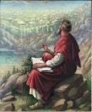
Revelation 17:1
“Then one of the seven angels who had the seven bowls came and spoke with me, saying, “Come here, I will show you the judgment of the great harlot who sits on many waters.”

Slide 8
5 Non-Chronological Parenthetical Insertions
Rev 7 – 144,000 Jews
Rev 10:1-11:13 – Announcement of no more delay and the two witnesses
Rev 12-14 – Israel’s flight, two beasts, six scenes of hope
Rev 16:13-16 – Gathering of the nations to Armageddon
Rev 17:1-19:6 – Babylon’s fall

Slide 9
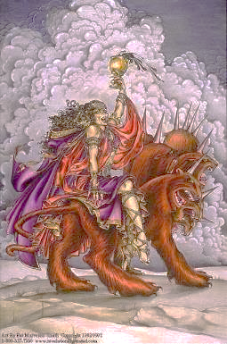
The Woman Rides the Beast Revelation 17
The Vision Concerning Babylon (17:1-6a)
The Interpretation Concerning Babylon (6b-18)

Slide 10
The Woman Rides the Beast Revelation 17
The Vision Concerning Babylon (17:1-6a)
The Interpretation Concerning Babylon (6b-18)

Slide 11
I. The Vision Concerning Babylon Revelation 17:1-6a
Her introduction (1a)
Her judgment (1b)
Her immorality (2)
Her influence (3)
Her appearance (4)
Her title (5)
Her persecution (6a)

Slide 12
The Woman Rides the Beast Revelation 17
The Vision Concerning Babylon (17:1-6a)
The Interpretation Concerning Babylon (6b-18)

Slide 13
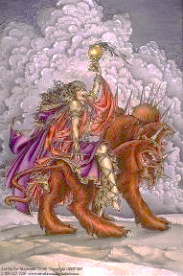
II. The Interpretation Concerning Babylon Revelation 17:6b-18
The Interpretation Promised (6b-7)
The Beast & His system (8-14)
Babylon (15-18)

Slide 14
II. The Interpretation Concerning Babylon Revelation 17:6b-18
The Interpretation Promised (6b-7)
The Beast & His system (8-14)
Babylon (15-18)

Slide 15
Revelation 17:3
“And he carried me away in the Spirit into a wilderness; and I saw a woman sitting on a scarlet beast, full of blasphemous names, having seven heads and ten horns.”

Slide 17
II. The Interpretation Concerning Babylon Revelation 17:6b-18
The Interpretation Promised (6b-7)
The Beast & His system (8-14)
Babylon (15-18)

Slide 18
B. The Beast & His System Revelation 17:8-14
The Beast (8)
The Seven Heads (9-11)
The Ten Horns (12-14)

Slide 19
B. The Beast & His System Revelation 17:8-14
The Beast (8)
The Seven Heads (9-11)
The Ten Horns (12-14)

Slide 20
Revelation 13:14
“And he deceives those who dwell on the earth because of the signs which it was given him to perform in the presence of the beast, telling those who dwell on the earth to make an image to the beast who had the wound of the sword and has come to life [záō].”

Slide 21
B. The Beast & His System Revelation 17:8-14
The Beast (8)
The Seven Heads (9-11)
The Ten Horns (12-14)

Slide 22
Revelation 17:3
“And he carried me away in the Spirit into a wilderness; and I saw a woman sitting on a scarlet beast, full of blasphemous names, having seven heads and ten horns.”

Slide 24
Revelation 17:9-10
“⁹ Here is the mind which has wisdom. The seven heads are seven mountains [oros] on which the woman sits, ¹⁰ and they are seven kings; five have fallen, one is, the other has not yet come; and when he comes, he must remain a little while.”

Slide 25
7 Kings or Kingdoms (Dan. 2:37-38) (Revelation 17:9-10)
Egypt
Assyria
Babylon
Persian
Greece
Rome I
Rome II

Slide 26
7 Kings or Kingdoms (Dan. 2:37-38) (Revelation 17:9-10)
Egypt
Assyria
Babylon
Persian
Greece
Rome I
Rome II

Slide 27
7 Kings or Kingdoms (Dan. 2:37-38) (Revelation 17:9-10)
Egypt
Assyria
Babylon
Persian
Greece
Rome I
Rome II

Slide 28
7 Kings or Kingdoms (Dan. 2:37-38) (Revelation 17:9-10)
Egypt
Assyria
Babylon
Persian
Greece
Rome I
Rome II

Slide 29
B. The Beast & His System Revelation 17:8-14
The Beast (8)
The Seven Heads (9-11)
The Ten Horns (12-14)

Slide 30
Revelation 17:3
“And he carried me away in the Spirit into a wilderness; and I saw a woman sitting on a scarlet beast, full of blasphemous names, having seven heads and ten horns.”

Slide 32
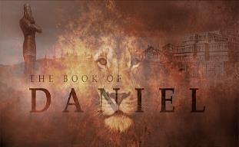
Daniel 7:24
“As for the ten horns, out of this kingdom ten kings will arise; and another will arise after them, and he will be different from the previous ones and will subdue three kings.”

Slide 33
Daniel 7:23
“Thus he said: ‘The fourth beast will be a fourth kingdom on the earth, which will be different from all the other kingdoms and will devour the whole earth and tread it down and crush it.”

Slide 34
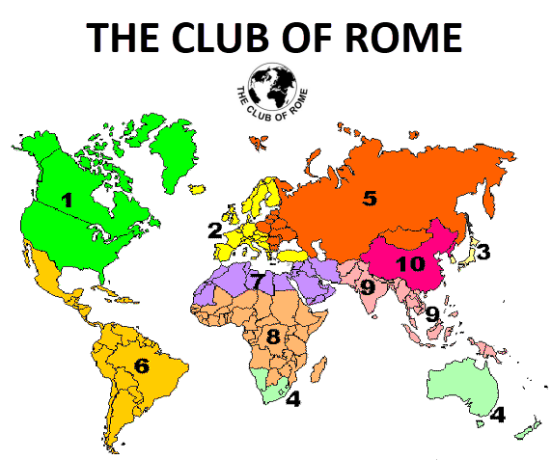

Slide 35
Daniel 7:24
“As for the ten horns, out of this kingdom ten kings will arise; and another will arise after them, and he will be different from the previous ones and will subdue three kings.”

Slide 36
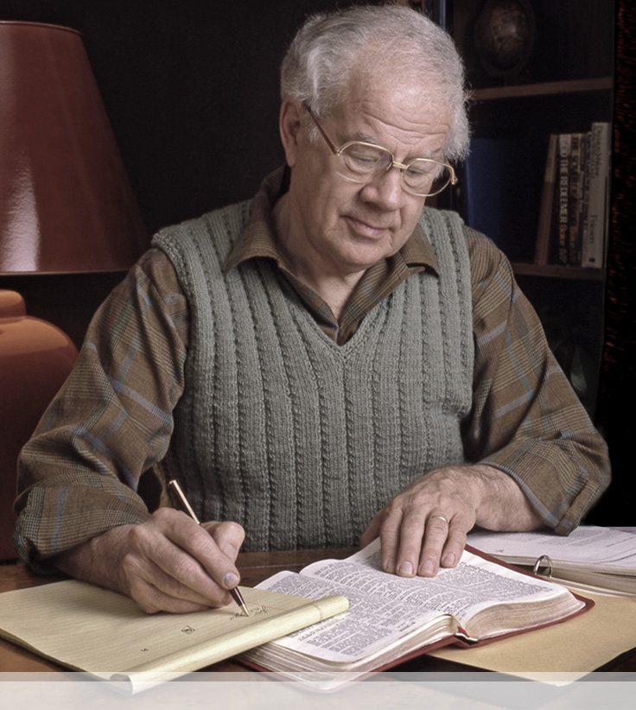
J. Dwight Pentecost
Things to Come, Page 321-22
“(3) From among those ten kingdoms there will arise one individual who will have control over the whole dominion of the ten kings (Dan. 7: 8, 24; Rev. 13: 1-10; 17: 13). In gaining his authority three of the ten kings are overthrown. (4) This final authority over the empire is wielded by one who is marked by blasphemy, hatred of God’s people, disregard for established law and order, who will continue for three and one-half years (Dan. 7: 26). (5) This final form of world power will have world-wide influence (Dan. 7: 23).”

Slide 37
II. The Interpretation Concerning Babylon Revelation 17:6b-18
The Interpretation Promised (6b-7)
The Beast & His system (8-14)
Babylon (15-18)

Slide 38
Revelation 17:3
“And he carried me away in the Spirit into a wilderness; and I saw a woman sitting on a scarlet beast, full of blasphemous names, having seven heads and ten horns.”

Slide 40
C. The Beast & His System Revelation 17:15-18
Her Influence (15)
Her Destruction (16-17)
Her Identification (18)

Slide 41
C. The Beast & His System Revelation 17:15-18
Her Influence (15)
Her Destruction (16-17)
Her Identification (18)

Slide 42
Parallels Between Jeremiah 50-51 & Revelation 17-18
 | Jeremiah | Revelation
Associated with a Golden cup | 51:7a | 17:3-4; 18:6
Dwelling on many waters | 51:13 | 17:1
Intoxicating the nations | 51:7b | 17:2
Same name | 50:1 | 17:5
Persecution of the saints | 51:49 | 17:6; 18:24
Stone sinking into Euphrates | 51:63-64 | 18:21
Sudden destruction | 51:8 | 18:8
Destroyed by fire | 51:30 | 17:16
Final, uninhabitable | 50:39 | 18:21
Deserved | 50:29 | 18:6
God’s people flee | 51:6, 45 | 18:4
Heaven rejoices | 51:48 | 18:20
Dyer, "The Identity of Babylon in Revelation 17–18 (Part 2)," 441-43.

Slide 43
OT Descriptions of Babylon in Rev 17–18
 | Revelation 17–18 | Old Testament
Waters | 17:1 | Psalm 137:1
Babylon the Great | 17:5 | Daniel 4:30
Mother harlots | 17:5 | Genesis 11:1-9
Fallen, fallen is Babylon | 18:2 | Isaiah 21:9
Will not see widowhood | 18:7 | Isaiah 47:7-9
Colorful attire | 17:4; 18:16 | Daniel 5:7, 16, 29
Sorcery | 18:23 | 1saiah 47:9-13

Slide 44
Genesis 11:1-4
¹ Now the whole earth used the same language and the same words. ² It came about as they journeyed east, that they found a plain in the land of Shinar and settled there. ³ They said to one another, “Come, let us make bricks and burn them thoroughly.” And they used brick for stone, and they used tar for mortar. ⁴ They said, “Come, let us build for ourselves a city, and a tower whose top will reach into heaven, and let us make for ourselves a name, otherwise we will be scattered abroad over the face of the whole earth.”

Slide 45
Spread of the Mother-Child Cult
 | Mother | Child
Assyria | Ishtar | Tammuz
Phoenicia | Astarte | Baal
Egypt | Isis | Osirus/Horus
Greece | Aphrodite | Eros
Rome | Venus | Cupid
Asia | Cybele | Desius
India | Isi | Aswara
Roman Catholicism | Mary | Jesus
Israel | Queen of Heaven (Jer. 7:18; 44:17) | Tammuz (Ezek. 8:14-15)
Alexander Hislop, Two Babylons

Slide 46
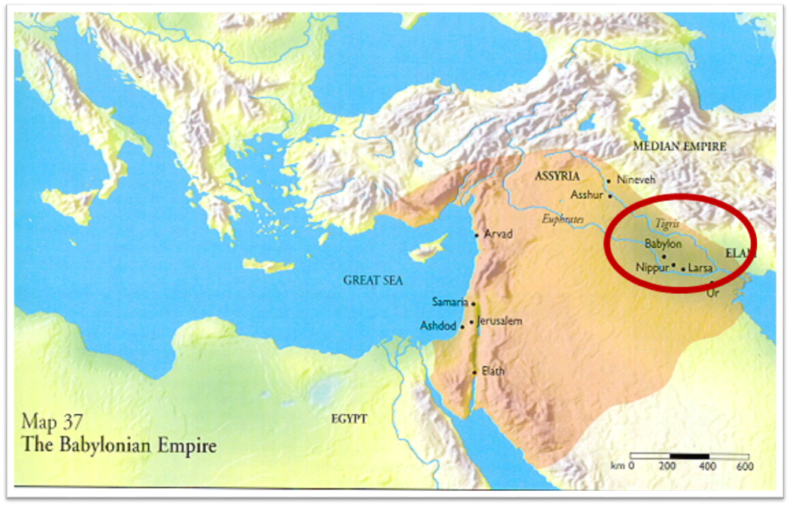

Slide 47
C. The Beast & His System Revelation 17:15-18
Her Influence (15)
Her Destruction (16-17)
Her Identification (18)

Slide 48
Revelation 17:3
“And he carried me away in the Spirit into a wilderness; and I saw a woman sitting on a scarlet beast, full of blasphemous names, having seven heads and ten horns.”

Slide 50
Parallels Between Jeremiah 50-51 & Revelation 17-18
 | Jeremiah | Revelation
Associated with a Golden cup | 51:7a | 17:3-4; 18:6
Dwelling on many waters | 51:13 | 17:1
Intoxicating the nations | 51:7b | 17:2
Same name | 50:1 | 17:5
Persecution of the saints | 51:49 | 17:6; 18:24
Stone sinking into Euphrates | 51:63-64 | 18:21
Sudden destruction | 51:8 | 18:8
Destroyed by fire | 51:30 | 17:16
Final, uninhabitable | 50:39 | 18:21
Deserved | 50:29 | 18:6
God’s people flee | 51:6, 45 | 18:4
Heaven rejoices | 51:48 | 18:20
Dyer, "The Identity of Babylon in Revelation 17–18 (Part 2)," 441-43.

Slide 51
ONE BABYLON
 | Rev. 17 | Rev. 18
Same name | 17:5 | 18:2
City | 17:18 | 18:10
Same clothing | 17:4 | 18:16
Holding a cup | 17:4 | 18:6
Fornicating with Kings | 17:2 | 18:3
Drunk with wine of immorality | 17:2 | 18:3
Persecuting believers | 17:6 | 18:20, 24
Destroyed by fire | 17:16 | 18:8, 18
Destroyed by God | 17:17 | 18:5, 8
Dyer, "The Identity of Babylon in Revelation 17–18 (Part 1)," 311-13.

Slide 52
C. The Beast & His System Revelation 17:15-18
Her Influence (15)
Her Destruction (16-17)
Her Identification (18)

Slide 53
“MYSTERY” IN HARLOT’S TITLE? REV. 17:5
And on her forehead a name was written: MYSTERY, BABYLON THE GREAT, THE MOTHER OF HARLOTS AND OF THE ABOMINATIONS OF THE EARTH. (KJV, NIV)
… and upon her forehead a name was written, a mystery, “BABYLON THE GREAT, THE MOTHER OF HARLOTS AND OF THE ABOMINATIONS OF THE EARTH.” (NASB)

Slide 54
Revelation 17:18
“The woman whom you saw is the great city, [polis] which reigns over the kings of the earth.

Slide 55
Bullinger The Apocalypse or “The Day of the Lord”, 509
“It is indeed surprising how any mistake could have been made in the identification of this woman. For the Holy Spirit first shows us her very name upon her forehead. Then, in verse 18, He tells us as plainly as words can tell anything, that ‘the woman which thou sawest is that great city, which reignest over the kings of the earth’, and chap. xvi. 19, as well as xvii. 5, identifies this city with Babylon. God says it is a ‘city.’ He does not say a system or a religion, but a ‘CITY.’”

Slide 56
Charles H. Dyer
“The Identity of Babylon in Revelation 17–18 (Part 2),” Bibliotheca sacra 144 (October-December 1987): 436.
“Whatever else is said about the harlot, she is first a city, not an ecclesiastical system.”

Slide 57
Two Babylons View
BABYLON | Ecclesiastical | Commercial
Chapter | Revelation 17 | Revelation 18
Literalness | Not literal | Literal
Time of Destruction | 1st half of Tribulation | Second Advent
Emphasis | Religion | Commercial & Political

Slide 58
John F. Walvoord The Revelation of Jesus Christ: A Commentary (Chicago: Moody, 1966), 267.
“Babylon, ecclesiastically symbolized by the woman in Revelation 17, proposes a common worship and a common religion through uniting in a world church. This is destroyed by the beast in Revelation 17:16 who thus fulfills the will of God (Rev. 17:17). Babylon, politically symbolized by the great city of Revelation 18, attempts to achieve its domination of the world by a world common market and a world government. These are destroyed by Christ at His second coming (Rev. 19:11–21).”

Slide 59
John F. Walvoord The Revelation of Jesus Christ: A Commentary (Chicago: Moody, 1966), 257, 263.
“The city here according to verse 5 is a mystery, not a literal city...The ultimate decision depends upon the judgment of the expositor, but in many respects it is simpler to postulate a rebuilt Babylon as fulfilling literally the Old Testament prophecies as well as that embodied in this chapter.”

Slide 60
Revelation 18:10
“standing at a distance because of the fear of her torment, saying, ‘Woe, woe, the great city [polis], Babylon, the strong city! For in one hour your judgment has come.’”

Slide 61
ONE BABYLON
 | Rev. 17 | Rev. 18
Same name | 17:5 | 18:2
City | 17:18 | 18:10
Same clothing | 17:4 | 18:16
Holding a cup | 17:4 | 18:6
Fornicating with Kings | 17:2 | 18:3
Drunk with wine of immorality | 17:2 | 18:3
Persecuting believers | 17:6 | 18:20, 24
Destroyed by fire | 17:16 | 18:8, 18
Destroyed by God | 17:17 | 18:5, 8
Dyer, "The Identity of Babylon in Revelation 17–18 (Part 1)," 311-13.

Slide 62
Conclusion

Slide 63
The Woman Rides the Beast Revelation 17
The Vision Concerning Babylon (17:1-6a)
The Interpretation Concerning Babylon (6b-18)

Slide 64
II. The Interpretation Concerning Babylon Revelation 17:6b-18
The Interpretation Promised (6b-7)
The Beast & His system (8-14)
Babylon (15-18)

Slide 65
“The Lord bless you and keep you; the Lord make his face shine on you and be gracious to you; the Lord turn his face toward you and give you peace.” (NIV)

