Slide 1
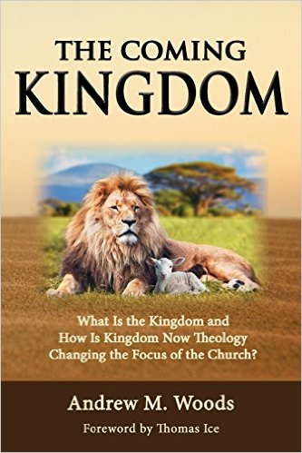

Slide 2

The Coming Kingdom
Chapter 22-26
Dr. Andy Woods
Senior Pastor – Sugar Land Bible Church
President – Chafer Theological Seminary

Slide 3

Kingdom Study Outline
What does the Bible Say About the Kingdom?
The Main Problem with Kingdom Now NT interpretations
Why do some believe that we are in the kingdom now?
Why does it matter?

Slide 4
Kingdom Study Outline
What does the Bible Say About the Kingdom?
The Main Problem with Kingdom Now NT interpretations
Why do some believe that we are in the kingdom now?
Why does it matter?

Slide 5

9 Ways Kingdom Now Theology
Impacts the Church
Loss of “pilgrim” status
Social Gospel
Ecumenical & interfaith alliances
Rejection or marginalization of Bible prophecy
Building the wrong kingdom
Charismatic theology
Prosperity Gospel
Anti-Israelism
Lordship Salvation

Slide 6
9 Ways Kingdom Now Theology
Impacts the Church
Loss of “pilgrim” status
Social Gospel
Ecumenical & interfaith alliances
Rejection or marginalization of Bible prophecy
Building the wrong kingdom
Charismatic theology
Prosperity Gospel
Anti-Israelism
Lordship Salvation

Slide 7

Lewis Sperry Chafer
vol. 5, Systematic Theology (Grand Rapids, MI: Kregel Publications, 1993), 350.
“So the church was fully warned from the beginning about the nature of this age, and taught concerning her pilgrim character while here and her holy calling and separateness from the ‘evil age.’”

Slide 8

Galatians 1:4
“who gave Himself for our sins so that He might rescue us from this present evil age, according to the will of our God and Father.”

Slide 9
James 1:1
“James, a bond-servant of God and of the Lord Jesus Christ, To the twelve tribes who are dispersed abroad (diaspora): Greetings.”

Slide 10
1 Peter 1:1; 2:11
“¹To those who reside as aliens (paraepidēmois), scattered throughout (diaspora) Pontus, Galatia, Cappadocia, Asia, and Bithynia, who are chosen…^{2:11} Beloved, I urge you as aliens and strangers (paraepidēmois) to abstain from fleshly lusts which wage war against the soul.”

Slide 11
Hebrews 11:13
“¹³ All these died in faith, without receiving the promises, but having seen them and having welcomed them from a distance, and having confessed that they were strangers and exiles (paraepidēmois) on the earth.”

Slide 12
9 Ways Kingdom Now Theology
Impacts the Church
Loss of “pilgrim” status
Social Gospel
Ecumenical & interfaith alliances
Rejection or marginalization of Bible prophecy
Building the wrong kingdom
Charismatic theology
Prosperity Gospel
Anti-Israelism
Lordship Salvation

Slide 13

Holistic Redemption?
“Negative-thinking theologians looked at the doctrine of sin, salvation and repentance...through distorted glasses tinted with mortification mentality. Too many prayers of confession of sin and repentance have been destructive to the emotional health of Christians...I am not fully forgiven until I allow God to write his new dream for my life on the blackboard of my mind, and I dare to believe 'I am; therefore, I can. I am a child of God...God has a great plan to redeem society...The emerging church, reformed according to the needs of self-esteem-starved-souls under the Lordship of Christ.... will help us to affirm the concept that 'While God's ideas may seem humanly impossible, he will give us these ideas which will lead to glorious, self-esteem-generating success.'"
Robert H. Schuller, Self-Esteem: The New Reformation (Waco, TX: Word Books, 1982), 104-05.

Slide 14
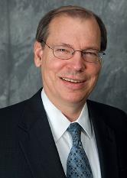
Progressive Dispensationalism & Social Gospel
Craig Blaising, “Dispensationalism: The Search for Definition,” in Dispensationalism, Israel and the Church, ed. Craig Blaising and Darrell Bock (Grand Rapids: Zondervan, 1992), 14, n. 3; idem, “Theological and Ministerial Issues in Progressive Dispensationalism,” in Progressive Dispensationalism, ed. Darrell Bock and Craig Blaising(Wheaton, IL: Victor, 1993), 288–89.
“Unfortunately, present-day dispensationalists have written very little in proposing a theology of social ministry…if we as a community of Christ worked on creating our community as a model of social justice and peace, then we really would have some suggestions to make for social reform in our cities and nations.”
Notes:
WRONG!!!

Slide 15
Emergent Church & the Kingdom
“The church has been preoccupied with the question, ‘What happens to your soul after you die?’ As if the reason for Jesus coming can be summed up in, ‘Jesus is trying to get more souls into heaven as opposed to hell, after they die.’ I just think a fair reading of the Gospels blows that out of the water.”
Brian McLaren, cited in Oakland, Faith Undone, 203.

Slide 16

Charles Ryrie
Dispensationalism, Page 176
“Holistic redemption can easily lead to placing unbalanced, if not wrong, priorities on political action, social agendas, and improving the structures of society.”

Slide 17
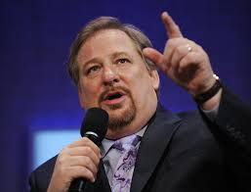
Kingdom
“P.E.A.C.E. is an acronym for Promote reconciliation; Equip servant leaders; Assist the poor; Care for the sick; and Educate the next generation. Coalition members see these actions as Jesus’ antidote to five ‘global giants,’—problems that affect billions of people worldwide: spiritual emptiness, self-centered leadership, poverty, pandemic disease, and illiteracy.”
Rick Warren and 1,700 Leaders Launch the Peace Coalition at “Purpose Driven Summit,” accessed November 15, 2014

Slide 18
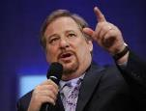
Social Gospel Confusion
“P.E.A.C.E. is an acronym for:
    Promote reconciliation;
    Equip servant leaders;
    Assist the poor;
    Care for the sick; and
    Educate the next generation.
Coalition members see these actions as Jesus’ antidote to five “global giants,”—problems that affect billions of people worldwide: spiritual emptiness, self-centered leadership, poverty, pandemic disease, and illiteracy.”
“Rick Warren and 1,700 Leaders Launch the Peace Coalition at Purpose Driven Summit,” accessed November 15, 2014, http://www.christiannewswire.com/news/249586720.html

Slide 19

The Great Omission
Romans 1:16-17
Matthew 28:19
John 20:21
Luke 24:46-49
Acts 1:4-8

Slide 20
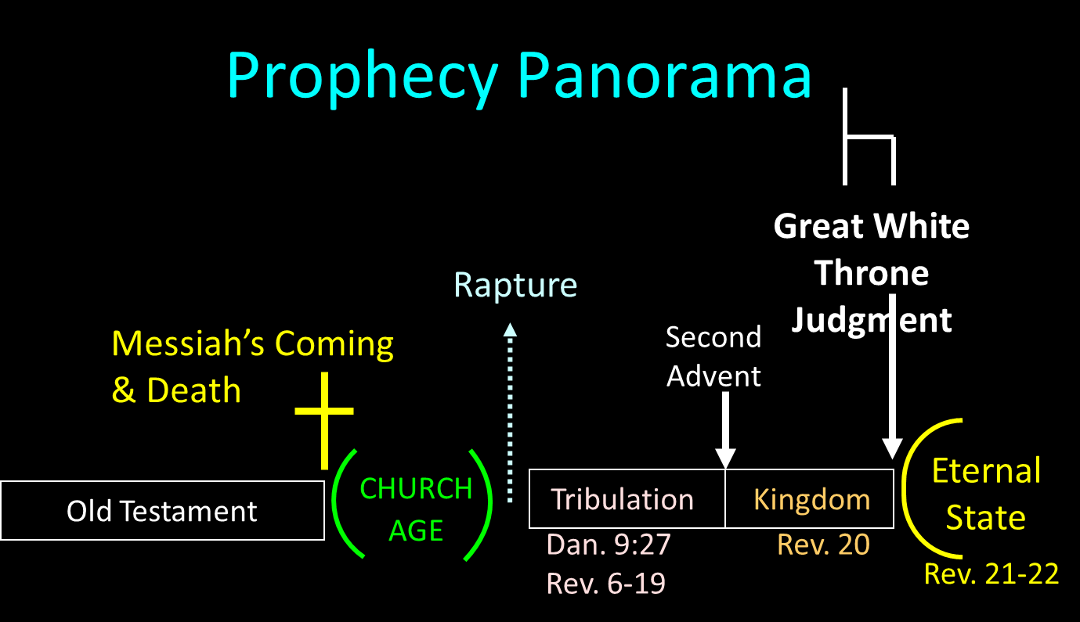

Slide 21
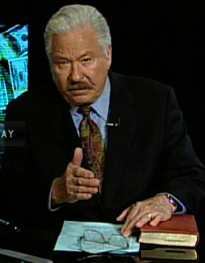
Hal Lindsey
The Road to Holocaust, 269
Bestselling author Hal Lindsey warned what could happen to the church in the last days if she began to see herself as the establisher of God's kingdom: “The last days of the church on the earth may be largely wasted seeking to accomplish a task that only the LORD Himself can and will do directly.”

Slide 22
9 Ways Kingdom Now Theology
Impacts the Church
Loss of “pilgrim” status
Social Gospel
Ecumenical & interfaith alliances
Rejection or marginalization of Bible prophecy
Building the wrong kingdom
Charismatic theology
Prosperity Gospel
Anti-Israelism
Lordship Salvation

Slide 23
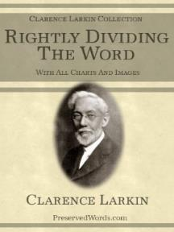
Clarence Larkin
Rightly Dividing the Word, 48.
“The great mistake the Church has made is in appropriating to herself in this Dispensation the promises of earthly conquest and glory which belong exclusively to Israel in the ‘Millennial Age.’ As soon as the Church enters into an ‘Alliance with the World,’ and seeks the help of Parliaments, Congresses, Legislatures, Federations and Reform Societies, largely made up of ungodly men and women, she loses her spiritual power and becomes helpless as a redeeming force.”

Slide 24

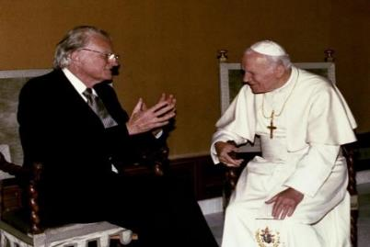
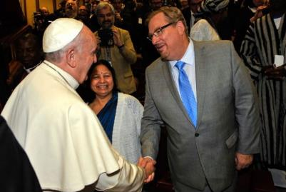
Evangelicals and Catholics Together

Slide 25
Ecumenisim
Matt Slick, “Rick Warren’s Comments on Roman Catholicism,” accessed July 20, 2015, http://www.carm.org.
“We have far more in common than what divides us. When you talk about Pentecostals, charismatics, evangelicals, fundamentalists, Catholics, Methodists, Baptists, Presbyterians, on and on and on and on. Well, they would all say we believe in the trinity; we believe in the Bible; we believe in the resurrection; we believe salvation is through Jesus Christ. These are the big issues. Sometimes Protestants think that Catholics worship Mary like she’s another god. But that’s not exactly catholic doctrine. . . . and people say well what are the saints all about? Why are you praying to the saints? And when you understand what they mean by what they’re saying there’s a whole lot more commonality.”

Slide 26
Ecumenisim
Matt Slick, “Rick Warren’s Comments on Roman Catholicism,” accessed July 20, 2015, http://www.carm.org.
“Now there are still real differences, no doubt about that. But the most important thing is if you love Jesus, we’re on the same team. The unity that I think we would see realistically is not a structural unity but a unity of mission. And so, when it comes to the family, we are co-workers in the field on this for the protection of what we call the sanctity of life, the sanctity of sex, and the sanctity of marriage. So there’s a great commonality and there’s no division on any of those three. Many times people have been beaten down for taking a biblical stance. And they start to feel, “Well, maybe I’m out here all by yourself.” No, you’re not (italics added)”

Slide 27
Conclusion

Slide 28
9 Ways Kingdom Now Theology
Impacts the Church
Loss of “pilgrim” status
Social Gospel
Ecumenical & interfaith alliances
Rejection or marginalization of Bible prophecy
Building the wrong kingdom
Charismatic theology
Prosperity Gospel
Anti-Israelism
Lordship Salvation

