Slide 1


Dr. Andy Woods
Senior Pastor – Sugar Land Bible Church
President – Chafer Theological Seminary

Slide 2


Slide 3
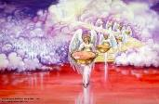

Seven Bowls
(Revelation 16)
1st Bowl (16:1-2) – Boils
2nd Bowl (16:3) – Sea becomes blood
3rd Bowl (16:4-7) – Freshwater destroyed
4th Bowl (16:8-9) – Sun scorches man
5th Bowl (16:10-11) – Darkness
6th Bowl (16:13-16) – Euphrates dried
7th Bowl (16:17-21) – Greatest earthquake

Slide 4
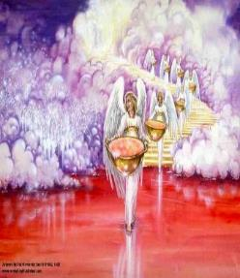
7. The Seventh Bowl
Revelation 16:17-21
7th angel pours out the bowl (17)
Lightning & thunder (18a)
Greatest earthquake (18b)
Jerusalem destroyed (19a)
Babylon destroyed (19b)
Every mountain & island moved (20)
100-pound hailstones (21a)
Man’s sinful reaction (21b)

Slide 5

Revelation 16:19
“The great city was split into three parts, and the cities of the nations fell. Babylon the great was remembered before God, to give her the cup of the wine of His fierce wrath.”

Slide 6


Revelation 17:1
“Then one of the seven angels who had the seven bowls came and spoke with me, saying, “Come here, I will show you the judgment of the great harlot who sits on many waters.”

Slide 7
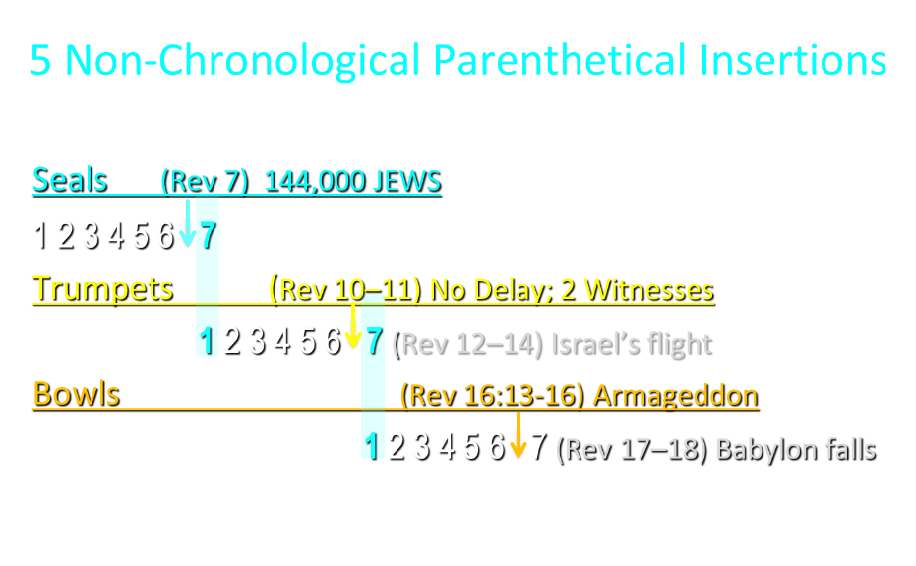

Slide 8
5 Non-Chronological Parenthetical Insertions
Rev 7 – 144,000 Jews
Rev 10:1-11:13 – Announcement of no more delay and the two witnesses
Rev 12-14 – Israel’s flight, two beasts, six scenes of hope
Rev 16:13-16 – Gathering of the nations to Armageddon
Rev 17:1-19:6 – Babylon’s fall

Slide 9
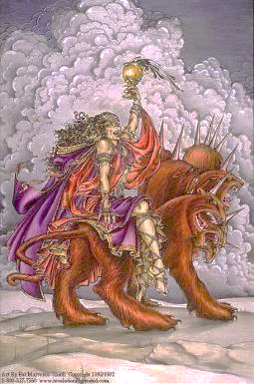
The Woman Rides the Beast
Revelation 17
The Vision Concerning Babylon (17:1-6a)
The Interpretation Concerning Babylon (6b-18)

Slide 10
The Woman Rides the Beast
Revelation 17
The Vision Concerning Babylon (17:1-6a)
The Interpretation Concerning Babylon (6b-18)

Slide 11
I. The Vision Concerning Babylon
Revelation 17:1-6a
Her introduction (1a)
Her judgment (1b)
Her immorality (2)
Her influence (3)
Her appearance (4)
Her title (5)
Her persecution (6a)

Slide 12
The Woman Rides the Beast
Revelation 17
The Vision Concerning Babylon (17:1-6a)
The Interpretation Concerning Babylon (6b-18)

Slide 13
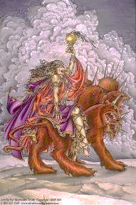
II. The Interpretation Concerning Babylon
Revelation 17:6b-18
The Interpretation Promised (6b-7)
The Beast & His system (8-14)
Babylon (15-18)

Slide 14
II. The Interpretation Concerning Babylon
Revelation 17:6b-18
The Interpretation Promised (6b-7)
The Beast & His system (8-14)
Babylon (15-18)

Slide 15

Revelation 17:3
“And he carried me away in the Spirit into a wilderness; and I saw a woman sitting on a scarlet beast, full of blasphemous names, having seven heads and ten horns.”

Slide 16


Slide 17

“We believe that the English translators have misled many by printing (on their own authority) the word ‘mystery’ in large capital letters, thus making it appear that this was a part of ‘the woman’s name. This we are assured is a mistake. That ‘mystery’ is connected with the ‘Woman’ herself and not with her ‘name’ is clear from v. 7, where the angel says unto John, ‘I will tell thee the mystery of the Woman, and of the beast which carrieth her.’”
Pink, The Antichrist, 262.

Slide 18
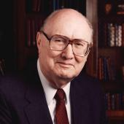
Two Rules of Interpretation
Search the immediate context
  Walvoord: 26X
Search the remote context
  Old Testament
  Thomas: 278 / 404 verses

Slide 19
II. The Interpretation Concerning Babylon
Revelation 17:6b-18
The Interpretation Promised (6b-7)
The Beast & His system (8-14)
Babylon (15-18)

Slide 20
B. The Beast & His System
Revelation 17:8-14
The Beast (8)
The Seven Heads (9-11)
The Ten Horns (12-14)

Slide 21
B. The Beast & His System
Revelation 17:8-14
The Beast (8)
The Seven Heads (9-11)
The Ten Horns (12-14)

Slide 22

Revelation 13:14
“And he deceives those who dwell on the earth because of the signs which it was given him to perform in the presence of the beast, telling those who dwell on the earth to make an image to the beast who had the wound of the sword and has come to life [záō].”

Slide 23
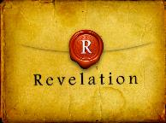
Revelation 2:8
“And to the angel of the church in Smyrna write: The first and the last, who was dead, and has come to life [záō], says this.”

Slide 24

Revelation 20:4-5
“⁴ Then I saw thrones, and they sat on them, and judgment was given to them. And I saw the souls of those who had been beheaded because of their testimony of Jesus and because of the word of God, and those who had not worshiped the beast or his image, and had not received the mark on their forehead and on their hand; and they came to life [záō] and reigned with Christ for a thousand years. ⁵ The rest of the dead did not come to life [záō] until the thousand years were completed. This is the first resurrection.”

Slide 25

2 Thessalonians 2:6-7
“⁶ And you know what restrains him now, so that in his time he will be revealed. ⁷ For the mystery of lawlessness is already at work; only he who now restrains will do so until he is taken out of the way.”

Slide 26
How Satan Imitates God and the Antichrist Imitates Jesus Christ
NO. | CATEGORY | JESUS CHRIST | ANTICHRIST
1. | World prepared in advance | Gal. 4:4 | 2 Thess. 2:7
2. | Revealed at the proper time | Gal. 4:4 | 2 Thess. 2:6
3. | Claim of deity | John 14:9 | 2 Thess. 2:4
4. | Heralded by a forerunner | John 1:23 | Rev. 13:12
5. | Forerunner comes in the Spirit and power of Elijah | Luke 1:17 | 1 Kgs. 8:37-38; Rev. 13:13
6. | Empowered by a higher source | 1 Cor. 6:14 | Rev. 13:14
7. | Member of a Trinity | Phil. 1:2; Acts 5:3-4; John 14:9 | Rev. 16:13; 20:10
8. | Head of a Church | Eph. 5:23 | Rev. 2:9; 3:9
9. | Miracle worker | Acts 2:22 | 2 Thess. 2:9
10. | Resurrection from the dead | 1 Cor. 15:3-6 | Rev. 13:3, 12, 14
11. | Given a throne | Rev. 3:21 | Rev. 13:2

Slide 27
How Satan Imitates God and the Antichrist Imitates Jesus Christ
NO. | CATEGORY | JESUS CHRIST | ANTICHRIST
12. | Ruling a political kingdom | Isa. 9:6-7 | Rev. 13:5
13. | Ushering in world peace | Isa. 9:6-7 | Rev. 6:1-4
14. | Activity in the Temple | Luke 2:41-50 | 2 Thess. 2:4
15. | Putting an end to animal sacrifices | Heb. 9:26-29 | Dan. 9:27
16. | Length of ministry | Over 3 years | Rev. 13:5
17. | Sealing ministry | Eph. 4:30 | Rev. 13:16-17
18. | Presentation to Israel as her Messiah | John 1:11 | John 5:43
19. | Covenant with Israel | Gen. 15:18 | Dan. 9:27
20. | Reception of worship | Zech. 14:16 | 2 Thess. 2:4
21. | Establishing Jerusalem as the center of worldwide worship | Zech. 14:17 | 2 Thess. 2:4

Slide 28
B. The Beast & His System
Revelation 17:8-14
The Beast (8)
The Seven Heads (9-11)
The Ten Horns (12-14)

Slide 29
Revelation 17:3
“And he carried me away in the Spirit into a wilderness; and I saw a woman sitting on a scarlet beast, full of blasphemous names, having seven heads and ten horns.”

Slide 31


Revelation 17:9-10
“Here is the mind which has wisdom. The seven heads are seven mountains [oros] on which the woman sits, ¹⁰ and they are seven kings; five have fallen, one is, the other has not yet come; and when he comes, he must remain a little while.”

Slide 32
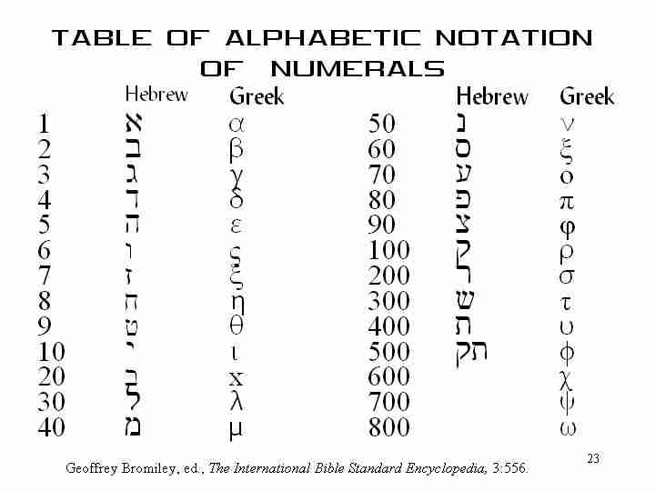
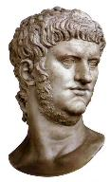

Slide 33
Revelation 17:9-10
“Here is the mind which has wisdom. The seven heads are seven mountains [oros] on which the woman sits, ¹⁰ and they are seven kings; five have fallen, one is, the other has not yet come; and when he comes, he must remain a little while.”

Slide 34
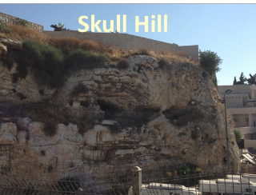
Revelation 11:8
“And their dead bodies will lie in the street of the great city which mystically is called Sodom and Egypt, where also their Lord was crucified.”

Slide 35
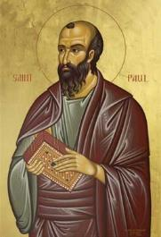
Galatians 4:24
“This is allegorically speaking, for these women are two covenants: one proceeding from Mount Sinai bearing children who are to be slaves; she is Hagar.”

Slide 36
Revelation 17:9-10
“Here is the mind which has wisdom. The seven heads are seven mountains [oros] on which the woman sits, ¹⁰ and they are seven kings; five have fallen, one is, the other has not yet come; and when he comes, he must remain a little while.”

Slide 37
Daniel 2:37-38
You, O king, are the king of kings, to whom the God of heaven has given the kingdom, the power, the strength and the glory; ³⁸ and wherever the sons of men dwell, or the beasts of the field, or the birds of the sky, He has given them into your hand and has caused you to rule over them all. You are the head of gold.

Slide 38
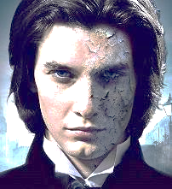
7 Kings or Kingdoms (Dan. 2:37-38)
(Revelation 17:9-10)
Egypt
Assyria
Babylon
Persian
Greece
Rome I
Rome II

Slide 39
7 Kings or Kingdoms (Dan. 2:37-38)
(Revelation 17:9-10)
Egypt
Assyria
Babylon
Persian
Greece
Rome I
Rome II

Slide 40
7 Kings or Kingdoms (Dan. 2:37-38)
(Revelation 17:9-10)
Egypt
Assyria
Babylon
Persian
Greece
Rome I
Rome II

Slide 41
7 Kings or Kingdoms (Dan. 2:37-38)
(Revelation 17:9-10)
Egypt
Assyria
Babylon
Persian
Greece
Rome I
Rome II

Slide 42
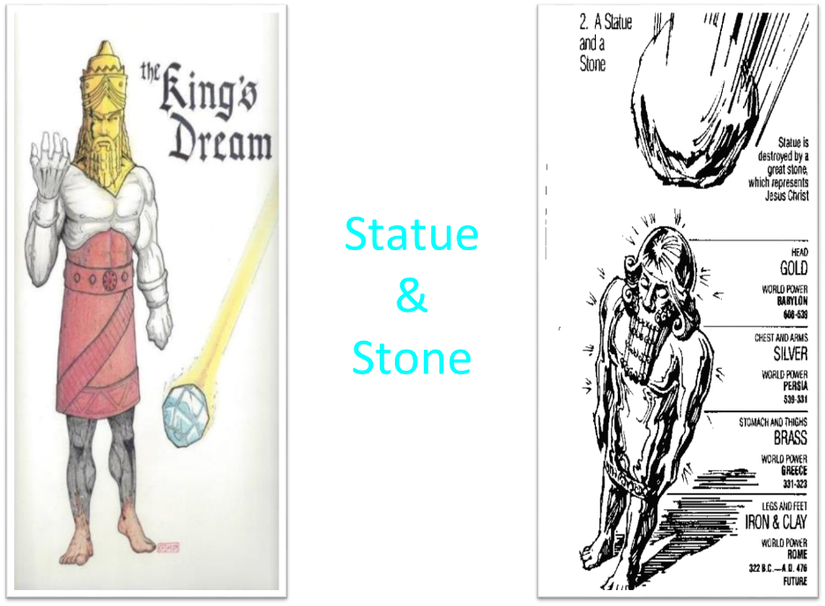

Slide 43
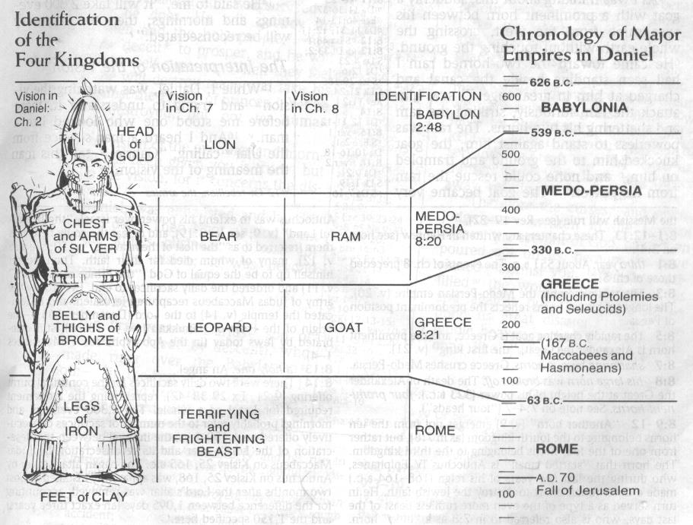
CHART OF NATIONS

Slide 44
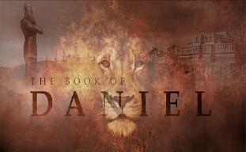
Daniel 7:12
“As for the rest of the beasts, their dominion was taken away, but an extension of life was granted to them for an appointed period of time.”

Slide 45
B. The Beast & His System
Revelation 17:8-14
The Beast (8)
The Seven Heads (9-11)
The Ten Horns (12-14)

Slide 46
Revelation 17:3
“And he carried me away in the Spirit into a wilderness; and I saw a woman sitting on a scarlet beast, full of blasphemous names, having seven heads and ten horns.”

Slide 47

Daniel 2:44
“In the days of those kings the God of heaven will set up a kingdom which will never be destroyed, and that kingdom will not be left for another people; it will crush and put an end to all these kingdoms, but it will itself endure forever.”

Slide 49
Daniel 7:24
“As for the ten horns, out of this kingdom ten kings will arise; and another will arise after them, and he will be different from the previous ones and will subdue three kings.”

Slide 50
CHART OF NATIONS

Slide 51
Daniel 7:23
“Thus he said: ‘The fourth beast will be a fourth kingdom on the earth, which will be different from all the other kingdoms and will devour the whole earth and tread it down and crush it.”

Slide 52
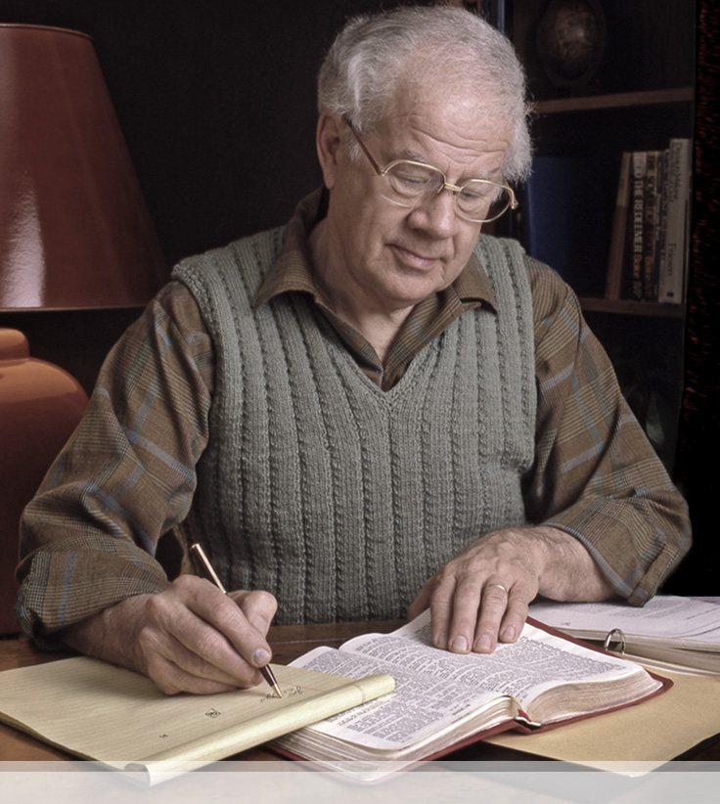
J. Dwight Pentecost
Things to Come, Page 321-22
“(3) From among those ten kingdoms there will arise one individual who will have control over the whole dominion of the ten kings (Dan. 7: 8, 24; Rev. 13: 1-10; 17: 13). In gaining his authority three of the ten kings are overthrown. (4) This final authority over the empire is wielded by one who is marked by blasphemy, hatred of God’s people, disregard for established law and order, who will continue for three and one-half years (Dan. 7: 26). (5) This final form of world power will have world-wide influence (Dan. 7: 23).”

Slide 53

Arnold Fruchtenbaum
Footsteps of the Messiah, Page 36
“This stage was seen in both Daniel 2 in the ten toes and in Daniel seven in the ten horns...the One World Government will divide into ten kingdoms that will cover the whole world – not merely Europe. It has become common today to refer to the ten kingdoms as being in Europe only, especially the Former Common Market, now the European Union. But the text does not allow for this kind of interpretation. At the very best, the European Union might become one of the ten, but it could hardly become all of the ten.”

Slide 54
Arnold Fruchtenbaum
Footsteps of the Messiah, Page 36
“A careful reading of the Daniel passage states that once the Fourth Empire rules the whole world, then this One World Government will split into ten kingdoms. This requires the ten kingdoms to cover the entire world, not just the territory known as Europe. It would be a mistake to make too much of the European Union as being the Ten Division Stage. It would be far more consistent with the text to view it as possibly one of the ten, but not the entire ten. More consistent with Daniel's prophecy is the recommendation of the Club of Rome that the world be divided into ten administrative districts to avoid a world economic collapse.”

Slide 55
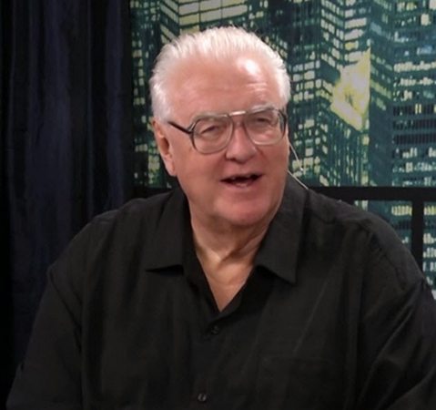
David Hocking
David Hocking, Babylon: Its History and Prophecies (Tustin, CA: Hope For Today Publications, 2015), 90.
“The ‘ten horns’ could represent ten nations of the end times, or perhaps more likely ten divisions of world government that will come into existence. Out of this confederacy will arise the ‘little horn’ or the ANTICHRIST himself empowered by Satan. His control and influence over the peoples of the world will be amazing!”

Slide 56
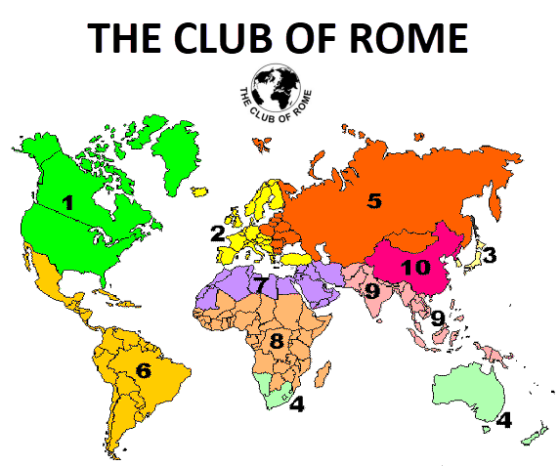

Slide 57

The Environmental Handbook (1970)
“...let's look at a few "root" mistakes the old-timers are about to make in the context of their new eco-concern. I use ‘old timer’...to indicate anybody‒regardless of age‒whose frames of reference are products of OLD TIME, i.e., the industrial revolution phase of history...They are about to initiate massive programs within old frames of centralized authority of the nation. Nations are such an artificial construct from an ecological point of view that any further energies poured into them are almost certain to do more long-term harm than good. Nations…must be phased out as quickly as possible and replaced with tribal or regional autonomous economies…Boycott the words "national" and "international.”
Keith Lampe, "Earth Read-Out," in The Environmental Handbook: Prepared for the First National Environmental Teach In, ed. Garrett De Bell(New York: Ballentine Books, 1970), 6.

Slide 58
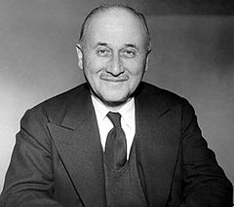
Jean Monet (1888‒1979)
“The sovereign nations of the past can no longer solve the problems of the present; they cannot ensure their own progress or control their own future… And the European community itself is only a stage on the way to the organized world of tomorrow.”
Jean Monet, Memoirs (New York: Doubleday, 1978), 524.

Slide 59
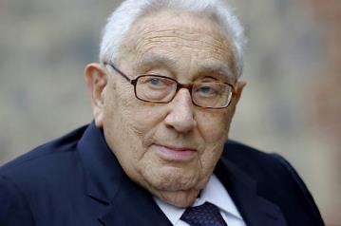
Regionalism
“The contemporary quest for world order will require a coherent strategy to establish a concept of order within the various regions and to relate these regional orders to one another.”
Henry Kissinger, New World Order (New York: Penguin, 2015), 371.

Slide 60

Open Borders
“In a private, paid speech to a Brazilian bank on May 16, 2013, Hillary Clinton said: ‘My dream is a hemispheric common market, with open trade and open borders, some time in the future with energy that is as green and sustainable as we can get it, powering growth and opportunity for every person in the hemisphere.’ This secret speech was released as part of the Podesta emails obtained by Wikileaks.”
http://www.breitbart.com/live/third-presidential-debate-fact-check-livewire/fact-check-yes-hillary-clinton-wants-open-borders/

Slide 61
Daniel 7:24
“As for the ten horns, out of this kingdom ten kings will arise; and another will arise after them, and he will be different from the previous ones and will subdue three kings.”

Slide 62
J. Dwight Pentecost
Things to Come, Page 321-22
“(3) From among those ten kingdoms there will arise one individual who will have control over the whole dominion of the ten kings (Dan. 7: 8, 24; Rev. 13: 1-10; 17: 13). In gaining his authority three of the ten kings are overthrown. (4) This final authority over the empire is wielded by one who is marked by blasphemy, hatred of God’s people, disregard for established law and order, who will continue for three and one-half years (Dan. 7: 26). (5) This final form of world power will have world-wide influence (Dan. 7: 23).”

Slide 63
II. The Interpretation Concerning Babylon
Revelation 17:6b-18
The Interpretation Promised (6b-7)
The Beast & His system (8-14)
Babylon (15-18)

Slide 64
Revelation 17:3
“And he carried me away in the Spirit into a wilderness; and I saw a woman sitting on a scarlet beast, full of blasphemous names, having seven heads and ten horns.”

Slide 66
C. The Beast & His System
Revelation 17:15-18
Her Influence (15)
Her Destruction (16-17)
Her Identification (18)

Slide 67
C. The Beast & His System
Revelation 17:15-18
Her Influence (15)
Her Destruction (16-17)
Her Identification (18)

Slide 68
Parallels Between Jeremiah 50-51 & Revelation 17-18
 | Jeremiah | Revelation
Associated with a Golden cup | 51:7a | 17:3-4; 18:6
Dwelling on many waters | 51:13 | 17:1
Intoxicating the nations | 51:7b | 17:2
Same name | 50:1 | 17:5
Persecution of the saints | 51:49 | 17:6; 18:24
Stone sinking into Euphrates | 51:63-64 | 18:21
Sudden destruction | 51:8 | 18:8
Destroyed by fire | 51:30 | 17:16
Final, uninhabitable | 50:39 | 18:21
Deserved | 50:29 | 18:6
God’s people flee | 51:6, 45 | 18:4
Heaven rejoices | 51:48 | 18:20
Dyer, "The Identity of Babylon in Revelation 17–18 (Part 2)," 441-43.

Slide 69
OT Descriptions of Babylon in Rev 17–18
 | Revelation 17–18 | Old Testament
Waters | 17:1 | Psalm 137:1
Babylon the Great | 17:5 | Daniel 4:30
Mother harlots | 17:5 | Genesis 11:1-9
Fallen, fallen is Babylon | 18:2 | Isaiah 21:9
Will not see widowhood | 18:7 | Isaiah 47:7-9
Colorful attire | 17:4; 18:16 | Daniel 5:7, 16, 29
Sorcery | 18:23 | 1saiah 47:9-13

Slide 70

Genesis 11:1-4
¹ Now the whole earth used the same language and the same words. ² It came about as they journeyed east, that they found a plain in the land of Shinar and settled there. ³ They said to one another, “Come, let us make bricks and burn them thoroughly.” And they used brick for stone, and they used tar for mortar. ⁴ They said, “Come, let us build for ourselves a city, and a tower whose top will reach into heaven, and let us make for ourselves a name, otherwise we will be scattered abroad over the face of the whole earth.”

Slide 71
Spread of the Mother-Child Cult
 | Mother | Child
Assyria | Ishtar | Tammuz
Phoenicia | Astarte | Baal
Egypt | Isis | Osirus/Horus
Greece | Aphrodite | Eros
Rome | Venus | Cupid
Asia | Cybele | Desius
India | Isi | Aswara
Roman Catholicism | Mary | Jesus
Israel | Queen of Heaven (Jer. 7:18; 44:17) | Tammuz (Ezek. 8:14-15)
Alexander Hislop, Two Babylons

Slide 72


Slide 73
C. The Beast & His System
Revelation 17:15-18
Her Influence (15)
Her Destruction (16-17)
Her Identification (18)

Slide 74
Revelation 17:3
“And he carried me away in the Spirit into a wilderness; and I saw a woman sitting on a scarlet beast, full of blasphemous names, having seven heads and ten horns.”

Slide 76
Parallels Between Jeremiah 50-51 & Revelation 17-18
 | Jeremiah | Revelation
Associated with a Golden cup | 51:7a | 17:3-4; 18:6
Dwelling on many waters | 51:13 | 17:1
Intoxicating the nations | 51:7b | 17:2
Same name | 50:1 | 17:5
Persecution of the saints | 51:49 | 17:6; 18:24
Stone sinking into Euphrates | 51:63-64 | 18:21
Sudden destruction | 51:8 | 18:8
Destroyed by fire | 51:30 | 17:16
Final, uninhabitable | 50:39 | 18:21
Deserved | 50:29 | 18:6
God’s people flee | 51:6, 45 | 18:4
Heaven rejoices | 51:48 | 18:20
Dyer, "The Identity of Babylon in Revelation 17–18 (Part 2)," 441-43.

Slide 77
ONE BABYLON
 | Rev. 17 | Rev. 18
Same name | 17:5 | 18:2
City | 17:18 | 18:10
Same clothing | 17:4 | 18:16
Holding a cup | 17:4 | 18:6
Fornicating with Kings | 17:2 | 18:3
Drunk with wine of immorality | 17:2 | 18:3
Persecuting believers | 17:6 | 18:20, 24
Destroyed by fire | 17:16 | 18:8, 18
Destroyed by God | 17:17 | 18:5, 8
Dyer, "The Identity of Babylon in Revelation 17–18 (Part 1)," 311-13.

Slide 78
C. The Beast & His System
Revelation 17:15-18
Her Influence (15)
Her Destruction (16-17)
Her Identification (18)

Slide 79
“MYSTERY” IN HARLOT’S TITLE? REV. 17:5
And on her forehead a name was written: MYSTERY, BABYLON THE GREAT, THE MOTHER OF HARLOTS AND OF THE ABOMINATIONS OF THE EARTH. (KJV, NIV)
… and upon her forehead a name was written, a mystery, “BABYLON THE GREAT, THE MOTHER OF HARLOTS AND OF THE ABOMINATIONS OF THE EARTH.” (NASB)

Slide 80


Revelation 17:18
“The woman whom you saw is the great city, [polis] which reigns over the kings of the earth.

Slide 81
Bullinger
The Apocalypse or “The Day of the Lord”, 509
“It is indeed surprising how any mistake could have been made in the identification of this woman. For the Holy Spirit first shows us her very name upon her forehead. Then, in verse 18, He tells us as plainly as words can tell anything, that ‘the woman which thou sawest is that great city, which reignest over the kings of the earth’, and chap. xvi. 19, as well as xvii. 5, identifies this city with Babylon. God says it is a ‘city.’ He does not say a system or a religion, but a ‘CITY.’”

Slide 82

Charles H. Dyer
“The Identity of Babylon in Revelation 17–18 (Part 2),” Bibliotheca sacra 144 (October-December 1987): 436.
“Whatever else is said about the harlot, she is first a city, not an ecclesiastical system.”

Slide 83

John F. Walvoord
The Revelation of Jesus Christ: A Commentary (Chicago: Moody, 1966), 267.
“Babylon, ecclesiastically symbolized by the woman in Revelation 17, proposes a common worship and a common religion through uniting in a world church. This is destroyed by the beast in Revelation 17:16 who thus fulfills the will of God (Rev. 17:17). Babylon, politically symbolized by the great city of Revelation 18, attempts to achieve its domination of the world by a world common market and a world government. These are destroyed by Christ at His second coming (Rev. 19:11–21).”

Slide 84

Revelation 18:10
“standing at a distance because of the fear of her torment, saying, ‘Woe, woe, the great city [polis], Babylon, the strong city! For in one hour your judgment has come.’”

Slide 85
ONE BABYLON
 | Rev. 17 | Rev. 18
Same name | 17:5 | 18:2
City | 17:18 | 18:10
Same clothing | 17:4 | 18:16
Holding a cup | 17:4 | 18:6
Fornicating with Kings | 17:2 | 18:3
Drunk with wine of immorality | 17:2 | 18:3
Persecuting believers | 17:6 | 18:20, 24
Destroyed by fire | 17:16 | 18:8, 18
Destroyed by God | 17:17 | 18:5, 8
Dyer, "The Identity of Babylon in Revelation 17–18 (Part 1)," 311-13.

Slide 86
Conclusion

Slide 87
The Woman Rides the Beast
Revelation 17
The Vision Concerning Babylon (17:1-6a)
The Interpretation Concerning Babylon (6b-18)

Slide 88

“The Lord bless you and keep you; the Lord make his face shine on you and be gracious to you; the Lord turn his face toward you and give you peace.” (NIV)

