Slide 1
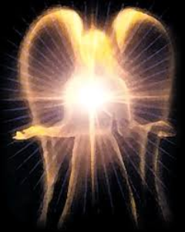
SATANOLOGY
Dr. Andy Woods
Senior Pastor – Sugar Land Bible Church
President – Chafer Theological Seminary

Slide 2
Preview of Angelology
Good angels
Satanology
Demonology
Gen. 6:1-4 controversy

Slide 3
Preview
Existence
Personhood
Names and titles
Original state and first sin
Works

Slide 4
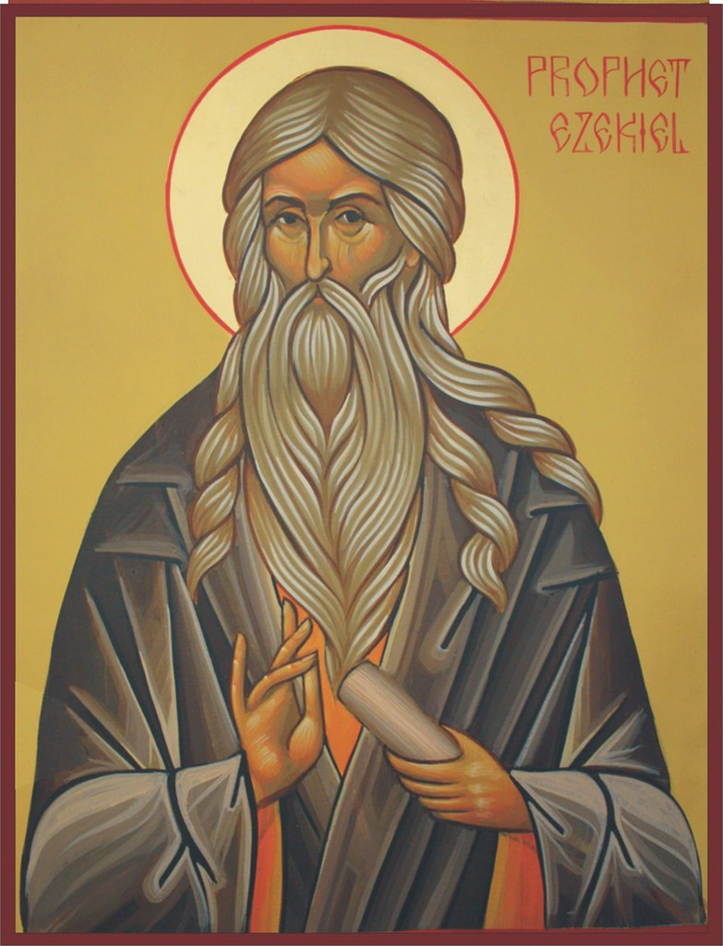
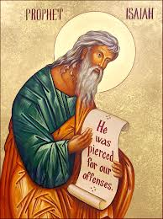
Satan’s Original State and First Sin
Ezekiel 28:12-17
Isaiah 14:12-15

Slide 5
Original State and First Sin (cont’d)
Time of Satan’s fall
In eternity past
In between Gen. 1:1-2 (gap theory?)
After Gen 1:31 but before Gen 3

Slide 6
Original State and First Sin (cont’d)
Time of Satan’s fall
In eternity past
In between Gen. 1:1-2 (gap theory?)
After Gen 1:31 but before Gen 3

Slide 7
Ezekiel 28:16-17
“¹⁶ By the abundance of your trade You were internally filled with violence, And you sinned; Therefore I have cast you as profane From the mountain of God. And I have destroyed you, O covering cherub, From the midst of the stones of fire. ¹⁷ “Your heart was lifted up because of your beauty; You corrupted your wisdom by reason of your splendor. I cast you to the ground; I put you before kings, That they may see you.”

Slide 8
Isaiah 14:12
“How you have fallen from heaven, O star of the morning, son of the dawn! You have been cut down to the earth, You who have weakened the nations!”

Slide 9
Original State and First Sin (cont’d)
Time of Satan’s fall
In eternity past
In between Gen. 1:1-2 (gap theory?)
After Gen 1:31 but before Gen 3

Slide 10
Gap Theory Preview
Definition of the Gap Theory
Evidence Favoring the Gap Theory
Response to Evidence Favoring the Gap Theory
Remaining Problems with the Gap Theory
Correct View of Gen. 1:1-2

Slide 11
Original State and First Sin (cont’d)
Time of Satan’s fall
In eternity past
In between Gen. 1:1-2 (gap theory?)
After Gen 1:31 but before Gen 3

Slide 12
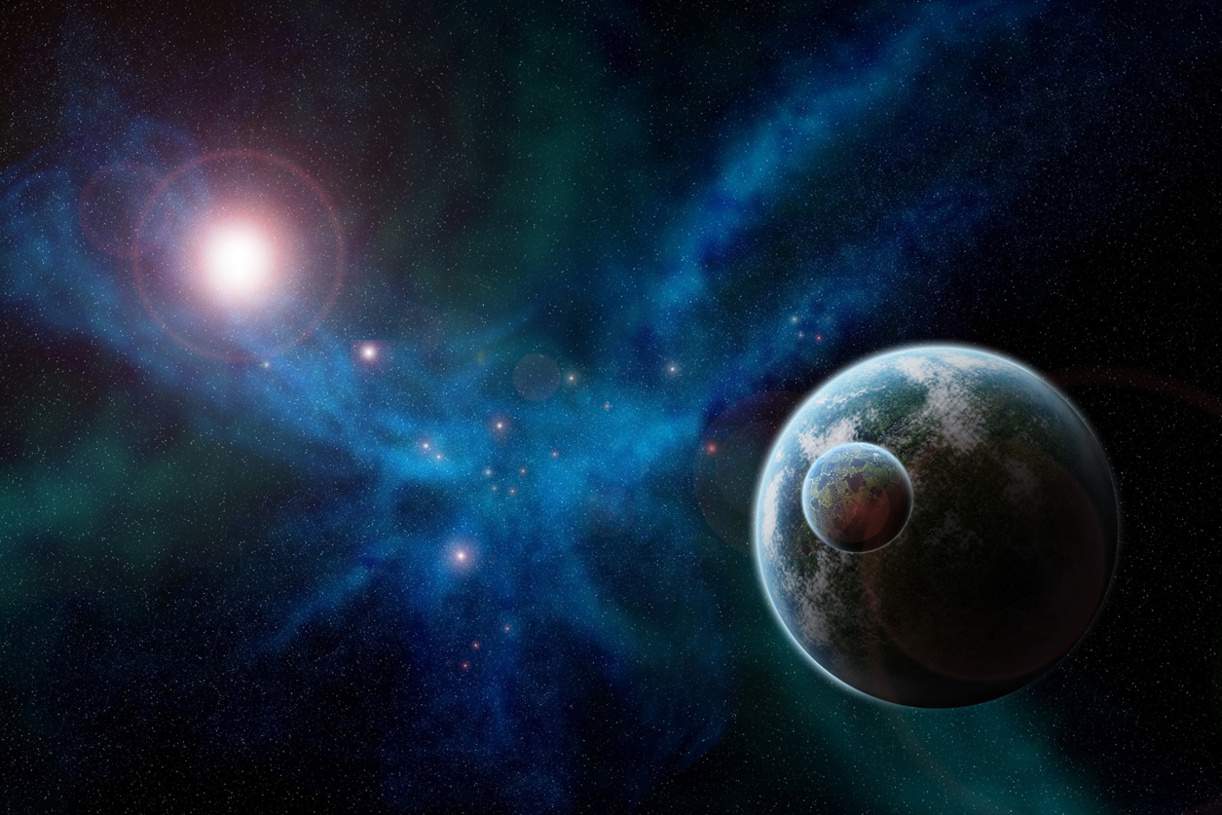
Genesis 1:31
“God saw all that He had made, and behold, it was very good. And there was evening and there was morning, the sixth day.”

Slide 13
Renald Showers
Renald Showers, Those Invisible Spirits Called Angels (Bellmawr, NJ: Friends of Israel, 1997), 82-83.
“When did Satan fall away from God? We noted earlier that sin was nonexistent in every part of God‘s creation, including the angels, through the end of the sixth or final day of creation (Gen. 1:31). Satan‘s fall therefore took place after the end of creation. However, Satan was evil by the time he came to earth to tempt man to fall away from God (Gen. 3). These things prompt the conclusion that Satan‘s fall took place in the interval between the end of creation and the fall of man. How long was the interval? It must have been quite short because when God created the first man and woman, he commanded them to be fruitful and multiply through procreation (Gen. 1:27–28), but there was no human conception until after the fall of man (Gen. 4:1).”

Slide 14
Preview
Existence
Personhood
Names and titles
Original state and first sin
Works

Slide 15
Works
Past
Present
Future

Slide 16
Works
Past
Present
Future

Slide 17
Works - Past
Lied to Adam and Eve (Gen 3:1ff)
Corrupted the pre-flood gene pool (Gen 6:1-4)
Accused and afflicted Job (Job 1–2)
Disputed Michael regarding Moses’ body (Jude 9)
Tempted David to take a census (1 Chr 21:1)
Accused Joshua (Zech 3:1-3)

Slide 18
Works – Past (cont’d)
Tempted Christ (Matt 4:1-11)
Tested Peter (Luke 22:31-33)
Possessed Judas (John 13:27)
Hindered Paul (1 Thess 2:18)
Afflicted Paul (2 Cor 12:7-10)
Influenced Ananias & Sapphira to lie (Acts 5:3-4, 8)

Slide 19
Works
Past
Present
Future

Slide 20
Works – Present
Snatches God’s Word (Luke 8:12)
Rules world (1 John 5:19)
Blinds the mind (2 Cor 4:4)
Sends false ministers (2 Cor 11:14-15)
Sends false gospels (2 Cor 11:3-4)
Sows unbelievers among believers (Matt 13:38-39)
Performs miracles (2 Thess 2:9)
Promotes immorality (Eph 2:1-3)
Opposes God’s people (Eph 6:11-12)

Slide 21
Works – Present
Snatches God’s Word (Luke 8:12)
Rules world (1 John 5:19)
Blinds the mind (2 Cor 4:4)
Sends false ministers (2 Cor 11:14-15)
Sends false gospels (2 Cor 11:3-4)
Sows unbelievers among believers (Matt 13:38-39)
Performs miracles (2 Thess 2:9)
Promotes immorality (Eph 2:1-3)
Opposes God’s people (Eph 6:11-12)

Slide 22
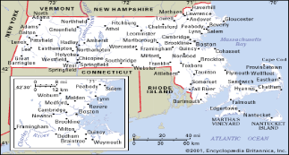
Old Satan Deluder Law: 1642 Massachusetts Church of the Holy Trinity v. U.S., 143 U.S. 457, 467 (1892)
“It being one chief project of that old deluder, Satan, to keep men from the knowledge of the Scriptures, as in former time…It is therefore ordered…that after the Lord hath increased the settlement…they shall…appoint one within their town, to teach all such children to read…they shall set up a grammar school to instruct youths…”

Slide 23
Works – Present
Snatches God’s Word (Luke 8:12)
Rules world (1 John 5:19)
Blinds the mind (2 Cor 4:4)
Sends false ministers (2 Cor 11:14-15)
Sends false gospels (2 Cor 11:3-4)
Sows unbelievers among believers (Matt 13:38-39)
Performs miracles (2 Thess 2:9)
Promotes immorality (Eph 2:1-3)
Opposes God’s people (Eph 6:11-12)

Slide 24
2 Thessalonians 2:6-7
“⁶ And you know what restrains him now, so that in his time he will be revealed. ⁷ For the mystery of lawlessness is already at work; only he who now restrains will do so until he is taken out of the way.”

Slide 25
Works – Present
Snatches God’s Word (Luke 8:12)
Rules world (1 John 5:19)
Blinds the mind (2 Cor 4:4)
Sends false ministers (2 Cor 11:14-15)
Sends false gospels (2 Cor 11:3-4)
Sows unbelievers among believers (Matt 13:38-39)
Performs miracles (2 Thess 2:9)
Promotes immorality (Eph 2:1-3)
Opposes God’s people (Eph 6:11-12)

Slide 26
Revelation 2:9
“I know your tribulation and your poverty (but you are rich), and the blasphemy by those who say they are Jews and are not, but are a synagogue of Satan.”

Slide 27
Works – Present
Snatches God’s Word (Luke 8:12)
Rules world (1 John 5:19)
Blinds the mind (2 Cor 4:4)
Sends false ministers (2 Cor 11:14-15)
Sends false gospels (2 Cor 11:3-4)
Sows unbelievers among believers (Matt 13:38-39)
Performs miracles (2 Thess 2:9)
Promotes immorality (Eph 2:1-3)
Opposes God’s people (Eph 6:11-12)

Slide 28
Antichrist’s Satanic Miracles (2 Thessalonians 2:9)
MIRACLE | GREEK | CHRIST’S MINISTRY
Powers | Dynamis | Matt. 11:20
Signs | Semēion | John 20:30
Wonders | Teras | Acts 2:22

Slide 29
Satanic/Demonic Miracles
Exod. 7–8
Deut. 13:1-3
Matt. 7:21-23; 24:24
Acts 8:9; 16:16
Gal. 1:6-9
2 Thess. 2:9
Rev. 13:3, 13, 15; 16:13-14

Slide 30
Works – Present
Snatches God’s Word (Luke 8:12)
Rules world (1 John 5:19)
Blinds the mind (2 Cor 4:4)
Sends false ministers (2 Cor 11:14-15)
Sends false gospels (2 Cor 11:3-4)
Sows unbelievers among believers (Matt 13:38-39)
Performs miracles (2 Thess 2:9)
Promotes immorality (Eph 2:1-3)
Opposes God’s people (Eph 6:11-12)

Slide 31
Works – Present (cont’d )
Tempts God’s people (1 Cor 7:5)
Uses the carnality of Christians (Eph 4:26-27)
Causes physical problems (Luke 13:11, 16)
Influences civil government (Dan 10:10ff)
Lies (John 8:44)
Deceives (Rev 12:9; 20:3)

Slide 32
Works – Present (cont’d )
Tempts God’s people (1 Cor 7:5)
Uses the carnality of Christians (Eph 4:26-27)
Causes physical problems (Luke 13:11, 16)
Influences civil government (Dan 10:10ff)
Lies (John 8:44)
Deceives (Rev 12:9; 20:3)

Slide 33
Romans 8:19-22
¹⁹ For the anxious longing of the creation waits eagerly for the revealing of the sons of God. ²⁰ For the creation was subjected to futility, not willingly, but because of Him who subjected it, in hope ²¹ that the creation itself also will be set free from its slavery to corruption into the freedom of the glory of the children of God. ²² For we know that the whole creation groans and suffers the pains of childbirth together until now.

Slide 34
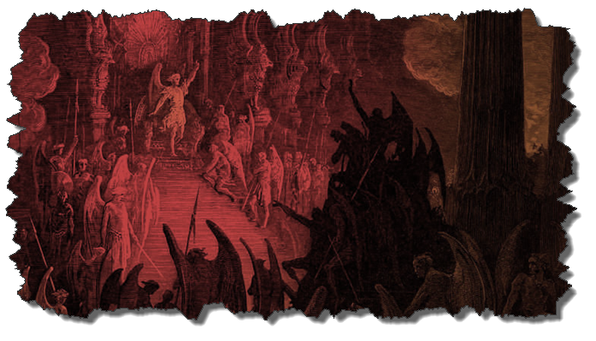
Not all Physical Infirmities are Attributable to Satan/Demon (works cont’d)
Matt 8:5-13
Matt 9:19-20, 27-30
Matt 12:9-14
Matt 14:35-36

Slide 35
Works – Present (cont’d )
Tempts God’s people (1 Cor 7:5)
Uses the carnality of Christians (Eph 4:26-27)
Causes physical problems (Luke 13:11, 16)
Influences civil government (Dan 10:10ff)
Lies (John 8:44)
Deceives (Rev 12:9; 20:3)

Slide 36
Works
Past
Present
Future

Slide 37
Works – Future
World government (Rev 13:3-4)
Oppose the 2nd Advent (Rev 17:14)
Attempt to annihilate Israel (Rev 12)
Bound (Rev 20:1-3)
Lead a final rebellion (Rev 20:7-9)
Cast into the Lake of Fire (Rev 20:10)

Slide 38
Works – Future
World government (Rev 13:3-4)
Oppose the 2nd Advent (Rev 17:14)
Attempt to annihilate Israel (Rev 12)
Bound (Rev 20:1-3)
Lead a final rebellion (Rev 20:7-9)
Cast into the Lake of Fire (Rev 20:10)

Slide 39
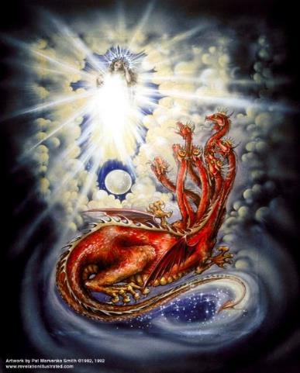
CAST OF 3 CHARACTERS Revelation 12:1-5
SON = MESSIAH
Ps. 2:9; Acts 1:9
DRAGON = SATAN
Rev. 12:9; 20:2
WOMAN = ISRAEL
Gen. 37:9-10

Slide 40
Genesis 37:9
Now he had still another dream, and related it to his brothers, and said, “Lo, I have had still another dream; and behold, the sun and the moon and eleven stars were bowing down to me.

Slide 41
Genesis 37:10
He related it to his father and to his brothers; and his father rebuked him and said to him, “What is this dream that you have had? Shall I and your mother and your brothers actually come to bow ourselves down before you to the ground?”

Slide 42
2 CYCLES OF SATANIC PERSECUTION
“Pursues the woman” = persecution of Israel 12:13-14
“Flood from his mouth” = tries to destroy Israel 12:15-16

Slide 43
Works – Future
World government (Rev 13:3-4)
Oppose the 2nd Advent (Rev 17:14)
Attempt to annihilate Israel (Rev 12)
Bound (Rev 20:1-3)
Lead a final rebellion (Rev 20:7-9)
Cast into the Lake of Fire (Rev 20:10)

Slide 44
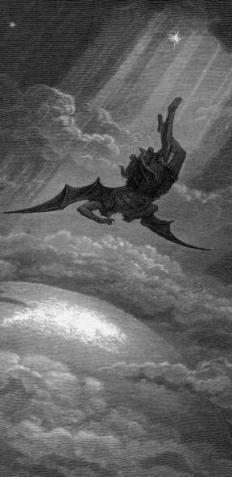
Satan’s Progressive Defeat
Initial eviction from heaven (Isa 14:12-15; Ezek 28:12-17)
Eden (Gen 3:15)
Pre-diluvian world (1 Pet 3:19-20)
Cross (John 12:31; 16:11; Col 2:15; Heb 2:14; 1 John 3:8)
Mid point of the Tribulation (Rev 12:9)
Beginning of millennium (Rev 20:2-3)
End of millennium (Rev 20:10)

Slide 45
Satan’s Progressive Defeat
Initial eviction from heaven (Isa 14:12-15; Ezek 28:12-17)
Eden (Gen 3:15)
Pre-diluvian world (1 Pet 3:19-20)
Cross (John 12:31; 16:11; Col 2:15; Heb 2:14; 1 John 3:8)
Mid point of the Tribulation (Rev 12:9)
Beginning of millennium (Rev 20:2-3)
End of millennium (Rev 20:10)

Slide 46
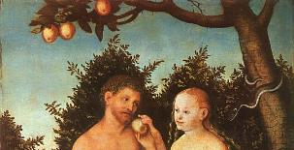
Genesis 3:15
“And I will put enmity between you and the woman, and between your seed and her seed; He shall bruise you on the head, and you shall bruise him on the heel.”

Slide 47
Satan’s Progressive Defeat
Initial eviction from heaven (Isa 14:12-15; Ezek 28:12-17)
Eden (Gen 3:15)
Pre-diluvian world (1 Pet 3:19-20)
Cross (John 12:31; 16:11; Col 2:15; Heb 2:14; 1 John 3:8)
Mid point of the Tribulation (Rev 12:9)
Beginning of millennium (Rev 20:2-3)
End of millennium (Rev 20:10)

Slide 48
 | David/Saul | Jesus/Satan
ANOINTED | David (1 Sam 16:13) | Jesus-Res./Ascension (Ps 2:7; 110:1)
NOW RULING | Saul (1 Sam 16:14) | Satan (Luke 4:5-7)
ILLEGITIMACY | Benjamin (Gen 49:10; 1 Sam. 9:21) | Gen. 1:26-28; 2:19-20; Dan 1:6-7)
FAITH | David (1 Sam 16:7) | Jesus (Heb 11:6)
MINORITY | David’s men (2 Sam 23:8-39) | Narrow road (Matt 7:14)
SIGHT | Saul (1 Sam 9:2) | Satan (2 Cor. 4:18; 1 John 2:15-17)
MAJORITY | Israel | Broad road (Matt. 7:13)
McClain, Greatness of the Kingdom, 440

Slide 49
CONCLUSION

Slide 50
Preview
Existence
Personhood
Names and titles
Original state and first sin
Works

