Slide 1
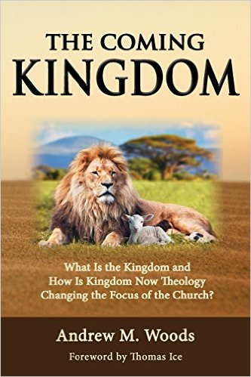

Slide 2
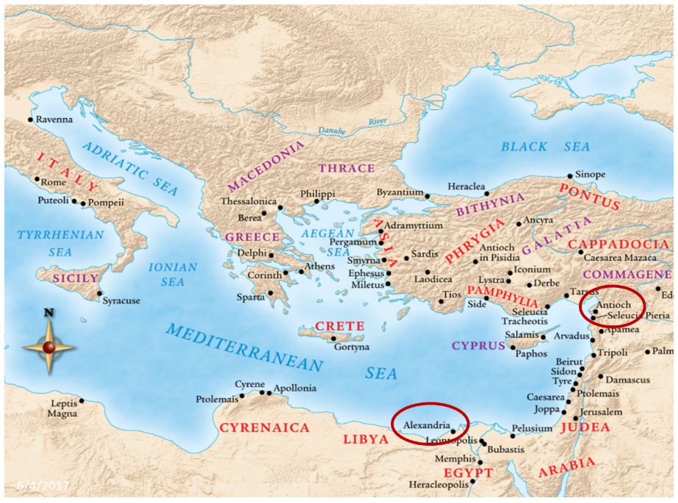

Slide 3
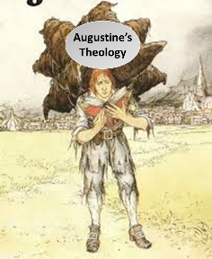
Augustine
The City of God, trans., Marcus Dods (NY: Random House, 1950), Book XX, chap. 9, p. 725-26.
Augustine wrote, “the saints reign with Christ during the same thousand years, understood in the same way, that is, of the time of His first coming” and “Therefore the Church even now is the kingdom of Christ, and the kingdom of heaven. Accordingly, even now His saints reign with Him.”

Slide 4

Emergent: Kingdom
“The Kingdom of God is a central conversation in emerging communities… And let me tell you ‘Kingdom of God’ language is really big in the emerging church” (Italics added).
Doug Pagitt, cited in Oakland, Faith Undone, 163.

Slide 5
Emergent: Kingdom
“He selected 12 and trained them in a new way of life. He sent them to teach everyone this new way of life...Even if only a few would practice this new way, many would benefit. Oppressed people would be free. Poor people would be liberated from poverty. Minorities would be treated with respect. Sinners would be loved, not resented.”
Brian McLaren, A Generous Orthodoxy, 111.

Slide 6
Emergent: Kingdom
“Industrialists would realize that God cares for sparrows and wildflowers-so their industries should respect, not rape, the environment. The homeless would be invited in for a hot meal. The kingdom of God would come – not everywhere at once, not suddenly, but gradually like a seed growing in a field, like yeast spreading in a lump of bread dough, like light spreading across the sky at dawn.”
Brian McLaren, A Generous Orthodoxy, 111.

Slide 7
Emergent: Kingdom
“If Revelation were a blueprint of the distant future, it would have been unintelligible to its original readers…In light of this, Revelation becomes a powerful book about the kingdom of God here and now, available to all.”
Brian McLaren, cited in Oakland, Faith Undone, 158.

Slide 8
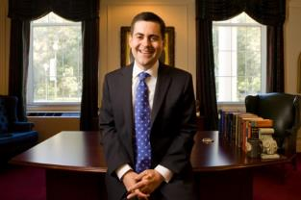
Russell Moore
President: Ethics and Religious Liberties Commission of the Southern Baptist Convention
“The locus of the kingdom of God in this age is within the church, where Jesus rules as king. As we live our lives together, we see the transforming power of the gospel and the in breaking of the future kingdom.”
Justin Taylor, “An Interview with Russell Moore,” www.thegospelcoalition.org.

Slide 9
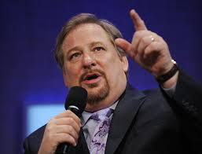
Kingdom
“I stand before you confidently right now and say to you that God is going to use you to change the world...I'm looking at a stadium full of people right now who are telling God they will do whatever it takes to establish God's Kingdom "on earth as it is in heaven." What will happen if the followers of Jesus say to Him, "We are yours?" What kind of spiritual awakening will occur?”
Rick Warren, cited in Oakland, Faith Undone, Kindle edition.

Slide 10

The Coming Kingdom
Chapter 22-26
Dr. Andy Woods
Senior Pastor – Sugar Land Bible Church
President – Chafer Theological Seminary

Slide 11
Kingdom Study Outline
What does the Bible Say About the Kingdom?
The Main Problem with Kingdom Now NT interpretations
Why do some believe that we are in the kingdom now?
Why does it matter?

Slide 12
Kingdom Study Outline
What does the Bible Say About the Kingdom?
The Main Problem with Kingdom Now NT interpretations
Why do some believe that we are in the kingdom now?
Why does it matter?

Slide 13

Dominoes in a Row

Slide 14


Areas of Systematic Theology
Prolegomena – Introduction
Theology – Study of God
Christology – Study of Christ
Pneumatology – Study of the Holy Spirit
Anthropology – Study of Man
Hamartiology – Study of sin
Soteriology – Study of salvation
Angelology – Study of angels
Ecclesiology – Study of the Church
Eschatology – Study of the end

Slide 15

Dr. Robert Lightner
Purposes of the Local Church
Glorify God (Eph 3:21)
Edify the saints (Eph 4:11-16)
Fulfill the Great Commission (Matt 28:18-20)

Slide 16

Alva J. McClain
Alva J. McClain, The Greatness of the Kingdom: An Inductive Study of the Kingdom of God as Set Forth in the Scriptures (Grand Rapids: Zondervan, 1959), 438-39.
“Theological confusion, especially in matters which have to do with the church, will inevitably produce consequences which are of grave practical concern. The identification of the Kingdom with the church has led historically to ecclesiastical policies and programs which, even when not positively evil, have been far removed from the original simplicity of the New Testament ekklēssia. It is easy to claim that in the ‘present kingdom of grace’ that the rule of the saints is wholly ‘spiritual,’ exerted only through moral principles and influence. But practically, once the church becomes the Kingdom in any realistic theological sense, it is impossible to draw any clear line between principles and their implementation through political and social devices. For the logical implications of a present ecclesiastical kingdom are unmistakable, and historically have always led in one direction, i.e., political control of the state by the church.”

Slide 17
Alva J. McClain
Alva J. McClain, The Greatness of the Kingdom: An Inductive Study of the Kingdom of God as Set Forth in the Scriptures (Grand Rapids: Zondervan, 1959), 438-39.
“The distances traveled down this road by various religious movements, and the forms of control which were developed, have been widely different. The difference is very great between the Roman Catholic system and modern Protestant efforts to control the state; also between the ecclesiastical rule of Calvin in Geneva and the fanaticism of Münster and the English ‘fifth-monarchy.’ But the basic assumption is always the same: The church in some sense is the kingdom, and therefore has a divine right to rule; or it is the business of the church to ‘establish’ fully the Kingdom of God among men. Thus the church loses its pilgrim character and the sharp edge of its divinely commissioned ‘witness’ is blunted. It becomes an ekklēssia which is not only in the world, but also of the world. It forgets that just as in the regeneration of the soul only God can effect the miracle, even so the ‘regeneration’ of the world can only be wrought by the intrusion of regal power from on high (Matt. 19:28).”

Slide 18

9 Ways Kingdom Now Theology
Impacts the Church
Loss of “pilgrim” status
Social Gospel
Ecumenical & interfaith alliances
Rejection or marginalization of Bible prophecy
Building the wrong kingdom
Charismatic theology
Prosperity Gospel
Anti-Israelism
Lordship Salvation

Slide 19
9 Ways Kingdom Now Theology
Impacts the Church
Loss of “pilgrim” status
Social Gospel
Ecumenical & interfaith alliances
Rejection or marginalization of Bible prophecy
Building the wrong kingdom
Charismatic theology
Prosperity Gospel
Anti-Israelism
Lordship Salvation

Slide 20

Lewis Sperry Chafer
vol. 5, Systematic Theology (Grand Rapids, MI: Kregel Publications, 1993), 350.
“So the church was fully warned from the beginning about the nature of this age, and taught concerning her pilgrim character while here and her holy calling and separateness from the ‘evil age.’”

Slide 21

Galatians 1:4
“who gave Himself for our sins so that He might rescue us from this present evil age, according to the will of our God and Father.”

Slide 22
James 1:1
“James, a bond-servant of God and of the Lord Jesus Christ, To the twelve tribes who are dispersed abroad (diaspora): Greetings.”

Slide 23
1 Peter 1:1; 2:11
“¹To those who reside as aliens (paraepidēmois), scattered throughout (diaspora) Pontus, Galatia, Cappadocia, Asia, and Bithynia, who are chosen…^{2:11} Beloved, I urge you as aliens and strangers (paraepidēmois) to abstain from fleshly lusts which wage war against the soul.”

Slide 24
Hebrews 11:13
“¹³ All these died in faith, without receiving the promises, but having seen them and having welcomed them from a distance, and having confessed that they were strangers and exiles (paraepidēmois) on the earth.”

Slide 25
9 Ways Kingdom Now Theology
Impacts the Church
Loss of “pilgrim” status
Social Gospel
Ecumenical & interfaith alliances
Rejection or marginalization of Bible prophecy
Building the wrong kingdom
Charismatic theology
Prosperity Gospel
Anti-Israelism
Lordship Salvation

Slide 26

Holistic Redemption?
“Negative-thinking theologians looked at the doctrine of sin, salvation and repentance...through distorted glasses tinted with mortification mentality. Too many prayers of confession of sin and repentance have been destructive to the emotional health of Christians...I am not fully forgiven until I allow God to write his new dream for my life on the blackboard of my mind, and I dare to believe 'I am; therefore, I can. I am a child of God...God has a great plan to redeem society...The emerging church, reformed according to the needs of self-esteem-starved-souls under the Lordship of Christ.... will help us to affirm the concept that 'While God's ideas may seem humanly impossible, he will give us these ideas which will lead to glorious, self-esteem-generating success.'"
Robert H. Schuller, Self-Esteem: The New Reformation (Waco, TX: Word Books, 1982), 104-05.

Slide 27
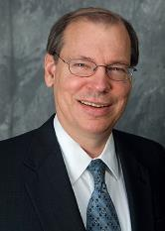
Progressive Dispensationalism & Social Gospel
Craig Blaising, “Dispensationalism: The Search for Definition,” in Dispensationalism, Israel and the Church, ed. Craig Blaising and Darrell Bock (Grand Rapids: Zondervan, 1992), 14, n. 3; idem, “Theological and Ministerial Issues in Progressive Dispensationalism,” in Progressive Dispensationalism, ed. Darrell Bock and Craig Blaising(Wheaton, IL: Victor, 1993), 288–89.
“Unfortunately, present-day dispensationalists have written very little in proposing a theology of social ministry…if we as a community of Christ worked on creating our community as a model of social justice and peace, then we really would have some suggestions to make for social reform in our cities and nations.”
Notes:
WRONG!!!

Slide 28
Emergent Church & the Kingdom
“The church has been preoccupied with the question, ‘What happens to your soul after you die?’ As if the reason for Jesus coming can be summed up in, ‘Jesus is trying to get more souls into heaven as opposed to hell, after they die.’ I just think a fair reading of the Gospels blows that out of the water.”
Brian McLaren, cited in Oakland, Faith Undone, 203.

Slide 29

Charles Ryrie
Dispensationalism, Page 176
“Holistic redemption can easily lead to placing unbalanced, if not wrong, priorities on political action, social agendas, and improving the structures of society.”

Slide 30
Kingdom
“P.E.A.C.E. is an acronym for Promote reconciliation; Equip servant leaders; Assist the poor; Care for the sick; and Educate the next generation. Coalition members see these actions as Jesus’ antidote to five ‘global giants,’—problems that affect billions of people worldwide: spiritual emptiness, self-centered leadership, poverty, pandemic disease, and illiteracy.”
Rick Warren and 1,700 Leaders Launch the Peace Coalition at “Purpose Driven Summit,” accessed November 15, 2014

Slide 31
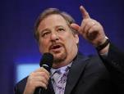
Social Gospel Confusion
“P.E.A.C.E. is an acronym for:
    Promote reconciliation;
    Equip servant leaders;
    Assist the poor;
    Care for the sick; and
    Educate the next generation.
Coalition members see these actions as Jesus’ antidote to five “global giants,”—problems that affect billions of people worldwide: spiritual emptiness, self-centered leadership, poverty, pandemic disease, and illiteracy.”
“Rick Warren and 1,700 Leaders Launch the Peace Coalition at Purpose Driven Summit,” accessed November 15, 2014, http://www.christiannewswire.com/news/249586720.html

Slide 32

The Great Omission?
Romans 1:16-17
Matthew 28:19
Mark 16:15
John 20:21
Luke 24:46-49
Acts 1:4-8

Slide 33
9 Ways Kingdom Now Theology
Impacts the Church
Loss of “pilgrim” status
Social Gospel
Ecumenical & interfaith alliances
Rejection or marginalization of Bible prophecy
Building the wrong kingdom
Charismatic theology
Prosperity Gospel
Anti-Israelism
Lordship Salvation

Slide 34
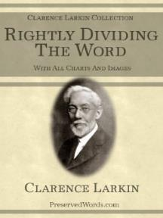
Clarence Larkin
Rightly Dividing the Word, 48.
“The great mistake the Church has made is in appropriating to herself in this Dispensation the promises of earthly conquest and glory which belong exclusively to Israel in the ‘Millennial Age.’ As soon as the Church enters into an ‘Alliance with the World,’ and seeks the help of Parliaments, Congresses, Legislatures, Federations and Reform Societies, largely made up of ungodly men and women, she loses her spiritual power and becomes helpless as a redeeming force.”

Slide 35

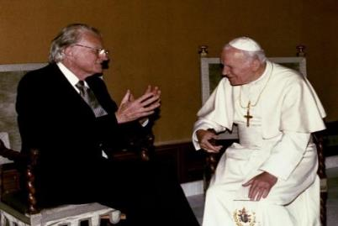
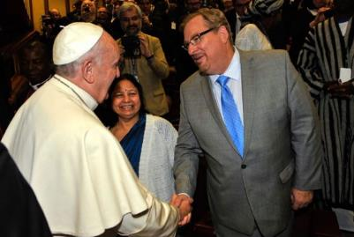
Evangelicals and Catholics Together

Slide 36
Ecumenisim
Matt Slick, “Rick Warren’s Comments on Roman Catholicism,” accessed July 20, 2015, http://www.carm.org.
“We have far more in common than what divides us. When you talk about Pentecostals, charismatics, evangelicals, fundamentalists, Catholics, Methodists, Baptists, Presbyterians, on and on and on and on. Well, they would all say we believe in the trinity; we believe in the Bible; we believe in the resurrection; we believe salvation is through Jesus Christ. These are the big issues. Sometimes Protestants think that Catholics worship Mary like she’s another god. But that’s not exactly catholic doctrine. . . . and people say well what are the saints all about? Why are you praying to the saints? And when you understand what they mean by what they’re saying there’s a whole lot more commonality.”

Slide 37
Ecumenisim
Matt Slick, “Rick Warren’s Comments on Roman Catholicism,” accessed July 20, 2015, http://www.carm.org.
“Now there are still real differences, no doubt about that. But the most important thing is if you love Jesus, we’re on the same team. The unity that I think we would see realistically is not a structural unity but a unity of mission. And so, when it comes to the family, we are co-workers in the field on this for the protection of what we call the sanctity of life, the sanctity of sex, and the sanctity of marriage. So there’s a great commonality and there’s no division on any of those three. Many times people have been beaten down for taking a biblical stance. And they start to feel, “Well, maybe I’m out here all by yourself.” No, you’re not (italics added)”

Slide 38
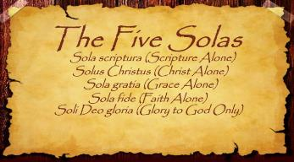
The Five Solas (Alone or By Itself)
Solus Christus-Christ alone
Sola Fide-faith alone
Sola Gratia-grace alone
Sola Scriptura-Scripture alone
Soli Deo Gloria-To the glory of God alone

Slide 39

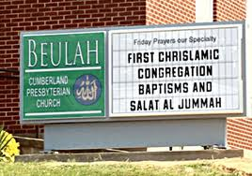

Slide 40
Ecumenisim
http://m.youtube.com/watch?v=nu7_rtUQiE0
“To my Islamic brother here from Italy, I would say I’m not really interested in inter-faith dialogue; I’m interested in inter-faith projects. We’ve got enough talk. So . . . a few weeks ago, at Georgetown University, we brought in three imams, we brought in three Catholic priests, we brought in three evangelical pastors, and we brought in three Rabbis and we said, ‘What can we do about AIDS?’ And we started on some common ground on those issues; what can we do that we all care about?”

Slide 41
Ecumenisim
https://www.youtube.com/watch?feature=player_detailpage&v=tJeNsPIC3vE
“I humbly ask this in the name of the one who changed my life, Yeshua, Isa, Jesus [Spanish pronunciation], Jesus, who taught us to pray.”

Slide 42
Ecumenisim
Eric Barger, “Rick Warren Invokes the Name of Islamic Jesus at Obama Inauguration” (January 2009), accessed January 4, 2015,
http://www.ericbarger.com/emailers/2009/update1-21-2009.htm.
“‘Isa’ in no way represents the Jesus of the Bible but is instead the false Jesus of the Qur’an (Koran) and the Muslim Hadith. ‘Isa’ (pronounced ‘eee-sa’) is the Islamic Jesus who was but a prophet and who certainly did not experience a sacrificial death on a cross let alone resurrect from the dead. In fact, in Islam the prophet Isa is actually the destroyer of Christianity—not it’s Savior. Obviously, this is simply NOT the same Jesus as is Yeshua.”

Slide 43
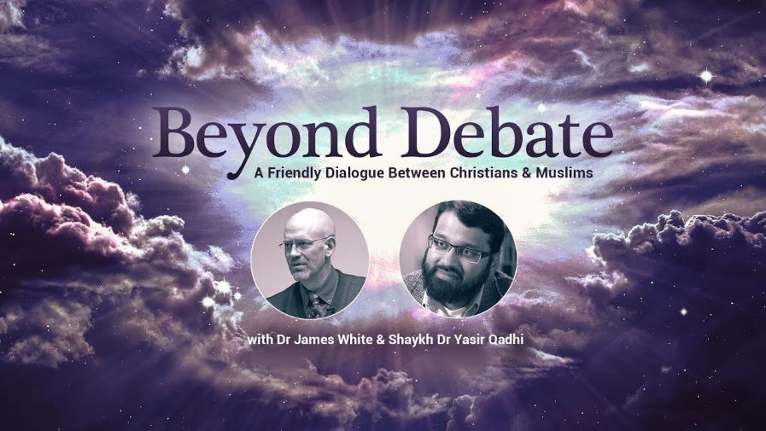

Slide 44

Seyyid Qutb
The Muslim Brotherhood’s senior theoretician, Seyyid Qutb, was transparent in the true agenda behind Islamic participation in interfaith dialogue, when he wrote, “The chasm between Islam and the Jahiliyyah [the society of unbelievers] is great, and a bridge is not to be built across it so that the people on the two sides may mix with each other, but only so that the people of the Jahiliyyah [the society of unbelievers] may come over to Islam."
Sayyid Qutb, Milestones, Salimiah (Kuwait: International Islamic Federation of Student Organizations, 1978 [written 1966]), 263.

Slide 45


The First Interfaith Dialogue
2 Cor 11:3
“But I fear, lest somehow, as the serpent deceived Eve by his craftiness, so your minds may be corrupted by from the simplicity that is in Christ.” (Italics mine)
Gen 3:1
“Now the serpent was more crafty than any beast of the field which the Lord God had made. And he said to the woman, ‘Indeed, has God said, ‘You shall not eat from any tree of the garden’?”

Slide 46
9 Ways Kingdom Now Theology
Impacts the Church
Loss of “pilgrim” status
Social Gospel
Ecumenical & interfaith alliances
Rejection or marginalization of Bible prophecy
Building the wrong kingdom
Charismatic theology
Prosperity Gospel
Anti-Israelism
Lordship Salvation

Slide 47
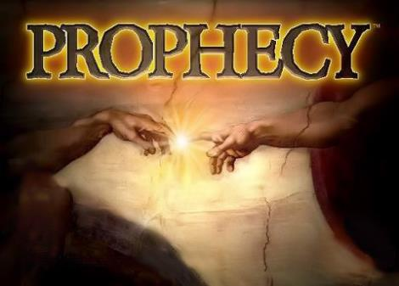
Biblical Prophecy: Importance
27% of Scripture was prophetic at the time it was written
2 Pet 1:19

Slide 48
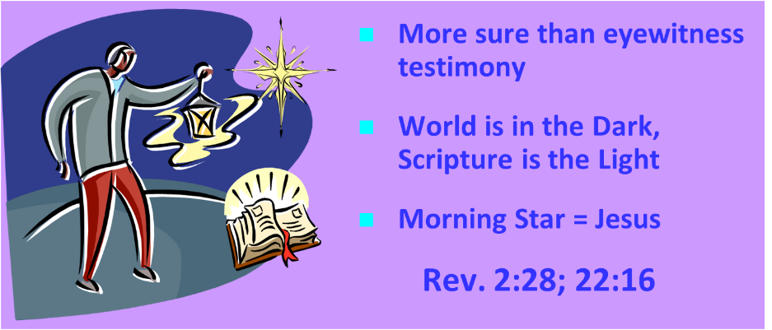
AUTHORITY OF SCRIPTURE
V. 19

Slide 49
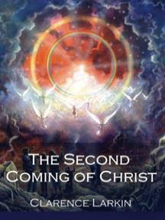
Clarence Larkin
The Second Coming of Christ, 51.
“The ‘Kingdom Idea’ has robbed the Church of her ‘UPWARD LOOK,’ and of the ‘BLESSED HOPE.’ There cannot be any ‘Imminent Coming’ to those who are seeking to ‘Set up the Kingdom.’”

Slide 50
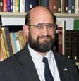
Ante-Nicene Fathers: “Heavenly and Eschatological" Interpretation of John 14:1-4
“Interestingly, references to John 14:1-3 virtually disappear when perusing the writings of the Nicene and Post-Nicene fathers. This is a bit surprising, given the abundance of material in these later writers when compared with the Ante-Nicenes. I would assume that with the rise of Augustinian amillennialism and its optimistic interpretation regarding the present arrival of the Kingdom of God, the kind of hope held out in John 14:1-3 ceased to hold relevance.”
George A. Gunn, “Jesus and the Rapture: John 14,” in Evidence for the Rapture: A Biblical Case for Pretribulationism, ed. John F. Hart (Chicago: Moody, 2015), 119, n. 22.

Slide 51
Rick Warren
Purpose Driven Life, 285-86.
“When the disciples wanted to talk about prophecy, Jesus quickly switched the conversation to evangelism. He wanted them to concentrate on their mission in the world. He said in essence, ‘The details of my return are none of your business. What is your business is the mission I have given you. Focus on that!’ If you want Jesus to come back sooner, focus on fulfilling your mission, not figuring out prophecy. Speculating on the exact timing of Christ’s return is futile, because Jesus said, ‘No one knows about that day or hour, not even the angels in heaven, nor the Son, but only the Father.’ Since Jesus said He didn’t know the day or hour, why should you try to figure it out? What we do know for sure is this: Jesus will not return until everyone God wants to hear the Good News has heard it.”

Slide 52
Rick Warren
Purpose Driven Life, 285-86.
“Jesus said, ‘The Good News about God’s kingdom will be preached in all the world, to every nation. Then the end will come.’ If you want Jesus to come back sooner, focus on fulfilling your mission, not figuring out prophecy. It is easy to get distracted and sidetracked from your mission because Satan would rather have you do anything besides sharing your faith. He will let you do all kinds of good things as long as you don’t take anyone to heaven with you. But the moment you become serious about your mission, expect the Devil to throw all kinds of diversions at you. When that happens, remember the words of Jesus: ‘Anyone who lets himself be distracted from the work I plan for him is not fit for the Kingdom of God.’”

Slide 53
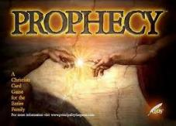
Emergent Eschatology and Genre
“The book of Revelation is an example of popular literary genre of ancient Judaism, known today as Jewish apocalyptic. Trying to read it without understanding its genre would be like watching Star Trek or some other science fiction show thinking it was a historical documentary…instead of being a book about the distant future, it becomes a way of talking about the challenges of the immediate present.”
Brian McLaren, The Secret Message of Jesus, 175-76

Slide 54
Charles Ryrie
Dispensationalism, Page 176-177
“…ignoring the great prophecy of the seventy weeks in Daniel 9:24–27. Nowhere in the progressives’ writings to date have I found any discussion of the passage, only very brief and occasional citations of the reference itself. . . . While not denying the pre-tribulation Rapture or the literal tribulation period, revisionists do not give much attention to these aspects of eschatology. Blaising and Bock do not take obvious opportunities to mention the Rapture, and in one place (discussing 1 Thessalonians 5) they say only that the rapture ‘would appear to be pre-tribulational.’ They decry (as do many of us normative dispensationalists) the sensationalism of some interpreters of prophecy. But abuse of a doctrine is no reason for playing down the truth of that doctrine.”

Slide 55
Charles Ryrie
Dispensationalism, Page 176-177
“Rather, it ought to make us more zealous to present it accurately and in a balanced fashion. Furthermore, there exists already in the writings of progressives a thrust towards positioning the Revelation as a book that is ‘difficult’ to interpret. Playing up the imagery in the book, as some revisionists do, seems to play down a plain interpretation of it. The locusts in chapter 9 and Babylon in chapters 17 and 18 are examples of such ‘literal/symbolic difficulty’ in interpreting the book.”

Slide 56
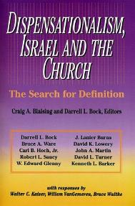
David L. Turner
“The New Jerusalem in Revelation 21:1-22:5; Consummation of a Biblical Continuum,” Dispensationalism, Israel, and the Church, ed., Craig A. Blaising and Darrell L. Bock (Grand Rapids: Zondervan, 1992), 277.
“Perhaps the absence of oysters large enough to produce such pearls in the absence of sufficient gold to pave such as city (do you just literally 1380 miles squared and high) is viewed as sufficient reason not to take these images as fully literal!… The preceding discussion serves to warn against a ‘hyper-literal’ approach to apocalyptic imagery….”

Slide 57
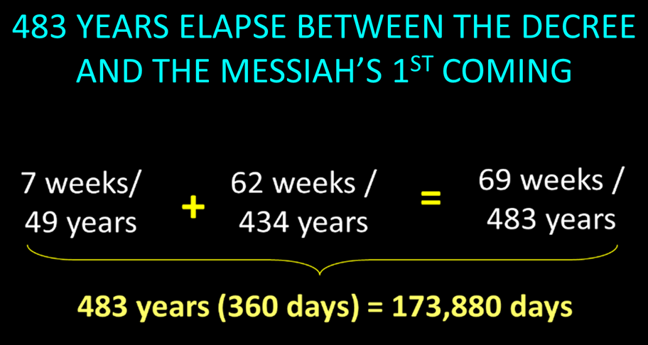

Slide 58
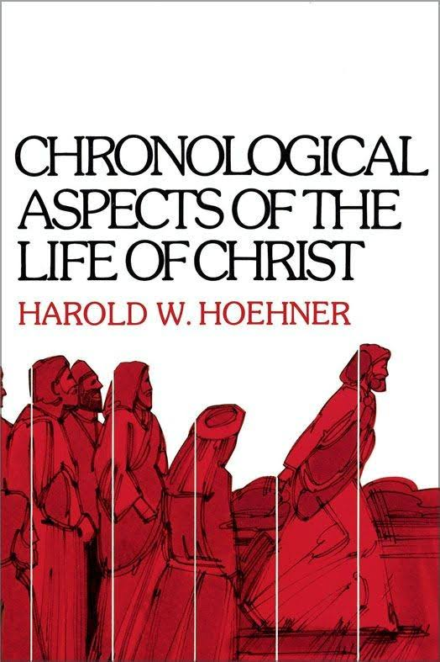
BIBLICAL MATHEMATICS
444 B.C. – (Artaxerxes decree of Nehemiah 2)
+33 A.D. – (Triumphal entry of Luke 19:28-44)
= 477 years
-1 – (1 B.C. to A.D. 1 = 1 year, not 2 years)
= 476 years
x 365 days
= 173, 740 days
+ 25 days – (March 5 to March 30)
= 173, 765 days
+115 days – (leap years)
= 173, 880 days

Slide 59
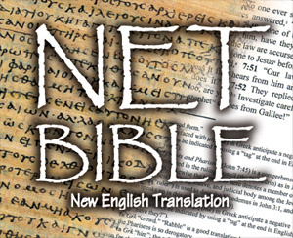
The NET Bible
New English Translation, Beta ed. (Biblical Studies Press, 2001), 1604.
The NET Bible, by contrast, denies such an interpretation even going so far as to say that the details of the text “make a messianic interpretation of the passage difficult, if not impossible.”

Slide 60
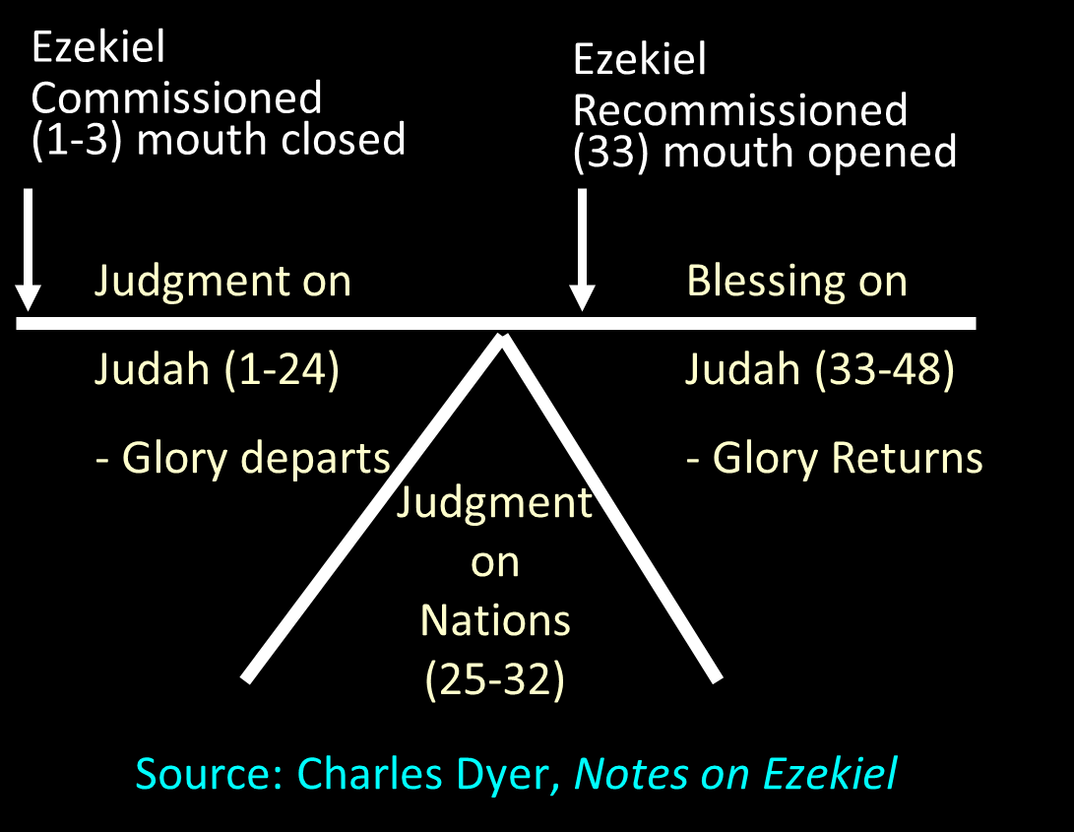

Slide 61
Mark F. Rooker
Mark F. Rooker, “Evidences from Ezekiel,” in A Case for Premillennialism, ed. Donald K. Campbell and Jeffrey L. Townsend (Chicago: Moody, 1992), 133.
“does not take the sacrifices in a literal sense but views Ezekiel writing in the 6th century B.C. describing worship from his unique perspective. . . . Ezekiel in referring to the literal worship of Yahweh in the millennium would be forced to use terms and concepts with which his audience was familiar.” Because Ezekiel’s audience would understand restoration in terms of the restoration of sacrifices, Ezekiel merely described restoration in these terms. Thus, Ezekiel’s vision must not be understood as predicting the literal restoration of sacrifices in the millennium.

Slide 62
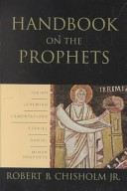
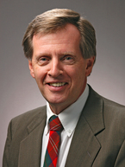
Robert Chisholm
Handbook on the Prophets, 285-86.
“Ezekiel’s vision of a Temple and a restored nation was not fulfilled in the postexilic period. How then should we expect the vision to be fulfilled? Scholars have answered this question in a variety of ways. On one end of the interpretive spectrum are those who see the vision as purely symbolic and as fulfilled in the New Testament church. On the opposite end are the hyper-literalists, who contend that the vision will be fulfilled exactly as described during the millennial age. In attempting to answer the question, one must first recognize that Ezekiel’s vision is contextualized for his sixth-century B.C. audience. He describes the reconciliation of God and his people in terms that would be meaningful to his audience.”

Slide 63
Robert Chisholm
Handbook on the Prophets, 285-86.
“They would naturally conceive of such reconciliation as involving the rebuilding of the temple, the reinstitution of the sacrificial system, the renewal of the Davidic dynasty, and the return and reunification of the twelve exiled tribes. Since the fulfillment of the vision transcends these culturally conditioned boundaries, we should probably view it as idealized to some extent and look for an essential, rather than an exact fulfillment of many of its features. . . . The inclusion of so many minute details suggests that the temple described here will be a literal reality in the Jerusalem of the future. . . . However, the final sacrifice of Jesus Christ has made the Levitical system obsolete. . . . To return to this system, with its sin offerings and such, would be a serious retrogression.”

Slide 64
Robert Chisholm
Handbook on the Prophets, 285-86.
“Ezekiel’s audience would have found it impossible to conceive of a restored covenant community apart from the sacrificial system. Now that the fulfillment of the vision transcends that cultural context, we can expect it to be essentially fulfilled when the Israel of the future celebrates the redemptive work of their savior in their new temple. . . . Ezekiel’s audience would have found this portrayal quite natural. However, Jesus, the one who fulfills the vision, will have no need to offer such sacrifices, nor will he institute a dynasty.”

Slide 65

“This passage is explained in various ways. I pass by the dreams of the Jews, who apply all passages of this kind to the temporal reign of the Messiah, which they have contrived by their own imagination.... I willingly view this passage as referring to Judea, and afterwards to other parts of the world.... Let us now see when this prophecy was fulfilled, or shall be fulfilled. The Lord began some kind of restoration when he brought his people out of Babylon: but that was only a foretaste, and, therefore, I have no hesitation in saying that this passage, as well as others of a similar kind, must refer to the kingdom of Christ; and in no other light could it be viewed, if we compare it with other prophecies.”
John Calvin
Commentary on Isaiah 35:1
Isaiah 35:1— “The wilderness and the solitary place shall be glad.”

Slide 66
“Here the Prophet describes the felicity which shall be under the reign of Christ: and we know that whenever the Prophets set forth promises of a happy and prosperous state to God’s people, they adopt metaphorical expressions, and say, that abundance of all good things shall flow, that there shall be the most fruitful produce, that provisions shall be bountifully supplied; for they accommodated their mode of speaking to the notions of that ancient people; it is therefore no wonder if they sometimes speak to them as to children. At the same time, the Spirit under these figurative expressions declares, that the kingdom of Christ shall in every way be happy and blessed, or that the Church of God, which means the same thing, shall be blessed, when Christ shall begin to reign.”
John Calvin
Commentary on Amos 9:13
Amos 9:13—“Behold the days come, saith the LORD, that the plowman shall overtake the reaper, and the treader of grapes him that soweth seed: and the mountains shall drop sweet wine, and all the hills shall melt.”

Slide 67
“For as we are dull and entangled in earthly thoughts, our minds can hardly rise up to heaven, though the Lord with a clear voice invites us to himself. The Prophet then, in order to aid our weakness, adds a vivid representation, as though God stood before their eyes. Stand, he says, shall his feet on the mount of Olives. He does not here promise a miracle, such as even the ignorant might conceive to be literal; nor does he do this in what follows, when he says, The mount shall be rent…half…to the east and half to the west. This has never happened, that mount has never been rent: but as the Prophet could not, under those grievous trials, which might have overwhelmed the minds of the godly a hundred times, have extolled the power of God…without employing a highly figurative language, he therefore accommodates himself, as I have said, to the capacity of our flesh.”
John Calvin
Commentary on Zechariah 14:4
Zechariah 14:4—“And his feet shall stand in that day upon the mount of Olives…and the mount of Olives shall cleave in the midst thereof toward the east and toward the west….”

Slide 68
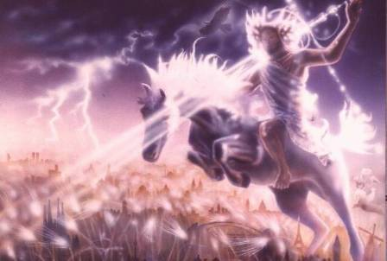
Isaiah 13-14
Day of the Lord (13:6-9)
Cosmic disturbances (13:10-13)
Global judgment (13:11-12)
Sodom and Gomorrah (13:19)
Complete and final desolation (13:20-22)
Universal peace and rest (14:5-8)
Israel’s regeneration (14:1-4)
Morris, Revelation Record, 348.

Slide 69
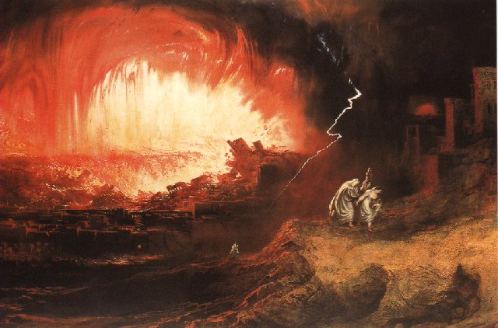
Jeremiah 50-51
Sudden destruction (51:8)
Complete destruction (50:3, 13, 26, 39-40; 51:29, 43, 62)
No reuse of building materials (51:26)
Believers flee (50:8; 51:6, 45)
Israel’s regeneration (50:2, 4-5, 20; 51:50)
Dyer, "The Identity of Babylon in Revelation 17–18 (Part 2)," 443-49.

Slide 70
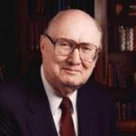
Dr. John Walvoord
The Nations in Prophecy, 63-64
“As far as the historic fulfillment is concerned, it is obvious from both Scripture and history that these verses have not been literally fulfilled. The city of Babylon continued to flourish after the Medes conquered it, and though its glory dwindled, especially after the control of the Medes and the Persians ended in 323 B.C., the city continued in some form or substance until A.D. 1000 and did not experience a sudden termination such as anticipated in this prophecy.”

Slide 71
Parallels Between Jeremiah 50-51 & Revelation 17-18
 | Jeremiah | Revelation
Associated with a Golden cup | 51:7a | 17:3-4; 18:6
Dwelling on many waters | 51:13 | 17:1
Intoxicating the nations | 51:7b | 17:2
Same name | 50:1 | 17:5
Stone sinking into Euphrates | 51:63-64 | 18:21
Sudden destruction | 51:8 | 18:8
Destroyed by fire | 51:30 | 17:16
Final, uninhabitable | 50:39 | 18:21
Deserved | 50:29 | 18:6
God’s people flee | 51:6, 45 | 18:4
Heaven rejoices | 51:48 | 18:20
Dyer, "The Identity of Babylon in Revelation 17–18 (Part 2)," 441-43.

Slide 72
Larkin, The Book of Revelation, 158.
“…and this is in exact harmony with the words of Isa. 13:19. ‘And Babylon, the glory of kingdoms, the beauty of the Chaldees’ excellency, shall be as when God overthrew Sodom and Gomorrah;’ and the Prophet Jeremiah makes the same statement. Jer. 50:40. The destruction of Sodom and Gomorrah was not protracted through many centuries, their glory disappeared in a few hours (Gen. 19:24–28), and as ancient Babylon was not thus destroyed, the prophecies of Isaiah and Jeremiah cannot be fulfilled unless there is to be a future Babylon that shall be thus destroyed. In Rev. 16:17–19, we are told that Babylon shall be destroyed by an Earthquake, attended with most vivid and incessant lightning and awful thunder.”

Slide 73
Homer Heater
"Do the Prophets Teach That Babylonia Will Rebuilt in the Eschaton?," Journal of the Evangelical Theological Society 41 (March 1998): 31-36; Robert B. Chisholm, Handbook on the Prophets (Grand Rapids: Baker, 2002), 53, 213
A similar approach is seen in Old Testament studies. Many view Isaiah 13-14 and Jeremiah 50-51 as describing Babylon's past fall in 539 B.C. rather than her future fall. The interpretation is held in spite of the fact that the details of these texts go far beyond the historic fall of Babylon. This interpretation is justified on the grounds that Ancient Near Eastern extra biblical writings often describe the destruction of foes in hyperbolic terms. Because Isaiah and Jeremiah incorporated a similar "destruction genre" in their description of Babylon's fall, the language of Babylon's destruction in Isaiah 13-14 and Jeremiah 50-51 can be applied to her historic fall rather than her future fall. Chisholm calls such language “stylized and exaggerated” and therefore argues that these texts were “essentially fulfilled” with the historic defeat of Babylon.

Slide 74
Reasons for Understanding 1000 Literally
John’s use of indefinite concepts elsewhere
  Revelation 20:8, 20:3
Exception to the “# of years” examples?
Other numbers are taken literally
  Two witnesses (11:3), 7000 people (11:13), 4 Angels (7:1) 7 Angels (8:6),144,000 Jews (7:4), 42 months (11:2), 1260 days (11:3)
Not always a symbolic interpretation
  (Rev. 17:18)

Slide 75
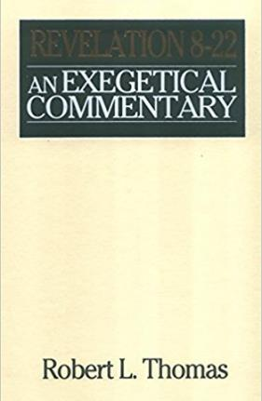
Robert Thomas
Revelation 8 to 22: An Exegetical Commentary (Chicago: Moody Press, 1992), 408.
Robert Thomas observes that, "no number in Revelation is verifiably a symbolic number.”

Slide 76

Darrell Bock
Darrell Bock; quoted in Ken Sidey, “For the Love of Zion,” Christianity Today, 9 March 1992, 50.
This minimization of the millennium is represented in the admission that Progressive Dispensationalism is less “land centered” and less “future centered” than traditional Dispensationalism.

Slide 77
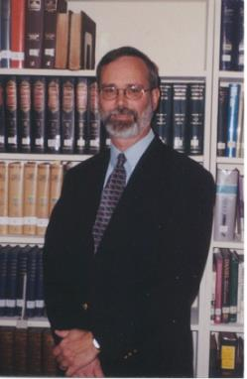
Kenneth L. Gentry
He Shall Have Dominion: A Post Millennial Eschatology (Tyler, Texas: Institute for Christian economics, 1992), page 335.
“The proper understanding of the thousand-year time frame in Revelation 20 is that it is representative of a long and glorious era and is not limited to a literal 365,000 days. The figure represents a perfect cube of 10, which is the number of quantitative perfection.”

Slide 78
John Calvin
Institutes of the Christian Religion, III, xxv, 5.
“But Satan has not only befuddled men’s senses to make them bury with the corpses the memory of resurrection; he has also attempted to corrupt this part of the doctrine with various falsifications…Now their fiction is too childish either to need or to be worth a refutation. And the Apocalypse, from which they undoubtedly drew a pretext for their error, does not support them. For the number ‘one thousand’ [Rev. 20:4] does not apply to the eternal blessedness of the church but only to the various disturbances that awaited the church, while still toiling on earth…Those who assign the children of God a thousand years in which to enjoy the inheritance of the life to come do not realize how much reproach they are casting upon Christ and his Kingdom.”

Slide 79
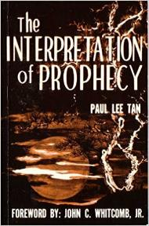
Paul Lee Tan
The Interpretation of Prophecy, 276-77
“Evangelicals who spiritualize Bible prophecy cannot logically forbid liberals and modernists from spiritualizing selected areas of Christology and Soteriology. If evangelicals can spiritualize Christ's earthly kingdom, may not liberals spiritualize the earthly ministry of Christ, including His miracles and resurrection? The same hermeneutical principles used to spiritualized Bible prophecy can be used to spiritualize Christ's first advent. Christians who spiritualize parts of the Scriptures, such as it's prophetic portions, have forfeited a major element of their defense against liberalism.”

Slide 80
9 Ways Kingdom Now Theology
Impacts the Church
Loss of “pilgrim” status
Social Gospel
Ecumenical & interfaith alliances
Rejection or marginalization of Bible prophecy
Building the wrong kingdom
Charismatic theology
Prosperity Gospel
Anti-Israelism
Lordship Salvation

Slide 81
Clarence Larkin
The Second Coming of Christ, 51.
“When the Church enters into an ‘Alliance with the World,’. . . the end of such an ‘Alliance’ will be a ‘Religious Political Regime’ that will pave the way for the revelation of Satan’s great ‘Religious Political Leader’ and ‘Superman’—the ANTICHRIST.”

Slide 82


Slide 83


Slide 84
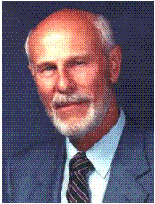
Dave Hunt
“Kingdom/Dominion Theology – Part 1” (February 1, 1987), accessed July 12, 2015, https://www.thebereancall.org/content/kingdomdominion-theology-part-i.
“There are many factors that make up the growing apostasy and seduction of the church. One of the most alarming, least understood, and fastest spreading errors is the teaching that earth instead of heaven is the ultimate home for the church, and that her goal is to take over the world and establish the kingdom of God. Only then, it is said, can Christ return—not, however, to take us to His Father’s house as He promised His disciples in John 14, but to reign over the Kingdom which we have established for Him. . . . [I]f the real Jesus Christ is going to catch His bride up from earth to meet Him in the air (1 Thess. 4:17), then those who work to build a kingdom for a ‘Christ’ whom they will meet with their feet planted on earth have been under heavy delusion indeed! They have been working for the Antichrist!”

Slide 85
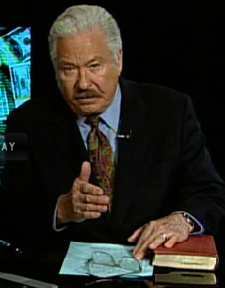
Hal Lindsey
The Road to Holocaust, 269
Bestselling author Hal Lindsey warned what could happen to the church in the last days if she began to see herself as the establisher of God's kingdom: “The last days of the church on the earth may be largely wasted seeking to accomplish a task that only the LORD Himself can and will do directly.”

Slide 86
9 Ways Kingdom Now Theology
Impacts the Church
Loss of “pilgrim” status
Social Gospel
Ecumenical & interfaith alliances
Rejection or marginalization of Bible prophecy
Building the wrong kingdom
Charismatic theology
Prosperity Gospel
Anti-Israelism
Lordship Salvation

Slide 87
The 7 Disputed Gifts
Apostle
Prophet
Worker of Miracles
Tongues
Interpretation of tongues
Healing
Knowledge

Slide 88
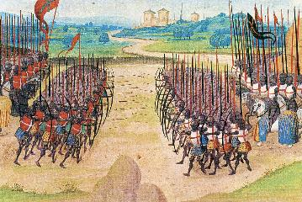
Two Camps
Charismatics – All the spiritual gifts are in operation today
Cessationists (selective)– Most of the spiritual gifts are in operation today

Slide 89
Isaiah 35:5-6
“⁵ Then the eyes of the blind will be opened And the ears of the deaf will be unstopped. ⁶ Then the lame will leap like a deer, And the tongue of the mute will shout for joy. For waters will break forth in the wilderness And streams in the Arabah.”

Slide 90

John Wimber
John Wimber and Kevin Springer, Power Evangelism (Bloomington, MN: Chosen, 2009), 19.
“I was already acquainted with George Eldon Ladd’s writings (he was a Fuller Theological Seminary professor), but it was not until I read his book Jesus and the Kingdom that I realized how his work on the kingdom formed a theological basis for power evangelism. As I read Dr. Ladd’s works, and then read afresh the gospel accounts, I became convinced that power evangelism was for today.”

Slide 91
John Wimber
The Vineyard Mission Statement
http://www.vineyardusa.org/site/about/vineyard-values/kingdom-of-god
“Commitment to the theology and practice of the kingdom of God is the most fundamental core value in the Vineyard. When the Vineyard talks about the kingdom, we are talking about the kingdom of God as a dynamic reality that is the future reign of God breaking into the present through the life and ministry of Jesus. We have been commissioned to proclaim the good news of the kingdom of God, bearing witness to the already and the not yet of the kingdom in words and deeds. This understanding of the kingdom of God is the central motif that gives both structure and definition to all of our theology. We view the kingdom of God as the overarching and integrating theme of the Bible (italics added).”

Slide 92
Charles Ryrie
Dispensationalism, Page 177
“Non-charismatic progressive dispensationalists have not faced the question as to why signs and wonders are not characteristic of the church if in fact Christ is already on David’s throne. During our Lord’s earthly life many signs validated His claim to be the promised Davidic king for Israel. Now that He is allegedly reigning as Davidic King (according to progressives), why are there not miraculous signs happening today in the ‘already’ stage of his Davidic reign?”

Slide 93
Order of Paul’s Letters
Galatians (A.D. 49)
1‒2 Thessalonians (A.D. 51)
1‒2 Corinthians (A.D. 56)
Romans (A.D. 57)
Ephesians, Colossians, Philemon, Philippians (A.D. 60‒62)
1 Timothy, Titus (A.D. 62‒66)
2 Timothy (A.D. 67)

Slide 94
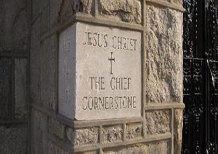
2 Timothy 4:20
“Erastus remained at Corinth, but Trophimus I left sick at Miletus.”

Slide 95
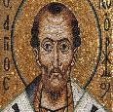
Chrysostom (A.D. 345‒407)
Patriarch of Constantinople
Chrysostom, Homily 29 on First Corinthians.
“This whole place is very obscure: but the obscurity is produced by our ignorance of the facts referred to and by their cessation, being such as then used to occur but now no longer take place. And why do they not happen now? Why look now, the cause too of the obscurity has produced us again another question: namely, why did they then happen, and now do so no more?”

Slide 96
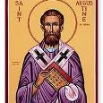
Augustine (A.D. 354‒430)
Bishop of Hippo
Homily 6:10 on the First Epistle of John.
“In the earliest times, the Holy Ghost fell upon them that believed: and they spoke with tongues, which they had not learned, as the Spirit gave them utterance. Acts 2:4 These were signs adapted to the time. For there behooved to be that betokening of the Holy Spirit in all tongues, to show that the Gospel of God was to run through all tongues over the whole earth. That thing was done for a betokening, and it passed away. . . . If then the witness of the presence of the Holy Ghost be not now given through these miracles, by what is it given, by what does one get to know that he has received the Holy Ghost?”

Slide 97

Philip Schaff
History of the Christian Church, vol. 1 , p. 236-37.
“We do not know how long the glossolalia, as thus described by Paul, continued. It passed away gradually with the other extraordinary or strictly supernatural gifts of the apostolic age. It is not mentioned in the Pastoral, nor in the Catholic Epistles. We have but a few allusions to it at the close of the second century. Irenæus (Adv. Haer. 1. v. c. 6 § 1,) speaks of ‘many brethren’ whom he heard in the church having the gift of prophecy and of speaking in ‘diverse tongues’ (παντοδαπαῖς γλώσσαις), bringing the hidden things of men (τὰ κρύφια τῶν ἀνθρώπων) to light and expounding the mysteries of God (τὰ μυστήρια τοῦ θεοῦ). It is not clear whether by the term ‘diverse,’ which does not elsewhere occur, he means a speaking in foreign languages, or in diversities of tongues altogether peculiar, like those meant by Paul.”

Slide 98
Philip Schaff
History of the Christian Church, vol. 1 , p. 236-37.
“The latter is more probable. Irenæus himself had to learn the language of Gaul. Tertullian (Adv. Marc. V. 8; comp. De Anima, c. 9) obscurely speaks of the spiritual gifts, including the gift of tongues, as being still manifest among the Montanists to whom he belonged. At the time of Chrysostom it had entirely disappeared; at least he accounts for the obscurity of the gift from our ignorance of the fact. From that time on the glossolalia was usually misunderstood as a miraculous and permanent gift of foreign languages for missionary purposes. But the whole history of missions furnishes no clear example of such a gift for such a purpose.”

Slide 99
9 Ways Kingdom Now Theology
Impacts the Church
Loss of “pilgrim” status
Social Gospel
Ecumenical & interfaith alliances
Rejection or marginalization of Bible prophecy
Building the wrong kingdom
Charismatic theology
Prosperity Gospel
Anti-Israelism
Lordship Salvation

Slide 100
Isaiah 35:5-6
“⁵ Then the eyes of the blind will be opened And the ears of the deaf will be unstopped. ⁶ Then the lame will leap like a deer, And the tongue of the mute will shout for joy. For waters will break forth in the wilderness And streams in the Arabah.”

Slide 101

Amos 9:13
“Behold, days are coming,” declares the Lord,
“When the plowman will overtake the reaper
And the treader of grapes him who sows seed;
When the mountains will drip sweet wine
And all the hills will be dissolved.”

Slide 102
Isaiah 65:21-22
“²¹ They will build houses and inhabit them;
They will also plant vineyards and eat their fruit.
²² They will not build and another inhabit,
They will not plant and another eat;
For as the lifetime of a tree, so will be the days of My people, And My chosen ones will wear out the work of their hands.”

Slide 103
Zechariah 8:12
“For there will be peace for the seed: the vine will yield its fruit, the land will yield its produce and the heavens will give their dew; and I will cause the remnant of this people to inherit all these things.”

Slide 104
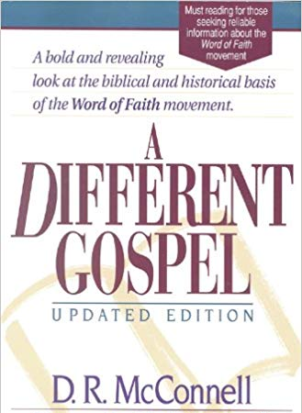
D.R. McConnell
A Different Gospel: A Bold and Revealing Look at the Historical Basis of the Word of Faith Movement, Updated and electronic ed. (Peabody, MA: Hendrickson, 2011), loc. 4813–4846.
“The Faith teachers deny that the kingdom of God is in the process of realization, claiming that it is present in the earth to the point that believers can be delivered from all sin, sickness, and poverty of the devil. They . . . claim that the believer has absolute authority to conquer and eradicate these forces of evil completely from his life. The only process of realization is in the faith of the believer, not in the presence of God’s kingdom. In the jargon of biblical theology, the Faith interpretation of the kingdom of God could be labeled as a ‘hyper-realized’ eschatology.”

Slide 105
D.R. McConnell
A Different Gospel: A Bold and Revealing Look at the Historical Basis of the Word of Faith Movement, Updated and electronic ed. (Peabody, MA: Hendrickson, 2011), loc. 4813–4846.
“The Faith eschatology is ‘hyper realized’ because of its extreme promises to the believer of a life which is absolutely invulnerable to any type of evil. It claims ‘that the powers of the age to come’ have completely come in this life and that these powers can be used at will by the believer with enough faith and knowledge of how to operate them. There is no process of realization of God’s kingdom in Faith eschatology; the kingdom can be completely realized in the lives of those who exercise Faith principles. We see this hyper-realized eschatology in the Faith doctrines of healing, authority, prosperity, identification and deification. The over-realized nature of Faith eschatology emphasizes the ‘Now’ of the kingdom of God. . . . The . . . ‘Not yet’ mystery of the kingdom and its powers is distorted by the hyper-realized eschatology of the Faith movement.”

Slide 106
Galatians 4:13-14
“¹³ but you know that it was because of a bodily illness that I preached the gospel to you the first time; ¹⁴ and that which was a trial to you in my bodily condition you did not despise or loathe, but you received me as an angel of God, as Christ Jesus Himself.”

Slide 107
1 Timothy 5:23
“No longer drink water exclusively, but use a little wine for the sake of your stomach and your frequent ailments.”

Slide 108
Order of Paul’s Letters
Galatians (A.D. 49)
1‒2 Thessalonians (A.D. 51)
1‒2 Corinthians (A.D. 56)
Romans (A.D. 57)
Ephesians, Colossians, Philemon, Philippians (A.D. 60‒62)
1 Timothy, Titus (A.D. 62‒66)
2 Timothy (A.D. 67)

Slide 109
2 Timothy 4:20
“Erastus remained at Corinth, but Trophimus I left sick at Miletus.”

Slide 110

Revelation 2:9
“I know your tribulation and your poverty (but you are rich), and the blasphemy by those who say they are Jews and are not, but are a synagogue of Satan.”

Slide 111
9 Ways Kingdom Now Theology
Impacts the Church
Loss of “pilgrim” status
Social Gospel
Ecumenical & interfaith alliances
Rejection or marginalization of Bible prophecy
Building the wrong kingdom
Charismatic theology
Prosperity Gospel
Anti-Israelism
Lordship Salvation

Slide 112
Alva J. McClain
Alva J. McClain, The Greatness of the Kingdom: An Inductive Study of the Kingdom of God as Set Forth in the Scriptures (Grand Rapids: Zondervan, 1959), 438.
“The confusion of our . . . Lord’s rule . . . leads to serious consequences. . . . [I]t makes the present age the period of the Mediatorial Kingdom. . . . [I]t dissolves the divinely covenanted purpose in the nation of Israel.”

Slide 113

Gary DeMar
Gary DeMar and Gary North quotes, can be found in H. Wayne House and Thomas Ice, Dominion Theology: Blessing or Curse? (Portland, OR: Multnomah, 1988), 409–11.
“God has not called us to forsake the earth, but to impress heaven’s pattern on earth.” He similarly notes, “Christians must be obedient to the mandate God has given to extend His kingdom to every sphere of life, to every corner of the globe (Gen. 1:26–28; Matt. 28:18–20). The following quotes (and sourcing) from various “kingdom now” theologians, such as.”

Slide 114
Gary DeMar
End Times Fiction: A Biblical Consideration of the Left Behind Theology (Nashville, TN: Nelson, 2001), 203.
“Where is this ‘super sign’ found in the Bible? Not in the New Testament. There is not a single verse in the entire New Testament that says anything about Israel becoming a nation again. Nothing prophetic in the New Testament depends on Israel becoming a nation again. If Israel becoming a nation again is such ‘a significant sign,’ then why doesn't the New Testament specifically mention it?”

Slide 115
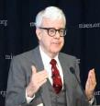
Gary North
Gary DeMar and Gary North quotes, can be found in H. Wayne House and Thomas Ice, Dominion Theology: Blessing or Curse? (Portland, OR: Multnomah, 1988), 409–11.
“The goal of establishing Christ’s international kingdom can be presented to citizens of any nation.”…“Christians are required to become active in the building God’s visible kingdom.”…“If the Christian church fails to build the visible kingdom by means of biblical law and the power of the gospel, despite the resurrection of Christ and the presence of the Holy Spirit, then what kind of religion are we preaching?”…“The parable (Matt. 13:24–30, 36–43) refers to the building of the kingdom of God, not simply to the institutional church.”

Slide 116

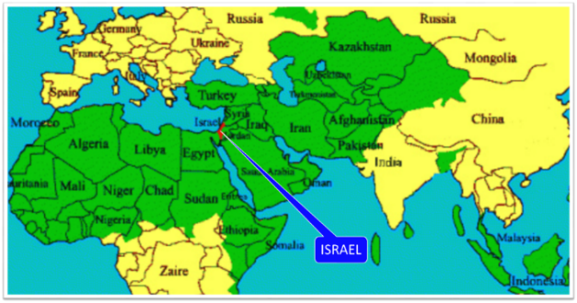
Thomas Ice
Personal letter from Gary North to Peter Lalonde, April 30, 1987 on file; cited in Thomas Ice, “Answering Those Who Oppose Israel,” 1, accessed October 21, 2015, http://www.pre-trib.org.
Thomas Ice reports, “Gary North has boasted that he has a book already in his computer for when ‘Israel gets pushed into the sea or converted to Christ.’”

Slide 117
Reformed Theology’s Denial of the Church as an Intercalation
“We’re not dispensationalists here....We believe that the church is essentially Israel. We believe that the answer to, ‘What about the Jews?’ is, ‘Here we are.’ We deny that the church is God’s ‘plan B.’ We deny that we are living in God’s redemptive parenthesis. There, we are again one people. In His holy and heavenly temple there is neither Jew nor Greek, male nor female, pre-mil nor post-mil. There, we are all together, the Israel of God, princes with God, and the ekklesia, the set apart ones.”
From Table Talk magazine, Spring of 1999, p. 2 (inside cover), by R. C. Sproul Jr., editor, emphasis is mine

Slide 118

“The story of the church begins with Israel, the Old Testament people of God…The identity of the church is necessary for the mission of the church. Only as a holy nation, called out of the darkness into the light of God‘s presence, can the church discharge it’s mission…Peter affirms that the church’s right to the titles of Israel, then describes the church’s witness of praise (1 Peter 2:9–10)...This understanding of the church as the new and true Israel of Christ must inspire our mission in the contemporary world.”
Edmund P. Clowney
Edmund P. Clowney, The Church, ed. Gerald Bray, Contours of Christian Theology (Downers Grove, ILL: InterVarsity Press, 1995), 28, 162-63.

Slide 119
David L. Turner
“The New Jerusalem in Revelation 21:1-22:5; Consummation of a Biblical Continuum,” Dispensationalism, Israel, and the Church, ed., Craig A. Blaising and Darrell L. Bock (Grand Rapids: Zondervan, 1992), 288.
“It is clear that all the above are connected with the number twelve (cf. Rev. 7:5-8; 12:1, 12). This number is perhaps the most familiar number of the Bible, most frequently associated with the sons of Jacob, the twelve tribes of Israel, and the twelve apostles of the ‘new Israel,’ the church.”

Slide 120
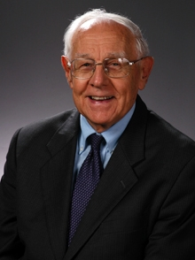
Stanley D. Toussaint
“Israel and the Church of a Traditional Dispensationalist,” in Three Central Issues in Contemporary Dispensationalism, ed. Herbert W. Bateman (Grand Rapids: Kregel, 1999), 259.
Of this designation, normative dispensationalist Stanley Toussaint appropriately comments, “This is precariously close to replacement theology.”

Slide 121
Romans 11:12-15
¹² “Now if their transgression is riches for the world and their failure is riches for the Gentiles, how much more will their fulfillment be! ¹³ But I am speaking to you who are Gentiles. Inasmuch then as I am an apostle of Gentiles, I magnify my ministry, ¹⁴ if somehow I might move to jealousy my fellow countrymen and save some of them. ¹⁵ For if their rejection is the reconciliation of the world, what will their acceptance be but life from the dead?”

Slide 122

Matthew 23:37-39
“Jerusalem, Jerusalem, who kills the prophets and stones those who are sent to her! How often I wanted to gather your children together, the way a hen gathers her chicks under her wings, and you were unwilling. ³⁸ Behold, your house is being left to you desolate! ³⁹ For I say to you, from now on you will not see Me until you say, ‘Blessed is He who comes in the name of the Lord!’”

Slide 123
Isaiah 2:2-3 (NASB)
“Now it will come about that In the last days The mountain of the house of the Lord Will be established as the chief of the mountains, And will be raised above the hills; And all the nations will stream to it.³ And many peoples will come and say, ‘Come, let us go up to the mountain of the Lord, To the house of the God of Jacob; That He may teach us concerning His ways And that we may walk in His paths.’ For the law will go forth from Zion And the word of the Lord from Jerusalem.”

Slide 124
Zechariah 14:16-18 (NASB)
“Then it will come about that any who are left of all the nations that went against Jerusalem will go up from year to year to worship the King, the Lord of hosts, and to celebrate the Feast of Booths. ¹⁷ And it will be that whichever of the families of the earth does not go up to Jerusalem to worship the King, the Lord of hosts, there will be no rain on them. ¹⁸ If the family of Egypt does not go up or enter, then no rain will fall on them; it will be the plague with which the Lord smites the nations who do not go up to celebrate the Feast of Booths.”

Slide 125

Robert Thomas
Four Views on the Book of Revelation, page 207.
“At the end of the Millennium that city will be Satan’s prime objective with his rebel army, because Israel will be a leader among the nations.”

Slide 126
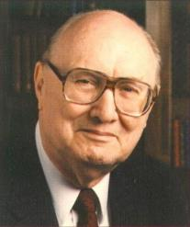
John Walvoord
Israel in Prophecy, Page 26
“Of the many peculiar phenomena which characterize the present generation, few events can claim equal significance as far as Biblical prophecy is concerned with that of the return of Israel to their land. It constitutes a preparation for the end of the age, the setting for the coming of the Lord for His church, and the fulfillment of Israel’s prophetic destiny.”

Slide 127
Israel’s Two Regatherings
THE PRESENT (FIRST) REGATHERING | THE PERMANENT (SECOND) REGATHERING
Return to part of the land | Return to all the land
Return in unbelief | Return in faith
Restored to the land only | Restored to the land and the Lord
Sets the stage for Tribulation (discipline) | Sets the stage for Millennium (blessing)
Adapted from: Price, Jerusalem In Prophecy, 219

Slide 128
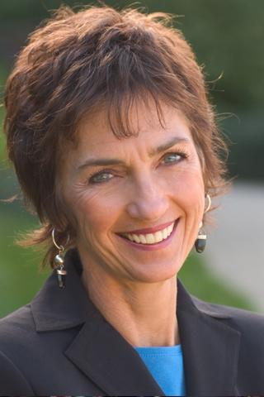
Lynne Hybels
Lynne Hybels, cited in Paul R. Wilkinson, Israel Betrayed: Volume 2: The Rise of Christian Palestinianism (San Antonio, TX: Ariel, 2018), 155.
“It is true: I am not a Christian Zionist…I do not hold to a theology asserting that the modern state of Israel represents a divinely mandated return of ancient Israel to the Promised Land… At the same time, I wholeheartedly support justice for the Palestinians.”

Slide 129

Tony Campolo
Tony Campolo, cited in Paul R. Wilkinson, Israel Betrayed: Volume 2: The Rise of Christian Palestinianism (San Antonio, TX: Ariel, 2018), 140.
“…a little nation that has survived primarily because of the wealth and the war materials supplied by the U.S. government.”

Slide 130
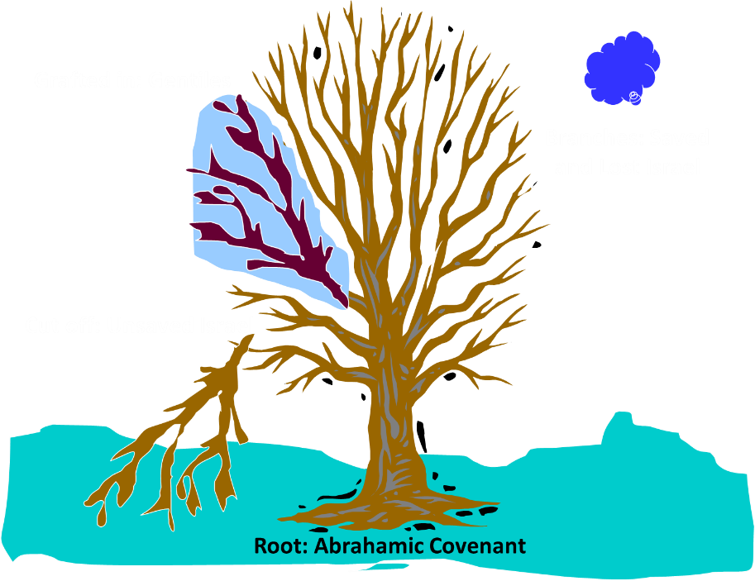
Notes:
130

Slide 131
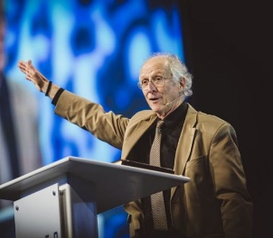
John Piper
John Piper, cited in Paul R. Wilkinson, Israel Betrayed: Volume 2: The Rise of Christian Palestinianism (San Antonio, TX: Ariel, 2018), 331-32.
“[God] has a saving purpose for Israel. All Israel will someday turn to the Lord Christ as a group. This is my deep understanding in belief of Romans 11. The broken off branches will be grafted in one day to the people of God, the bride of Christ, His church.”

Slide 132
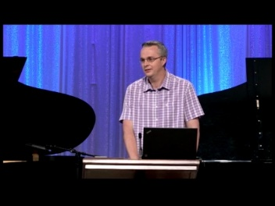
Paul Wilkinson
Paul R. Wilkinson, Israel Betrayed: Volume 2: The Rise of Christian Palestinianism (San Antonio, TX: Ariel, 2018), 332.
“On the basis of this kind of statement, many in the church are being misled into believing that Piper stands with Israel, but he does not. What Piper said is not what Paul taught. Israel’s destiny as a nation is not one of spiritual incorporation into the church, which is the classic Reformed, Calvinistic teaching. The church comprises individual Jews and Gentiles, not ‘Israel,’ which is a distinct national entity. The appointed destiny for Israel is for her to remain a nation in the sight of God and in the midst of all the nations, for as long as God’s ‘fixed order’ of creation endures (Jer. 31:36).”

Slide 133

Jeremiah 31:35-37
“Thus says the Lord, Who gives the sun for light by day And the fixed order of the moon and the stars for light by night, Who stirs up the sea so that its waves roar; The Lord of hosts is His name:³⁶ “If this fixed order departs From before Me,” declares the Lord, “Then the offspring of Israel also will cease From being a nation before Me forever.”³⁷ Thus says the Lord, “If the heavens above can be measured And the foundations of the earth searched out below, Then I will also cast off all the offspring of Israel For all that they have done,” declares the Lord.”

Slide 134

  “First, their synagogues should be set on fire…Secondly, their homes should likewise be broken down and destroyed…Thirdly, they should be deprived of their prayer books and Talmuds…”

Slide 135
  “…Fourthly, their rabbis must be forbidden under threat of death to teach any more…Fifthly, passport and traveling privileges should be absolutely forbidden to the Jews…Sixthly, they ought to be stopped from usury (charging interest on loans…”

Slide 136
  “Seventhly, let the young and strong Jews and Jewesses be given the flail, the ax, the hoe, the spade, the distaff, and spindle, and let the earn their bread by the sweat of their noses…We ought to drive the rascally lazy bones out of our system...”
Martin Luther, Concerning the Jews and Their Lies, cited in Michael Brown’s Our Hands Are Stained with Blood, pp. 14-15.

Slide 137
  “…Therefore away with them… To sum up, dear princes and nobles who have Jews in your domains, if this advice of mine does not suit you, then find a better one so that you and we may all be free of this insufferable devilish burden–the Jews.”
Martin Luther, Concerning the Jews and Their Lies, cited in Michael Brown’s Our Hands Are Stained with Blood, pp. 14-15.

Slide 138

  “But here he [the rabbi] not only betrays his ignorance, but his utter stupidity, since God so blinded the whole people that they were like restive dogs. I have had much conversation with many Jews: I have never seen either a drop of piety or a grain of truth or ingenuousness—nay, I have never found common sense in any Jew. But this fellow, who seems so sharp and ingenious, displays his own impudence to his great disgrace.”
John Calvin
Commentary on the Prophet Daniel (Vol 1, p. 185). Bellingham, WA: Logos Bible Software. Commentary on Daniel 2:44-45. (2010).

Slide 139
9 Ways Kingdom Now Theology
Impacts the Church
Loss of “pilgrim” status
Social Gospel
Ecumenical & interfaith alliances
Rejection or marginalization of Bible prophecy
Building the wrong kingdom
Charismatic theology
Prosperity Gospel
Anti-Israelism
Lordship Salvation

Slide 140


Lordship Salvation Defined
“Lordship Salvation refers to the belief which says the sinner who wants to be saved must not only trust Christ as his substitute for sin, but must also surrender every area of his life to the complete control of Christ.”
Lightner, Sin, the Savior, and Salvation, 202

Slide 141

John MacArthur
Faith Works, p. 25
“Jesus is Lord of all, and the faith He demands involves unconditional surrender…He does not bestow eternal life on those whose hearts remain set against Him.”

Slide 142
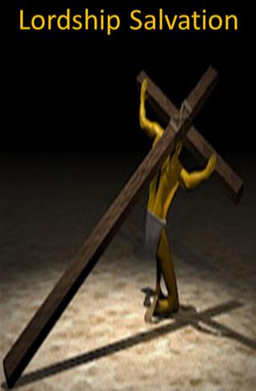
Lordship Salvation: 7 Problems
Changes the gospel
Places an impossible burden upon the unsaved
Confuses justification with sanctification
Confuses the result of with requirement for salvation
Fails to make basic dispensational distinctions
Ignores the reality of a carnal Christian
Destroys the assurance of salvation

Slide 143
Lordship Salvation: 7 Problems
Changes the gospel
Places an impossible burden upon the unsaved
Confuses justification with sanctification
Confuses the result of with requirement for salvation
Fails to make basic dispensational distinctions
Ignores the reality of a carnal Christian
Destroys the assurance of salvation

Slide 144
1 Corinthians 3:1-3
¹ And I, brethren, could not speak to you as to spiritual people but as to carnal, as to babes in Christ. ² I fed you with milk and not with solid food; for until now you were not able to receive it, and even now you are still not able; ³ for you are still carnal. For where there are envy, strife, and divisions among you, are you not carnal and behaving like mere men? (NKJV)

Slide 145
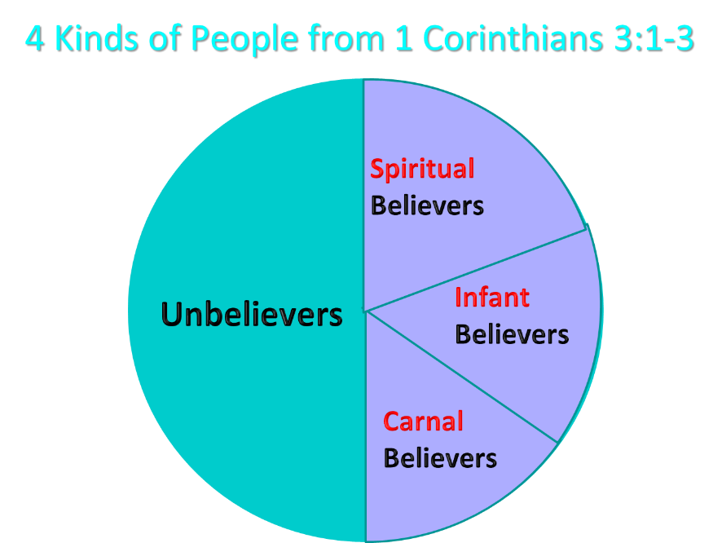
Notes:
Ray Steadman – “1st Californians”
Unbelievers vs Categories of Believers
Unbelievers – ψυχικός psuchikós; Natural, pertaining to the natural as distinguished from the spiritual
Spiritual Believers – πνευματικός pneumatikós; of persons who are spiritual, enlightened by the Holy Spirit
Infant Believers – σάρκινος sárkinos; with propensities of the flesh unto sin; νήπιος nḗpios; an infant, child, baby without any definite limitation of age. (This relates to immaturity and lack of instruction)
Carnal Believers – σαρκικός sarkikós; tendency to satisfy the flesh, implying sinfulness, sinful propensity, carnal (This relates to disobedience and open rebellion)

Slide 146
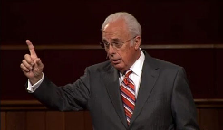
John MacArthur
“I was raised in a dispensational environment; there’s no question… But, as I got into seminary, I began to test some of those things. I have been perhaps aptly designated as a leaky dispensationalist….Here’s my dispensationalism – I’ll give it to you in one sentence: there’s a difference between the church and Israel – period!... At the same time in seminary, I began to be exposed to reading among more Reformed theologians… And over the years of exegeting the scripture, it has again yielded to me a Reformed theology….”

Slide 147
John MacArthur
“I was convinced of it (Reformed theology) when I started and I’m more convinced of it now as I’ve gone through the text. I was convinced of it when I started because I read so many noble men who have held that view (Reformed Theology). It was more at that point hero worship, and now it’s become my own.” (bold mine)
Transcribed from tape, #GC 70-15, entitled "Bible Questions and Answers." A copy of the tape can be obtained by writing, Word of Grace, P.O. Box 4000, Panorama City, CA 91412. Copyright 1994 by John MacArthur Jr., All Rights Reserved.
(My point here is only to demonstrate how John MacArthur, who claims to be a dispensationalist, has arrived at his position on Lordship salvation.)

Slide 148
John MacArthur
John MacArthur Jr. writes:
“There is a tendency, however, for dispensationalists to get carried away with compartmentalizing truth to the point that they make unbiblical differentiations. An almost obsessive desire to categorize and contrast related truths has carried various dispensationalist interpreters (Chafer, Ryrie, Hodges, etc.) far beyond the legitimate distinctions between Israel and the Church. Many would also draw hard lines between salvation and discipleship (justification and sanctification), the church and the kingdom, Christ's preaching and the apostolic message, faith and repentance, and the age of law and the age of grace." (bold & emphasis mine) “The Gospel According to Jesus,” page 31

Slide 149

  “Regrettably, some published materials written by DTS faculty members confirm my earlier concern. First there was Dr. Darrell Bock’s review of MacArthur’s The Gospel According to Jesus which showed significant confusion on the subject of assurance (see Bib Sac, Jan–Mar, 1989, pp. 21–40; see my review in the GES Journal, Spring 1989, pp. 79–83 and especially pp. 81–83). Darrell has told me both in person and in writing that his position is “soft lordship” salvation—a view that would have been rejected by the founder and first president of Dallas Seminary, Dr. Lewis Sperry Chafer.”
Zane Hodges
Zane C. Hodges, “Assurance and Works: An Evangelical Trainwreck,” Grace in Focus (March‒April 1994), accessed April 1, 2016, http://www.faithalone.org.

Slide 150
Conclusion

Slide 151
9 Ways Kingdom Now Theology
Impacts the Church
Loss of “pilgrim” status
Social Gospel
Ecumenical & interfaith alliances
Rejection or marginalization of Bible prophecy
Building the wrong kingdom
Charismatic theology
Prosperity Gospel
Anti-Israelism
Lordship Salvation

