Slide 1
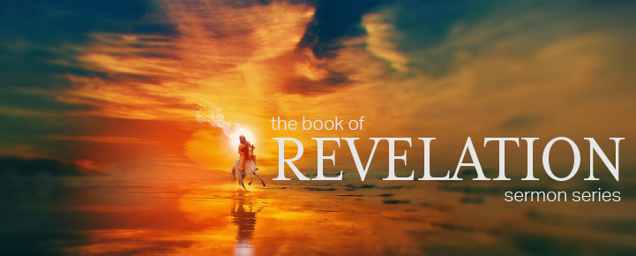

Dr. Andy Woods
Senior Pastor – Sugar Land Bible Church
President – Chafer Theological Seminary

Slide 2


Slide 3
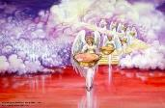

Seven Bowls
(Revelation 16)
1st Bowl (16:1-2) – Boils
2nd Bowl (16:3) – Sea becomes blood
3rd Bowl (16:4-7) – Freshwater destroyed
4th Bowl (16:8-9) – Sun scorches man
5th Bowl (16:10-11) – Darkness
6th Bowl (16:13-16) – Euphrates dried
7th Bowl (16:17-21) – Greatest earthquake

Slide 4
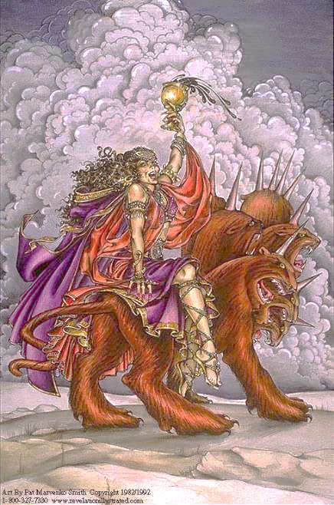
The Woman Rides the Beast
Revelation 17
The Vision Concerning Babylon (17:1-6a)
The Interpretation Concerning Babylon (6b-18)

Slide 5
The Woman Rides the Beast
Revelation 17
The Vision Concerning Babylon (17:1-6a)
The Interpretation Concerning Babylon (6b-18)

Slide 6
I. The Vision Concerning Babylon
Revelation 17:1-6a
Her introduction (1a)
Her judgment (1b)
Her immorality (2)
Her influence (3)
Her appearance (4)
Her title (5)
Her persecution (6a)

Slide 7
I. The Vision Concerning Babylon
Revelation 17:1-6a
Her introduction (1a)
Her judgment (1b)
Her immorality (2)
Her influence (3)
Her appearance (4)
Her title (5)
Her persecution (6a)

Slide 8
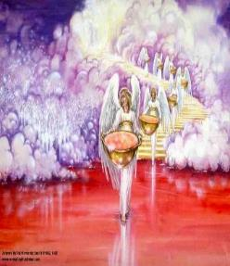
7. The Seventh Bowl
Revelation 16:17-21
7th angel pours out the bowl (17)
Lightning & thunder (18a)
Greatest earthquake (18b)
Jerusalem destroyed (19a)
Babylon destroyed (19b)
Every mountain & island moved (20)
100-pound hailstones (21a)
Man’s sinful reaction (21b)

Slide 9

Revelation 16:19
“The great city was split into three parts, and the cities of the nations fell. Babylon the great was remembered before God, to give her the cup of the wine of His fierce wrath.”

Slide 10


Revelation 17:1
“Then one of the seven angels who had the seven bowls came and spoke with me, saying, “Come here, I will show you the judgment of the great harlot who sits on many waters.”

Slide 11
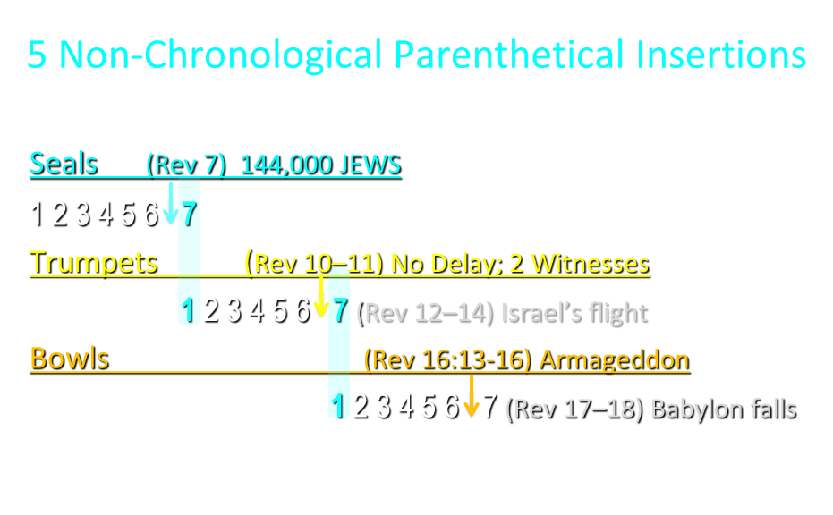

Slide 12
5 Non-Chronological Parenthetical Insertions
Rev 7 – 144,000 Jews
Rev 10:1-11:13 – Announcement of no more delay and the two witnesses
Rev 12-14 – Israel’s flight, two beasts, six scenes of hope
Rev 16:13-16 – Gathering of the nations to Armageddon
Rev 17:1-19:6 – Babylon’s fall

Slide 13
I. The Vision Concerning Babylon
Revelation 17:1-6a
Her introduction (1a)
Her judgment (1b)
Her immorality (2)
Her influence (3)
Her appearance (4)
Her title (5)
Her persecution (6a)

Slide 14
Parallels Between Jeremiah 50-51 & Revelation 17-18
 | Jeremiah | Revelation
Associated with a Golden cup | 51:7a | 17:3-4; 18:6
Dwelling on many waters | 51:13 | 17:1
Intoxicating the nations | 51:7b | 17:2
Same name | 50:1 | 17:5
Persecution of the saints | 51:49 | 17:6; 18:24
Stone sinking into Euphrates | 51:63-64 | 18:21
Sudden destruction | 51:8 | 18:8
Destroyed by fire | 51:30 | 17:16
Final, uninhabitable | 50:39 | 18:21
Deserved | 50:29 | 18:6
God’s people flee | 51:6, 45 | 18:4
Heaven rejoices | 51:48 | 18:20
Dyer, "The Identity of Babylon in Revelation 17–18 (Part 2)," 441-43.

Slide 15
OT Descriptions of Babylon in Rev 17–18
 | Revelation 17–18 | Old Testament
Waters | 17:1 | Psalm 137:1
Babylon the Great | 17:5 | Daniel 4:30
Mother harlots | 17:5 | Genesis 11:1-9
Fallen, fallen is Babylon | 18:2 | Isaiah 21:9
Will not see widowhood | 18:7 | Isaiah 47:7-9
Colorful attire | 17:4; 18:16 | Daniel 5:7, 16, 29
Sorcery | 18:23 | 1saiah 47:9-13

Slide 16
I. The Vision Concerning Babylon
Revelation 17:1-6a
Her introduction (1a)
Her judgment (1b)
Her immorality (2)
Her influence (3)
Her appearance (4)
Her title (5)
Her persecution (6a)

Slide 17

Genesis 11:1-4
¹ Now the whole earth used the same language and the same words. ² It came about as they journeyed east, that they found a plain in the land of Shinar and settled there. ³ They said to one another, “Come, let us make bricks and burn them thoroughly.” And they used brick for stone, and they used tar for mortar. ⁴ They said, “Come, let us build for ourselves a city, and a tower whose top will reach into heaven, and let us make for ourselves a name, otherwise we will be scattered abroad over the face of the whole earth.”

Slide 18
Spread of the Mother-Child Cult
 | Mother | Child
Assyria | Ishtar | Tammuz
Phoenicia | Astarte | Baal
Egypt | Isis | Osirus/Horus
Greece | Aphrodite | Eros
Rome | Venus | Cupid
Asia | Cybele | Desius
India | Isi | Aswara
Roman Catholicism | Mary | Jesus
Israel | Queen of Heaven (Jer. 7:18; 44:17) | Tammuz (Ezek. 8:14-15)
Alexander Hislop, Two Babylons

Slide 19
Parallels Between Jeremiah 50-51 & Revelation 17-18
 | Jeremiah | Revelation
Associated with a Golden cup | 51:7a | 17:3-4; 18:6
Dwelling on many waters | 51:13 | 17:1
Intoxicating the nations | 51:7b | 17:2
Same name | 50:1 | 17:5
Persecution of the saints | 51:49 | 17:6; 18:24
Stone sinking into Euphrates | 51:63-64 | 18:21
Sudden destruction | 51:8 | 18:8
Destroyed by fire | 51:30 | 17:16
Final, uninhabitable | 50:39 | 18:21
Deserved | 50:29 | 18:6
God’s people flee | 51:6, 45 | 18:4
Heaven rejoices | 51:48 | 18:20
Dyer, "The Identity of Babylon in Revelation 17–18 (Part 2)," 441-43.

Slide 20
I. The Vision Concerning Babylon
Revelation 17:1-6a
Her introduction (1a)
Her judgment (1b)
Her immorality (2)
Her influence (3)
Her appearance (4)
Her title (5)
Her persecution (6a)

Slide 21
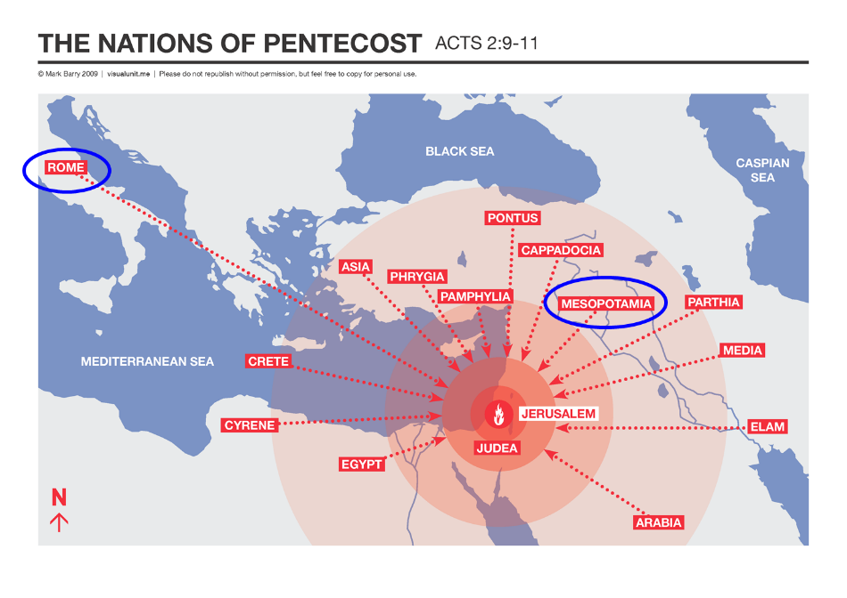

Slide 22

Revelation 17:3
“And he carried me away in the Spirit into a wilderness; and I saw a woman sitting on a scarlet beast, full of blasphemous names, having seven heads and ten horns.”

Slide 24
I. The Vision Concerning Babylon
Revelation 17:1-6a
Her introduction (1a)
Her judgment (1b)
Her immorality (2)
Her influence (3)
Her appearance (4)
Her title (5)
Her persecution (6a)

Slide 25
ONE BABYLON
 | Rev. 17 | Rev. 18
Same name | 17:5 | 18:2
City | 17:18 | 18:10
Same clothing | 17:4 | 18:16
Holding a cup | 17:4 | 18:6
Fornicating with Kings | 17:2 | 18:3
Drunk with wine of immorality | 17:2 | 18:3
Persecuting believers | 17:6 | 18:20, 24
Destroyed by fire | 17:16 | 18:8, 18
Destroyed by God | 17:17 | 18:5, 8
Dyer, "The Identity of Babylon in Revelation 17–18 (Part 1)," 311-13.

Slide 26
OT Descriptions of Babylon in Rev 17–18
 | Revelation 17–18 | Old Testament
Waters | 17:1 | Psalm 137:1
Babylon the Great | 17:5 | Daniel 4:30
Mother harlots | 17:5 | Genesis 11:1-9
Fallen, fallen is Babylon | 18:2 | Isaiah 21:9
Will not see widowhood | 18:7 | Isaiah 47:7-9
Colorful attire | 17:4; 18:16 | Daniel 5:7, 16, 29
Sorcery | 18:23 | 1saiah 47:9-13

Slide 27
Parallels Between Jeremiah 50-51 & Revelation 17-18
 | Jeremiah | Revelation
Associated with a Golden cup | 51:7a | 17:3-4; 18:6
Dwelling on many waters | 51:13 | 17:1
Intoxicating the nations | 51:7b | 17:2
Same name | 50:1 | 17:5
Persecution of the saints | 51:49 | 17:6; 18:24
Stone sinking into Euphrates | 51:63-64 | 18:21
Sudden destruction | 51:8 | 18:8
Destroyed by fire | 51:30 | 17:16
Final, uninhabitable | 50:39 | 18:21
Deserved | 50:29 | 18:6
God’s people flee | 51:6, 45 | 18:4
Heaven rejoices | 51:48 | 18:20
Dyer, "The Identity of Babylon in Revelation 17–18 (Part 2)," 441-43.

Slide 28
I. The Vision Concerning Babylon
Revelation 17:1-6a
Her introduction (1a)
Her judgment (1b)
Her immorality (2)
Her influence (3)
Her appearance (4)
Her title (5)
Her persecution (6a)

Slide 29
OT Descriptions of Babylon in Rev 17–18
 | Revelation 17–18 | Old Testament
Waters | 17:1 | Psalm 137:1
Babylon the Great | 17:5 | Daniel 4:30
Mother harlots | 17:5 | Genesis 11:1-9
Fallen, fallen is Babylon | 18:2 | Isaiah 21:9
Will not see widowhood | 18:7 | Isaiah 47:7-9
Colorful attire | 17:4; 18:16 | Daniel 5:7, 16, 29
Sorcery | 18:23 | 1saiah 47:9-13

Slide 30
Literal Geography in Revelation
Asia | 1:4 | Philadelphia | 3:7
Patmos | 1:9 | Laodicea | 3:14
Ephesus | 2:1 | Euphrates | 9:14;16:12
Smyrna | 2:8 | Jerusalem | 11:8
Pergamum | 2:12 | Armageddon | 16:16
Thyatira | 2:18 | Jerusalem | 20:9
Sardis | 3:1 | New Jerusalem | 21:2

Slide 31

John F. Walvoord
John F. Walvoord, The Revelation of Jesus Christ: A Commentary (Chicago: Moody, 1966), 257, 263.
“The city here according to verse 5 is a mystery, not a literal city...The ultimate decision depends upon the judgment of the expositor, but in many respects it is simpler to postulate a rebuilt Babylon as fulfilling literally the Old Testament prophecies as well as that embodied in this chapter.”

Slide 32
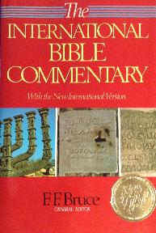
F. F. Bruce
“Revelation,” in International Bible Commentary, 1986, p. 1621.
“This title was written on her forehead: Mystery: ‘mystery’ indicates that the name she bears...is not to be understood literally, but allegorically: Babylon the Great is read, but ‘Rome’ is meant (cf. verses 9, 19).”

Slide 33
“MYSTERY” IN HARLOT’S TITLE? REV. 17:5
And on her forehead a name was written: MYSTERY, BABYLON THE GREAT, THE MOTHER OF HARLOTS AND OF THE ABOMINATIONS OF THE EARTH. (KJV, NIV)
… and upon her forehead a name was written, a mystery, “BABYLON THE GREAT, THE MOTHER OF HARLOTS AND OF THE ABOMINATIONS OF THE EARTH.” (NASB)

Slide 34
“Mystery” Defined
“In the N.T, it [mystērion] denotes, not the mysterious (as with the Eng. word), but that which, being outside the range of unassisted natural apprehension, can be made known only by Divine revelation, and is made known in a manner and at a time appointed by God, and to those who are illumined by His Spirit.”
W. E. Vine, Merrill F. Unger, and William White, Vine's Complete Expository Dictionary of the Old and New Testament Words (Nashville: Nelson, 1996), 424.

Slide 35

Colossians 1:26
“that is, the mystery which has been hidden from the past ages and generations, but has now been manifested to His.”

Slide 36
Revelation 17:3
“And he carried me away in the Spirit into a wilderness; and I saw a woman sitting on a scarlet beast, full of blasphemous names, having seven heads and ten horns.”

Slide 38
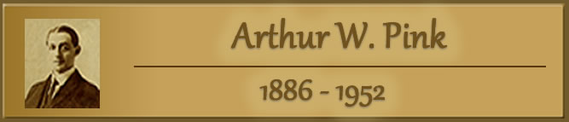
“We believe that the English translators have misled many by printing (on their own authority) the word ‘mystery’ in large capital letters, thus making it appear that this was a part of ‘the woman’s name. This we are assured is a mistake. That ‘mystery’ is connected with the ‘Woman’ herself and not with her ‘name’ is clear from v. 7, where the angel says unto John, ‘I will tell thee the mystery of the Woman, and of the beast which carrieth her.’”
Pink, The Antichrist, 262.

Slide 39


Slide 40
Genesis 11:1-4
¹ Now the whole earth used the same language and the same words. ² It came about as they journeyed east, that they found a plain in the land of Shinar and settled there. ³ They said to one another, “Come, let us make bricks and burn them thoroughly.” And they used brick for stone, and they used tar for mortar. ⁴ They said, “Come, let us build for ourselves a city, and a tower whose top will reach into heaven, and let us make for ourselves a name, otherwise we will be scattered abroad over the face of the whole earth.”

Slide 41
Spread of the Mother-Child Cult
 | Mother | Child
Assyria | Ishtar | Tammuz
Phoenicia | Astarte | Baal
Egypt | Isis | Osirus/Horus
Greece | Aphrodite | Eros
Rome | Venus | Cupid
Asia | Cybele | Desius
India | Isi | Aswara
Roman Catholicism | Mary | Jesus
Israel | Queen of Heaven (Jer. 7:18; 44:17) | Tammuz (Ezek. 8:14-15)
Alexander Hislop, Two Babylons

Slide 42
Larkin, The Book of Revelation, 151.
“The river Euphrates, on which the city of Babylon was built, was one of the four branches into which the river that flowed through the Garden of Eden was divided, and Satan doubtless chose the site of Babylon as his headquarters from which to sally forth to tempt Adam and Eve. It was doubtless here that the Antediluvian apostasy had its source that ended in the flood. To this centre the ‘forces of Evil’ gravitated after the Flood, and ‘Babel’ was the result. This was the origin of the nations, but the nations were not scattered abroad over the earth until Satan had implanted in them the “Virus” of a doctrine that has been the source of every false religion the world has ever known.”

Slide 43
Spread of the Mother-Child Cult
 | Mother | Child
Assyria | Ishtar | Tammuz
Phoenicia | Astarte | Baal
Egypt | Isis | Osirus/Horus
Greece | Aphrodite | Eros
Rome | Venus | Cupid
Asia | Cybele | Desius
India | Isi | Aswara
Roman Catholicism | Mary | Jesus
Israel | Queen of Heaven (Jer. 7:18; 44:17) | Tammuz (Ezek. 8:14-15)
Alexander Hislop, Two Babylons

Slide 44
I. The Vision Concerning Babylon
Revelation 17:1-6a
Her introduction (1a)
Her judgment (1b)
Her immorality (2)
Her influence (3)
Her appearance (4)
Her title (5)
Her persecution (6a)

Slide 45
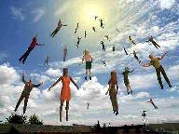
When Will the Rapture Take Place Relative to the Tribulation Period?
Pre-tribulation rapture theory
Mid-tribulation rapture theory
Post-tribulation rapture theory
Pre-wrath rapture theory
Partial rapture theory

Slide 46


Slide 47
Parallels Between Jeremiah 50-51 & Revelation 17-18
 | Jeremiah | Revelation
Associated with a Golden cup | 51:7a | 17:3-4; 18:6
Dwelling on many waters | 51:13 | 17:1
Intoxicating the nations | 51:7b | 17:2
Same name | 50:1 | 17:5
Persecution of the saints | 51:49 | 17:6; 18:24
Stone sinking into Euphrates | 51:63-64 | 18:21
Sudden destruction | 51:8 | 18:8
Destroyed by fire | 51:30 | 17:16
Final, uninhabitable | 50:39 | 18:21
Deserved | 50:29 | 18:6
God’s people flee | 51:6, 45 | 18:4
Heaven rejoices | 51:48 | 18:20
Dyer, "The Identity of Babylon in Revelation 17–18 (Part 2)," 441-43.

Slide 49
The Woman Rides the Beast
Revelation 17
The Vision Concerning Babylon (17:1-6a)
The Interpretation Concerning Babylon (16b-18)

Slide 50
II. The Interpretation Concerning Babylon
Revelation 17:6b-18
The Interpretation Promised (6b-7)
The Beast & His system (8-14)
Babylon (15-18)

Slide 51
II. The Interpretation Concerning Babylon
Revelation 17:6b-18
The Interpretation Promised (6b-7)
The Beast & His system (8-14)
Babylon (15-18)

Slide 52
Revelation 17:3
“And he carried me away in the Spirit into a wilderness; and I saw a woman sitting on a scarlet beast, full of blasphemous names, having seven heads and ten horns.”

Slide 54
“We believe that the English translators have misled many by printing (on their own authority) the word ‘mystery’ in large capital letters, thus making it appear that this was a part of ‘the woman’s name. This we are assured is a mistake. That ‘mystery’ is connected with the ‘Woman’ herself and not with her ‘name’ is clear from v. 7, where the angel says unto John, ‘I will tell thee the mystery of the Woman, and of the beast which carrieth her.’”
Pink, The Antichrist, 262.

Slide 55
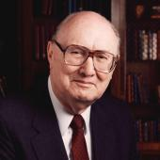
Two Rules of Interpretation
Search the immediate context
  Walvoord: 26X
Search the remote context
  Old Testament
  Thomas: 278 / 404 verses

Slide 56
II. The Interpretation Concerning Babylon
Revelation 17:6b-18
The Interpretation Promised (6b-7)
The Beast & His system (8-14)
Babylon (15-18)

Slide 57
B. The Beast & His System
Revelation 17:8-14
The Beast (8)
The Seven Heads (9-11)
The Ten Horns (12-14)

Slide 58
B. The Beast & His System
Revelation 17:8-14
The Beast (8)
The Seven Heads (9-11)
The Ten Horns (12-14)

Slide 59

Revelation 13:14
“And he deceives those who dwell on the earth because of the signs which it was given him to perform in the presence of the beast, telling those who dwell on the earth to make an image to the beast who had the wound of the sword and has come to life [záō].”

Slide 60
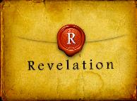
Revelation 2:8
“And to the angel of the church in Smyrna write: The first and the last, who was dead, and has come to life [záō], says this.”

Slide 61

Revelation 20:4-5
“⁴ Then I saw thrones, and they sat on them, and judgment was given to them. And I saw the souls of those who had been beheaded because of their testimony of Jesus and because of the word of God, and those who had not worshiped the beast or his image, and had not received the mark on their forehead and on their hand; and they came to life [záō] and reigned with Christ for a thousand years. ⁵ The rest of the dead did not come to life [záō] until the thousand years were completed. This is the first resurrection.”

Slide 62
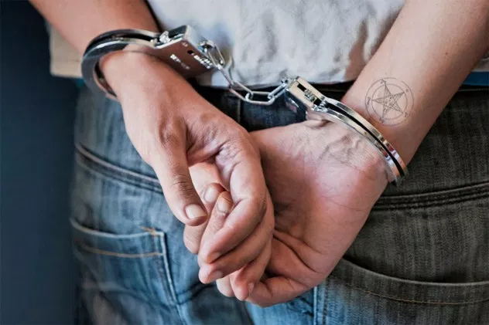
2 Thessalonians 2:6-7
“⁶ And you know what restrains him now, so that in his time he will be revealed. ⁷ For the mystery of lawlessness is already at work; only he who now restrains will do so until he is taken out of the way.”

Slide 63
B. The Beast & His System
Revelation 17:8-14
The Beast (8)
The Seven Heads (9-11)
The Ten Horns (12-14)

Slide 64
Revelation 17:3
“And he carried me away in the Spirit into a wilderness; and I saw a woman sitting on a scarlet beast, full of blasphemous names, having seven heads and ten horns.”

Slide 66


Revelation 17:9-10
“Here is the mind which has wisdom. The seven heads are seven mountains [oros] on which the woman sits, ¹⁰ and they are seven kings; five have fallen, one is, the other has not yet come; and when he comes, he must remain a little while.”

Slide 67
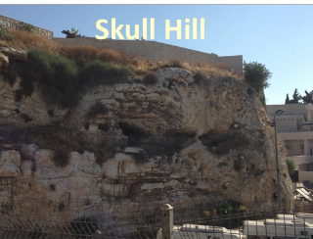
Revelation 11:8
“And their dead bodies will lie in the street of the great city which mystically is called Sodom and Egypt, where also their Lord was crucified.”

Slide 68
Revelation 17:9-10
“Here is the mind which has wisdom. The seven heads are seven mountains [oros] on which the woman sits, ¹⁰ and they are seven kings; five have fallen, one is, the other has not yet come; and when he comes, he must remain a little while.”

Slide 69
Daniel 2:37-38
You, O king, are the king of kings, to whom the God of heaven has given the kingdom, the power, the strength and the glory; ³⁸ and wherever the sons of men dwell, or the beasts of the field, or the birds of the sky, He has given them into your hand and has caused you to rule over them all. You are the head of gold.

Slide 70
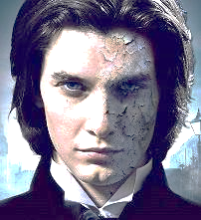
7 Kings or Kingdoms (Dan. 2:37-38)
(Revelation 17:9-10)
Egypt
Assyria
Babylon
Persian
Greece
Rome I
Rome II

Slide 71
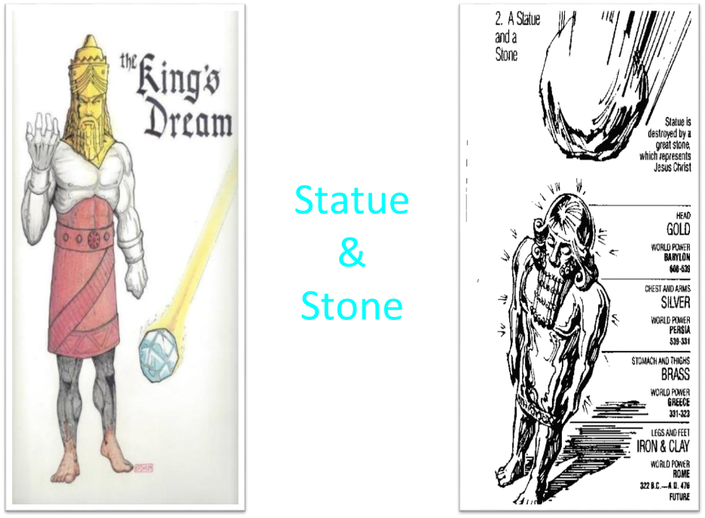

Slide 72
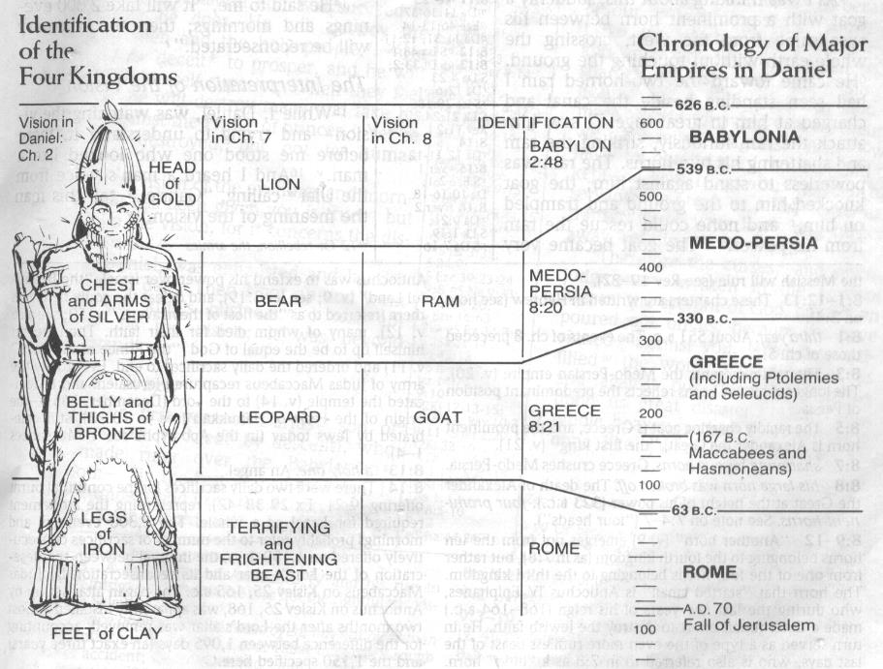
CHART OF NATIONS

Slide 73
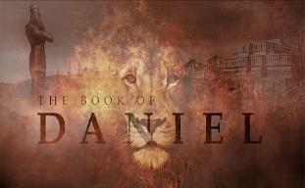
Daniel 7:12
“As for the rest of the beasts, their dominion was taken away, but an extension of life was granted to them for an appointed period of time.”

Slide 74
B. The Beast & His System
Revelation 17:8-14
The Beast (8)
The Seven Heads (9-11)
The Ten Horns (12-14)

Slide 75
Revelation 17:3
“And he carried me away in the Spirit into a wilderness; and I saw a woman sitting on a scarlet beast, full of blasphemous names, having seven heads and ten horns.”

Slide 76

Daniel 2:44
“In the days of those kings the God of heaven will set up a kingdom which will never be destroyed, and that kingdom will not be left for another people; it will crush and put an end to all these kingdoms, but it will itself endure forever.”

Slide 77
Daniel 7:24
“As for the ten horns, out of this kingdom ten kings will arise; and another will arise after them, and he will be different from the previous ones and will subdue three kings.”

Slide 78
Daniel 7:23
“Thus he said: ‘The fourth beast will be a fourth kingdom on the earth, which will be different from all the other kingdoms and will devour the whole earth and tread it down and crush it.”

Slide 79
Daniel 7:24
“As for the ten horns, out of this kingdom ten kings will arise; and another will arise after them, and he will be different from the previous ones and will subdue three kings.”

Slide 80
II. The Interpretation Concerning Babylon
Revelation 17:6b-18
The Interpretation Promised (6b-7)
The Beast & His system (8-14)
Babylon (15-18)

Slide 81
Revelation 17:3
“And he carried me away in the Spirit into a wilderness; and I saw a woman sitting on a scarlet beast, full of blasphemous names, having seven heads and ten horns.”

Slide 83
C. The Beast & His System
Revelation 17:15-18
Her Influence (15)
Her Destruction (16-17)
Her Identification (18)

Slide 84
C. The Beast & His System
Revelation 17:15-18
Her Influence (15)
Her Destruction (16-17)
Her Identification (18)

Slide 85
Parallels Between Jeremiah 50-51 & Revelation 17-18
 | Jeremiah | Revelation
Associated with a Golden cup | 51:7a | 17:3-4; 18:6
Dwelling on many waters | 51:13 | 17:1
Intoxicating the nations | 51:7b | 17:2
Same name | 50:1 | 17:5
Persecution of the saints | 51:49 | 17:6; 18:24
Stone sinking into Euphrates | 51:63-64 | 18:21
Sudden destruction | 51:8 | 18:8
Destroyed by fire | 51:30 | 17:16
Final, uninhabitable | 50:39 | 18:21
Deserved | 50:29 | 18:6
God’s people flee | 51:6, 45 | 18:4
Heaven rejoices | 51:48 | 18:20
Dyer, "The Identity of Babylon in Revelation 17–18 (Part 2)," 441-43.

Slide 86
OT Descriptions of Babylon in Rev 17–18
 | Revelation 17–18 | Old Testament
Waters | 17:1 | Psalm 137:1
Babylon the Great | 17:5 | Daniel 4:30
Mother harlots | 17:5 | Genesis 11:1-9
Fallen, fallen is Babylon | 18:2 | Isaiah 21:9
Will not see widowhood | 18:7 | Isaiah 47:7-9
Colorful attire | 17:4; 18:16 | Daniel 5:7, 16, 29
Sorcery | 18:23 | 1saiah 47:9-13

Slide 87
Genesis 11:1-4
¹ Now the whole earth used the same language and the same words. ² It came about as they journeyed east, that they found a plain in the land of Shinar and settled there. ³ They said to one another, “Come, let us make bricks and burn them thoroughly.” And they used brick for stone, and they used tar for mortar. ⁴ They said, “Come, let us build for ourselves a city, and a tower whose top will reach into heaven, and let us make for ourselves a name, otherwise we will be scattered abroad over the face of the whole earth.”

Slide 88
Spread of the Mother-Child Cult
 | Mother | Child
Assyria | Ishtar | Tammuz
Phoenicia | Astarte | Baal
Egypt | Isis | Osirus/Horus
Greece | Aphrodite | Eros
Rome | Venus | Cupid
Asia | Cybele | Desius
India | Isi | Aswara
Roman Catholicism | Mary | Jesus
Israel | Queen of Heaven (Jer. 7:18; 44:17) | Tammuz (Ezek. 8:14-15)
Alexander Hislop, Two Babylons

Slide 90
C. The Beast & His System
Revelation 17:15-18
Her Influence (15)
Her Destruction (16-17)
Her Identification (18)

Slide 91
Revelation 17:3
“And he carried me away in the Spirit into a wilderness; and I saw a woman sitting on a scarlet beast, full of blasphemous names, having seven heads and ten horns.”

Slide 93
Parallels Between Jeremiah 50-51 & Revelation 17-18
 | Jeremiah | Revelation
Associated with a Golden cup | 51:7a | 17:3-4; 18:6
Dwelling on many waters | 51:13 | 17:1
Intoxicating the nations | 51:7b | 17:2
Same name | 50:1 | 17:5
Persecution of the saints | 51:49 | 17:6; 18:24
Stone sinking into Euphrates | 51:63-64 | 18:21
Sudden destruction | 51:8 | 18:8
Destroyed by fire | 51:30 | 17:16
Final, uninhabitable | 50:39 | 18:21
Deserved | 50:29 | 18:6
God’s people flee | 51:6, 45 | 18:4
Heaven rejoices | 51:48 | 18:20
Dyer, "The Identity of Babylon in Revelation 17–18 (Part 2)," 441-43.

Slide 94
ONE BABYLON
 | Rev. 17 | Rev. 18
Same name | 17:5 | 18:2
City | 17:18 | 18:10
Same clothing | 17:4 | 18:16
Holding a cup | 17:4 | 18:6
Fornicating with Kings | 17:2 | 18:3
Drunk with wine of immorality | 17:2 | 18:3
Persecuting believers | 17:6 | 18:20, 24
Destroyed by fire | 17:16 | 18:8, 18
Destroyed by God | 17:17 | 18:5, 8
Dyer, "The Identity of Babylon in Revelation 17–18 (Part 1)," 311-13.

Slide 95
C. The Beast & His System
Revelation 17:15-18
Her Influence (15)
Her Destruction (16-17)
Her Identification (18)

Slide 96
Bullinger
The Apocalypse or “The Day of the Lord”, 509
“It is indeed surprising how any mistake could have been made in the identification of this woman. For the Holy Spirit first shows us her very name upon her forehead. Then, in verse 18, He tells us as plainly as words can tell anything, that ‘the woman which thou sawest is that great city, which reignest over the kings of the earth’, and chap. xvi. 19, as well as xvii. 5, identifies this city with Babylon. God says it is a ‘city.’ He does not say a system or a religion, but a ‘CITY.’”

Slide 97
Conclusion

Slide 98
The Woman Rides the Beast
Revelation 17
The Vision Concerning Babylon (17:1-6a)
The Interpretation Concerning Babylon (6b-18)

Slide 99

“The Lord bless you and keep you; the Lord make his face shine on you and be gracious to you; the Lord turn his face toward you and give you peace.” (NIV)

