Slide 1
Dr. Andy Woods
Senior Pastor – Sugar Land Bible Church
President – Chafer Theological Seminary

Slide 2
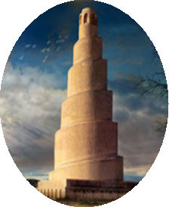
Seven Areas
Tower of Babel (Gen. 1–11)
Prophecies of Isaiah (13–14) & Jeremiah (50–51)
Prophecy of Zechariah (Zech. 5:5-11)
Kings of the East (Rev. 9:14; 16:12)
End-Time Harlot (Rev. 17–18)
Inadequate Theories
Current Events

Slide 3
Seven Areas
Tower of Babel (Gen. 1–11)
Prophecies of Isaiah (13–14) & Jeremiah (50–51)
Prophecy of Zechariah (Zech. 5:5-11)
Kings of the East (Rev. 9:14; 16:12)
End-Time Harlot (Rev. 17–18)
Inadequate Theories
Current Events

Slide 4
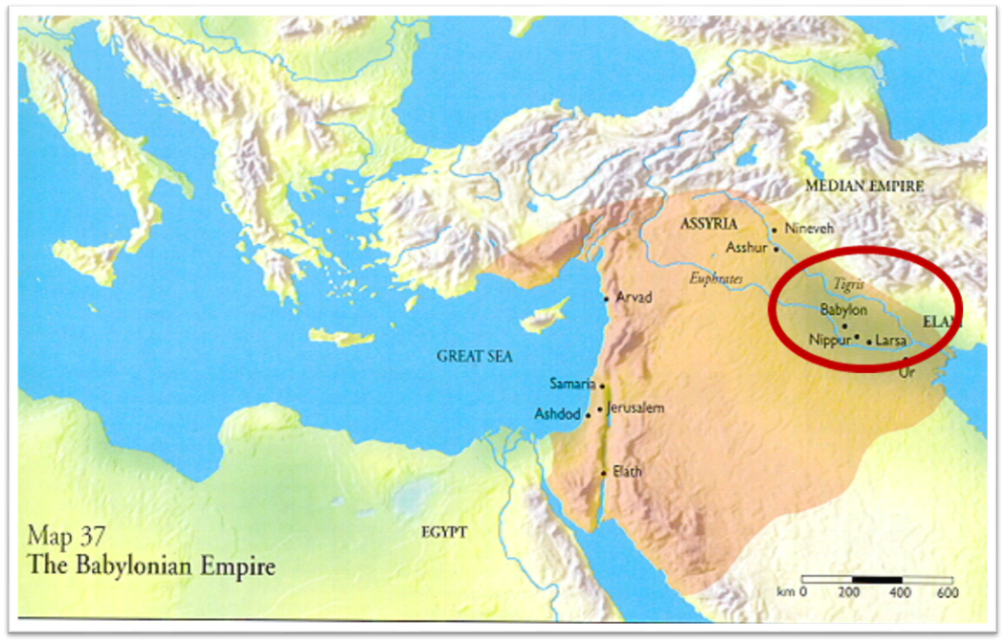

Slide 5
Spread of the Mother-Child Cult
 | Mother | Child
Assyria | Ishtar | Tammuz
Phoenicia | Astarte | Baal
Egypt | Isis | Osirus/Horus
Greece | Aphrodite | Eros
Rome | Venus | Cupid
Asia | Cybele | Desius
India | Isi | Aswara
Roman Catholicism | Mary | Jesus
Israel | Queen of Heaven (Jer. 7:18; 44:17) | Tammuz (Ezek. 8:14-15)
Alexander Hislop, Two Babylons

Slide 6
Seven Areas
Tower of Babel (Gen. 1–11)
Prophecies of Isaiah (13–14) & Jeremiah (50–51)
Prophecy of Zechariah (Zech. 5:5-11)
Kings of the East (Rev. 9:14; 16:12)
End-Time Harlot (Rev. 17–18)
Inadequate Theories
Current Events

Slide 7
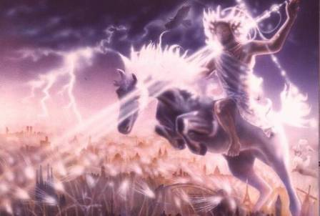
Isaiah 13-14
Day of the Lord (13:6-9)
Cosmic disturbances (13:10-13)
Global judgment (13:11-12)
Sodom and Gomorrah (13:19)
Complete and final desolation (13:20-22)
Universal peace and rest (14:5-8)
Israel’s regeneration (14:1-4)
Morris, Revelation Record, 348.

Slide 8
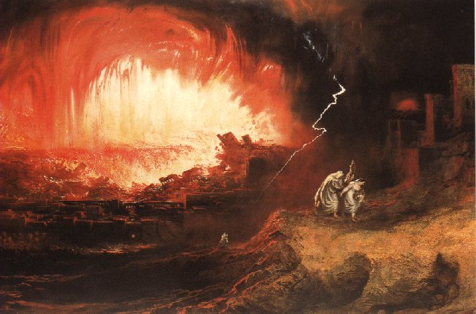
Jeremiah 50-51
Sudden destruction (51:8)
Complete destruction (50:3, 13, 26, 39-40; 51:29, 43, 62)
No reuse of building materials (51:26)
Believers flee (50:8; 51:6, 45)
Israel’s regeneration (50:2, 4-5, 20; 51:50)
Dyer, "The Identity of Babylon in Revelation 17–18 (Part 2)," 443-49.

Slide 10
Parallels Between Jeremiah 50-51 & Revelation 17-18
 | Jeremiah | Revelation
Associated with a Golden cup | 51:7a | 17:3-4; 18:6
Dwelling on many waters | 51:13 | 17:1
Intoxicating the nations | 51:7b | 17:2
Same name | 50:1 | 17:5
Stone sinking into Euphrates | 51:63-64 | 18:21
Sudden destruction | 51:8 | 18:8
Destroyed by fire | 51:30 | 17:16
Final, uninhabitable | 50:39 | 18:21
Deserved | 50:29 | 18:6
God’s people flee | 51:6, 45 | 18:4
Heaven rejoices | 51:48 | 18:20
Dyer, "The Identity of Babylon in Revelation 17–18 (Part 2)," 441-43.

Slide 11
Larkin, The Book of Revelation, 158.
“…and this is in exact harmony with the words of Isa. 13:19. ‘And Babylon, the glory of kingdoms, the beauty of the Chaldees’ excellency, shall be as when God overthrew Sodom and Gomorrah;’ and the Prophet Jeremiah makes the same statement. Jer. 50:40. The destruction of Sodom and Gomorrah was not protracted through many centuries, their glory disappeared in a few hours (Gen. 19:24–28), and as ancient Babylon was not thus destroyed, the prophecies of Isaiah and Jeremiah cannot be fulfilled unless there is to be a future Babylon that shall be thus destroyed. In Rev. 16:17–19, we are told that Babylon shall be destroyed by an Earthquake, attended with most vivid and incessant lightning and awful thunder.”

Slide 12
Seven Areas
Tower of Babel (Gen. 1–11)
Prophecies of Isaiah (13–14) & Jeremiah (50–51)
Prophecy of Zechariah (Zech. 5:5-11)
Kings of the East (Rev. 9:14; 16:12)
End-Time Harlot (Rev. 17–18)
Inadequate Theories
Current Events

Slide 13
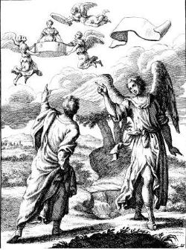
Zechariah 5:5-11
Woman (wickedness)
Ephah (commerce)
House (Temple-2 Sam 7; religion)
Shinar (Gen 10:10; 11:2; Dan 1:2)

Slide 15
Hitchcock The Second Coming of Babylon, 109.
ZECHARIAH 5:5-11 | REVELATION 17–18
Woman sitting in a basket | Woman sitting on beast, seven mountains, many waters (17: 3, 9, 15)
Emphasis on commerce (basket for measuring grain) | Emphasis on commerce (merchant of grain, 18:13)
Woman’s name is wickedness | Woman’s name is Babylon the Great, Mother of Harlots and Abominations of the Earth
Focus on False worship (temple is built for the woman) | Focus on False worship (17:5)
Woman taken to Babylon | Woman called Babylon

Slide 16
“The vision or prophecy (Zec. 5) contains the germ which is afterward expanded and developed in such detail in Rev. 17 and 18.” Pink, The Antichrist, 281.

Slide 17
Seven Areas
Tower of Babel (Gen. 1–11)
Prophecies of Isaiah (13–14) & Jeremiah (50–51)
Prophecy of Zechariah (Zech. 5:5-11)
Kings of the East (Rev. 9:14; 16:12)
End-Time Harlot (Rev. 17–18)
Inadequate Theories
Current Events

Slide 19
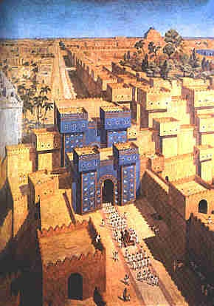
East = Babylon
Genesis 2:8
Genesis 11:2
Matthew 2:2

Slide 20
Seven Areas
Tower of Babel (Gen. 1–11)
Prophecies of Isaiah (13–14) & Jeremiah (50–51)
Prophecy of Zechariah (Zech. 5:5-11)
Kings of the East (Rev. 9:14; 16:12)
End-Time Harlot (Rev. 17–18)
Inadequate Theories
Current Events

Slide 21
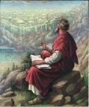
Revelation 18:10
“standing at a distance because of the fear of her torment, saying, ‘Woe, woe, the great city, Babylon, the strong city! For in one hour your judgment has come.’”

Slide 22
Literal Geography in Revelation
Asia | 1:4 | Philadelphia | 3:7
Patmos | 1:9 | Laodicea | 3:14
Ephesus | 2:1 | Euphrates | 9:14;16:12
Smyrna | 2:8 | Jerusalem | 11:8
Pergamum | 2:12 | Armageddon | 16:16
Thyatira | 2:18 | Jerusalem | 20:9
Sardis | 3:1 | New Jerusalem | 21:2

Slide 23
OT Descriptions of Babylon in Rev 17–18
 | Revelation 17–18 | Old Testament
Waters | 17:1 | Psalm 137:1
Babylon the Great | 17:5 | Daniel 4:30
Mother harlots | 17:5 | Genesis 11:1-9
Fallen, fallen is Babylon | 18:2 | Isaiah 21:9
Will not see widowhood | 18:7 | Isaiah 47:7-9
Colorful attire | 17:4; 18:16 | Daniel 5:7, 16, 29
Sorcery | 18:23 | 1saiah 47:9-13

Slide 24
John F. Walvoord John F. Walvoord, The Revelation of Jesus Christ: A Commentary (Chicago: Moody, 1966), 257, 263.
“The city here according to verse 5 is a mystery, not a literal city...The ultimate decision depends upon the judgment of the expositor, but in many respects it is simpler to postulate a rebuilt Babylon as fulfilling literally the Old Testament prophecies as well as that embodied in this chapter.”

Slide 25
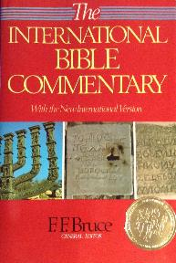
F. F. Bruce “Revelation,” in International Bible Commentary, 1986, p. 1621.
“This title was written on her forehead: Mystery: ‘mystery’ indicates that the name she bears...is not to be understood literally, but allegorically: Babylon the Great is read, but ‘Rome’ is meant (cf. verses 9, 19).”

Slide 26
“MYSTERY” IN HARLOT’S TITLE? REV. 17:5
And on her forehead a name was written: MYSTERY, BABYLON THE GREAT, THE MOTHER OF HARLOTS AND OF THE ABOMINATIONS OF THE EARTH. (KJV, NIV)
… and upon her forehead a name was written, a mystery, “BABYLON THE GREAT, THE MOTHER OF HARLOTS AND OF THE ABOMINATIONS OF THE EARTH.” (NASB)

Slide 27
“Mystery” Defined
“In the N.T, it [mystērion] denotes, not the mysterious (as with the Eng. word), but that which, being outside the range of unassisted natural apprehension, can be made known only by Divine revelation, and is made known in a manner and at a time appointed by God, and to those who are illumined by His Spirit.”
W. E. Vine, Merrill F. Unger, and William White, Vine's Complete Expository Dictionary of the Old and New Testament Words (Nashville: Nelson, 1996), 424.

Slide 28
Colossians 1:26
“that is, the mystery which has been hidden from the past ages and generations, but has now been manifested to His.”

Slide 29
Revelation 17:3
“And he carried me away in the Spirit into a wilderness; and I saw a woman sitting on a scarlet beast, full of blasphemous names, having seven heads and ten horns.”

Slide 30
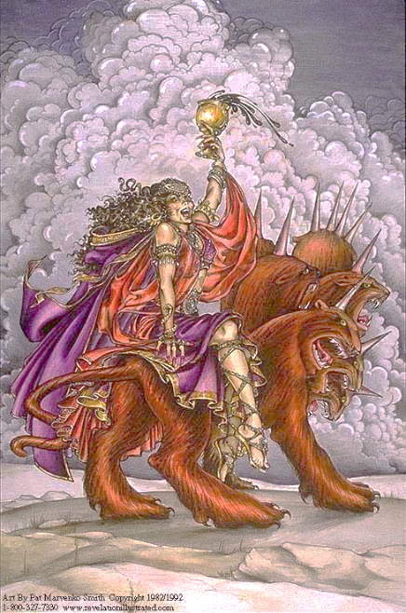

Slide 31
“We believe that the English translators have misled many by printing (on their own authority) the word ‘mystery’ in large capital letters, thus making it appear that this was a part of ‘the woman’s name. This we are assured is a mistake. That ‘mystery’ is connected with the ‘Woman’ herself and not with her ‘name’ is clear from v. 7, where the angel says unto John, ‘I will tell thee the mystery of the Woman, and of the beast which carrieth her.’”
Pink, The Antichrist, 262.

Slide 32
Seven Areas
Tower of Babel (Gen. 1–11)
Prophecies of Isaiah (13–14) & Jeremiah (50–51)
Prophecy of Zechariah (Zech. 5:5-11)
Kings of the East (Rev. 9:14; 16:12)
End-Time Harlot (Rev. 17–18)
Inadequate Theories
Current Events

Slide 33
Revelation 17:5
“and on her forehead a name was written, a mystery, “BABYLON THE GREAT, THE MOTHER OF HARLOTS AND OF THE ABOMINATIONS OF THE EARTH.”

Slide 34
Other Alternatives?
Religious system?
Jerusalem?
Rome?
Revived Rome?
Two Babylons?

Slide 35
Other Alternatives?
Religious system?
Jerusalem?
Rome?
Revived Rome?
Two Babylons?

Slide 36
Revelation 17:18
“The woman whom you saw is the great city, which reigns over the kings of the earth.

Slide 37
Revelation 18:10
“standing at a distance because of the fear of her torment, saying, ‘Woe, woe, the great city, Babylon, the strong city! For in one hour your judgment has come.’”

Slide 38
Bullinger The Apocalypse or “The Day of the Lord”, 509
“It is indeed surprising how any mistake could have been made in the identification of this woman. For the Holy Spirit first shows us her very name upon her forehead. Then, in verse 18, He tells us as plainly as words can tell anything, that ‘the woman which thou sawest is that great city, which reignest over the kings of the earth’, and chap. xvi. 19, as well as xvii. 5, identifies this city with Babylon. God says it is a ‘city.’ He does not say a system or a religion, but a ‘CITY.’”

Slide 39
John F. Walvoord The Revelation of Jesus Christ: A Commentary (Chicago: Moody, 1966), 267.
“Babylon, ecclesiastically symbolized by the woman in Revelation 17, proposes a common worship and a common religion through uniting in a world church. This is destroyed by the beast in Revelation 17:16 who thus fulfills the will of God (Rev. 17:17). Babylon, politically symbolized by the great city of Revelation 18, attempts to achieve its domination of the world by a world common market and a world government. These are destroyed by Christ at His second coming (Rev. 19:11–21).”

Slide 40
Other Alternatives?
Religious system?
Jerusalem?
Rome?
Revived Rome?
Two Babylons?

Slide 41
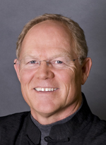
Hank Hanegraaff The Apocalypse Code: Find out What the Bible Really Says About the End Times and Why It Matters (Nashville, TN: Nelson, 2007), 118, 19-20.
“What has puzzled me over the years is not the identity of “the great prostitute,” but how so many could mistake her historical identity...In biblical history only one nation is inextricably linked to the moniker “harlot.” And that nation is Israel! Anyone who has read the Bible even once has flashbacks to the graphic images of apostate Israel when they first encounter the great prostitute of Revelation. From the Pentateuch to the Prophets, the image is repeated endlessly. Perhaps the most gut-wrenching portrayal of Israel as prostitute is found in Hosea.”

Slide 42
Isaiah 23:17
“It will come about at the end of seventy years that the Lord will visit Tyre. Then she will go back to her harlot’s wages and will play the harlot with all the kingdoms on the face of the earth.”

Slide 43
Nahum 3:4
“All because of the many harlotries of the harlot, The charming one, the mistress of sorceries, Who sells nations by her harlotries And families by her sorceries.”

Slide 44
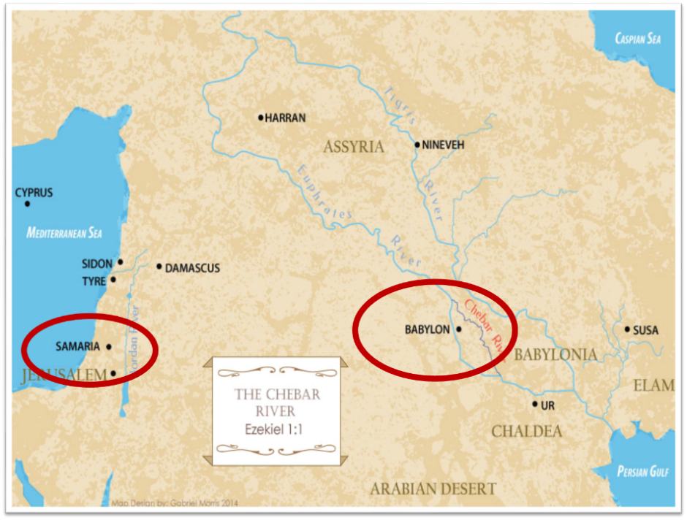

Slide 45
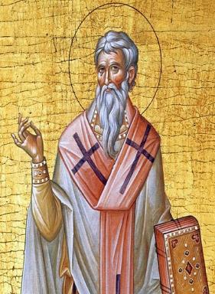
Late Date (A.D. 95) Irenaeus Against Heresies 5.30.3
“But if it had been necessary to announce his name plainly at the present time, it would have been spoken by him who saw the apocalypse. For it was not seen long ago, but almost in our own time, at the end of the reign of Domitian.”

Slide 46
Other Alternatives?
Religious system?
Jerusalem?
Rome?
Revived Rome?
Two Babylons?

Slide 48
Revelation 17:9-10
“Here is the mind which has wisdom. The seven heads are seven mountains [oros] on which the woman sits, ¹⁰ and they are seven kings; five have fallen, one is, the other has not yet come; and when he comes, he must remain a little while.”

Slide 49
Daniel 2:37-38
You, O king, are the king of kings, to whom the God of heaven has given the kingdom, the power, the strength and the glory; ³⁸ and wherever the sons of men dwell, or the beasts of the field, or the birds of the sky, He has given them into your hand and has caused you to rule over them all. You are the head of gold.

Slide 50
Revelation 17:3
“And he carried me away in the Spirit into a wilderness; and I saw a woman sitting on a scarlet beast, full of blasphemous names, having seven heads and ten horns.”

Slide 52
1 Peter 5:13
“She who is in Babylon, chosen together with you, sends you greetings, and so does my son, Mark.”

Slide 54
Galatians 2:7-8
“⁷ But on the contrary, seeing that I had been entrusted with the gospel to the uncircumcised, just as Peter had been to the circumcised ⁸ (for He who effectually worked for Peter in his apostleship to the circumcised effectually worked for me also to the Gentiles).”

Slide 56
Josephus Antiquities, 15.2.2
“But when Hyrcanus was brought into Parthia the king Phraates treated him after a very gentle manner, as having already learned of what an illustrious family he was; on which account he set him free from his bonds, and gave him a habitation at Babylon, where there were Jews in great numbers. These Jews honored Hyrcanus as their high priest and king, as did all the Jewish nation that dwelt as far as Euphrates; which respect was very much to his satisfaction...”

Slide 57
Strabo, Geography, 16.1.5?
“Strabo, who died in A.D. 25, is cited in proof that by this time no city was left. . . . This is an instance of how easily lax quotation or assertion may falsify both an author and an issue, which being once done, other writers too easily follow suit. What Strabo says is: ‘And now indeed [Selucia] has become greater than Babylon, which for the most part has become deserted’ (ἡ δʼ ἔρημοs ἡ πολλή).”
G. H. Lang, The Revelation of Jesus Christ: Select Studies (London: Paternoster, 1948), 302.

Slide 58
1 Peter 1:1
“To those who reside as aliens, scattered throughout Pontus, Galatia, Cappadocia, Asia, and Bithynia, who are chosen.”

Slide 60
Morris
The Revelation Record, 323
“At the very least, it would be confusing to John’s first century readers, as well as to later generations, for him to write so much about Babylon when he really meant Rome (Paul was not afraid to speak directly against Rome in his writings, so why should John be?) or ‘the false church’ (all the apostles , including John, wrote plainly and scathingly about false teachers and false doctrines in the church and would not hide their teachings by symbols). It must be stressed that Revelation means “unveiling,” not “veiling.” In the absence of any statement in the text to the contrary, therefore, we must assume that the term Babylon applies to the real city of Babylon…”

Slide 61
Martin Luther
"Against the Roman Papacy, an Institution of the Devil," in Luther's Works, ed. Eric. W. Gritsch (Philadelphia, PA: Fortress Press, 1966), 273-74.
“No man can believe what an abomination the papacy is. A Christian does not have to be of low intelligence, either, to recognize it. God himself must deride him in the hellish fire, and our Lord Jesus Christ, St. Paul says in II Thessalonians 2 [:8] will slay him with the breath of his mouth and destroy him by his glorious coming." I only deride, with my own weak derision, so that those who now live and those who will come after us should know what I have thought of the pope, the damned antichrist, and so that whoever wishes to be a Christian may be warned against such an abomination.”

Slide 62
John Calvin
Calvin, Institutes, IV, ii, 12.
“However, when we categorically deny to the papists the title of the church, we do not for this reason impugn the existence of churches among them. Rather, we are only contending about the true and lawful constitution of the church, required in the communion not only of the sacraments (which are the signs of profession) but also especially of doctrine. Daniel [Dan. 9:27] and Paul [2 Thess. 2:4] foretold that Antichrist would sit in the Temple of God. With us, it is the Roman pontiff we make the leader and standard bearer of that wicked and abominable kingdom. The fact that his seat is placed in the Temple of God signifies that his reign was not to be such as to wipe out either the name of Christ or of the…

Slide 63
John Calvin
Calvin, Institutes, IV, ii, 12.
…church. From this it therefore is evident that we by no means deny that the churches under his tyranny remain churches. But these he has profaned by his sacrilegious impiety, afflicted by his inhuman domination, corrupted and well-nigh killed by his evil and deadly doctrines, which are like poisoned drinks. In them Christ lies hidden, half buried, the gospel overthrown, piety scattered, the worship of God nearly wiped out. In them, briefly, everything is so confused that there we see the face of Babylon rather than that of the Holy City of God.”

Slide 64
Other Alternatives?
Religious system?
Jerusalem?
Rome?
Revived Rome?
Two Babylons?

Slide 66
Revelation 17:3
“And he carried me away in the Spirit into a wilderness; and I saw a woman sitting on a scarlet beast, full of blasphemous names, having seven heads and ten horns.”

Slide 68
Other Alternatives?
Religious system?
Jerusalem?
Rome?
Revived Rome?
Two Babylons?

Slide 69
John F. Walvoord The Revelation of Jesus Christ: A Commentary (Chicago: Moody, 1966), 267.
“Babylon, ecclesiastically symbolized by the woman in Revelation 17, proposes a common worship and a common religion through uniting in a world church. This is destroyed by the beast in Revelation 17:16 who thus fulfills the will of God (Rev. 17:17). Babylon, politically symbolized by the great city of Revelation 18, attempts to achieve its domination of the world by a world common market and a world government. These are destroyed by Christ at His second coming (Rev. 19:11–21).”

Slide 71
Two Babylons View
 | Ecclesiastical Babylon | Commercial Babylon
Chapter in Revelation | Revelation 17 | Revelation 18
Literalness | Not literal | Literal
Time of Destruction | 1st half of Tribulation | Second Advent
Emphasis | Religion | Commercial & Political

Slide 72
John F. Walvoord The Revelation of Jesus Christ: A Commentary (Chicago: Moody, 1966), 257, 263.
“The city here according to verse 5 is a mystery, not a literal city...The ultimate decision depends upon the judgment of the expositor, but in many respects it is simpler to postulate a rebuilt Babylon as fulfilling literally the Old Testament prophecies as well as that embodied in this chapter.”

Slide 73
Revelation 17:18
“The woman whom you saw is the great city, [polis] which reigns over the kings of the earth.

Slide 74
Revelation 18:10
“standing at a distance because of the fear of her torment, saying, ‘Woe, woe, the great city [polis], Babylon, the strong city! For in one hour your judgment has come.’”

Slide 75
Bullinger The Apocalypse or “The Day of the Lord”, 509
“It is indeed surprising how any mistake could have been made in the identification of this woman. For the Holy Spirit first shows us her very name upon her forehead. Then, in verse 18, He tells us as plainly as words can tell anything, that ‘the woman which thou sawest is that great city, which reignest over the kings of the earth’, and chap. xvi. 19, as well as xvii. 5, identifies this city with Babylon. God says it is a ‘city.’ He does not say a system or a religion, but a ‘CITY.’”

Slide 76
Revelation 17:1
“Then one of the seven angels who had the seven bowls came and spoke with me, saying, “Come here, I will show you the judgment of the great harlot who sits on many waters.”

Slide 78
5 Non-Chronological Parenthetical Insertions
Rev 7 – 144,000 Jews
Rev 10:1-11:13 – Announcement of no more delay and the two witnesses
Rev 12-14 – Israel’s flight, two beasts, six scenes of hope
Rev 16:13-16 – Gathering of the nations to Armageddon
Rev 17:1-19:6 – Babylon’s fall

Slide 79
ONE BABYLON
 | Rev. 17 | Rev. 18
Same name | 17:5 | 18:2
City | 17:18 | 18:10
Same clothing | 17:4 | 18:16
Holding a cup | 17:4 | 18:6
Fornicating with Kings | 17:2 | 18:3
Drunk with wine of immorality | 17:2 | 18:3
Persecuting believers | 17:6 | 18:20, 24
Destroyed by fire | 17:16 | 18:8, 18
Destroyed by God | 17:17 | 18:5, 8
Dyer, "The Identity of Babylon in Revelation 17–18 (Part 1)," 311-13.

Slide 80
Seven Areas
Tower of Babel (Gen. 1–11)
Prophecies of Isaiah (13–14) & Jeremiah (50–51)
Prophecy of Zechariah (Zech. 5:5-11)
Kings of the East (Rev. 9:14; 16:12)
End-Time Harlot (Rev. 17–18)
Inadequate Theories
Current Events

Slide 81
Early Babylon Interpreters
Govett (1813–1901) | Pink (1923)
Newton (1853) | Jennings (1937)
Newell (1935) | Pember (1941)
Bullinger (1909) | Cooper (1942)
Seiss (1909) | Lang (1948)
Larkin (1919) | Dyer (1979)
Ice, “Babylon in Bible Prophecy,” 5 . www.pre-trib.org.

Slide 83
Morris
The Revelation Record, 349
“Computer studies of the Institute for Creation Research have shown, for example, that Babylon is very near the geographical center of all the earth’s land masses. It is within navigable distances of the Persian Gulf and is at the crossroads of the three great continents of Europe, Asia and Africa. Thus there is no more ideal location anywhere for a world trade center, a world communication center, a world banking center, a world educational center, or especially, a world capital! The greatest historian of modern times, Arnold Toynbee, used to stress to all his readers and hearers that Babylon would be the best place in the world to build a future world cultural metropolis.”

Slide 84
June 2007 Conventional Oil Reserves
Rank | Country | Percentage of oil reserves
1 | Saudia Arabia | 21.9 %
2 | Iran | 11.4 %
3 | Iraq | 9.5 %
4 | Kuwait | 8.4 %
5 | United Arab Emirates | 8.1 %
6 | Venezuela | 6.6 %
7 | Russia | 6.6 %
8 | Libya | 3.4 %
David Jeremiah, What in the World is Going On, 207

Slide 85
Iraq Tries to Get Babylon on UNESCO World Heritage List Jan 20, 2015
“Iraqi Minister of Tourism and Antiquities on Monday said that his country is seeking to restore the ancient ruin city of Babylon onto the UNESCO world heritage list.”
http://news.xinhuanet.com/english/world/2015-01/19/c_133930811.htm

Slide 86
Iraq Celebrates Naming Babylon a UNESCO World Heritage Site
QASSIM ABDUL-ZAHRA of Times of Israel - July 6, 2019
“BAGHDAD (AP) — Iraq on Friday celebrated the UNESCO World Heritage Committee’s decision to name the historic city of Babylon a World Heritage Site in a vote held in Azerbaijan’s capital, years after Baghdad began campaigning for the site to be added to the list…The 4,300-year-old Babylon — now mainly an archaeological ruin and two important museums — is where dynasties have risen and fallen since the earliest days of settled human civilization. King Hammurabi wrote his famous code of laws in Babylon, while Nebuchadnezzar sent his vast army from the city to Jerusalem to put down an uprising and bring the Jews back as slaves.”

Slide 87
Iraq Celebrates Naming Babylon a UNESCO World Heritage Site
QASSIM ABDUL-ZAHRA of Times of Israel - July 6, 2019
“The Babylonian exile of the Jews lasted from 605 BCE until the Persian King Cyrus the Great conquered Babylon and in 539 BCE allowed the Jews to return home and build the Second Temple…Dozens of Iraqis waving their national flag gathered at the Ishtar Gate at the site celebrating their city’s new international status. Iraqi Prime Minister Adel Abdul-Mahdi described the vote as ‘another victory for the Iraq of civilizations that was and will always be a lighthouse to the world.’ President Barham Saleh tweeted that after Babylon, more ancient sites will be added to the list through which ‘Iraq will restore that status that it deserves.’”

Slide 88
“Want Middle East Stability? Move UN to Iraq”
“The idea of moving U.N. headquarters seems to resonate with many....Where should it go? Try Iraq…In order to maintain its fledgling democracy, Iraq needs international commitment, an inducement to stop factional violence, and a stable form of income not subject to the terrorists’ reprisals…New York is an expensive city, and representation at the U.N. is currently a costly endeavor…The remaining big spenders should have a positive effect on the Iraqi job market and improve the overall economy of the entire region, which might in turn reduce the tendency to…

Slide 89
“Want Middle East Stability? Move UN to Iraq”
…engage in violence. With such a large and formidable presence, fundamental human rights issues ranging from honor killing and female infanticide to state-imposed death sentences for children, religious converts, and political dissidents…could be more effectively addressed, transforming the region developmentally in the process.”
Cynthia E. Ayers and David W. Cammons, “Want Middle East Stability? Move UN to Iraq,” Newsweek, April 9, 2007, posted at: Http://newsweek.washingtonpost.com/postglobal/needtoknow/2007/04/want_middle_east_stability_mov.html

Slide 90
How Could Babylon Be Built So Quickly?
Imminency?
Chicago fire
Dubai
Neom, Saudi Arabia
Harbor?

Slide 91
How Could Babylon Be Built So Quickly?
Imminency?
Chicago fire
Dubai
Neom, Saudi Arabia
Harbor?

Slide 93
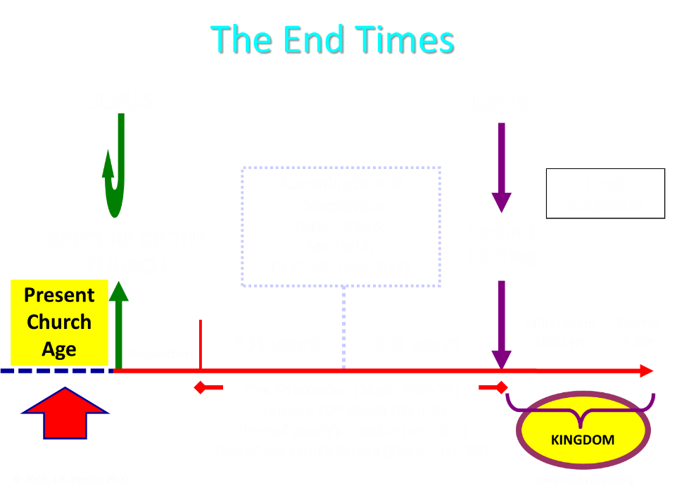

Slide 94
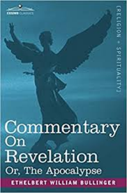
Bullinger (1909)
Commentary on Revelation, 577
“And Babylon, though fallen gradually, and very low, has never suffered such a destruction. There is only one conclusion, that in the interval of, say some 30 or more years between the removal of the church and the last "week "of Daniel's prophecy, it will be revived and exceed all its former magnificence.”

Slide 95
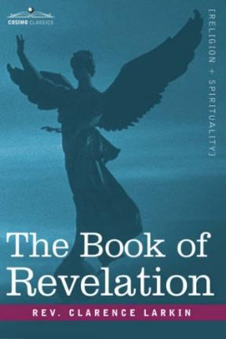
Larkin (1919)
The Book of Revelation, 162
“But I hear the protest, how can you say we be expecting Jesus to come at "any moment," if the city of Babylon must be rebuilt before He can come? There is not a word in Scripture that says that Jesus cannot come and take away His Church until Babylon is rebuilt. The Church may be taken out of the world 25 or even 50 years before that.”

Slide 96
How Could Babylon Be Built So Quickly?
Imminency?
Chicago fire
Dubai
Neom, Saudi Arabia
Harbor?

Slide 97
Larkin (1919)
The Book of Revelation, 162
“The rapid growth of modern cities is one of the remarkable phenomena of the times. Since 1880 more than 500 cities have been built in America. Less than 100 years ago the site of the City of Chicago was but a swampy expanse at the mouth of the Chicago river. Now it has been transformed into a beautiful Metropolis, stretching 25 miles along the shore of Lake Michigan, with 5000 miles of streets, many of them beautiful boulevards 120 feet wide. In 1840 Chicago had only 4470 inhabitants, today the population is over 3,000,000. Once the Capitalists of the world are ready the revived City of Babylon will spring up in a few years.”

Slide 98
How Could Babylon Be Built So Quickly?
Imminency?
Chicago fire
Dubai
Neom, Saudi Arabia
Harbor?

Slide 100
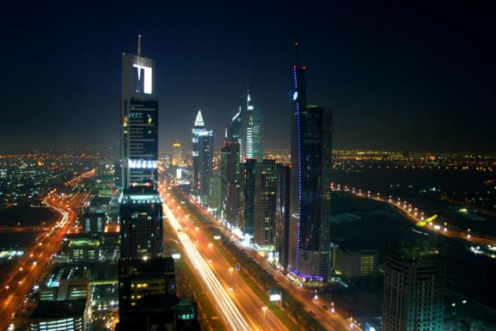
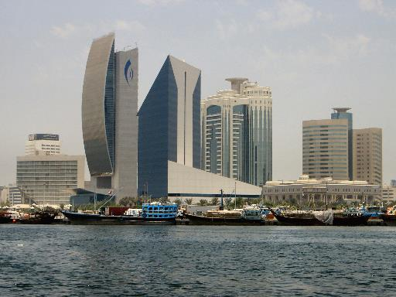

Slide 101
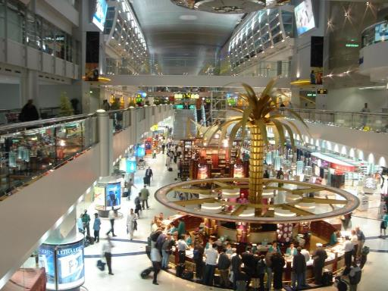
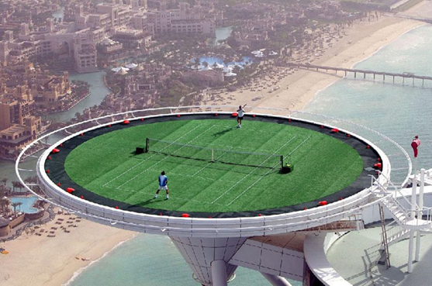
Dubai

Slide 102
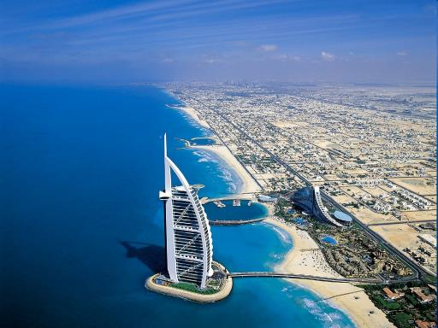
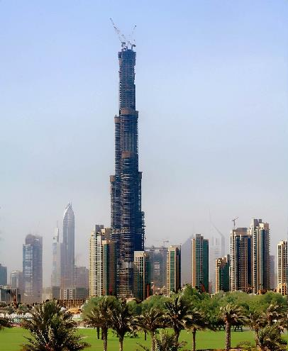

Slide 103
How Could Babylon Be Built So Quickly?
Imminency?
Chicago fire
Dubai
Neom, Saudi Arabia
Harbor?

Slide 104
A Prince’s $500 Billion Desert Dream: Flying Cars, Robot Dinosaurs and a Giant Artificial Moon
“Saudi Arabia’s crown prince turned to U.S. consultants for help imagining a massive new city-state in a barren section of his kingdom. What emerged was a Jetsons-style world of automation. SHARMA, Saudi Arabia—This seaside corner of northwest Saudi Arabia is so barren that the only abundant resources a group of consultants could identify were sunlight and ‘unlimited access to salt water.’ But Saudi crown prince Mohammed bin Salman didn’t see a wasteland when he landed in his helicopter here a few years ago. He saw the future — and hatched a plan for a $500 billion city-state to cover 10,000 square miles of rocky desert and empty coastline to attract the ‘world’s greatest minds and best talents’ to the world’s best paying jobs in the world’s most livable city.”
Justin Scheck, Rory Jones, and Summer Sawww.wsj.comid, “A Prince’s $500 Billion Dollar Desert Dream,” online:, 25 July 2019.

Slide 105
How Could Babylon Be Built So Quickly?
Imminency?
Chicago fire
Dubai
Neom, Saudi Arabia
Harbor?

Slide 106
Babylon Needs a Harbor?
“It was unacceptable to Saddam [Hussein] that a country as great as Iraq did not have a long coastline. Over and over he talked about the necessity of building a Navy and becoming a seafaring power. Iraq’s isolation from the sea was a cruel accident of history, he believed, and one that had to be rectified—a theme he continued to dwell on after his invasion of Kuwait.”
Elaine Sciolino, The Outlaw State: Saddam Hussein’s Quest for Power and the Gulf Crisis (New York: John Wiley & Sons, Inc., 1991), 191-192.

Slide 107
Babylon Needs a Harbor?
“Actually, the Tigris and Euphrates Rivers converge in southern Iraq and enter the Persian Gulf in Iraqi territory. The problem has been that Iran and Kuwait squeeze Iraq into a bottleneck at the mouth of the rivers and Iraq’s attempts to forge a harbor there have been thwarted by the hostile refusals of those two countries. But suppose international pressures were brought to bear upon Iran to allow Iraq access to the Shatt al-Arab waterway all the way to Basra and cooperation could be coerced from Kuwait to open up the area around its little island of Bubiyan and Warba.”
Dan Hayden, Iraq: In the Crosshairs of Destiny: What the Bible Says About the Future of Iraq (Altamonte Springs, FL: Advantage Books, 2008), 115.

Slide 108
Babylon Needs a Harbor?
“A commercial port and harbor for ships could become a reality for Babylon in a relatively short period of time. With modern dredging equipment, a deep channel waterway could be opened from the Persian Gulf all the way to Babylon. With its location on the Euphrates River, ships and sailors could indeed have access to this future queen of modern cities. The Antichrist ruler, with his political and economic power and global influence, could easily make that happen. So, as you can see, a harbor in Babylon is not at all out of the question.”
Dan Hayden, Iraq: In the Crosshairs of Destiny: What the Bible Says About the Future of Iraq (Altamonte Springs, FL: Advantage Books, 2008), 115.

Slide 109
Conclusion

Slide 110
Ecclesiastes 1:9
“That which has been is that which will be, And that which has been done is that which will be done. So there is nothing new under the sun.”

Slide 111
Seven Areas
Tower of Babel (Gen. 1–11)
Prophecies of Isaiah (13–14) & Jeremiah (50–51)
Prophecy of Zechariah (Zech. 5:5-11)
Kings of the East (Rev. 9:14; 16:12)
End-Time Harlot (Rev. 17–18)
Inadequate Theories
Current Events

