Slide 1
Law and Grace: An Overview Jim McGowan, Th.D. Sugar Land Bible Church 09-22-2019
…but grace and truth were realized through Jesus Christ - John 1:17
For the Law was given through Moses…
Special thanks to Dr. Vern Peterman for access to his insights and resources.

Slide 2
Session 23 Outline
Review
Purpose, Aim, and Objective
Session 22
Firsts & Beginnings in Christ’s Ministry – Matt. 4 – Part 2
General Information
Comments and Commentary
Concluding Observations

Slide 3
OUR PURPOSE, AIM AND OBJECTIVE
Law and Grace
…is to Compare and Contrast Law and Grace so as to properly understand these two important themes and how they are related to the life of the New Testament Believer.

Slide 4
C. I. SCOFIELD, D. D.
The Grace of God, The Fundamentals Vol. 3, Chapter VII, p. 98
We have, most of us, been reared and now live under the influence of Galatianism. Protestant theology, alas, is for the most part, thoroughly Galatianized, in that neither law nor grace are given their distinct and separated places, as in the counsels of God, but are mingled together in one incoherent system.
The law is no longer, as in the Divine intent, a ministration of death (2 Cor. 3:7), of cursing (Gal. 3:10), of conviction (Rom. 3:19), because we are taught that we must try to keep it, and that by Divine help we may.
Nor, on the other hand, does grace bring us blessed deliverance from the dominion of sin, for we are kept under the law as a rule of life despite the plain declaration, “Sin shall not have dominion over you: for ye are not under the law, but under grace” (Rom. 6:14). (emphasis mine)

Slide 5
William R. Newell
Romans Verse-by-Verse (p. 274).
Grand Rapids, MI: Christian Classics Ethereal Library.
It is because Reformed theology has kept us Gentiles under the Law,—if not as a means of righteousness, then as “a rule of life,” that all the trouble has arisen. The Law is no more a rule of life than it is a means of righteousness. Walking in the Spirit has now taken the place of walking by ordinances. God has another principle under which He has put his saints: “Ye are not under law, but, under grace!” (italics mine)

Slide 6
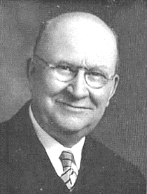
Henry Ironside
The Continual Burnt Offering: Daily Meditations on the Word of God (p. 265). Neptune, NJ: Loizeaux Brothers.
In Romans 7 we have a man renewed by the Spirit of God, but struggling under law, hoping thereby to subdue or find deliverance from the power of the old Adamic nature. In chapter 8 we have God’s way of deliverance through the death and resurrection of Christ with which the believer is identified before God. The chapter begins with “no condemnation” and ends with “no separation.” All who are in Christ Jesus are accepted in the Beloved and as free from every charge of guilt as He is Himself. He paid our penalty on the cross. Now we are linked up with Him in resurrection, not under law but under grace.

Slide 7
Session 23 Outline
Review
Purpose, Aim, and Objective
Session 22
Firsts & Beginnings in Christ’s Ministry – Matt. 4 – Part 2
General Information
Comments and Commentary
Concluding Observations

Slide 8
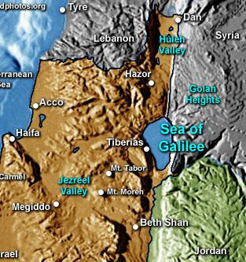
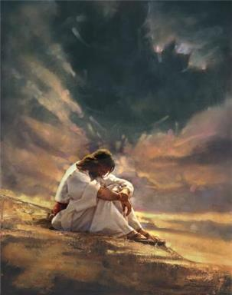
Law and Grace: Review Session 22
Temptations and Beginnings
Matthew 4:1-25
Chapter 4 of the Gospel of Matthew has two main parts:
Verses 1-11 tell of Christ’s temptation by Satan during a time of fasting.
Verses 12-25 tell of Christ beginning His public ministry, by locating Himself in northern Galilee, selecting disciples, and His healing ministry.

Slide 9
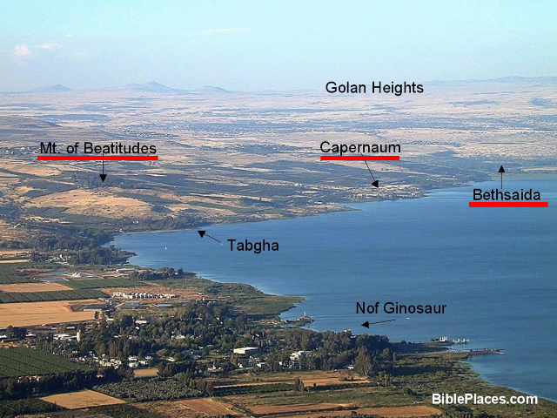
Law and Grace: Review Session 22
Northwest Portion of the Sea of Galilee

Slide 10
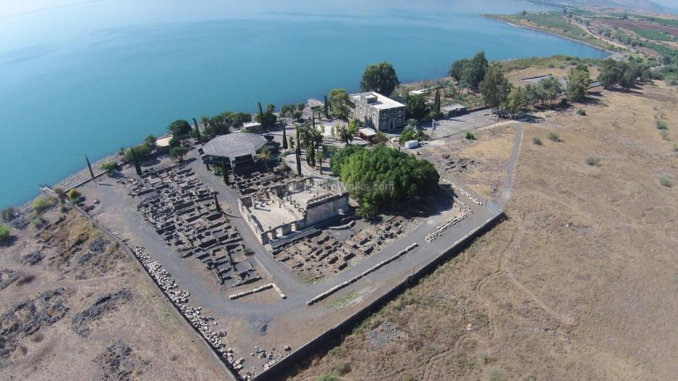
Law and Grace: Review Session 22
Capernaum Archaeological Park

Slide 11
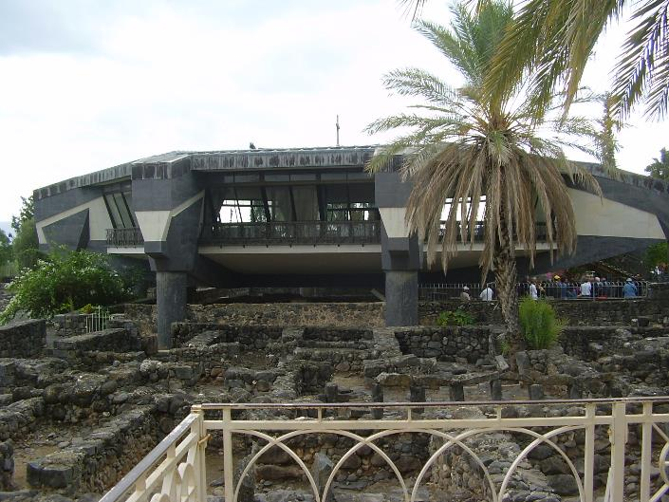
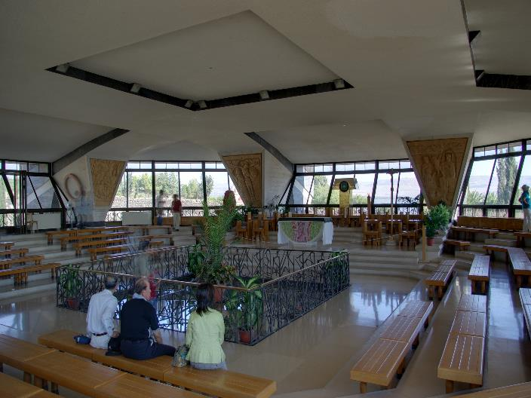
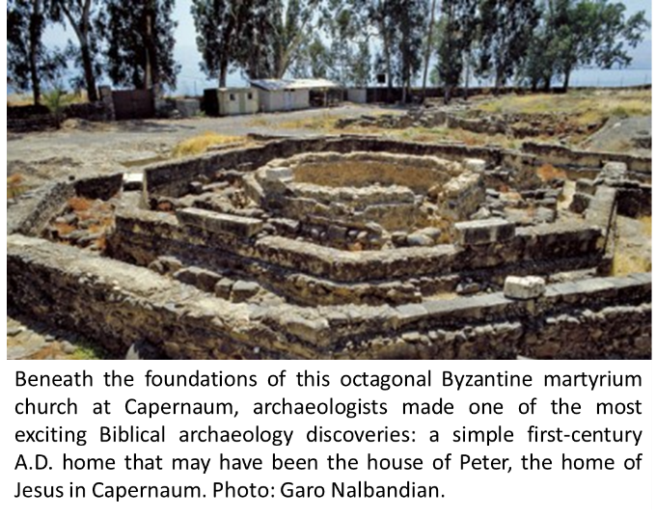
Law and Grace: Session 17
Capernaum Archaeological Park
Peter’s Home?

Slide 12
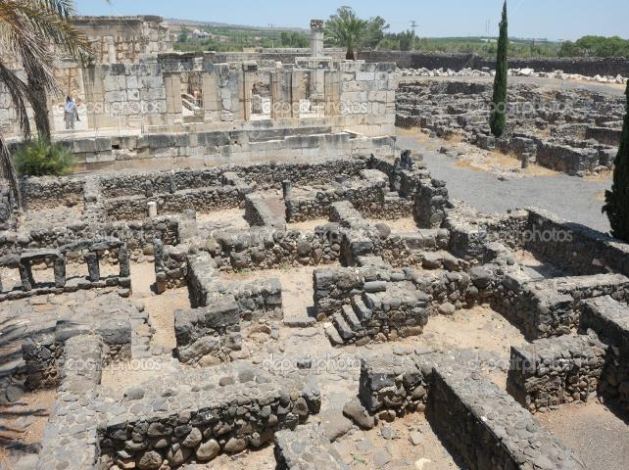
Law and Grace: Review Session 22
Capernaum Archaeological Park

Slide 13
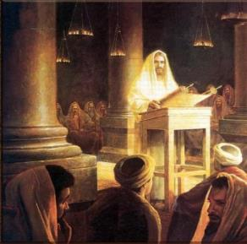
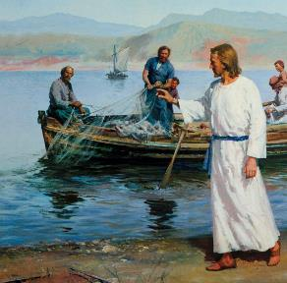
Law and Grace: Review Session 22
Temptations and Beginnings
Matthew 4:1-25
This ‘introduction to ministry’ in Matthew 4 concerns the people of Israel, the land of Israel, and the Law of Moses. (cf. Mark 1:12-13; Luke 4:1-13 for parallel accounts of the events recorded in Matthew 4:1-11.)

Slide 14
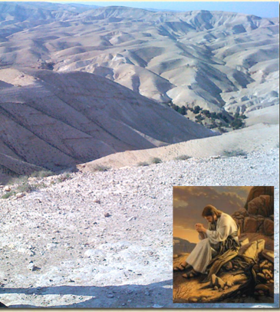
Law and Grace: Review Session 22
Christ was led into the wilderness
Matthew 4:1-11
Christ did not just encounter Satan in the wilderness by accident – the Holy Spirit led Him there.

Slide 15
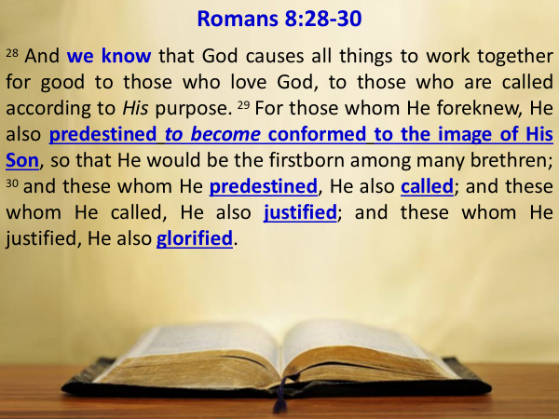
Law and Grace: Review Session 22
Christ was led into the wilderness
Matthew 4:1-11
Never forget that:
Satan will be held responsible for what he has done and will do (cf. Matt. 25:41).
Satan does not and cannot do anything that is out of God’s control.
Satan cannot thwart God’s purposes (cf. Rom. 8:28-30).

Slide 16
Law and Grace: Review Session 22
Christ’s temptation
Matthew 4:1-11 (cf. Phil. 2:5-11)
Philippians 2:5–11
⁵ Have this attitude in yourselves which was also in Christ Jesus, ⁶ who, although He existed in the form of God, did not regard equality with God a thing to be grasped, ⁷ but emptied Himself, taking the form of a bond-servant, and being made in the likeness of men. ⁸ Being found in appearance as a man, He humbled Himself by becoming obedient to the point of death, even death on a cross. ⁹ For this reason also, God highly exalted Him, and bestowed on Him the name which is above every name, ¹⁰ so that at the name of Jesus every knee will bow, of those who are in heaven and on earth and under the earth, ¹¹ and that every tongue will confess that Jesus Christ is Lord, to the glory of God the Father.

Slide 17
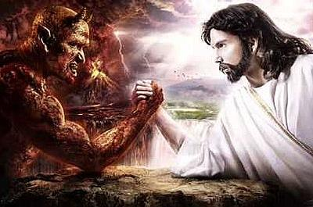
Law and Grace: Review Session 22
Christ’s temptation
Matthew 4:1-11

Slide 18
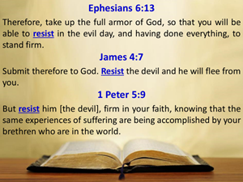
Law and Grace: Review Session 22
Christ’s temptation
Matthew 4:1-11
RESIST!
Eph. 6:13; Jam. 4:7; 1 Pet. 5:9

Slide 19
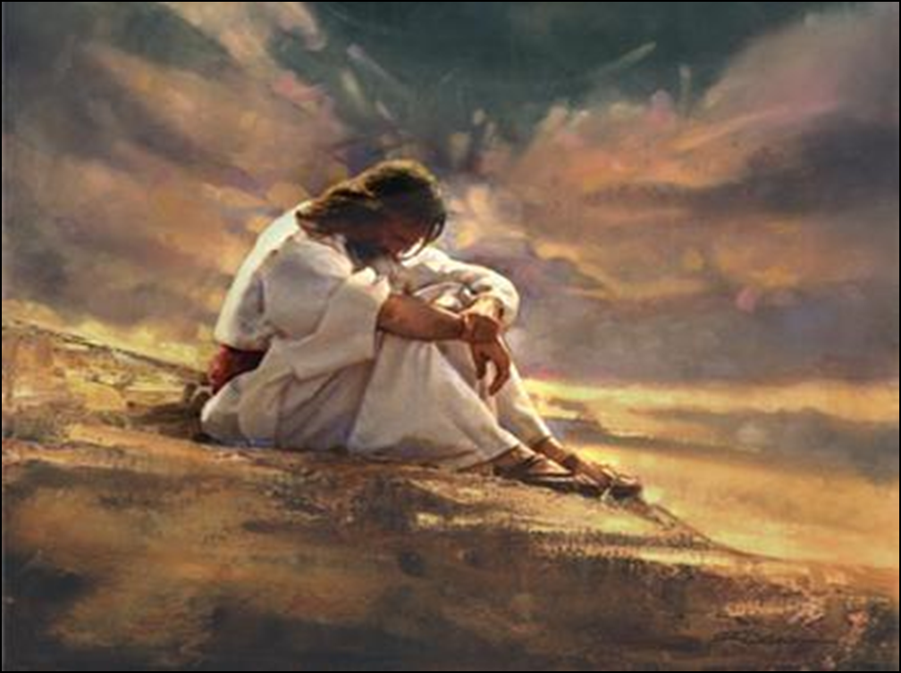
Law and Grace: Review Session 22
Was Christ able not to sin or not able to sin?
Matthew 4:1-11
Both – Christ was and is fully God and fully man.
Christ had a human body just as we have with all its vulnerabilities, but He did not have a Sin Nature to which Satan could appeal…we do!
Hebrews 4:15
For we do not have a high priest who cannot sympathize with our weaknesses, but One who has been tempted in all things as we are, yet without sin.

Slide 20
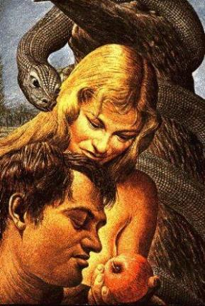
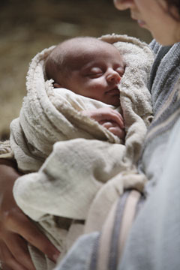
Law and Grace: Review Session 22
Adam vs. Christ
Matthew 4:1-11
Adam was created innocent without a Sin Nature, but still had the ability to choose contrary to God’s declared will.
Christ was not created! He was innocent, had no Sin Nature, but was and is also fundamentally righteous.

Slide 21
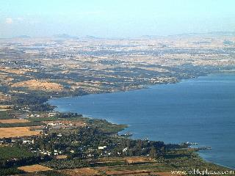
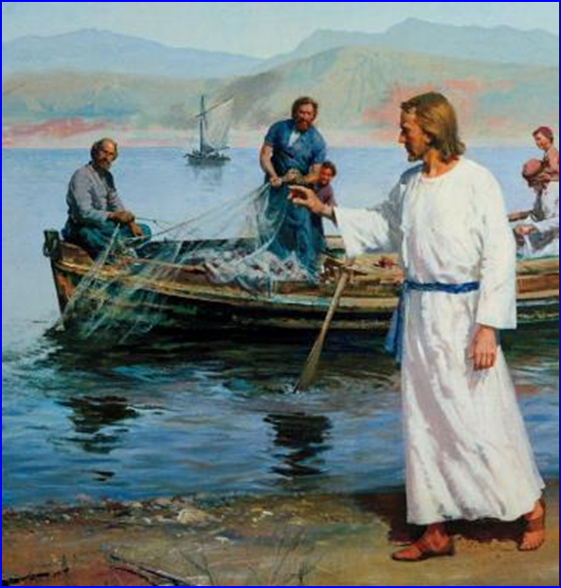
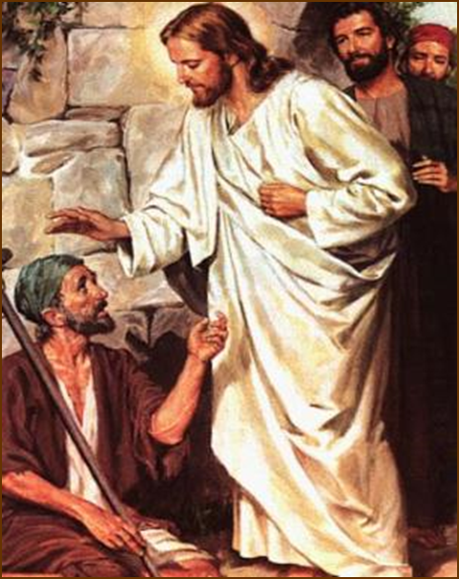
Law and Grace: Review Session 22
Christ’s Public Ministry
Matthew 4:12-25
As Christ began His public ministry:
He located Himself in the northern part of the sea of Galilee (v.12).
He selected disciples (vv. 18-22).
He performed miracles of healing (vv. 23-25).
Jesus also proclaimed the kingdom at hand (v. 17).
Selecting disciples meant that Jesus was beginning His ministry as a rabbi (a Jewish teacher).

Slide 22
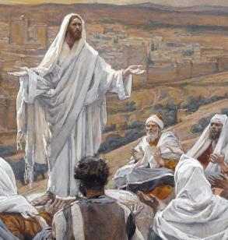
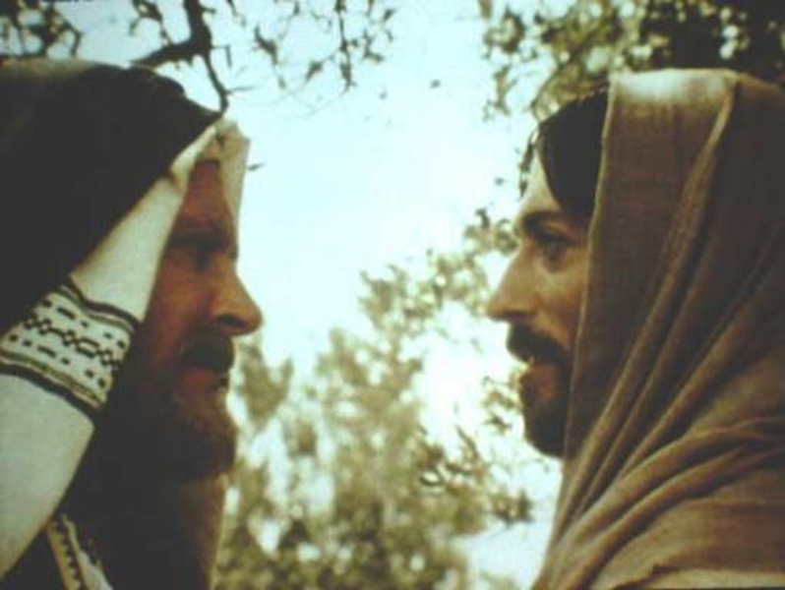
Law and Grace: Review Session 22
Jesus a Typical and Unique Rabbi
Matthew 4:12-25
Understanding that Jesus was both a typical and also a very unique rabbi and is critical to our study.
Jesus tells Nicodemus, “You must be born again”. However, according to Pharisaic tradition if you were a rabbi you were already ‘born again’!

Slide 23
Law and Grace: Review Session 22
BORN AGAIN
Type of Birth | Reference
1. Proselyte Conversion | Encyclopedia Judaica: Vol. 13, Jewish Encyclopedia: Vol. 10, pg. 223; Life and Times of Jesus the Messiah: Vol. 1, pg. 384; Nicodemus, A Rabbi’s Quest, Ariel Ministries, Manuscript #16, pg. 4 (Logos)
2. Crowned King | Life and Times of Jesus the Messiah: Vol. 1, pg. 384. Yalkut on 1 Sam. 13; Nicodemus, A Rabbi’s Quest, Ariel Ministries, Manuscript #16, pg. 4 (Logos)
3. Bar Mitzvah | Nicodemus, A Rabbi’s Quest, Ariel Ministries, Manuscript #16, pg. 4 (Logos)
4. Marriage | Life and Times of Jesus the Messiah, Vol. 1, pg. 384 (Logos); Nicodemus, A Rabbi’s Quest, Ariel Ministries, Manuscript #16, pg. 4 (Logos)
5. Rabbinic Ordination | Peninim on the Torah, pg. 233; Nicodemus, A Rabbi’s Quest, Ariel Ministries, Manuscript #16, pg. 5 (Logos)
6. Head of a Rabbinic Academy (Yeshiva) | Life and Times of Jesus the Messiah, Vol. 1, pg. 384; (Logos); Nicodemus, A Rabbi’s Quest, Ariel Ministries, Manuscript #16, pg. 5 (Logos)
Born of the Spirit | John 3:7
www.hadavar.org/getting-to-know-god/you-must-be-born-again/ (lists 8)

Slide 24
Law and Grace: Review Session 21

Slide 25
Session 23 Outline
Review
Purpose, Aim, and Objective
Session 22
Firsts & Beginnings in Christ’s Ministry – Matt. 4 – Part 2
General Information
Comments and Commentary
Concluding Observations

Slide 26
Matthew 4:12-25
¹² Now when Jesus heard that John had been taken into custody, He withdrew into Galilee; ¹³ and leaving Nazareth, He came and settled in Capernaum, which is by the sea, in the region of Zebulun and Naphtali. ¹⁴ This was to fulfill what was spoken through Isaiah the prophet: ¹⁵ “The land of Zebulun and the land of Naphtali, By the way of the sea, beyond the Jordan, Galilee of the Gentiles— ¹⁶ “The people who were sitting in darkness saw a great Light, And those who were sitting in the land and shadow of death, Upon them a Light dawned.” ¹⁷ From that time Jesus began to preach and say, …

Slide 27
Matthew 4:12-25
…“Repent, for the kingdom of heaven is at hand.” ¹⁸ Now as Jesus was walking by the Sea of Galilee, He saw two brothers, Simon who was called Peter, and Andrew his brother, casting a net into the sea; for they were fishermen. ¹⁹ And He said to them, “Follow Me, and I will make you fishers of men.” ²⁰ Immediately they left their nets and followed Him. ²¹ Going on from there He saw two other brothers, James the son of Zebedee, and John his brother, in the boat with Zebedee their father, mending their nets; and He called them. ²² Immediately they left the boat and their father, and…

Slide 28
Matthew 4:12-25
…followed Him. ²³ Jesus was going throughout all Galilee, teaching in their synagogues and proclaiming the gospel of the kingdom, and healing every kind of disease and every kind of sickness among the people. ²⁴ The news about Him spread throughout all Syria; and they brought to Him all who were ill, those suffering with various diseases and pains, demoniacs, epileptics, paralytics; and He healed them. ²⁵ Large crowds followed Him from Galilee and the Decapolis and Jerusalem and Judea and from beyond the Jordan.

Slide 29
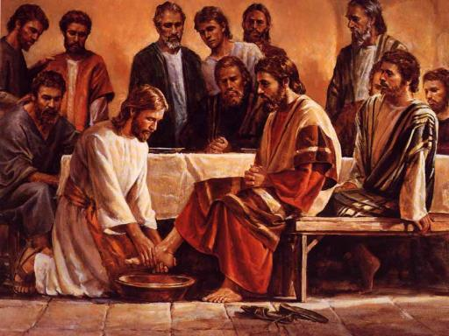
Law and Grace: Session 22
Jesus a Typical and Unique Rabbi
Matthew 4:12-25
A rabbi was not permitted to ask his disciples to wash his feet.

Slide 30
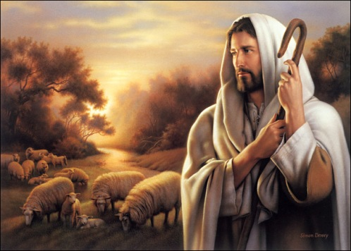
Law and Grace: Session 22
Jesus a Typical and Unique Rabbi
Matthew 4:12-25
"I AM the good shepherd; the good shepherd lays down His life for the sheep." John 10:11

Slide 31
Exodus 3:13–15
¹³ Then Moses said to God, “Behold, I am going to the sons of Israel, and I will say to them, ‘The God of your fathers has sent me to you.’ Now they may say to me, ‘What is His name?’ What shall I say to them?” ¹⁴ God said to Moses, “I AM WHO I AM”; and He said, “Thus you shall say to the sons of Israel, ‘I AM has sent me to you.’ ” ¹⁵ God, furthermore, said to Moses, “Thus you shall say to the sons of Israel, ‘The Lord, the God of your fathers, the God of Abraham, the God of Isaac, and the God of Jacob, has sent me to you.’ This is My name forever, and this is My memorial-name to all generations.

Slide 32
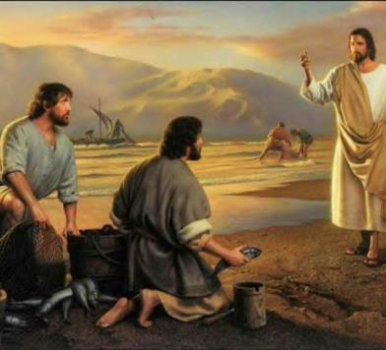
Law and Grace: Session 22
Jesus the Rabbi (teacher)
Matthew 4:12-25
As a rabbi, Jesus would seek and also select His disciples.
The gospels seem to say that all of the disciples followed Him right away, but that was done after Christ presented Himself as a rabbi.

Slide 33
Law and Grace: Session 22
Jesus the Rabbi (teacher)
Matthew 4:12-25
As we proceed with our ongoing study of Law & Grace, we will continue examining what it meant for Jesus to be a rabbi among the people, in the land of Israel.
So, the disciples did respond right away to Jesus’ invitation but only after he had presented himself as a rabbi, in the expected manner.

Slide 34
Session 23 Outline
Review
Purpose, Aim, and Objective
Session 22
Firsts & Beginnings in Christ’s Ministry – Matt. 4 – Part 2
General Information
Comments and Commentary
Concluding Observations

Slide 35
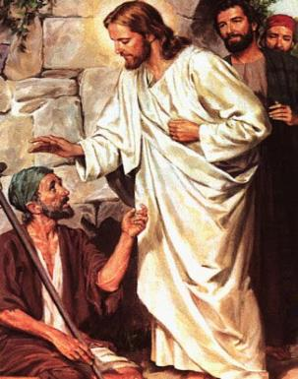
Law and Grace: Session 22
Why the healing miracles?
Matthew 4:12-25
Jesus performed miracles of healing as the validation and verification that He was indeed the long-promised Messiah.

Slide 36
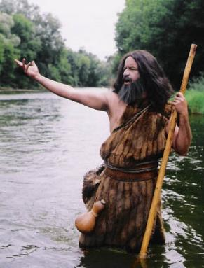
Law and Grace: Session 22
Why the healing miracles?
Matthew 4:12-25
Later in Matthew, after John the Baptist is jailed by Herod the tetrarch, John asks if Jesus is the promised One.
Jesus tells them to testify about the things that He has been doing: healing and proclaiming.

Slide 37
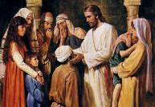
Matthew 11:2-6
² Now when John, while imprisoned, heard of the works of Christ, he sent word by his disciples ³ and said to Him, “Are You the Expected One, or shall we look for someone else?” ⁴ Jesus answered and said to them, “Go and report to John what you hear and see: ⁵ the blind receive sight and the lame walk, the lepers are cleansed and the deaf hear, the dead are raised up, and the poor have the gospel preached to them. ⁶ “And blessed is he who does not take offense at Me.” (cf. Isaiah 35:5; 42:18; 57:18,19; 61:1; Luke 4:16-21)

Slide 38
Law and Grace: Session 22
An insight into Christ’s 1st Coming
Matthew 4:12-25
While Christ was the steward who initiated the Church through the Apostles in His 1st Coming, His three years of ministry are often misunderstood by many Christians.

Slide 39
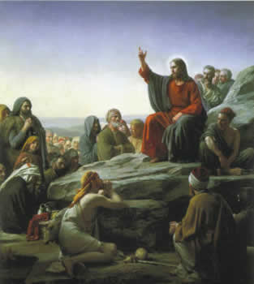
Law and Grace: Session 22
An insight into Christ’s 1st Coming
Matthew 4:12-25
In His 1st Coming Christ was sent to Earth to be born a Jew, in the land of Israel, to appeal only to the Jews, telling them that they should receive Him as their King and Messiah, and declaring TO THEM the Gospel of the Kingdom of God.

Slide 40
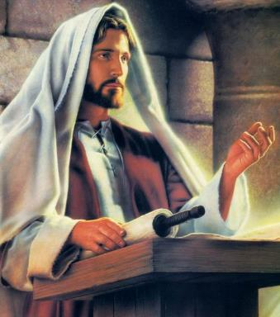
Law and Grace: Session 22
Not for we who are in the church?
Matthew 4:12-25
The Gospel of the Kingdom was the message of good news delivered to the Israelites, in the land of Israel, about Jesus, the King of Israel (Matt. 2:2 4:23; 9:35; 27:11).

Slide 41
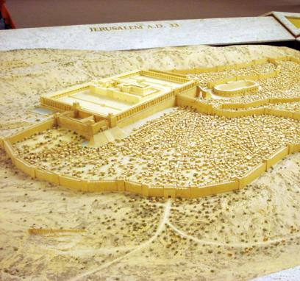
Law and Grace: Session 22
Not for we who are in the church?
Matthew 4:12-25
The Gospel of the Kingdom was Jesus telling the Nation of Israel that if she would acknowledge Him as her Messiah, the prophesied kingdom would come to the earth and Messiah would rule from Jerusalem, the city of the Great King (Matt. 5:35).

Slide 42
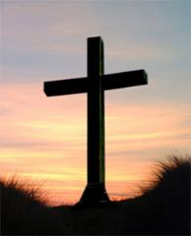
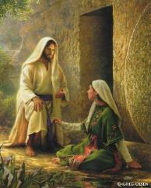
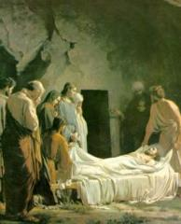
Law and Grace: Session 22
The Gospel of Substitution
Matthew 4:12-25
The Gospel of Substitution declares that anyone, (Jew or Gentile), believing that Christ, the Son of God, died for their sins, was buried, and rose again, for them, will be saved eternally (cf. 1 Cor. 15:1-11; Isa. 53). This is the Good News that we are to share with the lost, not the Gospel of the Kingdom!

Slide 43
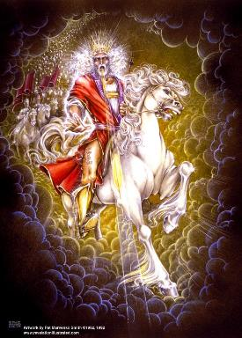
Law and Grace: Session 22
The Coming Kingdom
Matthew 4:12-25
The Church’s place in the coming Millennial Kingdom will be as the Bride of Christ, coming with Him to rule and reign.

Slide 44
Session 23 Outline
Review
Purpose, Aim, and Objective
Session 22
Firsts & Beginnings in Christ’s Ministry – Matt. 4 – Part 2
General Information
Comments and Commentary
Concluding Observations

Slide 45
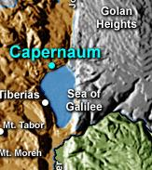
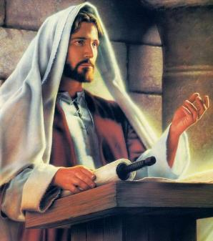
Law and Grace: Session 22
So in Jesus’ initial ministry…
Matthew 4:1-25
So in Jesus’ initial ministry, He settled in Capernaum in northern Galilee, teaching in the synagogues around Galilee, preaching the kingdom, and selecting disciples to follow Him.

Slide 46
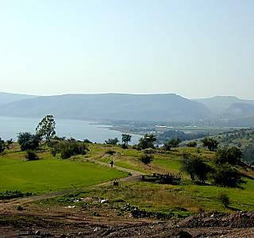
Law and Grace: Session 22
So in Jesus’ initial ministry…
Matthew 4:1-25
People came from areas to the north (Syria), from around Galilee, and from the southern part of Israel as well.

Slide 47
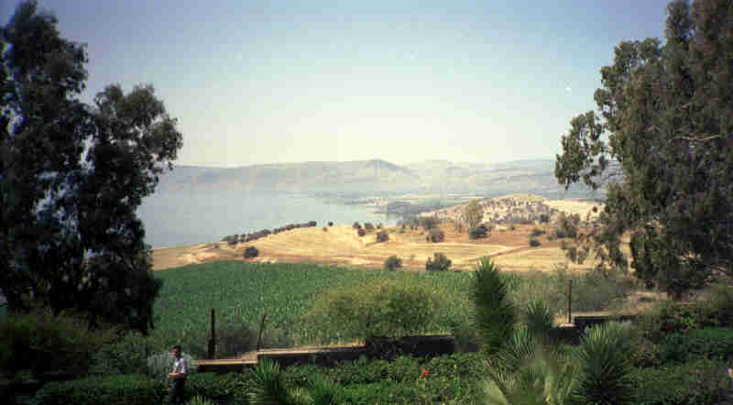
Law and Grace: Session 22
In Our Next Session - The Sermon on the Mount
Matthew 5-7

Slide 48
Law and Grace: An Overview Jim McGowan, Th.D. Sugar Land Bible Church 09-22-2019
…but grace and truth were realized through Jesus Christ - John 1:17
For the Law was given through Moses…
Special thanks to Dr. Vern Peterman for access to his insights and resources.

