Slide 1
SATANOLOGY
Dr. Andy Woods
Senior Pastor – Sugar Land Bible Church
President – Chafer Theological Seminary

Slide 2
Preview of Angelology
Good angels
Satanology
Demonology
Gen. 6:1-4 controversy

Slide 3
Preview
Existence
Personhood
Names and titles
Original state and first sin
Works

Slide 4
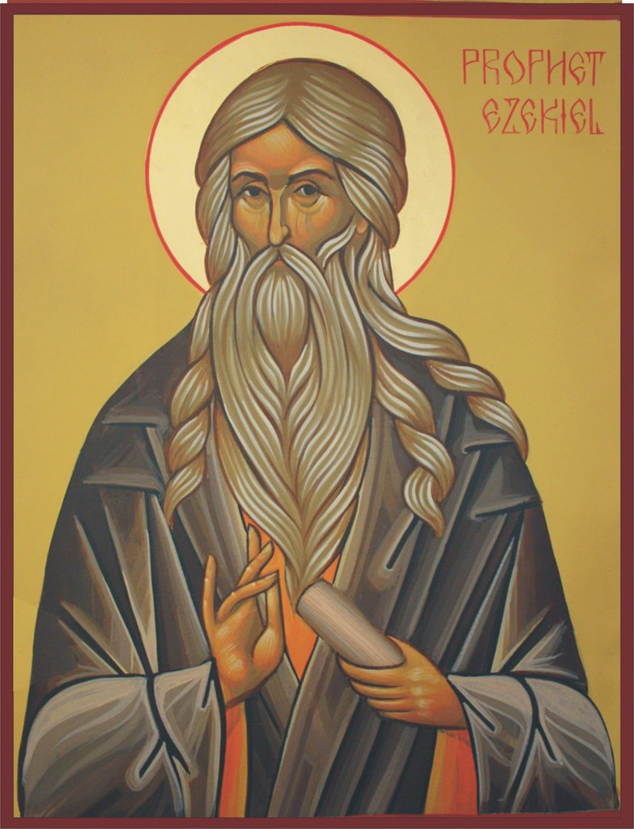
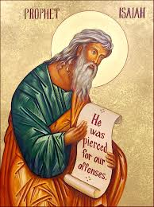
Satan’s Original State and First Sin
Ezekiel 28:12-17
Isaiah 14:12-15

Slide 5
Original State and First Sin (cont’d)
Time of Satan’s fall
In eternity past
In between Gen. 1:1-2 (gap theory?)
After Gen 1:31 but before Gen 3

Slide 6
Gap Theory Preview
Definition of the Gap Theory
Evidence Favoring the Gap Theory
Response to Evidence Favoring the Gap Theory
Remaining Problems with the Gap Theory
Correct View of Gen. 1:1-2

Slide 7
Gap Theory Preview
Definition of the Gap Theory
Evidence Favoring the Gap Theory
Response to Evidence Favoring the Gap Theory
Remaining Problems with the Gap Theory
Correct View of Gen. 1:1-2

Slide 8
Genesis 1:1-3
“¹ In the beginning God created the heavens and the earth. ² The earth was formless and void, and darkness was over the surface of the deep, and the Spirit of God was moving over the surface of the waters. ³ Then God said, ‘Let there be light’; and there was light.”

Slide 9
Gap Theory?
Original creation brought into existence (1:1)
Billions of years & Satan's fall in between verses 1 & 2
Chaotic conditions and fossil record (1:2)
Re-creation or Renovation (1:3-31)

Slide 10
Gap Theory Preview
Definition of the Gap Theory
Evidence Favoring the Gap Theory
Response to Evidence Favoring the Gap Theory
Remaining Problems with the Gap Theory
Correct View of Gen. 1:1-2

Slide 11
Gap Theory Preview
Definition of the Gap Theory
Evidence Favoring the Gap Theory
Response to Evidence Favoring the Gap Theory
Remaining Problems with the Gap Theory
Correct View of Gen. 1:1-2

Slide 12
The Gap Theory
NO. | Gen 1 | Evidence | Response
1. | vs. 2 | Conjunction = “but” | Conjunction = “and”
2. | vs. 2 | Hāyāh = “became” | Hāyāh = “was”
3. | vs. 2 | Tohu & Bohu = judgment | Tohu & Bohu = incompletion
4. | vs. 2 | Darkness = evil | Darkness = absence of light
5. | vs. 1, 3 | Bara & āsāh distinction | Bara & āsāh overlap
6. | vs. 2 | Lo tohu (Isa. 45:18) = God did not create the Earth desolate | Lo tohu (Isa. 45:18) = Original creation was good
7. | vs. 2 | Spirit = brooding (Eph. 4:30) | Spirit = moving

Slide 13
The Gap Theory
NO. | Scripture | Evidence | Response
8. | Gen. 1:28 | Male’ = “ to replenish” | Male’ = “to fill”
9. | Isa. 24:1 | The Earth was formerly in ruin | Context = future judgment
10. | Ezek. 28:13-14 | Satan was in a mineral garden | Context = heaven
11. | Gen. 1‒3 | Not enough time for angelic rebellion between Gen. 1:31 & 3:1 | Angelic rebellion & judgment = instantaneous
12. |  | Explanation of fossil record | Similarities between fossils and current counter parts
13. | Isa. 61:1-2 | Prophetic gaps are common | Genre confusion

Slide 14
The Gap Theory
NO. | Scripture | Evidence | Response
8. | Gen. 1:28 | Male’ = “ to replenish” | Male’ = “to fill”
9. | Isa. 24:1 | The Earth was formerly in ruin | Context = future judgment
10. | Ezek. 28:13-14 | Satan was in a mineral garden | Context = heaven
11. | Gen. 1‒3 | Not enough time for angelic rebellion between Gen. 1:31 & 3:1 | Angelic rebellion & judgment = instantaneous
12. |  | Explanation of fossil record | Similarities between fossils and current counter parts
13. | Isa. 61:1-2 | Prophetic gaps are common | Genre confusion

Slide 15
The Gap Theory
NO. | Scripture | Evidence | Response
8. | Gen. 1:28 | Male’ = “ to replenish” | Male’ = “to fill”
9. | Isa. 24:1 | The Earth was formerly in ruin | Context = future judgment
10. | Ezek. 28:13-14 | Satan was in a mineral garden | Context = heaven
11. | Gen. 1‒3 | Not enough time for angelic rebellion between Gen. 1:31 & 3:1 | Angelic rebellion & judgment = instantaneous
12. |  | Explanation of fossil record | Similarities between fossils and current counter parts
13. | Isa. 61:1-2 | Prophetic gaps are common | Genre confusion

Slide 16
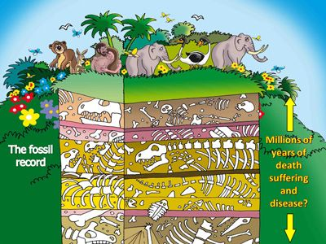

Slide 17
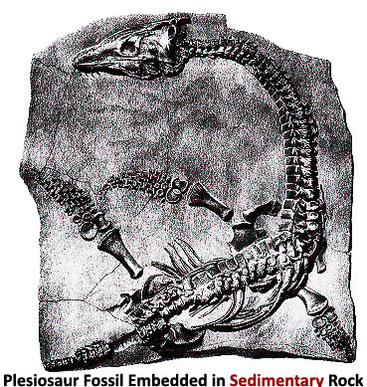

Slide 18
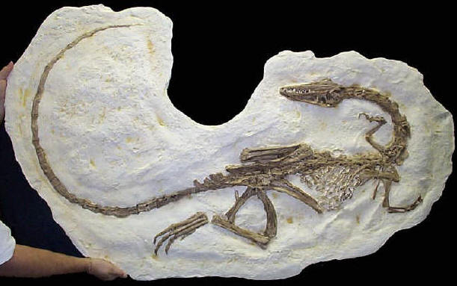

Slide 19
The Gap Theory
NO. | Scripture | Evidence | Response
8. | Gen. 1:28 | Male’ = “ to replenish” | Male’ = “to fill”
9. | Isa. 24:1 | The Earth was formerly in ruin | Context = future judgment
10. | Ezek. 28:13-14 | Satan was in a mineral garden | Context = heaven
11. | Gen. 1‒3 | Not enough time for angelic rebellion between Gen. 1:31 & 3:1 | Angelic rebellion & judgment = instantaneous
12. |  | Explanation of fossil record | Similarities between fossils and current counter parts
13. | Isa. 61:1-2 | Prophetic gaps are common | Genre confusion

Slide 21
Isaiah 9:6-7
⁶ For a child will be born to us, a son will be given to us; And the government will rest on His shoulders; And His name will be called Wonderful Counselor, Mighty God, Eternal Father, Prince of Peace.⁷ There will be no end to the increase of His government or of peace, On the throne of David and over his kingdom, To establish it and to uphold it with justice and righteousness From then on and forevermore. The zeal of the Lord of hosts will accomplish this.

Slide 22
Genre Confusion
Genesis 1:1-2 | Isaiah 9:6-7
Historical | Eschatological
Narrative | Prophetic
Looking backward | Looking forward

Slide 23
Gap Theory Preview
Definition of the Gap Theory
Evidence Favoring the Gap Theory
Response to Evidence Favoring the Gap Theory
Remaining Problems with the Gap Theory
Correct View of Gen. 1:1-2

Slide 24
4. Remaining Gap Theory Problems
Only one verse describing original creation?
Lack of information on what transpired in the gap
No supporting verses describing the angelic rebellion & judgment in the gap
Late 19th century accommodation attempt to explain the fossil record
God created (rather than renovated) during the creation week (Gen. 2:3-4; Exod. 20:8-11)

Slide 25
4. Remaining Gap Theory Problems
Only one verse describing original creation?
Lack of information on what transpired in the gap
No supporting verses describing the angelic rebellion & judgment in the gap
Late 19th century accommodation attempt to explain the fossil record
God created (rather than renovated) during the creation week (Gen. 2:3-4; Exod. 20:8-11)

Slide 26
4. Remaining Gap Theory Problems
Only one verse describing original creation?
Lack of information on what transpired in the gap
No supporting verses describing the angelic rebellion & judgment in the gap
Late 19th century accommodation attempt to explain the fossil record
God created (rather than renovated) during the creation week (Gen. 2:3-4; Exod. 20:8-11)

Slide 27
4. Remaining Gap Theory Problems
Only one verse describing original creation?
Lack of information on what transpired in the gap
No supporting verses describing the angelic rebellion & judgment in the gap
Late 19th century accommodation attempt to explain the fossil record
God created (rather than renovated) during the creation week (Gen. 2:3-4; Exod. 20:8-11)

Slide 28
4. Remaining Gap Theory Problems
Only one verse describing original creation?
Lack of information on what transpired in the gap
No supporting verses describing the angelic rebellion & judgment in the gap
Late 19th century accommodation attempt to explain the fossil record
God created (rather than renovated) during the creation week (Gen. 2:3-4; Exod. 20:8-11)

Slide 29
Two Views on Harmonization of Early Genesis with “Science”
Accommodation Model
Definition
W.H. Green (1892)
Old strategy
Backward Christian soldier
Not exegesis but eisegesis
Moving target (Job 38:4-7; Heb. 11:3; 1 Tim. 6:20)
Chalmers, Scofield, Chafer, Larkin, etc…

Slide 30
Job 38:3-10
“³ “Now gird up your loins like a man, And I will ask you, and you instruct Me! ⁴ “Where were you when I laid the foundation of the earth? Tell Me, if you have understanding, ⁵ Who set its measurements? Since you know. Or who stretched the line on it? ⁶ “On what were its bases sunk? Or who laid its cornerstone, . . .

Slide 31
Job 38:3-10
... ⁷ When the morning stars sang together And all thesons of God shouted for joy? ⁸ “Or who enclosed the sea with doors When, bursting forth, it went out from the womb; ⁹ When I made a cloud its garment And thick darkness its swaddling band, ¹⁰ And I placed boundaries on it And set a bolt and doors…”

Slide 32
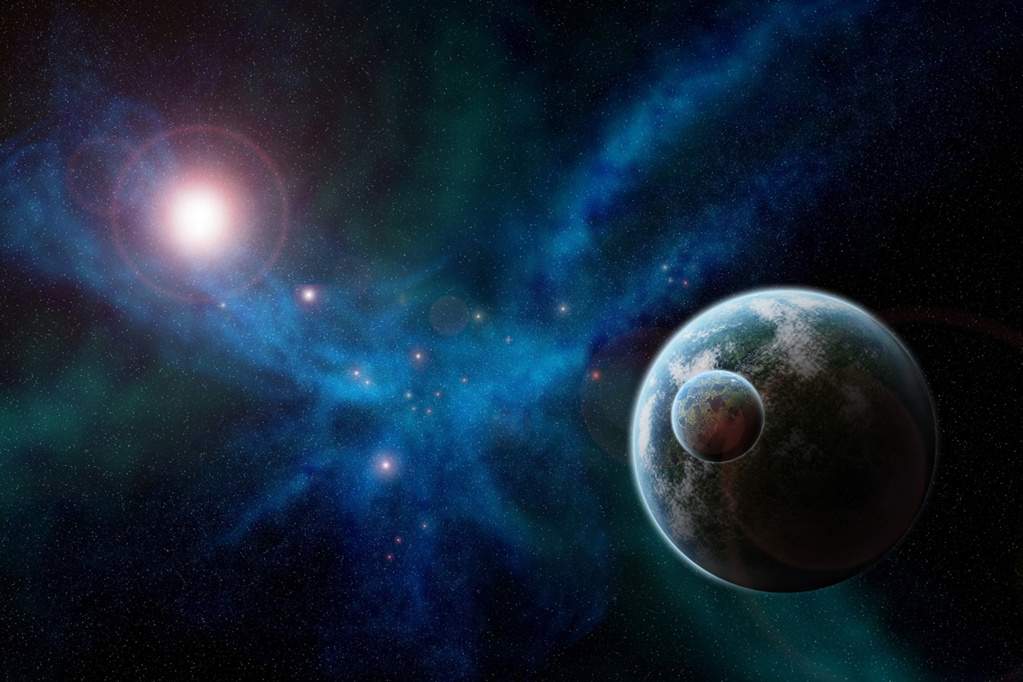
Hebrews 11:3
“By faith we understand that the worlds were prepared by the word of God, so that what is seen was not made out of things which are visible.”

Slide 33
1 Timothy 6:20
“O Timothy, keep that which is committed to thy trust, avoiding profane and vain babblings, and oppositions of science falsely so called.”

Slide 34
“Although it has been claimed that the Fathers believed it and some of the post – reformation exegetes taught it, its great popularity dates from the work of Chalmers (1780‒1847).…If it was Chalmers who first vigorously advocated it in modern times, it was the work of G. H. Pember (Earth’s Earliest Ages, first edition, 1876; frequently republished) which canonized it. Pember’s work became one of the core books which has shaped modern Fundamentalism.”
Bernard Ramm
The Christian View of Science and Scripture (Grand Rapids: Eerdmans, 1954), 196.

Slide 35
Two Views on Harmonization of Early Genesis with “Science”
Accommodation Model
Definition
W.H. Green (1892)
Old strategy
Backward Christian soldier
Not exegesis but eisegesis
Moving target (Job 38:4-7; Heb. 11:3; 1 Tim. 6:20)
Chalmers, Scofield, Chafer, Larkin, etc…

Slide 36
Two Views on Harmonization of Early Genesis with “Science”
Biblical Presupposition Model
Definition
“Genesis Flood” (1961) by Morris and Whitcomb
New strategy
Not eisegesis but exegesis
No need for the Gap Theory

Slide 37
4. Remaining Gap Theory Problems
Only one verse describing original creation?
Lack of information on what transpired in the gap
No supporting verses describing the angelic rebellion & judgment in the gap
Late 19th century accommodation attempt to explain the fossil record
God created (rather than renovated) during the creation week (Gen. 2:3-4; Exod. 20:8-11)

Slide 38
Genesis 2:3-4
“³ Then God blessed the seventh day and sanctified it, because in it He rested from all His work which God had created and made. ⁴ This is the account of the heavens and the earth when they were created, in the day that the Lord God made earth and heaven.”

Slide 39
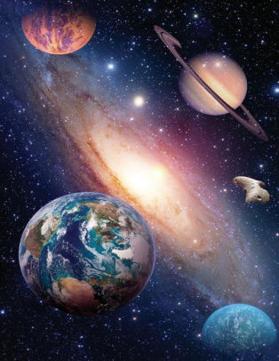
Exodus 20:11
“For in six days the Lord made the heavens and the earth, the sea and all that is in them, and rested on the seventh day; therefore the Lord blessed the sabbath day and made it holy.”

Slide 40
4. Remaining Gap Theory Problems
Scripture traces all death & chaos from Adam’s sin & not before Adam’s sin (Rom 5:12; 8:19-22)
“Good” (Gen 1:4, 9, 12, 18, 21, 25) & “very good” (Gen 1:31) after ruin?
Adam created at the beginning of creation (Matt. 19:4) & not after most of Earth’s history had already transpired
Lucifer’s instantaneous rebellion would not explain long ages in the fossil record

Slide 41
4. Remaining Gap Theory Problems
Scripture traces all death & chaos from Adam’s sin & not before Adam’s sin (Rom 5:12; 8:19-22)
“Good” (Gen 1:4, 9, 12, 18, 21, 25) & “very good” (Gen 1:31) after ruin?
Adam created at the beginning of creation (Matt. 19:4) & not after most of Earth’s history had already transpired
Lucifer’s instantaneous rebellion would not explain long ages in the fossil record

Slide 42
1 Corinthians 15:21-22
“²¹ For since by a man came death, by a man also came the resurrection of the dead. ²² For as in Adam all die, so also in Christ all will be made alive.”

Slide 43
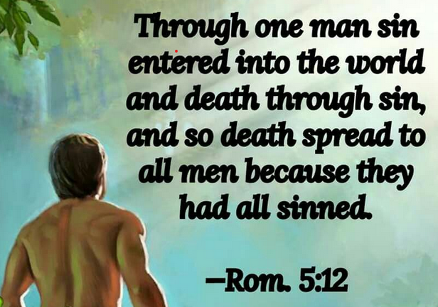
Romans 5:12
“Therefore, just as through one man sin entered into the world, and death through sin, and so death spread to all men, because all sinned—.”

Slide 44
Romans 8:19-22
¹⁹ For the anxious longing of the creation waits eagerly for the revealing of the sons of God. ²⁰ For the creation was subjected to futility, not willingly, but because of Him who subjected it, in hope ²¹ that the creation itself also will be set free from its slavery to corruption into the freedom of the glory of the children of God. ²² For we know that the whole creation groans and suffers the pains of childbirth together until now.

Slide 46
4. Remaining Gap Theory Problems
Scripture traces all death & chaos from Adam’s sin & not before Adam’s sin (Rom 5:12; 8:19-22)
“Good” (Gen 1:4, 9, 12, 18, 21, 25) & “very good” (Gen 1:31) after ruin?
Adam created at the beginning of creation (Matt. 19:4) & not after most of Earth’s history had already transpired
Lucifer’s instantaneous rebellion would not explain long ages in the fossil record

Slide 47
Genesis 1:31
“God saw all that He had made, and behold, it was very good. And there was evening and there was morning, the sixth day.”

Slide 49
4. Remaining Gap Theory Problems
Scripture traces all death & chaos from Adam’s sin & not before Adam’s sin (Rom 5:12; 8:19-22)
“Good” (Gen 1:4, 9, 12, 18, 21, 25) & “very good” (Gen 1:31) after ruin?
Adam created at the beginning of creation (Matt. 19:4) & not after most of Earth’s history had already transpired
Lucifer’s instantaneous rebellion would not explain long ages in the fossil record

Slide 50
Matthew 19:4-6
“³ Some Pharisees came to Jesus, testing Him and asking, “Is it lawful for a man to divorce his wife for any reason at all?” ⁴ And He answered and said, “Have you not read that He who created them from the beginning made them male and female, ⁵ and said, ‘For this reason a man shall leave his father and mother and be…

Slide 51
Matthew 19:4-6
…joined to his wife, and the two shall become one flesh’? ⁶ So they are no longer two, but one flesh. What therefore God has joined together, let no man separate.”

Slide 52
Mark 10:6
“But from the beginning of creation, God made them male and female.”

Slide 53
Mark 13:19
“For those days will be a time of tribulation such as has not occurred since the beginning of the creation (ap archēs kisteōs) which God created until now, and never will.”
(apo de archēs kisteōs)

Slide 54
2 Peter 3:4
“and saying, “Where is the promise of His coming? For ever since the fathers fell asleep, all continues just as it was from the beginning of creation (ap archēs kisteōs).”
(apo de archēs kisteōs)

Slide 55
Luke 11:50-51
“⁵⁰ so that the blood of all the prophets, shed since the foundation of the world, may be charged against this generation, ⁵¹ from the blood of Abel to the blood of Zechariah, who was killed between the altar and the house of God; yes, I tell you, it shall be charged against this generation.

Slide 56
Romans 1:20
“For since the creation of the world His invisible attributes, His eternal power and divine nature, have been clearly seen, being understood through what has been made, so that they are without excuse.”

Slide 57
4. Remaining Gap Theory Problems
Scripture traces all death & chaos from Adam’s sin & not before Adam’s sin (Rom 5:12; 8:19-22)
“Good” (Gen 1:4, 9, 12, 18, 21, 25) & “very good” (Gen 1:31) after ruin?
Adam created at the beginning of creation (Matt. 19:4) & not after most of Earth’s history had already transpired
Lucifer’s instantaneous rebellion would not explain long ages in the fossil record

Slide 58
4. Remaining Gap Theory Problems
Only one biblical flood (Matt. 24:38-39; 1 Pet. 3:18-21; 2 Pet. 2:4-5)
Why would God judge the entire earth because of the sin of one angel?

Slide 59
4. Remaining Gap Theory Problems
Only one biblical flood (Matt. 24:38-39; 1 Pet. 3:18-21; 2 Pet. 2:4-5)
Why would God judge the entire earth because of the sin of one angel?

Slide 60
2 Peter 3:5-7
“⁵ For when they maintain this, it escapes their notice that by the word of God the heavens existed long ago and the earth was formed out of water and by water, ⁶ through which the world at that time was destroyed, being flooded with water. ⁷ But by His word the present heavens and earth are being reserved for fire, kept for the day of judgment and destruction of ungodly men.”

Slide 61
2 Peter 2:5
“and did not spare the ancient world, but preserved Noah, a preacher of righteousness, with seven others, when He brought a flood upon the world of the ungodly.”

Slide 62
1 Peter 3:18-21
“¹⁸ For Christ also died for sins once for all, the just for the unjust, so that He might bring us to God, having been put to death in the flesh, but made alive in the spirit; ¹⁹ in which also He went and made proclamation to the spirits now in prison, ²⁰ who once were disobedient, when the patience of God kept waiting in the days of Noah, during the construction of the ark, in which a few, that is . . .

Slide 63
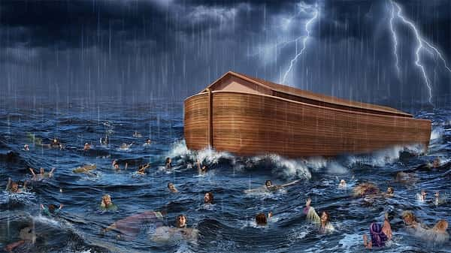
1 Peter 3:18-21
…eight persons, were brought safely through the water. ²¹ Corresponding to that, baptism now saves you—not the removal of dirt from the flesh, but an appeal to God for a good conscience—through the resurrection of Jesus Christ,

Slide 64
Mathew 24:38-39
“³⁸ For as in those days before the flood they were eating and drinking, marrying and giving in marriage, until the day that Noah entered the ark, ³⁹ and they did not understand until the flood came and took them all away; so will the coming of the Son of Man be.”

Slide 65
4. Remaining Gap Theory Problems
Only one biblical flood (Matt. 24:38-39; 1 Pet. 3:18-21; 2 Pet. 2:4-5)
Why would God judge the entire earth because of the sin of one angel?

Slide 66
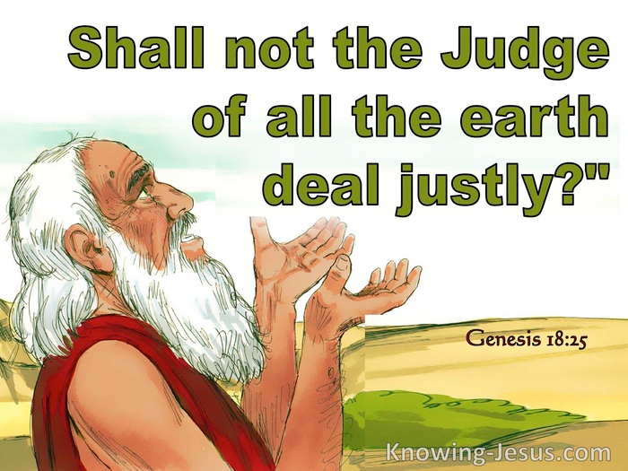
Genesis 18:25
“Far be it from You to do such a thing, to slay the righteous with the wicked, so that the righteous and the wicked are treated alike. Far be it from You! Shall not the Judge of all the earth deal justly?”

Slide 67
CONCLUSION

Slide 68
Gap Theory Preview
Definition of the Gap Theory
Evidence Favoring the Gap Theory
Response to Evidence Favoring the Gap Theory
Remaining Problems with the Gap Theory
Correct View of Gen. 1:1-2

