Slide 1


Slide 2

The Coming Kingdom
Chapter 20
Dr. Andy Woods
Senior Pastor – Sugar Land Bible Church
President – Chafer Theological Seminary

Slide 3

Kingdom Study Outline
What does the Bible Say About the Kingdom?
The Main Problem with Kingdom Now NT interpretations
Why do some believe that we are in the kingdom now?
Why does it matter?

Slide 4
Response to Kingdom Now Problem Passages
Passages from Christ’s ministry
Passages from Acts
Passages from Paul
Passages from the General letters
Passages from Revelation
Miscellaneous Arguments

Slide 5

4-5 Passages from:
The General Letters & Revelation
Receiving a kingdom (Heb. 12:28)
A kingdom of priests (1 Pet. 2:9)
A kingdom of priests (Rev. 1:6)
Fellow partaker in the kingdom (Rev. 1:9)
Jesus has the key of David (Rev. 3:7)
Jesus has already overcome (Rev 5:5)
Jesus as the King of the Nations (Rev 15:3)

Slide 6

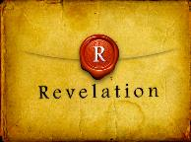
Revelation 5:5
“and one of the elders said to me, ‘Stop weeping; behold, the Lion that is from the tribe of Judah, the Root of David, has overcome so as to open the book and its seven seals.’”

Slide 7
Revelation 5:5 in Progressive Dispensationalism
“The victory, or at least the decisive act, has already occurred. He is qualified to open the scrolls and the seals because of what he has already done as a Davidite. . . . The timing of Revelation 5:5 is critical, since it precedes the seal judgments and the second coming, so the text shows Jesus has his regal victorious status before He returns in Revelation 19. The portrait of these Revelation texts is consistent. Jesus now rules in spiritual-salvific terms, in a new community that is part of the kingdom program, and in a way that inaugurates Davidic promises. That kingdom exists alongside the kingdoms of earth.”
Darrell Bock, “The Reign of the Lord Christ,” in Dispensationalism, Israel and the Church, ed. Craig Blaising and Darrell Bock (Grand Rapids: Zondervan, 1992), 64.
Notes:
WRONG!!!

Slide 8
Three Responses to “Kingdom Now”
Theology’s Use of Rev. 5:5
Absence of the noun “kingdom” [basileia] or the verb “to reign” [basileuō]
Jesus has not yet opened the seven-sealed scroll (Rev. 5:5; 6:1), which evicts Satan from the earth
A present reigning Church does not fit the context of Rev. 2‒3

Slide 9
Three Responses to “Kingdom Now”
Theology’s Use of Rev. 5:5
Absence of the noun “kingdom” [basileia] or the verb “to reign” [basileuō]
Jesus has not yet opened the seven-sealed scroll (Rev. 5:5; 6:1), which evicts Satan from the earth
A present reigning Church does not fit the context of Rev. 2‒3

Slide 10
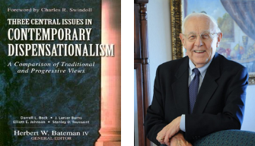
Stanley D. Toussaint
“Israel and the Church of a Traditional Dispensationalist,” in Three Central Issues in Contemporary Dispensationalism, ed. Herbert W. Bateman (Grand Rapids: Kregel, 1999), 248.
“But this [Rev. 5:5] does not prove a present spiritual form of the kingdom. Christ’s death and resurrection have defeated Satan but the kingdom is clearly future; this is especially seen in the Apocalypse.”

Slide 11
Three Responses to “Kingdom Now”
Theology’s Use of Rev. 5:5
Absence of the noun “kingdom” [basileia] or the verb “to reign” [basileuō]
Jesus has not yet opened the seven-sealed scroll (Rev. 5:5; 6:1), which evicts Satan from the earth
A present reigning Church does not fit the context of Rev. 2‒3

Slide 12

Telescoping
7th judgment releases 1st in next series
Seals: 1 2 3 4 5 6 7
Trumpets: 1 2 3 4 5 6 7
Bowls: 1 2 3 4 5 6 7

Slide 13
Ultimate Exodus
(Rev 11:15)
Sores: 6th plague (Ex 9:8-12), 1st bowl (Rev 16:1-2)
Rivers to blood: 1st plague (Ex 7:19-21), 3rd bowl (Rev 16:4-7)
Darkness: 9th plague (Ex 10:21-23), 5th bowl (Rev 16:10-11)
Frogs: 2nd plague (Ex 7:25‒8:15), 6th bowl (Rev 16:13)
Hail: 7th plague (Ex 9:22-26), 7th bowl (Rev 16:17-21)

Slide 14


Slide 15

Satan is a Defeated Foe
John 12:31
John 16:11
Col 2:15
Heb 2:14
1 John 3:8

Slide 16


Satan’s Progressive Defeat
Initial eviction from heaven (Isa 14:12-15; Ezek 28:12-17)
Eden (Gen 3:15)
Pre-diluvian world (1 Pet 3:19-20)
Cross (John 12:31; 16:11; Col 2:15; Heb 2:14; 1 John 3:8)
Mid point of the Tribulation (Rev 12:9)
Beginning of millennium (Rev 20:2-3)
End of millennium (Rev 20:10)

Slide 17
Satan’s Progressive Defeat
Initial eviction from heaven (Isa 14:12-15; Ezek 28:12-17)
Eden (Gen 3:15)
Pre-diluvian world (1 Pet 3:19-20)
Cross (John 12:31; 16:11; Col 2:15; Heb 2:14; 1 John 3:8)
Mid point of the Tribulation (Rev 12:9)
Beginning of millennium (Rev 20:2-3)
End of millennium (Rev 20:10)

Slide 18
Names & Titles Demonstrating Satan’s Post-Fall, Earthly Authority
(Job 1:7; 2:2; Luke 4:5-8; Rom. 8:19-22)
Prince of this world (John 12:31; 14:30; 16:11)
God of this age (2 Cor. 4:4)
Prince and power of the air (Eph. 2:2)
Who the believer wrestles with (Eph. 6:12)
Roaring lion (1 Pet. 5:8)
Whole world lies in his power (1 John 5:19)

Slide 19
Three Responses to “Kingdom Now”
Theology’s Use of Rev. 5:5
Absence of the noun “kingdom” [basileia] or the verb “to reign” [basileuō]
Jesus has not yet opened the seven-sealed scroll (Rev. 5:5; 6:1), which evicts Satan from the earth
A present reigning Church does not fit the context of Rev. 2‒3

Slide 20



Slide 21
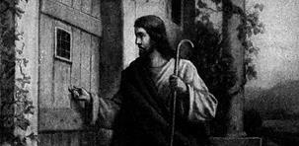

Slide 22

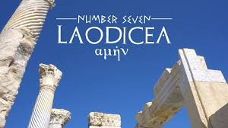
William Newell
The Book of the Revelation (Chicago: Moody, 1935), 75.
“The name comes from laos, people, and dikao, to rule: the rule of the people: ‘democracy,’ in other words.”

Slide 23
Revelation 3:19-20
“¹⁹ Those whom I love, I reprove and discipline; therefore be zealous and repent. ²⁰ Behold, I stand at the door and knock; if anyone hears My voice and opens the door, I will come in to him and will dine with him, and he with Me.”

Slide 24
4-5 Passages from:
The General Letters & Revelation
Receiving a kingdom (Heb. 12:28)
A kingdom of priests (1 Pet. 2:9)
A kingdom of priests (Rev. 1:6)
Fellow partaker in the kingdom (Rev. 1:9)
Jesus has the key of David (Rev. 3:7)
Jesus has already overcome (Rev 5:5)
Jesus as the King of the Nations (Rev 15:3)

Slide 25
Revelation 15:3
“And they sang the song of Moses, the bond-servant of God, and the song of the Lamb, saying, ‘Great and marvelous are Your works, O Lord God, the Almighty; Righteous and true are Your ways, King of the nations!’”

Slide 26
Revelation 15:4
“Who will not fear, O Lord, and glorify Your name? For You alone are holy; For all the nations will come [hēkō] and worship [proskyneō] before You, For Your righteous acts have been revealed.”

Slide 27

E.R. Craven
“Excursus on the Basileia,” in Revelation of John, J. P. Lange (New York: Scribner, 1874), 95.
“the passages which have been referred to as proving the doctrine of a present establishment” and “those passages which, it is alleged, logically imply a present establishment of the Basileia”…“There is no critically undisputed passage in the Scriptures which declares, or necessarily implies, even a partial establishment in New Testament times.”

Slide 28
Response to Kingdom Now Problem Passages
Passages from Christ’s ministry
Passages from Acts
Passages from Paul
Passages from the General letters
Passages from Revelation
Miscellaneous Arguments

Slide 29
The Coming Kingdom
Chapter 21
Dr. Andy Woods
Senior Pastor – Sugar Land Bible Church
President – Chafer Theological Seminary

Slide 30
Three Miscellaneous Arguments Advanced by “Kingdom Now Theology”
Alleged NT silence on a future kingdom
New Testament’s focus on the Eternal State
Jesus Christ’s alleged present inactivity

Slide 31
Three Miscellaneous Arguments Advanced by “Kingdom Now Theology”
Alleged NT silence on a future kingdom
New Testament’s focus on the Eternal State
Jesus Christ’s alleged present inactivity

Slide 32
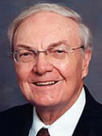
Bruce Waltke
Kingdom Promises As Spiritual, in Continuity in Discontinuity: Perspectives on the Relationship Between the Old Testament and New Testament, p.273
“Not one clear New Testament passage mentions the restoration of Israel as a political nation or predicts an earthly reign of Christ before His final appearing. None depicts the consummate glory of Christ as an earthly king ruling over the restored nation of Israel. The silence is deafening.”

Slide 33

Gary DeMar
End Times Fiction: A Biblical Consideration of the Left Behind Theology (Nashville, TN: Nelson, 2001), 203.
“Where is this ‘super sign’ found in the Bible? Not in the New Testament. There is not a single verse in the entire New Testament that says anything about Israel becoming a nation again. Nothing prophetic in the New Testament depends on Israel becoming a nation again. If Israel becoming a nation again is such ‘a significant sign,’ then why doesn't the New Testament specifically mention it?”

Slide 34

Colin Chapman
Colin Chapman, Whose Promised Land? The Continuing Conflict over Israel and Palestine (Oxford, England: Lion, 2015), 262.
“When the New Testament writers like John had seen the significance of the land and the nation in the context of the kingdom of God which had come into being in Jesus of Nazareth, they ceased to look forward to a literal fulfillment of Old Testament prophecies of a return to the land and a restoration of a Jewish state. The one and only fulfillment of all promises and prophecies was already there before their eyes in the person of Jesus. The way they interpreted the Old Testament should be the norm for the Christian interpretation of the Old Testament today.”

Slide 35
The Knox Seminary Open
Letter to Evangelicals http://www.bible-researcher.com/openletter.html
“Instructively, this same Simon Peter, the Apostle to the Circumcision, says nothing about the restoration of the kingdom to Israel in the land of Palestine. . . . No New Testament writer foresees a regathering of ethnic Israel in the land, as did the prophets of the Old Testament after the destruction of the first temple in 586 B.C.”

Slide 36
Bruce Scott Responding to Gary Burge
“Christian Anti-Zionism: On the Wrong Side of History, Justice, and the Bible,” Israel My Glory January/February 2014, 33.
“[They] use a fallacious argument from silence to prove their point. They falsely assume their position on the holy land is true simply because the New Testament writers spoke so infrequently of God’s land promises to Israel and Israel’s restoration to its land. On one occasion, when confronted about his argument from silence, Gary Burge countered, “‘It is such a loud silence.’”

Slide 37

Arnold Fruchtenbaum
“Israel’s Right to the Promised Land,” 21, accessed February 4, 2015, http://www.pre-trib.org
“Furthermore, the New Testament does not have to mention something specific from the Old Testament to maintain that the Old Testament promise is ongoing. What the author needs is a clear statement that says all the Land Promises have been fulfilled in at least a spiritual way, but this does not exist in the New Testament.”

Slide 38
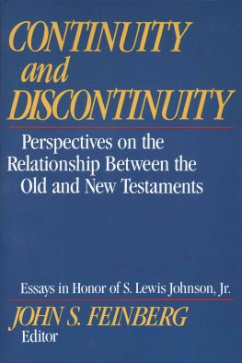
Paul D. Feinberg
“Hermeneutics of Discontinuity,” in Continuity and Discontinuity: Perspectives on the Relationship between the Old and New Testaments, ed. John S. Feinberg (Wheaton, IL: Crossway, 1988), 124.
“Why should something that is clearly a matter of Old Testament revelation have to be repeated in the New Testament for it to have continuing validity? Should not the very opposite be the case? Should not the promises of the Old Testament be regarded as still in effect unless the New Testament states otherwise? ”

Slide 39

Ephesians 3:3-6
“that by revelation there was made known to me the mystery, as I wrote before in brief. ⁴ By referring to this, when you read you can understand my insight into the mystery of Christ, ⁵ which in other generations was not made known to the sons of men, as it has now been revealed to His holy apostles and prophets in the Spirit; ⁶ to be specific, that the Gentiles are fellow heirs and fellow members of the body, and fellow partakers of the promise in Christ Jesus through the gospel”.

Slide 40
“Mystery” Defined
“In the N.T, it [mystērion] denotes, not the mysterious (as with the Eng. word), but that which, being outside the range of unassisted natural apprehension, can be made known only by Divine revelation, and is made known in a manner and at a time appointed by God, and to those who are illumined by His Spirit.”
W. E. Vine, Merrill F. Unger, and William White, Vine's Complete Expository Dictionary of the Old and New Testament Words (Nashville: Nelson, 1996), 424.

Slide 41
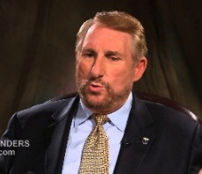
Randall Price
The Temple and Bible Prophecy: A Definitive Look at Its Past, Present, and Future (Eugene, OR: Harvest, 2005), 596.
“However, there are good reasons why the promise of Israel’s national restoration, so often stated in the Old Testament, would not be repeated in the New Testament. First, the Old Testament, as the Bible of the early church, already contained sufficient instruction on the subject, and New Testament authors would have assumed this doctrine and expected their audiences to understand it from the Old Testament text. The frequent citations and allusions to the Old Testament by New Testament authors demonstrate that the Old Testament had priority as the first authoritative revelation of God containing everything necessary to understand the divine program, which had its fulfillment in Christ. The New Testament was. . .

Slide 42
Randall Price
The Temple and Bible Prophecy: A Definitive Look at Its Past, Present, and Future (Eugene, OR: Harvest, 2005), 596.
“…not written to replace the Old Testament, but to add new revelation that attended to the coming Messiah and the formation of the church. Therefore, the New Testament does not need to repeat Old Testament revelation concerning national Israel, but builds upon it by explaining the relationship between Israel and the church. . . . While the New Testament does not change the original intent of its authors, who wrote about Israel’s future restoration in the land, neither does it feel compelled to repeat what was already taught and understood in Scripture. Second, the New Testament does not put Israel in a central position, as does the Old Testament, because the church has become the. . .

Slide 43
Randall Price
The Temple and Bible Prophecy: A Definitive Look at Its Past, Present, and Future (Eugene, OR: Harvest, 2005), 596.
. . .central position in salvation history. The New Testament epistles are written for the instruction of the church, and therefore should not be expected to include discussions about Israel’s restoration.”

Slide 44
Luke 21:24
“and they will fall by the edge of the sword, and will be led captive into all the nations; and Jerusalem will be trampled under foot by the Gentiles until (archi) the times of the Gentiles are fulfilled.”

Slide 45
Matthew 19:28
“And Jesus said to them, “Truly I say to you, that you who have followed Me, in the regeneration when the Son of Man will sit on His glorious throne, you also shall sit upon twelve thrones, judging the twelve tribes of Israel.”

Slide 46
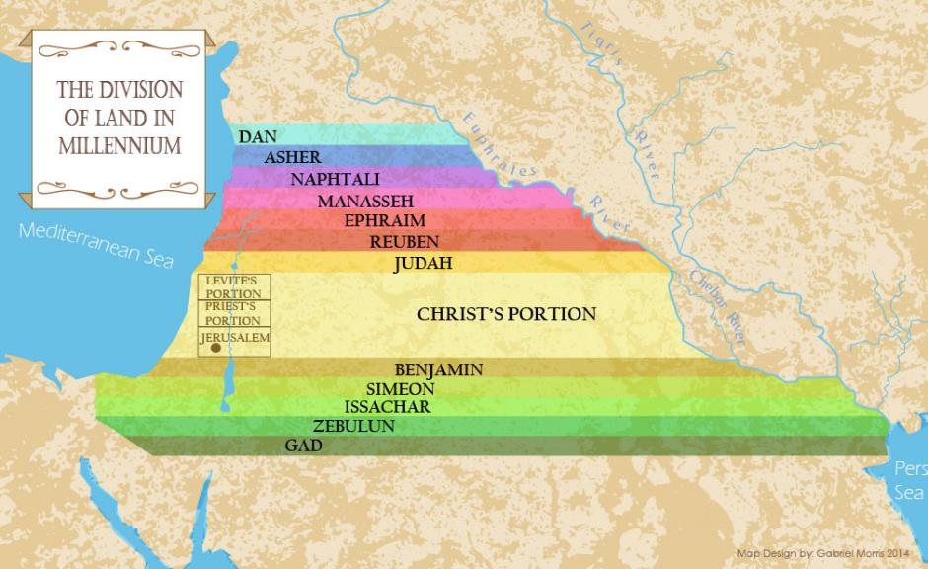

Slide 47
Matthew 23:38-39
“³⁸ Behold, your house is being left to you desolate! ³⁹ For I say to you, from now on you will not see Me until (heos) you say, ‘Blessed is He who comes in the name of the Lord!’”

Slide 48
Romans 11:25-27
“²⁵ For I do not want you, brethren, to be uninformed of this mystery—so that you will not be wise in your own estimation—that a partial hardening has happened to Israel until the fullness of the Gentiles has come in; ²⁶ and so all Israel will be saved; just as it is written, ‘The Deliverer will come from Zion, He will remove ungodliness from Jacob.’ ²⁷ ‘This is My covenant with them, When I take away their sins.’”

Slide 49


Slide 50
Distinctions Between 144,000 & Multitude
144,000 | MULTITUDE
Revelation 7:1-8 | Revelation 7:9-17
Numbered | Innumerable
Jews | All nations
Sealed | Slain
Sealed before the Tribulation | Converted out of the Tribulation
Hitchcock and Ice, The Truth Behind Left Behind, 77

Slide 51
Revelation 20:9
“And they came up on the broad plain of the earth and surrounded the camp of the saints and the beloved city, and fire came down from heaven and devoured them.”

Slide 52

Isaiah 2:2-3
“Now it will come about that In the last days The mountain of the house of the Lord Will be established as the chief of the mountains, And will be raised above the hills; And all the nations will stream to it.³ And many peoples will come and say, ‘Come, let us go up to the mountain of the Lord, To the house of the God of Jacob; That He may teach us concerning His ways And that we may walk in His paths.’ For the law will go forth from Zion And the word of the Lord from Jerusalem.”

Slide 53
Zechariah 14:16-18
“Then it will come about that any who are left of all the nations that went against Jerusalem will go up from year to year to worship the King, the Lord of hosts, and to celebrate the Feast of Booths. ¹⁷ And it will be that whichever of the families of the earth does not go up to Jerusalem to worship the King, the Lord of hosts, there will be no rain on them. ¹⁸ If the family of Egypt does not go up or enter, then no rain will fall on them; it will be the plague with which the Lord smites the nations who do not go up to celebrate the Feast of Booths.”

Slide 54

Robert Thomas
Four Views on the Book of Revelation, page 207.
“At the end of the Millennium that city will be Satan’s prime objective with his rebel army, because Israel will be a leader among the nations.”

Slide 55
Revelation 21:12
“It had a great and high wall, with twelve gates, and at the gates twelve angels; and names were written on them, which are the names of the twelve tribes of the sons of Israel.”

Slide 56
Three Miscellaneous Arguments Advanced by “Kingdom Now Theology”
Alleged NT silence on a future kingdom
New Testament’s focus on the Eternal State
Jesus Christ’s alleged present inactivity

Slide 57

Galatians 4:26
“But the Jerusalem above is free; she is our mother.”

Slide 58
Hebrews 11:10, 16; 12:22
“¹⁰ for he was looking for the city which has foundations, whose architect and builder is God…¹⁶ But as it is, they desire a better country, that is, a heavenly one. Therefore God is not ashamed to be called their God; for He has prepared a city for them. ²² But you have come to Mount Zion and to the city of the living God, the heavenly Jerusalem, and to myriads of angels.”

Slide 59
2 Peter 3:13
“But according to His promise we are looking for new heavens and a new earth, in which righteousness dwells.”

Slide 60
The Knox Seminary Open
Letter to Evangelicals
http://www.bible-researcher.com/openletter.html
“Instructively, this same Simon Peter, the Apostle to the Circumcision, says nothing about the restoration of the kingdom to Israel in the land of Palestine. Instead, as his readers contemplate the promise of Jesus’ Second Coming, he fixes their hope upon the new heavens and the new earth, in which righteousness dwells.”

Slide 61
Arnold Fruchtenbaum
Footsteps of the Messiah, rev. ed. (Tustin, CA: Ariel, 2003), 10–11.
“The majority of the things found in the first twenty chapters of the Book of Revelation are found elsewhere in the Old Testament. Only the last two chapters deal with things totally new. . . . The value of the Book of Revelation is not that it provides a lot of new information, but rather it takes the scattered Old Testament prophecies and puts them in a chronological order so that the sequence of events may be determined. However, the material found in the last two chapters is totally new material which describes the Eternal Order. The Old Testament prophets never foresaw anything . . .

Slide 62
Arnold Fruchtenbaum
Footsteps of the Messiah, rev. ed. (Tustin, CA: Ariel, 2003), 10–11.
. . . beyond the Messianic kingdom. Indeed the kingdom was the high point of Old Testament prophecy and no prophet ever saw anything beyond that. But the Eternal Order is the high point of New Testament prophecy, and Revelation 21 and 22 provide new information, as they describe the Eternal Order.”

Slide 63


Slide 64
Mark Hitchcock
101 Answers to the Most Asked Questions About the End Times (Sisters, OR: Multnomah, 2001), 212.
“Christ will rule over His kingdom on this present earth for one thousand years, and He will reign forever. The future kingdom of God has two parts or phases. Phase one is the millennial reign of Christ on this earth (Rev. 20:1–6), and phase two is the eternal state (Rev. 22:5). As I once heard it described, the Millennium is the front porch of eternity.”

Slide 65
Three Miscellaneous Arguments Advanced by “Kingdom Now Theology”
Alleged NT silence on a future kingdom
New Testament’s focus on the Eternal State
Jesus Christ’s alleged present inactivity

Slide 66

Dave Anderson
The King-Priest of Psalm 110 in Hebrews (New York: Lang, 2001), 2.
“But clearly Jesus did not set up a natural theocratic kingdom with Himself as the king ruling from Jerusalem on earth before His resurrection. So, what happened to the kingdom He promised? It was postponed, many NT interpreters suggest. . . . But if the premillennial view just espoused is true, that leaves the question concerning the present ministry of Christ. What is He doing right now?”

Slide 67
Dave Anderson
The King-Priest of Psalm 110 in Hebrews (New York: Lang, 2001), 296.
“But classical or revised dispensationalists should also recognize the already eschatology of Hebrews. Christ is not passive on the throne. He is reigning. He has subjects. And because He is the forerunner, there are many present blessings which belong to the eschatological age which can be enjoyed now because the Davidic Covenant with some of its blessings has been inaugurated.”

Slide 68
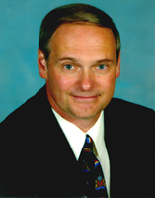
Steven Waterhouse
Not by Bread Alone (Amarillo, TX: Westcliff, 2007), 97.
“The Bible teaches that Christ is now at the right hand of God in glory (Acts 7:56; Col 3:1; Heb. 1:3; 8:1; 12:2). He is not in the least inactive.”

Slide 69

Lewis Sperry Chafer
vol. 5, Systematic Theology (Grand Rapids, MI: Kregel Publications, 1993), 273-74.
“The present ministry of Christ in heaven, known as His session, is far-reaching both in consequence and import. It, too, has not been treated even with a passing consideration by Covenant theologians, doubtless due to their inability—because of being confronted with their one covenant theory—to introduce features and ministries which indicate a new divine purpose in the Church and by so much tend to disrupt the unity of a supposed immutable purpose and covenant of God’s. Since, as will be seen, certain vital ministries of Christ in heaven provide completely for the believer’s security, the present session of Christ has been eschewed by Arminians in a manner equally unpardonable...”

Slide 70
Lewis Sperry Chafer
vol. 5, Systematic Theology (Grand Rapids, MI: Kregel Publications, 1993), 273-74.
“This neglect accounts very well for the emphasis of their pulpit ministrations. The Christian public, because deprived of the knowledge of Christ’s present ministry, are unaware of its vast realities, though they are able from childhood itself to relate the mere historical facts and activities of Christ during His three and one-half years of service on earth. That Christ is doing anything now is not recognized by Christians generally and for this part-truth kind of preaching is wholly responsible. It yet remains true, whether neglected by one or the other kind of theologian, that Christ is now engaged in ministry which determines the service and destiny of all those who have put their trust in Him.”

Slide 71
Christ’s High Priestly Activities in His Present Session
Sustains creation (Col. 1:16-17)
Head over the Church (Eph. 1:22-23)
Groom of the Church (Eph. 5:22-33)
Building the Church (Matt. 16:18; Acts 2:41; 4:4)
Bestowal of Spiritual Gifts (Eph. 4:7-12)
Melchizedekian High Priestly role (Heb. 6:20)
Keeps the Saints (John 10:27-29; 1 Pet. 1:5)
Intercedes for the Saints (Rom. 8:24; Heb. 7:25)
Advocate for the Saints (Heb. 9:24; 1 John 2:1)
Restores broken fellowship (1 John 1:9)
Disciplines His children (Heb. 12:5-13)

Slide 72

Matthew 16:18
“I also say to you that you are Peter, and upon this rock I will build [oikodomeō] My church; and the gates of Hades WILL NOT overpower it.”

Slide 73
Progress Reports in Acts
Clearest: Acts 2:47; 6:7; 9:31; 12:24; 16:5; 19:20; 28:30-31
Less clear: Acts 1:15; 2:41; 4:4, 31; 5:14, 42; 8:25, 40; 11:21; 13:49; 17:6

Slide 74
Lewis Sperry Chafer
vol. 5, Systematic Theology (Grand Rapids, MI: Kregel Publications, 1993), 277.
“The effect of the Christian’s sin upon himself is that he loses his fellowship with God, his joy, his peace, and his power. On the other hand, these experiences are restored in infinite grace on the sole ground that he confesses his sin (1 John 1:9).”

Slide 75

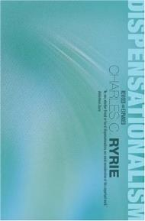
Charles Ryrie
Ryrie, Dispensationalism, 169
“If Christ inaugurated His Davidic reign at His Ascension, does it not seem incongruous that His first act as reigning Davidic king was the sending of the Holy Spirit (Acts 2:33), something not included in the promises of the Davidic Covenant?”

Slide 76
Lewis Sperry Chafer
vol. 5, Systematic Theology (Grand Rapids, MI: Kregel Publications, 1993), 278-79.
“Over and above all the stupendous present ministry of the resurrected, exalted Savior already noted is the attitude which He is said to maintain toward the day when, coming back to the earth, He will defeat all enemies and take the throne to reign. Important, indeed, is the revelation which discloses the fact that Christ is now in the attitude of expectation toward the oncoming day when, returning on the clouds of heaven, He will vanquish every foe....Hebrews 10:13 records His expectation, which reads: ‘From henceforth expecting till His enemies be made His footstool…. As High Priest over the true tabernacle on high, the Lord Jesus Christ has entered into heaven . . .

Slide 77
Lewis Sperry Chafer
vol. 5, Systematic Theology (Grand Rapids, MI: Kregel Publications, 1993), 278-79.
…itself there to minister as priest in behalf of those who are His own in the world (Heb. 8:1–2). . . . The fact that He sat down on His Father’s throne and not on His own throne reveals the truth, so constantly and consistently taught in the Scriptures, that He did not set up a kingdom on the earth at His first advent into the world, but that He is now ‘expecting’ until the time when His kingdom shall come in the earth and the divine will shall be done on earth as it is done in heaven. ‘The kingdoms of this world’ are yet to become ‘the kingdoms of our Lord, and of His Christ; and He shall reign forever and ever’ (Rev. 11:15), Father and He will give Him the nations for His . . .

Slide 78
Lewis Sperry Chafer
vol. 5, Systematic Theology (Grand Rapids, MI: Kregel Publications, 1993), 278-79.
. . .inheritance and the uttermost parts of the earth for His possession (Ps. 2:8). However, Scripture clearly indicates too that He is not now establishing that kingdom rule in the earth (Matt. 25:31–46), but that rather He is calling out from both the Jews and Gentiles a heavenly people who are related to Him as His Body and Bride. After the present purpose is accomplished, He will return and ‘build again the tabernacle of David, which is falling down’ (Acts 15:13–18). Though He is a King-Priest according to the Melchizedek type (Hebrews 5:10; 7:1–3), He is now serving as Priest and not as King.”

Slide 79
CONCLUSION

Slide 80
Three Miscellaneous Arguments Advanced by “Kingdom Now Theology”
Alleged NT silence on a future kingdom
New Testament’s focus on the Eternal State
Jesus Christ’s alleged present inactivity

