Slide 1
SATANOLOGY
Dr. Andy Woods
Senior Pastor – Sugar Land Bible Church
President – Chafer Theological Seminary

Slide 2
Preview of Angelology
Good angels
Satanology
Demonology
Gen. 6:1-4 controversy

Slide 3
Preview
Existence
Personhood
Names and titles
Original state and first sin
Works

Slide 4
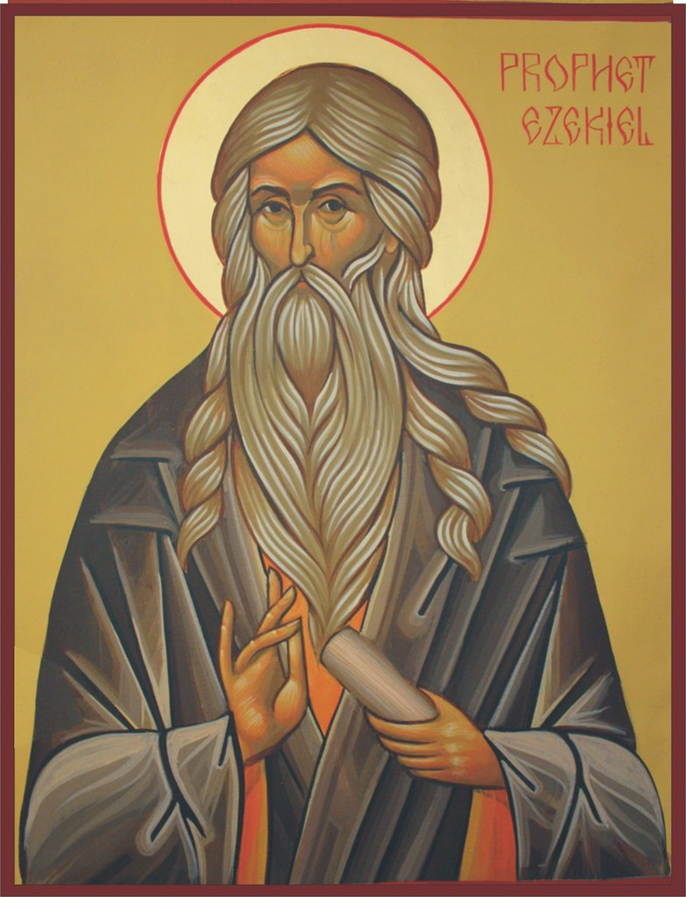
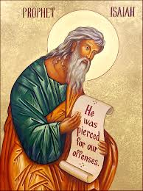
Satan’s Original State and First Sin
Ezekiel 28:12-17
Isaiah 14:12-15

Slide 5
Original State and First Sin (cont’d)
Time of Satan’s fall
In eternity past
In between Gen. 1:1-2 (gap theory?)
After Gen 1:31 but before Gen 3

Slide 6
Gap Theory Preview
Definition of the Gap Theory
Evidence Favoring the Gap Theory
Response to Evidence Favoring the Gap Theory
Remaining Problems with the Gap Theory
Correct View of Gen. 1:1-2

Slide 7
Gap Theory Preview
Definition of the Gap Theory
Evidence Favoring the Gap Theory
Response to Evidence Favoring the Gap Theory
Remaining Problems with the Gap Theory
Correct View of Gen. 1:1-2

Slide 8
Genesis 1:1-3
“¹ In the beginning God created the heavens and the earth. ² The earth was formless and void, and darkness was over the surface of the deep, and the Spirit of God was moving over the surface of the waters. ³ Then God said, ‘Let there be light’; and there was light.”

Slide 9
Gap Theory?
Original creation brought into existence (1:1)
Billions of years & Satan's fall in between verses 1 & 2
Chaotic conditions and fossil record (1:2)
Re-creation or Renovation (1:3-31)

Slide 10
Gap Theory Preview
Definition of the Gap Theory
Evidence Favoring the Gap Theory
Response to Evidence Favoring the Gap Theory
Remaining Problems with the Gap Theory
Correct View of Gen. 1:1-2

Slide 11
The Gap Theory
NO. | Gen 1 | Evidence | Response
1. | vs. 2 | Conjunction = “but” | Conjunction = “and”
2. | vs. 2 | Hāyāh = “became” | Hāyāh = “was”
3. | vs. 2 | Tohu & Bohu = judgment | Tohu & Bohu = incompletion
4. | vs. 2 | Darkness = evil | Darkness = absence of light
5. | vs. 1, 3 | Bara & āsāh distinction | Bara & āsāh overlap
6. | vs. 2 | Lo tohu (Isa. 45:18) = God did not create the Earth desolate | Lo tohu (Isa. 45:18) = Original creation was good
7. | vs. 2 | Spirit = brooding (Eph. 4:30) | Spirit = moving

Slide 12
The Gap Theory
NO. | Scripture | Evidence | Response
8. | Gen. 1:28 | Male’ = “ to replenish” | Male’ = “to fill”
9. | Isa. 24:1 | The Earth was formerly in ruin | Context = future judgment
10. | Ezek. 28:13-14 | Satan was in a mineral garden | Context = heaven
11. | Gen. 1‒3 | Not enough time for angelic rebellion between Gen. 1:31 & 3:1 | Angelic rebellion & judgment = instantaneous
12. |  | Explanation of fossil record | Similarities between fossils and current counter parts
13. | Isa. 61:1-2 | Prophetic gaps are common | Genre confusion

Slide 13
Gap Theory Preview
Definition of the Gap Theory
Evidence Favoring the Gap Theory
Response to Evidence Favoring the Gap Theory
Remaining Problems with the Gap Theory
Correct View of Gen. 1:1-2

Slide 14
Psalm 11:3
“If the foundations are destroyed, What can the righteous do?”

Slide 15
Proverbs 18:17
“The first to plead his case seems right, Until another comes and examines him.”

Slide 16
The Gap Theory
NO. | Gen 1 | Evidence | Response
1. | vs. 2 | Conjunction = “but” | Conjunction = “and”
2. | vs. 2 | Hāyāh = “became” | Hāyāh = “was”
3. | vs. 2 | Tohu & Bohu = judgment | Tohu & Bohu = incompletion
4. | vs. 2 | Darkness = evil | Darkness = absence of light
5. | vs. 1, 3 | Bara & āsāh distinction | Bara & āsāh overlap
6. | vs. 2 | Lo tohu (Isa. 45:18) = God did not create the Earth desolate | Lo tohu (Isa. 45:18) = Original creation was good
7. | vs. 2 | Spirit = brooding (Eph. 4:30) | Spirit = moving

Slide 17
Genesis 1:1-3
“¹ In the beginning God created the heavens and the earth. ² [but] The earth was formless and void, and darkness was over the surface of the deep, and the Spirit of God was moving over the surface of the waters. ³ Then God said, ‘Let there be light’; and there was light.”

Slide 18
Genesis 1:1-3
“¹ In the beginning God created the heavens and the earth. ² [Now] The earth was formless and void, and darkness was over the surface of the deep, and the Spirit of God was moving over the surface of the waters. ³ Then God said, ‘Let there be light’; and there was light.”

Slide 19
The Gap Theory
NO. | Gen 1 | Evidence | Response
1. | vs. 2 | Conjunction = “but” | Conjunction = “and”
2. | vs. 2 | Hāyāh = “became” | Hāyāh = “was”
3. | vs. 2 | Tohu & Bohu = judgment | Tohu & Bohu = incompletion
4. | vs. 2 | Darkness = evil | Darkness = absence of light
5. | vs. 1, 3 | Bara & āsāh distinction | Bara & āsāh overlap
6. | vs. 2 | Lo tohu (Isa. 45:18) = God did not create the Earth desolate | Lo tohu (Isa. 45:18) = Original creation was good
7. | vs. 2 | Spirit = brooding (Eph. 4:30) | Spirit = moving

Slide 20
Genesis 1:1-3
“¹ In the beginning God created the heavens and the earth. ² The earth was [hāyāh; became] formless and void, and darkness was over the surface of the deep, and the Spirit of God was moving over the surface of the waters. ³ Then God said, ‘Let there be light’; and there was light.”

Slide 21
“The interpretive objection is this: the entire interpretation of geology and Genesis is made to hinge on secondary meanings of two Hebrew words. To indicate that in some cases waw may mean but, and that hayah means became, does not give full warrant to insert these meanings in Genesis 1:2 and require all geology to conform.”
Bernard Ramm
The Christian View of Science and Scripture (Grand Rapids: Eerdmans, 1954), 203.

Slide 22
Jonah 3:3
“So Jonah arose and went to Nineveh according to the word of the Lord. Now Nineveh was [hāyāh] an exceedingly great city, a three days’ walk.”
Waw + noun + hayah (qal perfect 3rd person) = “was” and not “became” in rest of OT (Judges 8:11; Jonah 3:3)

Slide 23
The Gap Theory
NO. | Gen 1 | Evidence | Response
1. | vs. 2 | Conjunction = “but” | Conjunction = “and”
2. | vs. 2 | Hāyāh = “became” | Hāyāh = “was”
3. | vs. 2 | Tohu & Bohu = judgment | Tohu & Bohu = incompletion
4. | vs. 2 | Darkness = evil | Darkness = absence of light
5. | vs. 1, 3 | Bara & āsāh distinction | Bara & āsāh overlap
6. | vs. 2 | Lo tohu (Isa. 45:18) = God did not create the Earth desolate | Lo tohu (Isa. 45:18) = Original creation was good
7. | vs. 2 | Spirit = brooding (Eph. 4:30) | Spirit = moving

Slide 24
Genesis 1:1-3
“¹ In the beginning God created the heavens and the earth. ² The earth was formless and void [tohu & bohu], and darkness was over the surface of the deep, and the Spirit of God was moving over the surface of the waters. ³ Then God said, ‘Let there be light’; and there was light.”

Slide 25
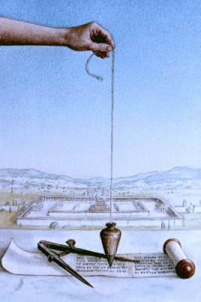
Isaiah 34:11
“But pelican and hedgehog will possess it, And owl and raven will dwell in it; And He will stretch over it the line of desolation And the plumb line of emptiness [tohu & bohu].”

Slide 26
Jeremiah 4:23-25
“²³ I looked on the earth, and behold, it was formless and void [tohu & bohu]; And to the heavens, and they had no light. ²⁴ I looked on the mountains, and behold, they were quaking, And all the hills moved to and fro. ²⁵ I looked, and behold, there was no man, And all the birds of the heavens had fled.”

Slide 27
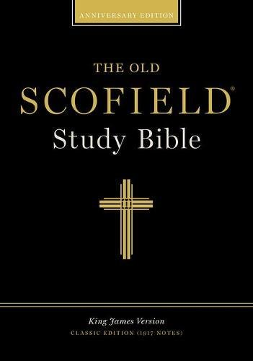
Scofield Reference Bible
Page 776 note
Jeremiah 4:23-“...[It] describes the condition of the earth as the result of judgment . . . which overthrew the primal order of Gen. I:I.”

Slide 28
“In the case of tohu and bohu…it is equally admissible to consider these words as referring to the unformed nature of the earth before God impressed upon it His creative will. A marble block and a crumbled statue are both formless. The former is in a state which awaits a form and from that formlessness emerges the image. When God made the earth He made it like a marble block out of which He would bring the beauty of the world.”
Bernard Ramm
The Christian View of Science and Scripture (Grand Rapids: Eerdmans, 1954), 203.

Slide 29
Shaping and Populating
(Gen 1:1)
Day 1: Light
Day 2: Water, sky
Day 3: Land, vegetation
Day 4: Luminaries
Day 5: Sea animals, birds
Day 6: Land animals, man

Slide 30
Ken Ham
Ken Ham et al, Answers in Genesis, rev ed. (Green Forest, AR: Master Books, 1990), 37-emphasis mine.
“Back in my father’s day, it took ten days to drive across the Australian outback during the day.”

Slide 31
George Gunn
John 14:1-3 – The Father’s House: Are We There Yet?, 30. www.pre-trib.org
“I ran out of ingredients for the salad, so I decided to make a quick run down to the store. While at the store, I left the car engine running while I made my purchase, thinking that I would be right out again. However, while I was in the store, I ran into my good friend Edward who was running for county supervisor. This resulted in my having to endure a somewhat long-winded run down on how his campaign was running. Finally, fearing that my car would run out of gas, I ran with great haste out to the parking lot and returned home with the car surely running only on fumes.”

Slide 32
Jeremiah 4:23-25
“²³ I looked on the earth, and behold, it was formless and void [tohu & bohu]; And to the heavens, and they had no light. ²⁴ I looked on the mountains, and behold, they were quaking, And all the hills moved to and fro. ²⁵ I looked, and behold, there was no man, And all the birds of the heavens had fled.”

Slide 33
Tohu & Bohu
Genesis 1:2 | Jeremiah 4:23
Original creation | Future judgment
Creation “very good” (Gen. 1:31) | Creation not “very good”
Entire earth (Gen. 1:1) | The Land of Israel
Looking backward | Looking forward
No humans | Surviving humans

Slide 34
The Gap Theory
NO. | Gen 1 | Evidence | Response
1. | vs. 2 | Conjunction = “but” | Conjunction = “and”
2. | vs. 2 | Hāyāh = “became” | Hāyāh = “was”
3. | vs. 2 | Tohu & Bohu = judgment | Tohu & Bohu = incompletion
4. | vs. 2 | Darkness = evil | Darkness = absence of light
5. | vs. 1, 3 | Bara & āsāh distinction | Bara & āsāh overlap
6. | vs. 2 | Lo tohu (Isa. 45:18) = God did not create the Earth desolate | Lo tohu (Isa. 45:18) = Original creation was good
7. | vs. 2 | Spirit = brooding (Eph. 4:30) | Spirit = moving

Slide 35
Genesis 1:1-3
“¹ In the beginning God created the heavens and the earth. ² The earth was formless and void, and darkness was over the surface of the deep, and the Spirit of God was moving over the surface of the waters. ³ Then God said, ‘Let there be light’; and there was light.”

Slide 36
John 3:19-21
“¹⁹ This is the judgment, that the Light has come into the world, and men loved the darkness rather than the Light, for their deeds were evil. ²⁰ For everyone who does evil hates the Light, and does not come to the Light for fear that his deeds will be exposed. ²¹ But he who practices the truth comes to the Light, so that his deeds may be manifested as having been wrought in God.”

Slide 37
Jude 13
“wild waves of the sea, casting up their own shame like foam; wandering stars, for whom the black darkness has been reserved forever.”

Slide 38
Genesis 1:1-3
“¹ In the beginning God created the heavens and the earth. ² The earth was formless and void, and darkness was over the surface of the deep, and the Spirit of God was moving over the surface of the waters. ³ Then God said, ‘Let there be light’; and there was light.”

Slide 39
Shaping and Populating
(Gen 1:1)
Day 1: Light
Day 2: Water, sky
Day 3: Land, vegetation
Day 4: Luminaries
Day 5: Sea animals, birds
Day 6: Land animals, man

Slide 40
The Gap Theory
NO. | Gen 1 | Evidence | Response
1. | vs. 2 | Conjunction = “but” | Conjunction = “and”
2. | vs. 2 | Hāyāh = “became” | Hāyāh = “was”
3. | vs. 2 | Tohu & Bohu = judgment | Tohu & Bohu = incompletion
4. | vs. 2 | Darkness = evil | Darkness = absence of light
5. | vs. 1, 3 | Bara & āsāh distinction | Bara & āsāh overlap
6. | vs. 2 | Lo tohu (Isa. 45:18) = God did not create the Earth desolate | Lo tohu (Isa. 45:18) = Original creation was good
7. | vs. 2 | Spirit = brooding (Eph. 4:30) | Spirit = moving

Slide 41
Genesis 1:1, 16
“¹ In the beginning God created [bara] the heavens and the earth. ² The earth was formless and void, and darkness was over the surface of the deep, and the Spirit of God was moving over the surface of the waters….¹⁶ God made [āsāh] the two great lights, the greater light to govern the day, and the lesser light to govern the night; He made the stars also.”

Slide 42
Scofield Reference Bible
Page 1 notes 3. 6
“Only three creative acts of God are recorded in this chapter: (1) the heavens and the earth, v. 1; (2) animal life, vv. 20-21; and (3) human life, vv 26-27. The first creative act refers to the dateless past. . . neither here (Genesis 1:3) nor in vv. 14-18 is an original creative act implied. A different word is used. The sense is made to appear, made visible. The sun and the moon were created 'in the beginning.' The light came from the sun, of course, but the vapor diffused the light. Later the sun appeared in an unclouded sky.”

Slide 43
Genesis 1:26-27
“²⁶ Then God said, ‘Let Us make [āsāh] man in Our image, according to Our likeness; and let them rule over the fish of the sea and over the birds of the sky and over the cattle and over all the earth, and over every creeping thing that creeps on the earth.’ ²⁷ God created [bara] man in His own image, in the image of God He created created [bara] him; male and female He created them.”

Slide 44
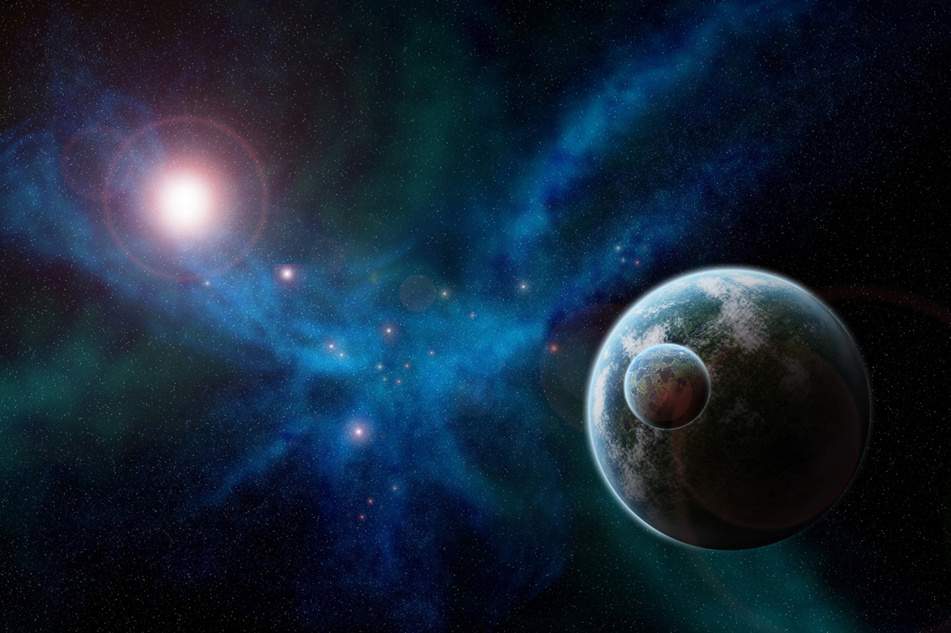
Genesis 2:4
“This is the account of the heavens and the earth when they were created created [bara], in the day that the Lord God made [āsāh] earth and heaven.”

Slide 45
Isaiah 43:7
“Everyone who is called by My name, And whom I have created [bara] for My glory, Whom I have formed, even whom I have made [āsāh].”

Slide 46
“Genesis 1:21 states that 'God created [bara] the great sea-monsters . . .' while verse 25 states that God made [asah] the beasts of the earth . . . Surely we are not to think that the sea creatures were directly created on the fifth day, but land animals were merely 'appointed' or 'made to appear' on the sixth day! All those who hold that bara and 'asah cannot be used on the same kind of divine activity are faced with a serious difficulty here. In fact, the difficulty is so severe that the New Scofield Reference Bible, in support of this distinction, suggests that the beasts which were made on the sixth day (vs. 25) were actually created on the fifth day (p. 2, note #2)!”
John Whitcomb
The Early Earth (Grand Rapids: Baker, 1952), 128.

Slide 47
The Gap Theory
NO. | Gen 1 | Evidence | Response
1. | vs. 2 | Conjunction = “but” | Conjunction = “and”
2. | vs. 2 | Hāyāh = “became” | Hāyāh = “was”
3. | vs. 2 | Tohu & Bohu = judgment | Tohu & Bohu = incompletion
4. | vs. 2 | Darkness = evil | Darkness = absence of light
5. | vs. 1, 3 | Bara & āsāh distinction | Bara & āsāh overlap
6. | vs. 2 | Lo tohu (Isa. 45:18) = God did not create the Earth desolate | Lo tohu (Isa. 45:18) = Original creation was good
7. | vs. 2 | Spirit = brooding (Eph. 4:30) | Spirit = moving

Slide 48
Isaiah 45:18
“For thus says the Lord, who created the heavens (He is the God who formed the earth and made it, He established it and did not create it a waste place [lo tohu], but formed it to be inhabited).”

Slide 49
Genesis 1:1-3
“¹ In the beginning God created the heavens and the earth. ² The earth was formless and void [tohu & bohu], and darkness was over the surface of the deep, and the Spirit of God was moving over the surface of the waters. ³ Then God said, ‘Let there be light’; and there was light.”

Slide 50
Genesis 1:31
“God saw all that He had made, and behold, it was very good. And there was evening and there was morning, the sixth day.”

Slide 51
The Gap Theory
NO. | Gen 1 | Evidence | Response
1. | vs. 2 | Conjunction = “but” | Conjunction = “and”
2. | vs. 2 | Hāyāh = “became” | Hāyāh = “was”
3. | vs. 2 | Tohu & Bohu = judgment | Tohu & Bohu = incompletion
4. | vs. 2 | Darkness = evil | Darkness = absence of light
5. | vs. 1, 3 | Bara & āsāh distinction | Bara & āsāh overlap
6. | vs. 2 | Lo tohu (Isa. 45:18) = God did not create the Earth desolate | Lo tohu (Isa. 45:18) = Original creation was good
7. | vs. 2 | Spirit = brooding (Eph. 4:30) | Spirit = moving

Slide 52
Genesis 1:2 (AMPC)
“The earth was without form and an empty waste, and darkness was upon the face of the very great deep. The Spirit of God was moving (hovering, brooding) over the face of the waters.”

Slide 53
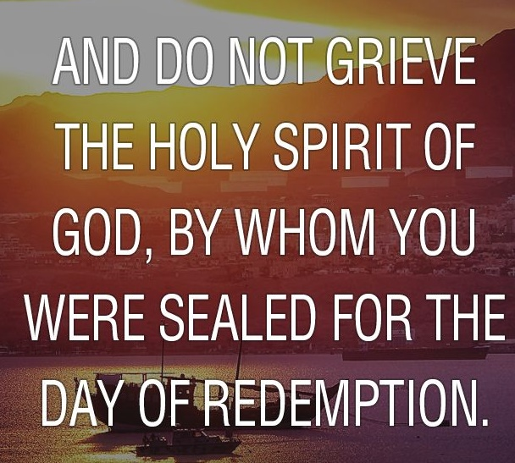
Ephesians 4:30
“Do not grieve the Holy Spirit of God, by whom you were sealed for the day of redemption.”

Slide 54
Shaping and Populating
(Gen 1:1)
Day 1: Light
Day 2: Water, sky
Day 3: Land, vegetation
Day 4: Luminaries
Day 5: Sea animals, birds
Day 6: Land animals, man

Slide 55
The Gap Theory
NO. | Scripture | Evidence | Response
8. | Gen. 1:28 | Male’ = “ to replenish” | Male’ = “to fill”
9. | Isa. 24:1 | The Earth was formerly in ruin | Context = future judgment
10. | Ezek. 28:13-14 | Satan was in a mineral garden | Context = heaven
11. | Gen. 1‒3 | Not enough time for angelic rebellion between Gen. 1:31 & 3:1 | Angelic rebellion & judgment = instantaneous
12. |  | Explanation of fossil record | Similarities between fossils and current counter parts
13. | Isa. 61:1-2 | Prophetic gaps are common | Genre confusion

Slide 56
The Gap Theory
NO. | Scripture | Evidence | Response
8. | Gen. 1:28 | Male’ = “ to replenish” | Male’ = “to fill”
9. | Isa. 24:1 | The Earth was formerly in ruin | Context = future judgment
10. | Ezek. 28:13-14 | Satan was in a mineral garden | Context = heaven
11. | Gen. 1‒3 | Not enough time for angelic rebellion between Gen. 1:31 & 3:1 | Angelic rebellion & judgment = instantaneous
12. |  | Explanation of fossil record | Similarities between fossils and current counter parts
13. | Isa. 61:1-2 | Prophetic gaps are common | Genre confusion

Slide 57
Genesis 1:28 (KJV)
“And God blessed them, and God said unto them, Be fruitful, and multiply, and replenish [male’] the earth, and subdue it: and have dominion over the fish of the sea, and over the fowl of the air, and over every living thing that moveth upon the earth.”

Slide 58
Replenish?
Gen 1:28 “replenish” (KJV)?
Male’ = “be full” or “fill” (BDB pp.569-71) and not “refill.”
No modern Bible English translation says “refill”
“Re” prefix did not always signify “again” but intensification as in “research.”

Slide 59
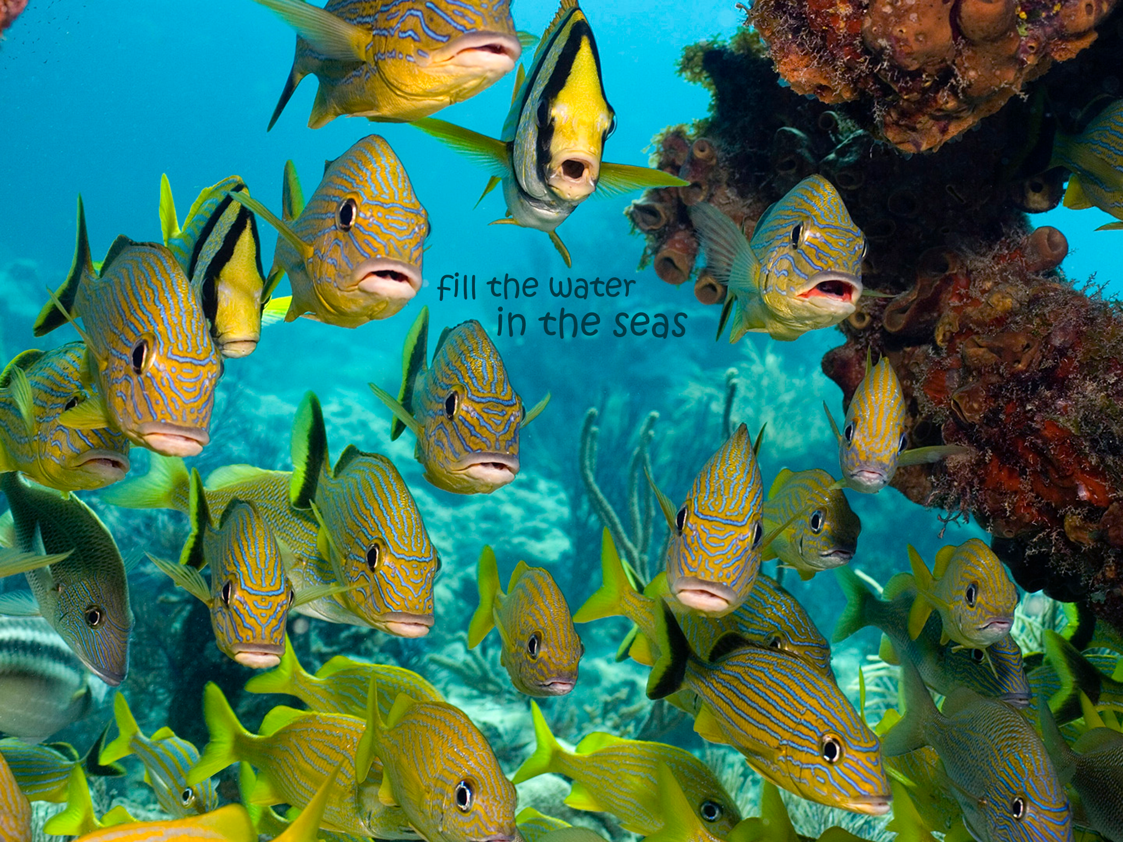
Genesis 1:22 (KJV)
“And God blessed them, saying, Be fruitful, and multiply, and fill [male’] the waters in the seas, and let fowl multiply in the earth.”

Slide 60
The Gap Theory
NO. | Scripture | Evidence | Response
8. | Gen. 1:28 | Male’ = “ to replenish” | Male’ = “to fill”
9. | Isa. 24:1 | The Earth was formerly in ruin | Context = future judgment
10. | Ezek. 28:13-14 | Satan was in a mineral garden | Context = heaven
11. | Gen. 1‒3 | Not enough time for angelic rebellion between Gen. 1:31 & 3:1 | Angelic rebellion & judgment = instantaneous
12. |  | Explanation of fossil record | Similarities between fossils and current counter parts
13. | Isa. 61:1-2 | Prophetic gaps are common | Genre confusion

Slide 61
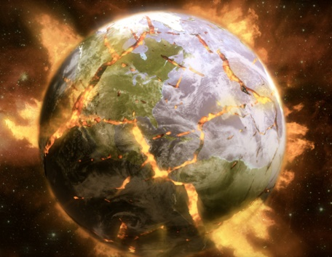
Isaiah 24:1
“Behold, the Lord lays the earth waste, devastates it, distorts its surface and scatters its inhabitants.”

Slide 62
The Gap Theory
NO. | Scripture | Evidence | Response
8. | Gen. 1:28 | Male’ = “ to replenish” | Male’ = “to fill”
9. | Isa. 24:1 | The Earth was formerly in ruin | Context = future judgment
10. | Ezek. 28:13-14 | Satan was in a mineral garden | Context = heaven
11. | Gen. 1‒3 | Not enough time for angelic rebellion between Gen. 1:31 & 3:1 | Angelic rebellion & judgment = instantaneous
12. |  | Explanation of fossil record | Similarities between fossils and current counter parts
13. | Isa. 61:1-2 | Prophetic gaps are common | Genre confusion

Slide 63
Ezekiel 28:13-14
“¹³ You were in Eden, the garden of God; Every precious stone was your covering: The ruby, the topaz and the diamond; The beryl, the onyx and the jasper; The lapis lazuli, the turquoise and the emerald; And the gold, the workmanship of your settings and sockets, Was in you. On the day that you were created They were prepared. ¹⁴ You were the anointed cherub who covers, And I placed you there. You were on the holy mountain of God; You walked in the midst of the stones of fire.”

Slide 64
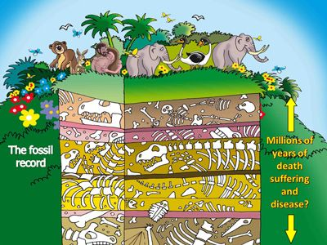

Slide 65
Ezekiel 28:16-17
“¹⁶ By the abundance of your trade You were internally filled with violence, And you sinned; Therefore I have cast you as profane From the mountain of God. And I have destroyed you, O covering cherub, From the midst of the stones of fire. ¹⁷ “Your heart was lifted up because of your beauty; You corrupted your wisdom by reason of your splendor. I cast you to the ground; I put you before kings, That they may see you.”

Slide 66
Isaiah 14:12
“How you have fallen from heaven, O star of the morning, son of the dawn! You have been cut down to the earth, You who have weakened the nations!”

Slide 67
Ezekiel 28:13-14, 16
“¹³ You were in Eden, the garden of God; Every precious stone was your covering: The ruby, the topaz and the diamond; The beryl, the onyx and the jasper; The lapis lazuli, the turquoise and the emerald; And the gold, the workmanship of your settings and sockets, Was in you. On the day that you were created They were prepared. ¹⁴ You were the anointed cherub who covers, And I placed you there. You . . .

Slide 68
Ezekiel 28:13-14, 16
. . . were on the holy mountain of God; You walked in the midst of the stones of fire… ¹⁶ By the abundance of your trade You were internally filled with violence, And you sinned; Therefore I have cast you as profane From the mountain of God. And I have destroyed you, O covering cherub, From the midst of the stones of fire.”

Slide 69
Revelation 21:10-12
“¹⁰ And he carried me away in the Spirit to a great and high mountain, and showed me the holy city, Jerusalem, coming down out of heaven from God, ¹¹ having the glory of God. Her brilliance was like a very costly stone, as a stone of crystal-clear jasper. ¹² It had a great and high wall, with twelve gates, and at the gates twelve angels; and names were written on them, which are the names of the twelve tribes of the sons of Israel.”

Slide 70
The Gap Theory
NO. | Scripture | Evidence | Response
8. | Gen. 1:28 | Male’ = “ to replenish” | Male’ = “to fill”
9. | Isa. 24:1 | The Earth was formerly in ruin | Context = future judgment
10. | Ezek. 28:13-14 | Satan was in a mineral garden | Context = heaven
11. | Gen. 1‒3 | Not enough time for angelic rebellion between Gen. 1:31 & 3:1 | Angelic rebellion & judgment = instantaneous
12. |  | Explanation of fossil record | Similarities between fossils and current counter parts
13. | Isa. 61:1-2 | Prophetic gaps are common | Genre confusion

Slide 71
The Gap Theory
NO. | Scripture | Evidence | Response
8. | Gen. 1:28 | Male’ = “ to replenish” | Male’ = “to fill”
9. | Isa. 24:1 | The Earth was formerly in ruin | Context = future judgment
10. | Ezek. 28:13-14 | Satan was in a mineral garden | Context = heaven
11. | Gen. 1‒3 | Not enough time for angelic rebellion between Gen. 1:31 & 3:1 | Angelic rebellion & judgment = instantaneous
12. |  | Explanation of fossil record | Similarities between fossils and current counter parts
13. | Isa. 61:1-2 | Prophetic gaps are common | Genre confusion

Slide 73
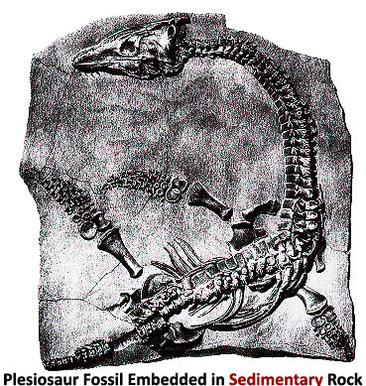

Slide 74
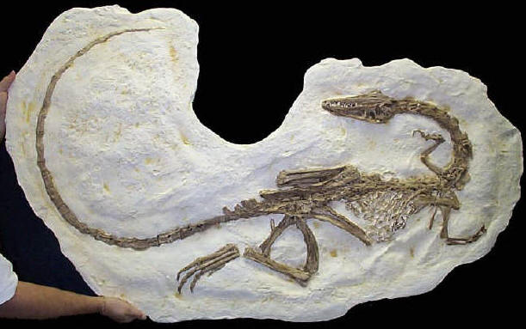

Slide 75
The Gap Theory
NO. | Scripture | Evidence | Response
8. | Gen. 1:28 | Male’ = “ to replenish” | Male’ = “to fill”
9. | Isa. 24:1 | The Earth was formerly in ruin | Context = future judgment
10. | Ezek. 28:13-14 | Satan was in a mineral garden | Context = heaven
11. | Gen. 1‒3 | Not enough time for angelic rebellion between Gen. 1:31 & 3:1 | Angelic rebellion & judgment = instantaneous
12. |  | Explanation of fossil record | Similarities between fossils and current counter parts
13. | Isa. 61:1-2 | Prophetic gaps are common | Genre confusion

Slide 77
Isaiah 9:6-7
⁶ For a child will be born to us, a son will be given to us; And the government will rest on His shoulders; And His name will be called Wonderful Counselor, Mighty God, Eternal Father, Prince of Peace.⁷ There will be no end to the increase of His government or of peace, On the throne of David and over his kingdom, To establish it and to uphold it with justice and righteousness From then on and forevermore. The zeal of the Lord of hosts will accomplish this.

Slide 78
Genre Confusion
Genesis 1:1-2 | Isaiah 9:6-7
Historical | Eschatological
Narrative | Prophetic
Looking backward | Looking forward

Slide 79
CONCLUSION

Slide 80
The Gap Theory
NO. | Gen 1 | Evidence | Response
1. | vs. 2 | Conjunction = “but” | Conjunction = “and”
2. | vs. 2 | Hāyāh = “became” | Hāyāh = “was”
3. | vs. 2 | Tohu & Bohu = judgment | Tohu & Bohu = incompletion
4. | vs. 2 | Darkness = evil | Darkness = absence of light
5. | vs. 1, 3 | Bara & āsāh distinction | Bara & āsāh overlap
6. | vs. 2 | Lo tohu (Isa. 45:18) = God did not create the Earth desolate | Lo tohu (Isa. 45:18) = Original creation was good
7. | vs. 2 | Spirit = brooding (Eph. 4:30) | Spirit = moving

Slide 81
The Gap Theory
NO. | Scripture | Evidence | Response
8. | Gen. 1:28 | Male’ = “ to replenish” | Male’ = “to fill”
9. | Isa. 24:1 | The Earth was formerly in ruin | Context = future judgment
10. | Ezek. 28:13-14 | Satan was in a mineral garden | Context = heaven
11. | Gen. 1‒3 | Not enough time for angelic rebellion between Gen. 1:31 & 3:1 | Angelic rebellion & judgment = instantaneous
12. |  | Explanation of fossil record | Similarities between fossils and current counter parts
13. | Isa. 61:1-2 | Prophetic gaps are common | Genre confusion

Slide 82
Gap Theory Preview
Definition of the Gap Theory
Evidence Favoring the Gap Theory
Response to Evidence Favoring the Gap Theory
Remaining Problems with the Gap Theory
Correct View of Gen. 1:1-2

