Slide 1
SATANOLOGY
Dr. Andy Woods
Senior Pastor – Sugar Land Bible Church
President – Chafer Theological Seminary

Slide 2
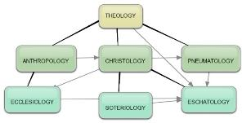
Areas of Systematic Theology
Prolegomena – Introduction
Theology – Study of God
Christology – Study of Christ
Pneumatology – Study of the Holy Spirit
Anthropology – Study of Man
Hamartiology – Study of sin
Soteriology – Study of salvation
Angelology – Study of angels
Ecclesiology – Study of the Church
Eschatology – Study of the end

Slide 3
Preview of Angelology
Good angels
Satanology
Demonology
Gen. 6:1-4 controversy

Slide 4
Preview
Existence
Personhood
Names and titles
Original state and first sin
Works

Slide 5
Preview
Existence
Personhood
Names and titles
Original state and first sin
Works

Slide 6
Existence
OT
Job 1–2; Zech 3:1; Gen 3:1 (Rev 12:9); 1 Chr 21:1
NT
Every author refers to Satan
Christ speaks of Satan 25x

Slide 7
Preview
Existence
Personhood
Names and titles
Original state and first sin
Works

Slide 8
Personhood
Elements of personhood
Intellect (2 Cor 2:11)
Emotions (Rev 12:12, 17)
Will (2 Tim 2:26)
Personal pronouns (Mt 4:10)
Moral accountability (Mt 25:41)

Slide 9
Preview
Existence
Personhood
Names and titles
Original state and first sin
Works

Slide 10
Names and Titles
Lucifer (2 Cor 11:14)
Satan (Zech 3:1)
Devil (Matt 4:11)
Serpent of old (Rev 12:9)
Destroyer (Rev 9:11)
Dragon (Rev 12:9)
Evil one (1 John 5:19)
Belial (2 Cor 6:15)
Anointed cherub (Ezek 28:14, 16)

Slide 11
Names and Titles
Prince of this world (John 12:31)
Prince and power of the air (Eph 2:2)
God of this world (2 Cor 4:4)
Beelzebub (Luke 11:15)
Tempter (Matt 4:3)
Accuser of the brethren (Rev 12:10)
Father of lies and murderer (John 8:44)
Roaring lion and adversary (1 Pet 5:8)
Enemy (Matt 13:39)

Slide 12
Preview
Existence
Personhood
Names and titles
Original state and first sin
Works

Slide 13
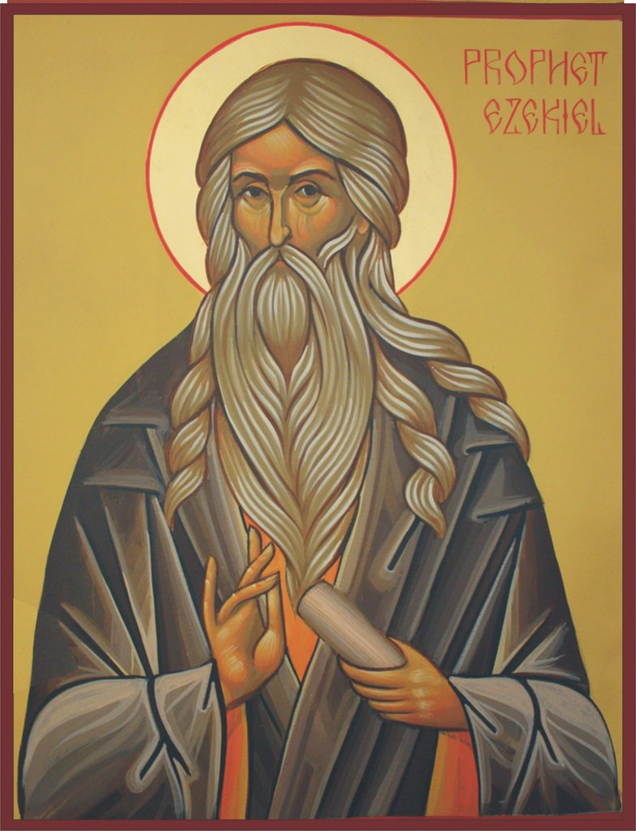
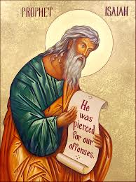
Satan’s Original State and First Sin
Ezekiel 28:12-17
Isaiah 14:12-15

Slide 14
Satan’s Original State and First Sin
Ezekiel 28:12-17
Isaiah 14:12-15

Slide 15
Original State and First Sin
Ezek 28:12-17
Attributes
Creature (15)
Angel (14, 16)
Powerful (14)
Without sin (15)
Beautiful (12-13)
Intelligent (12)
Nature of 1st sin (17)

Slide 16
Original State and First Sin (cont’d)
Ezek 28:12-17
Consequences
Fell (16-17)
Retains some access to heaven (Job 1:6; 2:1)
Some angels fell with him (14)
Fallen angels confirmed in wickedness (Matt 25:41)
Darkened thought process (17)

Slide 17
Satan’s Original State and First Sin
Ezekiel 28:12-17
Isaiah 14:12-15

Slide 18
Original State and First Sin (cont’d)
Isaiah 14:12-15
5 “I will” statements
Ascend to heaven (13)
Raise my throne above the stars of God (13)
Sit enthroned on the Mt. of the Assembly (13)
Ascend above the tops of the clouds (14)
Make myself like the Most High (14)

Slide 19
Original State and First Sin (cont’d)
Isaiah 14:12-15
3 Consequences
Fell (15)
Name changed from Lucifer (12) to Satan (Matt 16:23)
Banished from heaven (12)

Slide 20
Original State and First Sin (cont’d)
Time of Satan’s fall
In eternity past
In between Gen. 1:1-2 (gap theory?)
After Gen 1:31 but before Gen 3

Slide 21
Original State and First Sin (cont’d)
Time of Satan’s fall
In eternity past
In between Gen. 1:1-2 (gap theory?)
After Gen 1:31 but before Gen 3

Slide 22
Ezekiel 28:16-17
“¹⁶ By the abundance of your trade You were internally filled with violence, And you sinned; Therefore I have cast you as profane From the mountain of God. And I have destroyed you, O covering cherub, From the midst of the stones of fire. ¹⁷ “Your heart was lifted up because of your beauty; You corrupted your wisdom by reason of your splendor. I cast you to the ground; I put you before kings, That they may see you.”

Slide 23
Isaiah 14:12
“How you have fallen from heaven, O star of the morning, son of the dawn! You have been cut down to the earth, You who have weakened the nations!”

Slide 24
Original State and First Sin (cont’d)
Time of Satan’s fall
In eternity past
In between Gen. 1:1-2 (gap theory?)
After Gen 1:31 but before Gen 3

Slide 25
Gap Theory Preview
Definition of the Gap Theory
Evidence Favoring the Gap Theory
Response to Evidence Favoring the Gap Theory
Remaining Problems with the Gap Theory
Correct View of Gen. 1:1-2

Slide 26
Gap Theory Preview
Definition of the Gap Theory
Evidence Favoring the Gap Theory
Response to Evidence Favoring the Gap Theory
Remaining Problems with the Gap Theory
Correct View of Gen. 1:1-2

Slide 27
Genesis 1:1-3
“¹ In the beginning God created the heavens and the earth. ² The earth was formless and void, and darkness was over the surface of the deep, and the Spirit of God was moving over the surface of the waters. ³ Then God said, ‘Let there be light’; and there was light.”

Slide 28
Gap Theory?
Original creation brought into existence (1:1)
Billions of years & Satan's fall in between verses 1 & 2
Chaotic conditions and fossil record (1:2)
Re-creation or Renovation (1:3-31)

Slide 29
Gap Theory?
Original creation brought into existence (1:1)
Billions of years & Satan's fall in between verses 1 & 2
Chaotic conditions and fossil record (1:2)
Re-creation or Renovation (1:3-31)

Slide 30
Genesis 1:1-3
“¹ In the beginning God created the heavens and the earth. ² The earth was formless and void, and darkness was over the surface of the deep, and the Spirit of God was moving over the surface of the waters. ³ Then God said, ‘Let there be light’; and there was light.”

Slide 31
Gap Theory?
Original creation brought into existence (1:1)
Billions of years & Satan's fall in between verses 1 & 2
Chaotic conditions and fossil record (1:2)
Re-creation or Renovation (1:3-31)

Slide 32
Genesis 1:1-3
“¹ In the beginning God created the heavens and the earth. ² The earth was formless and void, and darkness was over the surface of the deep, and the Spirit of God was moving over the surface of the waters. ³ Then God said, ‘Let there be light’; and there was light.”

Slide 33
Gap Theory?
Original creation brought into existence (1:1)
Billions of years & Satan's fall in between verses 1 & 2
Chaotic conditions and fossil record (1:2)
Re-creation or Renovation (1:3-31)

Slide 34
Genesis 1:1-3
“¹ In the beginning God created the heavens and the earth. ² The earth was formless and void, and darkness was over the surface of the deep, and the Spirit of God was moving over the surface of the waters. ³ Then God said, ‘Let there be light’; and there was light.”

Slide 35
Gap Theory?
Original creation brought into existence (1:1)
Billions of years & Satan's fall in between verses 1 & 2
Chaotic conditions and fossil record (1:2)
Re-creation or Renovation (1:3-31)

Slide 36
Genesis 1:1-3
“¹ In the beginning God created the heavens and the earth. ² The earth was formless and void, and darkness was over the surface of the deep, and the Spirit of God was moving over the surface of the waters. ³ Then God said, ‘Let there be light’; and there was light.”

Slide 37
Gap Theory Preview
Definition of the Gap Theory
Evidence Favoring the Gap Theory
Response to Evidence Favoring the Gap Theory
Remaining Problems with the Gap Theory
Correct View of Gen. 1:1-2

Slide 38
The Gap Theory
NO. | Gen 1 | Evidence | Response
1. | vs. 2 | Conjunction = “but” | Conjunction = “and”
2. | vs. 2 | Hāyāh = “became” | Hāyāh = “was”
3. | vs. 2 | Tohu & Bohu = judgment | Tohu & Bohu = incompletion
4. | vs. 2 | Darkness = evil | Darkness = absence of light
5. | vs. 1, 3 | Bara & āsāh distinction | Bara & āsāh overlap
6. | vs. 2 | Lo tohu (Isa. 45:18) = God did not create the Earth desolate | Lo tohu (Isa. 45:18) = Original creation was good
7. | vs. 2 | Spirit = brooding (Eph. 4:30) | Spirit = moving

Slide 39
The Gap Theory
NO. | Gen 1 | Evidence | Response
1. | vs. 2 | Conjunction = “but” | Conjunction = “and”
2. | vs. 2 | Hāyāh = “became” | Hayah = “was”
3. | vs. 2 | Tohu & Bohu = judgment | Tohu & Bohu = incompletion
4. | vs. 2 | Darkness = evil | Darkness = absence of light
5. | vs. 1, 3 | Bara & āsāh distinction | Bara & Asah overlap
6. | vs. 2 | Lo tohu (Isa. 45:18) = God did not create the Earth desolate | Lo tohu (Isa. 45:18) = Original creation was good
7. | vs. 2 | Spirit = brooding (Eph. 4:30) | Spirit = moving

Slide 40
Genesis 1:1-3
“¹ In the beginning God created the heavens and the earth. ² [but] The earth was formless and void, and darkness was over the surface of the deep, and the Spirit of God was moving over the surface of the waters. ³ Then God said, ‘Let there be light’; and there was light.”

Slide 41
The Gap Theory
NO. | Gen 1 | Evidence | Response
1. | vs. 2 | Conjunction = “but” | Conjunction = “and”
2. | vs. 2 | Hāyāh = “became” | Hayah = “was”
3. | vs. 2 | Tohu & Bohu = judgment | Tohu & Bohu = incompletion
4. | vs. 2 | Darkness = evil | Darkness = absence of light
5. | vs. 1, 3 | Bara & āsāh distinction | Bara & Asah overlap
6. | vs. 2 | Lo tohu (Isa. 45:18) = God did not create the Earth desolate | Lo tohu (Isa. 45:18) = Original creation was good
7. | vs. 2 | Spirit = brooding (Eph. 4:30) | Spirit = moving

Slide 42
Genesis 1:1-3
“¹ In the beginning God created the heavens and the earth. ² The earth was [hāyāh; became] formless and void, and darkness was over the surface of the deep, and the Spirit of God was moving over the surface of the waters. ³ Then God said, ‘Let there be light’; and there was light.”

Slide 43
The Gap Theory
NO. | Gen 1 | Evidence | Response
1. | vs. 2 | Conjunction = “but” | Conjunction = “and”
2. | vs. 2 | Hāyāh = “became” | Hayah = “was”
3. | vs. 2 | Tohu & Bohu = judgment | Tohu & Bohu = incompletion
4. | vs. 2 | Darkness = evil | Darkness = absence of light
5. | vs. 1, 3 | Bara & āsāh distinction | Bara & Asah overlap
6. | vs. 2 | Lo tohu (Isa. 45:18) = God did not create the Earth desolate | Lo tohu (Isa. 45:18) = Original creation was good
7. | vs. 2 | Spirit = brooding (Eph. 4:30) | Spirit = moving

Slide 44
Genesis 1:1-3
“¹ In the beginning God created the heavens and the earth. ² The earth was formless and void [tohu & bohu], and darkness was over the surface of the deep, and the Spirit of God was moving over the surface of the waters. ³ Then God said, ‘Let there be light’; and there was light.”

Slide 45
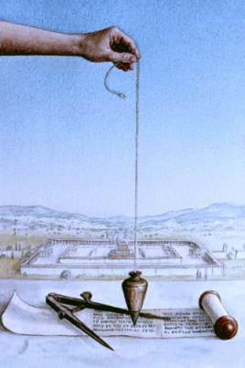
Isaiah 34:11
“But pelican and hedgehog will possess it, And owl and raven will dwell in it; And He will stretch over it the line of desolation And the plumb line of emptiness [tohu & bohu].”

Slide 46
Jeremiah 4:23-25
“²³ I looked on the earth, and behold, it was formless and void [tohu & bohu]; And to the heavens, and they had no light. ²⁴ I looked on the mountains, and behold, they were quaking, And all the hills moved to and fro. ²⁵ I looked, and behold, there was no man, And all the birds of the heavens had fled.”

Slide 47
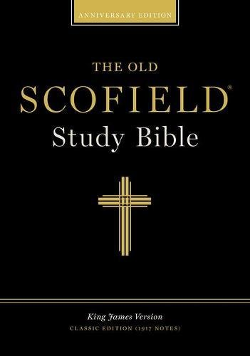
Scofield Reference Bible
Page 776 note
Jeremiah 4:23-“...[It] describes the condition of the earth as the result of judgment . . . which overthrew the primal order of Gen. I:I.”

Slide 48
The Gap Theory
NO. | Gen 1 | Evidence | Response
1. | vs. 2 | Conjunction = “but” | Conjunction = “and”
2. | vs. 2 | Hāyāh = “became” | Hayah = “was”
3. | vs. 2 | Tohu & Bohu = judgment | Tohu & Bohu = incompletion
4. | vs. 2 | Darkness = evil | Darkness = absence of light
5. | vs. 1, 3 | Bara & āsāh distinction | Bara & Asah overlap
6. | vs. 2 | Lo tohu (Isa. 45:18) = God did not create the Earth desolate | Lo tohu (Isa. 45:18) = Original creation was good
7. | vs. 2 | Spirit = brooding (Eph. 4:30) | Spirit = moving

Slide 49
Genesis 1:1-3
“¹ In the beginning God created the heavens and the earth. ² The earth was formless and void, and darkness was over the surface of the deep, and the Spirit of God was moving over the surface of the waters. ³ Then God said, ‘Let there be light’; and there was light.”

Slide 50
John 3:19-21
“¹⁹ This is the judgment, that the Light has come into the world, and men loved the darkness rather than the Light, for their deeds were evil. ²⁰ For everyone who does evil hates the Light, and does not come to the Light for fear that his deeds will be exposed. ²¹ But he who practices the truth comes to the Light, so that his deeds may be manifested as having been wrought in God.”

Slide 51
Jude 13
“wild waves of the sea, casting up their own shame like foam; wandering stars, for whom the black darkness has been reserved forever.”

Slide 52
The Gap Theory
NO. | Gen 1 | Evidence | Response
1. | vs. 2 | Conjunction = “but” | Conjunction = “and”
2. | vs. 2 | Hāyāh = “became” | Hayah = “was”
3. | vs. 2 | Tohu & Bohu = judgment | Tohu & Bohu = incompletion
4. | vs. 2 | Darkness = evil | Darkness = absence of light
5. | vs. 1, 3 | Bara & āsāh distinction | Bara & Asah overlap
6. | vs. 2 | Lo tohu (Isa. 45:18) = God did not create the Earth desolate | Lo tohu (Isa. 45:18) = Original creation was good
7. | vs. 2 | Spirit = brooding (Eph. 4:30) | Spirit = moving

Slide 53
Genesis 1:1, 16
“¹ In the beginning God created [bara] the heavens and the earth. ² The earth was formless and void, and darkness was over the surface of the deep, and the Spirit of God was moving over the surface of the waters….¹⁶ God made [āsāh] the two great lights, the greater light to govern the day, and the lesser light to govern the night; He made the stars also.”

Slide 54
Scofield Reference Bible
Page 1 notes 3. 6
“Only three creative acts of God are recorded in this chapter: (1) the heavens and the earth, v. 1; (2) animal life, vv. 20-21; and (3) human life, vv 26-27. The first creative act refers to the dateless past. . . neither here (Genesis 1:3) nor in vv. 14-18 is an original creative act implied. A different word is used. The sense is made to appear, made visible. The sun and the moon were created 'in the beginning.' The light came from the sun, of course, but the vapor diffused the light. Later the sun appeared in an unclouded sky.”

Slide 55
The Gap Theory
NO. | Gen 1 | Evidence | Response
1. | vs. 2 | Conjunction = “but” | Conjunction = “and”
2. | vs. 2 | Hāyāh = “became” | Hayah = “was”
3. | vs. 2 | Tohu & Bohu = judgment | Tohu & Bohu = incompletion
4. | vs. 2 | Darkness = evil | Darkness = absence of light
5. | vs. 1, 3 | Bara & āsāh distinction | Bara & Asah overlap
6. | vs. 2 | Lo tohu (Isa. 45:18) = God did not create the Earth desolate | Lo tohu (Isa. 45:18) = Original creation was good
7. | vs. 2 | Spirit = brooding (Eph. 4:30) | Spirit = moving

Slide 56
Isa. 45:18
“For thus says the Lord, who created the heavens (He is the God who formed the earth and made it, He established it and did not create it a waste place [lo tohu], but formed it to be inhabited).”

Slide 57
Genesis 1:1-3
“¹ In the beginning God created the heavens and the earth. ² The earth was formless and void [tohu & bohu], and darkness was over the surface of the deep, and the Spirit of God was moving over the surface of the waters. ³ Then God said, ‘Let there be light’; and there was light.”

Slide 58
The Gap Theory
NO. | Gen 1 | Evidence | Response
1. | vs. 2 | Conjunction = “but” | Conjunction = “and”
2. | vs. 2 | Hāyāh = “became” | Hayah = “was”
3. | vs. 2 | Tohu & Bohu = judgment | Tohu & Bohu = incompletion
4. | vs. 2 | Darkness = evil | Darkness = absence of light
5. | vs. 1, 3 | Bara & āsāh distinction | Bara & Asah overlap
6. | vs. 2 | Lo tohu (Isa. 45:18) = God did not create the Earth desolate | Lo tohu (Isa. 45:18) = Original creation was good
7. | vs. 2 | Spirit = brooding (Eph. 4:30) | Spirit = moving

Slide 59
Genesis 1:2 (AMPC)
“The earth was without form and an empty waste, and darkness was upon the face of the very great deep. The Spirit of God was moving (hovering, brooding) over the face of the waters.”

Slide 60
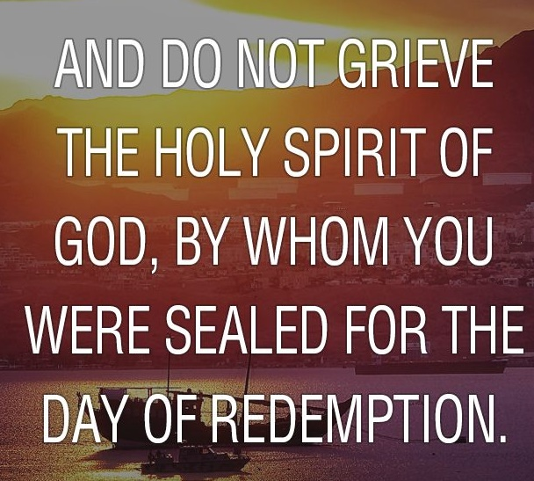
Ephesians 4:30
“Do not grieve the Holy Spirit of God, by whom you were sealed for the day of redemption.”

Slide 61
The Gap Theory
NO. | Scripture | Evidence | Response
8. | Gen. 1:28 | Male’ = “ to replenish” | Male’ = “to fill”
9. | Isa. 24:1 | The Earth was formerly in ruin | Context = future judgment
10. | Ezek. 28:13-14 | Satan was in a mineral garden | Context = heaven
11. | Gen. 1‒3 | Not enough time for angelic rebellion between Gen. 1:31 & 3:1 | Angelic rebellion & judgment = instantaneous
12. |  | Explanation of fossil record | Similarities between fossils and current counter parts
13. | Isa. 61:1-2 | Prophetic gaps are common | Genre confusion

Slide 62
The Gap Theory
NO. | Scripture | Evidence | Response
8. | Gen. 1:28 | Male’ = “ to replenish” | Male’ = “to fill”
9. | Isa. 24:1 | The Earth was formerly in ruin | Context = future judgment
10. | Ezek. 28:13-14 | Satan was in a mineral garden | Context = heaven
11. | Gen. 1‒3 | Not enough time for angelic rebellion between Gen. 1:31 & 3:1 | Angelic rebellion & judgment = instantaneous
12. |  | Explanation of fossil record | Similarities between fossils and current counter parts
13. | Isa. 61:1-2 | Prophetic gaps are common | Genre confusion

Slide 63
Genesis 1:28 (KJV)
“And God blessed them, and God said unto them, Be fruitful, and multiply, and replenish [male’] the earth, and subdue it: and have dominion over the fish of the sea, and over the fowl of the air, and over every living thing that moveth upon the earth.”

Slide 64
The Gap Theory
NO. | Scripture | Evidence | Response
8. | Gen. 1:28 | Male’ = “ to replenish” | Male’ = “to fill”
9. | Isa. 24:1 | The Earth was formerly in ruin | Context = future judgment
10. | Ezek. 28:13-14 | Satan was in a mineral garden | Context = heaven
11. | Gen. 1‒3 | Not enough time for angelic rebellion between Gen. 1:31 & 3:1 | Angelic rebellion & judgment = instantaneous
12. |  | Explanation of fossil record | Similarities between fossils and current counter parts
13. | Isa. 61:1-2 | Prophetic gaps are common | Genre confusion

Slide 65
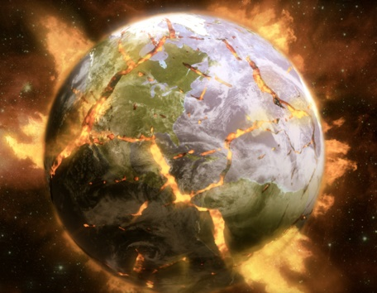
Isaiah 24:1
“Behold, the Lord lays the earth waste, devastates it, distorts its surface and scatters its inhabitants.”

Slide 66
The Gap Theory
NO. | Scripture | Evidence | Response
8. | Gen. 1:28 | Male’ = “ to replenish” | Male’ = “to fill”
9. | Isa. 24:1 | The Earth was formerly in ruin | Context = future judgment
10. | Ezek. 28:13-14 | Satan was in a mineral garden | Context = heaven
11. | Gen. 1‒3 | Not enough time for angelic rebellion between Gen. 1:31 & 3:1 | Angelic rebellion & judgment = instantaneous
12. |  | Explanation of fossil record | Similarities between fossils and current counter parts
13. | Isa. 61:1-2 | Prophetic gaps are common | Genre confusion

Slide 67
Ezekiel 28:13-14
“¹³ You were in Eden, the garden of God; Every precious stone was your covering: The ruby, the topaz and the diamond; The beryl, the onyx and the jasper; The lapis lazuli, the turquoise and the emerald; And the gold, the workmanship of your settings and sockets, Was in you. On the day that you were created They were prepared. ¹⁴ You were the anointed cherub who covers, And I placed you there. You were on the holy mountain of God; You walked in the midst of the stones of fire.”

Slide 68
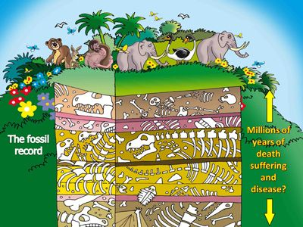

Slide 69
The Gap Theory
NO. | Scripture | Evidence | Response
8. | Gen. 1:28 | Male’ = “ to replenish” | Male’ = “to fill”
9. | Isa. 24:1 | The Earth was formerly in ruin | Context = future judgment
10. | Ezek. 28:13-14 | Satan was in a mineral garden | Context = heaven
11. | Gen. 1‒3 | Not enough time for angelic rebellion between Gen. 1:31 & 3:1 | Angelic rebellion & judgment = instantaneous
12. |  | Explanation of fossil record | Similarities between fossils and current counter parts
13. | Isa. 61:1-2 | Prophetic gaps are common | Genre confusion

Slide 70
The Gap Theory
NO. | Scripture | Evidence | Response
8. | Gen. 1:28 | Male’ = “ to replenish” | Male’ = “to fill”
9. | Isa. 24:1 | The Earth was formerly in ruin | Context = future judgment
10. | Ezek. 28:13-14 | Satan was in a mineral garden | Context = heaven
11. | Gen. 1‒3 | Not enough time for angelic rebellion between Gen. 1:31 & 3:1 | Angelic rebellion & judgment = instantaneous
12. |  | Explanation of fossil record | Similarities between fossils and current counter parts
13. | Isa. 61:1-2 | Prophetic gaps are common | Genre confusion

Slide 71
The Gap Theory
NO. | Scripture | Evidence | Response
8. | Gen. 1:28 | Male’ = “ to replenish” | Male’ = “to fill”
9. | Isa. 24:1 | The Earth was formerly in ruin | Context = future judgment
10. | Ezek. 28:13-14 | Satan was in a mineral garden | Context = heaven
11. | Gen. 1‒3 | Not enough time for angelic rebellion between Gen. 1:31 & 3:1 | Angelic rebellion & judgment = instantaneous
12. |  | Explanation of fossil record | Similarities between fossils and current counter parts
13. | Isa. 61:1-2 | Prophetic gaps are common | Genre confusion

Slide 72
Isaiah 9:6-7
⁶ For a child will be born to us, a son will be given to us; And the government will rest on His shoulders; And His name will be called Wonderful Counselor, Mighty God, Eternal Father, Prince of Peace.⁷ There will be no end to the increase of His government or of peace, On the throne of David and over his kingdom, To establish it and to uphold it with justice and righteousness From then on and forevermore. The zeal of the Lord of hosts will accomplish this.

Slide 73
Zechariah 9:9-10
⁹ Rejoice greatly, O daughter of Zion! Shout in triumph, O daughter of Jerusalem! Behold, your king is coming to you; He is just and endowed with salvation, Humble, and mounted on a donkey, Even on a colt, the foal of a donkey.¹⁰ I will cut off the chariot from Ephraim And the horse from Jerusalem; And the bow of war will be cut off. And He will speak peace to the nations; And His dominion will be from sea to sea, And from the River to the ends of the earth..

Slide 74
Isaiah 61:1-2
¹ The Spirit of the Lord God is upon me, Because the Lord has anointed me To bring good news to the afflicted; He has sent me to bind up the brokenhearted, To proclaim liberty to captives And freedom to prisoners;² To proclaim the favorable year of the Lord And the day of vengeance of our God; To comfort all who mourn.

Slide 75
Luke 4:16-21
¹⁶ And He came to Nazareth, where He had been brought up; and as was His custom, He entered the synagogue on the Sabbath, and stood up to read. ¹⁷ And the book of the prophet Isaiah was handed to Him. And He opened the book and found the place where it was written,¹⁸ “The Spirit of the Lord is upon Me, Because He anointed Me to preach the gospel to the poor. He has sent Me to proclaim release to the captives, And recovery of sight to the blind, To set …

Slide 76
Luke 4:16-21
…free those who are oppressed, ¹⁹ To proclaim the favorable year of the Lord.” ²⁰ And He closed the book, gave it back to the attendant and sat down; and the eyes of all in the synagogue were fixed on Him. ²¹ And He began to say to them, “Today this Scripture has been fulfilled in your hearing.”

Slide 77
Isaiah 61:1-2
¹ The Spirit of the Lord God is upon me, Because the Lord has anointed me To bring good news to the afflicted; He has sent me to bind up the brokenhearted, To proclaim liberty to captives And freedom to prisoners;² To proclaim the favorable year of the Lord And the day of vengeance of our God; To comfort all who mourn.

Slide 78
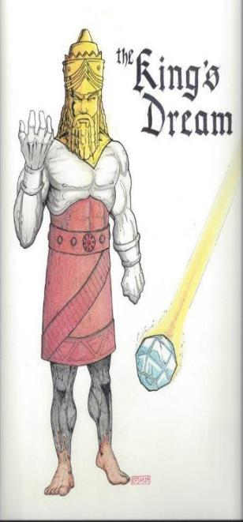
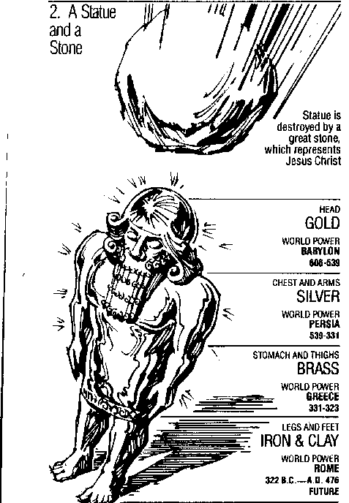
Statue
&
Stone

Slide 80
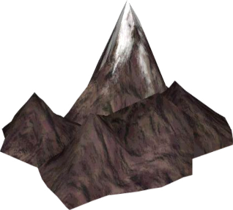
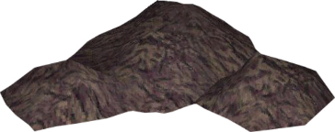
Understanding Daniel’s
Prophetic Perspective
Antichrist
Antiochus IV
(Daniel 11:36-45)
(Daniel 11:21-35)
Far
Fulfillment
Near
Fulfillment
Daniel

Slide 82
1 Peter 1:10-11
¹⁰ As to this salvation, the prophets who prophesied of the grace that would come to you made careful searches and inquiries, ¹¹ seeking to know what person or time the Spirit of Christ within them was indicating as He predicted the sufferings of Christ and the glories to follow.

Slide 83
Gap Theory Preview
Definition of the Gap Theory
Evidence Favoring the Gap Theory
Response to Evidence Favoring the Gap Theory
Remaining Problems with the Gap Theory
Correct View of Gen. 1:1-2

Slide 84
Psalm 11:3
“If the foundations are destroyed, What can the righteous do?”

Slide 85
Proverbs 18:17
“The first to plead his case seems right, Until another comes and examines him.”

Slide 86
CONCLUSION

Slide 87
Preview
Existence
Personhood
Names and titles
Original state and first sin
Works

