Slide 1


Dr. Andy Woods
Senior Pastor – Sugar Land Bible Church
President – Chafer Theological Seminary

Slide 2


Slide 3
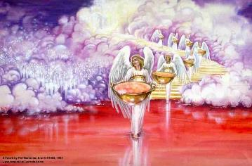
Bowl Judgments
Revelation 15‒16
Bowl Judgment Preparation (Rev. 15)
Bowl Judgement Manifestation (Rev. 16)

Slide 4
Bowl Judgments
Revelation 15‒16
Bowl Judgment Preparation (Rev. 15)
Bowl Judgement Manifestation (Rev. 16)

Slide 5
Bowl Judgments
Revelation 15‒16
Bowl Judgment Preparation (Rev. 15)
Bowl Judgement Manifestation (Rev. 16)

Slide 6


Seven Bowls
(Revelation 16)
1st Bowl (16:1-2) – Boils
2nd Bowl (16:3) – Sea becomes blood
3rd Bowl (16:4-7) – Freshwater destroyed
4th Bowl (16:8-9) – Sun scorches man
5th Bowl (16:10-11) – Darkness
6th Bowl (16:13-16) – Euphrates dried
7th Bowl (16:17-21) – Greatest earthquake

Slide 7
Seven Bowls
(Revelation 16)
1st Bowl (16:1-2) – Boils
2nd Bowl (16:3) – Sea becomes blood
3rd Bowl (16:4-7) – Freshwater destroyed
4th Bowl (16:8-9) – Sun scorches man
5th Bowl (16:10-11) – Darkness
6th Bowl (16:13-16) – Euphrates dried
7th Bowl (16:17-21) – Greatest earthquake

Slide 8



Slide 9
Seven Bowls
(Revelation 16)
1st Bowl (16:1-2) – Boils
2nd Bowl (16:3) – Sea becomes blood
3rd Bowl (16:4-7) – Freshwater destroyed
4th Bowl (16:8-9) – Sun scorches man
5th Bowl (16:10-11) – Darkness
6th Bowl (16:13-16) – Euphrates dried
7th Bowl (16:17-21) – Greatest earthquake

Slide 10


Seven Trumpets
(Revelation 8‒11)
1st Trumpet (8:7) – 1/3 vegetation destroyed
2nd Trumpet (8:8-9) – 1/3 ocean destroyed
3rd Trumpet (8:10-11) – 1/3 water destroyed
4th Trumpet (8:12-13) – 1/3 luminaries darkened
5th Trumpet (9:1-12) – Demons released
6th Trumpet (9:13-21) – 1/3 humanity destroyed
7th Trumpet (11:14-19) – Legal transfer announced

Slide 11
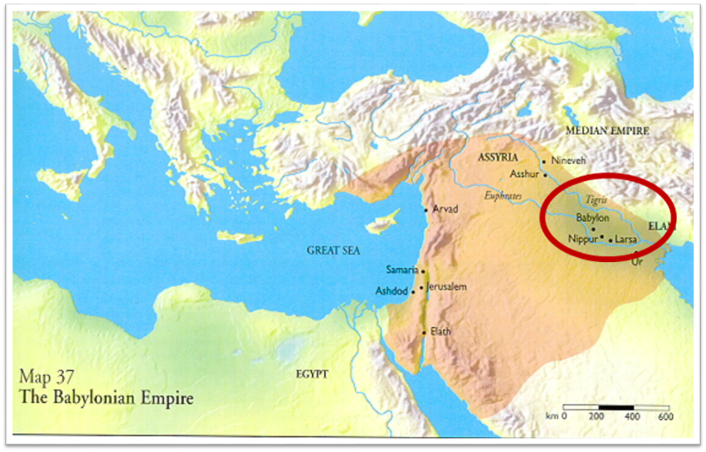

Slide 12
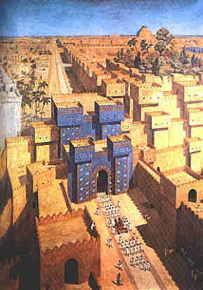
East = Babylon
Genesis 2:8 (Eden)
Genesis 11:2 (Shinar)
Matthew 2:2 (Magi)

Slide 13
Literal Geography in Revelation
Asia | 1:4 | Philadelphia | 3:7
Ephesus | 2:1 | Laodicea | 3:14
Smyrna | 2:8 | Euphrates | 9:14;16:12
Pergamum | 2:12 | Jerusalem | 11:8
Thyatira | 2:18 | Armageddon | 16:16
Sardis | 3:1 | Jerusalem | 20:9

Slide 14
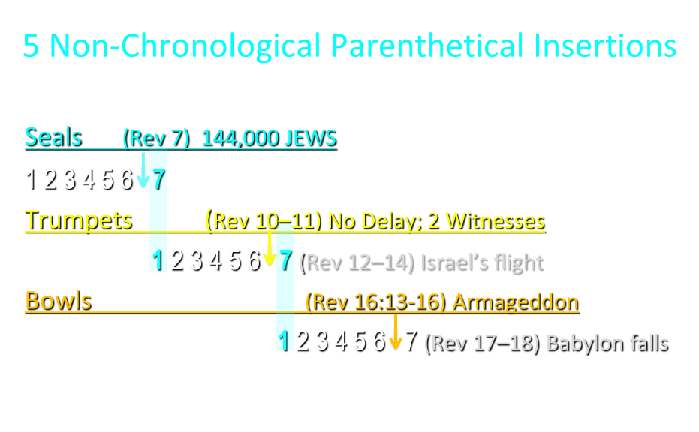

Slide 15
5 Non-Chronological Parenthetical Insertions
Rev 7 – 144,000 Jews
Rev 10:1-11:13 – Announcement of no more delay and the two witnesses
Rev 12-14 – Israel’s flight, two beasts, six scenes of hope
Rev 16:13-16 – Gathering of the nations to Armageddon
Rev 17:1-19:6 – Babylon’s fall

Slide 16
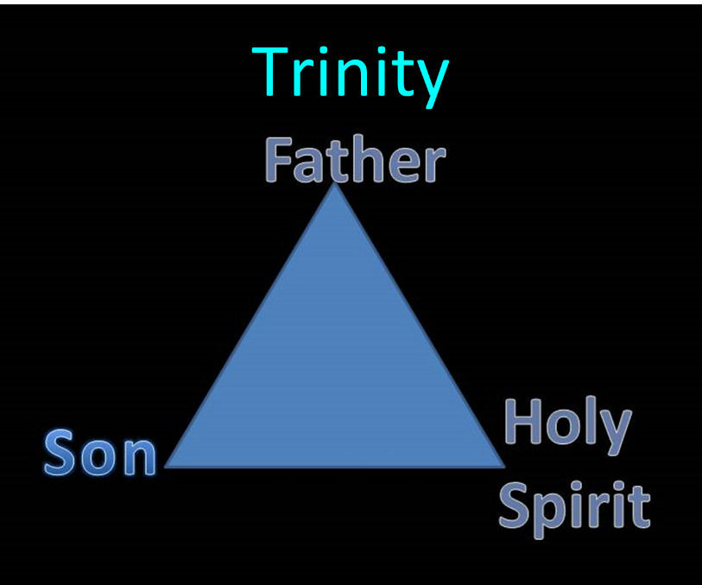

Slide 17
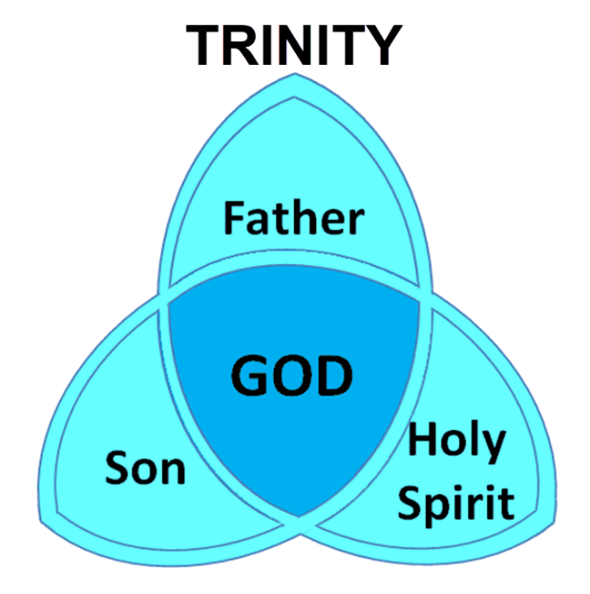

Slide 18
How Satan Imitates God and the Antichrist Imitates Jesus Christ
NO. | CATEGORY | JESUS CHRIST | ANTICHRIST
1. | World prepared in advance | Gal. 4:4 | 2 Thess. 2:7
2. | Revealed at the proper time | Gal. 4:4 | 2 Thess. 2:6
3. | Claim of deity | John 14:9 | 2 Thess. 2:4
4. | Heralded by a forerunner | John 1:23 | Rev. 13:12
5. | Forerunner comes in the Spirit and power of Elijah | Luke 1:17 | 1 Kgs. 8:37-38; Rev. 13:13
6. | Empowered by a higher source | 1 Cor. 6:14 | Rev. 13:14
7. | Member of a Trinity | Phil. 1:2; Acts 5:3-4; John 14:9 | Rev. 16:13; 20:10
8. | Head of a Church | Eph. 5:23 | Rev. 2:9; 3:9
9. | Miracle worker | Acts 2:22 | 2 Thess. 2:9
10. | Resurrection from the dead | 1 Cor. 15:3-6 | Rev. 13:3, 12, 14
11. | Given a throne | Rev. 3:21 | Rev. 13:2

Slide 19
How Satan Imitates God and the Antichrist Imitates Jesus Christ
NO. | CATEGORY | JESUS CHRIST | ANTICHRIST
12. | Ruling a political kingdom | Isa. 9:6-7 | Rev. 13:5
13. | Ushering in world peace | Isa. 9:6-7 | Rev. 6:1-4
14. | Activity in the Temple | Luke 2:41-50 | 2 Thess. 2:4
15. | Putting an end to animal sacrifices | Heb. 9:26-29 | Dan. 9:27
16. | Length of ministry | Over 3 years | Rev. 13:5
17. | Sealing ministry | Eph. 4:30 | Rev. 13:16-17
18. | Presentation to Israel as her Messiah | John 1:11 | John 5:43
19. | Covenant with Israel | Gen. 15:18 | Dan. 9:27
20. | Reception of worship | Zech. 14:16 | 2 Thess. 2:4
21. | Establishing Jerusalem as the center of worldwide worship | Zech. 14:17 | 2 Thess. 2:4

Slide 20
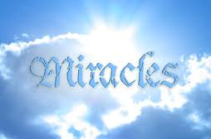
Satanic/Demonic Miracles
Exod 7–8
Deut 13:1-3
Matt 7:21-23; 24:24
Acts 8:9; 16:16
Gal 1:6-9
2 Thess 2:9
Rev 13:3, 13, 15; 16:13-14

Slide 21


1 John 4:1
“Beloved, do not believe every spirit, but test the spirits to see whether they are from God, because many false prophets have gone out into the world.”

Slide 22

Charles L. Feinberg
God Remembers: A Study of Zechariah (Wheaton: Van Kampen, 1950, p. 218, 222.
“The last section of the latter part of Zechariah’s prophecy deals with events in the distant future…As a portion of the prophetic Scriptures it is second to none in importance in this book or any other Old Testament book. It is indispensable to an understanding of the events of the last days for Israel‒the time of the Great Tribulation and the establishment of God’s kingdom on earth...In the time of our passage all the nations of earth will be bitten by the virus of anti-Semitism.”

Slide 23
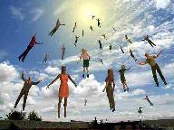
When Will the Rapture Take Place Relative to the Tribulation Period?
Pre-tribulation rapture theory
Mid-tribulation rapture theory
Post-tribulation rapture theory
Pre-wrath rapture theory
Partial rapture theory

Slide 24


Slide 25
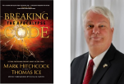
Thomas Ice
“A Thief in the Night,” Pre-Trib. Perspectives, August 2013, 1, 4-5.
Some become confused how the rapture can possibly comfort since they incorrectly associate the "thief in the night" imagery with the rapture. Since a thief breaking into one's house in the middle of the night is a harmful and negative occurrence, people mis-associate such negativity with the rapture. However, the New Testament never analogizes the rapture with the coming of a thief. While the New Testament uses "thief" imagery seven times (Matt. 24:43; Luke 12:39; 1 Thess. 5:2,4; 2 Pet. 3:10; Rev. 3:3; 16:15), none of these references contextually allude to the rapture.

Slide 26

Seven Beatitudes of Revelation:
“Blessed” (makarios)
Blessing upon the reader & heeder of Revelation (1:3)
Blessing upon the Tribulation martyrs (14:13)
Blessing upon the spiritually prepared (16:15)
Blessing upon the Marriage Supper invitees (19:9)
Blessing upon the First Resurrection’s participants (20:6)
Blessing upon the heeder of Revelation (22:7)
Blessing upon the eternal city’s citizens (22:14)
John F. Walvoord, "Revelation," in Bible Knowledge Commentary, ed. John F. Walvoord and Roy B. Zuck (Colorado Springs, CO: Victor, 1983), 929

Slide 27
Seven Beatitudes of Revelation:
“Blessed” (makarios)
Blessing upon the reader & heeder of Revelation (1:3)
Blessing upon the Tribulation martyrs (14:13)
Blessing upon the spiritually prepared (16:15)
Blessing upon the Marriage Supper invitees (19:9)
Blessing upon the First Resurrection’s participants (20:6)
Blessing upon the heeder of Revelation (22:7)
Blessing upon the eternal city’s citizens (22:14)
John F. Walvoord, "Revelation," in Bible Knowledge Commentary, ed. John F. Walvoord and Roy B. Zuck (Colorado Springs, CO: Victor, 1983), 929

Slide 28
Literal Geography in Revelation
Asia | 1:4 | Philadelphia | 3:7
Ephesus | 2:1 | Laodicea | 3:14
Smyrna | 2:8 | Euphrates | 9:14;16:12
Pergamum | 2:12 | Jerusalem | 11:8
Thyatira | 2:18 | Armageddon | 16:16
Sardis | 3:1 | Jerusalem | 20:9

Slide 30
5 Non-Chronological Parenthetical Insertions
Rev 7 – 144,000 Jews
Rev 10:1-11:13 – Announcement of no more delay and the two witnesses
Rev 12-14 – Israel’s flight, two beasts, six scenes of hope
Rev 16:13-16 – Gathering of the nations to Armageddon
Rev 17:1-19:6 – Babylon’s fall

Slide 31
Seven Bowls
(Revelation 16)
1st Bowl (16:1-2) – Boils
2nd Bowl (16:3) – Sea becomes blood
3rd Bowl (16:4-7) – Freshwater destroyed
4th Bowl (16:8-9) – Sun scorches man
5th Bowl (16:10-11) – Darkness
6th Bowl (16:13-16) – Euphrates dried
7th Bowl (16:17-21) – Greatest earthquake

Slide 32
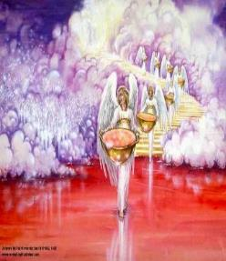
7. The Seventh Bowl
Revelation 16:17-21
7th angel pours out the bowl (17)
Lightning & thunder (18a)
Greatest earthquake (18b)
Jerusalem destroyed (19a)
Babylon destroyed (19b)
Every mountain & island moved (20)
100-pound hailstones (21a)
Man’s sinful reaction (21b)

Slide 33
7. The Seventh Bowl
Revelation 16:17-21
7th angel pours out the bowl (17)
Lightning & thunder (18a)
Greatest earthquake (18b)
Jerusalem destroyed (19a)
Babylon destroyed (19b)
Every mountain & island moved (20)
100-pound hailstones (21a)
Man’s sinful reaction (21b)

Slide 35
7. The Seventh Bowl
Revelation 16:17-21
7th angel pours out the bowl (17)
Lightning & thunder (18a)
Greatest earthquake (18b)
Jerusalem destroyed (19a)
Babylon destroyed (19b)
Every mountain & island moved (20)
100-pound hailstones (21a)
Man’s sinful reaction (21b)

Slide 36
7. The Seventh Bowl
Revelation 16:17-21
7th angel pours out the bowl (17)
Lightning & thunder (18a)
Greatest earthquake (18b)
Jerusalem destroyed (19a)
Babylon destroyed (19b)
Every mountain & island moved (20)
100-pound hailstones (21a)
Man’s sinful reaction (21b)

Slide 37
7. The Seventh Bowl
Revelation 16:17-21
7th angel pours out the bowl (17)
Lightning & thunder (18a)
Greatest earthquake (18b)
Jerusalem destroyed (19a)
Babylon destroyed (19b)
Every mountain & island moved (20)
100-pound hailstones (21a)
Man’s sinful reaction (21b)

Slide 38

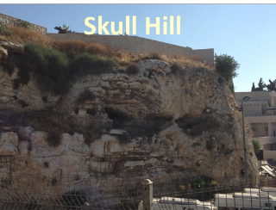
Revelation 11:8
“And their dead bodies will lie in the street of the great city which mystically is called Sodom and Egypt, where also their Lord was crucified.”

Slide 39
Revelation 11:8
“And their dead bodies will lie in the street of the great city which mystically is called Sodom and Egypt, where also their Lord was crucified.”

Slide 40
Zechariah 14:16-18
“Then it will come about that any who are left of all the nations that went against Jerusalem will go up from year to year to worship the King, the Lord of hosts, and to celebrate the Feast of Booths. ¹⁷ And it will be that whichever of the families of the earth does not go up to Jerusalem to worship the King, the Lord of hosts, there will be no rain on them. ¹⁸ If the family of Egypt does not go up or enter, then no rain will fall on them; it will be the plague with which the Lord smites the nations who do not go up to celebrate the Feast of Booths.”

Slide 41
Isaiah 2:2-3
“Now it will come about that In the last days The mountain of the house of the Lord Will be established as the chief of the mountains, And will be raised above the hills; And all the nations will stream to it.³ And many peoples will come and say, ‘Come, let us go up to the mountain of the Lord, To the house of the God of Jacob; That He may teach us concerning His ways And that we may walk in His paths.’ For the law will go forth from Zion And the word of the Lord from Jerusalem.”

Slide 42

Robert Thomas
Four Views on the Book of Revelation, page 207.
“At the end of the Millennium that city will be Satan’s prime objective with his rebel army, because Israel will be a leader among the nations.”

Slide 43
7. The Seventh Bowl
Revelation 16:17-21
7th angel pours out the bowl (17)
Lightning & thunder (18a)
Greatest earthquake (18b)
Jerusalem destroyed (19a)
Babylon destroyed (19b)
Every mountain & island moved (20)
100-pound hailstones (21a)
Man’s sinful reaction (21b)

Slide 45
5 Non-Chronological Parenthetical Insertions
Rev 7 – 144,000 Jews
Rev 10:1-11:13 – Announcement of no more delay and the two witnesses
Rev 12-14 – Israel’s flight, two beasts, six scenes of hope
Rev 16:13-16 – Gathering of the nations to Armageddon
Rev 17:1-19:6 – Babylon’s fall

Slide 46

Promised Exemption from Divine Wrath
The promise (1 Thess 1:10; 5:9; Rom 5:9; 8:1; Rev 3:10)
Tribulation = divine wrath (Rev 6:16-17; 11:18; 15:1, 7; 16:1, 19)

Slide 47
7. The Seventh Bowl
Revelation 16:17-21
7th angel pours out the bowl (17)
Lightning & thunder (18a)
Greatest earthquake (18b)
Jerusalem destroyed (19a)
Babylon destroyed (19b)
Every mountain & island moved (20)
100-pound hailstones (21a)
Man’s sinful reaction (21b)

Slide 48
Israel’s Four Temples
Solomon’s pre exilic temple (Kings and Chronicles)
Zerubbabel’s post exilic temple (Ezra 1-6; John 2:20)
Antichrist's temple (Dan 9:27; Matt 24:15; 2 Thess 2:4; Rev 11:1-2)
Millennial temple (Ezek 40-48)

Slide 49
Israel’s Four Temples
Solomon’s pre exilic temple (Kings and Chronicles)
Zerubbabel’s post exilic temple (Ezra 1-6; John 2:20)
Antichrist's temple (Dan 9:27; Matt 24:15; 2 Thess 2:4; Rev 11:1-2)
Millennial temple (Ezek 40-48)

Slide 50


Slide 51


Slide 52
7. The Seventh Bowl
Revelation 16:17-21
7th angel pours out the bowl (17)
Lightning & thunder (18a)
Greatest earthquake (18b)
Jerusalem destroyed (19a)
Babylon destroyed (19b)
Every mountain & island moved (20)
100-pound hailstones (21a)
Man’s sinful reaction (21b)

Slide 53
Ultimate Exodus
(Rev 11:15)
Sores: 6th plague (Ex 9:8-12), 1st bowl (Rev 16:1-2)
Rivers to blood: 1st plague (Ex 7:19-21), 3rd bowl (Rev 16:4-7)
Darkness: 9th plague (Ex 10:21-23), 5th bowl (Rev 16:10-11)
Frogs: 2nd plague (Ex 7:25‒8:15), 6th bowl (Rev 16:13)
Hail: 7th plague (Ex 9:22-26), 7th bowl (Rev 16:17-21)

Slide 54


Slide 55
7. The Seventh Bowl
Revelation 16:17-21
7th angel pours out the bowl (17)
Lightning & thunder (18a)
Greatest earthquake (18b)
Jerusalem destroyed (19a)
Babylon destroyed (19b)
Every mountain & island moved (20)
100-pound hailstones (21a)
Man’s sinful reaction (21b)

Slide 56

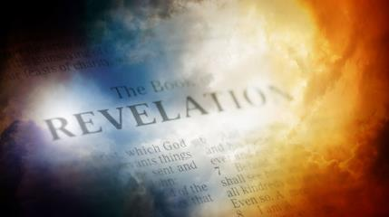
David Hocking
The Book of Revelation: Understanding the Future (Tustin, CA: Hope For Today Publications, 2014), 471 .
“It is quite astonishing to read the response of the people of Earth to this remarkable disaster. All hope of survival will be gone, and nothing but ruins and evidences of total destruction will be evident. And still, men do not repent, but instead blaspheme God for doing it!”

Slide 57
Conclusion

Slide 58
Seven Bowls
(Revelation 16)
1st Bowl (16:1-2) – Boils
2nd Bowl (16:3) – Sea becomes blood
3rd Bowl (16:4-7) – Freshwater destroyed
4th Bowl (16:8-9) – Sun scorches man
5th Bowl (16:10-11) – Darkness
6th Bowl (16:13-16) – Euphrates dried
7th Bowl (16:17-21) – Greatest earthquake

Slide 59

“The Lord bless you and keep you; the Lord make his face shine on you and be gracious to you; the Lord turn his face toward you and give you peace.” (NIV)

