Slide 1
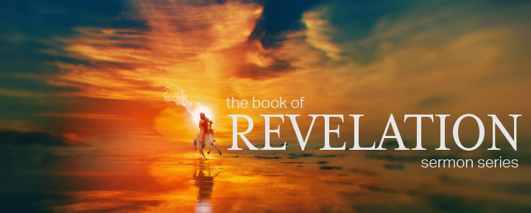

Dr. Andy Woods
Senior Pastor – Sugar Land Bible Church
President – Chafer Theological Seminary

Slide 2


Slide 3
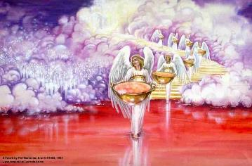
Bowl Judgments
Revelation 15‒16
Bowl Judgment Preparation (Rev. 15)
Bowl Judgement Manifestation (Rev. 16)

Slide 4
Bowl Judgments
Revelation 15‒16
Bowl Judgment Preparation (Rev. 15)
Bowl Judgement Manifestation (Rev. 16)

Slide 5
Bowl Judgment Preparation
Revelation 15:1-8
The Manifestation of the Seven Plagues (1)
The Martyrs (2-4)
The Heavenly Tabernacle – Temple (5-8)

Slide 6
Bowl Judgments
Revelation 15‒16
Bowl Judgment Preparation (Rev. 15)
Bowl Judgement Manifestation (Rev. 16)

Slide 7


Seven Bowls
(Revelation 16)
1st Bowl (16:1-2) – Boils
2nd Bowl (16:3) – Sea becomes blood
3rd Bowl (16:4-7) – Freshwater destroyed
4th Bowl (16:8-9) – Sun scorches man
5th Bowl (16:10-11) – Darkness
6th Bowl (16:13-16) – Euphrates dried
7th Bowl (16:17-21) – Greatest earthquake

Slide 8
Seven Bowls
(Revelation 16)
1st Bowl (16:1-2) – Boils
2nd Bowl (16:3) – Sea becomes blood
3rd Bowl (16:4-7) – Freshwater destroyed
4th Bowl (16:8-9) – Sun scorches man
5th Bowl (16:10-11) – Darkness
6th Bowl (16:13-16) – Euphrates dried
7th Bowl (16:17-21) – Greatest earthquake

Slide 9

1st Six Seals (Revelation 6)
6:1-2 – Advent of antichrist
6:3-4 – War
6:5-6 – Famine
6:7-8 – Death
6:9-11 – Martyrdoms
6:12-17 – Cosmic disturbances

Slide 10


Seven Trumpets
(Revelation 8‒11)
1st Trumpet (8:7) – 1/3 vegetation destroyed
2nd Trumpet (8:8-9) – 1/3 ocean destroyed
3rd Trumpet (8:10-11) – 1/3 water destroyed
4th Trumpet (8:12-13) – 1/3 luminaries darkened
5th Trumpet (9:1-12) – Demons released
6th Trumpet (9:13-21) – 1/3 humanity destroyed
7th Trumpet (11:14-19) – Legal transfer announced

Slide 11

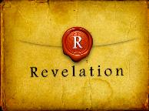
Revelation 1:6; 5:10
“and He has made us to be a kingdom, priests to His God and Father—to Him be the glory and the dominion forever and ever. Amen…You have made them to be a kingdom and priests to our God; and they will reign [basileuō] upon the earth [gē].”

Slide 13

Promised Exemption from Divine Wrath
The promise (1 Thess 1:10; 5:9; Rom 5:9; 8:1; Rev 3:10)
Tribulation = divine wrath (Rev 6:16-17; 11:18; 15:1, 7; 16:1, 19)

Slide 14
Seven Bowls
(Revelation 16)
1st Bowl (16:1-2) – Boils
2nd Bowl (16:3) – Sea becomes blood
3rd Bowl (16:4-7) – Freshwater destroyed
4th Bowl (16:8-9) – Sun scorches man
5th Bowl (16:10-11) – Darkness
6th Bowl (16:13-16) – Euphrates dried
7th Bowl (16:17-21) – Greatest earthquake

Slide 16
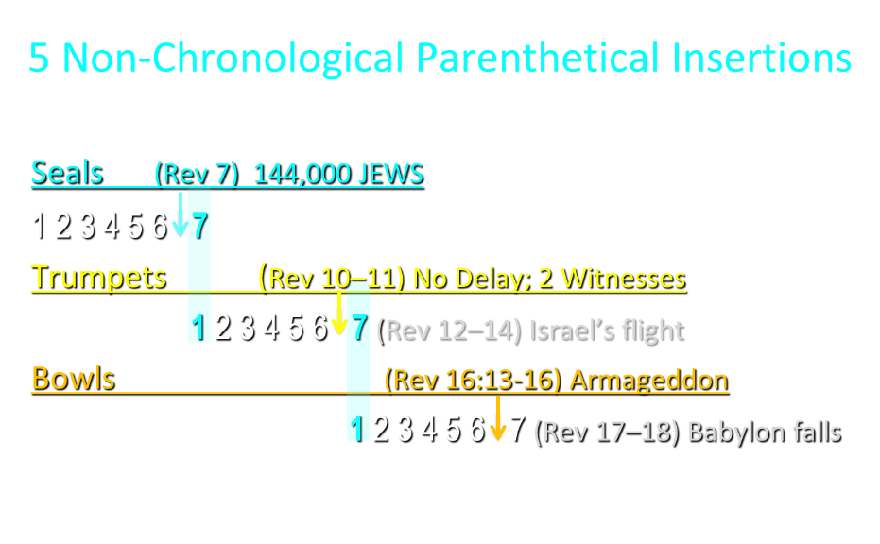

Slide 17
5 Non-Chronological Parenthetical Insertions
Rev 7 – 144,000 Jews
Rev 10:1-11:13 – Announcement of no more delay and the two witnesses
Rev 12-14 – Israel’s flight, two beasts, six scenes of hope
Rev 16:13-16 – Gathering of the nations to Armageddon
Rev 17:1-19:6 – Babylon’s fall

Slide 18

Revelation 1:11
“saying, ‘Write in a book what you see, and send it to the seven churches: to Ephesus and to Smyrna and to Pergamum and to Thyatira and to Sardis and to Philadelphia and to Laodicea.’”

Slide 19
Seven Bowls
(Revelation 16)
1st Bowl (16:1-2) – Boils
2nd Bowl (16:3) – Sea becomes blood
3rd Bowl (16:4-7) – Freshwater destroyed
4th Bowl (16:8-9) – Sun scorches man
5th Bowl (16:10-11) – Darkness
6th Bowl (16:13-16) – Euphrates dried
7th Bowl (16:17-21) – Greatest earthquake

Slide 20
Revelation 1:19
“Therefore write the things which you have seen, and the things which are, and the things which will take place after these things [meta tauta].”

Slide 21

Revelation 1:19
Seen (Chapter 1)
Are (Chapters 2–3)
After these things (Chapters 4–22)

Slide 22
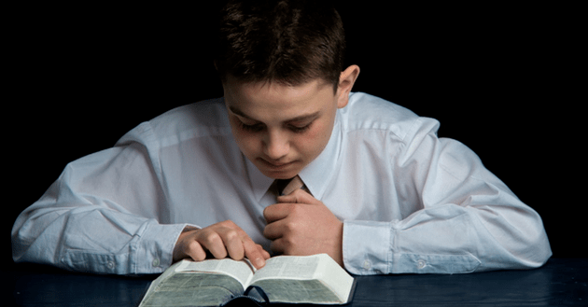
Psalm 50:5 (NKJV)
“Gather My saints together to Me,
Those who have made a covenant with Me by sacrifice.”

Slide 23
Psalm 149:1 (NKJV)
“Praise the Lord! Sing to the Lord a new song, And His praise in the assembly of saints.”

Slide 24
The Plagues of Egypt
NO. | DESCRIPTION | SCRIPTURE | Egyptian Deity
1. | Water to Blood | Exod. 7:14-25 | Hapi, Khnum
2. | Frogs | Exod. 8:1-15 | Heqt
3. | Gnats | Exod. 8:16-19 | Set
4. | Flies | Exod. 8:20-32 | Uatchit
5. | Disease on Cattle | Exod. 9:1-7 | Hathor, Apis
6. | Boils | Exod. 9:8-12 | Sekhmet, Serapis
7. | Hail | Exod. 9:13-35 | Seth, Nut
8. | Locusts | Exod. 10:1-20 | Seth, Nut, Osiris
9. | Darkness | Exod. 10:21-29 | Re, Horus, Atum
10. | Death of the First Born | Exod. 12:29-36 | Min, Osiris, Heqt, Isis

Slide 25

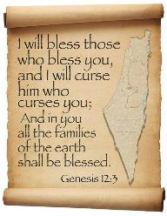
Genesis 12:3
“And I will bless those who bless you, And the one who curses you I will curse. And in you all the families of the earth will be blessed.”

Slide 26
Genesis 12:3
“And I will bless those who bless you, And the one who curses you I will curse. And in you all the families of the earth will be blessed.”

Slide 27


Slide 28
Seven Bowls
(Revelation 16)
1st Bowl (16:1-2) – Boils
2nd Bowl (16:3) – Sea becomes blood
3rd Bowl (16:4-7) – Freshwater destroyed
4th Bowl (16:8-9) – Sun scorches man
5th Bowl (16:10-11) – Darkness
6th Bowl (16:13-16) – Euphrates dried
7th Bowl (16:17-21) – Greatest earthquake

Slide 29
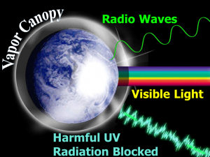

Slide 30
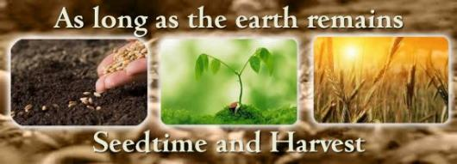
Genesis 8:22
While the earth remains, Seedtime and harvest, And cold and heat, And summer and winter, And day and night Shall not cease.

Slide 31
Seven Trumpets
(Revelation 8‒11)
1st Trumpet (8:7) – 1/3 vegetation destroyed
2nd Trumpet (8:8-9) – 1/3 ocean destroyed
3rd Trumpet (8:10-11) – 1/3 water destroyed
4th Trumpet (8:12-13) – 1/3 luminaries darkened
5th Trumpet (9:1-12) – Demons released
6th Trumpet (9:13-21) – 1/3 humanity destroyed
7th Trumpet (11:14-19) – Legal transfer announced

Slide 32
Seven Bowls
(Revelation 16)
1st Bowl (16:1-2) – Boils
2nd Bowl (16:3) – Sea becomes blood
3rd Bowl (16:4-7) – Freshwater destroyed
4th Bowl (16:8-9) – Sun scorches man
5th Bowl (16:10-11) – Darkness
6th Bowl (16:13-16) – Euphrates dried
7th Bowl (16:17-21) – Greatest earthquake

Slide 33
Seven Bowls
(Revelation 16)
1st Bowl (16:1-2) – Boils
2nd Bowl (16:3) – Sea becomes blood
3rd Bowl (16:4-7) – Freshwater destroyed
4th Bowl (16:8-9) – Sun scorches man
5th Bowl (16:10-11) – Darkness
6th Bowl (16:13-16) – Euphrates dried
7th Bowl (16:17-21) – Greatest earthquake

Slide 34
Seven Trumpets
(Revelation 8‒11)
1st Trumpet (8:7) – 1/3 vegetation destroyed
2nd Trumpet (8:8-9) – 1/3 ocean destroyed
3rd Trumpet (8:10-11) – 1/3 water destroyed
4th Trumpet (8:12-13) – 1/3 luminaries darkened
5th Trumpet (9:1-12) – Demons released
6th Trumpet (9:13-21) – 1/3 humanity destroyed
7th Trumpet (11:14-19) – Legal transfer announced

Slide 35
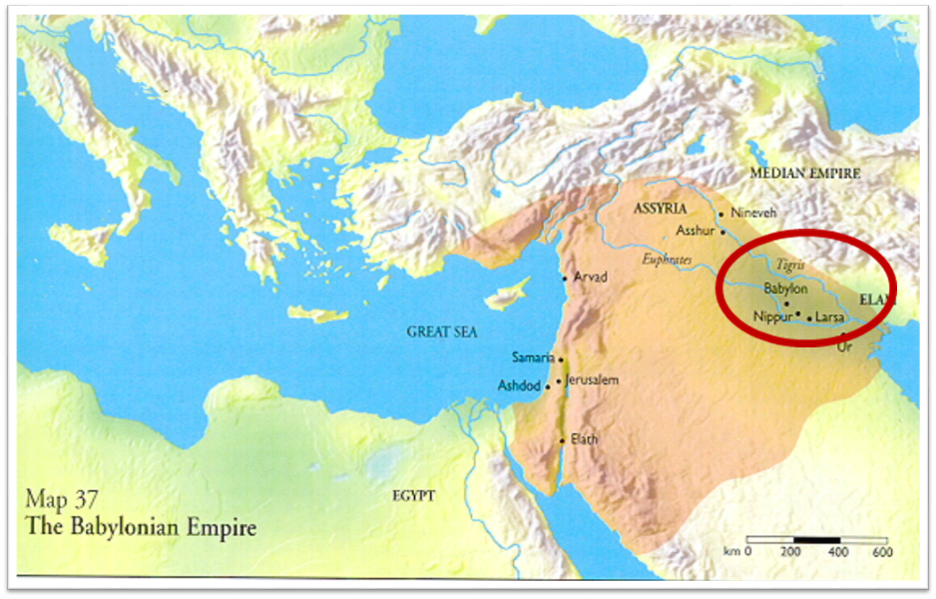

Slide 36
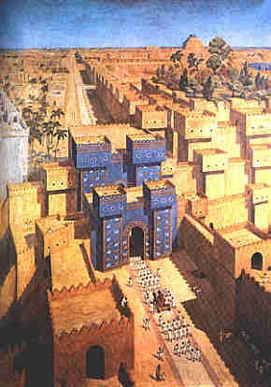
East = Babylon
Genesis 2:8 (Eden)
Genesis 11:2 (Shinar)
Matthew 2:2 (Magi)

Slide 37
Literal Geography in Revelation
Asia | 1:4 | Philadelphia | 3:7
Ephesus | 2:1 | Laodicea | 3:14
Smyrna | 2:8 | Euphrates | 9:14;16:12
Pergamum | 2:12 | Jerusalem | 11:8
Thyatira | 2:18 | Armageddon | 16:16
Sardis | 3:1 | Jerusalem | 20:9

Slide 39
5 Non-Chronological Parenthetical Insertions
Rev 7 – 144,000 Jews
Rev 10:1-11:13 – Announcement of no more delay and the two witnesses
Rev 12-14 – Israel’s flight, two beasts, six scenes of hope
Rev 16:13-16 – Gathering of the nations to Armageddon
Rev 17:1-19:6 – Babylon’s fall

Slide 40
How Satan Imitates God and the Antichrist Imitates Jesus Christ
NO. | CATEGORY | JESUS CHRIST | ANTICHRIST
1. | World prepared in advance | Gal. 4:4 | 2 Thess. 2:7
2. | Revealed at the proper time | Gal. 4:4 | 2 Thess. 2:6
3. | Claim of deity | John 14:9 | 2 Thess. 2:4
4. | Heralded by a forerunner | John 1:23 | Rev. 13:12
5. | Forerunner comes in the Spirit and power of Elijah | Luke 1:17 | 1 Kgs. 8:37-38; Rev. 13:13
6. | Empowered by a higher source | 1 Cor. 6:14 | Rev. 13:14
7. | Member of a Trinity | Phil. 1:2; Acts 5:3-4; John 14:9 | Rev. 16:13; 20:10
8. | Head of a Church | Eph. 5:23 | Rev. 2:9; 3:9
9. | Miracle worker | Acts 2:22 | 2 Thess. 2:9
10. | Resurrection from the dead | 1 Cor. 15:3-6 | Rev. 13:3, 12, 14
11. | Given a throne | Rev. 3:21 | Rev. 13:2

Slide 41
How Satan Imitates God and the Antichrist Imitates Jesus Christ
NO. | CATEGORY | JESUS CHRIST | ANTICHRIST
12. | Ruling a political kingdom | Isa. 9:6-7 | Rev. 13:5
13. | Ushering in world peace | Isa. 9:6-7 | Rev. 6:1-4
14. | Activity in the Temple | Luke 2:41-50 | 2 Thess. 2:4
15. | Putting an end to animal sacrifices | Heb. 9:26-29 | Dan. 9:27
16. | Length of ministry | Over 3 years | Rev. 13:5
17. | Sealing ministry | Eph. 4:30 | Rev. 13:16-17
18. | Presentation to Israel as her Messiah | John 1:11 | John 5:43
19. | Covenant with Israel | Gen. 15:18 | Dan. 9:27
20. | Reception of worship | Zech. 14:16 | 2 Thess. 2:4
21. | Establishing Jerusalem as the center of worldwide worship | Zech. 14:17 | 2 Thess. 2:4

Slide 42
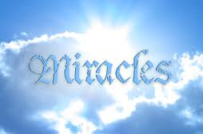
Satanic/Demonic Miracles
Exod 7–8
Deut 13:1-3
Matt 7:21-23; 24:24
Acts 8:9; 16:16
Gal 1:6-9
2 Thess 2:9
Rev 13:3, 13, 15; 16:13-14

Slide 43

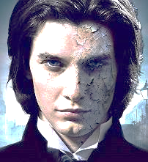
1 John 4:1
“Beloved, do not believe every spirit, but test the spirits to see whether they are from God, because many false prophets have gone out into the world.”

Slide 44

Charles L. Feinberg
God Remembers: A Study of Zechariah (Wheaton: Van Kampen, 1950, p. 218, 222.
“The last section of the latter part of Zechariah’s prophecy deals with events in the distant future…As a portion of the prophetic Scriptures it is second to none in importance in this book or any other Old Testament book. It is indispensable to an understanding of the events of the last days for Israel‒the time of the Great Tribulation and the establishment of God’s kingdom on earth...In the time of our passage all the nations of earth will be bitten by the virus of anti-Semitism.”

Slide 45
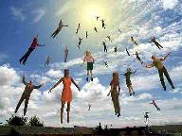
When Will the Rapture Take Place Relative to the Tribulation Period?
Pre-tribulation rapture theory
Mid-tribulation rapture theory
Post-tribulation rapture theory
Pre-wrath rapture theory
Partial rapture theory

Slide 46


Slide 47
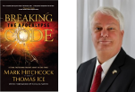
Thomas Ice
“A Thief in the Night,” Pre-Trib. Perspectives, August 2013, 1, 4-5.
Some become confused how the rapture can possibly comfort since they incorrectly associate the "thief in the night" imagery with the rapture. Since a thief breaking into one's house in the middle of the night is a harmful and negative occurrence, people mis-associate such negativity with the rapture. However, the New Testament never analogizes the rapture with the coming of a thief. While the New Testament uses "thief" imagery seven times (Matt. 24:43; Luke 12:39; 1 Thess. 5:2,4; 2 Pet. 3:10; Rev. 3:3; 16:15), none of these references contextually allude to the rapture.

Slide 48

Seven Beatitudes of Revelation:
“Blessed” (makarios)
Blessing upon the reader & heeder of Revelation (1:3)
Blessing upon the Tribulation martyrs (14:13)
Blessing upon the spiritually prepared (16:15)
Blessing upon the Marriage Supper invitees (19:9)
Blessing upon the First Resurrection’s participants (20:6)
Blessing upon the heeder of Revelation (22:7)
Blessing upon the eternal city’s citizens (22:14)
John F. Walvoord, "Revelation," in Bible Knowledge Commentary, ed. John F. Walvoord and Roy B. Zuck (Colorado Springs, CO: Victor, 1983), 929

Slide 49
Seven Beatitudes of Revelation:
“Blessed” (makarios)
Blessing upon the reader & heeder of Revelation (1:3)
Blessing upon the Tribulation martyrs (14:13)
Blessing upon the spiritually prepared (16:15)
Blessing upon the Marriage Supper invitees (19:9)
Blessing upon the First Resurrection’s participants (20:6)
Blessing upon the heeder of Revelation (22:7)
Blessing upon the eternal city’s citizens (22:14)
John F. Walvoord, "Revelation," in Bible Knowledge Commentary, ed. John F. Walvoord and Roy B. Zuck (Colorado Springs, CO: Victor, 1983), 929

Slide 50
Literal Geography in Revelation
Asia | 1:4 | Philadelphia | 3:7
Ephesus | 2:1 | Laodicea | 3:14
Smyrna | 2:8 | Euphrates | 9:14;16:12
Pergamum | 2:12 | Jerusalem | 11:8
Thyatira | 2:18 | Armageddon | 16:16
Sardis | 3:1 | Jerusalem | 20:9

Slide 52
5 Non-Chronological Parenthetical Insertions
Rev 7 – 144,000 Jews
Rev 10:1-11:13 – Announcement of no more delay and the two witnesses
Rev 12-14 – Israel’s flight, two beasts, six scenes of hope
Rev 16:13-16 – Gathering of the nations to Armageddon
Rev 17:1-19:6 – Babylon’s fall

Slide 53
Seven Bowls
(Revelation 16)
1st Bowl (16:1-2) – Boils
2nd Bowl (16:3) – Sea becomes blood
3rd Bowl (16:4-7) – Freshwater destroyed
4th Bowl (16:8-9) – Sun scorches man
5th Bowl (16:10-11) – Darkness
6th Bowl (16:13-16) – Euphrates dried
7th Bowl (16:17-21) – Greatest earthquake

Slide 54
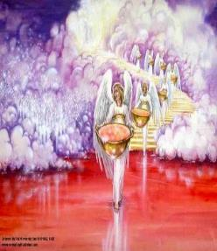
7. The Seventh Bowl
Revelation 16:17-21
7th angel pours out the bowl (17)
Lightning & thunder (18a)
Greatest earthquake (18b)
Jerusalem destroyed (19a)
Babylon destroyed (19b)
Every mountain & island moved (20)
100-pound hailstones (21a)
Man’s sinful reaction (21b)

Slide 55
7. The Seventh Bowl
Revelation 16:17-21
7th angel pours out the bowl (17)
Lightning & thunder (18a)
Greatest earthquake (18b)
Jerusalem destroyed (19a)
Babylon destroyed (19b)
Every mountain & island moved (20)
100-pound hailstones (21a)
Man’s sinful reaction (21b)

Slide 56
7. The Seventh Bowl
Revelation 16:17-21
7th angel pours out the bowl (17)
Lightning & thunder (18a)
Greatest earthquake (18b)
Jerusalem destroyed (19a)
Babylon destroyed (19b)
Every mountain & island moved (20)
100-pound hailstones (21a)
Man’s sinful reaction (21b)

Slide 57
7. The Seventh Bowl
Revelation 16:17-21
7th angel pours out the bowl (17)
Lightning & thunder (18a)
Greatest earthquake (18b)
Jerusalem destroyed (19a)
Babylon destroyed (19b)
Every mountain & island moved (20)
100-pound hailstones (21a)
Man’s sinful reaction (21b)

Slide 58
7. The Seventh Bowl
Revelation 16:17-21
7th angel pours out the bowl (17)
Lightning & thunder (18a)
Greatest earthquake (18b)
Jerusalem destroyed (19a)
Babylon destroyed (19b)
Every mountain & island moved (20)
100-pound hailstones (21a)
Man’s sinful reaction (21b)

Slide 59

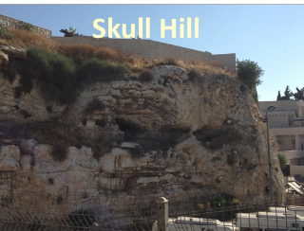
Revelation 11:8
“And their dead bodies will lie in the street of the great city which mystically is called Sodom and Egypt, where also their Lord was crucified.”

Slide 60
Revelation 11:8
“And their dead bodies will lie in the street of the great city which mystically is called Sodom and Egypt, where also their Lord was crucified.”

Slide 61
Zechariah 14:16-18
“Then it will come about that any who are left of all the nations that went against Jerusalem will go up from year to year to worship the King, the Lord of hosts, and to celebrate the Feast of Booths. ¹⁷ And it will be that whichever of the families of the earth does not go up to Jerusalem to worship the King, the Lord of hosts, there will be no rain on them. ¹⁸ If the family of Egypt does not go up or enter, then no rain will fall on them; it will be the plague with which the Lord smites the nations who do not go up to celebrate the Feast of Booths.”

Slide 62
Isaiah 2:2-3
“Now it will come about that In the last days The mountain of the house of the Lord Will be established as the chief of the mountains, And will be raised above the hills; And all the nations will stream to it.³ And many peoples will come and say, ‘Come, let us go up to the mountain of the Lord, To the house of the God of Jacob; That He may teach us concerning His ways And that we may walk in His paths.’ For the law will go forth from Zion And the word of the Lord from Jerusalem.”

Slide 63

Robert Thomas
Four Views on the Book of Revelation, page 207.
“At the end of the Millennium that city will be Satan’s prime objective with his rebel army, because Israel will be a leader among the nations.”

Slide 64
7. The Seventh Bowl
Revelation 16:17-21
7th angel pours out the bowl (17)
Lightning & thunder (18a)
Greatest earthquake (18b)
Jerusalem destroyed (19a)
Babylon destroyed (19b)
Every mountain & island moved (20)
100-pound hailstones (21a)
Man’s sinful reaction (21b)

Slide 66
5 Non-Chronological Parenthetical Insertions
Rev 7 – 144,000 Jews
Rev 10:1-11:13 – Announcement of no more delay and the two witnesses
Rev 12-14 – Israel’s flight, two beasts, six scenes of hope
Rev 16:13-16 – Gathering of the nations to Armageddon
Rev 17:1-19:6 – Babylon’s fall

Slide 67
7. The Seventh Bowl
Revelation 16:17-21
7th angel pours out the bowl (17)
Lightning & thunder (18a)
Greatest earthquake (18b)
Jerusalem destroyed (19a)
Babylon destroyed (19b)
Every mountain & island moved (20)
100-pound hailstones (21a)
Man’s sinful reaction (21b)

Slide 68
Israel’s Four Temples
Solomon’s pre exilic temple (Kings and Chronicles)
Zerubbabel’s post exilic temple (Ezra 1-6; John 2:20)
Antichrist's temple (Dan 9:27; Matt 24:15; 2 Thess 2:4; Rev 11:1-2)
Millennial temple (Ezek 40-48)

Slide 69
Israel’s Four Temples
Solomon’s pre exilic temple (Kings and Chronicles)
Zerubbabel’s post exilic temple (Ezra 1-6; John 2:20)
Antichrist's temple (Dan 9:27; Matt 24:15; 2 Thess 2:4; Rev 11:1-2)
Millennial temple (Ezek 40-48)

Slide 70


Slide 71


Slide 72
7. The Seventh Bowl
Revelation 16:17-21
7th angel pours out the bowl (17)
Lightning & thunder (18a)
Greatest earthquake (18b)
Jerusalem destroyed (19a)
Babylon destroyed (19b)
Every mountain & island moved (20)
100-pound hailstones (21a)
Man’s sinful reaction (21b)

Slide 73
Ultimate Exodus
(Rev 11:15)
Sores: 6th plague (Ex 9:8-12), 1st bowl (Rev 16:1-2)
Rivers to blood: 1st plague (Ex 7:19-21), 3rd bowl (Rev 16:4-7)
Darkness: 9th plague (Ex 10:21-23), 5th bowl (Rev 16:10-11)
Frogs: 2nd plague (Ex 7:25‒8:15), 6th bowl (Rev 16:13)
Hail: 7th plague (Ex 9:22-26), 7th bowl (Rev 16:17-21)

Slide 75
7. The Seventh Bowl
Revelation 16:17-21
7th angel pours out the bowl (17)
Lightning & thunder (18a)
Greatest earthquake (18b)
Jerusalem destroyed (19a)
Babylon destroyed (19b)
Every mountain & island moved (20)
100-pound hailstones (21a)
Man’s sinful reaction (21b)

Slide 76

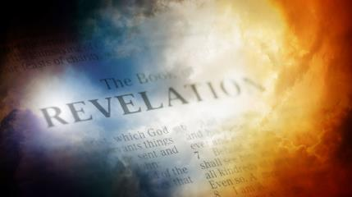
David Hocking
The Book of Revelation: Understanding the Future (Tustin, CA: Hope For Today Publications, 2014), 471 .
“It is quite astonishing to read the response of the people of Earth to this remarkable disaster. All hope of survival will be gone, and nothing but ruins and evidences of total destruction will be evident. And still, men do not repent, but instead blaspheme God for doing it!”

Slide 77
Conclusion

Slide 78
Seven Bowls
(Revelation 16)
1st Bowl (16:1-2) – Boils
2nd Bowl (16:3) – Sea becomes blood
3rd Bowl (16:4-7) – Freshwater destroyed
4th Bowl (16:8-9) – Sun scorches man
5th Bowl (16:10-11) – Darkness
6th Bowl (16:13-16) – Euphrates dried
7th Bowl (16:17-21) – Greatest earthquake

Slide 79

“The Lord bless you and keep you; the Lord make his face shine on you and be gracious to you; the Lord turn his face toward you and give you peace.” (NIV)

