Slide 1
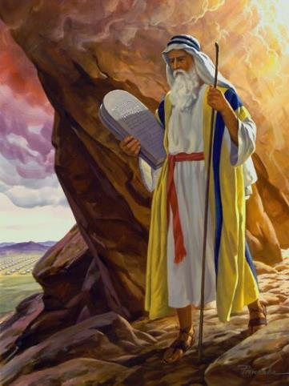
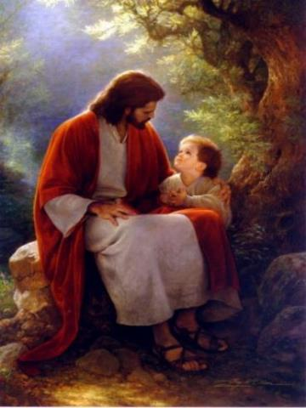
Law and Grace: An Overview Jim McGowan, Th.D. Sugar Land Bible Church 08-18-2019
…but grace and truth were realized through Jesus Christ - John 1:17
For the Law was given through Moses…
Special thanks to Dr. Vern Peterman for access to his insights and resources.

Slide 2
Session 22 Outline
Review
Purpose, Aim, and Objective
Session 21
Firsts & Beginnings in Christ’s Ministry – Matt. 4
General Information
Comments and Commentary
Concluding Observations

Slide 3
OUR PURPOSE, AIM AND OBJECTIVE
Law and Grace
…is to Compare and Contrast Law and Grace so as to properly understand these two important themes and how they are related to the life of the New Testament Believer.

Slide 4
C. I. SCOFIELD, D. D.
The Grace of God, The Fundamentals Vol. 3, Chapter VII, p. 98
We have, most of us, been reared and now live under the influence of Galatianism. Protestant theology, alas, is for the most part, thoroughly Galatianized, in that neither law nor grace are given their distinct and separated places, as in the counsels of God, but are mingled together in one incoherent system.
The law is no longer, as in the Divine intent, a ministration of death (2 Cor. 3:7), of cursing (Gal. 3:10), of conviction (Rom. 3:19), because we are taught that we must try to keep it, and that by Divine help we may.
Nor, on the other hand, does grace bring us blessed deliverance from the dominion of sin, for we are kept under the law as a rule of life despite the plain declaration, “Sin shall not have dominion over you: for ye are not under the law, but under grace” (Rom. 6:14). (emphasis mine)

Slide 5
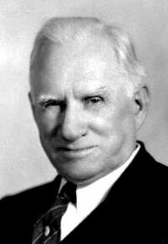
William R. Newell
Romans Verse-by-Verse (p. 274).
Grand Rapids, MI: Christian Classics Ethereal Library.
It is because Reformed theology has kept us Gentiles under the Law,—if not as a means of righteousness, then as “a rule of life,” that all the trouble has arisen. The Law is no more a rule of life than it is a means of righteousness. Walking in the Spirit has now taken the place of walking by ordinances. God has another principle under which He has put his saints: “Ye are not under law, but, under grace!” (italics mine)

Slide 6
Session 22 Outline
Review
Purpose, Aim, and Objective
Session 21
Firsts & Beginnings in Christ’s Ministry – Matt. 4
General Information
Comments and Commentary
Concluding Observations

Slide 7
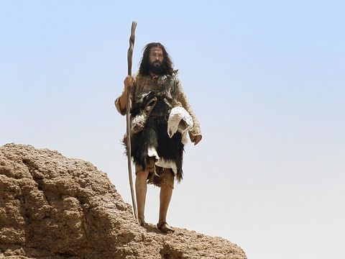
Law and Grace: Review Session 21
Who is John the Baptist?
Matthew 3:1, 4-6

Slide 8
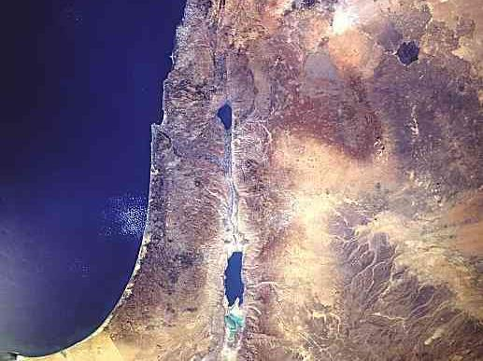
Law and Grace: Review Session 21
Who is John the Baptist?
Matthew 3:1, 4-6
Sea of Galilee
John the Baptist
Jordan River
Dead Sea

Slide 9
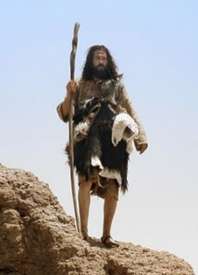
Law and Grace: Review Session 21
Who is John the Baptist?
Matthew 3:1, 4-6
He lived out in the wilderness…according to Christian tradition he was born in Ein Karem.
Matthew 3:1
Now in those days John the Baptist came, preaching in the wilderness of Judea,…

Slide 10
Law and Grace: Review Session 21
Who is John the Baptist?
Matthew 3:1, 4-6
He wore rough and wild clothing and ate a rough and wild diet of locusts and wild honey which was allowed by the Law of Moses (cf. Lev. 11:22).
Matthew 3:4
⁴ Now John himself had a garment of camel’s hair and a leather belt around his waist; and his food was locusts and wild honey.

Slide 11
Law and Grace: Session 21
Repent! Matthew 3:2
Repenting means to have ‘a change of mind’ that moves us from unbelief to belief in what God says is true.
Matthew 3:1–2
¹ Now in those days John the Baptist came, preaching in the wilderness of Judea, saying, ² “Repent, for the kingdom of heaven is at hand.”

Slide 12
Law and Grace: Review Session 21
Make ready the way!
Matthew 3:3
John the Baptist came morally and spiritually clearing and leveling and making straight the way before the coming of Jesus Christ.
Matthew 3:3
For this is the one referred to by Isaiah the prophet when he said, “The voice of one crying in the wilderness, ‘Make ready the way of the Lord, Make His paths straight!’ ”

Slide 13
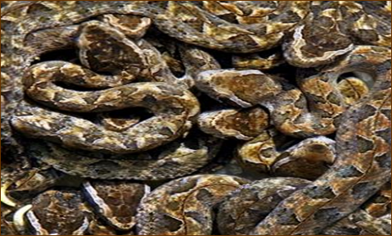
Law and Grace: Review Session 21
Pharisees & Sadducees
Matthew 3:7-10
John said that judgment would precede the kingdom, and no Jew, be they Scribe, Pharisee, or Sadducee, would be exempt!

Slide 14
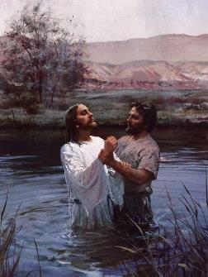
Law and Grace: Review Session 21
Why would Jesus be baptized?
Matthew 3:13-15
Jesus didn’t need to repent or to confess His sins.
Jesus’ baptism had a three-fold effect:
It authenticated John’s ministry and message of repentance.
It presented Jesus as the spiritually, ethically, and morally, clean, Messiah, Who fulfilled God’s will.
It identified Him with sinners.

Slide 15
Law and Grace: Review Session 21
After Jesus was baptized
Matthew 3:16-17
At Jesus’ baptism we see the presence of all three persons of the Trinity: The Father, Son and Holy Spirit and we also see the approval of God the Father toward God the Son in this event.
Matthew 3:16-17
¹⁶ After being baptized,…he saw the Spirit of God descending as a dove… ¹⁷ and behold, a voice…said, “This is My beloved Son, in whom I am well-pleased.”

Slide 16
Law and Grace: Review Session 21

Slide 17
Session 22 Outline
Review
Purpose, Aim, and Objective
Session 21
Firsts & Beginnings in Christ’s Ministry – Matt. 4
General Information
Comments and Commentary
Concluding Observations

Slide 18
Matthew 4:1-11
¹ Then Jesus was led up by the Spirit into the wilderness to be tempted by the devil. ² And after He had fasted forty days and forty nights, He then became hungry. ³ And the tempter came and said to Him, “If You are the Son of God, command that these stones become bread.” ⁴ But He answered and said, “It is written, ‘Man shall not live on bread alone, but on every word that proceeds out of the mouth of God.’ ” ⁵ Then the devil took Him into the holy city and had Him stand on the pinnacle of the temple, ⁶ and said to Him, “If You are the Son of God, throw Yourself down; for it is written, ‘He will command His angels concerning You’; and ‘On their hands …

Slide 19
Matthew 4:1-11
…they will bear You up, So that You will not strike Your foot against a stone.’ ” ⁷ Jesus said to him, “On the other hand, it is written, ‘You shall not put the Lord your God to the test.’ ” ⁸ Again, the devil took Him to a very high mountain and showed Him all the kingdoms of the world and their glory; ⁹ and he said to Him, “All these things I will give You, if You fall down and worship me.” ¹⁰ Then Jesus said to him, “Go, Satan! For it is written, ‘You shall worship the Lord your God, and serve Him only.’ ” ¹¹ Then the devil left Him; and behold, angels came and began to minister to Him.

Slide 20
Matthew 4:12-25
¹² Now when Jesus heard that John had been taken into custody, He withdrew into Galilee; ¹³ and leaving Nazareth, He came and settled in Capernaum, which is by the sea, in the region of Zebulun and Naphtali. ¹⁴ This was to fulfill what was spoken through Isaiah the prophet: ¹⁵ “The land of Zebulun and the land of Naphtali, By the way of the sea, beyond the Jordan, Galilee of the Gentiles— ¹⁶ “The people who were sitting in darkness saw a great Light, And those who were sitting in the land and shadow of death, Upon them a Light dawned.” ¹⁷ From that time Jesus began to preach and say, …

Slide 21
Matthew 4:12-25
…“Repent, for the kingdom of heaven is at hand.” ¹⁸ Now as Jesus was walking by the Sea of Galilee, He saw two brothers, Simon who was called Peter, and Andrew his brother, casting a net into the sea; for they were fishermen. ¹⁹ And He said to them, “Follow Me, and I will make you fishers of men.” ²⁰ Immediately they left their nets and followed Him. ²¹ Going on from there He saw two other brothers, James the son of Zebedee, and John his brother, in the boat with Zebedee their father, mending their nets; and He called them. ²² Immediately they left the boat and their father, and…

Slide 22
Matthew 4:12-25
…followed Him. ²³ Jesus was going throughout all Galilee, teaching in their synagogues and proclaiming the gospel of the kingdom, and healing every kind of disease and every kind of sickness among the people. ²⁴ The news about Him spread throughout all Syria; and they brought to Him all who were ill, those suffering with various diseases and pains, demoniacs, epileptics, paralytics; and He healed them. ²⁵ Large crowds followed Him from Galilee and the Decapolis and Jerusalem and Judea and from beyond the Jordan.

Slide 23
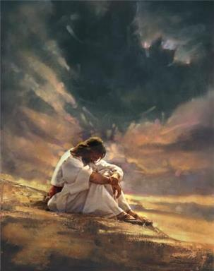
Law and Grace: Session 22
Temptations and Beginnings
Matthew 4:1-25
Chapter 4 of the Gospel of Matthew has two main parts:
Verses 1-11 tell of Christ’s temptation by Satan.
Verses 12-25 describe the beginning of Christ’s ministry.

Slide 24
Law and Grace: Session 22
Temptations and Beginnings
Matthew 4:1-25
Chapter 4 of the Gospel of Matthew has two main parts:
Verses 1-11 tell of Christ’s temptation by Satan during a time of fasting.

Slide 25
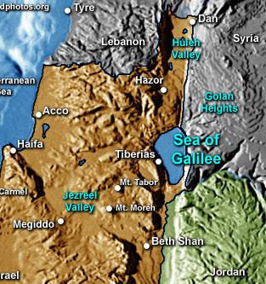
Law and Grace: Session 22
Temptations and Beginnings
Matthew 4:1-25
Verses 12-25 tell of Christ beginning His public ministry, by locating Himself in northern Galilee, selecting disciples, and His healing ministry.

Slide 26
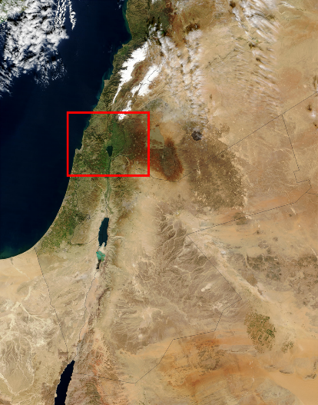
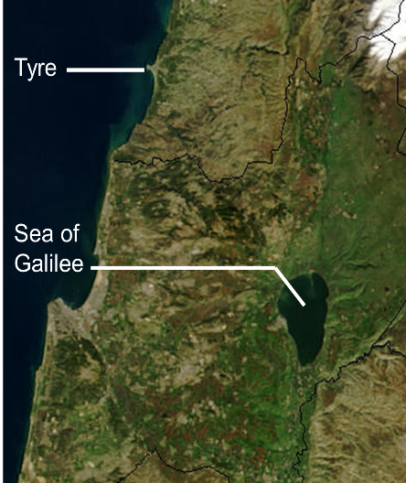
Law and Grace: Session 22
Israel, Galilee, and Surrounding Region

Slide 27
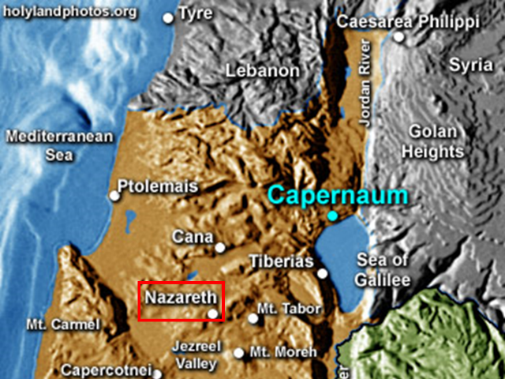
Law and Grace: Session 22
Galilee and Surrounding Cities

Slide 28
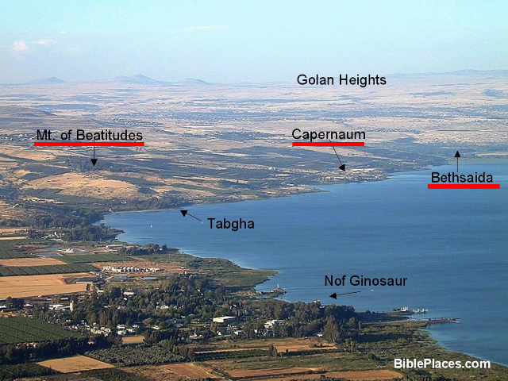
Law and Grace: Session 22
Northwest Portion of the Sea of Galilee

Slide 29
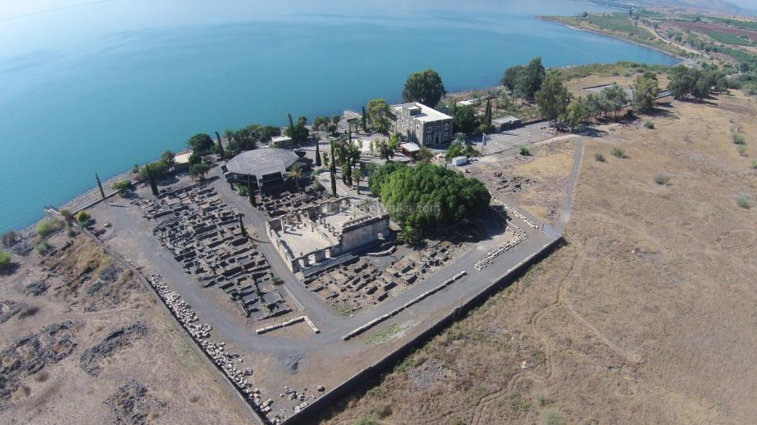
Law and Grace: Session 22
Capernaum Archaeological Park

Slide 30
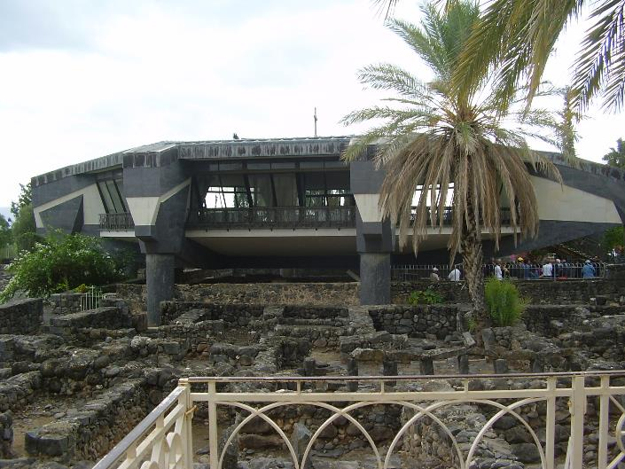
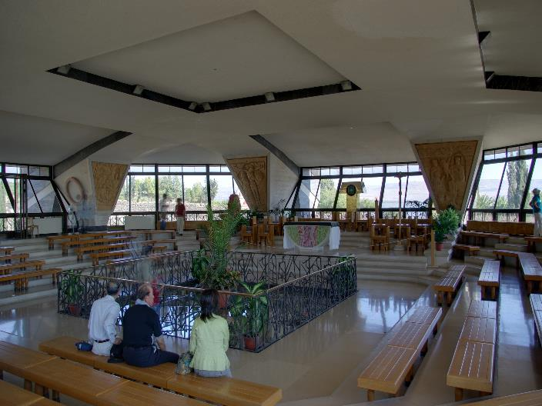
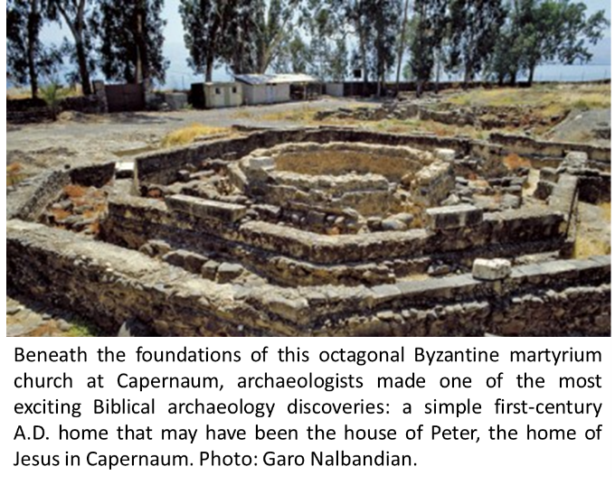
Law and Grace: Session 17
Capernaum Archaeological Park
Peter’s Home?

Slide 31
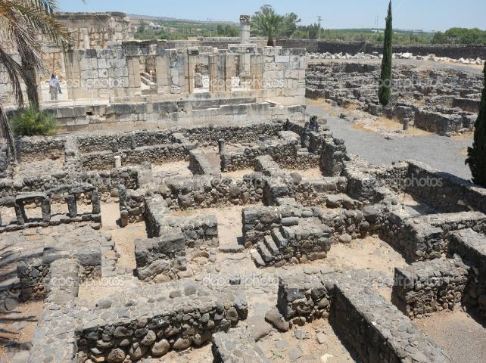
Law and Grace: Session 22
Capernaum Archaeological Park

Slide 32
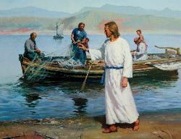
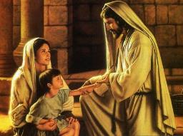
Law and Grace: Session 22
Temptations and Beginnings
Matthew 4:1-25
Chapter 4:1-25, tells us about the beginning of Christ's ministry, how it began, where He located Himself, along the northern part of the Sea of Galilee, how He selected His disciples, as well as instances of miraculous healings.

Slide 33
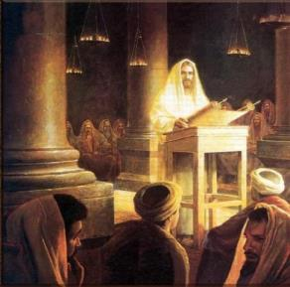
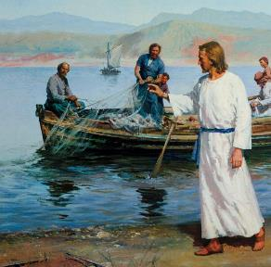
Law and Grace: Session 22
Temptations and Beginnings
Matthew 4:1-25
This ‘introduction to ministry’ in Matthew 4 concerns the people of Israel, the land of Israel, and the Law of Moses. (cf. Mark 1:12-13; Luke 4:1-13 for parallel accounts of the events recorded in Matthew 4:1-11.)

Slide 34
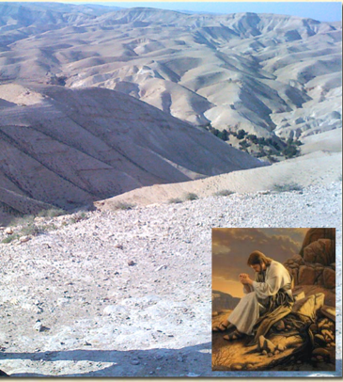
Law and Grace: Session 22
Christ was led into the wilderness
Matthew 4:1-11
Christ did not just encounter Satan in the wilderness by accident – the Holy Spirit led Him there.

Slide 35
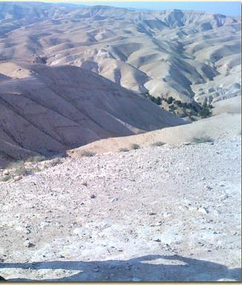
Law and Grace: Session 22
Christ was led into the wilderness
Matthew 4:1-11
Never forget that:
Satan will be held responsible for what he has done and will do (cf. Matt. 25:41).
Satan does not and cannot do anything that is out of God’s control.
Satan cannot thwart God’s purposes.

Slide 36
Romans 8:28-30
²⁸ And we know that God causes all things to work together for good to those who love God, to those who are called according to His purpose. ²⁹ For those whom He foreknew, He also predestined to become conformed to the image of His Son, so that He would be the firstborn among many brethren; ³⁰ and these whom He predestined, He also called; and these whom He called, He also justified; and these whom He justified, He also glorified.

Slide 37
Law and Grace: Session 22
Christ’s temptation
Matthew 4:1-11
Christ’s temptations by Satan were three appeals:
For Christ to use the powers and privileges of His deity.
Satan said, “Make these stones into bread.”
For Christ to step back from the pains and vulnerability of His humanity.
Satan said, “Throw Yourself down so that You will be rescued.”
For Christ to grant Satan higher honor.
Satan said, “Worship me.”

Slide 38
Philippians 2:5-11
⁵ Have this attitude in yourselves which was also in Christ Jesus, ⁶ who, although He existed in the form of God, did not regard equality with God a thing to be grasped, ⁷ but emptied Himself, taking the form of a bond-servant, and being made in the likeness of men. ⁸ Being found in appearance as a man, He humbled Himself by becoming obedient to the point of death, even death on a cross. ⁹ For this reason also, God highly exalted Him, and bestowed on Him the name which is above every name, ¹⁰ so that at the name of Jesus every knee will bow, of those who are in heaven and on earth and under the earth, ¹¹ and that every tongue will confess that Jesus Christ is Lord, to the glory of God the Father.

Slide 39
Law and Grace: Session 22
Christ’s temptation
Matthew 4:1-11
Satan even quoted Scripture in his 2nd temptation of Christ, but in each case, when Satan would offer a temptation, Christ quoted from the last book of the Law of Moses: Deuteronomy.
Psalm 91:11-12
¹¹ For He will give His angels charge concerning you, to guard you in all your ways. ¹² They will bear you up in their hands, That you do not strike your foot against a stone.

Slide 40
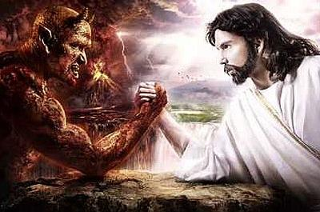
Law and Grace: Session 22
Christ’s temptation
Matthew 4:1-11

Slide 41
Deuteronomy 8:3
“He humbled you and let you be hungry, and fed you with manna which you did not know, nor did your fathers know, that He might make you understand that man does not live by bread alone, but man lives by everything that proceeds out of the mouth of the LORD.
Deuteronomy 6:16
“You shall not put the Lord your God to the test, as you tested Him at Massah.
Deuteronomy 10:20
“You shall fear the LORD your God; you shall serve Him and cling to Him, and you shall swear by His name.

Slide 42
Law and Grace: Session 22
Christ’s temptation
Matthew 4:1-11

Slide 43
Ephesians 6:13
Therefore, take up the full armor of God, so that you will be able to resist in the evil day, and having done everything, to stand firm.
James 4:7
Submit therefore to God. Resist the devil and he will flee from you.
1 Peter 5:9
But resist him [the devil], firm in your faith, knowing that the same experiences of suffering are being accomplished by your brethren who are in the world.

Slide 44
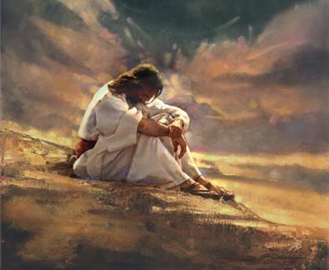
Law and Grace: Session 22
Was Christ able not to sin or not able to sin?
Matthew 4:1-11

Slide 45
Law and Grace: Session 22
Was Christ able not to sin or not able to sin?
Matthew 4:1-11
Both – Christ was and is fully God and fully man.
It meant that Satan could appeal to His humanity to tempt Him just as we can be and are likewise tempted (cf. Hebrews 4:15).
Hebrews 4:15
For we do not have a high priest who cannot sympathize with our weaknesses, but One who has been tempted in all things as we are, yet without sin.

Slide 46
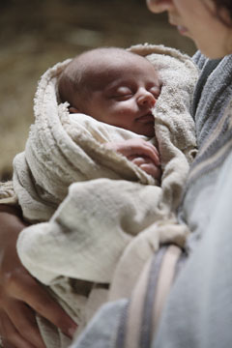
Law and Grace: Session 22
Was Christ able not to sin or not able to sin?
Matthew 4:1-11
Yet Christ, with a human body like ours did not have a Sin Nature as we have.
While Christ had all the human vulnerabilities of the body that we have, there was no Sin Nature to which Satan could to appeal.

Slide 47
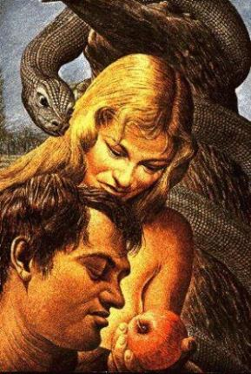
Law and Grace: Session 22
Adam vs. Christ
Matthew 4:1-11
Adam was created innocent, but still had the ability to choose contrary to God’s declared will.
Christ, however, was not only innocent, but was and is also fundamentally righteous.
John 8:46
“Which one of you convicts Me of sin? If I speak truth, why do you not believe Me?

Slide 48
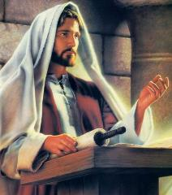
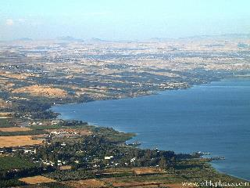
Law and Grace: Session 22
Christ’s Public Ministry
Matthew 4:12-25
As Christ began His public ministry:
He located Himself in the northern part of the sea of Galilee (v.12).
He selected disciples (vv. 18-22).
He performed miracles of healing (vv. 23-25).
Jesus also proclaimed the kingdom at hand (v. 17).

Slide 49
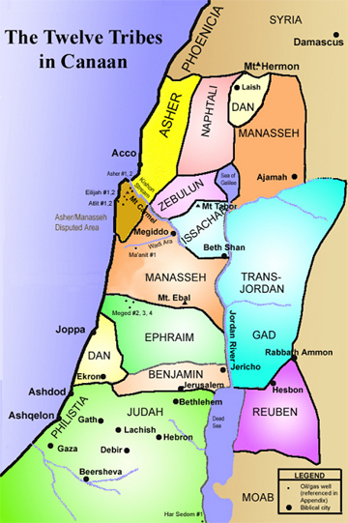
Law and Grace: Session 22
Christ’s Public Ministry
Matthew 4:12-25
You may remember back in sessions 14-15, that we discussed Joshua and the conquest of Canaan and how the 12 tribes were commanded to take over all the land and drive out the Canaanites.

Slide 50
Law and Grace: Session 22
Christ’s Public Ministry
Matthew 4:12-25
You can see the areas that Zebulun and Naphtali inherited on the north and on the west side of the Sea of Galilee. This is the same area where Christ, the Messiah would settle and carry out ministry – in Capernaum.
“Galilee of the Gentiles”

Slide 51
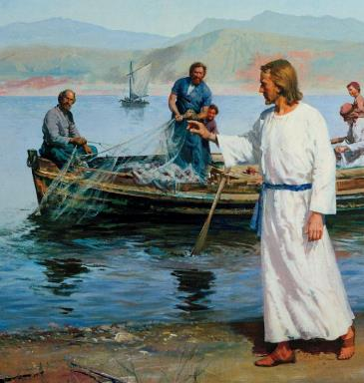
Law and Grace: Session 22
Jesus selected disciples
Matthew 4:12-25
In this passage, we see that Jesus selected disciples – two sets of brothers:
Simon Peter and Andrew, then James and John, the sons of Zebedee.
Selecting disciples meant that Jesus was beginning His ministry as a rabbi (a Jewish teacher).

Slide 52
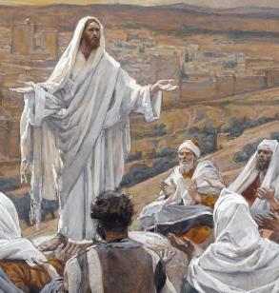
Law and Grace: Session 22
Jesus a Typical and Unique Rabbi
Matthew 4:12-25
In this, Jesus was both typical and also a very unique rabbi.
Understanding Jesus to be both a typical and a very unique rabbi, will become critical to our study.

Slide 53
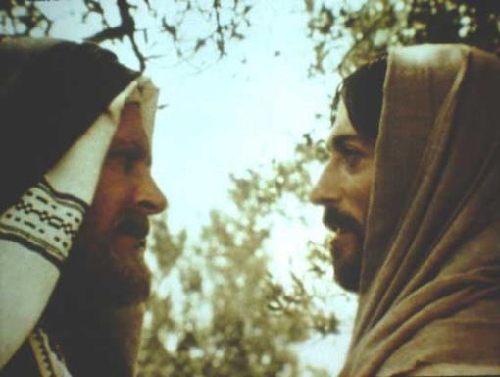
Law and Grace: Session 22
Jesus a Typical and Unique Rabbi
Matthew 4:12-25
Jesus tells Nicodemus, “You must be born again”. However, according to Pharisaic tradition if you were a rabbi you were already ‘born again’!

Slide 54
Law and Grace: Session 22
BORN AGAIN
Type of Birth | Reference
1. Proselyte Conversion | Encyclopedia Judaica: Vol. 13, Jewish Encyclopedia: Vol. 10, pg. 223; Life and Times of Jesus the Messiah: Vol. 1, pg. 384; Nicodemus, A Rabbi’s Quest, Ariel Ministries, Manuscript #16, pg. 4 (Logos)
2. Crowned King | Life and Times of Jesus the Messiah: Vol. 1, pg. 384. Yalkut on 1 Sam. 13; Nicodemus, A Rabbi’s Quest, Ariel Ministries, Manuscript #16, pg. 4 (Logos)
3. Bar Mitzvah | Nicodemus, A Rabbi’s Quest, Ariel Ministries, Manuscript #16, pg. 4 (Logos)
4. Marriage | Life and Times of Jesus the Messiah, Vol. 1, pg. 384 (Logos); Nicodemus, A Rabbi’s Quest, Ariel Ministries, Manuscript #16, pg. 4 (Logos)
5. Rabbinic Ordination | Peninim on the Torah, pg. 233; Nicodemus, A Rabbi’s Quest, Ariel Ministries, Manuscript #16, pg. 5 (Logos)
6. Head of a Rabbinic Academy (Yeshiva) | Life and Times of Jesus the Messiah, Vol. 1, pg. 384; (Logos); Nicodemus, A Rabbi’s Quest, Ariel Ministries, Manuscript #16, pg. 5 (Logos)
Born of the Spirit | John 3:7
www.hadavar.org/getting-to-know-god/you-must-be-born-again/ (lists 8)

Slide 55
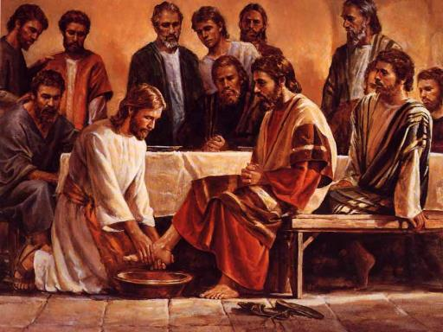
Law and Grace: Session 22
Jesus a Typical and Unique Rabbi
Matthew 4:12-25
A rabbi was not permitted to ask his disciples to wash his feet.

Slide 56
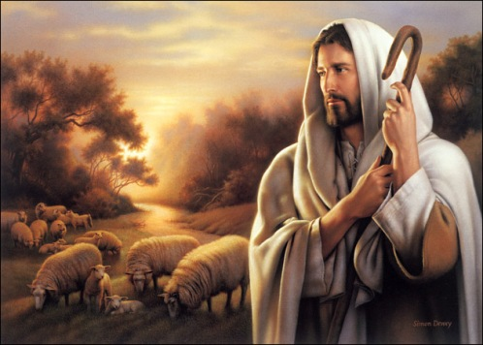
Law and Grace: Session 22
Jesus a Typical and Unique Rabbi
Matthew 4:12-25
"I AM the good shepherd; the good shepherd lays down His life for the sheep." John 10:11

Slide 57
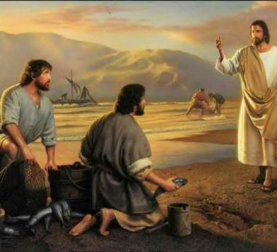
Law and Grace: Session 22
Jesus the Rabbi (teacher)
Matthew 4:12-25
As a rabbi, Jesus would seek and also select His disciples.
The gospels seem to say that all of the disciples followed Him right away, but that was done after Christ presented Himself as a rabbi.

Slide 58
Law and Grace: Session 22
Jesus the Rabbi (teacher)
Matthew 4:12-25
As we proceed with our ongoing study of Law & Grace, we will continue examining what it meant for Jesus to be a rabbi among the people, in the land of Israel.
So, the disciples did respond right away to Jesus’ invitation but only after he had presented himself as a rabbi, in the expected manner.

Slide 59
Session 22 Outline
Review
Purpose, Aim, and Objective
Session 21
Firsts & Beginnings in Christ’s Ministry – Matt. 4
General Information
Comments and Commentary
Concluding Observations

Slide 60
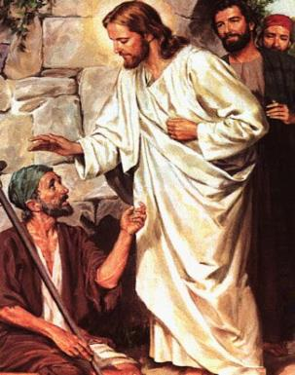
Law and Grace: Session 22
Why the healing miracles?
Matthew 4:12-25
Jesus performed miracles of healing as the validation and verification that He was indeed the long-promised Messiah.

Slide 61
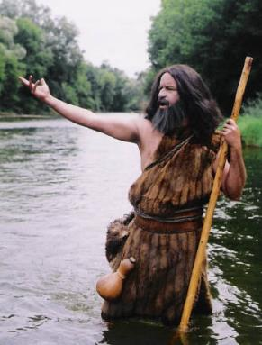
Law and Grace: Session 22
Why the healing miracles?
Matthew 4:12-25
Later in Matthew, after John the Baptist is jailed by Herod the tetrarch, John asks if Jesus is the promised One.
Jesus tells them to testify about the things that He has been doing: healing and proclaiming.

Slide 62
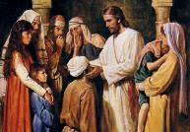
Matthew 11:2-6
² Now when John, while imprisoned, heard of the works of Christ, he sent word by his disciples ³ and said to Him, “Are You the Expected One, or shall we look for someone else?” ⁴ Jesus answered and said to them, “Go and report to John what you hear and see: ⁵ the blind receive sight and the lame walk, the lepers are cleansed and the deaf hear, the dead are raised up, and the poor have the gospel preached to them. ⁶ “And blessed is he who does not take offense at Me.” (cf. Isaiah 35:5; 42:18; 57:18,19; 61:1; Luke 4:16-21)

Slide 63
Law and Grace: Session 22
An insight into Christ’s 1st Coming
Matthew 4:12-25
While Christ was the steward who initiated the Church through the Apostles in His 1st Coming, His three years of ministry are often misunderstood by many Christians.

Slide 64
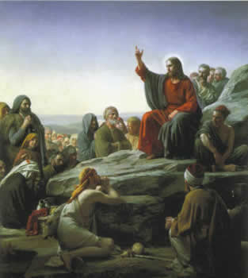
Law and Grace: Session 22
An insight into Christ’s 1st Coming
Matthew 4:12-25
In His 1st Coming Christ was sent to Earth to be born a Jew, in the land of Israel, to appeal only to the Jews, telling them that they should receive Him as their King and Messiah, and declaring to them the Gospel of the Kingdom of God.

Slide 65
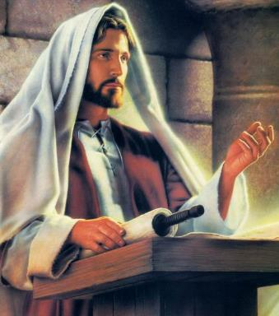
Law and Grace: Session 22
Not for us who are in the church?
Matthew 4:12-25
In a word – No! The Gospel of the Kingdom was the message of good news delivered to the Israelites, in the land of Israel, about Jesus, the King of Israel (Matt. 2:2 4:23; 9:35; 27:11).

Slide 66
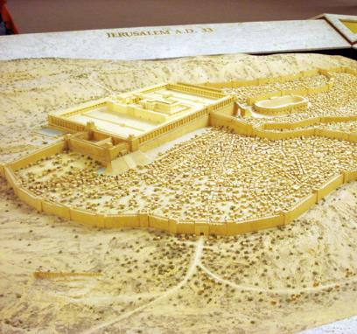
Law and Grace: Session 22
Not for us who are in the church?
Matthew 4:12-25
The Gospel of the Kingdom was Jesus telling the Nation of Israel that if she would acknowledge Him as her Messiah, the prophesied kingdom would come to the earth and Messiah would rule from Jerusalem, the city of the Great King (Matt. 5:35).

Slide 67
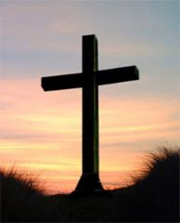
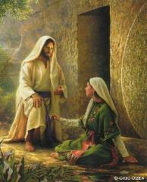
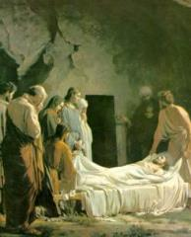
Law and Grace: Session 22
The Gospel of Substitution
Matthew 4:12-25
The Gospel of Substitution declares that anyone, (Jew or Gentile), believing that Christ, the Son of God, died for their sins, was buried, and rose again, for them, will be saved eternally (cf. 1 Cor. 15:1-11; Isa. 53). This is the Good News that we are to share with the lost.

Slide 68
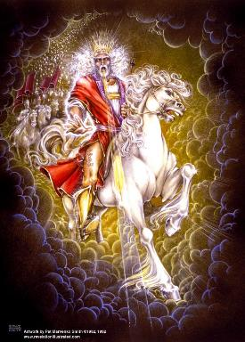
Law and Grace: Session 22
The Coming Kingdom
Matthew 4:12-25
The Church’s place in the coming Millennial Kingdom will be as the Bride of Christ, coming with Him to rule and reign.

Slide 69
Session 22 Outline
Review
Purpose, Aim, and Objective
Session 21
Firsts & Beginnings in Christ’s Ministry – Matt. 4
General Information
Comments and Commentary
Concluding Observations

Slide 70
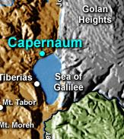
Law and Grace: Session 22
So in Jesus’ initial ministry…
Matthew 4:12-25
So in Jesus’ initial ministry, He settled in Capernaum in northern Galilee, teaching in the synagogues around Galilee, preaching the kingdom, and selecting disciples to follow Him.

Slide 71
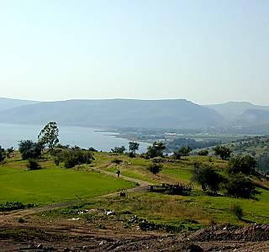
Law and Grace: Session 22
So in Jesus’ initial ministry…
Matthew 4:12-25
People came from areas to the north (Syria), from around Galilee, and from the southern part of Israel as well.

Slide 72
Law and Grace: Session 22
In Our Next Session - The Sermon on the Mount
Matthew 5-7

Slide 73
Law and Grace: An Overview Jim McGowan, Th.D. Sugar Land Bible Church 08-18-2019
…but grace and truth were realized through Jesus Christ - John 1:17
For the Law was given through Moses…
Special thanks to Dr. Vern Peterman for access to his insights and resources.

