Slide 1
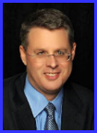
Dr. Andy Woods
Senior Pastor – Sugar Land Bible Church
President – Chafer Theological Seminary

Slide 3
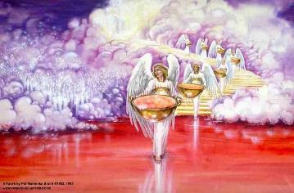
Bowl Judgments Revelation 15‒16
Bowl Judgment Preparation (Rev. 15)
Bowl Judgement Manifestation (Rev. 16)

Slide 4
Bowl Judgments Revelation 15‒16
Bowl Judgment Preparation (Rev. 15)
Bowl Judgement Manifestation (Rev. 16)

Slide 5
Bowl Judgment Preparation Revelation 15:1-8
The Manifestation of the Seven Plagues (1)
The Martyrs (2-4)
The Heavenly Tabernacle-Temple (5-8)

Slide 6
Bowl Judgment Preparation Revelation 15:1-8
The Manifestation of the Seven Plagues (1)
The Martyrs (2-4)
The Heavenly Tabernacle-Temple (5-8)

Slide 7
Bowl Judgment Preparation Revelation 15:1-8
The Manifestation of the Seven Plagues (1)
The Martyrs (2-4)
The Heavenly Tabernacle-Temple (5-8)

Slide 8
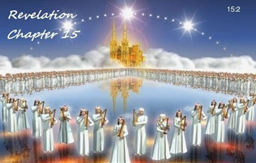
II. The Martyrs Revelation 15:2-4
Their identity (2)
Their praise (3-4)
Song of Moses (3a)
Song of the Lamb (3b)
Doxology (3c-4)

Slide 9
3. Their Doxology Revelation 15:3c-4
His works (3c)
His might (3d)
His ways (3e)
His regal authority (3f)
His doxological purpose (4a)
His holiness (4b)
His regal destiny (4c)
His righteous acts (4d)

Slide 10
Bowl Judgment Preparation Revelation 15:1-8
The Manifestation of the Seven Plagues (1)
The Martyrs (2-4)
The Heavenly Tabernacle-Temple (5-8)

Slide 11
III. The Heavenly Tabernacle Revelation 15:5-8
Tabernacle opened (5)
Angels emerge (6)
Angels given the bowls (7)
Tabernacle filled with God’s glory (8a)
Barred entrance into Tabernacle (8b)

Slide 12
III. The Heavenly Tabernacle Revelation 15:5-8
Tabernacle opened (5)
Angels emerge (6)
Angels given the bowls (7)
Tabernacle filled with God’s glory (8a)
Barred entrance into Tabernacle (8b)

Slide 13
III. The Heavenly Tabernacle Revelation 15:5-8
Tabernacle opened (5)
Angels emerge (6)
Angels given the bowls (7)
Tabernacle filled with God’s glory (8a)
Barred entrance into Tabernacle (8b)

Slide 14
Activities of the Angels
Past
Witnessed creation (Job 38:7)
Brought judgment (Gen 19:22; Acts 12:22-23)
Accompanied the Law (Gal 3:19)
Announced births of John and Christ (Luke 1:11-13, 26-27)
Strengthened Christ (Matt 4:11)
Announced resurrection (Matt 28:1-7)
Observed Ascension (Acts 1:11)
Brought messages (Luke 1:13)

Slide 15
III. The Heavenly Tabernacle Revelation 15:5-8
Tabernacle opened (5)
Angels emerge (6)
Angels given the bowls (7)
Tabernacle filled with God’s glory (8a)
Barred entrance into Tabernacle (8b)

Slide 17
Rev. 6:16-17 Robert L. Thomas, Revelation 1–7: An Exegetical Commentary, ed. Kenneth Barker (Chicago: Moody, 1992), 457-58.
"Mankind in his rebellion correctly analyzes the cosmic and terrestrial disturbances as a part of the great end-time day of wrath from the one sitting on the throne and from the Lamb. The verb ēlethen (‘has come’) is aorist indicative, referring to a previous arrival of wrath, not something that is about to take place. Men see the arrival of this day at least as early as the cosmic upheavals that characterize the sixth seal (6:12-14), but upon reflection they probably recognize that it was already in effect with the death of one-fourth of the population (6:7-8), the worldwide famine (6:5-6), and the global warfare (6:3-4). The rapid sequence of all of these events could not escape notice, but the light of their true explanation does not dawn upon human consciousness until the severe phenomena of the sixth seal arrive."

Slide 18
Promised Exemption from Divine Wrath
The promise (1 Thess 1:10; 5:9; Rom 5:9; 8:1; Rev 3:10)
Tribulation = divine wrath (Rev 6:16-17; 11:18; 15:1, 7; 16:1, 19)

Slide 19
Revelation 15:7
“Then one of the four living creatures gave to the seven angels seven golden bowls full of the wrath [thymos] of God, who lives forever and ever.”

Slide 20
Revelation 15:7
“Then one of the four living creatures gave to the seven angels seven golden bowls full of the wrath of God, who lives forever and ever.”

Slide 21
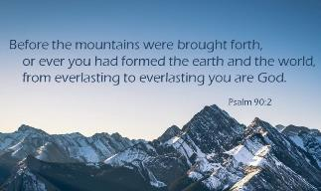
Psalm 90:2
“Before the mountains were born Or You gave birth to the earth and the world, Even from everlasting (olam) to everlasting (olam), You are God.”

Slide 22
Romans 16:26
“but now is manifested, and by the Scriptures of the prophets, according to the commandment of the eternal (aiōnios) God, has been made known to all the nations, leading to obedience of faith

Slide 23
III. The Heavenly Tabernacle Revelation 15:5-8
Tabernacle opened (5)
Angels emerge (6)
Angels given the bowls (7)
Tabernacle filled with God’s glory (8a)
Barred entrance into Tabernacle (8b)

Slide 24
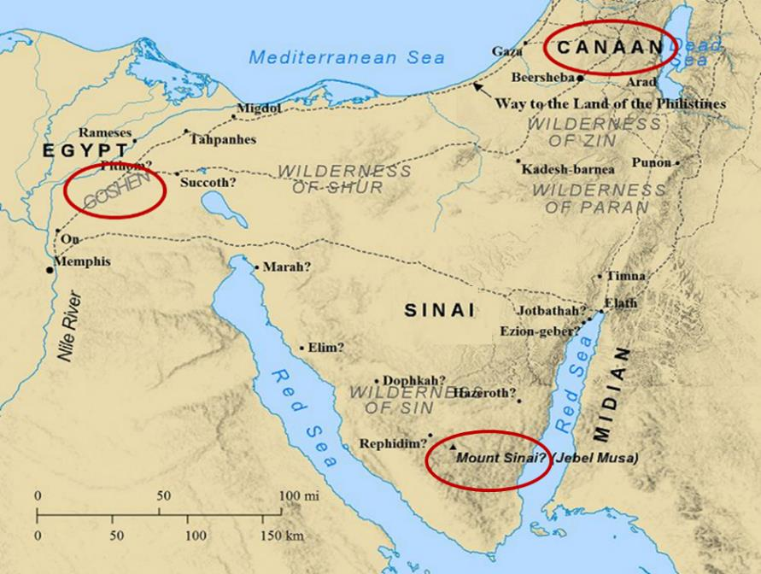

Slide 25
Israel’s Four Temples
Solomon’s pre exilic temple (Kings and Chronicles)
Zerubbabel’s post exilic temple (Ezra 1-6; John 2:20)
Antichrist's temple (Dan 9:27; Matt 24:15; 2 Thess 2:4; Rev 11:1-2)
Millennial temple (Ezek 40-48)

Slide 26
Israel’s Four Temples
Solomon’s pre exilic temple (Kings and Chronicles)
Zerubbabel’s post exilic temple (Ezra 1-6; John 2:20)
Antichrist's temple (Dan 9:27; Matt 24:15; 2 Thess 2:4; Rev 11:1-2)
Millennial temple (Ezek 40-48)

Slide 27
Israel’s Four Temples
Solomon’s pre exilic temple (Kings and Chronicles)
Zerubbabel’s post exilic temple (Ezra 1-6; John 2:20)
Antichrist's temple (Dan 9:27; Matt 24:15; 2 Thess 2:4; Rev 11:1-2)
Millennial temple (Ezek 40-48)

Slide 29
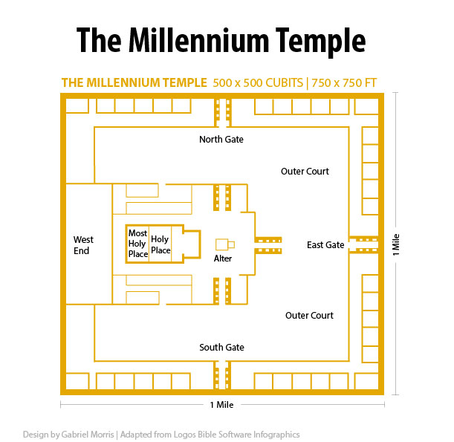

Slide 30
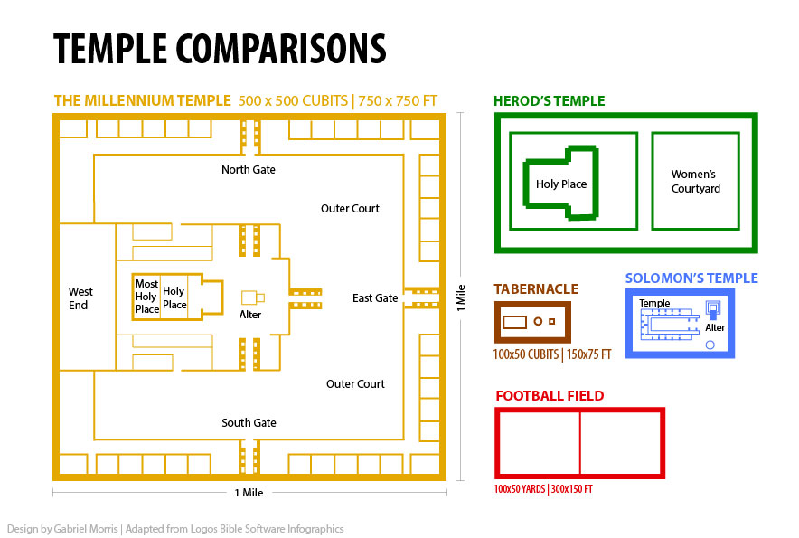

Slide 31
III. The Heavenly Tabernacle Revelation 15:5-8
Tabernacle opened (5)
Angels emerge (6)
Angels given the bowls (7)
Tabernacle filled with God’s glory (8a)
Barred entrance into Tabernacle (8b)

Slide 32
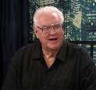
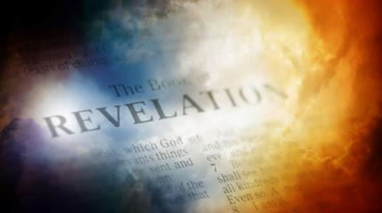
David Hocking
David Hocking, The Book of Revelation: Understanding the Future (Tustin, CA: Hope For Today Publications, 2014), 459.
“God's plan includes the coming of God's wrath, and it will be ‘fulfilled’ (completed). Until it is finished, no one could enter the temple in heaven, dramatically emphasizing the importance of these seven last plagues in the overall plan of God.”

Slide 33
John F. Walvoord John F. Walvoord, The Revelation of Jesus Christ: A Commentary (Chicago: Moody, 1966), 230.
“As the angels emerge from the sanctuary, it is filled with smoke proceeding from the glory of God and His power, a pointed reminder of the ineffable holiness of God. The scene can be compared to that when the cloud filled the Tabernacle in Exodus 40:34–35. Access into the sanctuary is made impossible by the smoke until the judgments contained in the seven plagues are fulfilled. It is an ominous sign of impending doom for those who persist in their blasphemous disregard of the sovereignty and holiness of God.”

Slide 34
Seven Bowls (Revelation 16)
1st Bowl (16:1-2) – Boils
2nd Bowl (16:3) – Sea becomes blood
3rd Bowl (16:4-7) – Freshwater destroyed
4th Bowl (16:8-9) – Sun scorches man
5th Bowl (16:10-11) – Darkness
6th Bowl (16:13-16) – Euphrates dried
7th Bowl (16:17-21) – Greatest earthquake

Slide 35
Conclusion

Slide 36
Bowl Judgment Preparation Revelation 15:1-8
The Manifestation of the Seven Plagues (1)
The Martyrs (2-4)
The Heavenly Tabernacle-Temple (5-8)

Slide 37
Bowl Judgments Revelation 15‒16
Bowl Judgment Preparation (Rev. 15)
Bowl Judgement Manifestation (Rev. 16)

Slide 38
“The Lord bless you and keep you; the Lord make his face shine on you and be gracious to you; the Lord turn his face toward you and give you peace.” (NIV)

