Slide 1
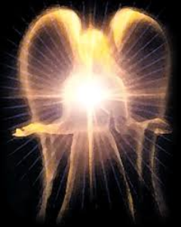
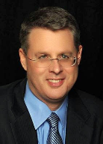
SATANOLOGY
Dr. Andy Woods
Senior Pastor – Sugar Land Bible Church
President – Chafer Theological Seminary

Slide 2
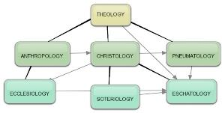
Areas of Systematic Theology
Prolegomena – Introduction
Theology – Study of God
Christology – Study of Christ
Pneumatology – Study of the Holy Spirit
Anthropology – Study of Man
Hamartiology – Study of sin
Soteriology – Study of salvation
Angelology – Study of angels
Ecclesiology – Study of the Church
Eschatology – Study of the end

Slide 3
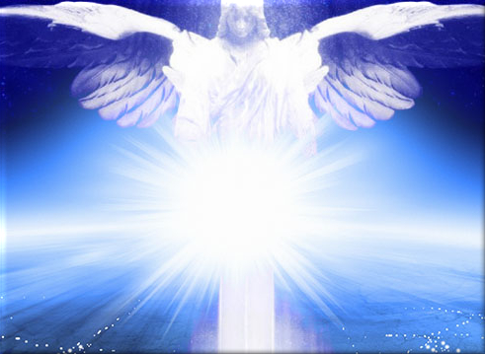
Preview of Angelology
Good angels
Satanology
Demonology
Gen. 6:1-4 controversy

Slide 4
Preview
Existence
Personhood
Names and titles
Original state and first sin
Works

Slide 5
Preview
Existence
Personhood
Names and titles
Original state and first sin
Works

Slide 6
Existence
OT
Job 1–2; Zech 3:1; Gen 3:1 (Rev 12:9); 1 Chr 21:1
NT
Every author refers to Satan
Christ speaks of Satan 25x

Slide 7
Preview
Existence
Personhood
Names and titles
Original state and first sin
Works

Slide 8
Personhood
Elements of personhood
Intellect (2 Cor 2:11)
Emotions (Rev 12:12, 17)
Will (2 Tim 2:26)
Personal pronouns (Mt 4:10)
Moral accountability (Mt 25:41)

Slide 9
Preview
Existence
Personhood
Names and titles
Original state and first sin
Works

Slide 10
Names and Titles
Lucifer (2 Cor 11:14)
Satan (Zech 3:1)
Devil (Matt 4:11)
Serpent of old (Rev 12:9)
Destroyer (Rev 9:11)
Dragon (Rev 12:9)
Evil one (1 John 5:19)
Belial (2 Cor 6:15)
Anointed cherub (Ezek 28:14, 16)

Slide 11
Names and Titles
Prince of this world (John 12:31)
Prince and power of the air (Eph 2:2)
God of this world (2 Cor 4:4)
Beelzebub (Luke 11:15)
Tempter (Matt 4:3)
Accuser of the brethren (Rev 12:10)
Father of lies and murderer (John 8:44)
Roaring lion and adversary (1 Pet 5:8)
Enemy (Matt 13:39)

Slide 12
Preview
Existence
Personhood
Names and titles
Original state and first sin
Works

Slide 13
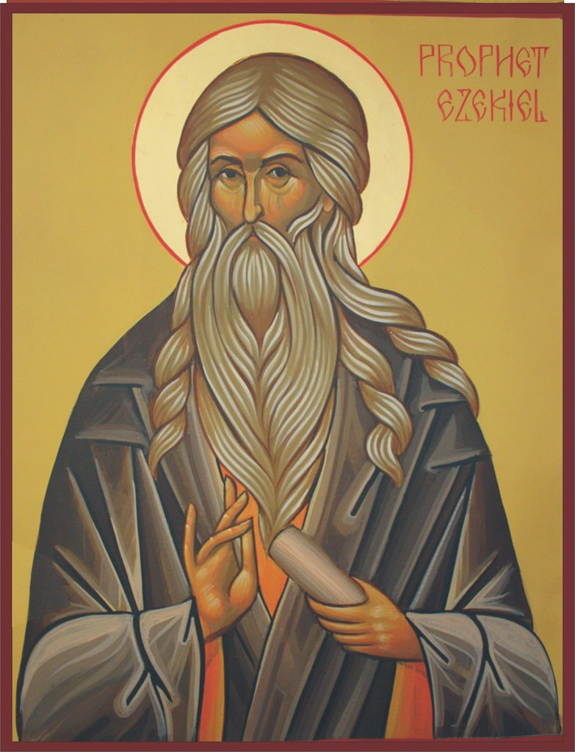
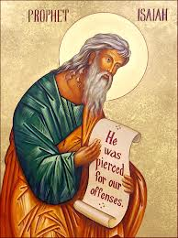
Satan’s Original State and First Sin
Ezekiel 28:12-17
Isaiah 14:12-15

Slide 14
Satan’s Original State and First Sin
Ezekiel 28:12-17
Isaiah 14:12-15

Slide 15
Original State and First Sin
Ezek 28:12-17
Attributes
Creature (15)
Angel (14, 16)
Powerful (14)
Without sin (15)
Beautiful (12-13)
Intelligent (12)
Nature of 1st sin (17)

Slide 16
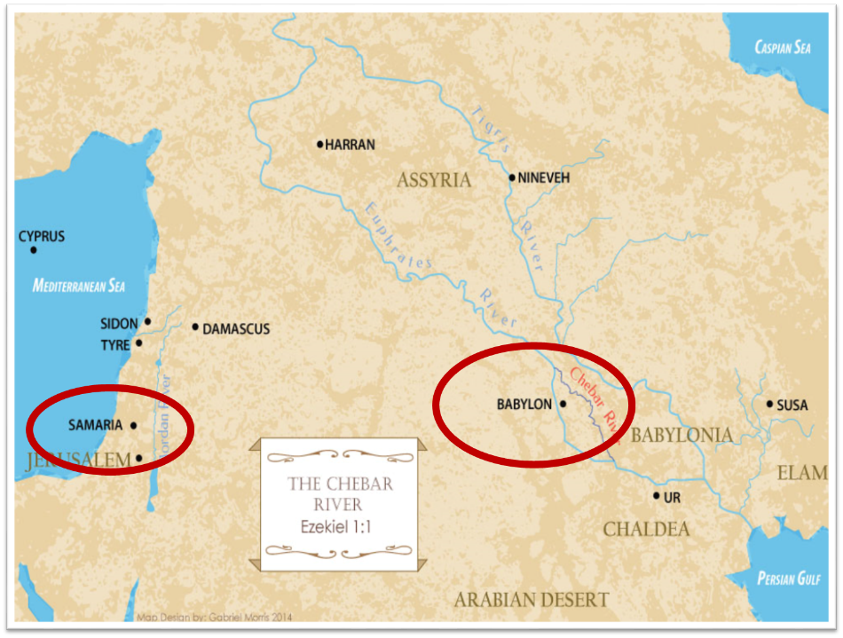

Slide 17
Original State and First Sin
Ezek 28:12-17
Attributes
Creature (15)
Angel (14, 16)
Powerful (14)
Without sin (15)
Beautiful (12-13)
Intelligent (12)
Nature of 1st sin (17)

Slide 18
Original State and First Sin
Ezek 28:12-17
Attributes
Creature (15)
Angel (14, 16)
Powerful (14)
Without sin (15)
Beautiful (12-13)
Intelligent (12)
Nature of 1st sin (17)

Slide 19
Ezekiel 28:13, 15
“¹³ You were in Eden, the garden of God; Every precious stone was your covering: The ruby, the topaz and the diamond; The beryl, the onyx and the jasper; The lapis lazuli, the turquoise and the emerald; And the gold, the workmanship of your settings and sockets, Was in you. On the day that you were created They were prepared… ¹⁵ You were blameless in your ways From the day you were created Until unrighteousness was found in you.”

Slide 20
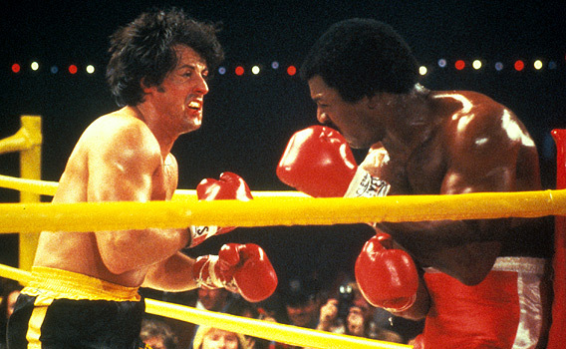

Slide 21
Original State and First Sin
Ezek 28:12-17
Attributes
Creature (15)
Angel (14, 16)
Powerful (14)
Without sin (15)
Beautiful (12-13)
Intelligent (12)
Nature of 1st sin (17)

Slide 22
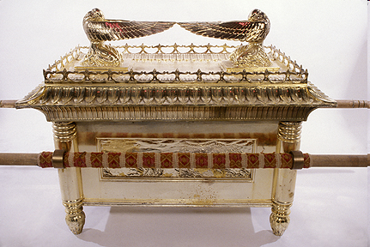
Ark of the Covenant

Slide 23
Original State and First Sin
Ezek 28:12-17
Attributes
Creature (15)
Angel (14, 16)
Powerful (14)
Without sin (15)
Beautiful (12-13)
Intelligent (12)
Nature of 1st sin (17)

Slide 24
Original State and First Sin
Ezek 28:12-17
Attributes
Creature (15)
Angel (14, 16)
Powerful (14)
Without sin (15)
Beautiful (12-13)
Intelligent (12)
Nature of 1st sin (17)

Slide 25
Original State and First Sin
Ezek 28:12-17
Attributes
Creature (15)
Angel (14, 16)
Powerful (14)
Without sin (15)
Beautiful (12-13)
Intelligent (12)
Nature of 1st sin (17)

Slide 26
Original State and First Sin
Ezek 28:12-17
Attributes
Creature (15)
Angel (14, 16)
Powerful (14)
Without sin (15)
Beautiful (12-13)
Intelligent (12)
Nature of 1st sin (17)

Slide 27
Original State and First Sin
Ezek 28:12-17
Attributes
Creature (15)
Angel (14, 16)
Powerful (14)
Without sin (15)
Beautiful (12-13)
Intelligent (12)
Nature of 1st sin (17)

Slide 28
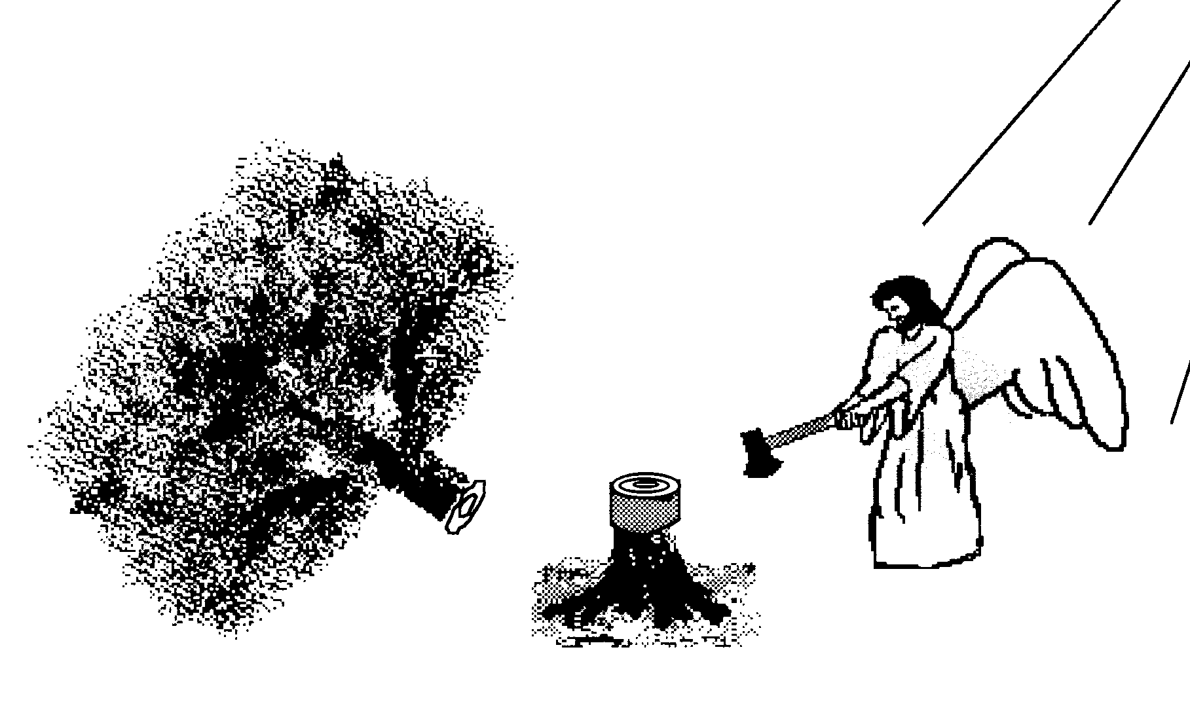
Hall of the Humbled (Prov. 16:18; 1 Peter 5:5)
Satan (Isa. 14:12-15; Ezek. 28:12-17; 1 Tim. 3:6)
Nebuchadnezzar (Dan. 4:30-31)
Uzziah (2 Chron. 26:16)
Herod (Acts 12:20-23)
Paul (2 Cor. 12:1-10)

Slide 29
Original State and First Sin (cont’d)
Ezek 28:12-17
Consequences
Fell (16-17)
Retains some access to heaven (Job 1:6; 2:1)
Some angels fell with him (14)
Fallen angels confirmed in wickedness (Matt 25:41)
Darkened thought process (17)

Slide 30
Original State and First Sin (cont’d)
Ezek 28:12-17
Consequences
Fell (16-17)
Retains some access to heaven (Job 1:6; 2:1)
Some angels fell with him (14)
Fallen angels confirmed in wickedness (Matt 25:41)
Darkened thought process (17)

Slide 31
Original State and First Sin (cont’d)
Ezek 28:12-17
Consequences
Fell (16-17)
Retains some access to heaven (Job 1:6; 2:1)
Some angels fell with him (14)
Fallen angels confirmed in wickedness (Matt 25:41)
Darkened thought process (17)

Slide 32
Original State and First Sin (cont’d)
Ezek 28:12-17
Consequences
Fell (16-17)
Retains some access to heaven (Job 1:6; 2:1)
Some angels fell with him (14)
Fallen angels confirmed in wickedness (Matt 25:41)
Darkened thought process (17)

Slide 33
Original State and First Sin (cont’d)
Ezek 28:12-17
Consequences
Fell (16-17)
Retains some access to heaven (Job 1:6; 2:1)
Some angels fell with him (14)
Fallen angels confirmed in wickedness (Matt 25:41)
Darkened thought process (17)

Slide 34
Original State and First Sin (cont’d)
Ezek 28:12-17
Consequences
Fell (16-17)
Retains some access to heaven (Job 1:6; 2:1)
Some angels fell with him (14)
Fallen angels confirmed in wickedness (Matt 25:41)
Darkened thought process (17)

Slide 35
Original State and First Sin (cont’d)
Ezek 28:12-17
Consequences
Fell (16-17)
Retains some access to heaven (Job 1:6; 2:1)
Some angels fell with him (14)
Fallen angels confirmed in wickedness (Matt 25:41)
Darkened thought process (17)

Slide 36
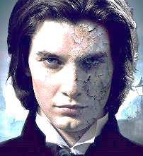
Ezekiel 28:12
“Son of man, take up a lamentation over the king of Tyre and say to him, ‘Thus says the Lord God, “You had the seal of perfection, Full of wisdom and perfect in beauty.””

Slide 37
Ezekiel 28:17
“Your heart was lifted up because of your beauty; You corrupted your wisdom by reason of your splendor.”

Slide 38
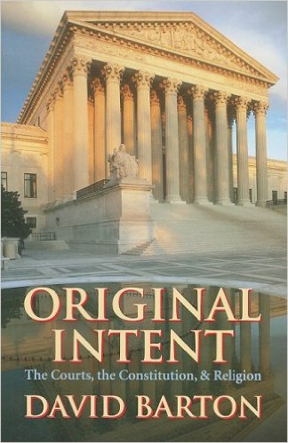
David Barton, Original Intent, p. 245

Slide 39
Satan’s Original State and First Sin
Ezekiel 28:12-17
Isaiah 14:12-15

Slide 40
Original State and First Sin (cont’d)
Isaiah 14:12-15
5 “I will” statements
Ascend to heaven (13)
Raise my throne above the stars of God (13)
Sit enthroned on the Mt. of the Assembly (13)
Ascend above the tops of the clouds (14)
Make myself like the Most High (14)

Slide 41
Original State and First Sin (cont’d)
Isaiah 14:12-15
5 “I will” statements
Ascend to heaven (13)
Raise my throne above the stars of God (13)
Sit enthroned on the Mt. of the Assembly (13)
Ascend above the tops of the clouds (14)
Make myself like the Most High (14)

Slide 42
Original State and First Sin (cont’d)
Isaiah 14:12-15
5 “I will” statements
Ascend to heaven (13)
Raise my throne above the stars of God (13)
Sit enthroned on the Mt. of the Assembly (13)
Ascend above the tops of the clouds (14)
Make myself like the Most High (14)

Slide 43
Original State and First Sin (cont’d)
Isaiah 14:12-15
5 “I will” statements
Ascend to heaven (13)
Raise my throne above the stars of God (13)
Sit enthroned on the Mt. of the Assembly (13)
Ascend above the tops of the clouds (14)
Make myself like the Most High (14)

Slide 44
Original State and First Sin (cont’d)
Isaiah 14:12-15
5 “I will” statements
Ascend to heaven (13)
Raise my throne above the stars of God (13)
Sit enthroned on the Mt. of the Assembly (13)
Ascend above the tops of the clouds (14)
Make myself like the Most High (14)

Slide 45
Isaiah 2:2-3
“Now it will come about that In the last days The mountain of the house of the Lord Will be established as the chief of the mountains, And will be raised above the hills; And all the nations will stream to it. ³ And many peoples will come and say, “Come, let us go up to the mountain of the Lord, To the house of the God of Jacob; That He may teach us concerning His ways And that we may walk in His paths.” For the law will go forth from Zion And the word of the Lord from Jerusalem.”

Slide 46
Original State and First Sin (cont’d)
Isaiah 14:12-15
5 “I will” statements
Ascend to heaven (13)
Raise my throne above the stars of God (13)
Sit enthroned on the Mt. of the Assembly (13)
Ascend above the tops of the clouds (14)
Make myself like the Most High (14)

Slide 47
Original State and First Sin (cont’d)
Isaiah 14:12-15
5 “I will” statements
Ascend to heaven (13)
Raise my throne above the stars of God (13)
Sit enthroned on the Mt. of the Assembly (13)
Ascend above the tops of the clouds (14)
Make myself like the Most High (14)

Slide 48
Original State and First Sin (cont’d)
Isaiah 14:12-15
3 Consequences
Fell (15)
Name changed from Lucifer (12) to Satan (Matt 16:23)
Banished from heaven (12)

Slide 49
Original State and First Sin (cont’d)
Isaiah 14:12-15
3 Consequences
Fell (15)
Name changed from Lucifer (12) to Satan (Matt 16:23)
Banished from heaven (12)

Slide 50
Original State and First Sin (cont’d)
Isaiah 14:12-15
3 Consequences
Fell (15)
Name changed from Lucifer (12) to Satan (Matt 16:23)
Banished from heaven (12)

Slide 51
Original State and First Sin (cont’d)
Isaiah 14:12-15
3 Consequences
Fell (15)
Name changed from Lucifer (12) to Satan (Matt 16:23)
Banished from heaven (12)

Slide 52
Original State and First Sin (cont’d)
Isaiah 14:12-15
3 Consequences
Fell (15)
Name changed from Lucifer (12) to Satan (Matt 16:23)
Banished from heaven (12)

Slide 53
CONCLUSION

Slide 54
Preview
Existence
Personhood
Names and titles
Original state and first sin
Works

