Slide 1
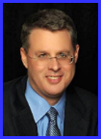
Dr. Andy Woods
Senior Pastor – Sugar Land Bible Church
President – Chafer Theological Seminary

Slide 3
Seven Trumpets (Revelation 8‒11)
1st Trumpet (8:7) – 1/3 vegetation destroyed
2nd Trumpet (8:8-9) – 1/3 ocean destroyed
3rd Trumpet (8:10-11) – 1/3 water destroyed
4th Trumpet (8:12-13) – 1/3 luminaries darkened
5th Trumpet (9:1-12) – Demons released
6th Trumpet (9:13-21) – 1/3 humanity destroyed
7th Trumpet (11:14-19) – Legal transfer announced

Slide 4
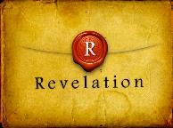
Revelation 11:15
“Then the seventh angel sounded; and there were loud voices in heaven, saying, ‘The kingdom of the world has become the kingdom of our Lord and of His Christ; and He will reign (basileuō) forever and ever.’” (cf. Matt. 6:10)

Slide 6
5 Non-Chronological Parenthetical Insertions
Rev 7 – 144,000 Jews
Rev 10:1-11:13 – Announcement of no more delay and the two witnesses
Rev 12-14 – Israel’s flight, two beasts, six scenes of hope
Rev 16:13-16 – Gathering of the nations to Armageddon
Rev 17:1-19:6 – Babylon’s fall

Slide 7
Revelation 12‒14
Rev 12 – Israel’s flight
Rev 13 – Two beasts
Rev 14 – Six scenes of hope

Slide 9
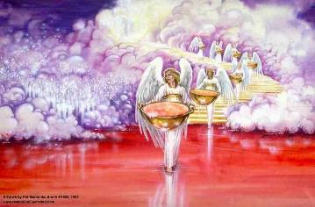
Bowl Judgments Revelation 15‒16
Bowl Judgment Preparation (Rev. 15)
Bowl Judgement Manifestation (Rev. 16)

Slide 10
Bowl Judgments Revelation 15‒16
Bowl Judgment Preparation (Rev. 15)
Bowl Judgement Manifestation (Rev. 16)

Slide 11
Bowl Judgment Preparation Revelation 15:1-8
The Manifestation of the Seven Plagues (1)
The Martyrs (2-4)
The Heavenly Tabernacle-Temple (5-8)

Slide 12
Bowl Judgment Preparation Revelation 15:1-8
The Manifestation of the Seven Plagues (1)
The Martyrs (2-4)
The Heavenly Tabernacle-Temple (5-8)

Slide 13
Telescoping
7th judgment releases 1st in next series
Seals: 1 2 3 4 5 6 7
Trumpets: 1 2 3 4 5 6 7
Bowls: 1 2 3 4 5 6 7

Slide 15
Bowl Judgment Preparation Revelation 15:1-8
The Manifestation of the Seven Plagues (1)
The Martyrs (2-4)
The Heavenly Tabernacle-Temple (5-8)

Slide 16
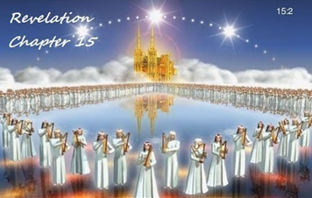
II. The Martyrs Revelation 15:2-4
Their identity (2)
Their praise (3-4)
Song of Moses (3a)
Song of the Lamb (3b)
Doxology (3c-4)

Slide 17
II. The Martyrs Revelation 15:2-4
Their identity (2)
Their praise (3-4)
Song of Moses (3a)
Song of the Lamb (3b)
Doxology (3c-4)

Slide 18
Distinctions Between 144,000 & Multitude
144,000 | MULTITUDE
Revelation 7:1-8 | Revelation 7:9-17
Numbered | Innumerable
Jews | All nations
Sealed | Slain
Sealed before the Tribulation | Converted out of the Tribulation
Hitchcock and Ice, The Truth Behind Left Behind, 77

Slide 19
II. The Martyrs Revelation 15:2-4
Their identity (2)
Their praise (3-4)
Song of Moses (3a)
Song of the Lamb (3b)
Doxology (3c-4)

Slide 20
II. The Martyrs Revelation 15:2-4
Their identity (2)
Their praise (3-4)
Song of Moses (3a)
Song of the Lamb (3b)
Doxology (3c-4)

Slide 21
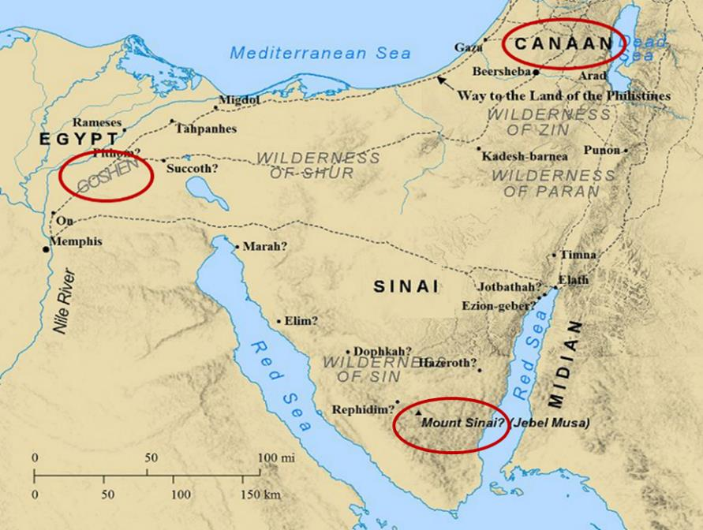

Slide 22
II. The Martyrs Revelation 15:2-4
Their identity (2)
Their praise (3-4)
Song of Moses (3a)
Song of the Lamb (3b)
Doxology (3c-4)

Slide 23
II. The Martyrs Revelation 15:2-4
Their identity (2)
Their praise (3-4)
Song of Moses (3a)
Song of the Lamb (3b)
Doxology (3c-4)

Slide 24
3. Their Doxology Revelation 15:3c-4
His works (3c)
His might (3d)
His ways (3e)
His regal authority (3f)
His doxological purpose (4a)
His holiness (4b)
His regal destiny (4c)
His righteous acts (4d)

Slide 25
3. Their Doxology Revelation 15:3c-4
His works (3c)
His might (3d)
His ways (3e)
His regal authority (3f)
His doxological purpose (4a)
His holiness (4b)
His regal destiny (4c)
His righteous acts (4d)

Slide 26
3. Their Doxology Revelation 15:3c-4
His works (3c)
His might (3d)
His ways (3e)
His regal authority (3f)
His doxological purpose (4a)
His holiness (4b)
His regal destiny (4c)
His righteous acts (4d)

Slide 27
3. Their Doxology Revelation 15:3c-4
His works (3c)
His might (3d)
His ways (3e)
His regal authority (3f)
His doxological purpose (4a)
His holiness (4b)
His regal destiny (4c)
His righteous acts (4d)

Slide 28
3. Their Doxology Revelation 15:3c-4
His works (3c)
His might (3d)
His ways (3e)
His regal authority (3f)
His doxological purpose (4a)
His holiness (4b)
His regal destiny (4c)
His righteous acts (4d)

Slide 29
Revelation 1:6; 5:10
“and He has made us to be a kingdom, priests to His God and Father—to Him be the glory and the dominion forever and ever. Amen…You have made them to be a kingdom and priests to our God; and they will reign [basileuō] upon the earth [gē].”

Slide 30
3. Their Doxology Revelation 15:3c-4
His works (3c)
His might (3d)
His ways (3e)
His regal authority (3f)
His doxological purpose (4a)
His holiness (4b)
His regal destiny (4c)
His righteous acts (4d)

Slide 31
3. Their Doxology Revelation 15:3c-4
His works (3c)
His might (3d)
His ways (3e)
His regal authority (3f)
His doxological purpose (4a)
His holiness (4b)
His regal destiny (4c)
His righteous acts (4d)

Slide 32
3. Their Doxology Revelation 15:3c-4
His works (3c)
His might (3d)
His ways (3e)
His regal authority (3f)
His doxological purpose (4a)
His holiness (4b)
His regal destiny (4c)
His righteous acts (4d)

Slide 33
3. Their Doxology Revelation 15:3c-4
His works (3c)
His might (3d)
His ways (3e)
His regal authority (3f)
His doxological purpose (4a)
His holiness (4b)
His regal destiny (4c)
His righteous acts (4d)

Slide 34
Bowl Judgment Preparation Revelation 15:1-8
The Manifestation of the Seven Plagues (1)
The Martyrs (2-4)
The Heavenly Tabernacle-Temple (5-8)

Slide 35
III. The Heavenly Tabernacle Revelation 15:5-8
Tabernacle opened (5)
Angels emerge (6)
Angels given the bowls (7)
Tabernacle filled with God’s glory (8a)
Barred entrance into Tabernacle (8b)

Slide 36
III. The Heavenly Tabernacle Revelation 15:5-8
Tabernacle opened (5)
Angels emerge (6)
Angels given the bowls (7)
Tabernacle filled with God’s glory (8a)
Barred entrance into Tabernacle (8b)

Slide 37
III. The Heavenly Tabernacle Revelation 15:5-8
Tabernacle opened (5)
Angels emerge (6)
Angels given the bowls (7)
Tabernacle filled with God’s glory (8a)
Barred entrance into Tabernacle (8b)

Slide 38
Activities of the Angels
Past
Witnessed creation (Job 38:7)
Brought judgment (Gen 19:22; Acts 12:22-23)
Accompanied the Law (Gal 3:19)
Announced births of John and Christ (Luke 1:11-13, 26-27)
Strengthened Christ (Matt 4:11)
Announced resurrection (Matt 28:1-7)
Observed Ascension (Acts 1:11)
Brought messages (Luke 1:13)

Slide 39
III. The Heavenly Tabernacle Revelation 15:5-8
Tabernacle opened (5)
Angels emerge (6)
Angels given the bowls (7)
Tabernacle filled with God’s glory (8a)
Barred entrance into Tabernacle (8b)

Slide 40
Promised Exemption from Divine Wrath
The promise (1 Thess 1:10; 5:9; Rom 5:9; 8:1; Rev 3:10)
Tribulation = divine wrath (Rev 6:16-17; 11:18; 15:1, 7; 16:1, 19)

Slide 41
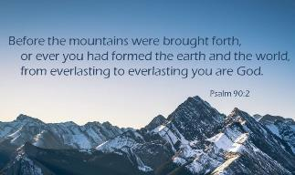
Psalm 90:2
“Before the mountains were born Or You gave birth to the earth and the world, Even from everlasting (olam) to everlasting (olam), You are God.”

Slide 42
Romans 16:26
“but now is manifested, and by the Scriptures of the prophets, according to the commandment of the eternal (aiōnios) God, has been made known to all the nations, leading to obedience of faith

Slide 43
III. The Heavenly Tabernacle Revelation 15:5-8
Tabernacle opened (5)
Angels emerge (6)
Angels given the bowls (7)
Tabernacle filled with God’s glory (8a)
Barred entrance into Tabernacle (8b)

Slide 44
III. The Heavenly Tabernacle Revelation 15:5-8
Tabernacle opened (5)
Angels emerge (6)
Angels given the bowls (7)
Tabernacle filled with God’s glory (8a)
Barred entrance into Tabernacle (8b)

Slide 45
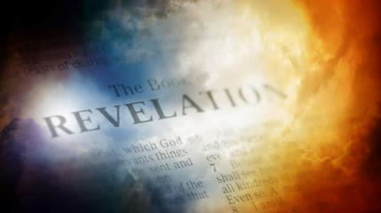
David Hocking
David Hocking, The Book of Revelation: Understanding the Future (Tustin, CA: Hope For Today Publications, 2014), 459.
“God's plan includes the coming of God's wrath, and it will be ‘fulfilled’ (completed). Until it is finished, no one could enter the temple in heaven, dramatically emphasizing the importance of these seven last plagues in the overall plan of God.”

Slide 46
Conclusion

Slide 47
Bowl Judgment Preparation Revelation 15:1-8
The Manifestation of the Seven Plagues (1)
The Martyrs (2-4)
The Heavenly Tabernacle-Temple (5-8)

Slide 48
Bowl Judgments Revelation 15‒16
Bowl Judgment Preparation (Rev. 15)
Bowl Judgement Manifestation (Rev. 16)

Slide 49
“The Lord bless you and keep you; the Lord make his face shine on you and be gracious to you; the Lord turn his face toward you and give you peace.” (NIV)

